Slide 1
What is a Web Page?
Web pages are text files containing HTML
HTML – Hyper Text Markup Language
  A notation for describing
    document structure (semantic markup)
    formatting (presentation markup)
  Looks (looked?) like:
    A Microsoft Word document
The markup tags provide information about the page content structure

Slide 2




How the Web Works?
WWW use classical client / server architecture
  HTTP is text-based request-response protocol
HTTP
Server response
HTTP
Server running Web Server Software (IIS, Apache, etc.)
Client running a Web Browser

Slide 3
Creating HTML Pages
An HTML file must have an .htm or .html file extension
HTML files can be created with text editors:
  NotePad, NotePad ++, PSPad
HTML editors (WYSIWYG Editors):
  Microsoft FrontPage
  Macromedia Dreamweaver
  Netscape Composer
  Microsoft Word
  Visual Studio

Slide 4
HTML Structure
a standard HTML document has two main structural elements
  head contains setup information for the browser & the Web page
    e.g., the title for the browser window, style definitions, JavaScript code, …
  body contains the actual content to be displayed in the Web page
<html>
<!–- Version information --
-- File: page01.html --
-- Author: COMP519 --
-- Creation: 22.09.09 --
-- Description: introductory page --
-- Copyright: U.Liverpool --
-->
<head>
<title>My first HTML document</title>
</head>
<body>
<p> Hello world! </p>
</body>
</html>
HTML documents begin and end with <html> and </html> tags
Comments appear between <!-- and -->
head section enclosed between <head> and </head> tags
body section enclosed between <body> and </body>
view page

Slide 5
First HTML Page: Tags
<html>
<head>
<title>My First HTML Page</title>
</head>
<body>
<p>This is some text...</p>
</body>
</html>
Opening tag
Closing tag

Slide 6
First HTML Page: Header
HTML header
<!DOCTYPE HTML>
<html>
<head>
<title>My First HTML Page</title>
</head>
<body>
<p>This is some text...</p>
</body>
</html>

Slide 7
First HTML Page: Body
<!DOCTYPE HTML>
<html>
<head>
<title>My First HTML Page</title>
</head>
<body>
<p>This is some text...</p>
</body>
</html>
HTML body

Slide 8
Headings and Paragraphs
Heading Tags (h1 – h6)
<h1>Heading 1</h1>
<h2>Sub heading 2</h2>
<h3>Sub heading 3</h3>
Paragraph Tags
<p>This is my first paragraph</p>
<p>This is my second paragraph</p>

Slide 9
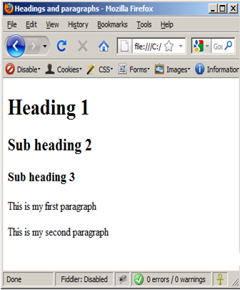
Headings and Paragraphs – Example
headings.html
<html>
<head><title>Headings and paragraphs</title></head>
<body>
<h1>Heading 1</h1>
<h2>Sub heading 2</h2>
<h3>Sub heading 3</h3>
<p>This is my first paragraph</p>
<p>This is my second paragraph</p>
</body>
</html>

Slide 10
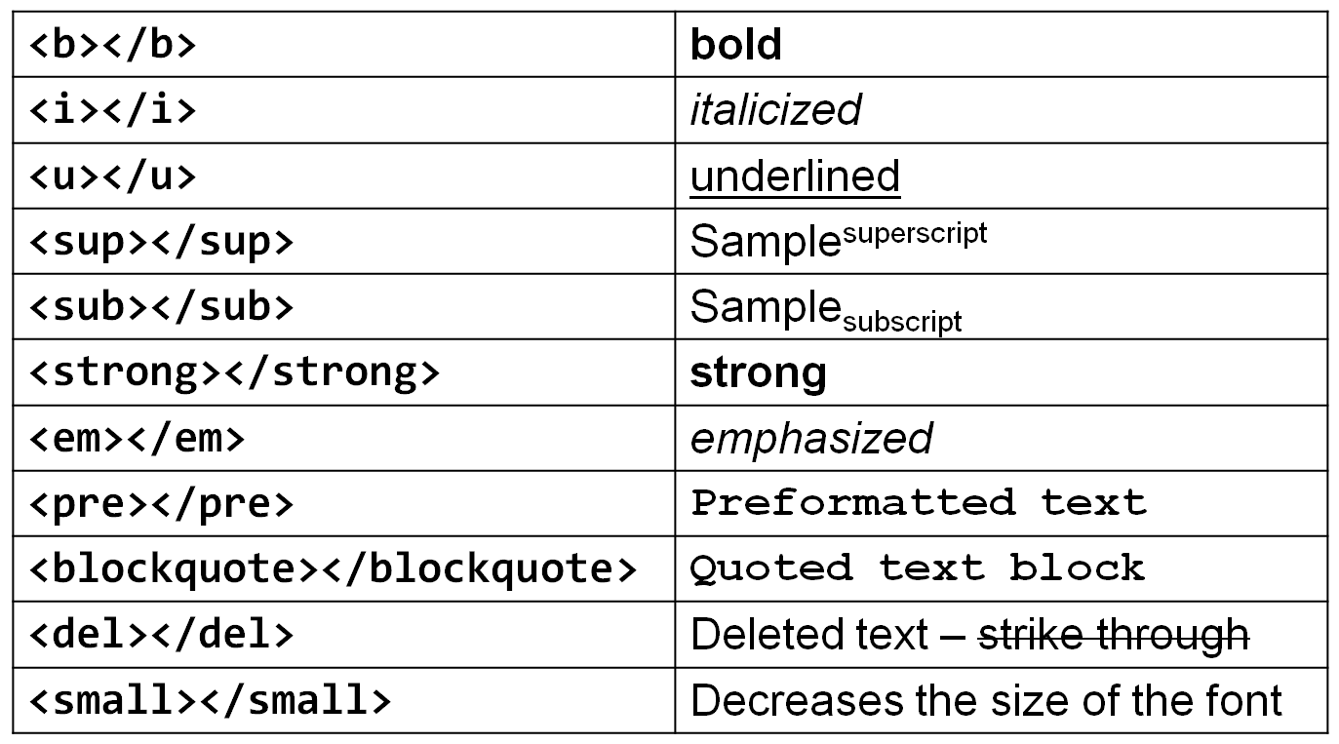
Text Formatting
Text formatting tags modify the text between the opening tag and the closing tag
Ex. <b>Hello</b> makes “Hello” bold

Slide 11
<html><head>
<title>Text Variations and Escape Sequences</title> </head>
<body>
<h1>Text Variations</h1>
<p>We can use <b>simple</b> tags to
<i>change</i> the appearance of
<strong>text</strong> within
<tt>Web pages</tt>.
Even super<sup>script</sup>
and sub<sub>scripts</sub> are
<em>supported</em>.</p>
<h1>Text Escape Sequences</h1>
<p> &amp; &lt; &gt; &quot; &copy; </p>
<h1>Preformatted text</h1>
<pre>hello
India
</pre> </body> </html>

Slide 12
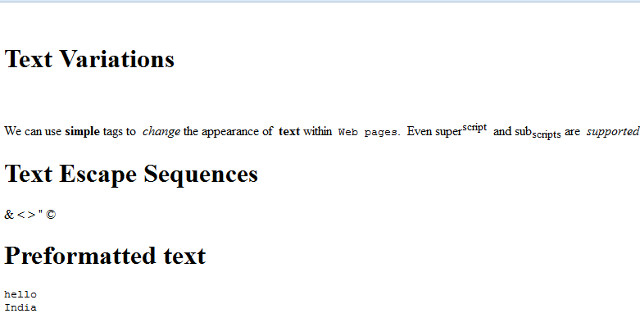
Output:

Slide 13
Line Breaks:
<body>
<p>The Earth<br />gets one hundred tons heavier every day<br/>due to falling space dust.</p>
</body>
Output:
The Earth
gets one hundred tons heavier every day
due to falling space dust.

Slide 14
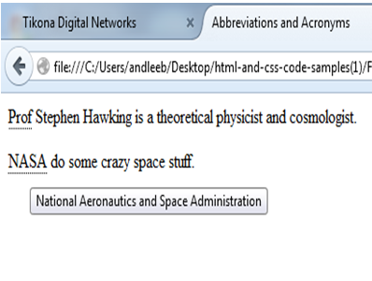
Abbreviations
Output:
<body>
<p><abbr title="Professor">Prof</abbr> Stephen Hawking is a theoretical physicist and cosmologist.</p>
<p><acronym title="National Aeronautics and Space Administration">NASA</acronym> do some crazy space stuff.</p>
</body>

Slide 15
Definitions
<body>
<p>A <dfn>black hole</dfn> is a region of space from which nothing, not even light, can escape.</p>
</body>
Output-
A black hole is a region of space from which nothing, not even light, can escape.

Slide 16
Quotations
<body>
<blockquote cite="http://en.wikipedia.org"> <p>Did you ever stop to think, and forget to start again?</p> </blockquote>
<p>As A.A. Milne said, <q>Some people talk to animals. Not many listen though. That's the problem.</q></p>
</body>
Output:
Did you ever stop to think, and forget to start again?
As A.A. Milne said, “Some people talk to animals. Not many listen though. That's the problem.”

Slide 17
Citation
<p><cite>A Brief History of Time</cite> by Stephen Hawking has sold over ten million copies worldwide.</p>
Output:
A Brief History of Time by Stephen Hawking has sold over ten million copies worldwide.

Slide 18
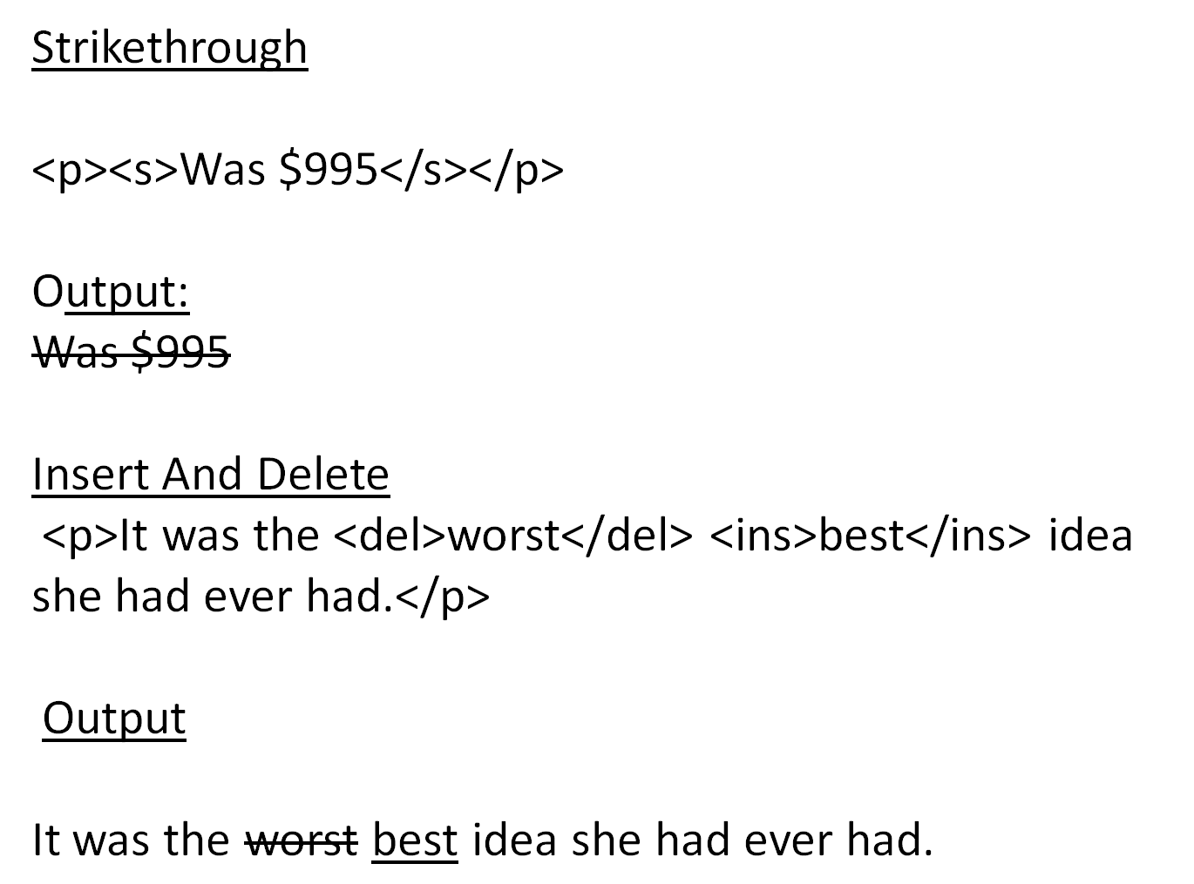

Slide 19
Miscellaneous Tags
<hr />: Draws a horizontal rule (line):
<hr size="5" width="70%" />
<center></center>: Deprecated!
<center>Hello World!</center>
<font></font>: Deprecated!
<font size="3" color="blue">Font3</font>
<font size="+4" color="blue">Font+4</font>

Slide 20
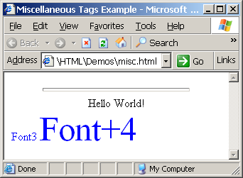
Miscellaneous Tags – Example
<html>
<head>
<title>Miscellaneous Tags Example</title>
</head>
<body>
<hr size="5" width="70%" />
<center>Hello World!</center>
<font size="3" color="blue">Font3</font>
<font size="+4" color="blue">Font+4</font>
</body>
</html>

Slide 21
HTML Entities
Symbol Name
HTML Entity
Symbol
Copyright Sign
&copy;
©
Registered Trademark Sign
&reg;
®
Trademark Sign
&trade;
™
Less Than
&lt;
<
Greater Than
&gt;
>
Ampersand
&amp;
&
Non-breaking Space
&nbsp;
Em Dash
&mdash;
—
Quotation Mark
&quot;
"
Euro
&#8364;
€
British Pound
&pound;
£
Japanese Yen
&yen;
¥

Slide 22
Special Characters – Example
<p>[&gt;&gt;&nbsp;&nbsp;Welcome
&nbsp;&nbsp;&lt;&lt;]</p>
<p>&#9658;I have following cards:
A&#9827;, K&#9830; and 9&#9829;.</p>
<p>&#9658;I prefer hard rock &#9835;
music &#9835;</p>
<p>&copy; 2006 by Svetlin Nakov &amp; his team</p>

Slide 23
