Slide 1
HTML
Working with Images

Slide 2


Slide 3
Adding Images
Images are usually added to a site using the <img> element. It must also carry ---
src attribute indicating the source of the image and
an alt attribute whose value is an alternate description for the image in case it does not load or the user has a visual impairment.
  <img src="logo.gif" alt="Wrox logo" />
  If file is to be accessed over the Web, must start with http:// (if not, will assume local file)

Slide 4
Image Attributes
    src: URL or filename for the image. The URL can be an absolute URL or a relative URL.
    width/height: to specify size of image.
    border: to specify borders around image in pixel.
    alt: recommended for users running a text browser.
    hspace/vspace: recommended for adding white spaces around image.
    Align : for horizontal & vertical aligning of image with text
    Ismap/usemap
    name

Slide 5
Changing Image Size
Images on a computer are not like photographs. Computer images are made up of a lot of little colored dots known as pixels.
Every image is made up of pixels and we can manipulate the image's size using pixels.
Height & Width attribute can be used to command the image tag for image manipulation.
    <IMG HEIGHT="##" WIDTH="##" SRC="image.gif">
replace the "##" with a number of pixels for height and width.

Slide 6
Images in Another Folder
If not specified, the browser expects to find the image in the same folder as the web page.
However, it is common to store images in a sub-folder. You must then include the folder name in the src attribute
      <img src="/images/myimage.gif“>

Slide 7
Where to Place Images
Here are some ways to add paragraphs and image togather--
<html>
  <body>
  <div style="width:450">
  <img src="images/bird.gif" alt="Bird" width="100" height="100" />
  <p> Some Text </p> <hr />
  <p><img src="images/bird.gif" alt="Bird" width="100" height="100" />
  Some Text </p> <hr />
  <p>Some Text <img src="images/bird.gif" alt="Bird" width="100" height="100" /> More Text </p>
  </div>
  </body>
  </html>

Slide 8
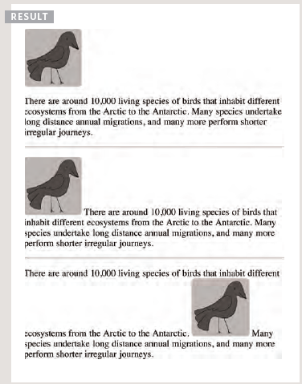
OUTPUT

Slide 9
In first paragraph text will appear after image.
In second , paragraph text will be bottom aligned with image.
In third, Text will be followed by image and further text will be bottom aligned with image.

Slide 10
Aligning Images Horizontally
The align attribute is used to align the image within the page or the element that contains the image such as table cell or div.
<html>
  <body>
    <div style="width:450">
    <p><img src="images/bird.gif" alt="Bird" width="100" height="100" align="left" /> Some Text</p> <hr />
    <p><img src="images/bird.gif" alt="Bird" width="100" height="100" align="right" /> Some Text</p>
    </div>
    </body>
</html>

Slide 11
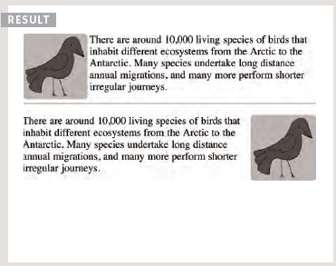
OUTPUT

Slide 12
Aligning Images Vertically
Align attribute can be used to command the image alignment.
<html>
  <body>
    <div style="width:450">
    <p><img src="images/bird.gif" alt="Bird" width="100" height="100" align=“top" /> Some Text</p> <hr />
    <p><img src="images/bird.gif" alt="Bird" width="100" height="100" align=“middle" /> Some Text</p>
    <p><img src="images/bird.gif" alt="Bird" width="100" height="100" align=“bottom" /> Some Text</p>
    </div>
    </body>
</html>
*** Default is bottom alignment.

Slide 13
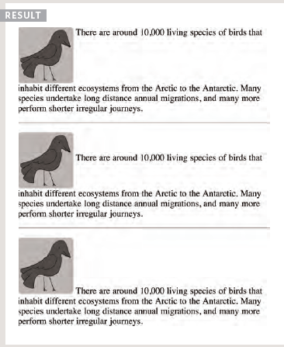
OUTPUT

Slide 14
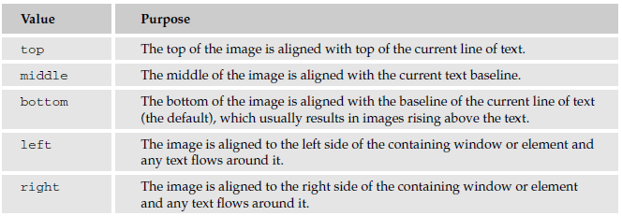
Values of align attribute

Slide 15
The hspace and vspace Attributes
The hspace and vspace attributes are used to control the amount of whitespace around an image.
  hspace="10“ vspace="14“
The value is the amount in pixels of whitespace that should be left around the image, and is like a white border.
The hspace and vspace attributes are particularly helpful because text can flow around an image.

Slide 16
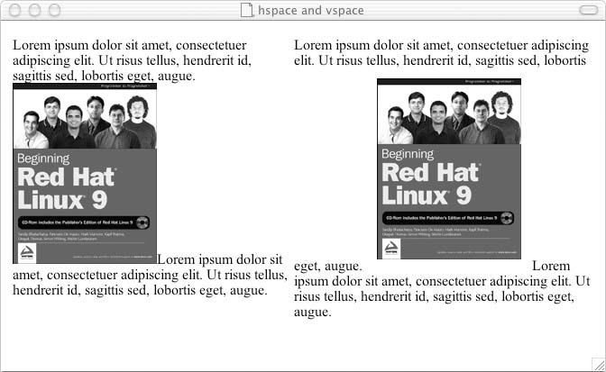
Look of the page after using hspace & vspace:

Slide 17
Figure and Figure Caption
The figure element represents a unit of content, optionally with a caption, that is self-contained, that is typically referenced as a single unit from the main flow of the document.
It can be moved away from the main flow of the document without affecting the document’s meaning.
A caption can be associated with the <figure> element by inserting a <figcaption>inside it (as the first or the last child).

Slide 18
An image with <figure> & <figcaption>
<html>
<body>
<figure>
<img src="/macaque.jpg" alt="Macaque in the trees">
<figcaption>A cheeky macaque, Lower Kintaganban River, Borneo. Original by <a href= "http://www.flickr.com/photos/rclark/"> Richard Clark</a>
  </figcaption>
  </figure>
  </body>
  </html>

Slide 19
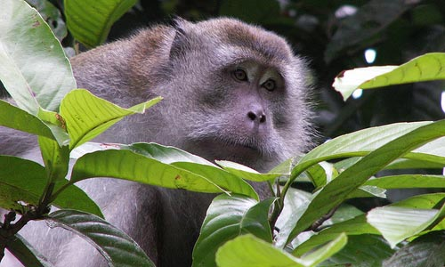
A cheeky macaque, Lower Kintaganban River, Borneo. Original by Richard Clark

