Slide 1
Using HTML Tables

Slide 2
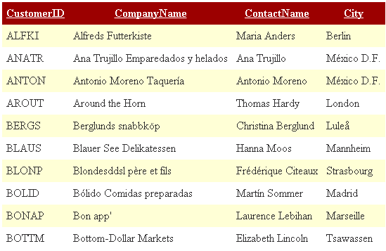
Table Example

Slide 3
Defining a Table Structure
The first step to creating a table is to specify the table structure:
  the number of rows and columns
  the location of column headings
  the placement of a table caption
Once the table structure is in place, one can start entering data into the table.

Slide 4
The General Table Structure
  <table>
  <tr>
  <td> First Cell </td>
  <td> Second Cell </td>
  </tr>
  <tr>
  <td> Third Cell </td>
  <td> Fourth Cell </td>
  </tr>
  </table>
two rows
two columns

Slide 5
HTML Structure of a Table
beginning of the table structure
table cells
You do not need to indent the <td> tags or place them on separate lines, but you may find it easier to interpret your code if you do so.
After the table structure is in place, you’re ready to add the text for each cell.
first row of all in the table
end of the table structure

Slide 6
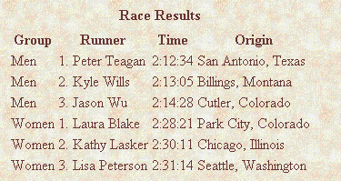
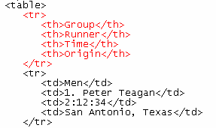
Adding Table Headings to the Table
Text in cells formatted with the <th> tag is bold and centered above each table column.
table headings

Slide 7
Using the <table>, <tr>, <td>and <th> Tags
Graphical tables are enclosed within a two-sided <table> tag that identifies the start and ending of the table structure.
Each row of the table is indicated using a two-sided <tr> (for table row).
Within each table row, a two-sided <td> (for table data) tag indicates the presence of individual table cells.
HTML provides the <th> tag for table headings.

Slide 8
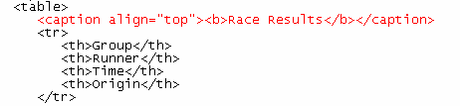
Table Caption
caption text
caption will be centered above the table

Slide 9
Creating a Table Caption
HTML allows you to specify a caption for a table.
The syntax for creating a caption is: <caption align=“alignment”>caption text</caption>
  alignment indicates the caption placement
  a value of “bottom” centers the caption below the table
  a value of “top” or “center” centers the caption above the table
  a value of “left” or “right” place the caption above the table to the left or right

Slide 10
Tables with Different Borders Values
This figure shows the effect on a table’s border when the border size is varied.

Slide 11
Adding a Table Border
By default, browsers display tables without table borders.
A table border can be added using the border attribute to the <table> tag.
The syntax for creating a table border is: <table border=“value”>
  value is the width of the border in pixels
The size attribute is optional; if you don’t specify a size, the browser creates a table border 1 pixel wide.

Slide 12
Cell Spacing and Padding
Tables have two important attributes:
cellspacing
Defines the empty space between cells
cellpadding
Defines the empty space around the cell content
cell
cell
cell
cell
cell
cell
cell
cell

Slide 13
Tables with Different Cell Spacing & Cell Padding Values
different cell spacing values
different cell padding values
Syntax : <table cellspacing=“5" cellpadding=“5">

Slide 14
Defining Cell Padding & Cell Spacing
Cell spacing refers to the space between the cells.
The syntax for specifying the cell space is:
  <table cellspacing=“value”>
  value is the width of the interior borders in pixels
  the default cell spacing is 2 pixels
Cell padding refers to the space within the cells.
The syntax for this attribute is:
<table cellpadding=“value”>
  value is the distance from the table text to the cell border, as measured in pixels
  the default cell padding value is 1 pixel

Slide 15
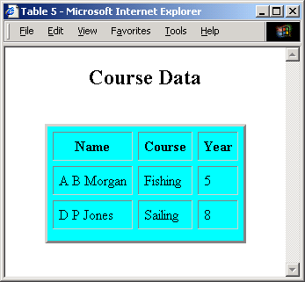
Table attributes
<table border="3" align="center" cellspacing="6" cellpadding="6" bgcolor="cyan">
<caption>
<h2>Course Data</h2>
</caption>
<tr>
<th>Name</th>
<th>Course</th>
<th>Year</th>
</tr>
<tr>
<td>A B Morgan</td>
<td>Fishing</td>
<td>5</td>
</tr>
<!– etc -->

Slide 16
Table Width and Height
  Table Width & Height is optional.
  Width & Height can be defined in the open table tag
    Example: <table width=“100” height=“100”>
    If no size values are specified, the browser will decide on an appropriate size. Results will vary between browsers.
    To create a table whose height is equal to the entire height of the display area, enter the attribute height=“100%”.

Slide 17
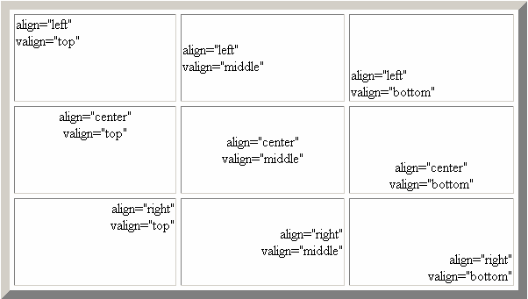
Values of the Align & Valign Attributes

Slide 18
Aligning a Table on the Web Page
By default, a browser places a table on the left margin of a Web page, with surrounding text placed above and below the table.
To align a table with the surrounding text, use the align attribute as follows: align=“alignment”
  alignment equals “left”, “right”, or “center”
  left or right alignment places the table on the margin of the Web page and wraps surrounding text to the side
  center alignment places the table in the horizontal center of the page, but does not allow text to wrap around it
The align attribute is similar to the align attribute used with the <img> tag.

Slide 19

Column and Row Span – Example - 1
<TABLE border="1">
<TR>
<TD>1</TD>
<TD rowspan="2">2 </TD>
<TD>3</TD>
</TR>
<TR>
<TD>4 </TD>
<TD>6</TD>
</TR>
<TR>
<TD>7 </TD>
<TD>8 </TD>
<TD>9 </TD>
</TR>
</TABLE>

Slide 20
Column and Row Span – Example - 2
<table cellspacing="0">
<tr>
<td>Cell[1,1]</td>
<td colspan="2">Cell[2,1]</td>
</tr>
<tr>
<td>Cell[1,2]</td>
<td rowspan="2">Cell[2,2]</td>
<td>Cell[3,2]</td>
</tr>
<tr>
<td>Cell[1,3]</td>
<td>Cell[2,3]</td>
</tr>
</table>
Cell[1,1]
Cell[2,1]
Cell[1,2]
Cell[2,2]
Cell[3,2]
Cell[1,3]
Cell[2,3]

Slide 21
Spanning Rows and Columns
To merge several cells into one, you need to create a spanning cell.
A spanning cell is a cell that occupies more than one row or column in a table.
Spanning cells are created by inserting the rowspan and colspan attribute in a <td> or <th> tag.
The syntax for these attributes is: rowspan=“value” colspan=“value”
  value is the number of rows or columns that the cell spans in the table

Slide 22
Applying a Background Color
Table elements support the bgcolor attribute.
To specify a background color for all of the cells in a table, all of the cells in a row, or for individual cells, by adding the bgcolor attribute to either the <table>, <tr>, <td>, or <th> tags as follows:
  <table bgcolor=“color”>
  <tr bgcolor=“color”>
  <td bgcolor=“color”>
  <th bgcolor=“color”>
  color is either a color name or hexadecimal color value

Slide 23


The bordercolor Attribute
By default, table borders are displayed in two shades of gray that create a three-dimensional effect.
The syntax for the bordercolor attribute is:
<table bordercolor=“color”>
  color is an HTML color name or hexadecimal color value
Internet Explorer and Netscape apply this attribute differently.
<table border=“10” bordercolor=“blue”>
Internet Explorer
Netscape

Slide 24

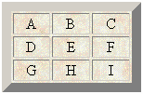
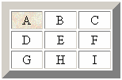
Applying a Table Background
Add a background image to your tables using the background attribute.
A background can be applied to the entire table or to a cell.
parch.jpg
<table background=“parch.jpg”>
<td background=“parch.jpg”>

