Slide 1

AI/ML Part-02
Date
Name
Title

Slide 2
Objectives
Understand the concept and applications of linear regression.
Learn the mathematical foundation of regression models.
Build and train linear regression models using machine learning tools.
Understand cost functions and optimization techniques.
Evaluate model performance using regression metrics.
Apply linear regression to real-world prediction problems.
Interpret model coefficients and make data-driven decisions.

Slide 3
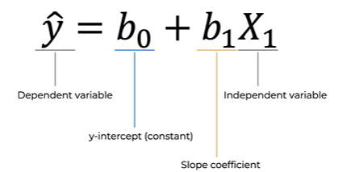
Understanding Simple Linear Regression
Simple Linear Regression is one of the most fundamental algorithms in machine learning.
It helps us predict the value of one variable (the dependent variable) based on another variable (the independent variable).
The Simple Linear Regression Equation
The equation for simple linear regression is:

Slide 4
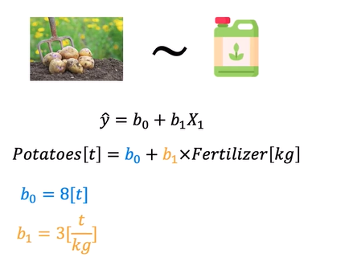
Example: Predicting Potato Yield
Suppose a farmer wants to predict the potato yield based on the amount of nitrogen fertilizer used.
The regression equation becomes:
After training the regression model on historical farm data, we obtain:
Intercept (b₀) = 8 tons
Slope (b₁) = 3 tons per kilogram
So the equation becomes:

Slide 5
What Do These Values Mean?
Intercept (b₀ = 8)
The intercept represents the predicted potato yield when no fertilizer is used.
If fertilizer = 0 kg
Predicted potato yield = 8 tons
Slope (b₁ = 3)
The slope tells us how the potato yield changes with fertilizer usage.
A slope of 3 means:
For every additional 1 kilogram of nitrogen fertilizer applied, the predicted potato yield increases by 3 tons.
This indicates a positive relationship between fertilizer usage and potato production.

Slide 6
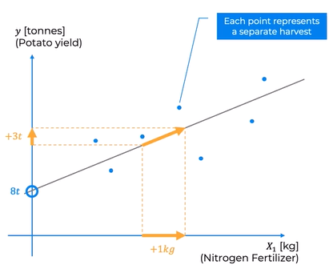
Visual Interpretation
Imagine plotting the data on a graph:
X-axis: Nitrogen fertilizer used (kg)
Y-axis: Potato yield (tons)
Each point on the scatter plot represents a different harvest season.
How much fertilizer was applied
How many tons of potatoes were harvested
These observations form a collection of data points.
The linear regression algorithm then fits the best-fit straight line through these points.
The line starts at the Y-intercept (8 tons).
It rises with a slope of 3, meaning the predicted yield increases by 3 tons for every additional kilogram of fertilizer.

Slide 7
Key Takeaways
The dependent variable (Y) is the value being predicted.
The independent variable (X) is the predictor.
The intercept (b₀) is the predicted value of Y when X is zero.
The slope (b₁) shows how much Y changes for each one-unit increase in X.
A scatter plot visualizes the data, while the regression line represents the best linear relationship between the variables.

Slide 8
Ordinary Least Squares (OLS): Finding the Best Regression Line
When working with Simple Linear Regression, one important question arises:
How do we determine which regression line best fits the data?
Since multiple straight lines can be drawn through the same set of data points, we need a systematic way to identify the one that provides the most accurate predictions.
This is where the Ordinary Least Squares (OLS) method comes into play.

Slide 9
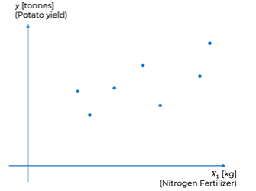
Why Do We Need Ordinary Least Squares?
Imagine a scatter plot representing historical data. For example:
X-axis: Nitrogen fertilizer used (kg)
Y-axis: Potato yield (tons)
Several straight lines could potentially fit these data points. Some may be steeper, others flatter, and each one produces different predictions.

Slide 10
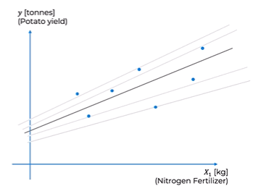
Why Do We Need Ordinary Least Squares?
The challenge is to determine:
Which line represents the data most accurately?
How do we define the "best" fit?
The Ordinary Least Squares (OLS) method provides the answer by measuring how well each candidate line predicts the observed data.

Slide 11

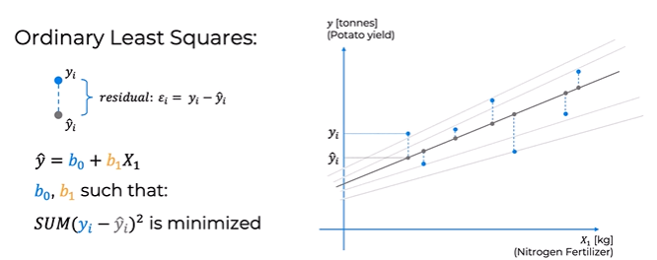
What Is a Residual?
The difference between the actual value and the predicted value is called the residual (or prediction error).
Using our example:
Actual yield = 2 tons
Predicted yield = 1.5 tons
Residual:
2−1.5=0.5 tons
A residual indicates how far the prediction is from the actual observation.

Slide 12
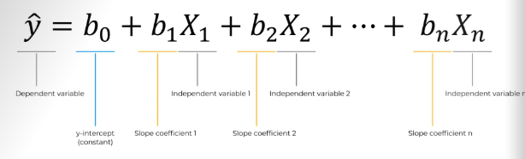
Introduction to Multiple Linear Regression
Multiple Linear Regression allows us to use multiple independent variables to make predictions.
The Multiple Linear Regression Equation
The general equation for Multiple Linear Regression is:

Slide 13
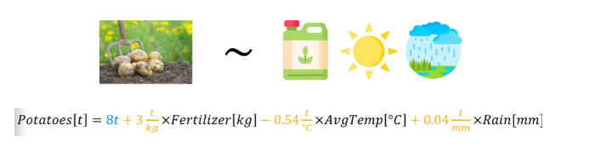
Example: Predicting Potato Yield
Suppose we want to predict potato production based on three different factors:
Amount of nitrogen fertilizer used
Average temperature during the season
Amount of rainfall received
The regression equation could look like:

Slide 14
Interpreting the Equation
The diagram above illustrates the Machine Learning process.
Intercept: 8 Tons
The value 8 tons represents the predicted potato yield when all input variables are zero.
This is the baseline value of the model.

Slide 15
Interpreting the Equation
Fertilizer Coefficient: 3 Tons per Kilogram
For every additional kilogram of nitrogen fertilizer used, potato production increases by approximately 3 tons, assuming temperature and rainfall remain unchanged.
This is a positive relationship.

Slide 16
Interpreting the Equation
Temperature Coefficient: -0.54 Tons per Degree Celsius
For every 1°C increase in temperature, potato production decreases by 0.54 tons, assuming fertilizer and rainfall remain constant.
The negative value indicates an inverse relationship.
Higher temperatures may reduce potato yield.

Slide 17
Interpreting the Equation
Rainfall Coefficient: 0.04 Tons per Millimeter
Every additional millimeter of rainfall increases the predicted potato yield by 0.04 tons, assuming other factors remain unchanged.
This represents a positive relationship between rainfall and production

Slide 18
Why Use Multiple Linear Regression?
Real-world problems are rarely influenced by only one factor.
For example, potato production depends on many environmental conditions:
Fertilizer usage
Temperature
Rainfall
Soil quality
Sunlight
Irrigation

Slide 19
Thank you

