Slide 1

TypeScript
Date
Name
Title

Slide 2
Objectives
Understand TypeScript fundamentals and type system.
Understand TypeScript data types
Work with arrays and functions
Use spread & rest operators
Learn proper usage of var, let, and const
Write type-safe functions and classes
Use types, interfaces, and enums effectively
Notes:
https://www.javabrahman.com/java-8/java-8-java-util-stream-collector-basics-tutorial-with-examples/
https://www.journaldev.com/2763/java-8-functional-interfaces
http://winterbe.com/posts/2014/03/16/java-8-tutorial/
https://www.oreilly.com/learning/java-8-functional-interfaces

Slide 3

ARTIFICIAL INTELLIGENCE Vs. MACHINE LEARNING Vs. DEEP LEARNING
EASY
ADVANCED

Slide 4
ARTIFICIAL INTELLIGENCE Vs. MACHINE LEARNING Vs. DEEP LEARNING Vs. DATA SCIENCE
ARTIFICIAL INTELLIGENCE (AI)
MACHINE LEARNING (ML)
DATA SCIENCE (DS)
DEEP LEARNING (DL)

Slide 5
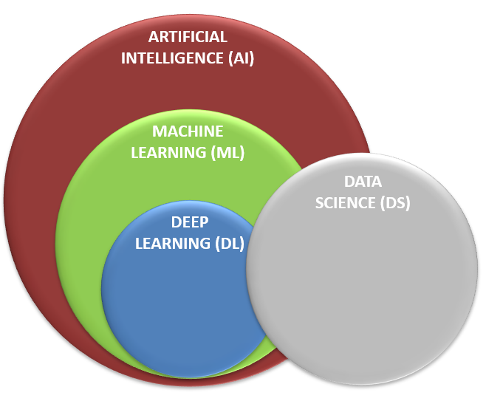

ARTIFICIAL INTELLIGENCE (AI)
AI is the science that enable computers to think like humans.
AI allows computers to imitate human intelligence and do things that humans do!
AI can make decision (Example: buy/sell stocks), understand text (Example: read articles), and detect faces.

Slide 6
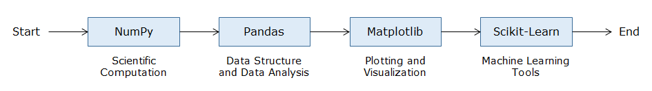
Why Python Libraries?
Few of the popular libraries in data science include NumPy, Pandas, Matplotlib and Scikit-Learn.

Slide 7
Python Libraries?
Numpy
To get the mathematical and structural understanding of such data
To build a base for Pandas, the data manipulation library
To get familiar with terms like arrays, axis, vectorization etc
Pandas
To read the data
To explore the data
To do operations on the data
To manipulate the data
To draw simple visualizations for self-consumption
To generate insights

Slide 8
Python Libraries?
Matplotlib
To visualize the data
To generate deep insights
To present the data to the leadership
To get a visual understanding of various features
Sci-kit learn
To get data ready for model building
To build predictive models
To evaluate the models
To infer the model results and present to the leadership

Slide 9


Introduction to Numpy
A python List can be used to store a group of elements together in a sequence. It can contain heterogeneous elements.
Following are some examples of List:
To perform operations on the List elements, one needs to iterate through the List. For example, if five extra marks need to be awarded to all the entries in the student marks list. The following approach can be used to achieve the same:

Slide 10
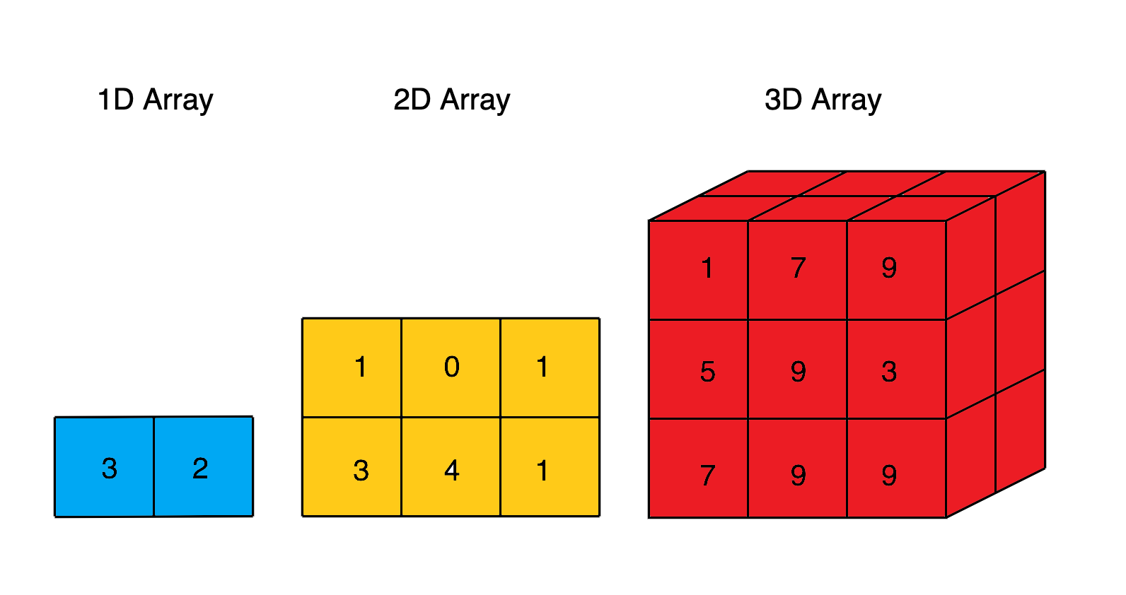
Data structures in Numpy
The main data structure of NumPy is the ndarray or n-dimensional array.
The ndarray is a multidimensional container of elements of the same type as depicted below. It can easily deal with matrix and vector operations.

Slide 11
the benefits of using Numpy
As the array size increases, Numpy can execute more parallel operations, thereby making computation faster. When the array size gets close to 5,000,000, NumPy gets around 120 times faster than Python List.
NumPy has many optimized built-in mathematical functions. These functions helps in performing variety of complex mathematical computations faster and with very minimal code.
Another great feature of NumPy is that it has multidimensional array data structures that can represent vectors and matrices. This can be useful as lot of machine learning algorithms rely on matrix operations.

Slide 12

Importing Numpy
Numpy library needs to be imported in the environment before it can be used as shown below. 'np' is the standard alias used for Numpy.

Slide 13

Numpy object creation
Numpy library needs to be imported in the environment before it can be used as shown below. 'np' is the standard alias used for Numpy.

Slide 14
Numpy object creation
Numpy array can be created by using array() function. The array() function in Numpy returns an array object named ndarray.
Syntax: np.array(object, dtype)
object – A python object(for example, a list)
dtype – data type of object (for example, integer)

Slide 15
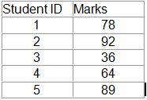

Numpy object creation
Example: Consider the following marks scored by students:
These marks can be represented in a one-dimensional Numpy array as shown below:

Slide 16
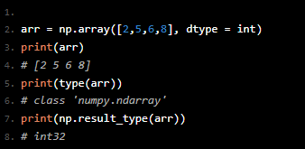
Numpy object creation
Array Creation
A NumPy nd-array inputs a basic Python list as an argument along with an explicit datatype (for typecasting) as shown below:
Here, we have used np.array() function which takes 2 arguments, the input list, and the corresponding data type (dtype). To check the data type of a particular NumPy object we have used np.result_type() command.

Slide 17
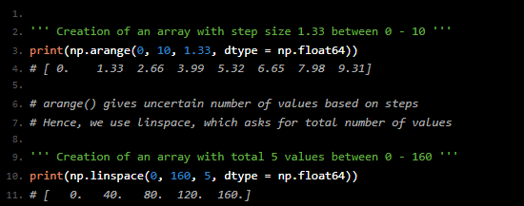
Numpy object creation
Most of the time, it is not an intuitive way to pass a list of predefined components. Therefore, NumPy offers some frequently used functions to create a NumPy object as shown below:

Slide 18
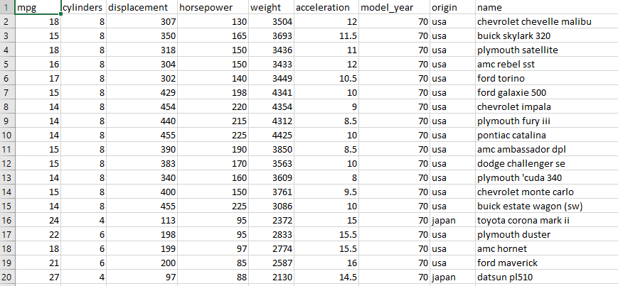
Unsupervised Machine Learning
The following dataset has been provided by XYZ Custom Cars. This data comes in a csv file format.
There are various columns in this dataset. Each column contains multiple values.
These values can be represented as lists of items. Since each column contains homogenous values, Numpy arrays can be used to represent them.

Slide 19

NumPy Array
Let us understand , how to represent the car ‘horsepower’ values in a Numpy array.

Slide 20
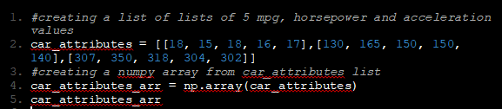

NumPy Array
How can multiple columns be represented together?
This can be achieved by creating the Numpy array from List of Lists.
Let us understand , how to represent the car 'mpg', ‘horsepower’, and 'acceleration' values in a Numpy array.

Slide 21
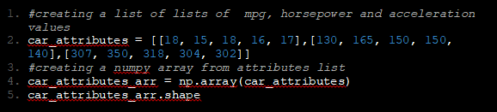
NumPy Array
The numpy.ndarray.shape returns a tuple that describes the shape of the array.
For example:
a one-dimensional array having 10 elements will have a shape as (10,)
a two-dimensional array having 10 elements distributed evenly in two rows will have a shape as (2,5)
Let us comprehend, how to find out the shape of car attributes array.
Here, 3 represents the number of rows and 5 represents the number of elements in each row.

Slide 22
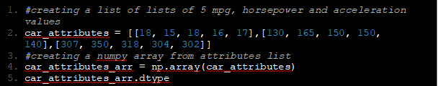

'dtype' of ndarray
'dtype' refers to the data type of the data contained by the array. Numpy supports multiple datatypes like integer, float, string, boolean etc.
Below is an example of using dtype property to identify the data type of elements in an array.

Slide 23
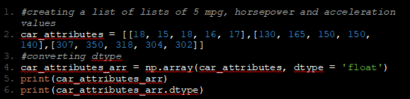

Changing dtype
Numpy dtype can be changed as per requirements. For example, an array of integers can be converted to float.
Below is an example of using dtype as an argument of np.array() function to convert the data type of elements from integer to float.

Slide 24

Accessing Numpy arrays
The elements in the ndarray are accessed using index within the square brackets [ ].
In Numpy, both positive and negative indices can be used to access elements in the ndarray.
Positive indices start from the beginning of the array, while negative indices start from the end of the array.
Array indexing starts from 0 in positive indexing and from -1 in negative indexing.

Slide 25


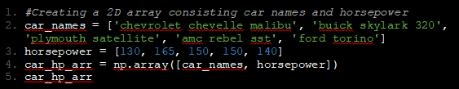

Accessing Numpy arrays
1. Accessing element from 1D array.
2. Accessing elements from a 2D array

Slide 26

Accessing Numpy arrays
Accessing elements from a 2D array
The syntax for accessing elements in a 2D NumPy array is:

Slide 27


Slicing Numpy arrays
Slicing is a way to access and obtain subsets of ndarray in Numpy.
Syntax:
array_name[start : end] – index starts at ‘start’ and ends at ‘end - 1’.
Slicing from 1D array

Slide 28
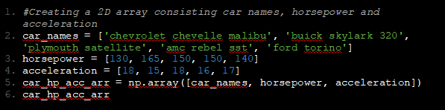
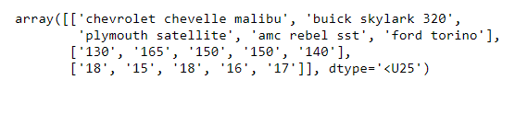
Slicing Numpy arrays
Slicing from a 2D array

Slide 29
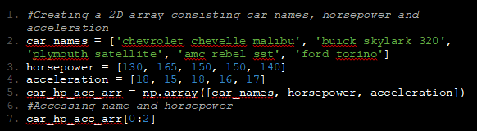

Slicing Numpy arrays
Slicing from a 2D array

Slide 30
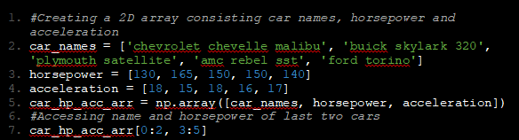

Slicing Numpy arrays
Slicing from a 2D array

Slide 31
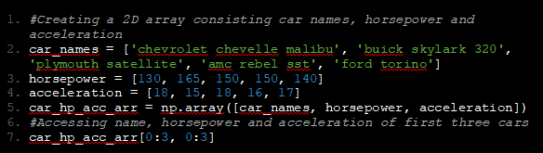

Slicing Numpy arrays
Slicing from a 2D array

Slide 32
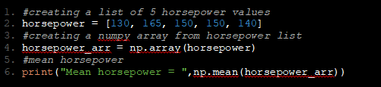

Mean and Median
Problem Statement:
The engineers at XYZ Custom Cars want to know about the mean and median of horsepower.
Solution:
The mean and median can be calculated with the help of following code:

Slide 33
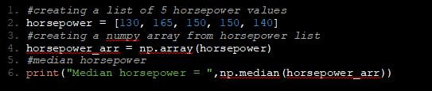

Mean and Median
Problem Statement:
The engineers at XYZ Custom Cars want to know about the mean and median of horsepower.
Solution:
The mean and median can be calculated with the help of following code:

Slide 34
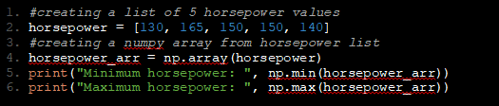

Mean and Median
Problem Statement:
The engineers at XYZ Custom Cars want to know about the minimum and maximum horsepower.
Solution:
The min and max can be calculated with the help of following code:

Slide 35
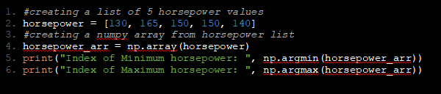

Finding the index of minimum and maximum values:
'argmin()' and 'argmax()' return the index of minimum and maximum values in an array respectively.

Slide 36
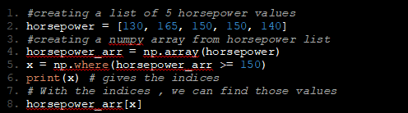

Querying/searching in an array
Problem Statement:
The engineers at XYZ Custom Cars want to know the horsepower of cars that are greater than or equal to 150.
Solution:
The 'where' function can be used for this requirement. Given a condition, 'where' function returns the indexes of the array where the condition satisfies. Using these indexes, the respective values from the array can be obtained.

Slide 37
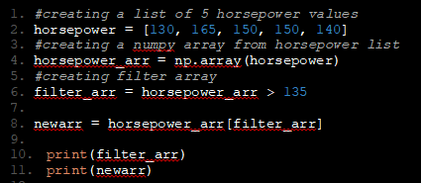

Filter data
Problem Statement:
The Engineers at XYZ Custom Cars want to create a separate array consisting of filtered values of horsepower greater than 135.
Solution:
Getting some elements out of an existing array based on certain conditions and creating a new array out of them is called filtering.
The following code can be used to accomplish this:

Slide 38
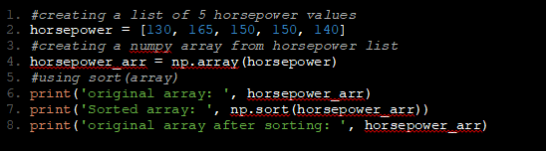

Sorting an array
Problem Statement:
The engineers at XYZ Custom Cars want the horsepower in sorted order.
Solution:
The numpy array can be sorted by passing the array to the function sort(array) or by array.sort.
So, what is the difference between these two functions though they are used for the same functionality?

Slide 39
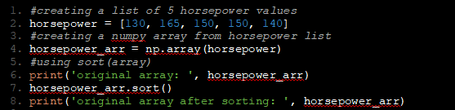

Sorting an array
Problem Statement:
The engineers at XYZ Custom Cars want the horsepower in sorted order.
Solution:
The numpy array can be sorted by passing the array to the function sort(array) or by array.sort.
The difference is that the array.sort() function modifies the original array by default, whereas the sort(array) function does not.

Slide 40
Vectorized operations
The mathematical operations can be performed on Numpy arrays.
Numpy makes use of optimized, pre-compiled code to perform mathematical operations on each array element.
This eliminates the need of using loops, thereby enhancing the performance. This process is called vectorization.
Numpy provides various mathematical functions such as sum(), add(), sub(), log(), sin() etc. which uses vectorization.

Slide 41
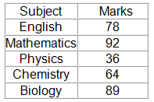
Vectorized operations
Consider an example of marks scored by a student:

Slide 42


Vectorized operations
Problem Statement:
Calculate the sum of all the marks.
Solution:
The sum() function can be used which internally uses vectorizaton

Slide 43


Vectorized operations
Problem Statement:
Award extra marks in subjects as follows:
English: +2
Mathematics: +2
Physics: +5
Chemistry: +10
Biology: +2
Solution:
Below is the solution to the problem:

Slide 44

Vectorized operations
Also, the same operation can be performed as shown below:
Both the above methods use vectorization internallly eliminating the need of loops.

Slide 45
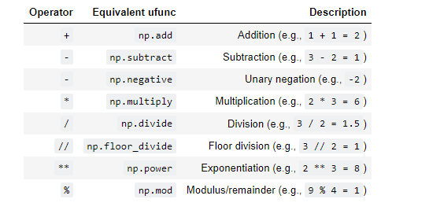
Vectorized operations
Other arithmetic operations can also be performed in a similar manner.

Slide 46
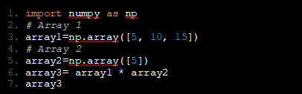
Broadcasting
"Broadcasting" refers to the term on how Numpy handles arrays with different shapes during arithmetic operations.
Array of smaller size is stretched or copied across the larger array.
For example, considering the following arithmetic operations across 2 arrays:
In this example, the array2 is being stretched or copied to match array1 during the arithmetic operation resulting in new array array3 with the same shape as array1.

Slide 47

Broadcasting
The following diagram explains broadcasting:
In the first operation, the shape of first array is 1x3 and the shape of second array is 1x1. Hence, according to broadcasting rules, the second array gets stretched to match the shape of first array and the shape of the resulting array is 1x3.

Slide 48

Broadcasting
The following diagram explains broadcasting:
In the second operation, the shape of first array is 3x3 and the shape of second array is 1x3. Hence, according to broadcasting rules, the second array gets stretched to match the shape of first array and the shape of the resulting array is 3x3.

Slide 49

Broadcasting
The following diagram explains broadcasting:
In the third operation, the shape of first array is 3x1 and the shape of second array is 1x3. Hence, according to broadcasting rules, both first and second arrays get stretched and the shape of the resulting array is 3x3.

Slide 50
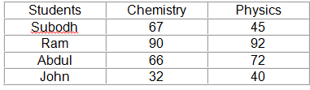

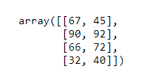
Broadcasting - demo
Consider the following table consisting marks scored by four student in two different subjects:
The teacher of these students wants to represent their marks in an array. To do so, the marks can be stored using a 4x2 array as follows:

Slide 51
Thank you

