Slide 1

AI/ML Part-03
Date
Name
Title

Slide 2
Objectives
Understand the concepts of Multiple Linear Regression.
Prepare and preprocess data for regression analysis.
Encode categorical variables using dummy variables.
Avoid the Dummy Variable Trap and understand multicollinearity.
Build and train Multiple Linear Regression models using Python and Scikit-learn.
Make predictions and interpret regression coefficients.

Slide 3
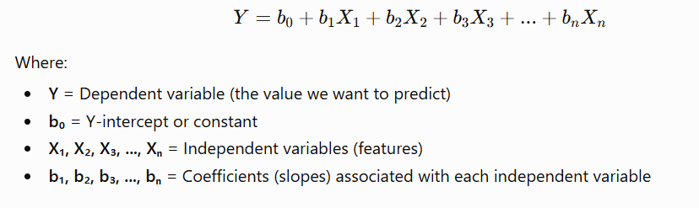
Introduction to Multiple Linear Regression
While Simple Linear Regression predicts an outcome using one independent variable, Multiple Linear Regression allows us to use multiple independent variables to make predictions
The Multiple Linear Regression Equation

Slide 4
Understanding the Coefficients
In Multiple Linear Regression, each independent variable has its own coefficient.
The coefficient represents how much the dependent variable changes when that particular feature increases by one unit, while keeping all other variables constant.
For example:
A positive coefficient means the feature increases the predicted outcome.
A negative coefficient means the feature decreases the predicted outcome.

Slide 5
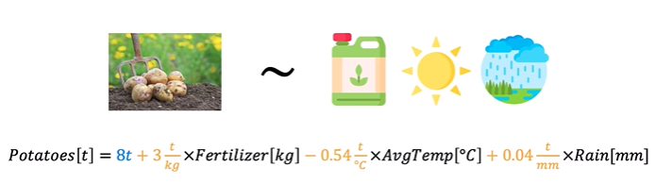
Example: Predicting Potato Yield
Let's return to our farming example.
Suppose we want to predict potato production based on three different factors:
Amount of nitrogen fertilizer used
Average temperature during the season
Amount of rainfall received
The regression equation could look like:

Slide 6
Interpreting the Equation
Intercept: 8 Tons
The value 8 tons represents the predicted potato yield when all input variables are zero.
This is the baseline value of the model.
Fertilizer Coefficient: 3 Tons per Kilogram
For every additional kilogram of nitrogen fertilizer used, potato production increases by approximately 3 tons, assuming temperature and rainfall remain unchanged.
This is a positive relationship.
Temperature Coefficient: -0.54 Tons per Degree Celsius
For every 1°C increase in temperature, potato production decreases by 0.54 tons, assuming fertilizer and rainfall remain constant.
The negative value indicates an inverse relationship.
Higher temperatures may reduce potato yield.

Slide 7
Interpreting the Equation
Rainfall Coefficient: 0.04 Tons per Millimeter
Every additional millimeter of rainfall increases the predicted potato yield by 0.04 tons, assuming other factors remain unchanged.
This represents a positive relationship between rainfall and production.

Slide 8
Why Use Multiple Linear Regression?
Real-world problems are rarely influenced by only one factor.
For example, potato production depends on many environmental conditions:
Fertilizer usage
Temperature
Rainfall
Soil quality
Sunlight
Irrigation
Using multiple variables allows the model to capture more complex relationships and often improves prediction accuracy.

Slide 9
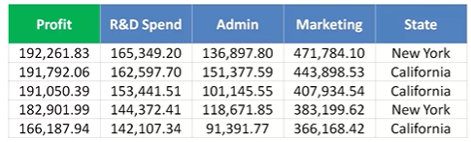
Dummy Variables in Linear Regression Explained
When building a linear regression model, not all variables in a dataset are numerical.
Some variables, such as a company's state of operation, are categorical.
Since regression models work with numbers, categorical data must be converted into a numerical format. This is where dummy variables come into play.

Slide 10
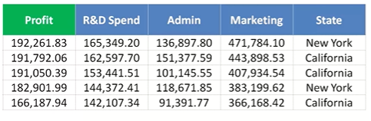
Problem Statement
Suppose we have a dataset containing information about startups, including:
Profit (Target/Dependent Variable)
R&D Spend
Administration Spend
Marketing Spend
State (New York or California)

Slide 11

Problem Statement
The objective is to determine whether these factors influence a company's profit and to build a model that can predict profit based on these variables.
Here:
Dependent Variable (Y): Profit
Independent Variables (X):
R&D Spend
Administration Spend
Marketing Spend
State
The regression equation initially looks like this:

Slide 12
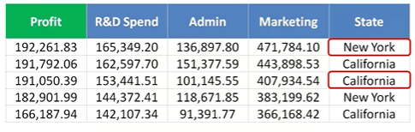
What is a Dummy Variable?
A dummy variable is a numerical representation of a categorical variable.
Dummy variables allow regression models to work with categorical data.

Slide 13
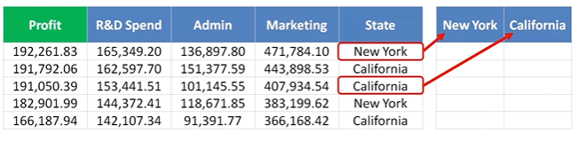
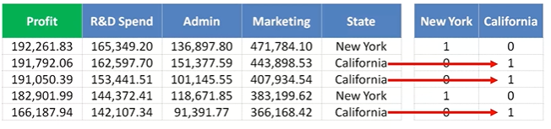
Creating Dummy Variables
Assume the State column has two categories:
New York
California
We create separate columns for each category.

Slide 14
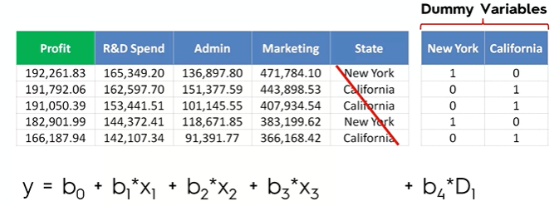
Why Don't We Use Both Dummy Variables?
Although we create two dummy columns, we do not include both in the regression model.
Instead, we use only one dummy variable.
For example:
Keep New York
Drop California

Slide 15
Dummy Variables as Switches
A simple way to understand dummy variables is to think of them as ON/OFF switches.
For the New York dummy:
1 (ON): Company operates in New York.
0 (OFF): Company operates in California.
Since only two states exist, there is no need for any value other than 0 or 1.

Slide 16
Key Takeaways
Regression models require numerical inputs.
Categorical variables must be converted into dummy variables.
Dummy variables contain only 0s and 1s.
For n categories, only n − 1 dummy variables should be included in the model.
The omitted category becomes the reference (baseline).
Dummy variables act like switches, turning the effect of a category ON (1) or OFF (0).
Avoid including all dummy variables to prevent the Dummy Variable Trap.

Slide 17
Support Vector Machine (SVM)
Support Vector Machine (SVM) is a powerful supervised learning algorithm used for both classification and regression tasks.
Support Vector Machine (SVM) is one of the most widely used supervised machine learning algorithms. It is capable of solving both:
Classification problems
Regression problems
Classification
In classification, the target variable belongs to a finite set of categories, such as:
Yes / No
Spam / Not Spam
Fraud / Genuine

Slide 18
Support Vector Machine (SVM)
Regression
In regression, the target variable contains continuous numerical values, such as:
House prices
Temperature
Sales prediction
Although SVM can perform both tasks, it is primarily used for classification problems because of its high accuracy and ability to create robust decision boundaries.

Slide 19
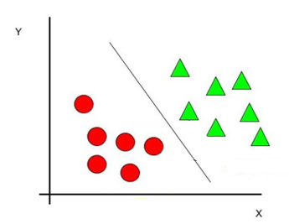
Working Principle of SVM
Suppose we have a dataset containing two classes:
Red circles
Green triangles
The objective of an SVM classifier is to find a hyperplane that separates these two classes.
A hyperplane is a decision boundary that divides the data into different classes. In a two-dimensional dataset, a hyperplane is simply a straight line.
However, there can be multiple hyperplanes that separate the same dataset.
The important question is:
Which hyperplane should we choose?
The answer lies in the concept of margin.

Slide 20
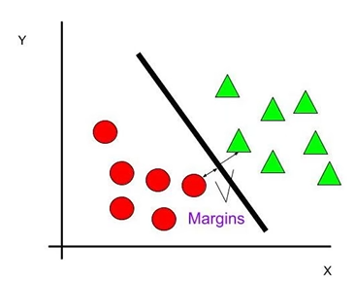
What is Margin?
The margin is the perpendicular distance between the hyperplane and the nearest data points from both classes.
These nearest data points are called support vectors, and they play a crucial role in determining the optimal decision boundary.
Consider two possible hyperplanes:
Hyperplane A
Suppose the nearest data points are relatively far from the hyperplane.
Margin = A
Hyperplane B
Now consider another hyperplane where the nearest data points are much closer.
Margin = B
If:
Margin A > Margin B
then Hyperplane A is considered the better choice.

Slide 21
What is Margin?
Consider two possible hyperplanes:
Hyperplane A
Suppose the nearest data points are relatively far from the hyperplane.
Margin = A
Hyperplane B
Now consider another hyperplane where the nearest data points are much closer.
Margin = B
If:
Margin A > Margin B
then Hyperplane A is considered the better choice.

Slide 22
Maximum Margin Principle
The main objective of an SVM classifier is to:
Draw all possible hyperplanes that separate the classes.
Compute the margin for each hyperplane.
Select the hyperplane with the maximum margin.
A larger margin generally leads to:
Better generalization
Higher classification accuracy
Reduced risk of overfitting
This is known as the Maximum Margin Principle.

Slide 23
Types of Support Vector Machine
There are two major types of SVM:
Linear SVM
Nonlinear SVM

Slide 24
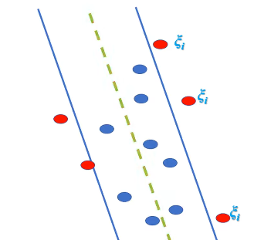
Types of Support Vector Machine
1. Linear SVM
A Linear SVM is used when the data is linearly separable, meaning a straight line (or hyperplane) can successfully divide the dataset into different classes.
Example
Suppose we have:
Red circles
Green circles
If a straight line can perfectly separate these two groups, then the dataset is linearly separable.
In such cases, Linear SVM is the appropriate algorithm.

Slide 25
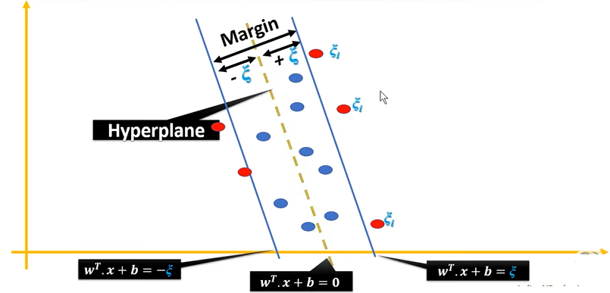
Types of Support Vector Machine
Instead of separating classes, SVR attempts to fit a function that predicts continuous output values while allowing a certain amount of prediction error.
Unlike Linear Regression, which tries to minimize the error for every data point, SVR introduces an acceptable error margin, known as epsilon (ε).
The main objective of SVR is to fit as many data points as possible inside this margin.

Slide 26
Understanding the Epsilon (ε) Margin
Instead of fitting every point exactly, SVR creates an epsilon tube around the regression line.
This tube consists of:
Upper boundary = Regression Line + ε
Lower boundary = Regression Line − ε
Any data point lying inside this tube is considered acceptable and does not contribute to the model’s error.
Only the data points outside the epsilon tube influence the regression model. These points are known as support vectors.
The goal of SVR is to maximize the number of observations inside the epsilon tube while maintaining a simple and generalized model.

Slide 27
Types of Support Vector Machine
2.Non Linear SVM
A Nonlinear SVM is used when the data cannot be separated using a straight line.
Example
Suppose the two classes are arranged in a circular pattern.
In this situation:
No straight line can separate the classes.
Linear SVM fails.
Therefore, we use Nonlinear SVM.

Slide 28
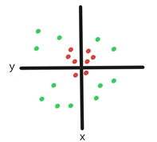
How Does Nonlinear SVM Work?
The key idea behind Nonlinear SVM is to transform the original data into a higher-dimensional feature space, where it becomes linearly separable.
For example, suppose the original dataset has two features:
X
Y
We introduce a new feature:
Z
Now the data is represented in three dimensions (X, Y, Z)
After this transformation, the previously inseparable data often becomes linearly separable.
Once the data is transformed, a simple hyperplane can separate the classes.
.

Slide 29
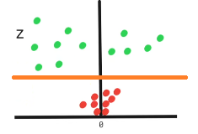

How do we calculate the new feature (Z)?
Instead of manually computing new dimensions, SVM uses kernel functions.
A kernel transforms the data into a higher-dimensional space without explicitly performing the transformation, making the computation much more efficient.
One simple example of a transformation is:
Applying this transformation to every data point can convert a nonlinear dataset into a linearly separable one.
Once the transformation is complete, a linear hyperplane can be used to classify the data accurately.
This approach is known as the Kernel Trick.

Slide 30
Important Parameters in SVR
Several parameters control the performance of an SVR model.
1. Epsilon (ε)
The epsilon parameter defines the width of the acceptable error margin.
Larger ε → Wider margin, fewer support vectors, simpler model.
Smaller ε → Narrower margin, more support vectors, potentially higher accuracy.
Choosing an appropriate epsilon value is essential for achieving a good balance between bias and variance.

Slide 31
Important Parameters in SVR
2. Regularization Parameter (C)
The parameter C controls the trade-off between:
Keeping the model simple
Reducing prediction errors
Small C
Allows more prediction errors.
Produces a smoother regression function.
Better generalization.
Large C
Penalizes errors more heavily.
Attempts to fit the training data more closely.
May increase the risk of overfitting.

Slide 32
Important Parameters in SVR
Kernel Functions in SVR
Real-world datasets are often nonlinear.
To model nonlinear relationships, SVR uses kernel functions, which transform the data into a higher-dimensional feature space where a linear relationship can be established.
Commonly used kernels include:
Linear Kernel
Polynomial Kernel
Radial Basis Function (RBF) Kernel
Sigmoid Kernel
Selecting the appropriate kernel depends on the nature of the dataset.

Slide 33
Support Vector Regression (SVR): Intuition and Working
Support Vector Regression (SVR) is one of the most powerful supervised machine learning algorithms used for solving regression problems. Unlike traditional linear regression, which focuses on minimizing prediction errors for every data point, SVR introduces a unique concept called the epsilon-insensitive tube, allowing the model to ignore small errors while concentrating only on significant deviations.
This makes SVR highly effective for datasets that contain noise or minor fluctuations.

Slide 34

Comparing Linear Regression and Support Vector Regression
To understand SVR, it helps to compare it with Simple Linear Regression.
Simple Linear Regression
In simple linear regression, the objective is to find the best-fit line through the data.
The model is trained using the Ordinary Least Squares (OLS) method, which minimizes the squared difference between:
The actual value (Y)
The predicted value (Ŷ)

Slide 35
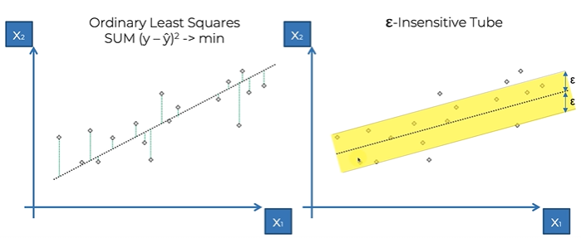
How Support Vector Regression is Different
Support Vector Regression follows a completely different philosophy.
Instead of fitting a single line that minimizes every error, SVR creates a tube around the regression line.
This tube is called the epsilon-insensitive tube.
The width of the tube is represented by the parameter ε (epsilon).

Slide 36
The Epsilon-Insensitive Tube
The key idea behind SVR is simple:
Errors inside the tube are ignored.
If a data point falls inside the epsilon tube, the model considers its prediction sufficiently accurate.
The distance between the actual point and the regression line is not penalized.
This creates a tolerance zone where small prediction errors are accepted.
Instead of trying to perfectly fit every observation, SVR allows a small margin of error.

Slide 37
Errors Outside the Tube
Not every point will lie inside the epsilon tube.
Some observations fall outside the allowable margin.
For these points:
The prediction error is no longer ignored.
The model measures the distance from the point to the boundary of the tube—not to the regression line itself.
These distances are called slack variables.
They represent how far a point lies beyond the permitted error margin.
The optimization process aims to minimize these slack variables while keeping the regression model as simple as possible.

Slide 38
Why Ignore Small Errors?
Real-world data almost always contains:
Measurement errors
Noise
Random fluctuations
Outliers
Trying to perfectly fit every data point often causes overfitting, where the model captures noise instead of the underlying relationship.
SVR avoids this problem by saying:
"Small errors are acceptable. Only large deviations deserve attention."
This tolerance makes SVR more robust and better at generalizing to unseen data.

Slide 39
What are Support Vectors?
Every observation in the dataset can be represented as a vector in feature space.
However, not every point influences the final regression model.
The observations that lie outside (or on the boundary of) the epsilon tube determine:
The position of the regression line
The width of the tube
The final prediction function
These influential points are called Support Vectors.
They "support" or define the structure of the regression model.
Points well inside the tube have little or no effect on the final model.
This is why the algorithm is called Support Vector Regression.

Slide 40
Optimization Objective
Unlike ordinary least squares, which minimizes the squared error of all observations, SVR minimizes:
The model complexity
The total amount by which points exceed the epsilon tube
Only points outside the tube contribute to the optimization.
As a result:
Small errors are ignored.
Large errors are minimized.
The model remains robust against noise.

Slide 41
Advantages of Support Vector Regression
SVR offers several benefits over traditional regression methods:
Handles noisy datasets effectively.
Ignores insignificant prediction errors.
Reduces the risk of overfitting.
Produces robust predictions.
Works well with both linear and nonlinear relationships (using kernel methods).
Performs effectively even in high-dimensional feature spaces.

Slide 42
Limitations of SVR
Despite its strengths, SVR has some limitations:
Choosing the right value of ε (epsilon) is important.
Selecting appropriate hyperparameters can be challenging.
Training can become computationally expensive for very large datasets.
Interpretation is less straightforward than linear regression.

Slide 43
Understanding Non-Linear Support Vector Regression (SVR)
we explored the intuition behind Support Vector Regression (SVR) using a linear regression model.
While this provides an excellent foundation for understanding how SVR works, it is only the beginning.
In practice, many real-world datasets exhibit non-linear relationships, making linear SVR insufficient for capturing complex patterns.
To address these challenges, Support Vector Regression can be extended using kernel functions, allowing it t

Slide 44
From Linear SVR to Non-Linear SVR
The SVR model discussed previously was a Linear Support Vector Regression model.
In Linear SVR:
The regression function is a straight line.
An epsilon-insensitive tube surrounds the regression line.
Only points outside the tube influence the model.
This approach works well when the relationship between input features and the target variable is approximately linear.
However, many real-world problems involve curved or complex relationships that cannot be represented by a straight line.
For such cases, we use Non-Linear Support Vector Regression.

Slide 45
What is Non-Linear Support Vector Regression?
Non-Linear Support Vector Regression extends the capabilities of linear SVR by using kernel functions.
Instead of fitting a straight line, the model learns curved regression functions that can capture complex relationships within the data.
This allows SVR to make accurate predictions even when the data follows non-linear patterns.

Slide 46
The Role of Kernel Functions
A kernel function is the key component that enables non-linear SVR.
Instead of working directly in the original feature space, the kernel function implicitly maps the data into a higher-dimensional space, where a linear regression can be performed.
The predictions are then transformed back into the original space.
This process allows the model to learn highly complex relationships while avoiding the computational cost of explicitly creating higher-dimensional features.
.

Slide 47
Radial Basis Function (RBF) Kernel
One of the most commonly used kernels in Support Vector Regression is the Radial Basis Function (RBF) Kernel.
The RBF kernel allows the regression model to fit smooth, flexible curves rather than straight lines.
As a result:
The model adapts to complex datasets.
Curved relationships can be learned effectively.
Prediction accuracy often improves for non-linear data.
Many machine learning libraries, including Scikit-learn, use the RBF kernel as the default kernel for SVR because of its versatility.

Slide 48
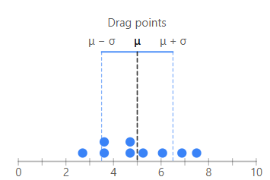

2. Standardization (Z-Score Scaling)
Standard deviation is a statistical measure that tells us how spread out the values in a dataset are from the mean (average).
Low standard deviation → Values are close to the average.
High standard deviation → Values are spread far away from the average.

Slide 49
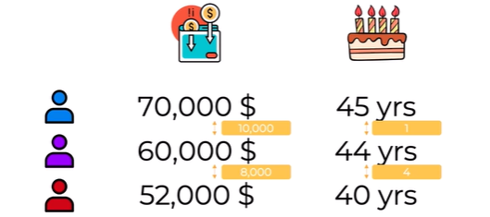
Example: Comparing People
Suppose we have the following dataset.
Our goal is to determine:
Which person is most similar to the Purple person?

Slide 50
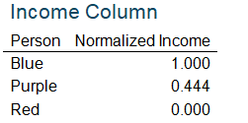
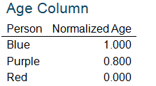
Example: Comparing People
Applying Normalization
Now normalize each feature independently
Now both features are on the same scale (0–1).

Slide 51
When is Feature Scaling Required?
Feature scaling is especially important for algorithms that rely on distance calculations or optimization.
Examples include:
K-Nearest Neighbors (KNN)
K-Means Clustering
Support Vector Machines (SVM)
Logistic Regression
Linear Regression (especially when using gradient descent)
Neural Networks
Principal Component Analysis (PCA)
Some algorithms, such as Decision Trees and Random Forests, generally do not require feature scaling because they are not based on distance calculations.

Slide 52
Thank you

