Slide 1

TypeScript
Date
Name
Title

Slide 2
Objectives
Understand TypeScript fundamentals and type system.
Understand TypeScript data types
Work with arrays and functions
Use spread & rest operators
Learn proper usage of var, let, and const
Write type-safe functions and classes
Use types, interfaces, and enums effectively
Notes:
https://www.javabrahman.com/java-8/java-8-java-util-stream-collector-basics-tutorial-with-examples/
https://www.journaldev.com/2763/java-8-functional-interfaces
http://winterbe.com/posts/2014/03/16/java-8-tutorial/
https://www.oreilly.com/learning/java-8-functional-interfaces

Slide 3
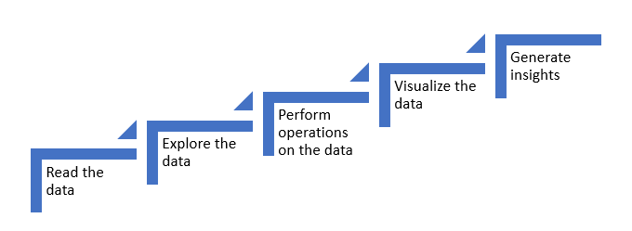
Introduction to pandas
Pandas is an open-source library for real world data analysis in python. It is built on top of Numpy.
Using Pandas, data can be cleaned, transformed, manipulated, and analyzed.
It is suited for different kinds of data including tabular as in a SQL table or a Excel spreadsheets, time series data, observational or statistical datasets.
The steps involved to perform data analysis using Pandas are as follows:

Slide 4
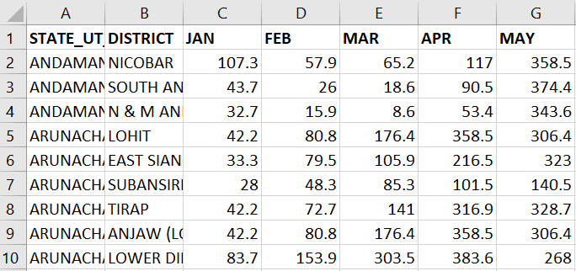
Python Libraries?
Reading the data
The first step is to read the data. There are multiple formats in which data can be obtained such as '.csv', '.json', '.xlsx' etc.
Below are the examples:
Example of an excel file:

Slide 5
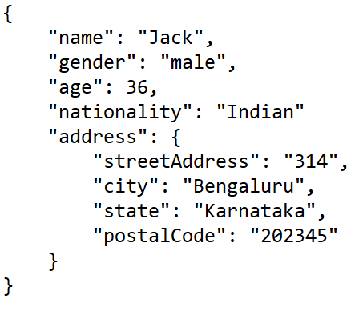
Python Libraries?
Example of a json (javascript object notation) file:

Slide 6
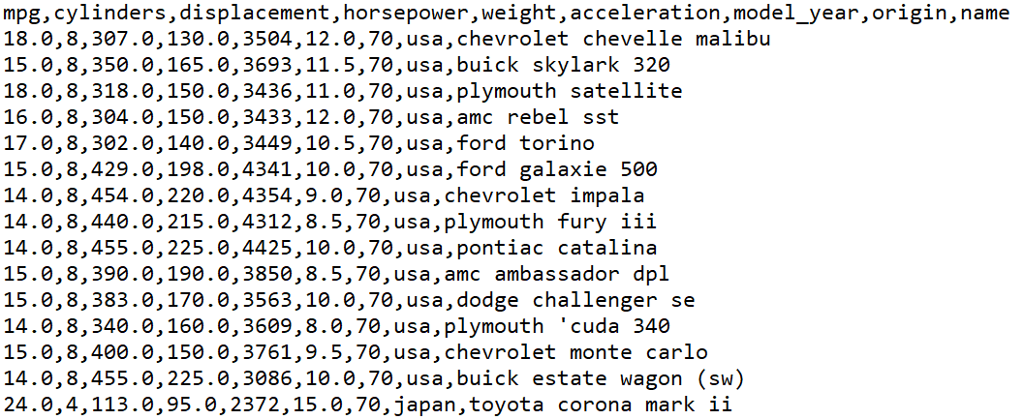
Python Libraries?
Example of a csv (comma separated values) file:

Slide 7
Steps in data analysis
Exploring the data
The next step is to explore the data. Exploring data helps to:
know the shape(number of rows and columns) of the data
understand the nature of the data by obtaining subsets of the data
identify missing values and treat them accordingly
get insights about the data using descriptive statistics

Slide 8
Steps in data analysis
Performing operations on the data
Some of the operations supported by pandas for data manipulation are as follows:
Grouping operations
Sorting operations
Masking operations
Merging operations
Concatenating operations

Slide 9
Steps in data analysis
Visualizing data
The next step is to visualize the data to get a clear picture of various relationshipsamong the data. The following plots can help visualize the data:
Scatter plot
Box plot
Bar plot
Histogram and many more

Slide 10
Steps in data analysis
Generating Insights
All the above steps help generating insights about our data.

Slide 11
Why Pandas?
Pandas is one of the most popular data wrangling and analysis tools because it:
has the capability to load huge sizes of data easily
provides us with extremely streamlined forms of data representation
can handle heterogenous data, has extensive set of data manipulation features and makes data flexible and customizable

Slide 12
Introduction to Pandas objects
Pandas Series object
Pandas DataFrame object

Slide 13
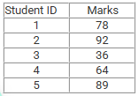
Pandas Series object
Series is one dimensional labelled array. It supports different datatypes like integer, float, string etc. Let us understand more about series with the following example.
Consider the scenario where marks of students are given as shown in the following table:

Slide 14
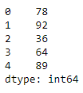

Pandas Series object
The pandas series object can be used to represent this data in a meaningful manner. Series is created using the following syntax:
Syntax:
pd.Series(data, index, dtype)
data – It can be a list, a list of lists or even a dictionary.
index – The index can be explicitly defined for different valuesif required.
dtype – This represents the data type used in the series (optional parameter).
As shown in the above output, the series object provides the values along with their index attributes.

Slide 15



Pandas Series object
Series.values provides the values.
Series.index provides the index.

Slide 16



Accessing data in series:
Data can be accessed by the associated index using [ ].
Slicing a series:

Slide 17
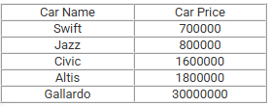
Custom index in series
By default, series creates an integer index. The custom index can also be defined.
For example, consider the following table containing car details:

Slide 18
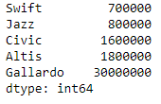
Custom index in series
A Pandas series can be created using the following syntax:

Slide 19

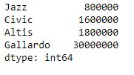
Custom index in series
Values can be accessed as:
In this case, observations are that the output starts from Jazz and goes till Gallardo(inclusive). This is the fundamental difference between implicit and explicit indexing.

Slide 20
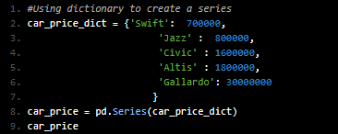
Series as a specialized dictionary
Series can also be viewed as a specialized dictionary where the keys act as index and corresponding values act as values.
Let us create a series out of the dictionary data structure.

Slide 21
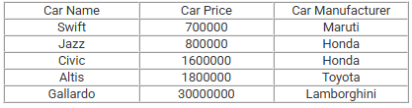
Pandas DataFrame object
A series gives a useful way to view and manipulate one dimensional data. But when data is present in rows and columns, it becomes necessary to make use of the Pandas DataFrame object.
A DataFrame is a collection of series where each series represents a column from a table.
For example, consider the following table containing car details:

Slide 22
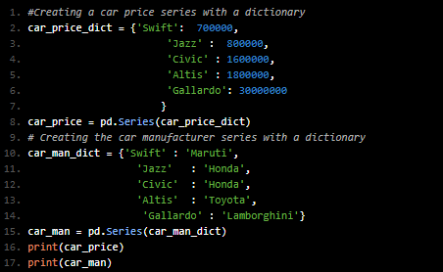
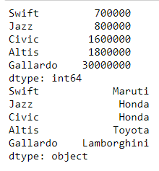
Pandas DataFrame object
Let us create two series from two dictionaries - one containing car name and price and the other with car name and manufacturer.

Slide 23
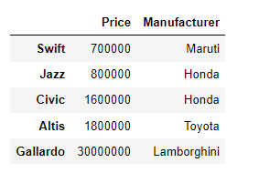
Pandas DataFrame object
Let us create a Dataframe object using the series objects as shown below:
Syntax:
pd.DataFrame(data, index, columns)
data - data can contain Series or list-like objects. If data is a dictionary, column order follows insertion-order.
index- index for dataframe that is created. By default, it will be RangeIndex(0, 1, 2, …, n) if no explicit index is provided
columns- If data contains column labels, it will use the same . Else, default to RangeIndex(0, 1, 2, …, n)

Slide 24

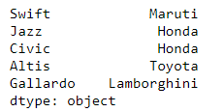
Dataframe Object
To access individual features, the following code can be used:

Slide 25
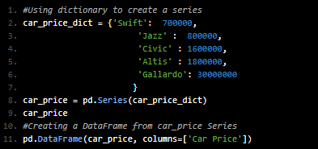
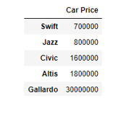
Ways to create a DataFrame
There are different approaches to create a DataFrame such as:
1. From a single series object
A DataFrame is a collection of Series objects, and a single-column DataFrame can be constructed from a single Series:

Slide 26

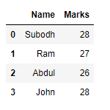

Ways to create a DataFrame
2. From a list of dictionaries
Consider the following data of marks for four students.

Slide 27



Ways to create a DataFrame
Suppose there is a following table to be represented as a dataframe ?
Each dictionary element in the list is taken as a row . Index is representing different subjects.
Note: NaN(Not a Number) represents missing values.

Slide 28
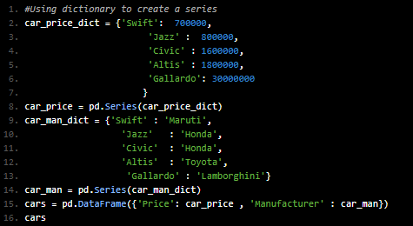
Ways to create a DataFrame
3. From a dictionary of series objects
A DataFrame can be constructed from a dictionary of Series objects:

Slide 29
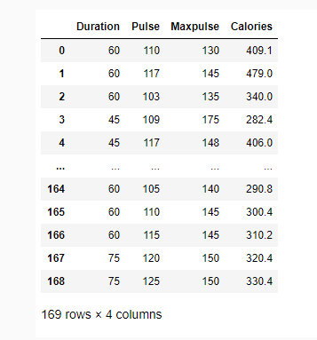

Ways to create a DataFrame
4. From an existing file
In most real world scenarios, the data is in different file formats like csv, xlsx, json etc. Pandas supports reading the data from these files. Below is an example of creating a DataFrame from a json file.
Click here to download the json file used in the demo.

Slide 30
The axis keyword
One of the important parameters used while performing operations on DataFrames is 'axis'. Axis takes two values: 0 and 1.
axis = 0 represents row specific operations.
axis = 1 represents column specific operations.

Slide 31
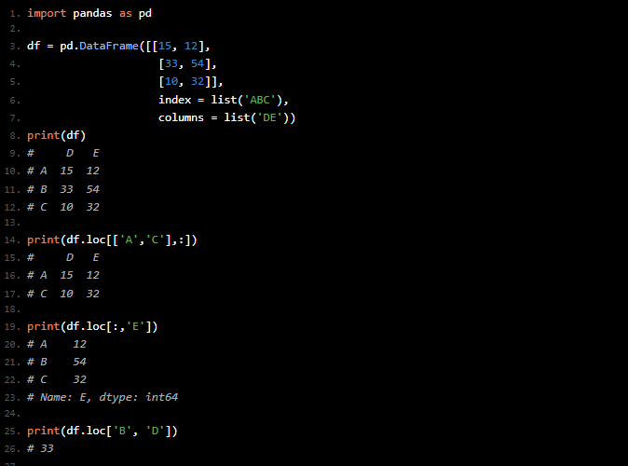
Indexing and selection
Selection types
We can select part of dataframe through various methods like:
1. Selection by Position
The .loc attribute is the governing parameter to select data by a label. Slicing is performed based on the label of the index.

Slide 32
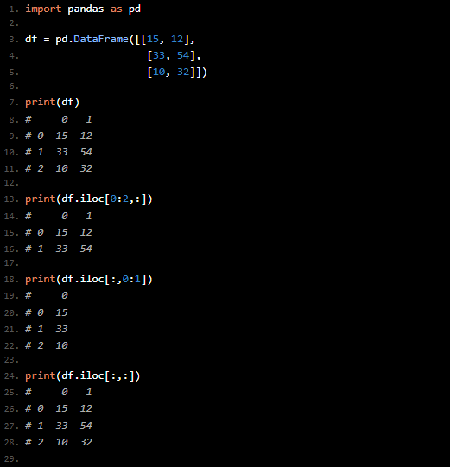
Indexing and selection
Selection types
We can select part of dataframe through various methods like:
2. Selection by Position
Here, the .iloc attribute is the governing parameter to select data and slicing is performed based on the position.

Slide 33
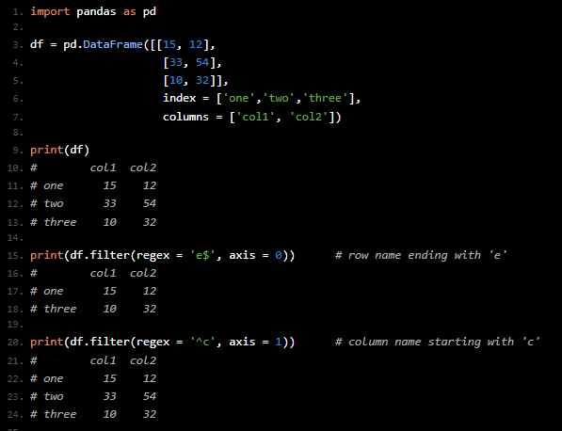
Indexing and selection
Selection types
3. Selection Using Regular Expression
Regex expression comes handy to select a particular data (row/column) using filter () function.

Slide 34
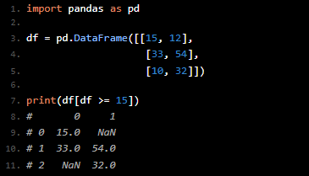
Indexing and selection
Selection types
4. Boolean Indexing
We can also derive condition based selection which returns the True elements and NaN for False elements i.e. where condition became results into False.

Slide 35
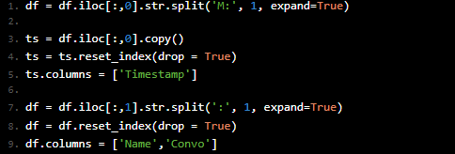
Data Cleaning and Feature Engineering
Selection types
Data Cleaning
To reach the objective of our given scenario, we now have to perform following tasks:
1. Split timestamp and chat in different columns
To do so, we split each row by keeping the breaking point at M: and save the timestamp into a new dataframe ts. Next, we split our original dataframe df into two columns each for Name [ Name] and respective Conversation [ Convo].

Slide 36

Data Cleaning and Feature Engineering
2. Map phone numbers to their person name
Sometimes there are people whose names are not saved in our contact directory and therefore we see their phone numbers during the chat. If needed we can provide them their names in this optional step.

Slide 37
Data Cleaning and Feature Engineering
3. Remove instances where someone changes their number
It happens most of the time that we come across the following message:
Dean number was changed from +91 55555 55555 to +91 22222 22222. ‎Tap to add.
To remove such instances which are not needed for current analysis, we can use regular expressions and remove any instance(s) which has 2 digits followed by 5 digits and again 5 digits. Of course, you can develop this approach to a next level if any conflict arises with your analysis.

Slide 38

Data Cleaning and Feature Engineering
4. Remove either of the instance: <image omitted>, <GIF omitted> and <video omitted>
Since our current motive is to work with text, therefore, we can neglect rows which contained either image, gif or a video.

Slide 39
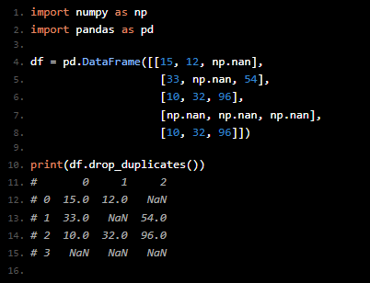
Data Cleaning and Feature Engineering
Handling Redundancy
We can now arrive at our first outcome of retrieving the topmost 3 words used by every friend from the group. To do so, we first have to select all the unique names from the Name column. This can be done by creating a list of unique names using drop_duplicates() function. Before we proceed with our outcome here is a sample program on drop_duplicates() function.

Slide 40
Thank you

