Slide 1

MLflow Part-01
Date
Name
Title

Slide 2
Objectives
MLflow is an open-source platform that helps manage the complete Machine Learning lifecycle. It is one of the core tools used in MLOps (Machine Learning Operations).
Understand MLflow and its role in MLOps.
Track experiments, parameters, metrics, and artifacts.
Manage and version ML models.
Use the MLflow Model Registry.
Deploy and serve MLflow models.

Slide 3
What is MLflow?
MLflow is an open-source platform that helps manage the complete Machine Learning lifecycle. It is one of the core tools used in MLOps (Machine Learning Operations).
MLflow provides capabilities for:
Experiment Tracking
Model Packaging
Model Registry
Model Deployment
Collaboration among Data Scientists

Slide 4
Why Do We Need MLflow?
Imagine a team of data scientists working on an anomaly detection project.
Example Scenario
Two data scientists, Kathy and Venkat, are working on the same problem.
Kathy experiments with:
Logistic Regression
Different hyperparameters
Dataset Version 1
Multiple feature engineering techniques
After a month, a new dataset (Version 2) arrives with additional features.

Slide 5
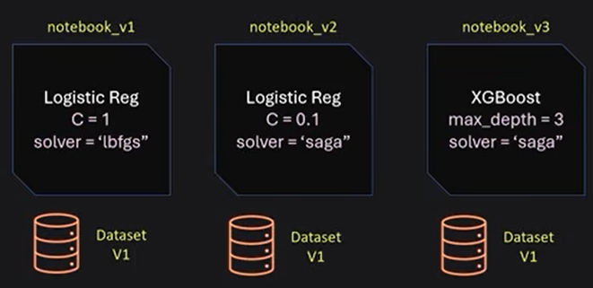

What is Machine Learning?

Slide 6
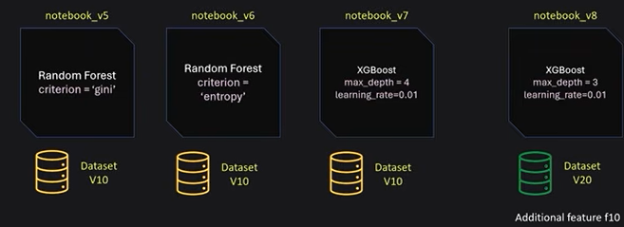

Why Do We Need MLflow?
Meanwhile, Venkat is:
Working on class imbalance
Trying Random Forest
Trying XGBoost
Using SMOTE
Testing different parameters

Slide 7
Why Do We Need MLflow?
Each person now has:
Multiple notebooks
Different datasets
Different model versions
Different hyperparameters
Different evaluation metrics
Managing all of this manually becomes difficult.

Slide 8
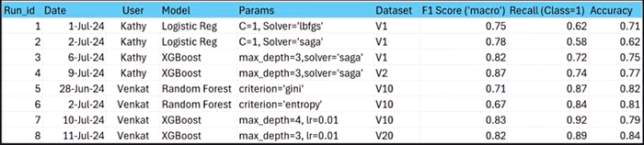
Problems Without MLflow
Teams often store experiment results in Excel or Google Sheets.
This approach has several drawbacks:
Easy to forget recording experiments
Manual errors
Difficult to compare models
Cannot download trained models
No version control
Difficult collaboration

Slide 9
How MLflow Solves These Problems
MLflow automatically stores:
Experiment name
Run information
Parameters
Metrics
Model artifacts
Dataset information
Model versions
Instead of Excel, everything is stored centrally.

Slide 10
MLflow Components
The four major components of MLflow are:
MLflow Tracking
MLflow Projects
MLflow Models
MLflow Model Registry

Slide 11
MLflow Tracking
Machine learning development is fundamentally an experimental process. Data scientists rarely train a model just once. Instead, they perform numerous experiments by changing:
Training datasets
Feature sets
Model architectures
Hyperparameters
Source code
Evaluation strategies
The objective is to identify the best-performing model through continuous experimentation.

Slide 12
The Challenge
After running dozens or even hundreds of experiments, an important question arises:
Which combination of hyperparameters produced the best model?
Which version of the code was used?
Which dataset was used for training?
What evaluation metrics did the model achieve?
Can another team member reproduce the same results?
Traditionally, many data scientists manually maintain experiment records using local folders, spreadsheets, or files with names such as:
final_model.py
final_model_v2.py
final_latest.py
final_latest_new.py
This approach quickly becomes difficult to manage, especially in collaborative environments.

Slide 13
How MLflow Tracking Solves the Problem
MLflow Tracking provides a centralized way to record every machine learning experiment.
It automatically logs important experiment information such as:
Hyperparameters
Source code version
Evaluation metrics
Model outputs
Artifacts
Execution details
This enables teams to:
Organize experiments efficiently.
Compare different model runs.
Reproduce previous experiments.
Share experiment results with colleagues.

Slide 14
MLflow Tracking UI
The diagram above illustrates the Machine Learning process.
One of the biggest advantages of MLflow Tracking is its web-based user interface.
Instead of searching through terminal logs or local folders, users can visualize:
Experiment runs
Logged parameters
Performance metrics
Training history
Model comparisons
The graphical interface makes it significantly easier to analyze experiments and identify the best-performing models.

Slide 15
Thank you

