Slide 1

AWS CodeBuild Part-01
Date
Name
Title

Slide 2
Objectives
Understand the purpose and architecture of AWS CodeBuild within the AWS DevOps ecosystem.
Create and configure CodeBuild projects using the AWS Management Console
.Develop and manage buildspec.yml files to automate build, test, and deployment tasks.
Integrate AWS CodeBuild with source code repositories such as GitHub, AWS CodeCommit, and Bitbucket.
Configure build environments, runtime versions, and environment variables for different application types.

Slide 3
What is AWS CodeBuild?
AWS Code Build is a fully managed continuous integration service that automates the process of building software applications.
It helps developers:
Compile source code
Run automated tests
Generate deployment-ready software packages
By automating these tasks, Code Build streamlines the software development lifecycle and improves deployment efficiency.

Slide 4
Benefits of AWS CodeBuild
One of the major advantages of CodeBuild is that it is fully managed by AWS. This means:
No need to provision build servers.
No infrastructure management overhead.
Automatic scaling based on workload demands.
AWS handles the underlying infrastructure, allowing developers to focus solely on building and deploying applications.

Slide 5
What is a Buildspec File?
A buildspec.yml file is a YAML-formatted configuration file that contains:
Build commands
Environment settings
Runtime configurations
Build phases
Artifact definitions
AWS CodeBuild reads this file and executes the specified instructions during the build process.

Slide 6
Key Points
The default filename is buildspec.yml.
It should be placed in the root of your source code repository.
You can use a different filename or location, but you must explicitly specify it in the CodeBuild project settings.
Each CodeBuild project can use only one buildspec file.

Slide 7
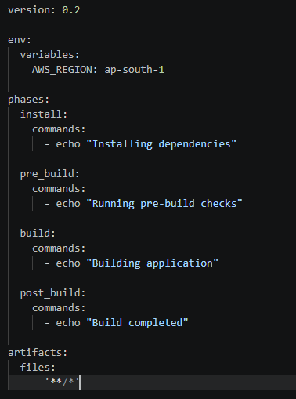
Structure of a Buildspec File
A typical buildspec.yml contains the following sections:

Slide 8


Environment Variables (env)
The env section allows you to define variables that can be used throughout the build process.
Example
You can reference the variable using:

Slide 9
Sources for Variables
Environment variables can be:
Custom variables defined directly in the buildspec file.
Values retrieved from AWS Systems Manager Parameter Store.
Values stored in AWS Secrets Manager.
This helps keep sensitive information secure and centralized.

Slide 10
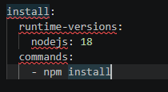
CodeBuild Phases
AWS CodeBuild executes commands through several phases. Each phase serves a specific purpose.
1. Install Phase
The install phase is used to:
Configure runtime versions
Install dependencies
Prepare the build environment
Example:

Slide 11
CodeBuild Phases
2. Pre-Build Phase
The pre-build phase performs validation and preparation tasks before the actual build begins.
Typical activities include:
Authentication
Connectivity checks
Environment validation
Dependency verification
Example:

Slide 12

CodeBuild Phases
3. Build Phase
This is the core phase where the application is compiled, tested, and packaged.
Example:

Slide 13

CodeBuild Phases
4. Post-Build Phase
The post-build phase runs after the build completes.
Typical activities include:
Cleanup operations
Publishing reports
Deploying artifacts
Sending notifications
Example:

Slide 14

CodeBuild Phases
Artifacts in CodeBuild
Artifacts are the files generated during the build process that need to be stored or used later.
Examples include:
Compiled applications
ZIP packages
Docker images
Machine learning models
Deployment packages
Example:

Slide 15
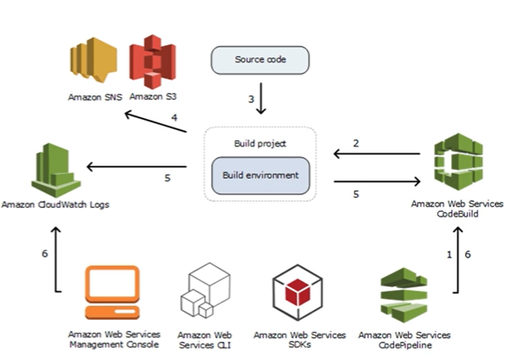
How AWS CodeBuild Works
The CodeBuild workflow generally follows these steps:
Source code is stored in repositories such as:
AWS CodeCommit
GitHub
Bitbucket
A build is triggered.
CodeBuild creates the required build environment.
Source code is downloaded.
CodeBuild reads the buildspec.yml file.

Slide 16
How AWS CodeBuild Works
The CodeBuild workflow generally follows these steps:
Commands are executed phase by phase:
Install
Pre-Build
Build
Build artifacts are generated.
Artifacts are uploaded to Amazon S3 (if configured).
Logs are sent to Amazon CloudWatch Logs.

Slide 17
Thank you

