Slide 1

AWS CodeBuild Part-01
Date
Name
Title

Slide 2
Objectives
Understand the CI/CD workflow using AWS services.
Integrate GitHub repositories with AWS for automated builds.
Configure and use AWS CodeBuild to build and test applications.
Build and push Docker images to Amazon ECR (Elastic Container Registry).
Deploy containerized applications on Amazon ECS (Elastic Container Service).

Slide 3
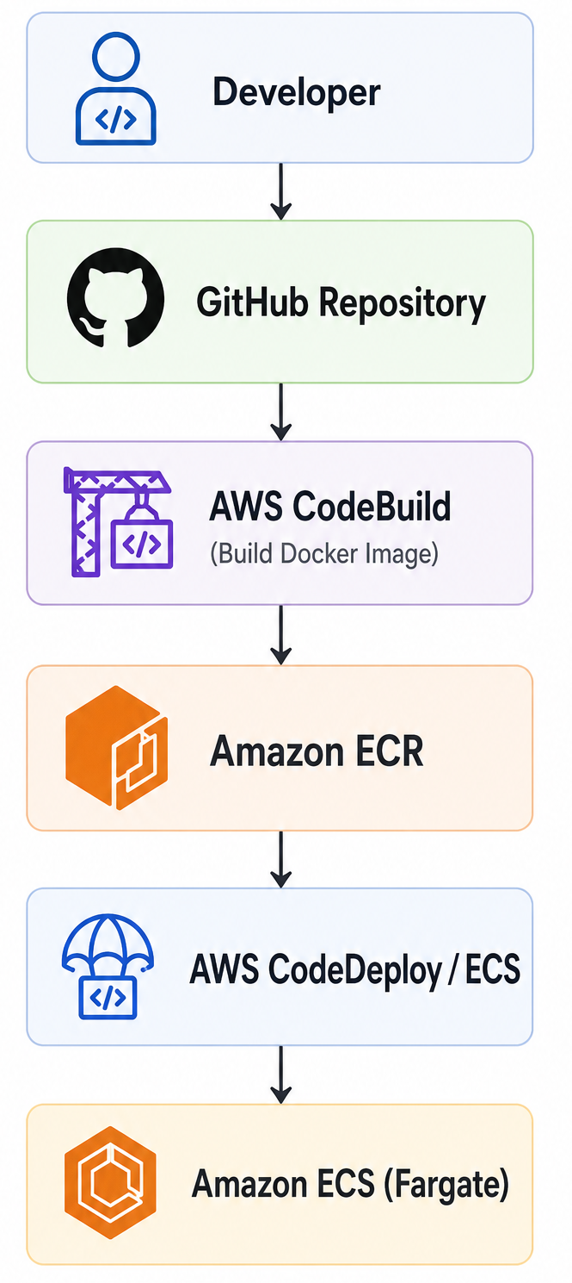
Architecture Overview
The deployment flow looks like this:

Slide 4
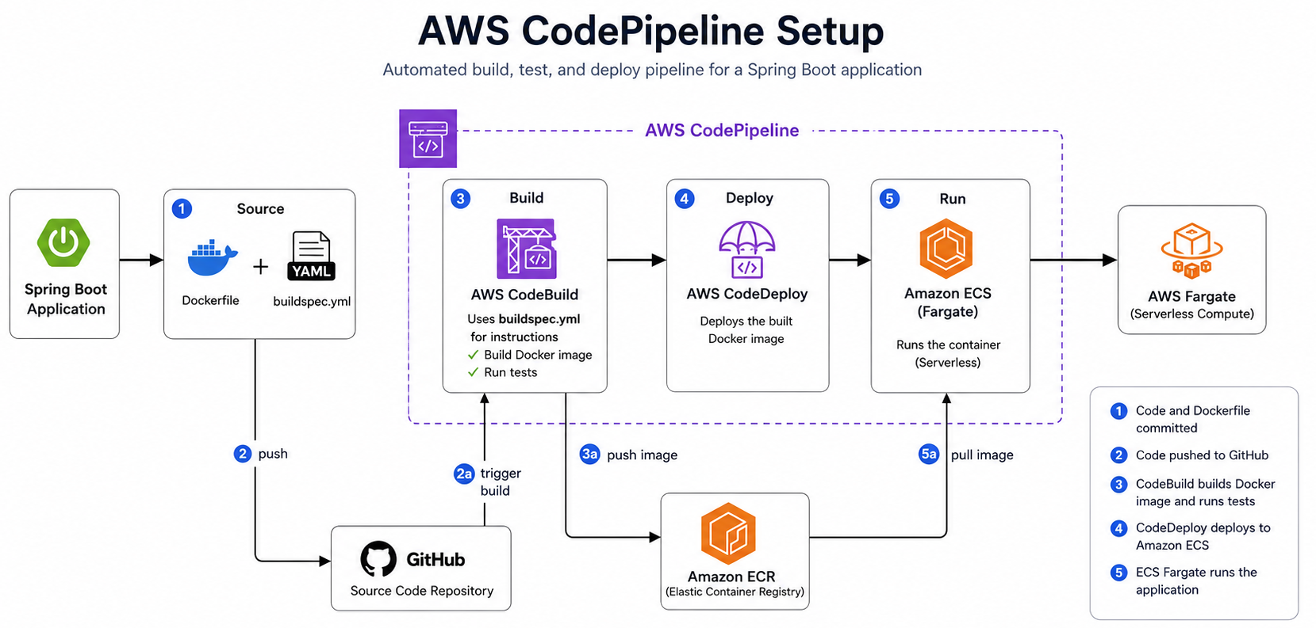
AWS CodePipeline Setup

Slide 5
Thank you

