Slide 1

Ansible_Part-01
Date
Name
Title

Slide 2
Objectives
Learn Ansible fundamentals and architecture.
Configure and manage servers using automation.
Create inventories, playbooks, roles, and variables.
Automate software installation and configuration.
Manage multiple servers efficiently and consistently.Apply Ansible for real-world DevOps tasks.
Notes:
https://www.javabrahman.com/java-8/java-8-java-util-stream-collector-basics-tutorial-with-examples/
https://www.journaldev.com/2763/java-8-functional-interfaces
http://winterbe.com/posts/2014/03/16/java-8-tutorial/
https://www.oreilly.com/learning/java-8-functional-interfaces

Slide 3
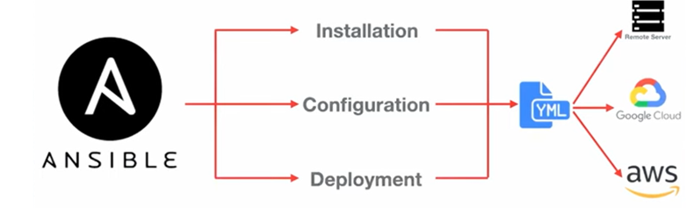
What Is Ansible?
Ansible is an open-source automation tool that can help with several important DevOps tasks.

Slide 4
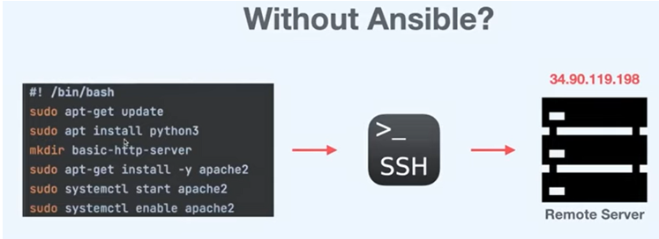
Why Do We Need Ansible?
Suppose we have a remote Linux server where we need to:
Install Python
Create a directory
Install Apache 2
Enable and start Apache
Verify that everything is working

Slide 5
Ansible Automation
Ansible is Open Source Configuration management tool.
Ansible is very easy to install, setup and very powerful at the same time.
Ansible will be helpful to perform
Configuration Management
Application Deployment
Task Automation
Infra Orchestration

Slide 6
How Ansible Works
To use Ansible, a system administrator first prepares a dedicated machine where Ansible is installed.
This machine can be:
A laptop
A desktop
A virtual machine
A cloud instance
This machine is known as the Ansible Controller.
The servers that Ansible manages are known as Hosts or Managed Nodes.
The controller communicates with all the managed servers and performs the required tasks automatically.

Slide 7
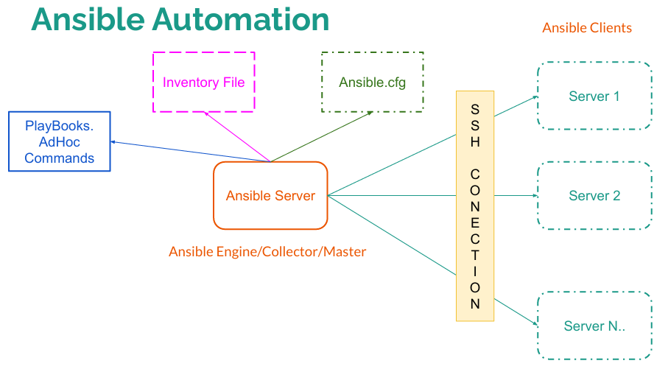
Ansible Automation

Slide 8
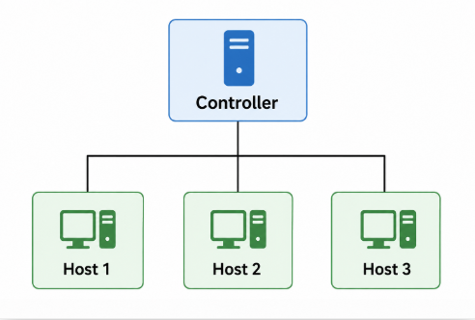
Understanding Ansible Architecture
At its core, Ansible works with two types of machines:
Controller Machine
Host Machines (Managed Nodes)
The controller sends instructions to one or more host machines and automates administrative tasks across them.

Slide 9
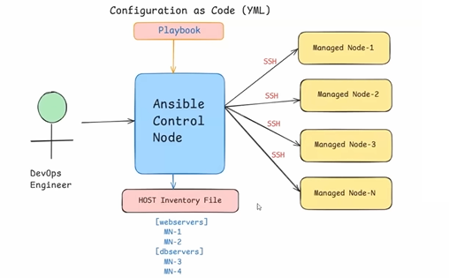
Ansible Setup in Amazon Linux VMs
The Controller is the machine where Ansible is installed.
The systems managed by the controller are called Host Machines or Managed Nodes.

Slide 10
Ansible Playbook
A Playbook is the heart of Ansible.
It is a YAML (.yml) file that contains the tasks Ansible must execute.
A playbook defines:
Which servers to target
What tasks to perform
The order of execution
Configuration details
For example, a playbook may instruct Ansible to:
Install Apache
Start the Apache service
Copy configuration files
Restart the web server
All these steps are executed automatically.

Slide 11
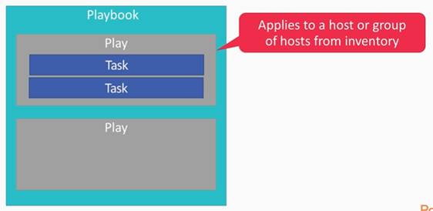
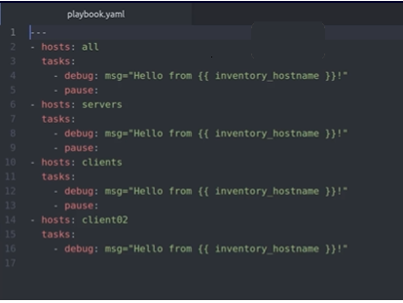
Playbook Structure

Slide 12
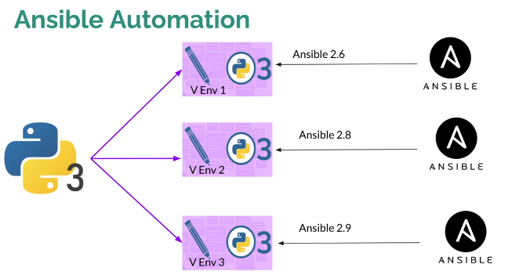
Ansible Installation

Slide 13
Thank you

