Slide 1
TypeScript
Part-001

Slide 2
Objectives
What is Asynchronous JavaScript?
Synchronous vs Asynchronous JavaScript
How Callbacks Work in JavaScript
How Promises Work in JavaScript
How Async / Await Works in JavaScript
Notes:
https://www.javabrahman.com/java-8/java-8-java-util-stream-collector-basics-tutorial-with-examples/
https://www.journaldev.com/2763/java-8-functional-interfaces
http://winterbe.com/posts/2014/03/16/java-8-tutorial/
https://www.oreilly.com/learning/java-8-functional-interfaces

Slide 3
What is a Synchronous System?
In a synchronous system, tasks are completed one after another.
A synchronous system is a system in which all operations happen in a coordinated, step-by-step manner, controlled by a common clock or timing mechanism.
Think of this as if you have just one hand to accomplish 10 tasks. So, you have to complete one task at a time.

Slide 4
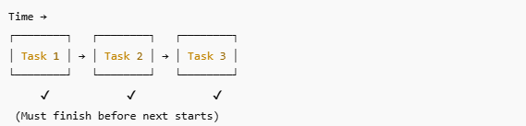
Diagram: Synchronous System (Step-by-Step)
Each task waits for the previous task to complete
Controlled by time / clock / order

Slide 5
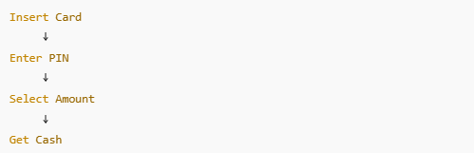
Real-World Examples of Synchronous Systems
1. ATM Machine (Classic Example)
Flow:
Insert card
Enter PIN
Select operation
Receive cash

Slide 6
What is an Asynchronous System?
An asynchronous system is a system in which tasks do not wait for each other to finish. Multiple operations can start, run, and complete independently, and the system handles their results when they are ready.
In this system, tasks are completed independently.
Here, imagine that for 10 tasks, you have 10 hands. So, each hand can do each task independently and at the same time.

Slide 7
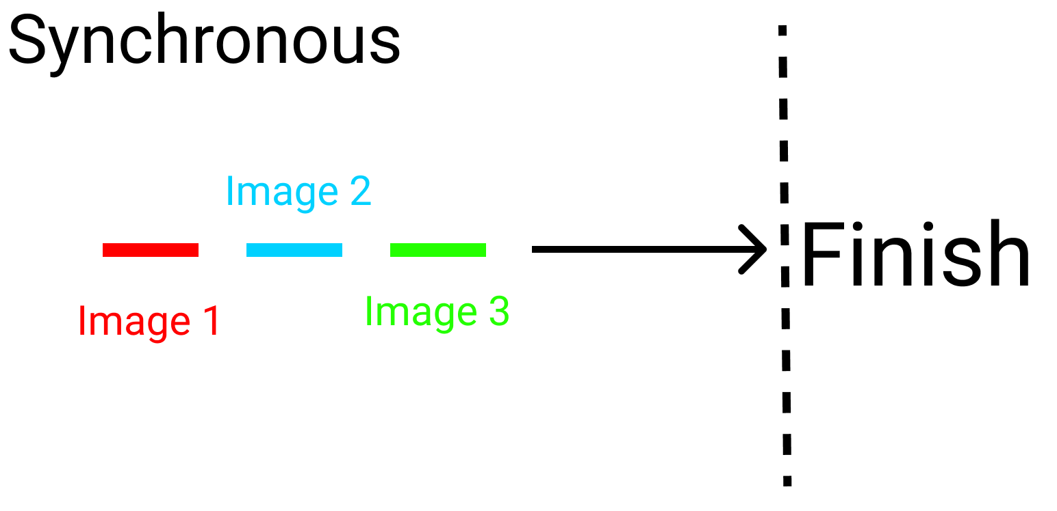
To Summarize Synchronous vs Asynchronous JS:
When three images are on a marathon, in a:
Synchronous system, three images are in the same lane. One can't overtake the other. The race is finished one by one. If image number 2 stops, the following image stops.

Slide 8
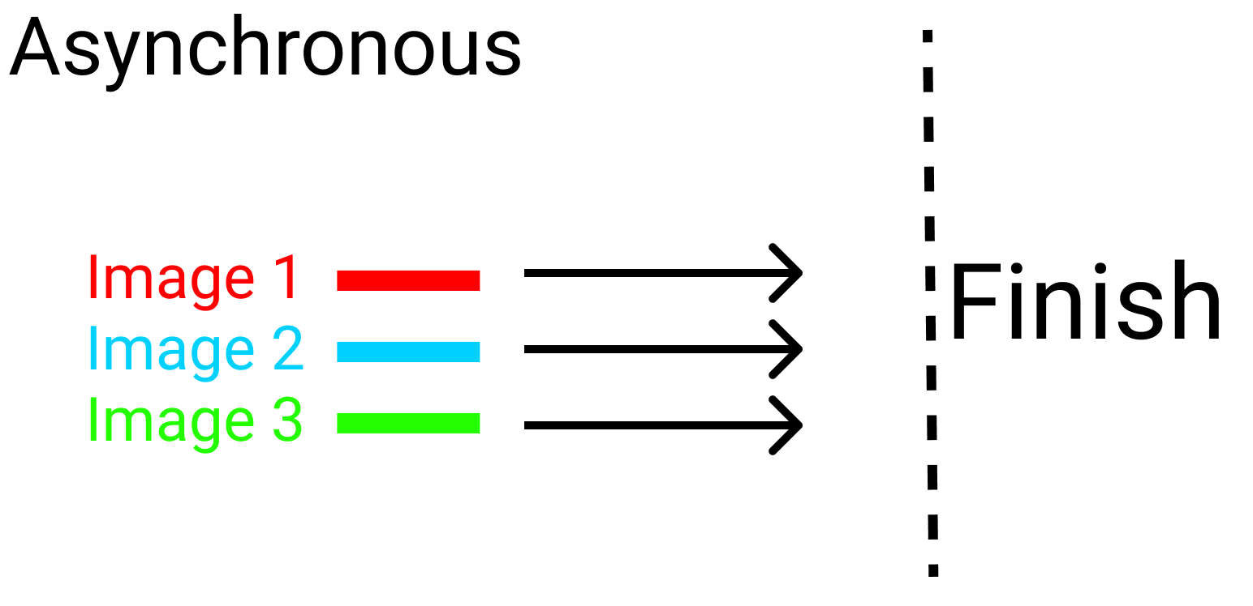
To Summarize Synchronous vs Asynchronous JS:
Asynchronous system, the three images are in different lanes. They'll finish the race on their own pace. Nobody stops for anybody:

Slide 9
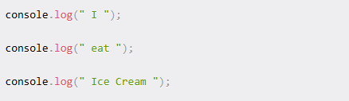
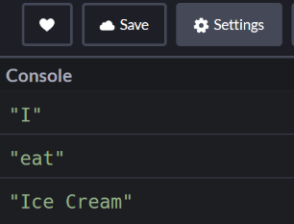
Synchronous Code Example
To test a synchronous system, write this code in JavaScript:
Here's the result in the console: 👇

Slide 10
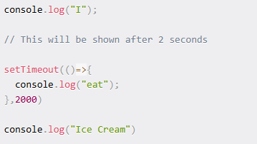
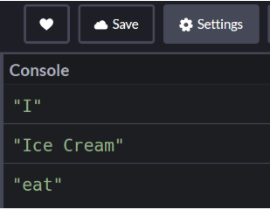
Asynchronous code example
Let's say it takes two seconds to eat some ice cream. Now, let's test out an asynchronous system. Write the below code in JavaScript.
And here's the result in the console: 👇

Slide 11
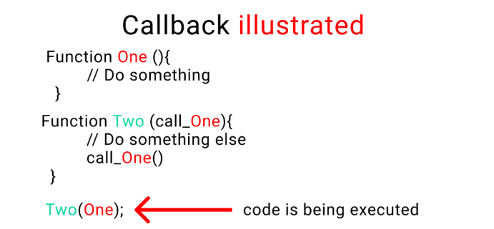
What are Callbacks in JavaScript?
When you nest a function inside another function as an argument, that's called a callback.

Slide 12
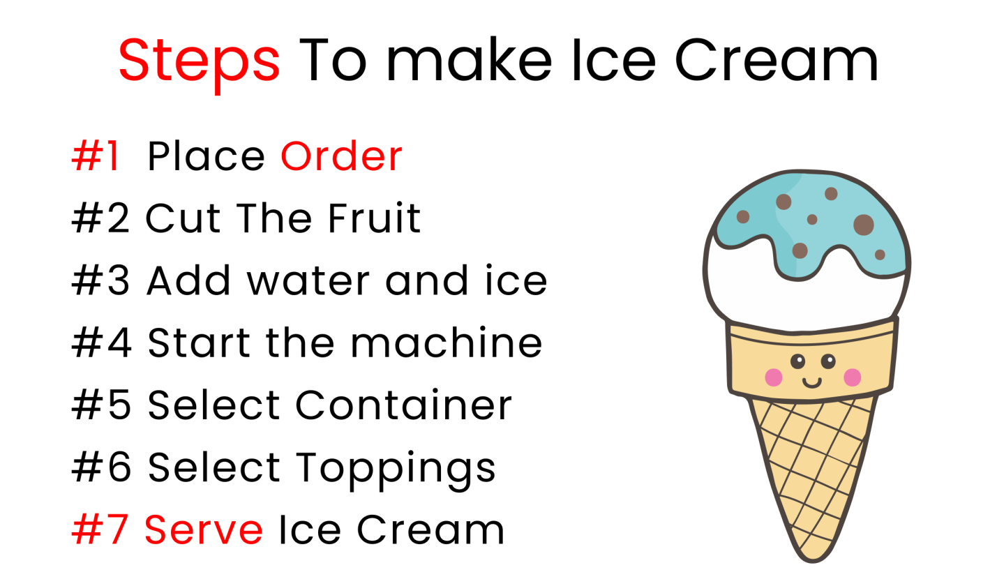
Why do we use callbacks?
When doing a complex task, we break that task down into smaller steps.
To help us establish a relationship between these steps according to time (optional) and order, we use callbacks.
Take a look at this example:👇
Chart contains steps to make ice cream

Slide 13
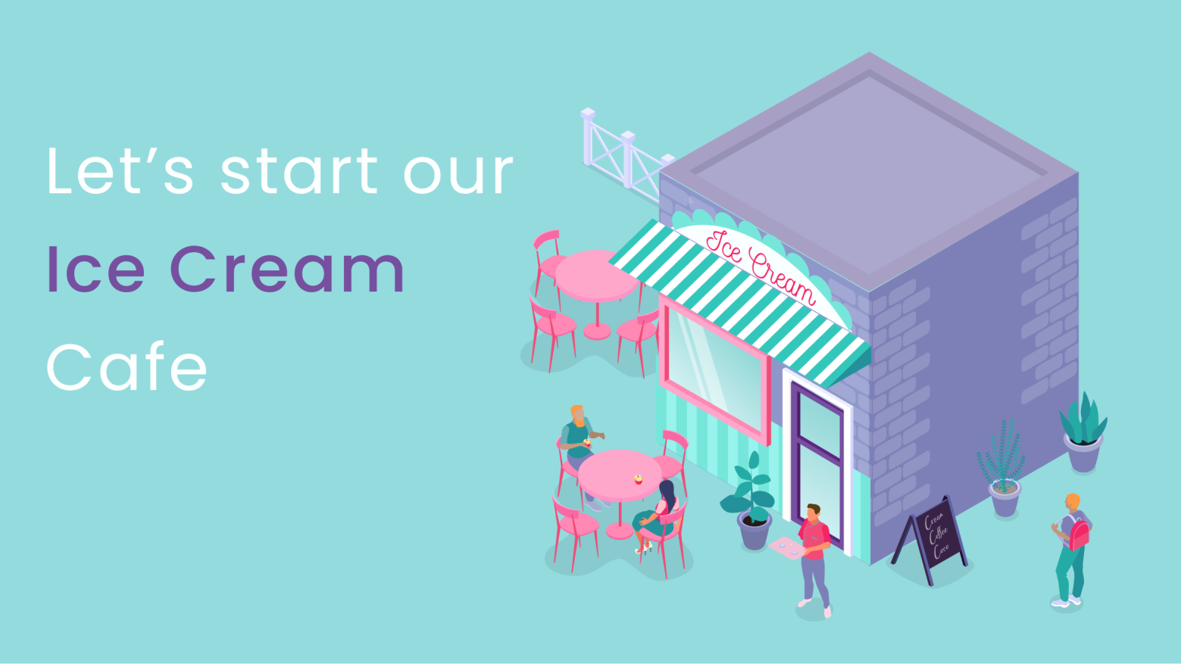
Why do we use callbacks?
These are the small steps you need to take to make ice cream. Also note that in this example, the order of the steps and timing are crucial. You can't just chop the fruit and serve ice cream.
At the same time, if a previous step is not completed, we can't move on to the next step.

Slide 14
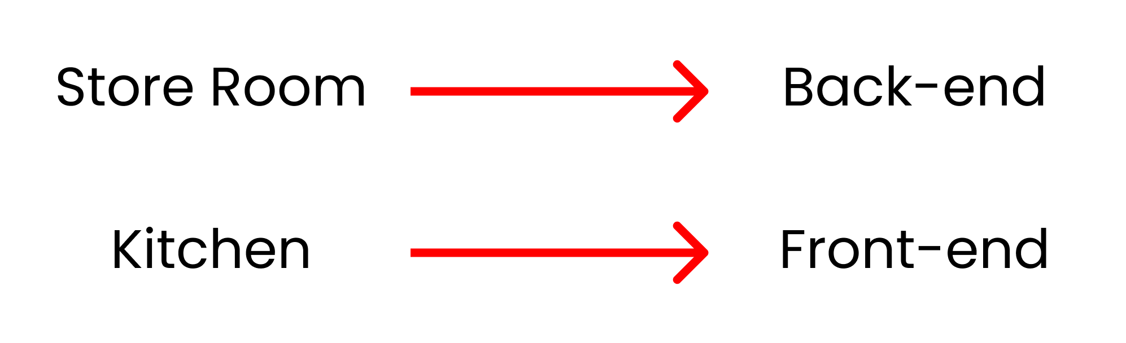
Why do we use callbacks?
To explain that in more detail, let's start our ice cream shop business.
The shop will have two parts:
The storeroom will have all the ingredients [Our Backend]
We'll produce ice cream in our kitchen [The frontend]

Slide 15
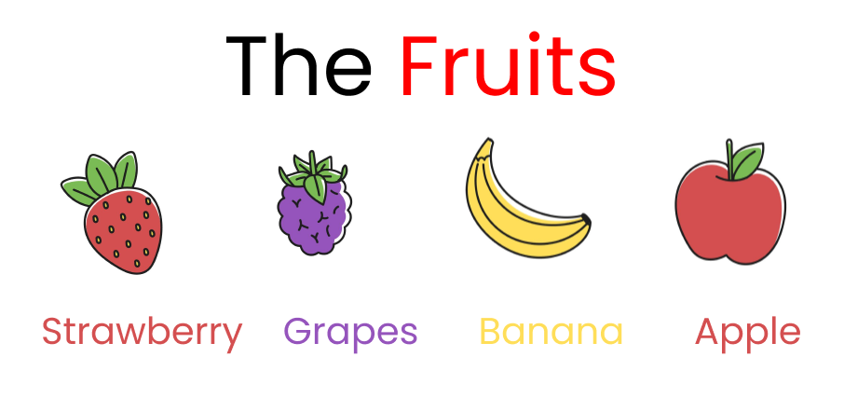
Why do we use callbacks?
Let's store our data
Now, we're gonna store our ingredients inside an object. Let's start!
You can store the ingredients inside objects like this: 👇
let stocks = {
Fruits : ["strawberry", "grapes", "banana", "apple"]
}

Slide 16
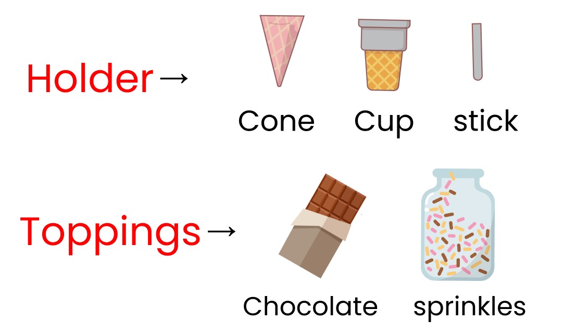
any
Our other ingredients are here: 👇

Slide 17
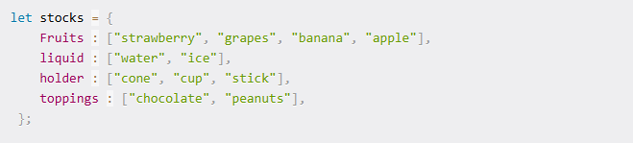
void
You can store these other ingredients in JavaScript objects like this: 👇
let stocks = {
Fruits : ["strawberry", "grapes", "banana", "apple"],
liquid : ["water", "ice"], holder : ["cone", "cup", "stick"],
toppings : ["chocolate", "peanuts"],
};

Slide 18
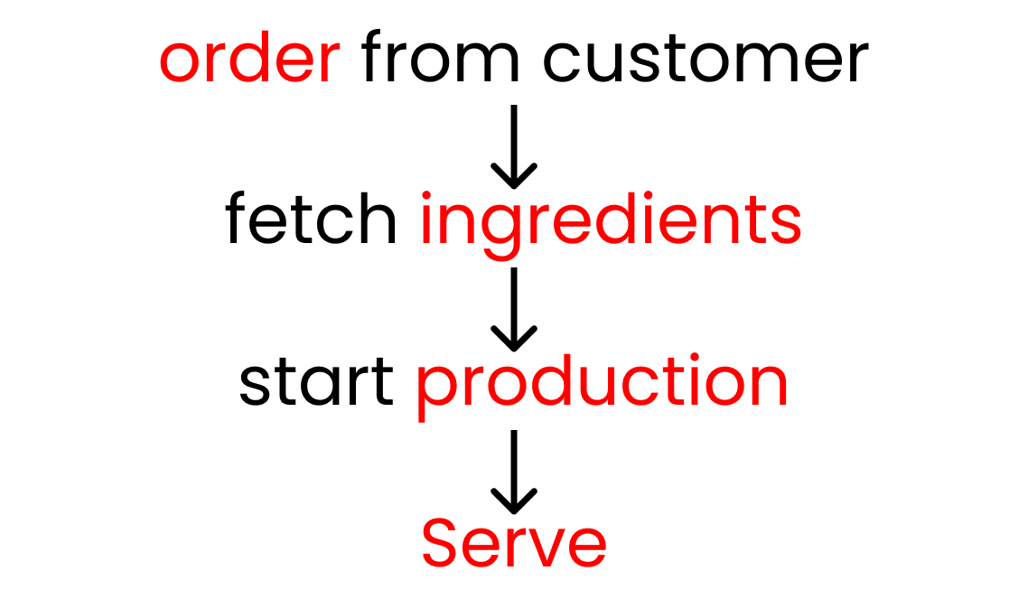
void
The entire business depends on what a customer orders. Once we have an order, we start production and then we serve ice cream. So, we'll create two functions ->
order
production
This is how it all works: 👇

Slide 19

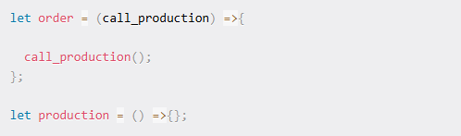
never:
Get order from customer, fetch ingredients, start production, then serve.
Let's make our functions. We'll use arrow functions here:
Now, let's establish a relationship between these two functions using a callback, like this: 👇

Slide 20
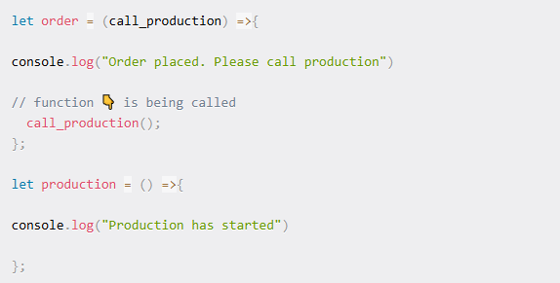
Let's do a small test
We'll use the console.log() function to conduct tests to clear up any doubts we might have regarding how we established the relationship between the two functions.

Slide 21

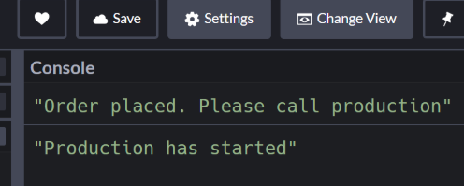
union:
To run the test, we'll call the order function. And we'll add the second function named production as its argument.
Here's the result in our console 👇

Slide 22
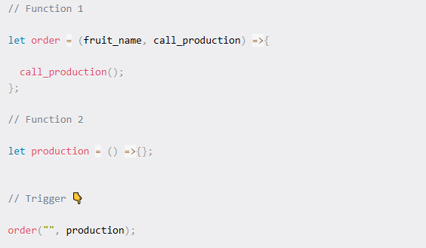
Clear out the console.log
:
Keep this code and remove everything [don't delete our stocks variable]. On our first function, pass another argument so that we can receive the order [Fruit name]:

Slide 23
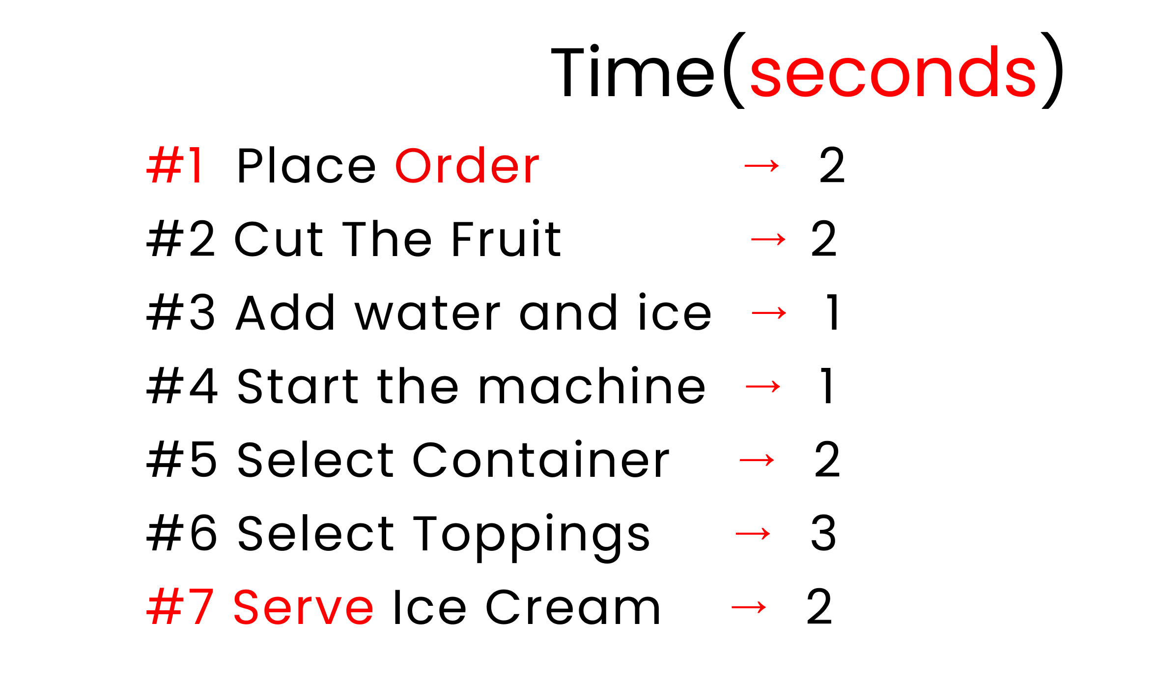
Symbol :
Here are our steps, and the time each step will take to execute.
Chart contains steps to make ice cream

Slide 24
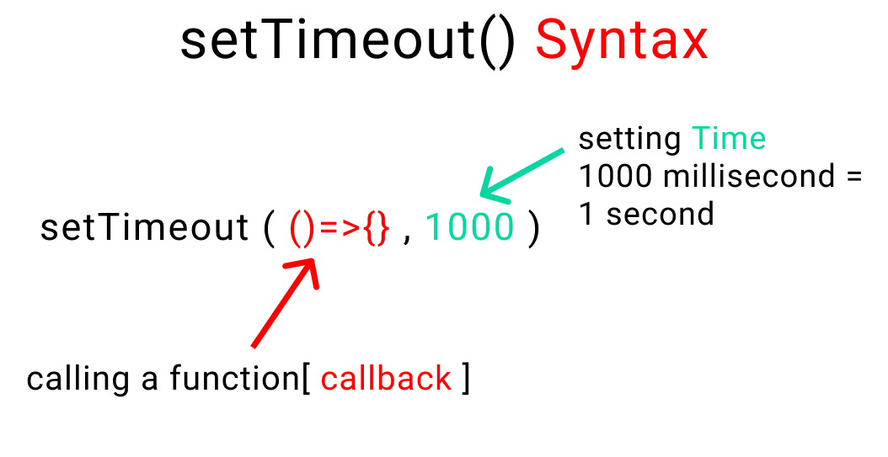
Symbol :
In this chart, you can see that step 1 is to place the order, which takes 2 seconds. Then step 2 is cut the fruit (2 seconds), step 3 is add water and ice (1 second), step 4 is to start the machine (1 second), step 5 is to select the container (2 seconds), step 6 is to select the toppings (3 seconds) and step 7, the final step, is to serve the ice cream which takes 2 seconds.
To establish the timing, the function setTimeout() is excellent as it is also uses a callback by taking a function as an argument.

Slide 25
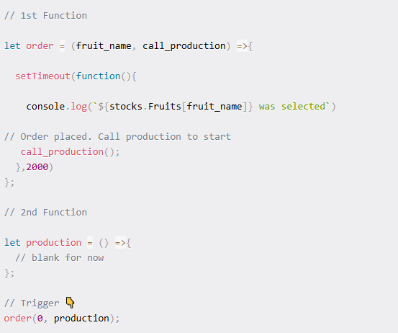
Type Annotation
Syntax of a setTimeout() function
Now, let's select our fruit and use this function:

Slide 26
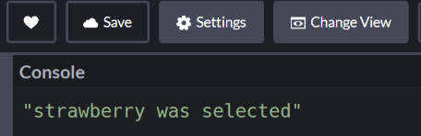
Enum
And here's the result in the console: 👇
Note that the result is displayed after 2 seconds.

Slide 27
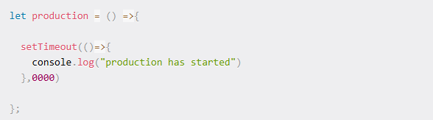
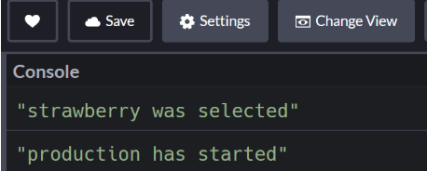
Enum
Now we'll start writing our production function with the following code.👇 We'll use arrow functions:
And here's the result 👇

Slide 28
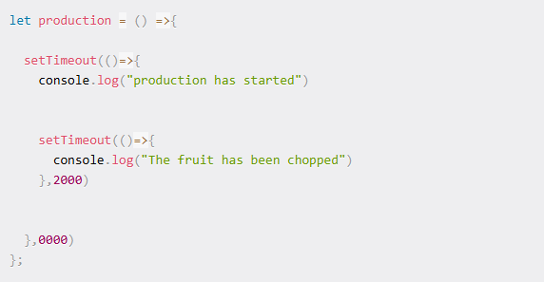
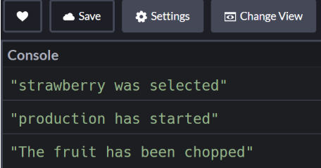
Enum
We'll nest another setTimeout function in our existing setTimeout function to chop the fruit. Like this:
And here's the result 👇

Slide 29
Arrays
If you remember, here are our steps:
Chart contains steps to make ice cream

Slide 30
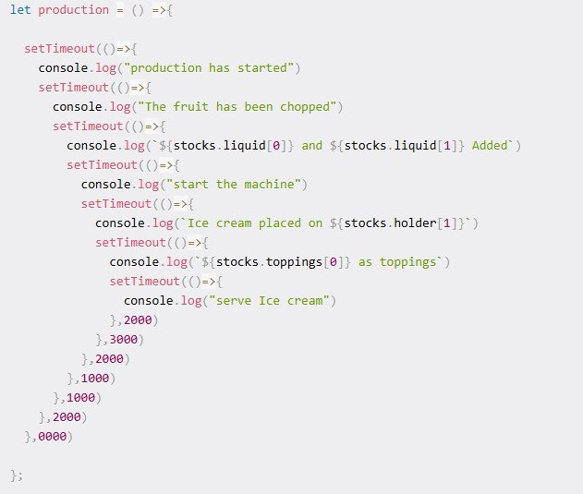
Arrays
Let's complete our ice cream production by nesting a function inside another function – this is also known as a callback, remember?

Slide 31
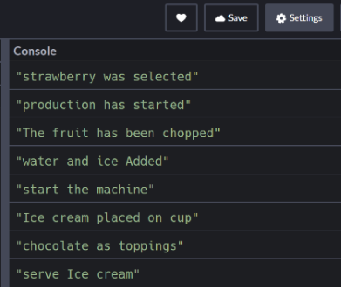
Arrays
And here's the result in the console 👇

Slide 32
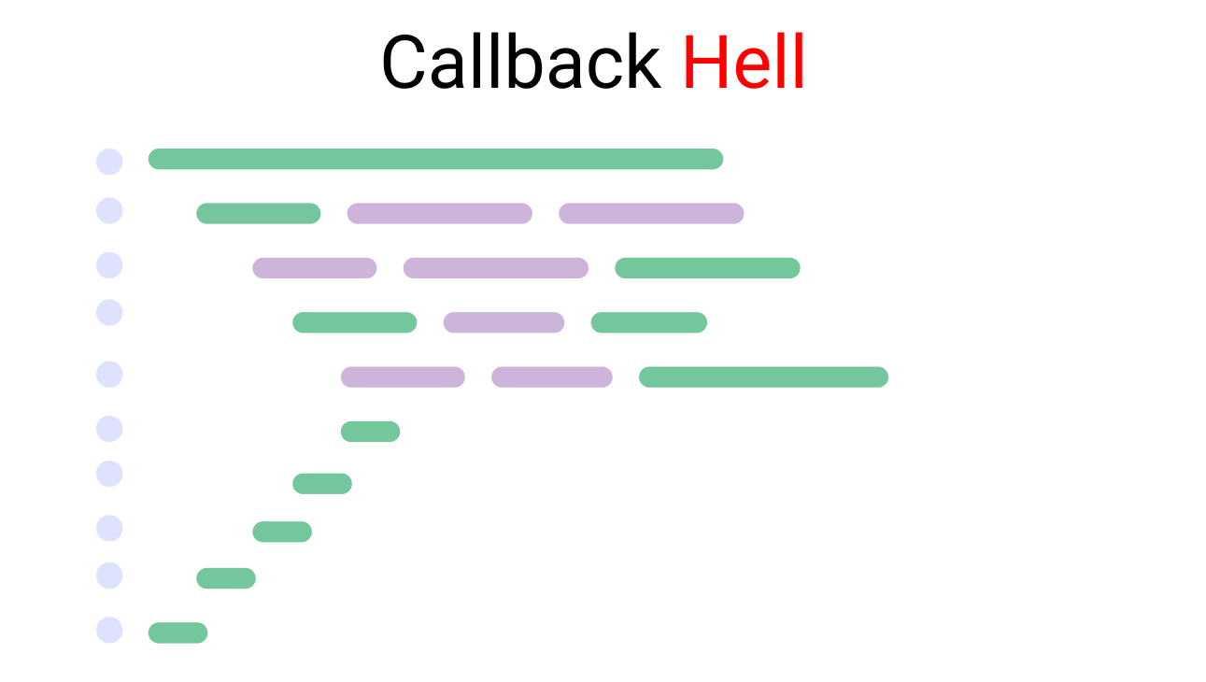
Callback Hell
This is called callback hell. It looks something like this (remember that code just above?): 👇

Slide 33
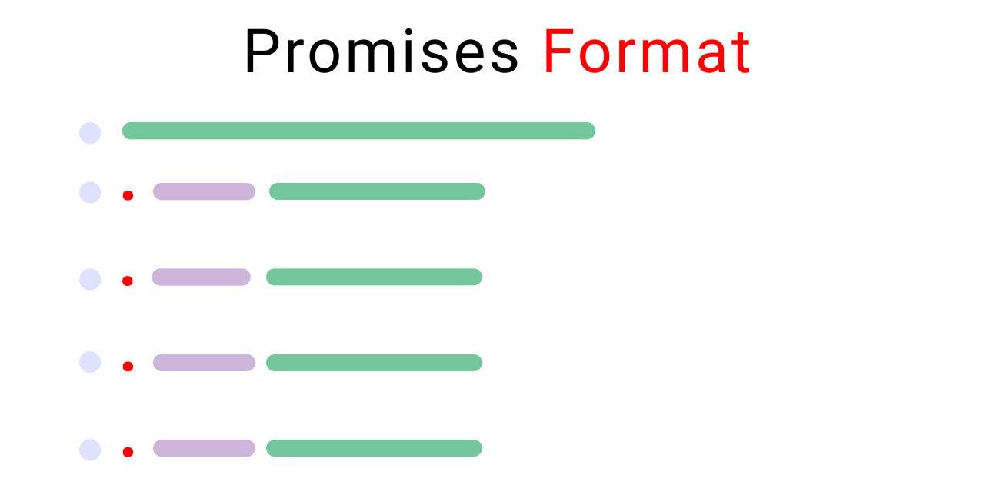
How to Use Promises to Escape Callback Hell
Promises were invented to solve the problem of callback hell and to better handle our tasks.
This is how a promise looks:

Slide 34
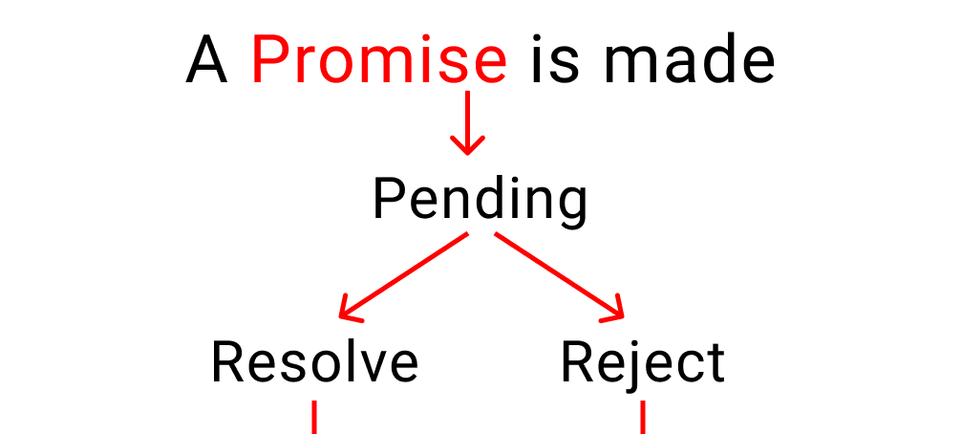
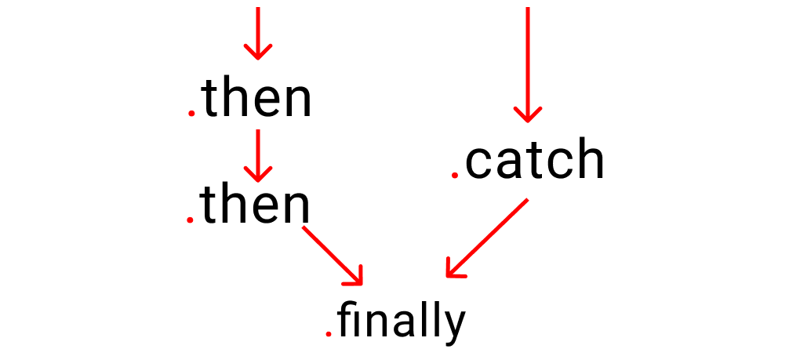
Promise
Let's dissect promises together.

Slide 35
An illustration of the life of a promise
As the above charts show, a promise has three states:
Pending: This is the initial stage. Nothing happens here. Think of it like this, your customer is taking their time giving you an order. But they haven't ordered anything yet.
Resolved: This means that your customer has received their food and is happy.
Rejected: This means that your customer didn't receive their order and left the restaurant.
Let's adopt promises to our ice cream production case study.

Slide 36
Tuple
We need to understand four more things first ->
Relationship between time and work
Promise chaining
Error handling
The .finally handler
Let's start our ice cream shop and understand each of these concepts one by one by taking baby steps.

Slide 37
Relationship between time and work
If you remember, these are our steps and the time each takes to make ice cream"
Chart contains steps to make ice cream

Slide 38

Rest and spread operators
For this to happen, let's create a variable in JavaScript: 👇
Now create a function named order and pass two arguments named time, work:

Slide 39
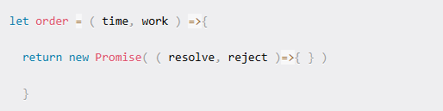
Using Destructuring
Now, we're gonna make a promise to our customer, "We will serve you ice-cream" Like this ->
Our promise has 2 parts:
Resolved [ ice cream delivered ]
Rejected [ customer didn't get ice cream ]

Slide 40
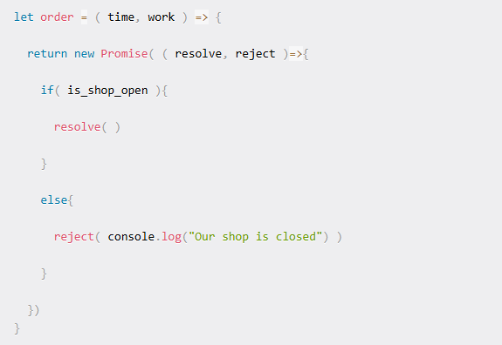
Using Destructuring
Now, we're gonna use our newly created function to start ice-cream production.

Slide 41

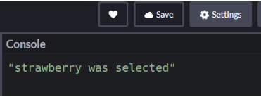
Using Destructuring
Now, we're gonna use our newly created function to start ice-cream production.
The result 👇 after 2 seconds looks like this:

Slide 42
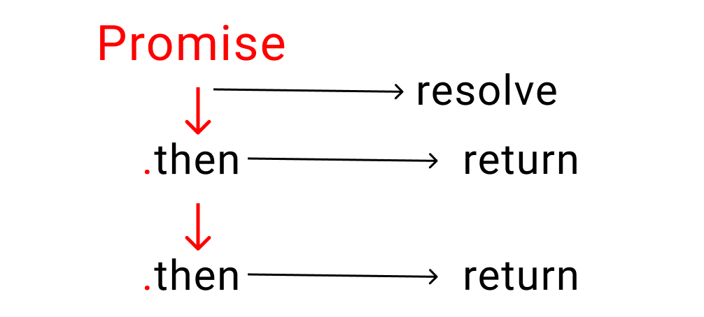
Promise chaining
In this method, we defining what we need to do when the first task is complete using the .then handler. It looks something like this
Illustration of promise chaining using .then handler
The .then handler returns a promise when our original promise is resolved.

Slide 43
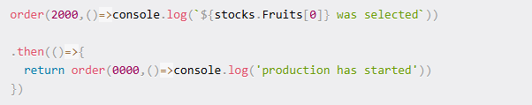
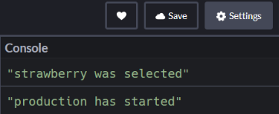
Promise chaining
Let me make it simpler: it's similar to giving instructions to someone. You tell someone to " First do this, then do that, then this other thing, then.., then.., then..." and so on.
The first task is our original promise.
The rest of the tasks return our promise once one small bit of work is completed
Let's implement this on our project. At the bottom of your code write the following lines. 👇
Note: don't forget to write the return word inside your .then handler. Otherwise, it won't work properly. If you're curious, try removing the return once we finish the steps:
And here's the result: 👇

Slide 44
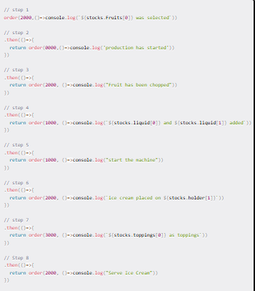
Promise chaining
Using the same system, let's finish our project:👇

Slide 45
Error handling
We need a way to handle errors when something goes wrong. But first, we need to understand the promise cycle:

Slide 46

Error handling
To catch our errors, let's change our variable to false.
Which means our shop is closed. We're not selling ice cream to our customers anymore.
To handle this, we use the .catch handler. Just like .then, it also returns a promise, but only when our original promise is rejected.
A small reminder here:
.then works when a promise is resolved
.catch works when a promise is rejected

Slide 47

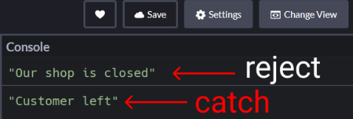
Error handling
Just remember that there should be nothing between your previous .then handler and the .catch handler.
Here's the result:

Slide 48

Error handling
A couple things to note about this code:
The 1st message is coming from the reject() part of our promise
The 2nd message is coming from the .catch handler
How to use the .finally() handler
There's something called the finally handler which works regardless of whether our promise was resolved or rejected.
For example: whether we serve no customers or 100 customers, our shop will close at the end of the day
If you're curious to test this, come at very bottom and write this code: 👇

Slide 49
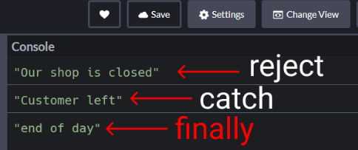
Promise chaining
The result:

Slide 50
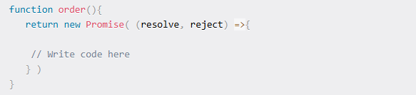
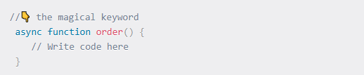
How Does Async / Await Work in JavaScript?
Before async/await, to make a promise we wrote this:
Now using async/await, we write one like this:

