Slide 1
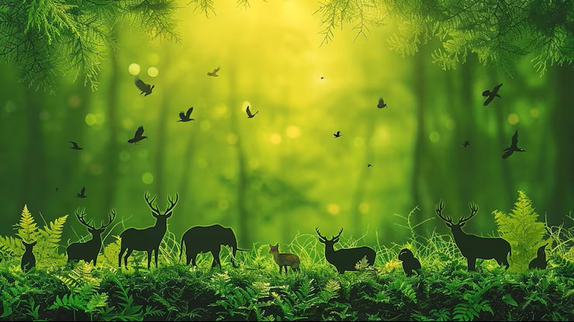
Wildlife species classification
Name : Shiv Trivedi
Student id : 100536444
Supervisor : Cheng Wang

Slide 2
Introduction
“To understand wildlife, we must first learn to see what often goes unseen.”
— Anonymous
There are countless mysteries hidden within our forests, such as unseen animal species, animal movements, and changes within the forest that we are still not fully aware of.
To understand wildlife better, we must study animals and their movements using advanced technologies that allow us to observe them without causing harm.
Camera traps provide an effective, non-invasive solution for addressing this gap by enabling the use of advanced technology to monitor and study wildlife in their natural environment.

Slide 3
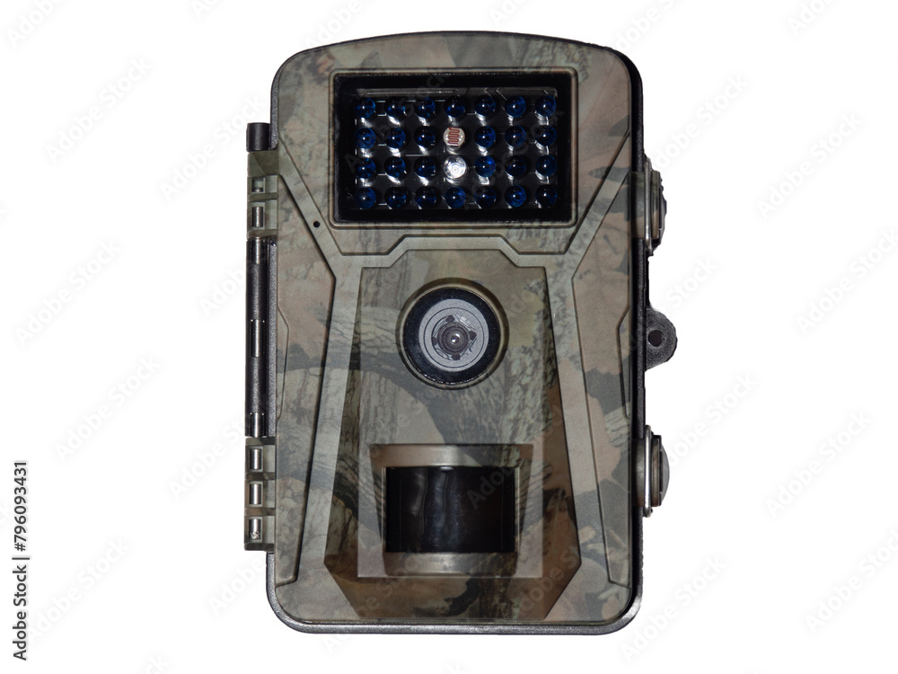
Camera- traps
Camera traps are considered as one of the useful weapon in wildlife industry.
Camera traps are automated cameras which captures the images of wildlife whenever the moment is captured
These devices allow researchers and ecologists to monitor wildlife species and their movements without causing any disturbance or inconvenience to the animals.
They capture large amounts of visual data under various environmental conditions, both during the day and at night, which can be used for species identification, population monitoring, and behavioural analysis

Slide 4
Core Aim
The main objective of this dissertation is to develop an automated animal classification system using machine learning models to identify different wildlife species from camera-trap images.
The system uses convolutional neural networks (CNNs) to analyse wildlife images and perform automated species classification, providing an effective approach to processing large-scale camera-trap data.
I have developed a systematic pipeline for image classification, starting from data preprocessing and preparation, followed by model training, depth integration, and model evaluation to achieve reliable wildlife species classification.

Slide 5
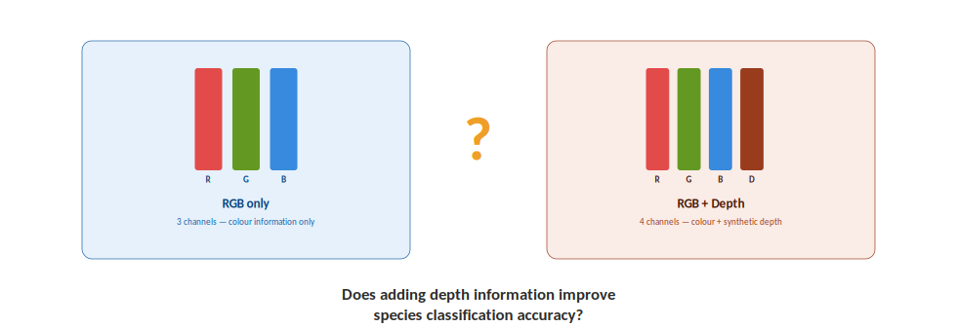
Central Research Question
Before discussing the further stages of this research, I would like to highlight the central question of this study: “Does adding depth information improve wildlife species classification?”
This research provides a clear comparison between three-channel RGB images and four-channel RGB images enhanced with depth information.
The RGB model uses the conventional three colour channels to learn visual features such as colour, shape, texture, and appearance.
The depth-enhanced model adds a fourth depth channel, providing additional spatial information about the distance and structure of objects within the scene.
The comparison helps determine whether the additional depth information provides a measurable improvement in wildlife species classification compared with RGB information alone.

Slide 6
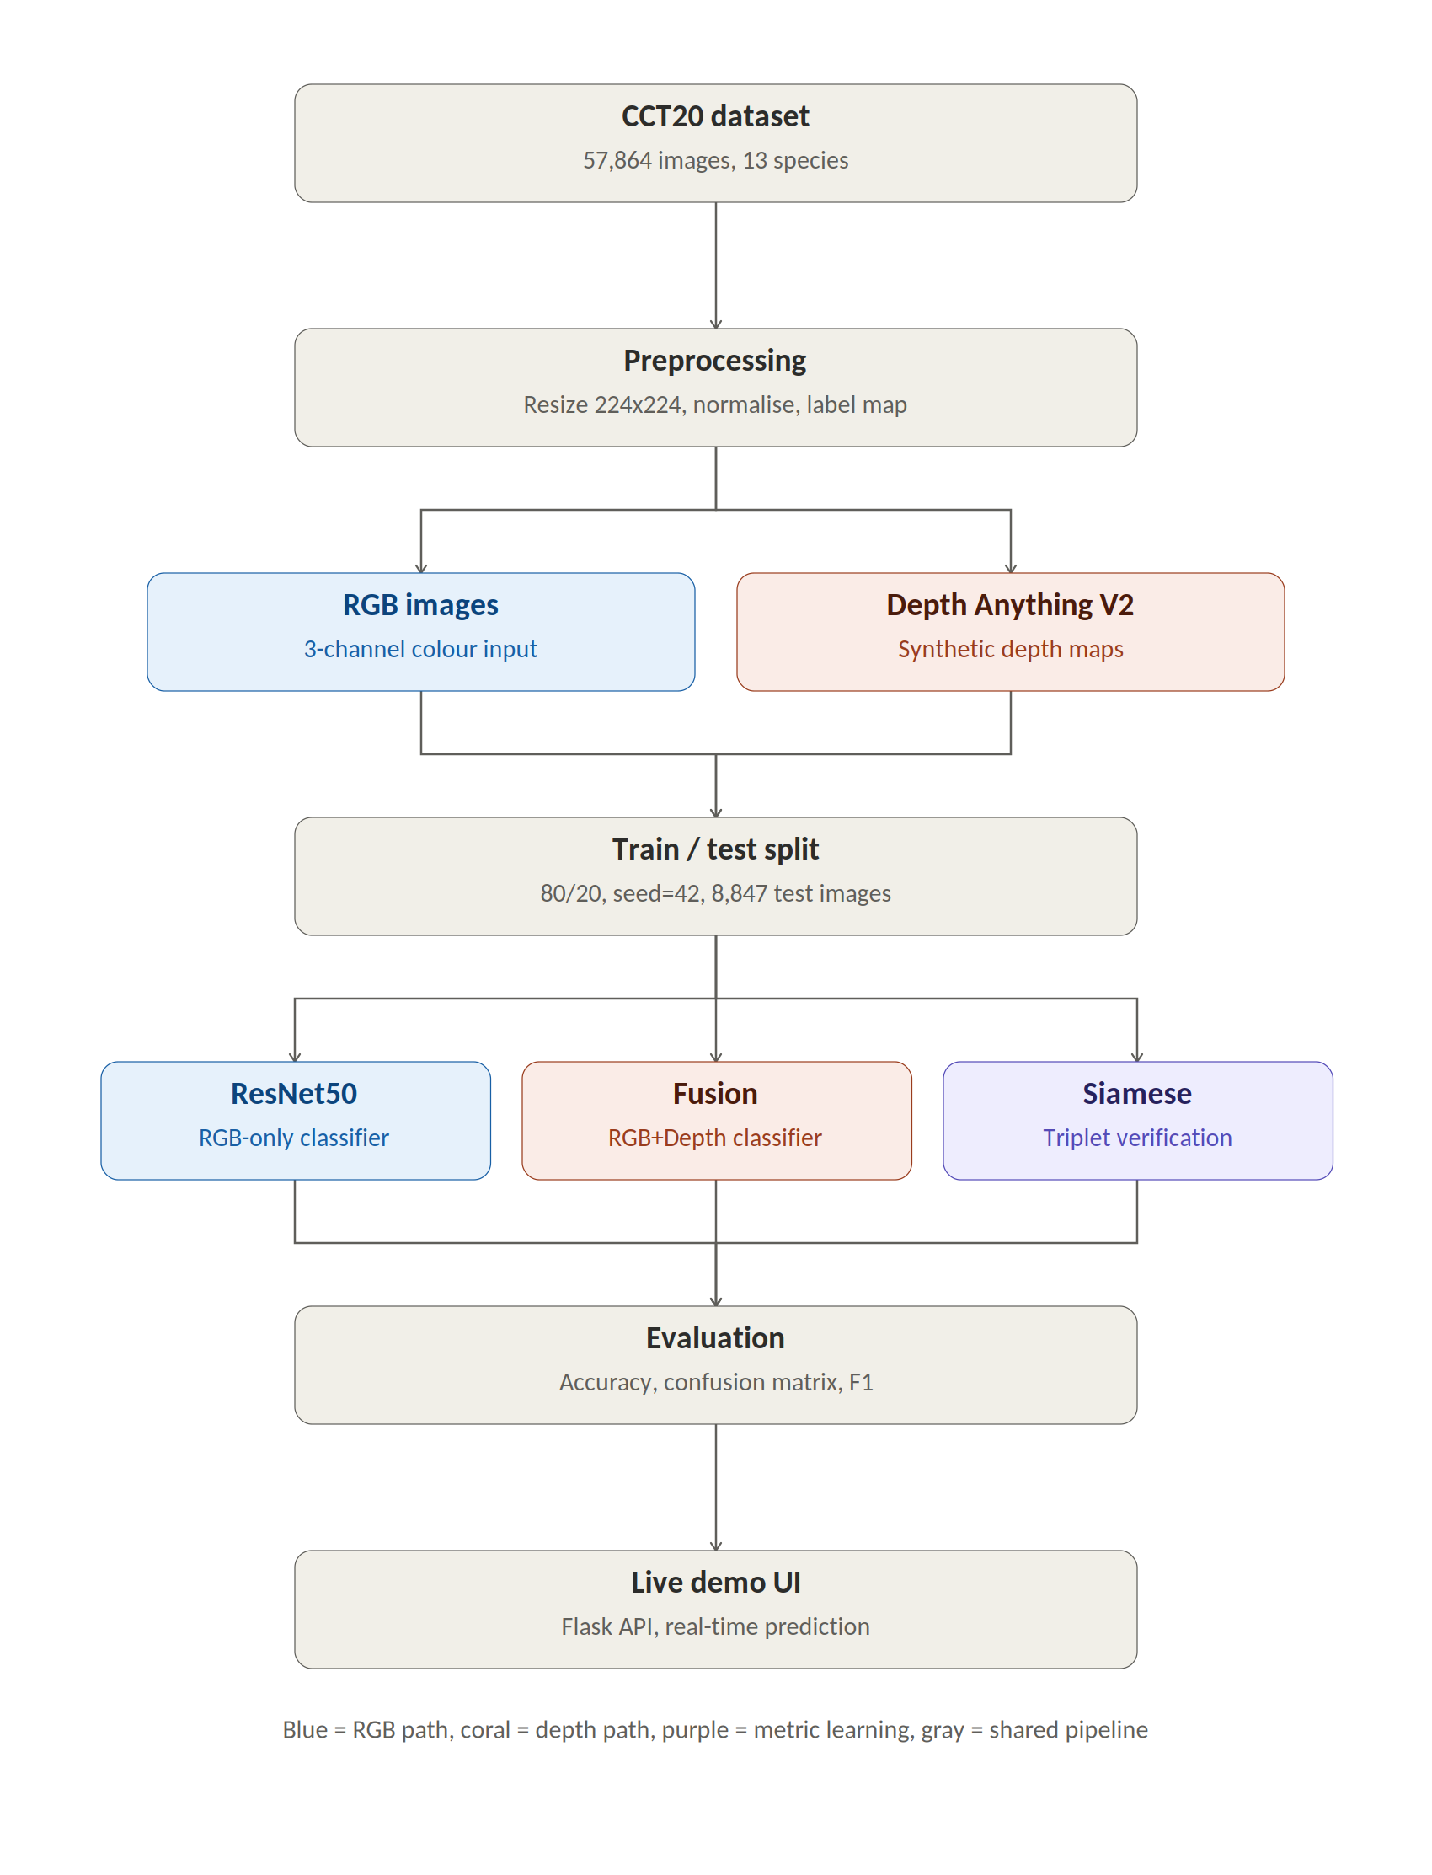
Working Flow
The diagram shows complete working of my dissertation using CCT20 dataset consist of 57,864 images across 13 animal species begins with pre-processing of dataset ends with live demosntrartion of final classification layer.
The images first pre-processed and used to generate both the original RGB inputs and additional depth information.
After pre-processing the next important step is model learning approach, I conducted different modelling approaches to compare RGB-only classification with RGB and depth-based approaches.
The outputs were then evaluated using standard classification metrics, and finally, the best-performing approach was integrated into a Flask-based live demonstration.
So, in simple terms, this slide shows the complete journey of my project — from the dataset, through modelling and evaluation, to the final working system.”

Slide 7
Dataset Exploring
The first and most fundamental step of my research was to download and explore the dataset to understand its structure, content, and suitability for this research.
I used the CCT20 dataset, which contains 57,864 camera-trap images across 13 animal species. Before proceeding with model development.
During dataset exploration, I found that different animal species contained different numbers of image samples. To reduce the impact of class imbalance, I selected only the species with more than 100 image samples for training and evaluation. This ensured that each class had sufficient data for reliable model learning and comparison.
After applying the filtering criteria on annotation file, I retained 13 animal species that had more than 100 image samples and were suitable for my classification task. These included bobcat, opossum, coyote, raccoon, bird, dog, cat, squirrel, rabbit, skunk, rodent, deer and dog.

Slide 8
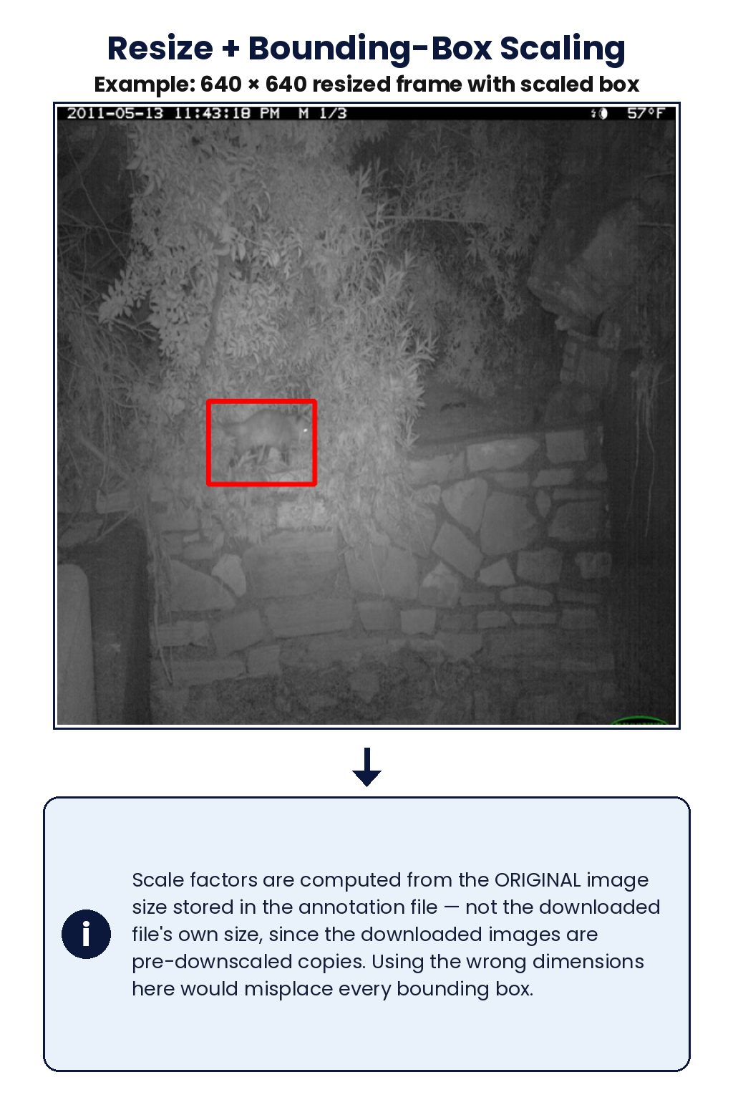
Pre-processing
The pre-processing pipeline performs simple four process to provide essential input to model for appropriate learning.
Those four processes are Image resizing, Bounding-box calculation according to resizing value, pixel normalization and filtering out non-essential categories running this across full dataset
Image resizing
All 57,864 downloaded images were resized with OpenCV to a common 640 × 640, with scale factors computed from the original annotation-file dimensions (see example, right).
2. Bounding-box adjustment
Each box's x, y, width and height were scaled by the same factors, so it still lines up with the animal after resizing.

Slide 9
Pre-processing — Dataset Preparation
3. Pixel normalisation
Pixel values were normalised from 0–255 to 0–1 by dividing each value by 255.
4. Category filtering & dataset preparation
Categories with more than 100 annotations were retained (excluding ‘empty’ and ‘car’), reducing 20 raw categories to the 14 categories used for training.
Running this across the full dataset saved 42,294 images and 44,232 boxes to disk — full breakdown next slide.
Categories with 100 or fewer annotations (plus ‘empty’ and ‘car’) were dropped, taking the raw annotation file from 20 categories down to the 14 used for training.
The full pipeline was then run end-to-end and the results saved to disk — but a large share of annotated images were never actually downloaded locally, which shows up as a sharp drop for several species below.

Slide 10
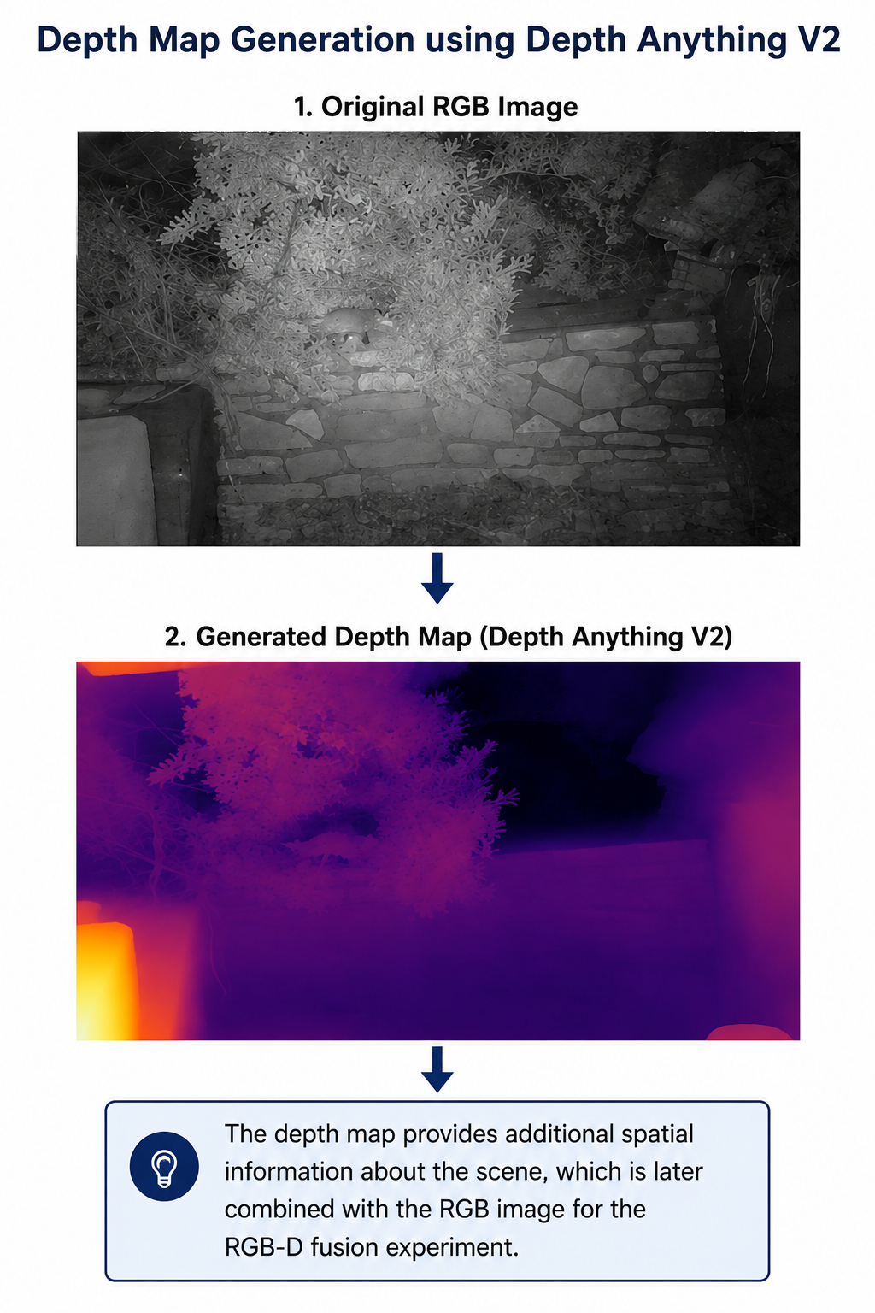
Depth Map Generation
To generate monocular depth information for each RGB image I have used depth anything v2.
The model was configured to use GPU when available, with CPU as a fallback
I have selected randomly 20 images from dataset to test depth map generation, the image shows is one of the example of depth map.
This whole process gets monitored using an processing log to see which images are not processed, skipped and failed images.
The generated depth maps were then resized to 224 × 224 and normalised to 0–1.
Finally, the single-channel depth information was combined with the three RGB channels, producing a 4-channel RGB-D input for the fusion model.

Slide 11
Train/Test Split
After pre-processing and depth map generation for whole images in dataset, next step is to divide whole data into two parts:
Train: This section contains the data used to train all three models. It is the data through which the models learn, and it consists of 80% of the dataset.
Test: This section contains the unseen data used to evaluate all three models. It is kept separate from the training data to measure how well the models perform on new images, and it consists of 20% of the dataset.
I have used an fixed random seed which provides same training data and testing data to all the models to ensure fair comparision across all models.

Slide 12
Model Development
This next step of this research is to develop machine learning models to investigate the impact of depth information on animal classification
Three experimental approaches were developed to investigate the effect of depth information on animal classification:
ResNet50 — RGB Only :
Used as the baseline model, using only RGB image information.
RGB + Depth Fusion :
Combined the three RGB channels with the generated depth channel to evaluate whether additional depth information improves classification.
Siamese Network — RGB + Depth :
Used to learn similarity between animal images using the combined RGB-D information.

Slide 13
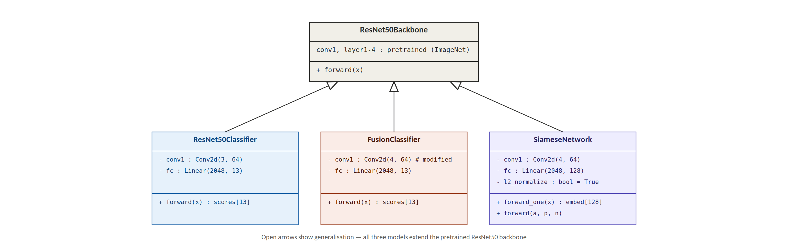
Model Architecture (UML)
All three models use the same pretrained ResNet50 backbone, with differences in their input channels, output layers, and training objectives.
ResNet50 provides the RGB-only baseline, Fusion combines RGB with depth for classification, while the Siamese network uses RGB-D information for similarity learning.

Slide 14
Model 1: ResNet50 (RGB-only)
For the first model, I used a standard ResNet50 architecture pretrained on ImageNet, since transfer learning helps the model reuse general visual features such as edges, shapes and textures.
The model takes a 3-channel RGB image resized to 224 x 224 pixels as input, and I replaced the original classification layer with a fully connected layer of 13 output classes, matching the animal species in my dataset.
I trained this model using Cross-Entropy Loss with the Adam optimizer, a learning rate of 0.0001, a batch size of 32, for 5 epochs.
This model acts as my baseline, giving me a reference point to compare against the depth-fusion and Siamese approaches.

Slide 15
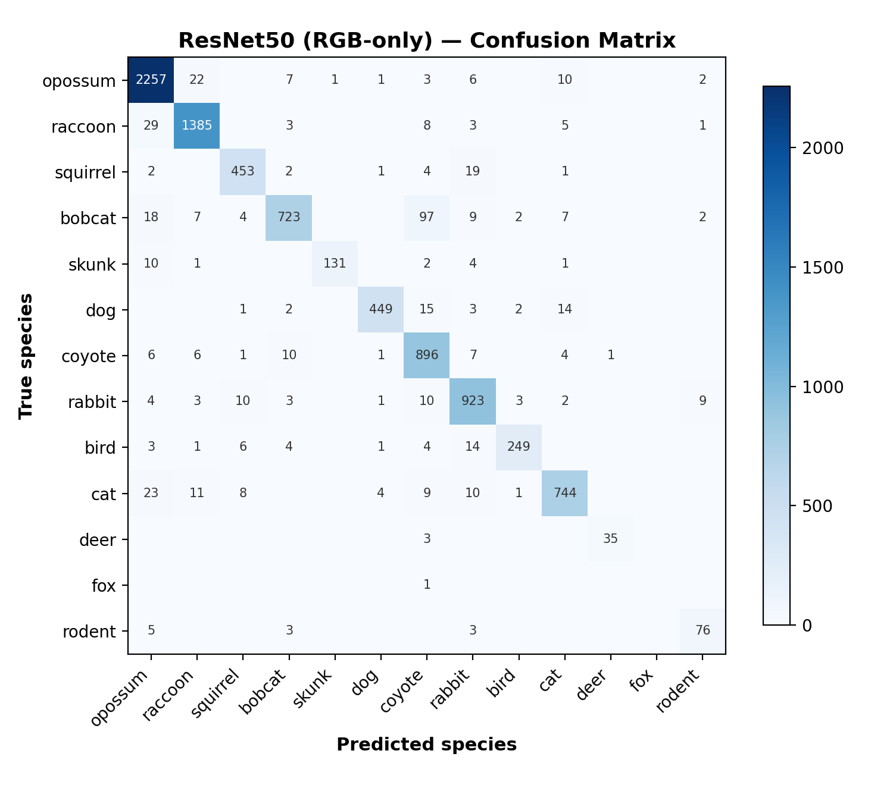
ResNet50 Results
After training, the RGB-only ResNet50 achieved an accuracy of 94.05% on the fixed seeded test set of 8,847 images.
The macro-average F1-score was 0.86 while the weighted-average F1-score was 0.94. This gap shows that species with fewer samples were classified less effectively, confirming the effect of class imbalance in the dataset.
Opossum and raccoon achieved the highest F1-scores of 0.97, while fox scored 0.00 because it only had one test sample.
Bobcat and coyote were the most confused pair, with 97 bobcat images misclassified as coyote, since both species have similar body structure and colouring.

Slide 16
Model 2: RGB + Depth Fusion
The second model uses the same ResNet50 backbone, but I modified the first convolutional layer (conv1) to accept 4 input channels instead of 3, adding a depth channel alongside the original RGB channels.
The pretrained RGB weights were kept unchanged for the first three channels, and I initialised the new depth channel using the weights from the red channel, since there is no pretrained depth-specific weight available.
The depth information for each image was generated using Depth Anything V2, and combined with the RGB channels before being passed to the model.
This model was trained with the same settings as the RGB baseline: Cross-Entropy Loss, Adam optimizer, learning rate 0.0001, batch size 32, for 5 epochs.

Slide 17
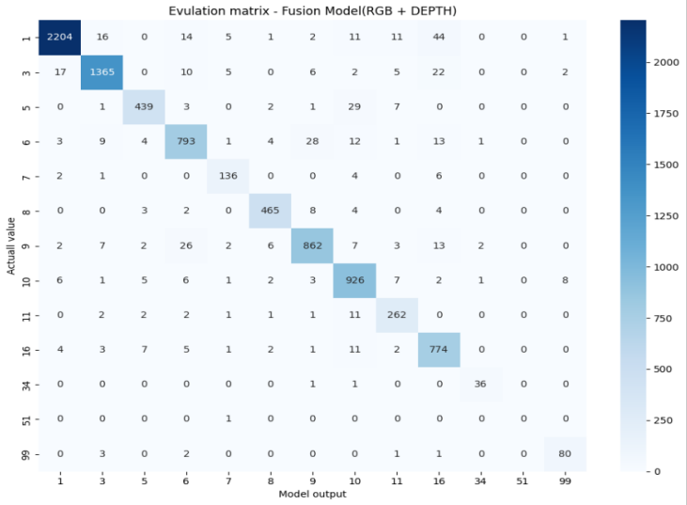
Fusion Model Results
The RGB+Depth fusion model achieved an accuracy of 94% on the same test set, almost identical to the RGB-only baseline of 94.05%.
The training loss dropped steadily across the 5 epochs, from 0.5311 to 0.0762, showing that the model was learning properly throughout training.
Looking only at overall accuracy, adding depth information does not appear to make a meaningful difference. However, the per-class F1-score comparison tells a more detailed story.

Slide 18
RGB vs Fusion: The Real Finding
When I compared both models species by species, depth information improved the F1-score for 4 out of 13 classes: bobcat, dog, coyote and rodent, with the biggest improvement of +0.04 for rodent.
For most other classes, RGB-only performed marginally better, usually by only 0.01 to 0.03.
Both models completely failed on fox, scoring 0.00 F1, because there was only 1 test sample for this class. This is a dataset limitation, not a weakness of either model architecture.
My overall conclusion is that synthetic depth information does not improve the aggregate classification accuracy, but it does carry some useful, species-specific signal, particularly for animals with similar colouring but different body shapes, such as bobcat and coyote.

Slide 19
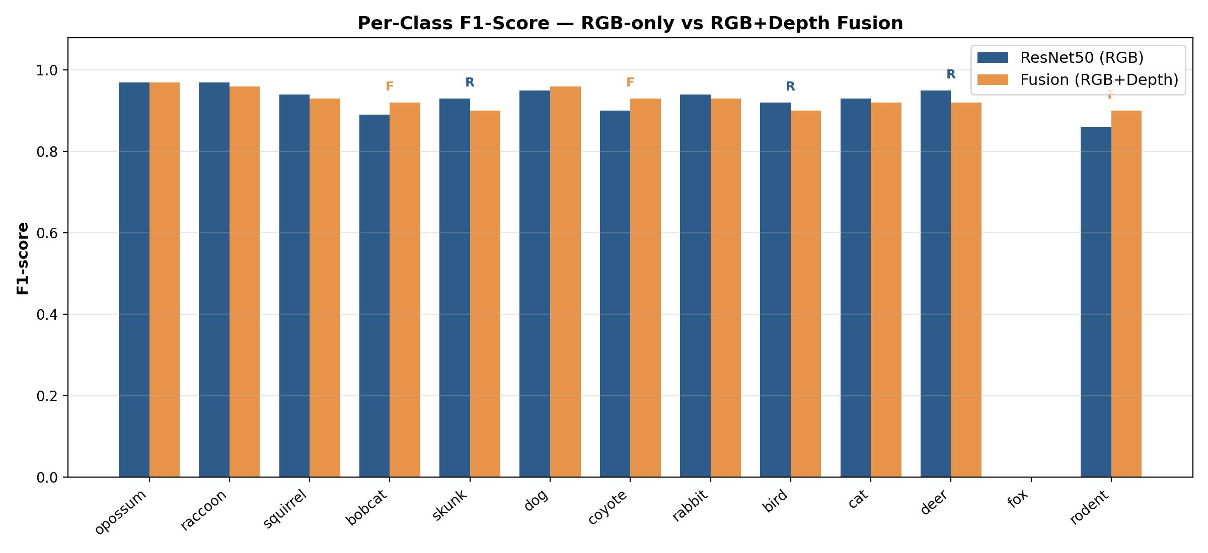
F1-Score Comparision

Slide 20
Model 3: Siamese Verification Network
My original proposal included individual animal re-identification, but the CCT20 dataset does not provide individual identity labels, only species-level labels. After discussing this limitation with my supervisor, I changed my methodology to species-level similarity verification instead.
This model uses the same 4-channel ResNet50 backbone as the fusion model, but the final layer is replaced with a 128-dimensional embedding output, which is L2-normalised.
I trained this model using Triplet Margin Loss with a margin of 1.0, where each training sample is a triplet: an anchor image, a positive image from the same species, and a negative image from a different species.
The goal is to bring the anchor and positive embeddings closer together, while pushing the anchor and negative embeddings further apart, allowing the model to learn species-level similarity instead of a fixed label.

Slide 21
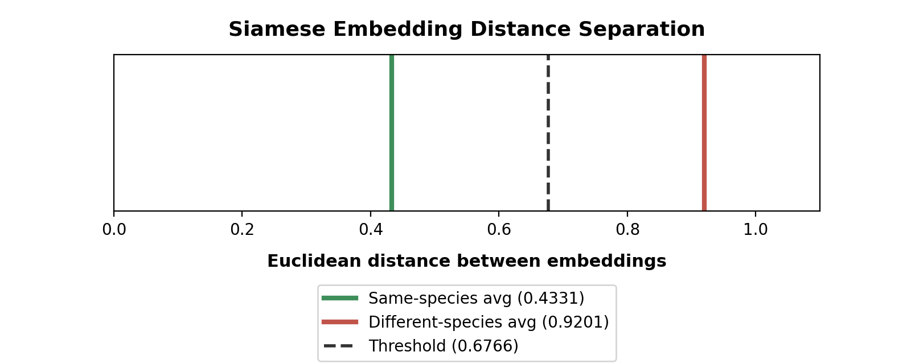
Siamese Network Results
I evaluated this model in two different ways. Using relative ranking, where I check whether the same-species image is closer than the different-species image within each triplet, the model achieved 78.14% accuracy.
Using a fixed distance threshold instead, where each pair is judged independently, the model achieved 72% accuracy.
The average distance between same-species embeddings was 0.4331, while different-species embeddings averaged 0.9201, showing a clear, healthy separation between the two groups.
This confirms the model has genuinely learned meaningful species-similarity structure, even though this task is harder than direct 13-class classification.

Slide 22
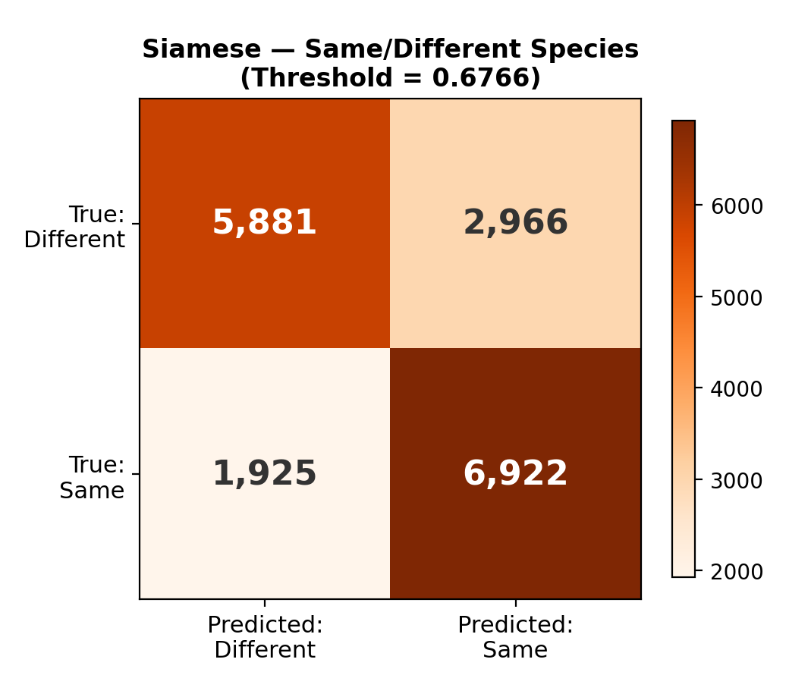
Siamese Verification — Confusion Matrix
Using the fixed threshold of 0.6766, I built a confusion matrix to evaluate how well the model separates same-species pairs from different-species pairs.
The model correctly identified 5,881 different-species pairs and 6,922 same-species pairs.
However, it incorrectly classified 2,966 different-species pairs as same, and 1,925 same-species pairs as different.
This shows the model has a slightly higher recall for same-species pairs (0.78) compared with different-species pairs (0.66), meaning it leans towards over-matching rather than under-matching.

Slide 23
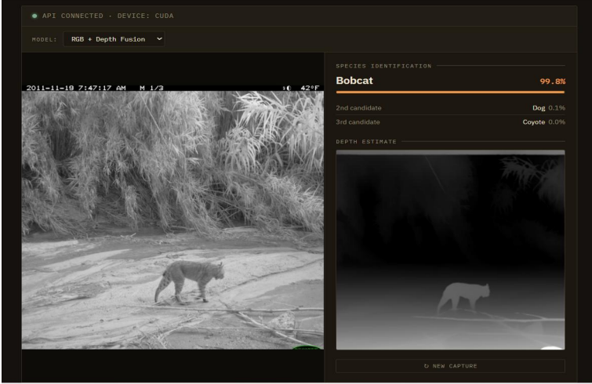
Live Demonstration
To demonstrate the trained models in a practical way, I built a Flask-based API connected to a browser interface, allowing real-time species prediction.
When an image is uploaded, the depth map is generated live using Depth Anything V2, combined with the RGB image, and passed through the fusion model to return the top-3 predicted species with confidence scores.
I tested this live system using both real camera-trap images and images from the internet outside the dataset. A coyote image was correctly classified with 100% confidence, and a dog image was correctly classified with 97% confidence.
However, when I tested a fox image, the model incorrectly predicted dog with 91.5% confidence, and fox did not even appear in the top-3 predictions. This live result directly confirms the class-imbalance limitation I identified earlier in the evaluation.

Slide 24
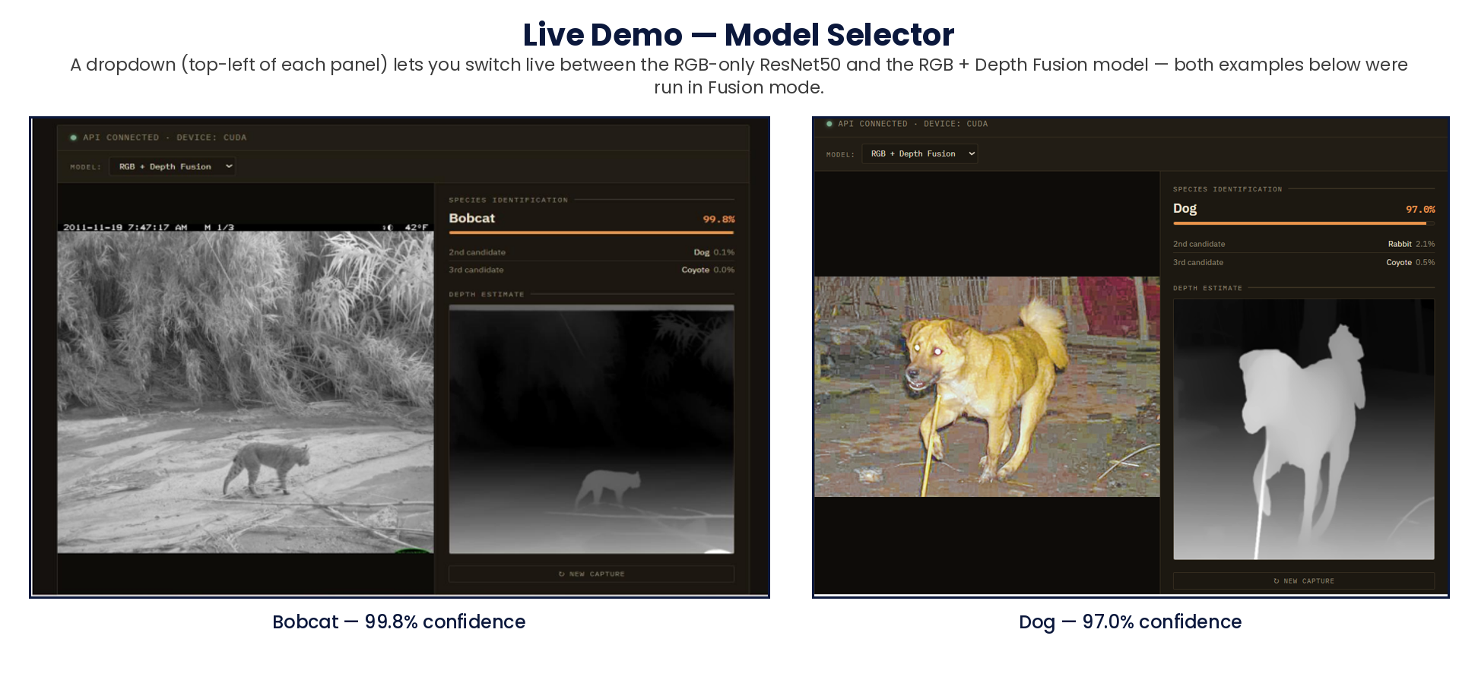
Live Demo — Switchable Model
The interface also includes a model selector, so predictions can be generated live using either the RGB-only ResNet50 or the RGB + Depth Fusion model on the same uploaded image.
Both examples below were captured with the dropdown (top-left of each panel) set to RGB + Depth Fusion mode — the same control lets me switch models without restarting anything.

Slide 25
Limitations
While working on this project, I identified several limitations that are important to acknowledge.
The depth channel was normalised using general placeholder values rather than statistics calculated specifically for the depth data.
The fourth channel's weights were initialised using the original red-channel weights, which is a reasonable heuristic but not necessarily the optimal choice.
All three models were trained for only 5 epochs, which may not be enough time for the network to fully learn how to use the newly added depth information.
The depth maps were generated using Depth Anything V2 rather than a real depth sensor, so there is no ground-truth depth data available to directly validate their accuracy.
Finally, the Siamese/triplet model is a harder task than direct classification, and I also observed some overfitting, since the training loss dropped much further than the test-set verification performance.

Slide 26
Findings
The RGB-only ResNet50 achieved 94.05% accuracy, while the RGB + Depth Fusion model achieved 94.00%.
Therefore before reaching any decision I found that, adding depth information did not improve the overall species classification accuracy.
However, depth information improved classification performance for specific species, including bobcat, coyote, dog and rodent.
This suggests that depth provides useful spatial and shape information for certain visually similar species.
The Siamese Network achieved 78.14% relative accuracy, demonstrating meaningful species-level similarity learning.
Overall, synthetic depth information provided useful additional information, but it was not sufficient to improve aggregate classification performance under the conditions of this study.

Slide 27
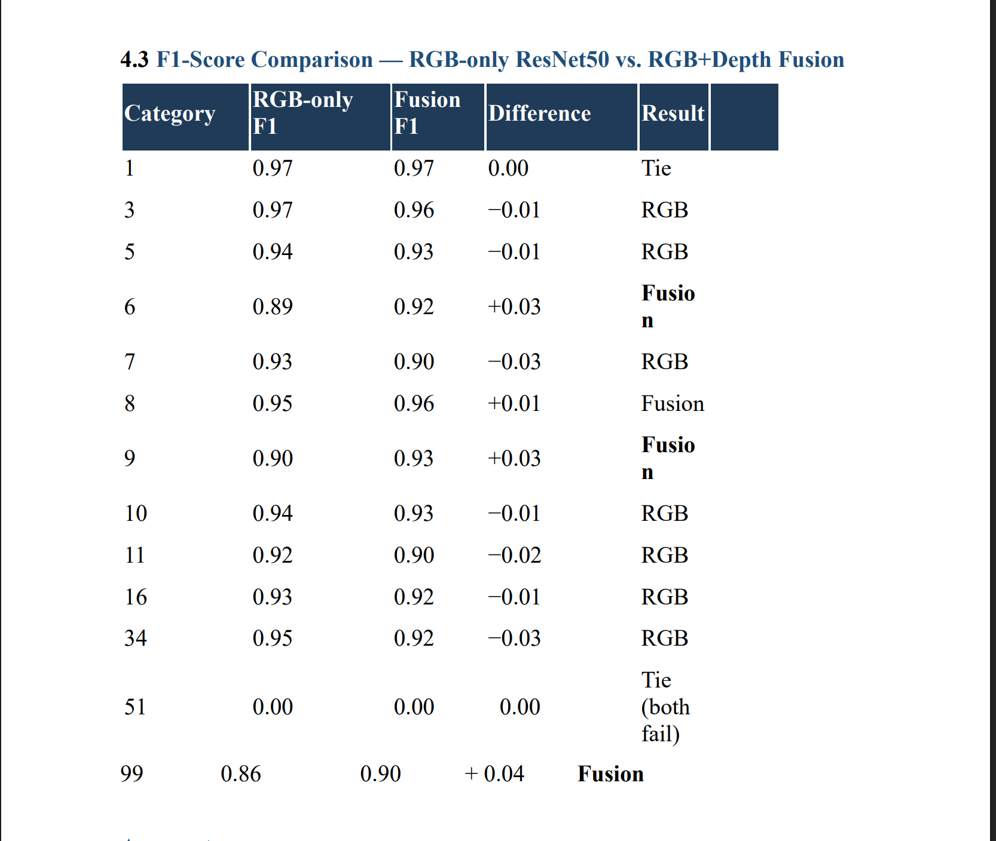
Per class accuracy
“This table compares the F1-score of the RGB-only ResNet50 model with the RGB-plus-depth fusion model across the different categories.
Overall, the results are mixed. The fusion model improves performance in categories 6, 8, 9 and 99, with the largest improvement of 0.04 in category 99. This suggests that depth information can provide useful additional spatial information for certain categories.
However, RGB-only performs better in several other categories, including 3, 5, 7, 10, 11, 16 and 34. There is also a tie in category 1, while both models fail completely on category 51.

Slide 28
Future Planning Work
Model training can be further improved and fine-tuned using better-prepared input data.
Class-weighted loss and data augmentation could improve performance for underrepresented species.
Depth-specific normalisation could help the fusion model learn and utilise depth information more effectively.
For the Siamese model, hard-negative mining and longer training could improve species-similarity prediction.
An alternative to the four-channel RGB-D approach, such as a two-branch RGB and Depth architecture, could be explored for improved performance.
Finally, the same model architecture could be tested on a dataset containing real depth-sensor data, with the aim of investigating individual animal re-identification, which was the original proposed application of the dataset.

Slide 29
Conclusion
After this research, I concluded that adding depth or spatial information provides benefits for only certain species, as discussed throughout my research.
Therefore, it is difficult to give a simple “yes” or “no” answer to my research question: “Does adding depth information improve overall animal species classification?”
The overall accuracy remained almost unchanged between the RGB-only and RGB + Depth approaches, although some individual species showed improvements with depth information.
This suggests that the usefulness of depth information may depend on the characteristics of the species and the visual information available in the images.
Based on the findings and experience gained from this research, I plan to investigate alternative methodologies that could make better use of depth information and help address this research gap.
“Ultimately, this research shows that depth information is not universally beneficial, but it contains additional information that could be valuable when used with a more suitable methodology.”

