Slide 1
staycatin story
File created on: 19/06/23 12:42:47 pm IST

Slide 3


Slide 4
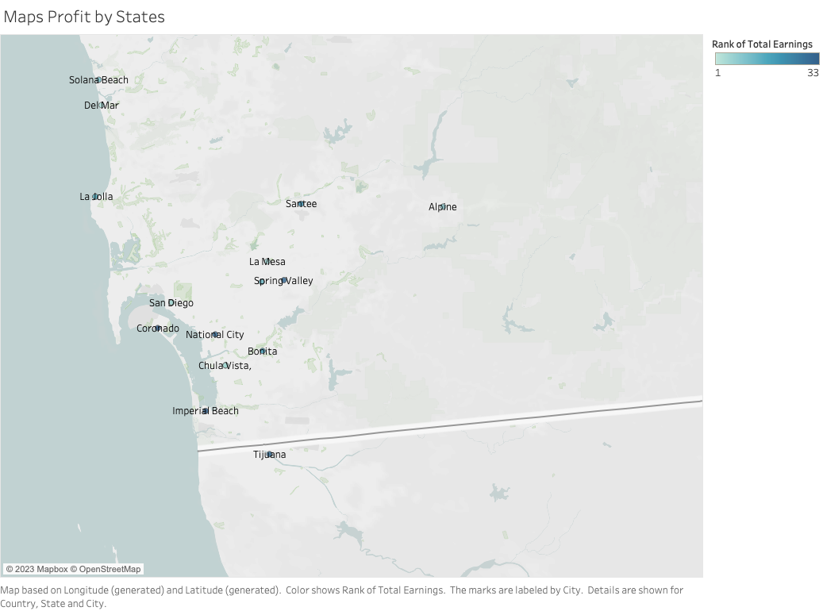

Slide 5
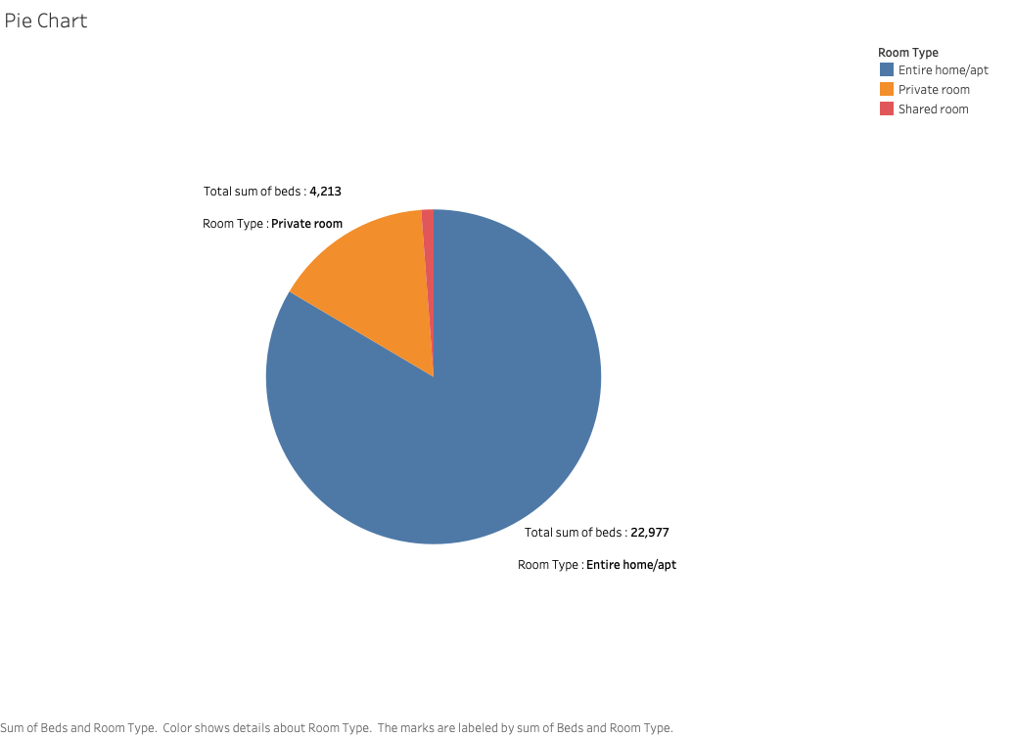

Slide 6
