Slide 1



consumer_goods_insight
View in Power BI
Last data refresh:
10/1/2024 6:22:32 AM UTC
Downloaded at:
10/6/2024 5:23:02 AM UTC

Slide 2
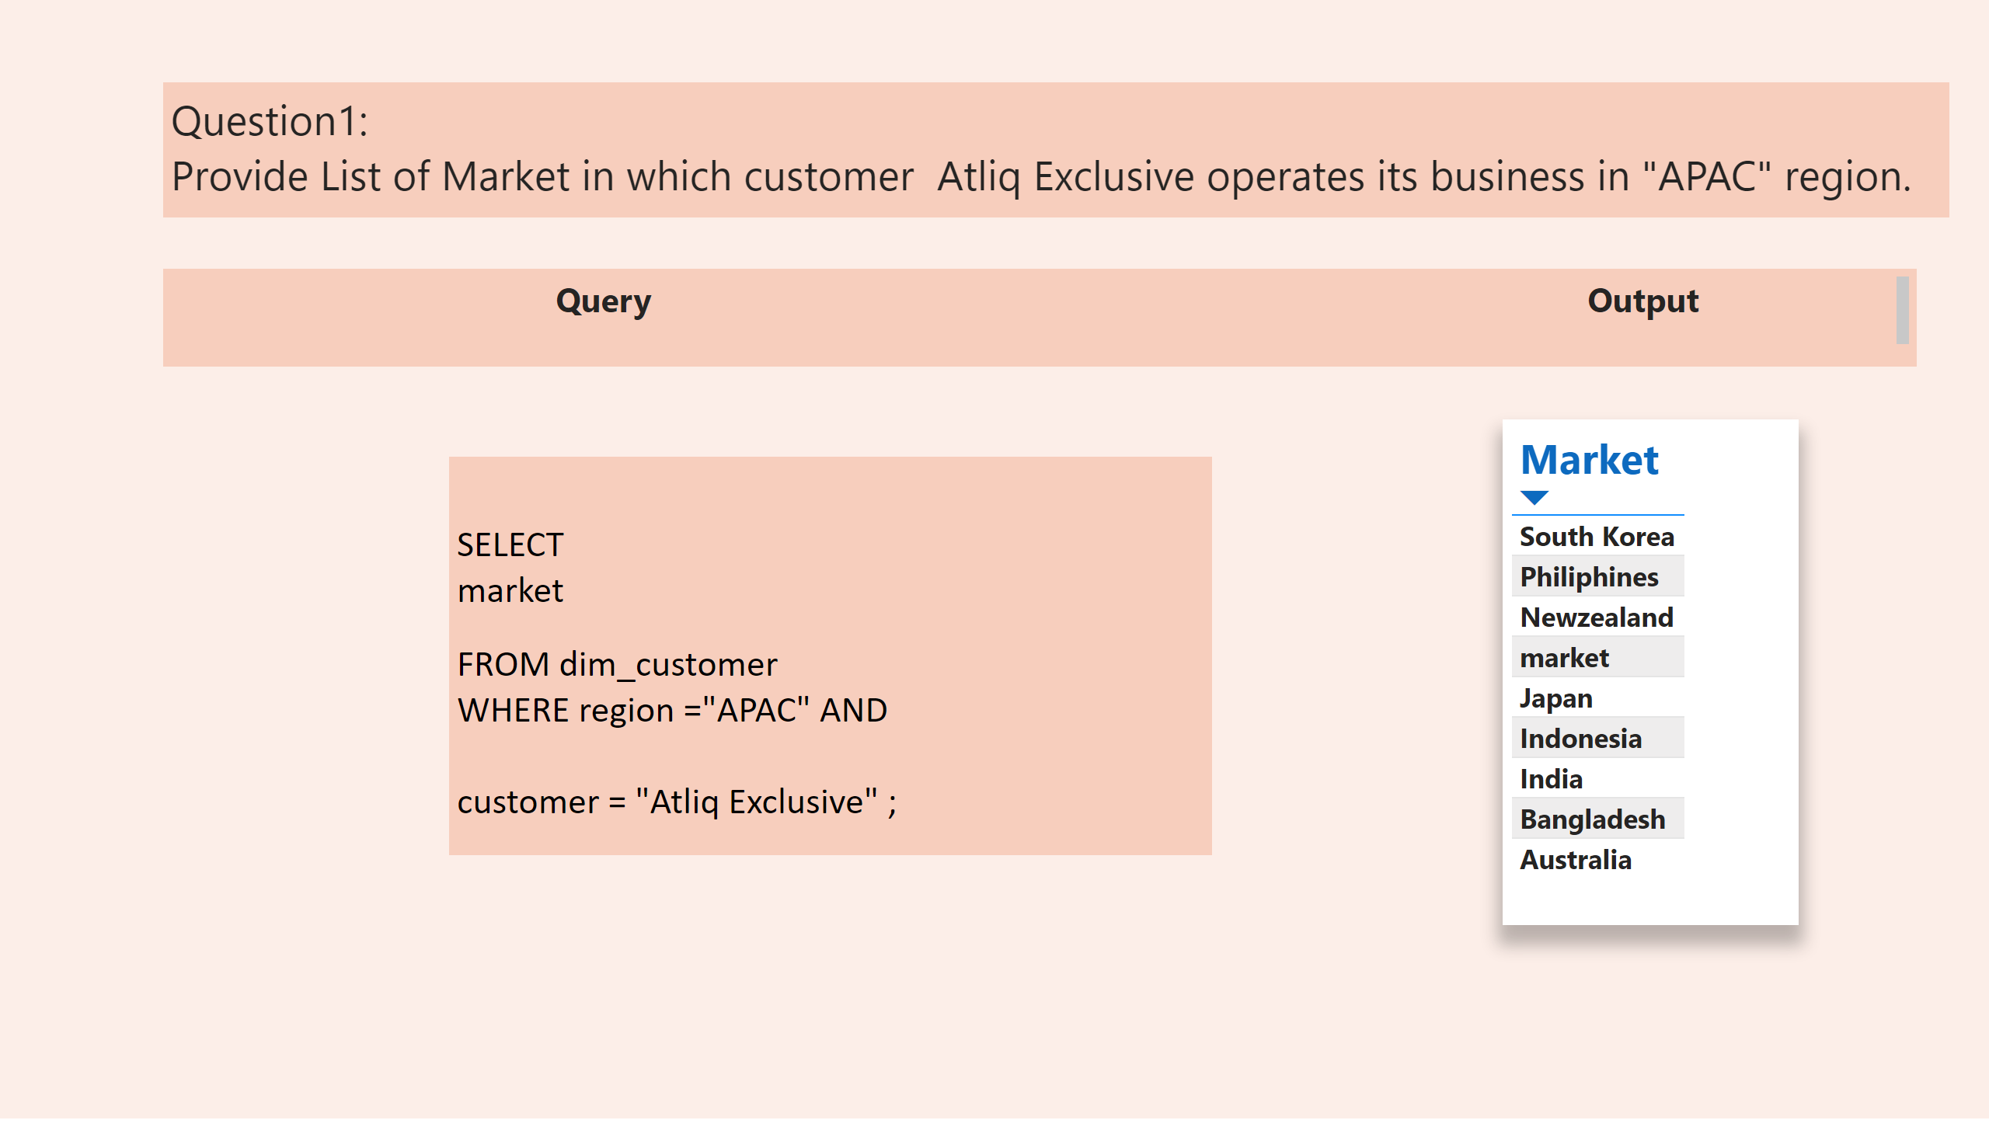
Marketlist_APAC
Notes:
tableEx
No alt text provided
textbox
No alt text provided
textbox
No alt text provided
textbox
No alt text provided

Slide 3
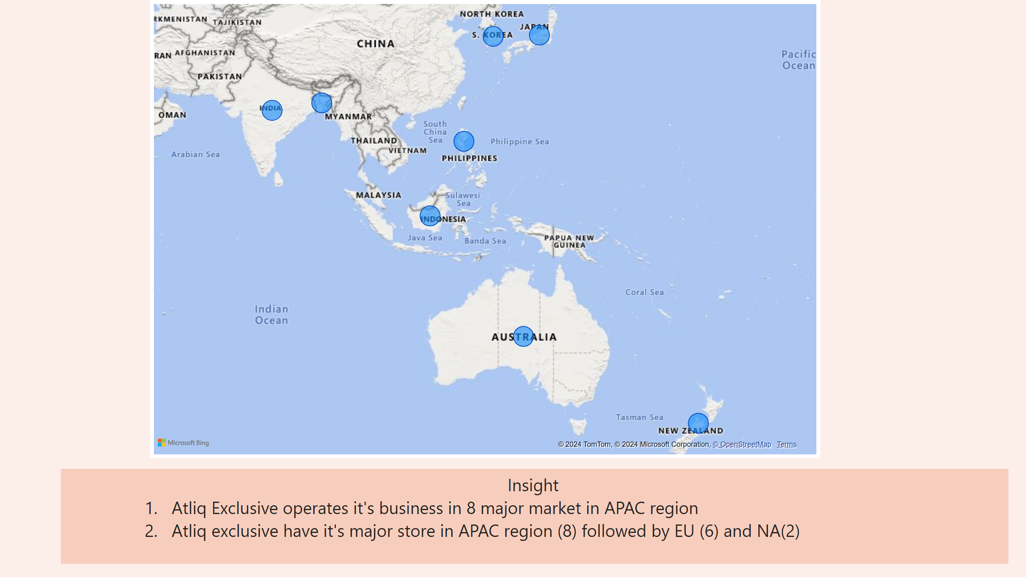
Insight_market
Notes:
map
No alt text provided
textbox
No alt text provided

Slide 4
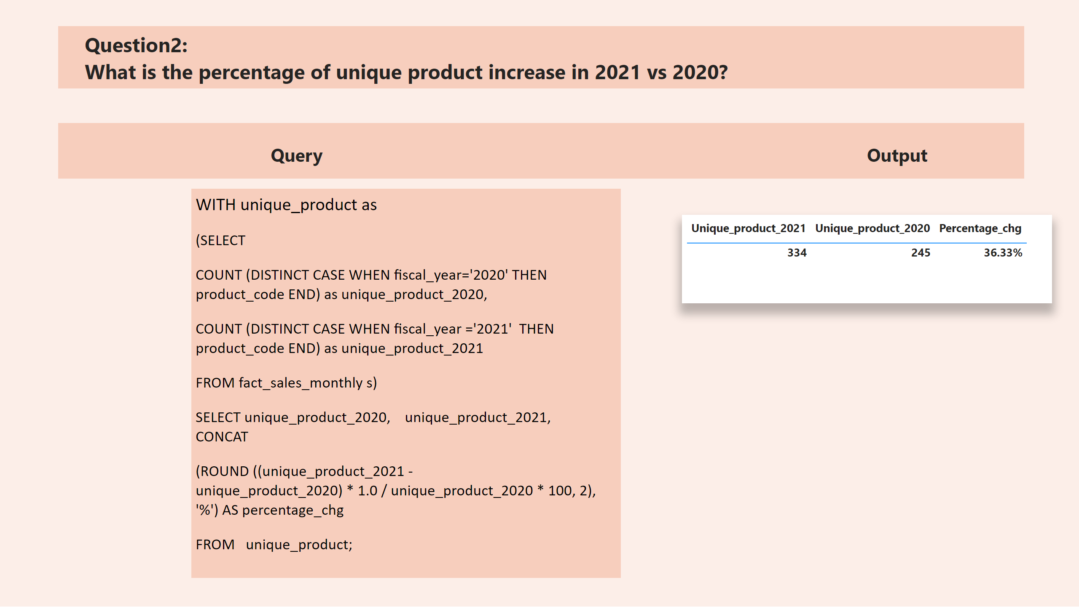
product_count_percentage_chg
Notes:
tableEx
No alt text provided
textbox
No alt text provided
textbox
No alt text provided
textbox
No alt text provided

Slide 5
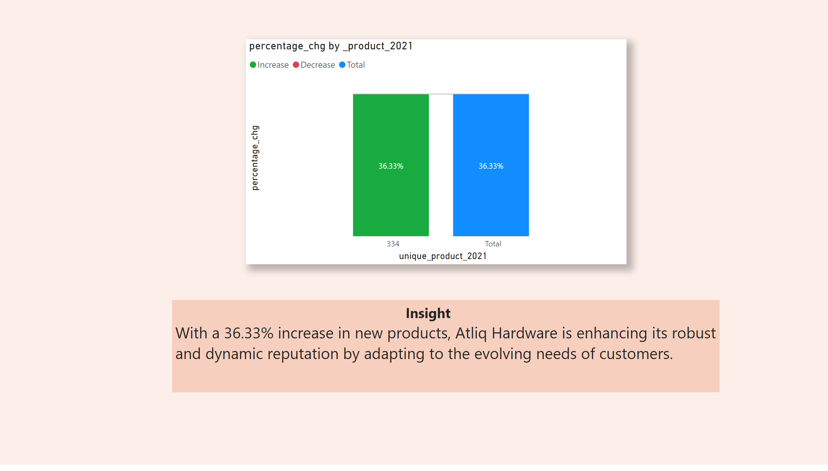
insight_percentage_chag
Notes:
percentage_chg by _product_2021
No alt text provided
textbox
No alt text provided

Slide 6
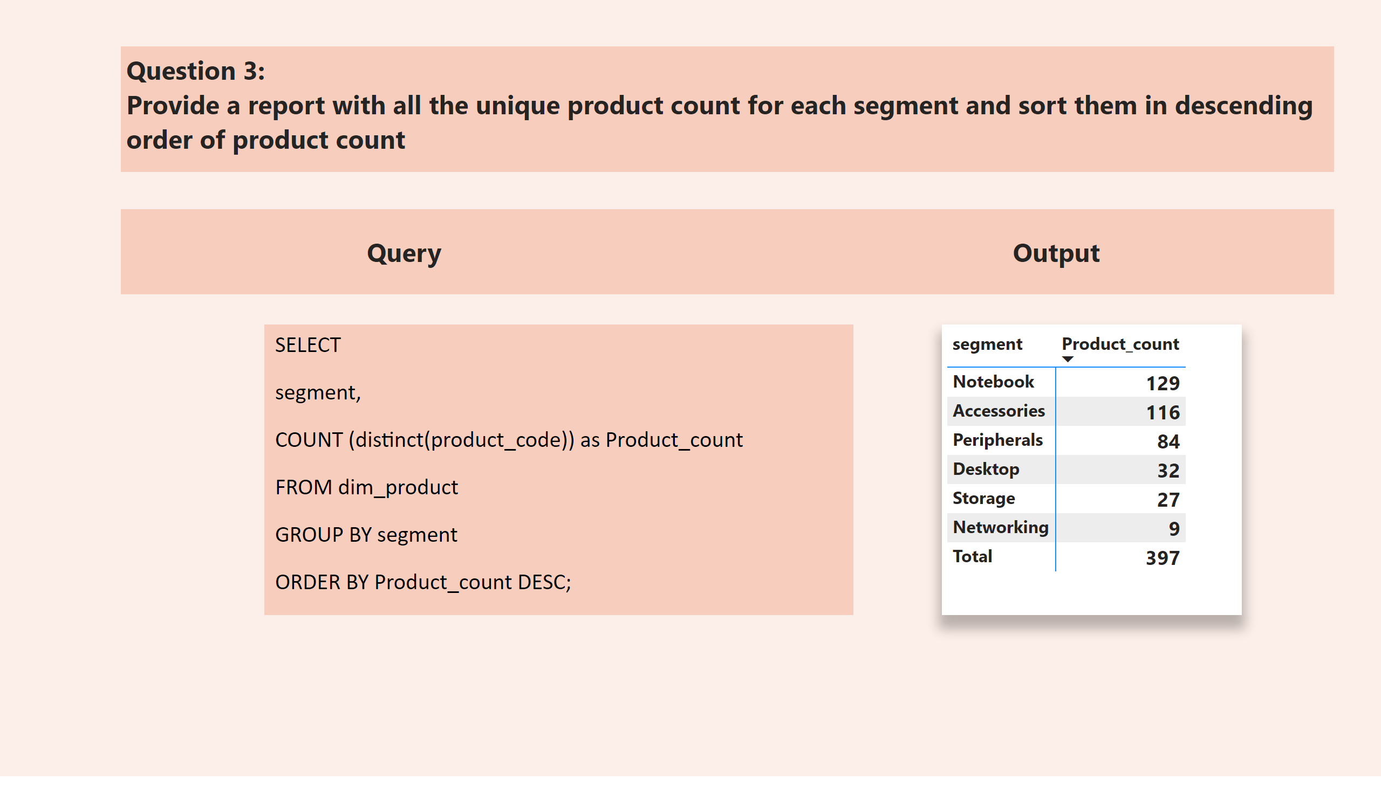
product_count
Notes:
pivotTable
No alt text provided
textbox
No alt text provided
textbox
No alt text provided
textbox
No alt text provided

Slide 7
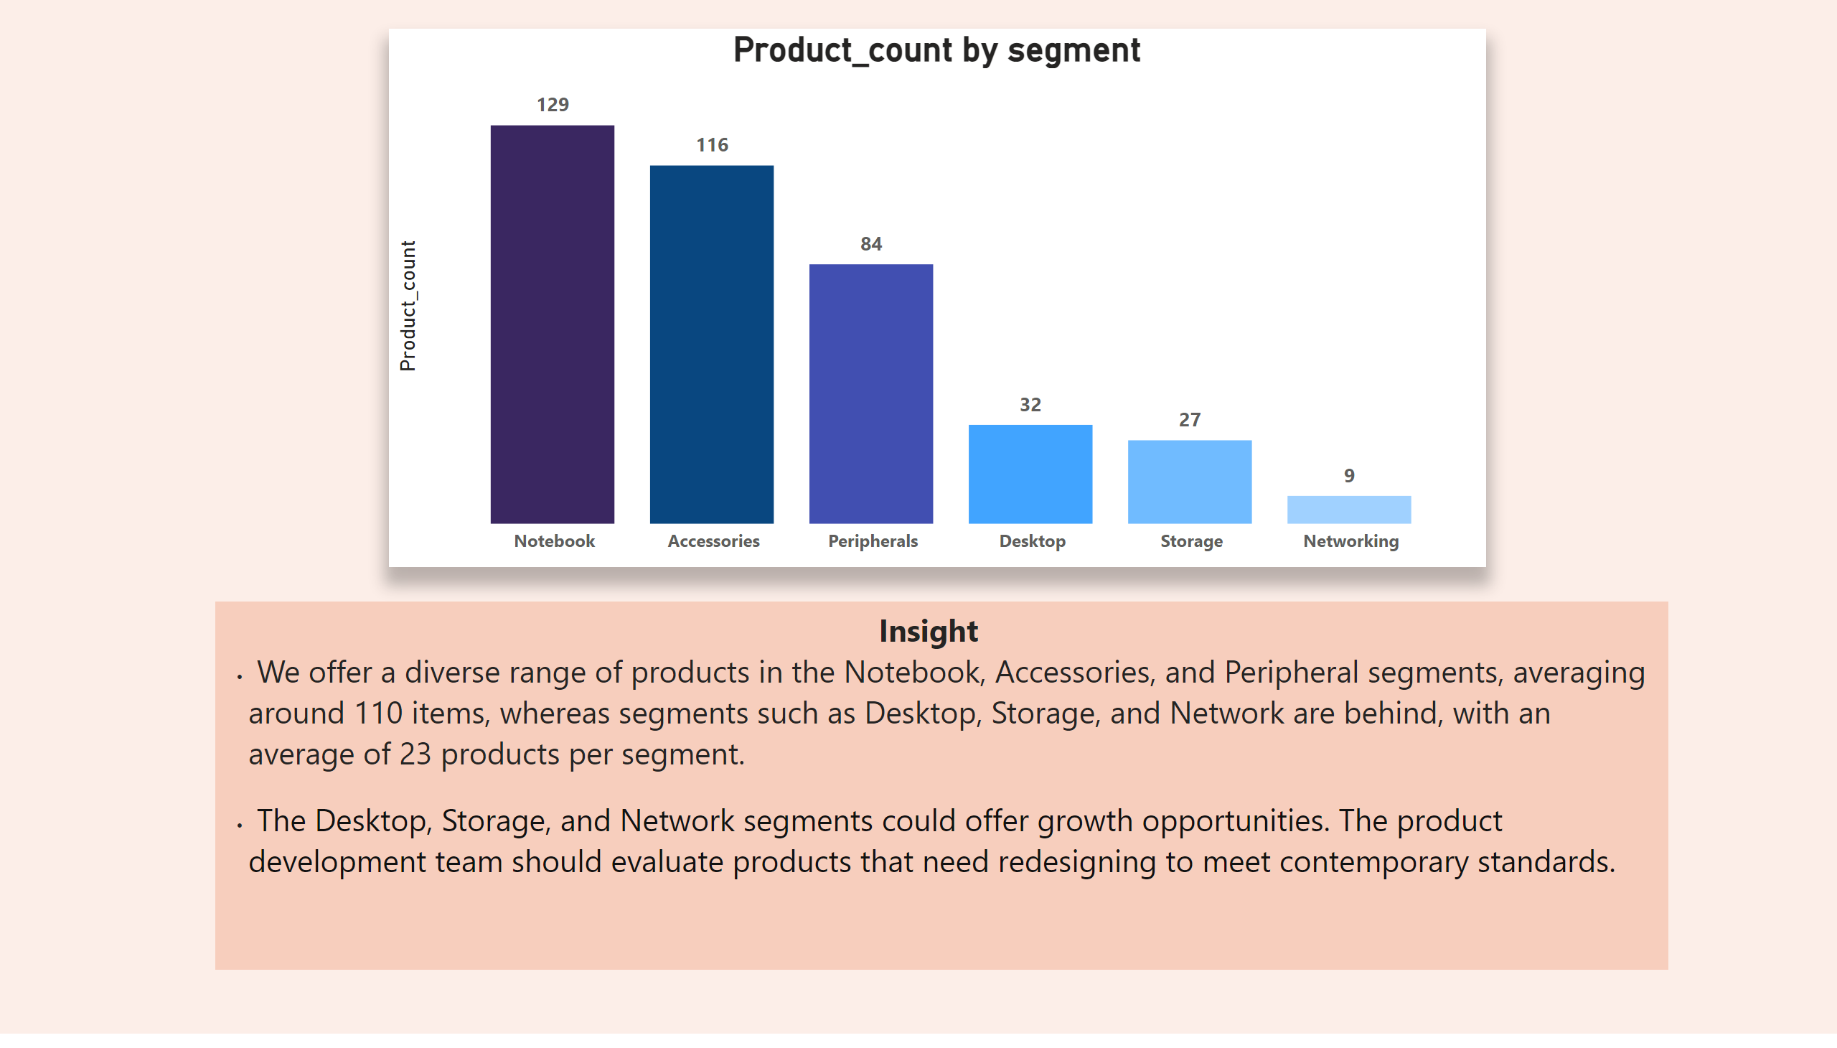
Product_count_insight
Notes:
columnChart
No alt text provided
textbox
No alt text provided

Slide 8
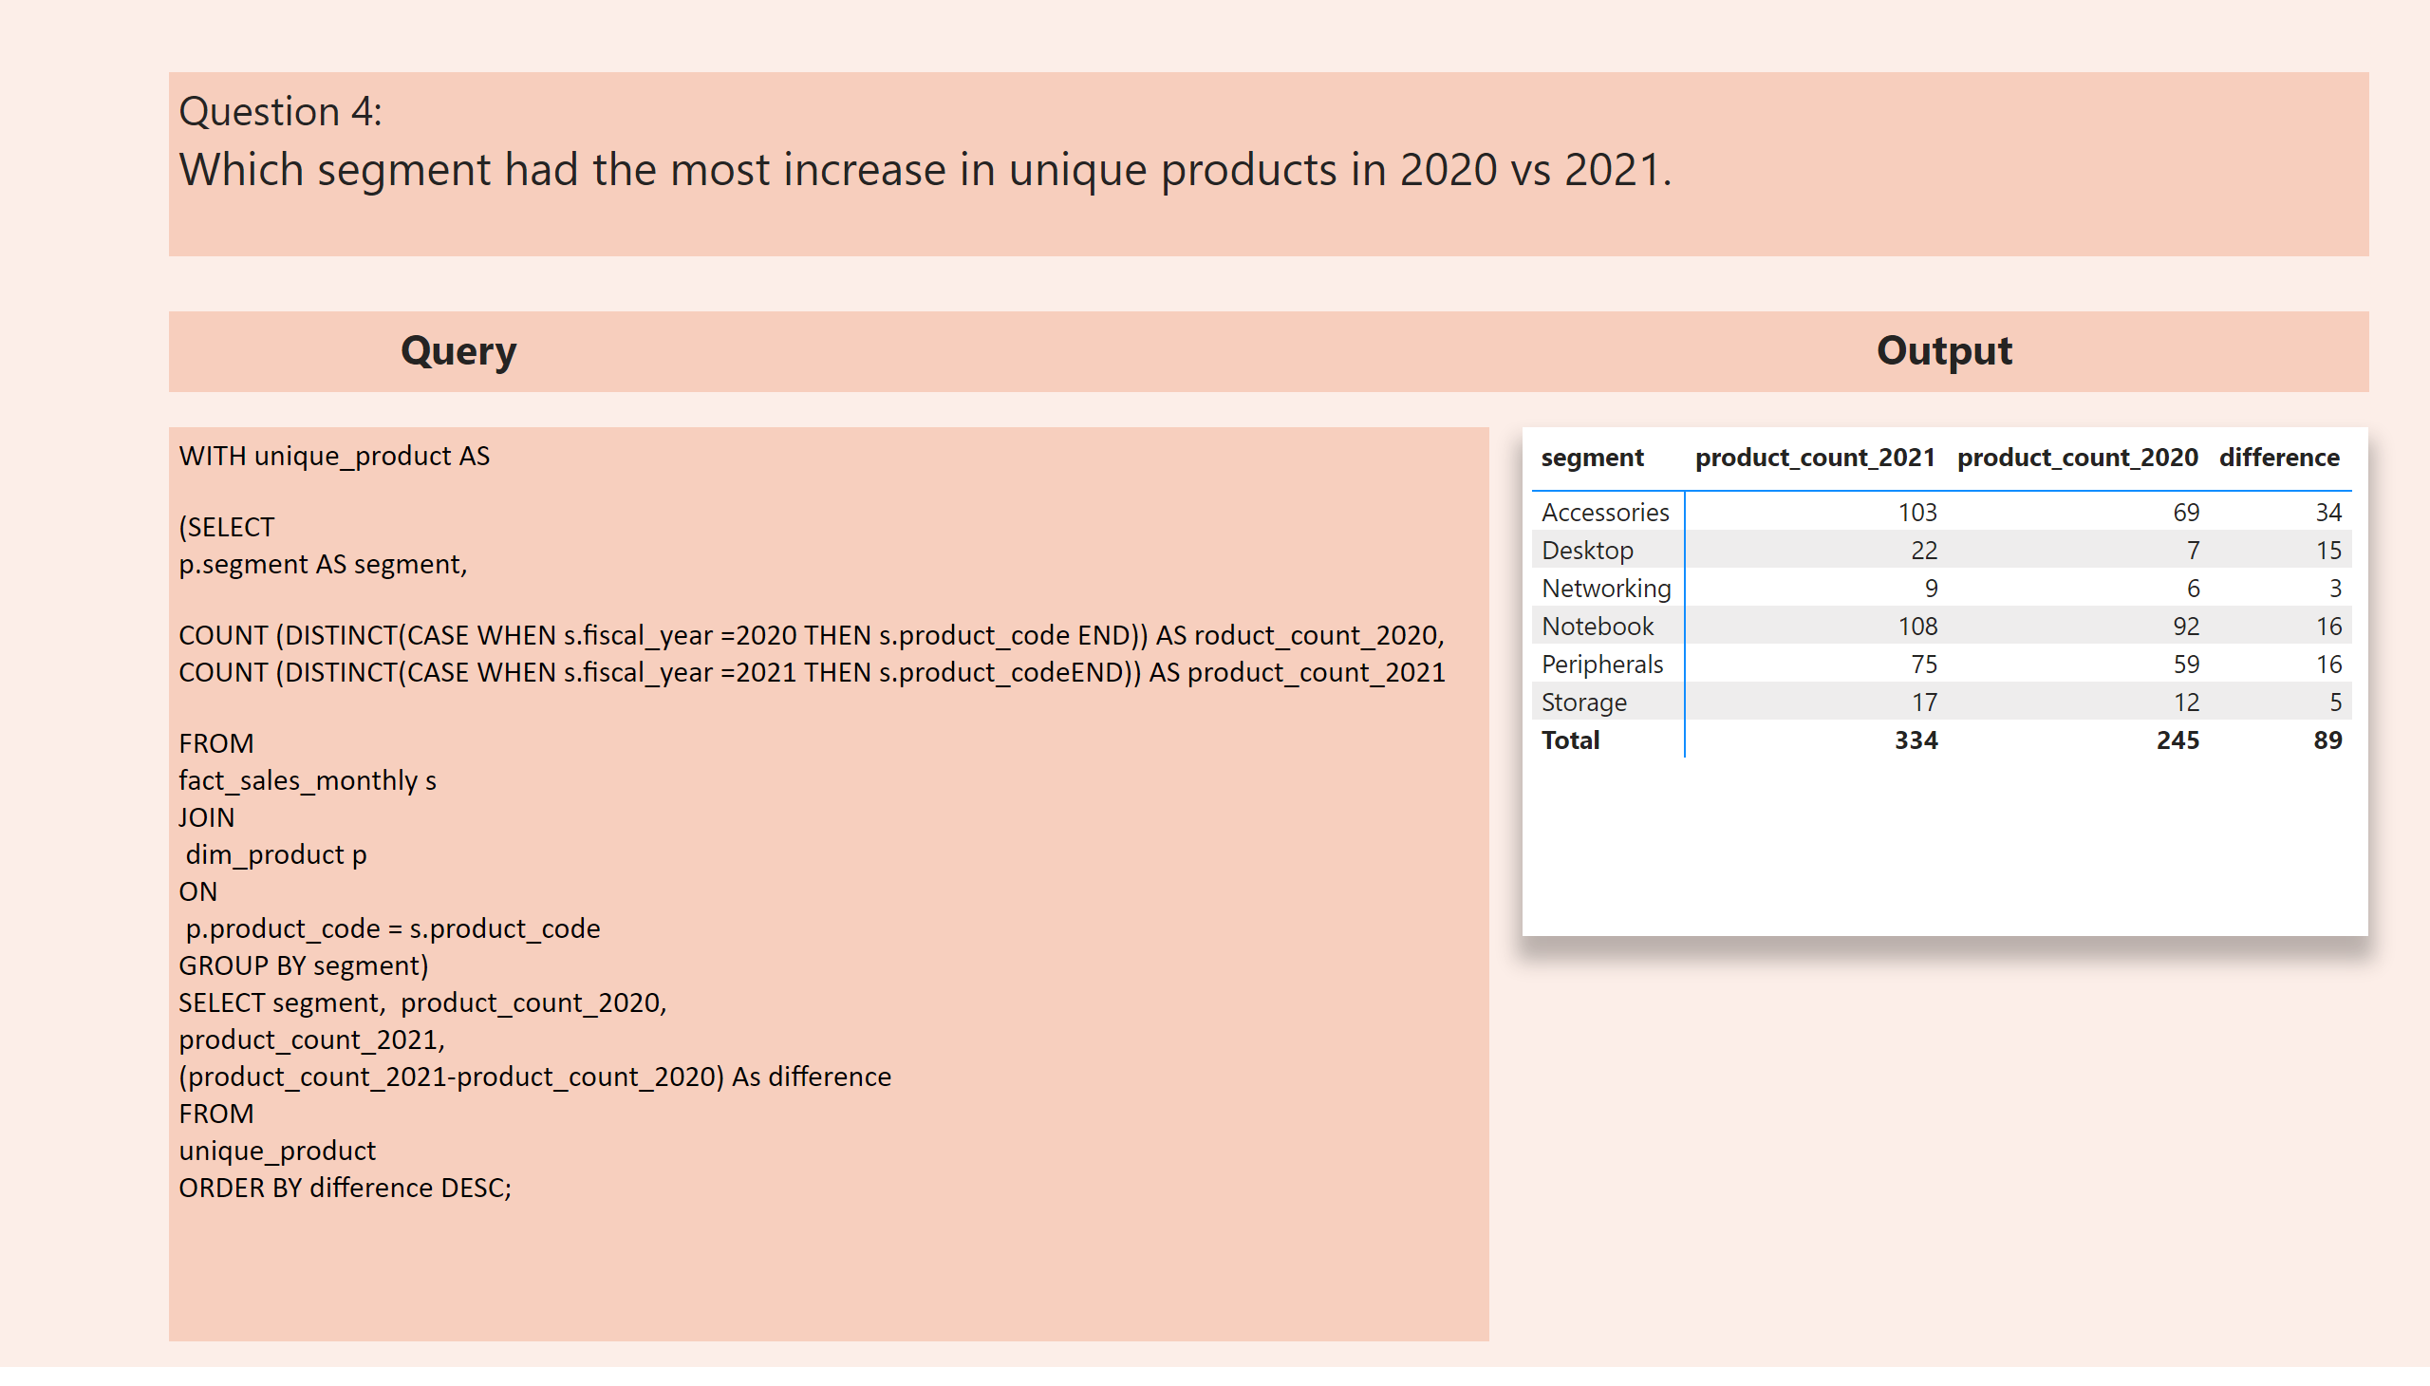
product_count_diffence
Notes:
pivotTable
No alt text provided
textbox
No alt text provided
textbox
No alt text provided
textbox
No alt text provided

Slide 9
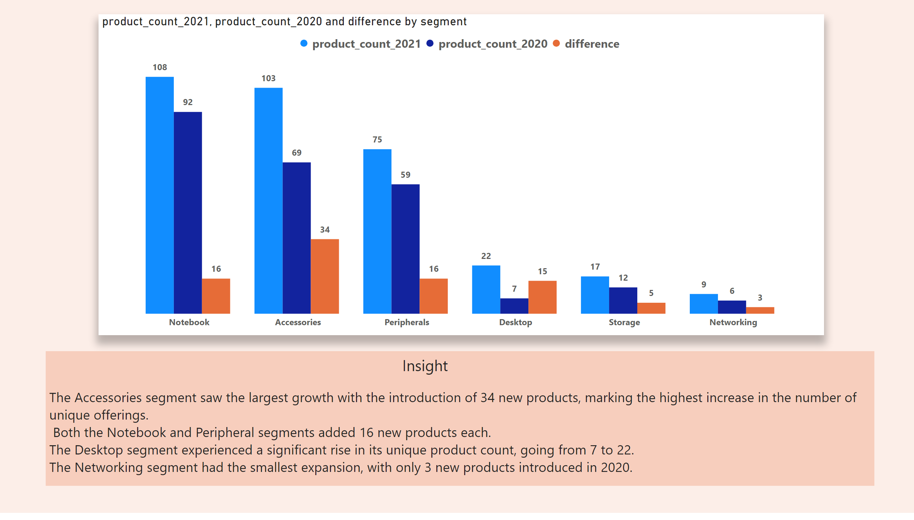
insight_product_count_diff
Notes:
clusteredColumnChart
No alt text provided
textbox
No alt text provided

Slide 10
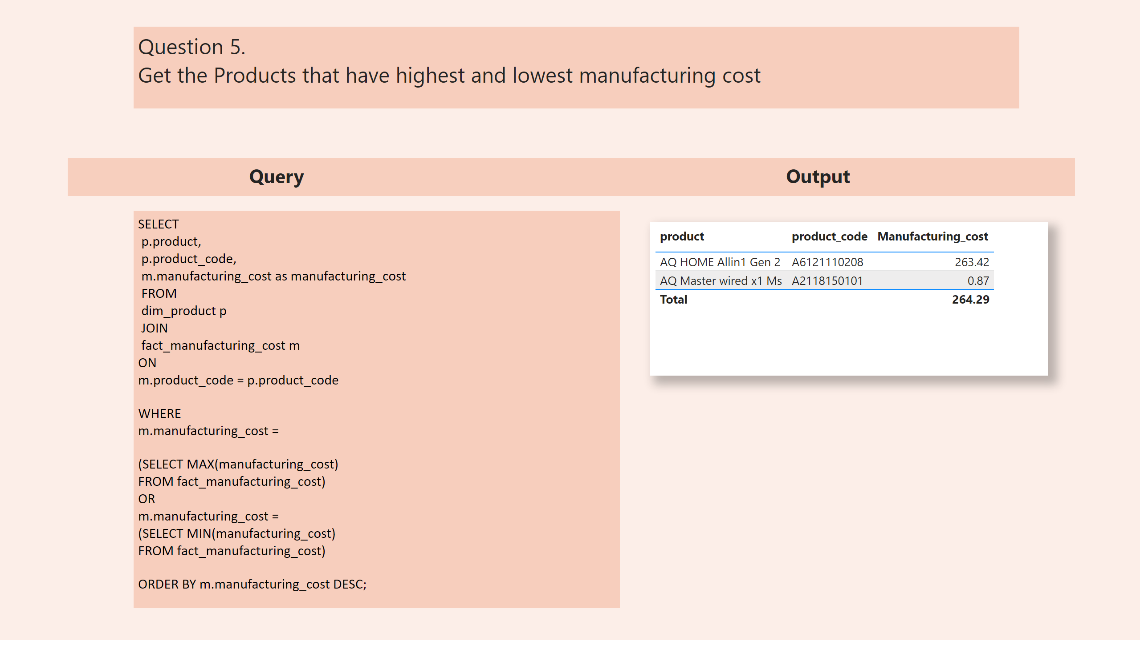
manufacturing_cost
Notes:
tableEx
No alt text provided
textbox
No alt text provided
textbox
No alt text provided
textbox
No alt text provided

Slide 11
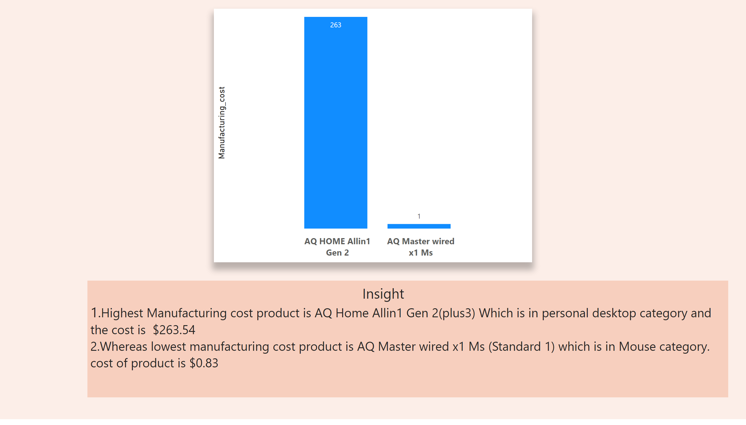
manufacturing-cost_insight
Notes:
columnChart
No alt text provided
textbox
No alt text provided

Slide 12
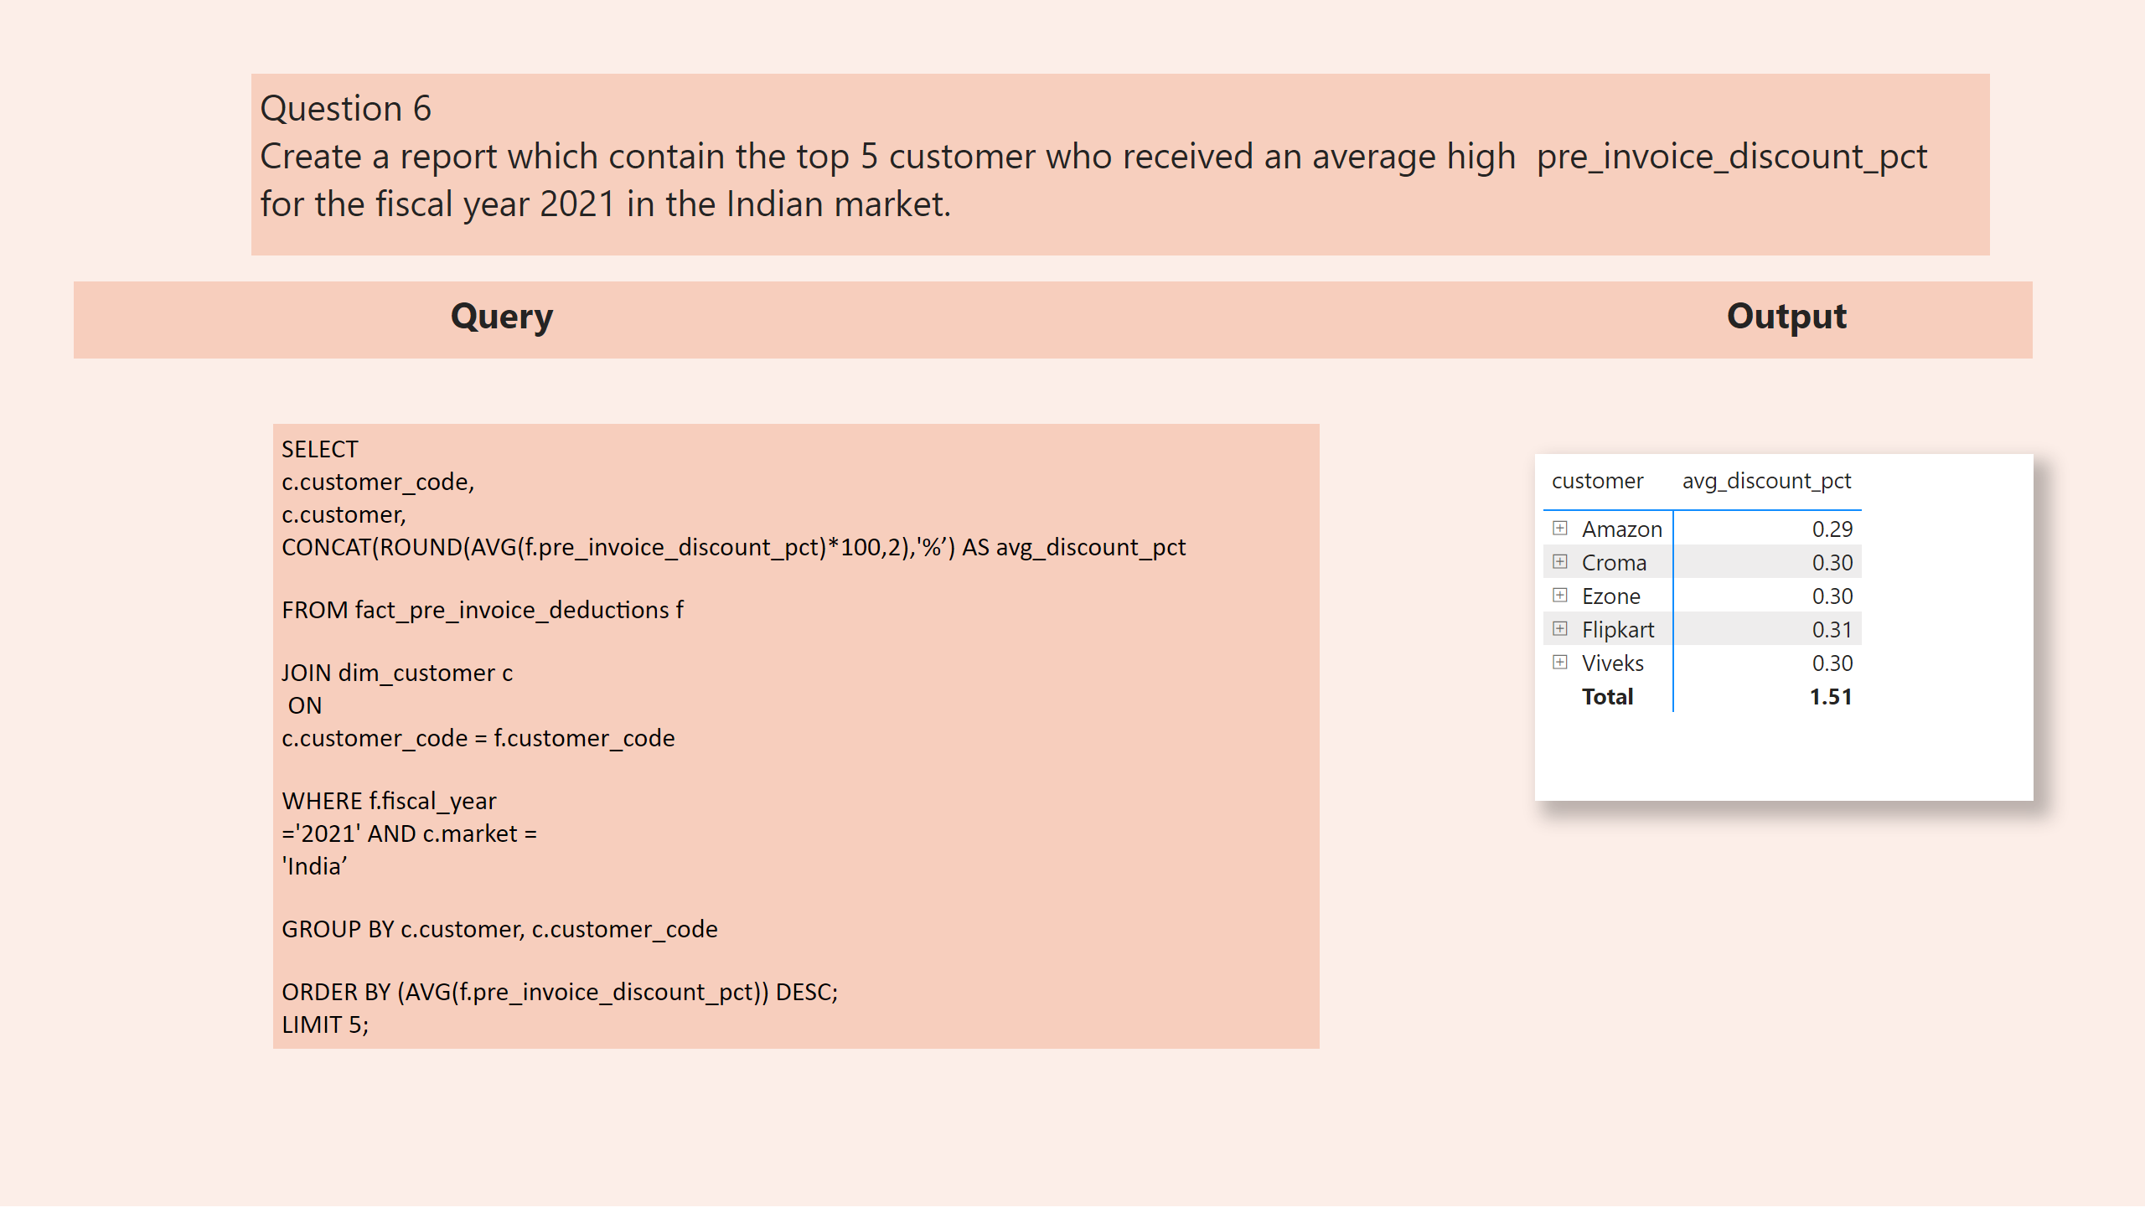
Avg_discount_pct
Notes:
pivotTable
No alt text provided
textbox
No alt text provided
textbox
No alt text provided
textbox
No alt text provided

Slide 13
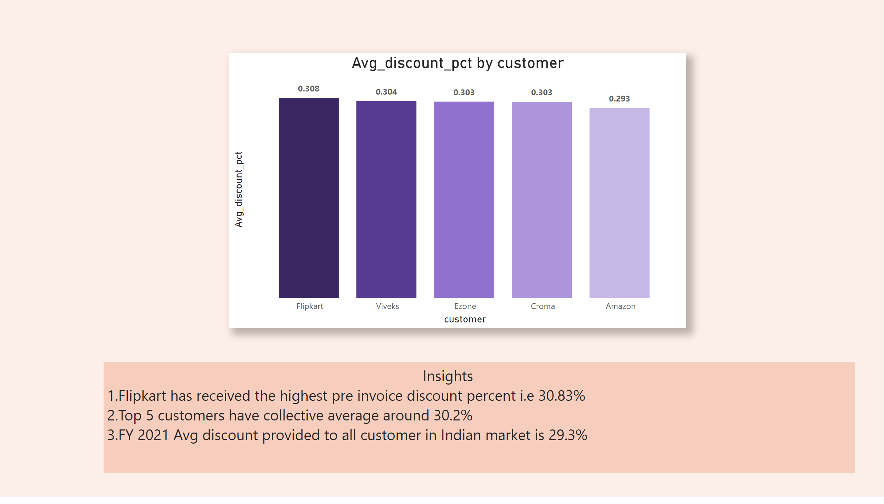
Avg_discount_pct_insight
Notes:
columnChart
No alt text provided
textbox
No alt text provided

Slide 14
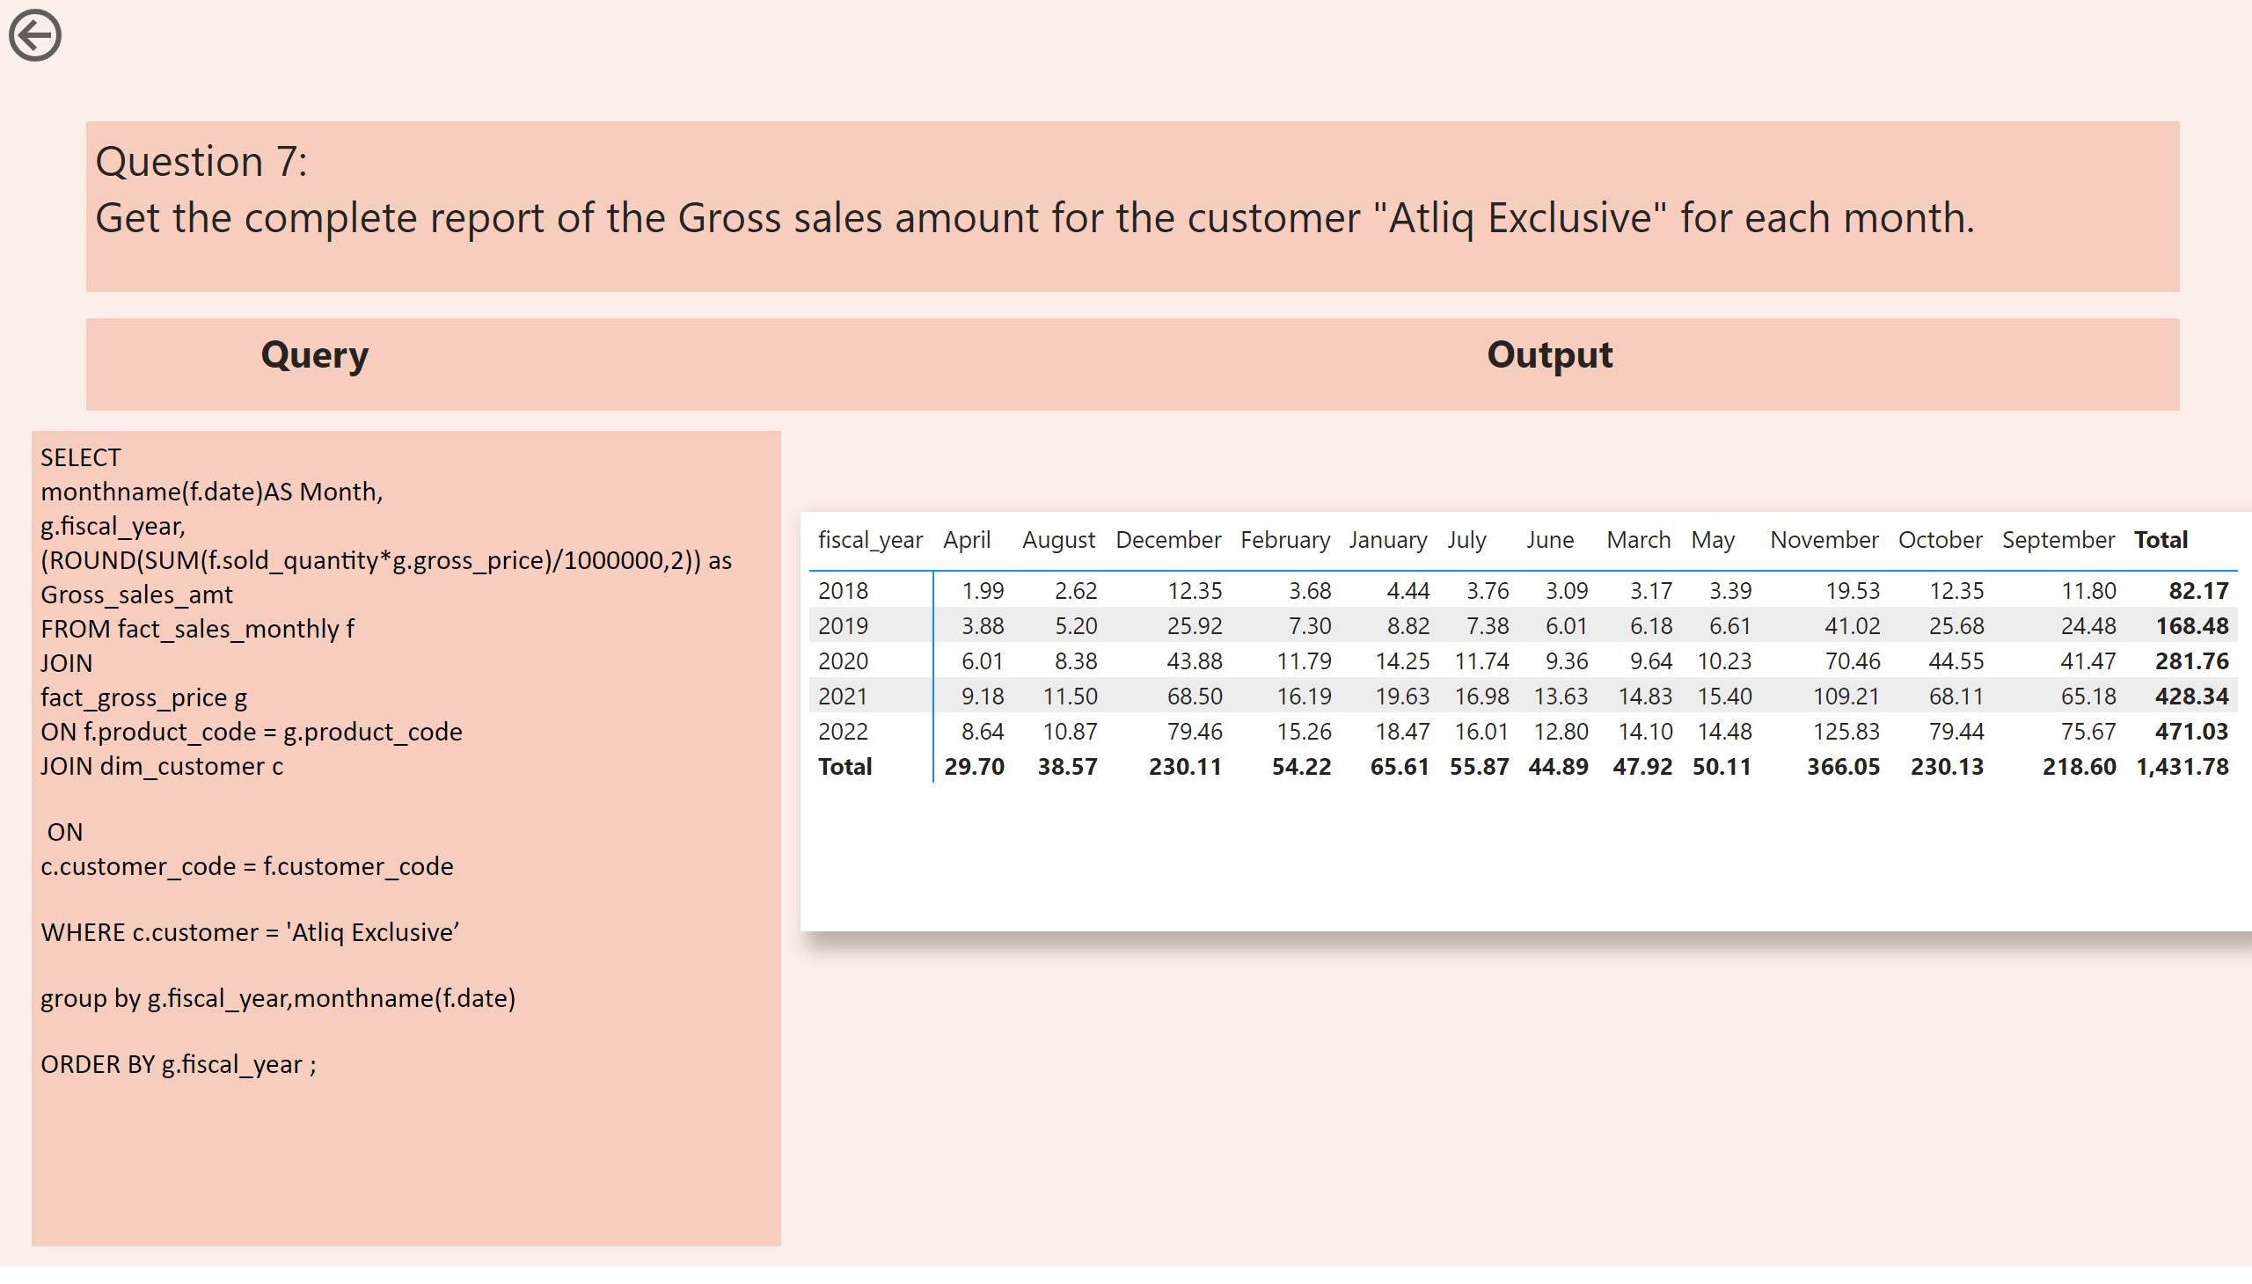
gross_sales_amount_month
Notes:
pivotTable
No alt text provided
actionButton
No alt text provided
textbox
No alt text provided
textbox
No alt text provided
textbox
No alt text provided

Slide 15
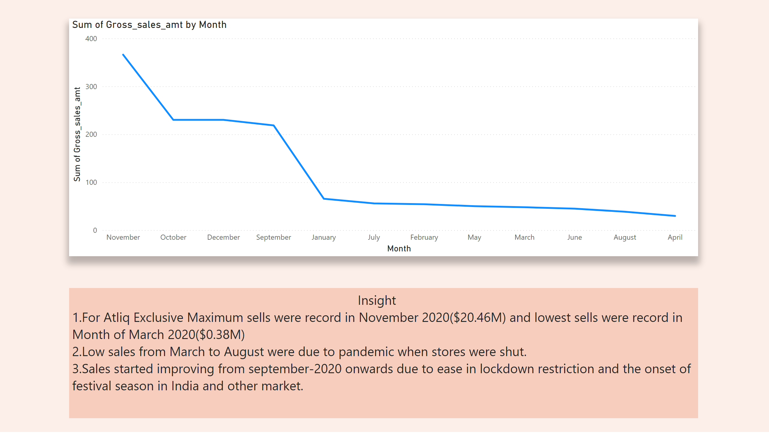
insight_gross_sales
Notes:
lineChart
No alt text provided
textbox
No alt text provided

Slide 16
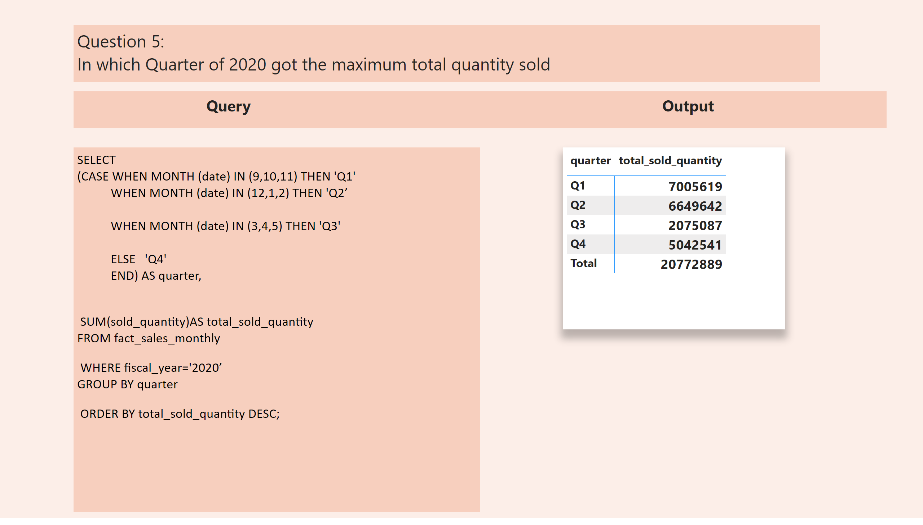
quarter_wise_sale
Notes:
pivotTable
No alt text provided
textbox
No alt text provided
textbox
No alt text provided
textbox
No alt text provided

Slide 17
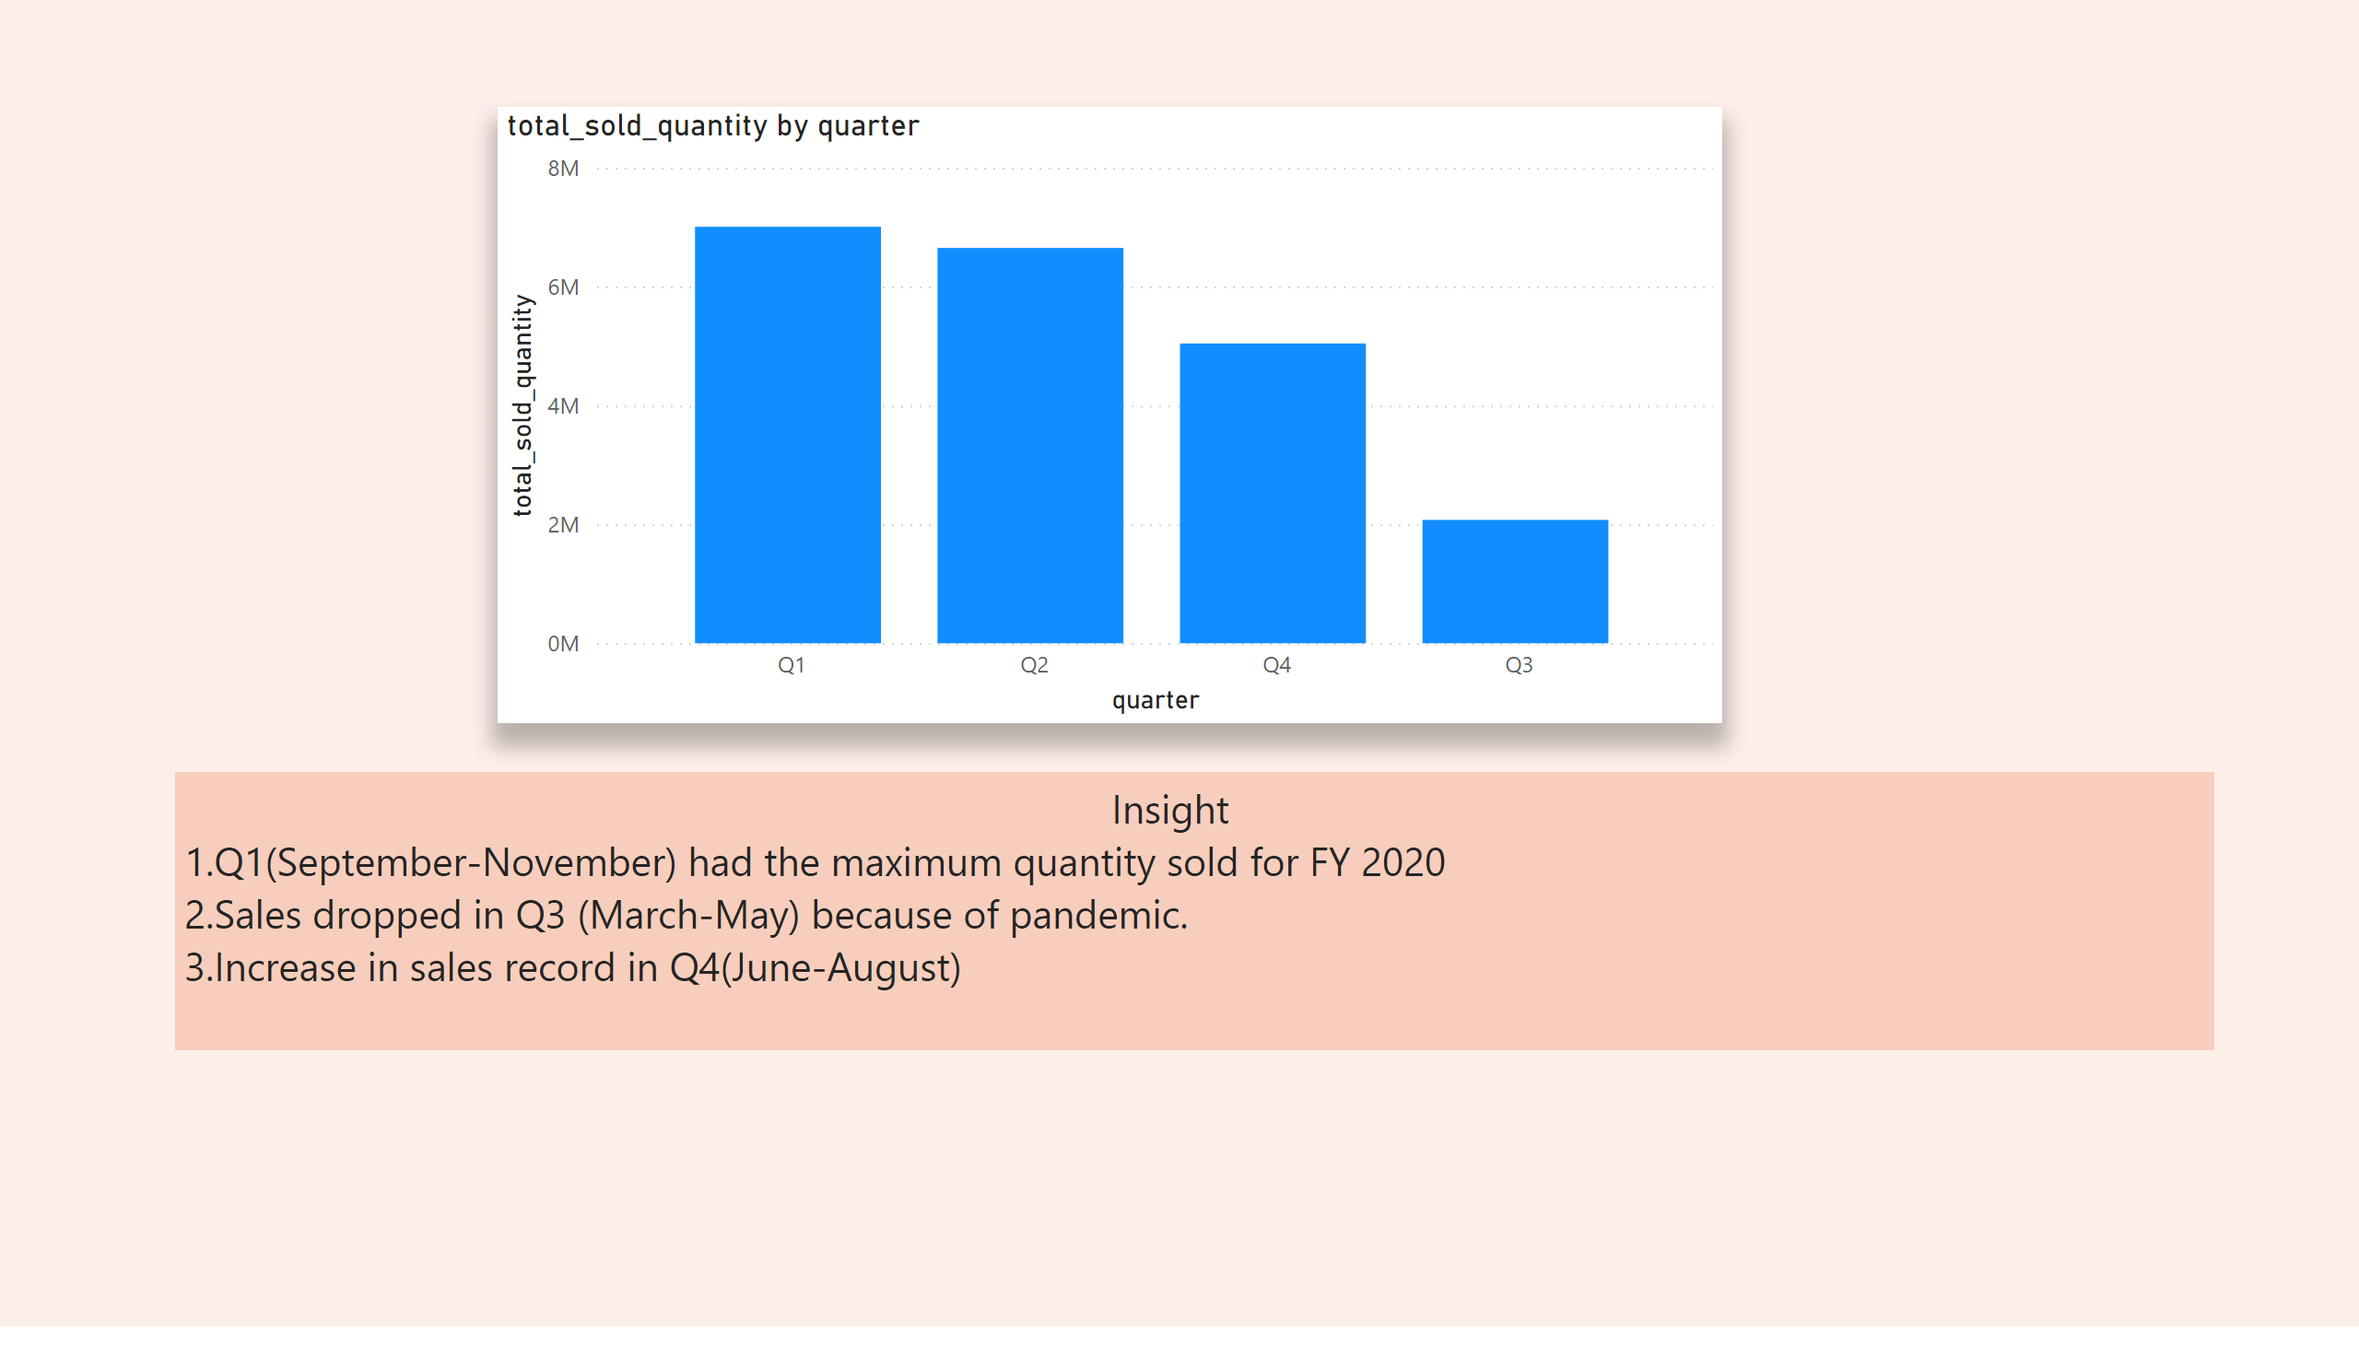
insight_quarter
Notes:
columnChart
No alt text provided
textbox
No alt text provided

Slide 18
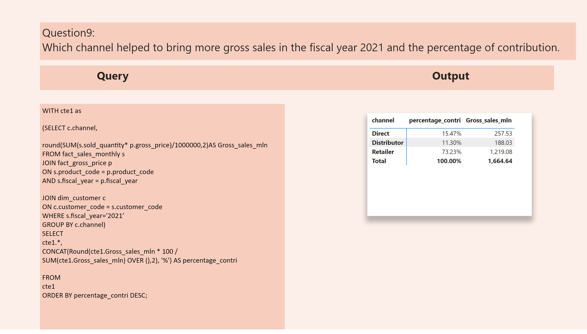
Gross_sales_channelwise
Notes:
pivotTable
No alt text provided
textbox
No alt text provided
textbox
No alt text provided
textbox
No alt text provided

Slide 19
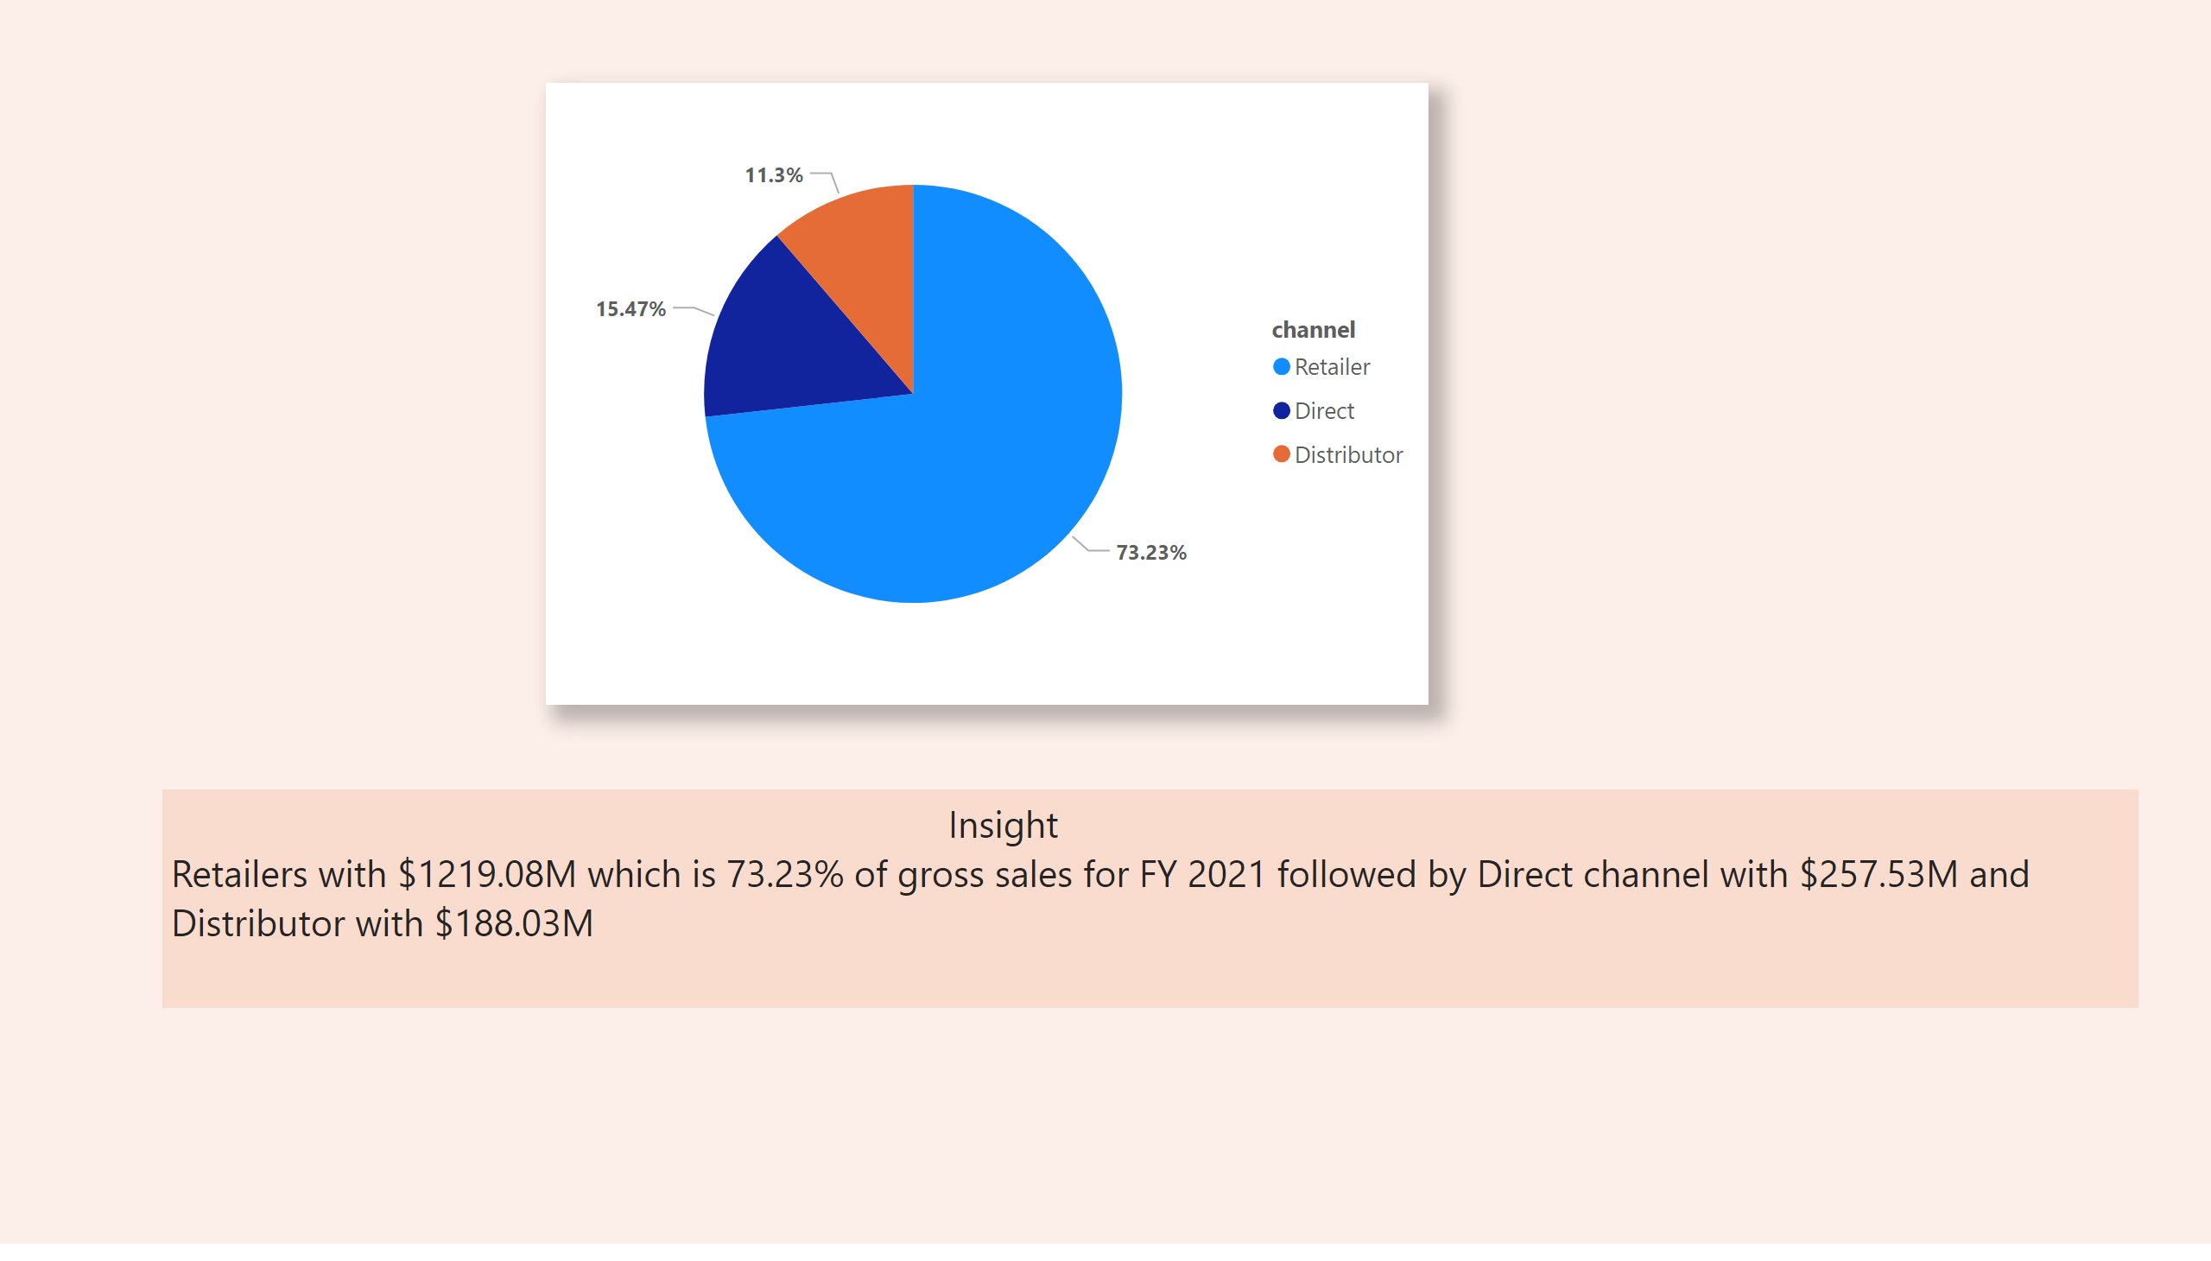
Channel_insight
Notes:
pieChart
No alt text provided
textbox
No alt text provided

Slide 20
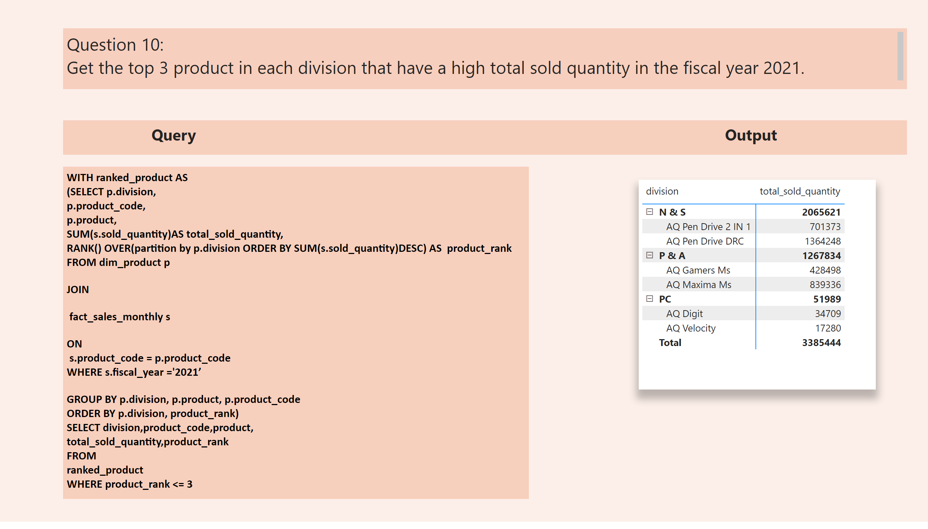
top5_product_rank
Notes:
pivotTable
No alt text provided
textbox
No alt text provided
textbox
No alt text provided
textbox
No alt text provided

Slide 21
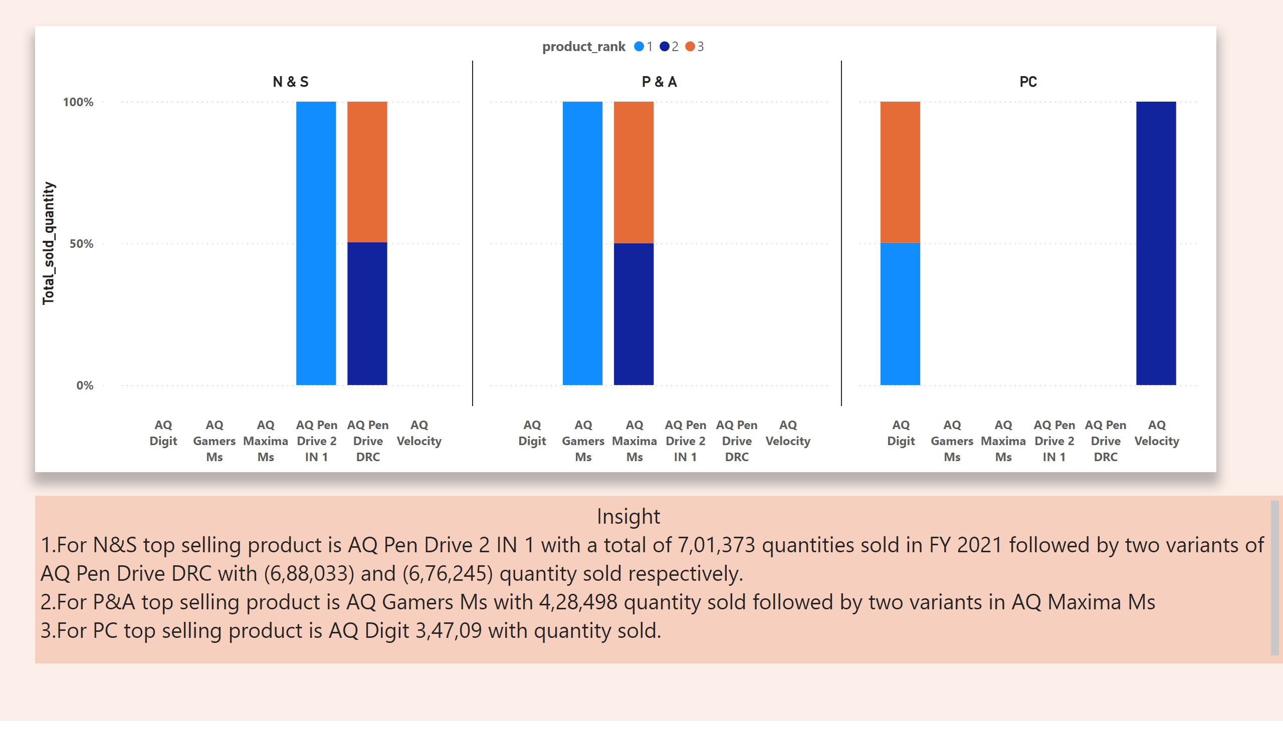
insight_Top5_product-division
Notes:
hundredPercentStackedColumnChart
No alt text provided
textbox
No alt text provided

