Slide 1
QA Automation Progress Report – 5th September 2025
As per the plan, we have started working on Market and Placement Insights.
Covering multiple dashboards, pages, and features based on the test cases identified by the manual team
We began working on the existing framework structure, but faced challenges with maintainability, scalability, and reusability. To address these, we restructured the end-to-end automation framework
Test cases are first validated manually, then automated if stable. PRs are raised daily, with feedback addressed the next day before merging into the mid-level branch.
Vidushi has completed most of the chart-related common functions, and we are aligned on the same terminology as of today. I am focusing on the database, documents, and other common factors, and working in close coordination to achieve our target

Slide 2
QA Automation – Test case status
Overall Test case automation status against the identified test cases is as follows

Slide 3
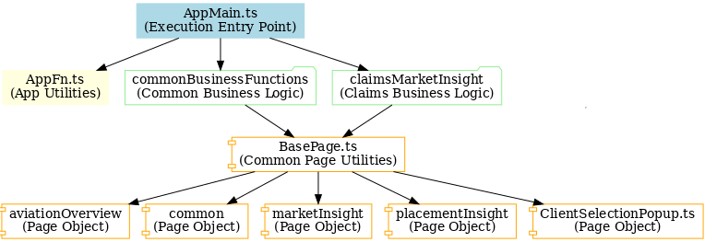
QA Automation – Test case status
Summary of framework and code refactoring activities completed as of today

Slide 4
QA Automation – Test case status
Framework Summary provides clarity on the implementation and highlights the outcomes achieved
Class Name | Objective / Purpose | Methods / Functions | Advantage in Framework
Aviation Overview | Encapsulates page object elements and interactions specific to the Aviation Overview module. | Page locators, navigation methods, validation methods. | Provides modular and reusable automation for Aviation Overview pages, making tests cleaner and easier to maintain.
common | Defines reusable page objects and functions applicable across modules. | Generic locators, UI interaction helpers, utilities. | Reduces code duplication and ensures consistency across test cases by centralizing shared logic.
marketInsight | Handles page objects and interactions for Market Insights module. | Data fetch functions, filter interaction methods, validation functions. | Simplifies Market Insights automation by abstracting complex steps into reusable methods.
placementInsight | Represents page objects and methods for Placement Insight workflows. | Navigation functions, data verification methods. | Ensures placement related flows are tested in a structured, modular manner, improving readability and maintenance.
BasePage.ts | Acts as a parent class for all page objects, providing common functionality. | navigate(), waitForElement(), click(), getText(), etc. | Establishes a standard layer for all page objects, increasing consistency and reducing redundant code.
ClientSelectionPopup.ts | Encapsulates the client selection popup UI and interactions. | selectClient(), searchClient(), confirmSelection(). | Streamlines handling of client selection across tests, ensuring uniformity in popup interaction.
commonBusinessFunctions | Provides high-level reusable business logic functions (cross-modular). | Wrapper functions for login, logout, navigation, validations. | Promotes reusability of common business workflows, improving test coverage with less redundancy.
claimsMarketInsight | Business logic for Claims Market Insights workflows. | Data fetch methods, validation functions for claims-specific insights. | Provides reusable domain specific functions, making claims testing efficient and less error-prone.
AppFn.ts | Holds application-level utility functions. | App initialization, environment setup, cleanup functions. | Centralizes app related operations, reducing duplication and making framework setup consistent.
AppMain.ts | Entry point for application/test execution flow. | Main execution bootstrap logic. | Manage framework execution, ensuring all modules integrate smoothly.

Slide 5
QA Automation – Test case status
Grouped by Categories
Class | Purpose | Categories → Methods
AppMain.ts | Main entry point for execution | Utility → Bootstrap/start tests, orchestrate execution
AppFn.ts | Application-level utility functions | Utility → App initialization, environment setup, cleanup
commonBusinessFunctions | Business functions shared across modules | Navigation → Login, Logout, Module navigation Validation → Common validations across modules Utility → Shared business workflows
claimsMarketInsight | Business logic for Claims workflows | Business Logic → Claims data fetch, claims-specific workflows Validation → Domain-specific checks
BasePage.ts | Base class for all page objects | Navigation → Navigate to page, wait for elements Utility → Click, getText, input handling
ClientSelectionPopup.ts | Encapsulates client selection popup | Navigation → Open/close popup, search client Validation → Ensure correct client selected
aviationOverview | Aviation Overview module page object | Navigation → Navigate to aviation dashboard/overview Validation → Data validation for aviation module
marketInsight | Market Insights module page object | Business Logic → Fetch market data, apply filters Validation → Market insights data validation
placementInsight | Placement Insights module page object | Business Logic → Placement workflows Validation → Placement-related checks
common | Shared/common page objects | Utility → Shared locators, reusable UI actions

Slide 6
QA Automation – Test case status
Reports bugs as on today

Slide 7
QA Automation – Test case status
Challenges / Risks

Slide 8
QA Automation – Test case status

