Slide 1

Team_ATAA
VIRTUAL MONITORING FRAMEWORK
Team Members:
Tvisha Trivedi
Arunima Paul Chaudhuri
Ahana Dutta
Aastha Sood

Slide 2
Early Education Monitoring
We aim to update the education system through progressive analysis of students by pointing out their strengths and weaknesses, and give necessary suggestions so that education does not become a burden for the them.
The students of the age group 4 years till 10 years will be subjected to an annual psychometric assessment as part of their yearly syllabus. the results will be published to both parents as well as the school management, plus a copy would be kept with the system. Suggestions would be given based on previous performance.

Slide 3
Value Proposition
The progress can be monitored and can help the students to work out on the grey areas.
The parents will also have a proper report and analysis of their child's strengths and weaknesses, so that they are not pushed towards a particular career path.
We believe that every student in unique and immensely talented. It's just the matter of finding them. And that is exactly what we aim to do. To bring out the best performance in every child.
Utilizing artificial intelligence and natural language processing for better output.
There are no winners or losers in this tests, only learners.

Slide 4
Customers
Our major market share would be first given to the Govt. of the respective nation, the Ministry of Human Resource Development to be exact.
Going further we also aim to establish business with private schools to add a pinch of sophistication to the system for better results and wholesome development
Since education is a major area of work, we wish to not localize our sales to individuals because it can come to use as a curriculum part for better results.
We aim to emphasize on the fact that the education system is based on tests and examination, the proposal would not be any contemporary idea. It will be very well acquainted to the students.

Slide 5
Addressable Market
As per the framework, we aim to minimize human governance in our system. Having said that, instead of manpower, we are implementing artificial intelligence and Natural Language Processing to read and understand the questions and their respective responses so that the next set of questions would be adequately addressed with respect to how well the answers were given by the students. This means that the questionnaire will evolve with the student and provide results with each round of testing.
However these questions will be based on the recommendation from child psychologists and educators.
India has around 367 universities, 18,000 colleges, about half a million teachers, and 11 million pupils. The private education industry is estimated to be between 20,000–25,000 crores. There are about 1,500 management institutes, 3,500 engineering institutes, and 1,200 medical colleges in the country.
Thus there is ample opportunities for our product to survive.

Slide 6
Market: Competition and Advantage
Education is fundamental for economic and social well-being.
However there are gaps between education and learning, which is why children are often found dreading in going to school and attending classes or tests.
There are not many organizations who are focusing on bridging this gap.
In that respect, this project can substantially have a advantage in this sector.
Furthermore, we intend to keep this project freely available to the mass. This is based on the fact that education is an important factor in the lives of people.
As students and parents are already paying a hefty fees to schools for education, this project can be implemented to enhance that experience.

Slide 7
Marketing Channel
The purpose of this system is to measure the strengths and work on the weaknesses of students.
Hence, we would propose our product to the Govt. of the respective country, more precisely the Ministry of Education.
They can incorporate this system as part of student's curriculum for their skill development.
Apart from that we would use open-source software to execute this project, which would help in minimizing the cost.

Slide 8
The 4P Framework
Product
Price
An analysis of students by pointing out their strengths and weaknesses
Giving necessary suggestions so that education does not become a burden for the them.
Lifelong access
Unique credentials
PRODUCT
Sustainable system
Priced neither too high nor too low
Special financial aid to economically weak people
PRICE
PLACE
PROMOTION
Promotion
Place
Social media marketing
Direct marketing
School representatives
Online presence in the form of website
Govt. approved apps

Slide 9
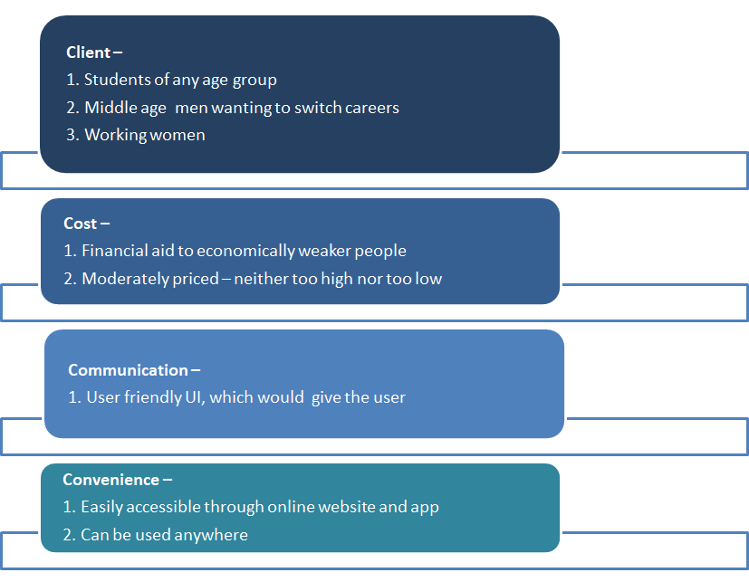
The 4C Framework

Slide 10
Market Segmentation
PRODUCT
People
Primary School Kids
High School and College students
Working People
Retired People
Help them in accessing their weak areas
Help them in choosing a career as per their strengths
Looking to change their skills
Looking to upskill themselves

Slide 11
Thank You

