Slide 1
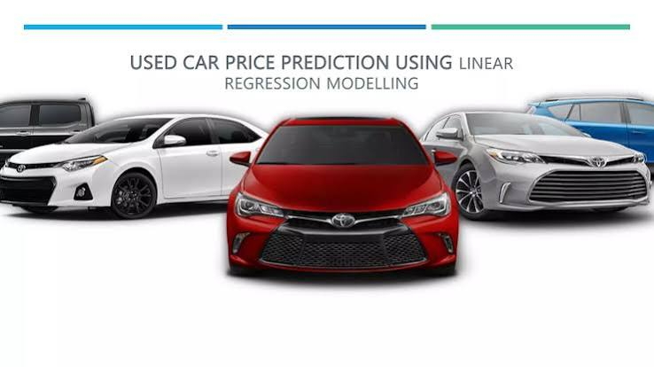

Slide 2


Slide 3
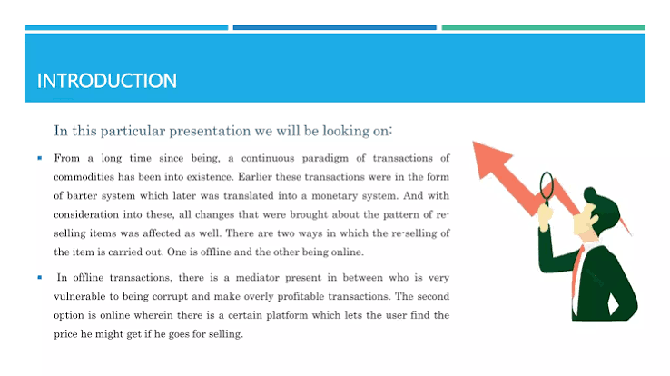

Slide 4
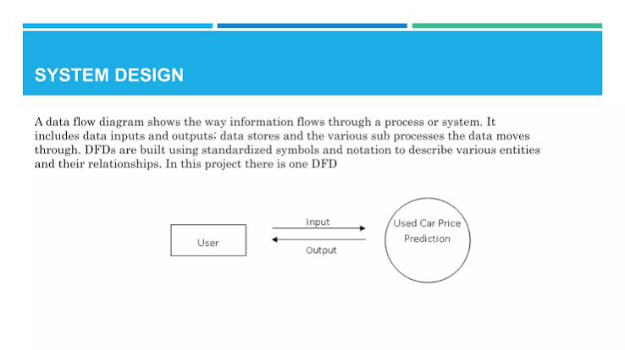

Slide 5
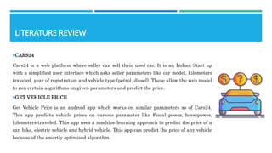

Slide 6
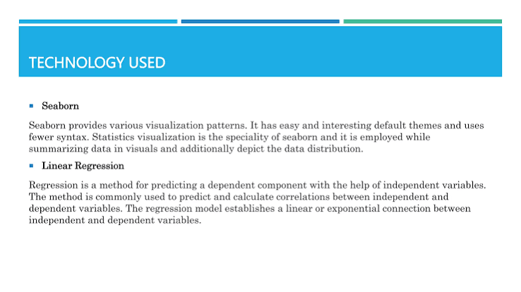

Slide 7
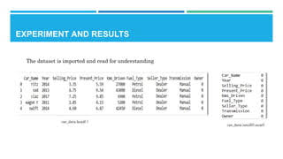

Slide 8
conclusion:
The conclusion for a car price prediction presentation highlights that machine learning models—specifically Random Forest and XGBoost—provide highly accurate vehicle valuations. These systems empower buyers and sellers to make informed decisions by analyzing key features like mileage, year, and condition car price prediction. [1, 2, 3, 4, 5]

