Slide 1
The power of hashing
Abhilash Kumar
Triveni Mahatha

Slide 2
Introduction
Many times in practice we come across problems where we require to search for a value in a given set of data. Various data structures are there to solve the problem -
For dynamic set : we have height balanced binary search trees (AVL tree, Red- black tree).
O( log N ) worst case per query
For static set : we can sort the numbers first and perform binary search per query.
O( log N ) worst case per query
Above data structures ensure bound on worst case query time, which is good. :)
Q : But can we think of some data structure that is much faster and much simpler than them?
Notes:
Idea of hashing exploits this interesting fact and provides an impressive performance on average case. But worst case time for this simple hashing is O(s) per query.

Slide 3
Problem Definition
Given
A universe U = { 1,2,3,........m} and
A set of integers S.
S ⊆ U and s = | S |
s << m
Example : |U| = 10^18 and s = 10^4
Q : Given an ‘i’ we have to answer. Does ‘i’ belongs to set S ? (for any i which belongs to U)
Notes:
As we saw talked about it earlier we can simply use binary search. But what if U is set of strings rather than integers we have various data structures ( like tries for strings ) then binary search is nearly useless will take O( L log N ) time per query. Also binary search has worst case time complexity of O(log N). We want to achieve much better lower bound and also space required must be minimal.

Slide 4
Motivation
Consider you need to search for a book in library.
Important questions to ask -
How should you arrange the books ?
What should be the procedure to search it ?
One way is to keeps the books serially based on some ID. It sounds logical rather than keeping them in no order !
Better approach is to make sections. We know beforehand that to which section a particular book may belong if it exists. We simply go to that section and search that book.
Seems Nice :)
Notes:
Motivation for hashing( we have to think about this) ?? Why would someone think about it.
Books sorted according to some number. ( binary search ) ?? doesnt sond good.
Better approach is to make sections. We know beforehand that to which section a particular book may belong if it exists.

Slide 5
Hashing
The idea of hash function is on the similar lines.
Let H be a function such that H : U → (0..M-1)
Basically what H does is that it partitions U into several disjoint subsets based on what value it maps a particular number to.
It is like we create M buckets which will hold those objects which gets mapped to a bucket by the hash function.
Properties of good hash function H :
computation time O(1)
space required to store O(1)
What can be a good hash function ?
Notes:
Explain about good hash function in this silde and introduce about remainder as a good hash function.

Slide 6
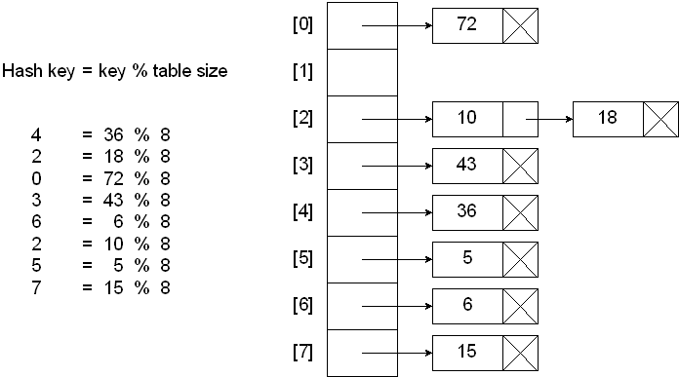
Hashing
A simple hash function as H(x) = x % M is found to be very good in practice where M is size of hash table. (% is remainder operator)
The universe U gets partitioned into M disjoint buckets with respect to H.
For a given set of input S, we proceed -
We first make a Hash Table
T : an array of linked lists of size M
For each element e, in S,
we insert e into the linked list at T[H(e)]
Answering Query : To search if x is present or not.
h = H(x)
search for h in linked list at T[h]
If present return success
otherwise return failure
Notes:
Explain collision.
How O(N/M + 1) search time.
For M = N , its O(1)

Slide 7
Suppose input is random which is often the case in real life data.
Then following things can be shown -
expected running time is O(N/M + 1) per query
Space requirement is O(N + M)
preprocessing time is only O(N + M)
Where hash table size =M.
When M = N, then
Seems pretty Impressive :)
But it can be seen that the above hash function can some time lead to long chains if data is biased. Making the query time O(N) per query.
Hashing Expected running time is O(1). Space required is O(N) Preprocessing time is O(N) | Binary Search Running time O(log N) Space required is O(N) Preprocessing takes O(N log N)

Slide 8


What to do if data given is not random ??
The problem is if we fix a hash function it can perform very poorly on some input.
So to avoid this problem we select a hash function uniformly and randomly from a family of hash functions (we call it universal hash family). Which have following property :-
A simple example of such hash function is H(x) = kx % p % M where k is selected randomly from (1...p-1) and p is a prime greater than |U|.
Basic intuition behind selecting a hash function from a family of hash function is that in a sense it maps elements of U → U, and since the hash function is chosen at random this mapping is also random (unpredictable by the adversary).
Notes:
Better approach -> kx % p % M.
The expected running time is still O(1) for M = N, but the probability of formation of long chains in hash table is very low and is independent of the input.

Slide 9
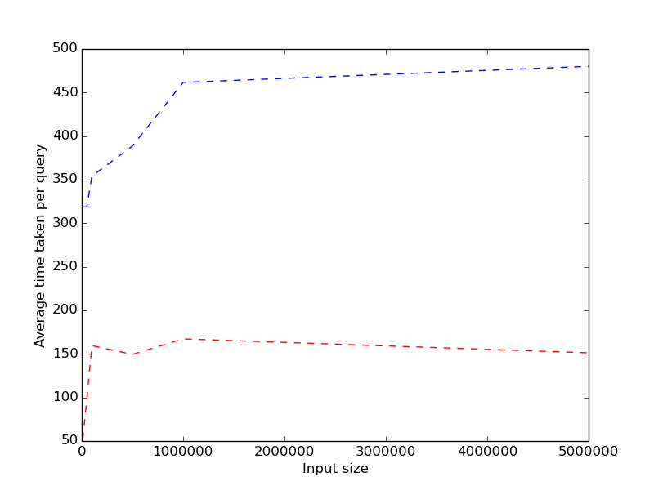
How well this hashing performs?
Average Running time comparison for the above hashing technique and binary search.
Binary Search
(ns)
Hashing

Slide 10
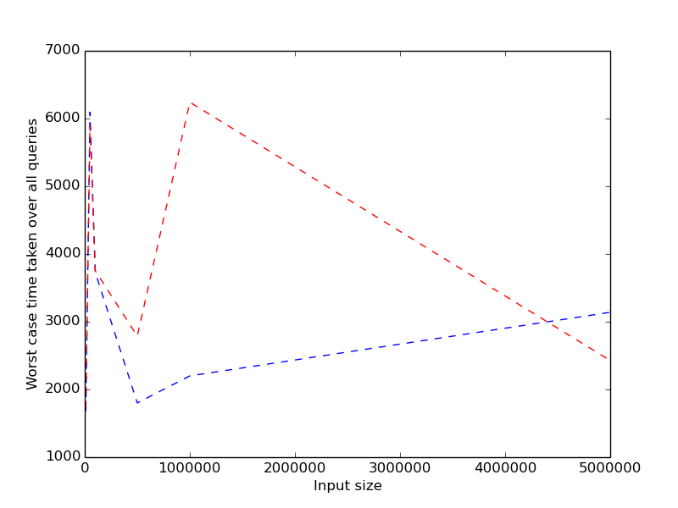
Can we do something better ?
Expected running time is O(1) but worst case running time per query is still comparable to that of binary search.
(ns)
Hashing
Binary Search

Slide 11
But expected O(1) time per query is not good enough as worst case is still O( log n ) . Can we attain better worst case running time ?
Let us try to see why worst running time is that bad ?
Even if we assume that data is randomly generated or hash function is good the length of longest chain is still O( log N) on expectation.
The above statement can be explained by ball bin problem. Suppose N balls fall into N bins uniformly and randomly , maximum load is going to be Ω(log N / log log N ) with high probability.
Since there is some constant probability that length of some chain in hash table is going to be Ω(log N / log log N ) hence worst case running time becomes comparable to that of binary search.
We somehow need to reduce the maximum load.
Notes:
Prove that if data is randomly generated or hash function is good the length of longest chain is still O( log N)

Slide 12
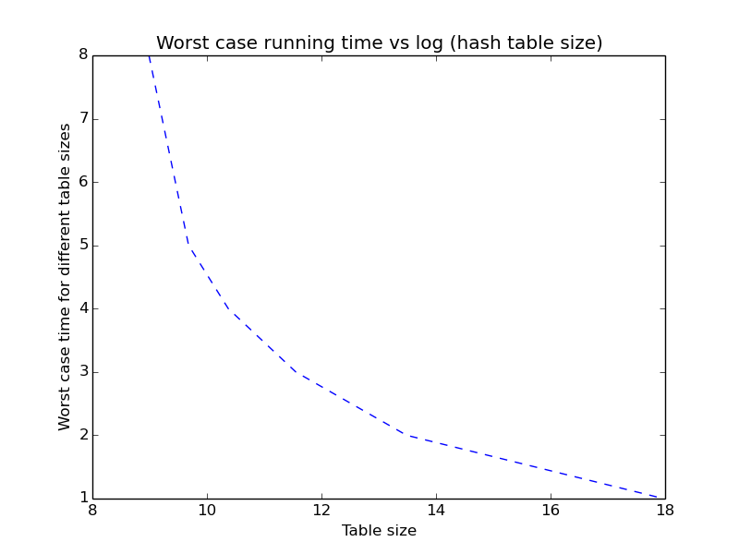
Performance vs Hash Table Size
How we can improve worst case bound ?
Obvious and intuitive answer is to increase size of hash table. That is if we increase the number of bins, then maximum load will decrease and hence worst case bound will improve.
Lets observe the worst case running time for various sizes of hash table. N , 5N , N log N , N sqrt N , N^2

Slide 13
Performance vs Hash Table Size
Given a set S of size N. And hash table of size M.
Let H be a universal Hash Family, P(h_{r}(i) = h_{r}(j) for i ≠ j) ≤ 2/M
X : number of collisions when h is selected randomly from H.
Q : What is the expected value of X ?
A : For each i, j ∈ S, define random variables
X_{i, j} = {1 if h(i) = h(j), 0 otherwise
clearly X = ∑_{i < j} X_{i, j} or, E[X] = ∑_{i < j} E[X_{i, j}] (using linearity of expectation)
or, E[X] = ∑_{i < j} P(X_{i, j} = 1)
or, E[X] ≤ ∑_{i < j} 2/M
or, E[X] ≤ N * (N-1) / M = O(N²/M)
It suggests that to have a hash table with O(1) collisions, M = O(N²). Which is same as what the graph suggests !
Notes:
It can be shown that E[X] is O(1) with constant probability.

Slide 14
Motivation for Perfect Hashing
We observed various things :-
Hashing with O(1) worst case guarantee can be achieved using O(N²) space.
Most of the cells in the hash table will be vacant, as there are only N elements.
If we use primary hash table of size O(N),
total number of collisions is very less - O(N) only
This suggests that size of the maximum loaded buckets can not be too high.
We also, notice that for smaller set, quadratic memory is not as bad as it is for larger sets.
Q : How to achieve perfect hashing in O(N) memory with O(1) worst case guarantee ?

Slide 15
Perfect Hashing
To achieve perfect hashing using O(N) space we do :-
Set the primary table size, M = N.
Total number of collisions, E[X] = O(N * N / N) = O(N).
Let the buckets sizes be b[i] for 0 <= i < M.
Since there are total O(N) collisions, there will be some buckets with size > 1.
For those buckets, j^{th} bucket, we make another hash table using O(b[j]²) size hash table.
It is clear that primary table is consuming O(N)space.
Q : How much space does the second level hash tables use ?

Slide 16
Perfect Hashing
We have :
Total space = M + ∑_{i < M and b[i] > 1} b[i]²
Total collisions, X = ∑_{i < M and b[i] > 1}(b[i] * (b[i] - 1) / 2)
or, 2X = ∑_{i < M and b[i] > 1}(b[i]² - b[i])
or, ∑_{i < M and b[i] > 1}b[i]² = 2X + ∑_{i < M and b[i] > 1} b[i]
or, Total space = M + 2X + N
since, M = N, X = O(N)
Total space = O(N)
Hence, we shown that total space used is O(N).

Slide 17
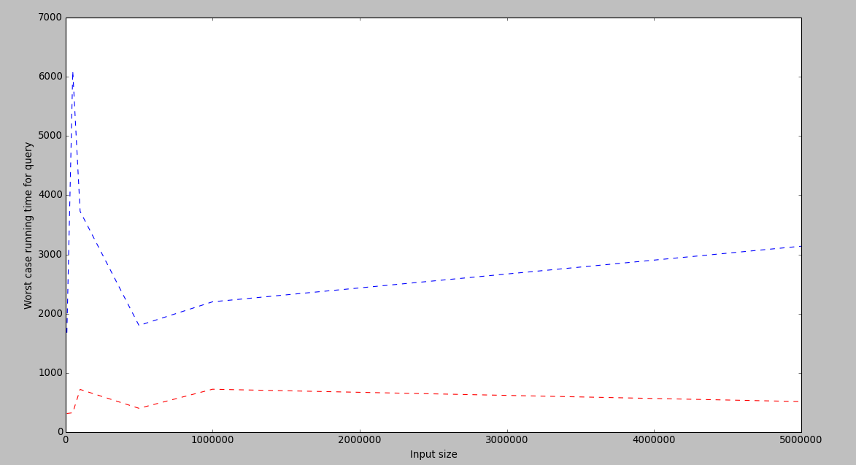
Has the worst case improved ?
Let’s now compare worst case running time of our hash table with binary search.
(ns)
Binary Search
Hash Table

Slide 18
Applications
Q : How store a set of strings and answer queries that if a string is present in the set ?
A1 : Store all strings and sort them. Do binary search.
Lot of memory required :(
Time consuming - O(log(s) * length of strings)
A2 : Make a trie of the strings and then do searching in trie.
O(length of string) time per query. But size of the trie can be large ! :(
The data structure is little complicated and hard to implement
Idea : Use fingerprinting of the strings in A1 to avoid too much memory (Monte - Carlo).
Store all the strings to make it Las - Vegas
Why not use Hashing and Fingerprinting together ! :)
Q : How to store a N - dimensional data points and answer queries that if a point is present or not ?
A : Hashing + Fingerpriting.

Slide 19
Using fingerprint technique in hashing
Given a string we first find its fingerprint. And now we insert this fingerprint into the hash table.
And whenever we need to check if given string exists or not. We first find its fingerprint and then seach this fingerprint in the hash table created as described above.
Running time of this method is far far better than that of binary search. And in practice it beats dedicated data structure like trie and suffix tree too.

Slide 20
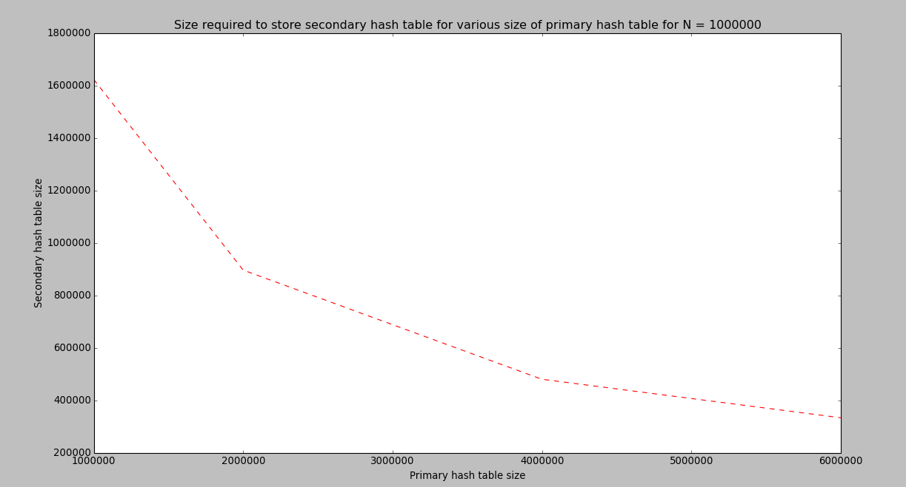
Can we further optimize space requirement
Let us compare space required for 2nd level hashing for various sizes of primary hash table. N , 2N , N log log N , N (log N)^½

Slide 21
Using Optimal Space
We observe that as the size of primary hash table increases, number of collisions decreases. Which indicates that size of the secondary hash tables decreases !
More precisely if size of primary hash table is g(N) ( we will later choose a suitable g(N) ) then space used for secondary hash table is O(N²/g(N)).
If we choose g(N) such that lim N/g(N) → 0
Then size of secondary hash table is o(N).
But now size of primary is much larger.
But most of the space in primary hash table will be unused.
Can we somehow use this fact and compress primary hash table
to store it in lesser number of bits?

Slide 22
Using Optimal Space
Hash Function :
H(e) = (a * e ) % p % g(N)
Where, a and b are selected randomly between 1 to p.
p is a prime number greater than |U|.
At most N of g(N) blocks are non-empty. For them -
We keep a single array T in which all the elements are kept.
Formally -
(a) If the bucket contains a single element
We put the element in T. And update that the corresponding bucket is singleton.
(b) If there are more than one element
Then we calculate address where the corresponding secondary level hash table is stored in T using data structure described below.
The next 3 elements in T contains the details about the secondary hash function of bucket.
Details are - (size of the bucket, a, p)
Next “size” elements are second level hashing for this bucket.

Slide 23
Using Optimal Space
We have two additional boolean arrays of size g(N) / log(N).
isEmpty array: i^{th} bit of this array is 1 if i^{th} bucket is empty, 0 otherwise.
isSingleton : i^{th} bit is 1 if i^{th} bucket contains single element, 0 otherwise
Clearly space required by these two array is o(N).
Storing base address -
We partition the interval [1, g(N)] into N²/g(N) subintervals of size (g(N)/N)². With each of the N²/g(N) subintervals we associate a base address B[], which is the address of the location immediately
preceding the cells in T.
We have another array A, such that it contains offset for each i such that A[i] + B[sigma] gives the direct address at T. Where sigma is number of intervals before i.
If the corresponding bucket is singleton we directly store that element into this address (A[i] + B[sigma]) else we store the address T’ in T where the secondary level hash table start for this particular bucket. If bucket is empty it takes no space in T.

Slide 24
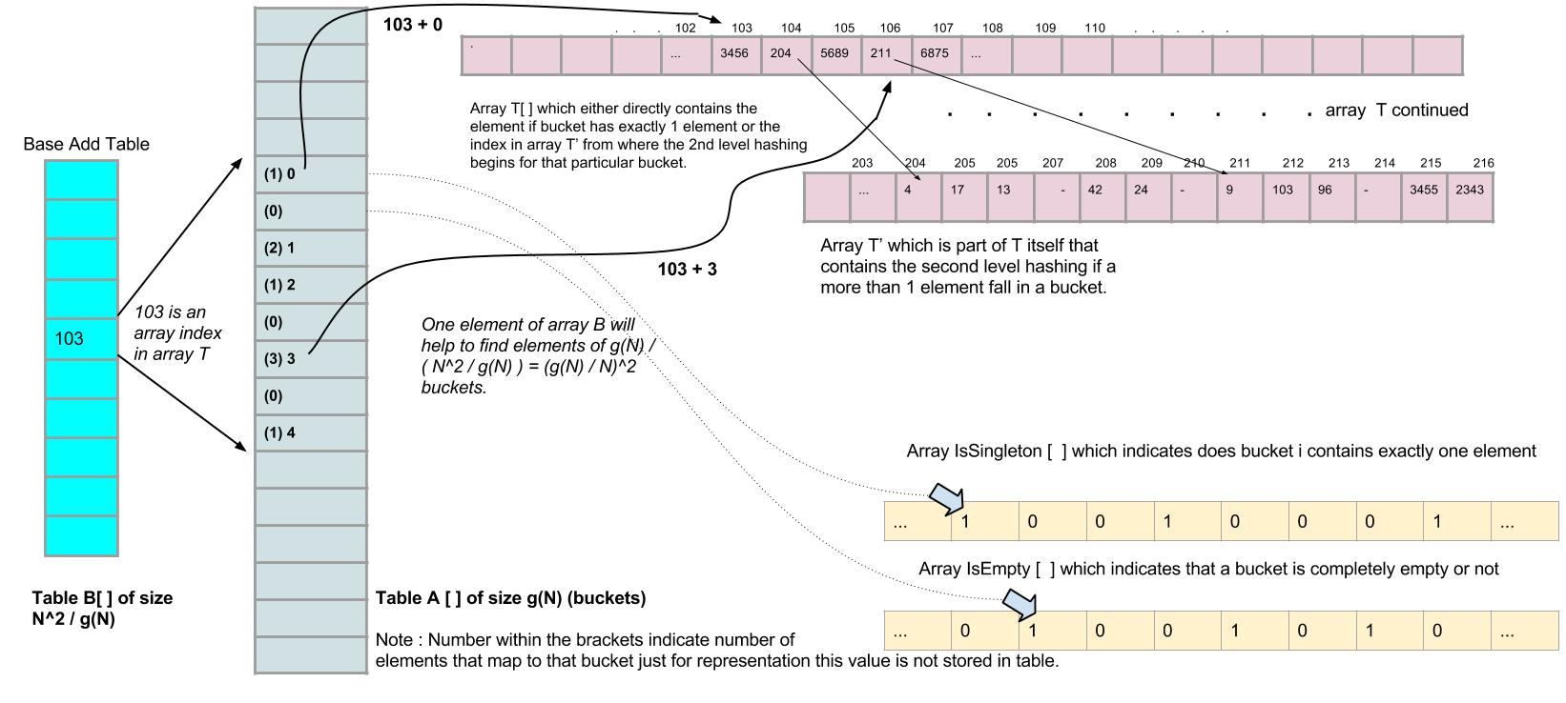

Slide 25
Using Optimal Space
A[j] is bounded by ((g(N)/N)²+ 1)) ( = f (N ) ).
Hence the entire table A[j], can be packed into O(g(N)log(f(N))/log N) words.
Picking g(N) = N(log N)^½ the resulting space requirement for the A[j] table is o(N).
So the total space requirement for our data structure is N + o(N).

Slide 26
Space required for optimal space hashing
Size of input set | Total space used to store hash table
10000 | 17406
50000 | 90128
100000 | 182783
500000 | 941905
1000000 | 1906849
5000000 | 9791070
We can see that size required to store the hash table is not even 2*N.

Slide 27
Thanks, Hope you got motivated towards the powerful technique of hashing
All codes are publicly available at http://www.github.com/triveni692/CS648
Thanks Prof. Surender Baswana for making us realize the power of randomized algorithms
References :
Fredman, Michael L., János Komlós, and Endre Szemerédi. "Storing a sparse table with 0 (1) worst case access time." Journal of the ACM (JACM) 31.3 (1984): 538-544.
Image credits :
en.wikipedia.org

