Slide 1

Voice-to-Sign Language Converter With Visual Sign Representations
By
N.Trineesha
J.Triveni
K.Manasa Phanisri
G.Mahitha

Slide 2
Bridging the Communication Gap
The Challenge
The Solution
Millions around the world experience communication barriers due to hearing loss or deafness. This limits access to information, education, and social opportunities.
Voice to sign language conversion technology empowers deaf and hard-of-hearing individuals to participate fully in society.

Slide 3
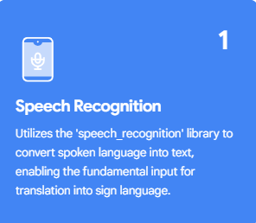
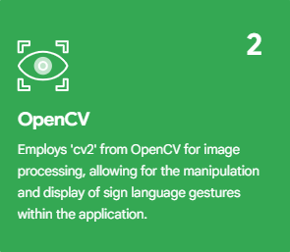
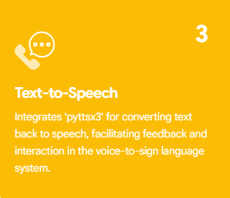
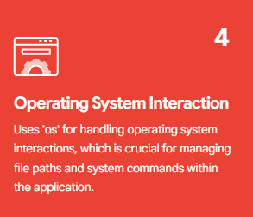
LIBRARIES

Slide 4
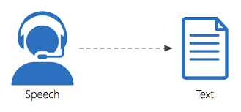
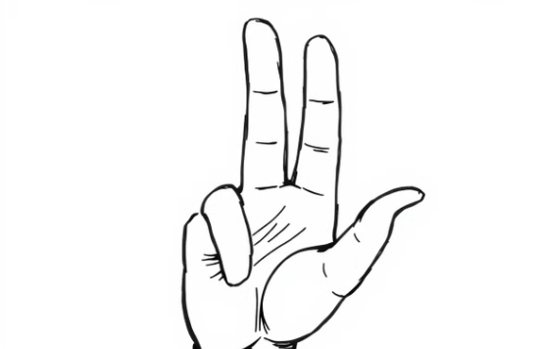

DIAGRAMTIC REPRESENTATION

Slide 5
WORKFLOW
Voice Input
Conversion of voice to Text
Map Text to sign Language
Sign Language Representation
Text Output

Slide 6
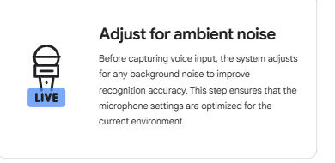
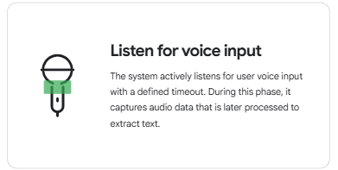
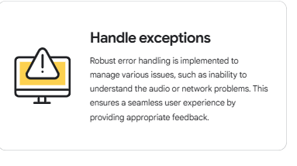
Voice Input

Slide 7
ALGORITHM
Step 1: Initialize Components
Step 4: Map Characters to Sign Images
speech_recognition
pyttsx3
Step 5: Resize Images
OpenCV
Step 2: Capture Voice Input
Step 6: Combine and Display Images
Step 3: Process Recognized Text

Slide 8
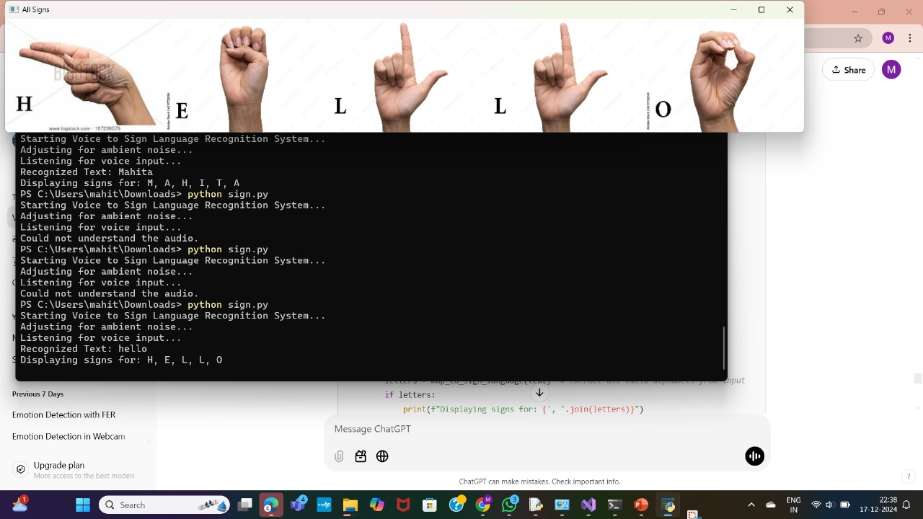
OUTPUT

Slide 9
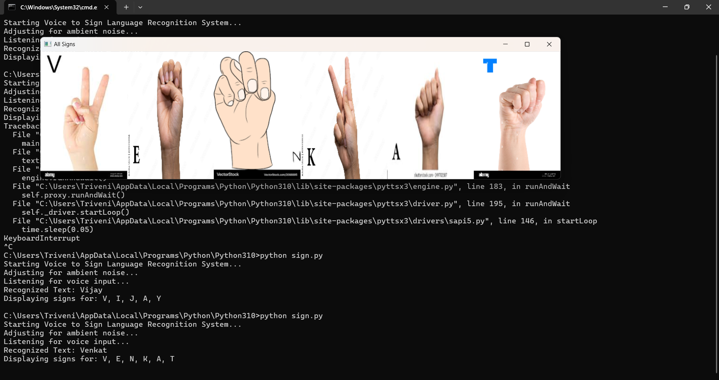
OUTPUT

Slide 10
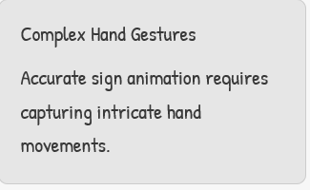
Navigating the Challenges
Sign Language Variation
Different sign languages exist with unique signs and grammar rules.

Slide 11

Transforming Communication
Education
Emergency Services
Interactive sign language learning for deaf and hard-of-hearing students.
Real-time sign language interpretation for emergency responders.
1
2
3
4
Healthcare
Accessibility
Improved communication between patients and healthcare providers.
Making public spaces and events accessible to deaf and hard-of-hearing individuals.

Slide 12


