Slide 1
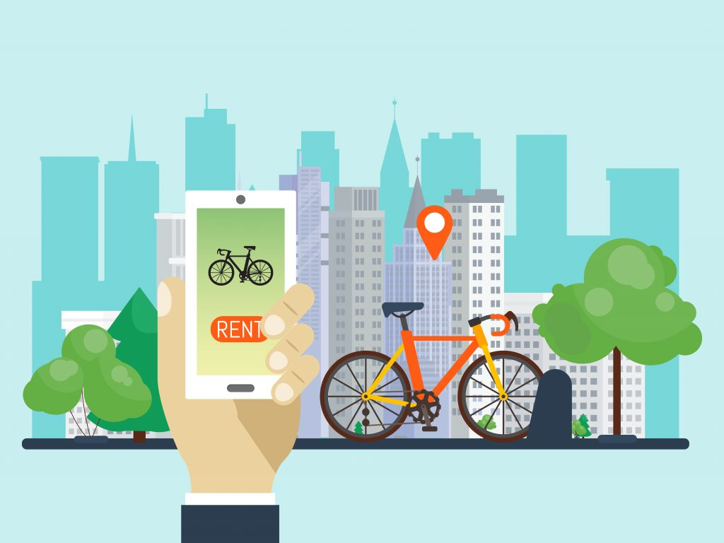

SPARKS
Sustainable path against global warming

Slide 2
College: MITAOE, Alandi, Pune Branch: Electronic and Telecommunication Topic: Sustainability Group name: SPARKS Group Guide: Shilpa Rudrawar Group leader: Vaishnavi D Gaikwad Group Members: 1.Triveni Gaidhane 2.Vaishanvi Deshmukh
WiT-ACE Hackathon

Slide 3
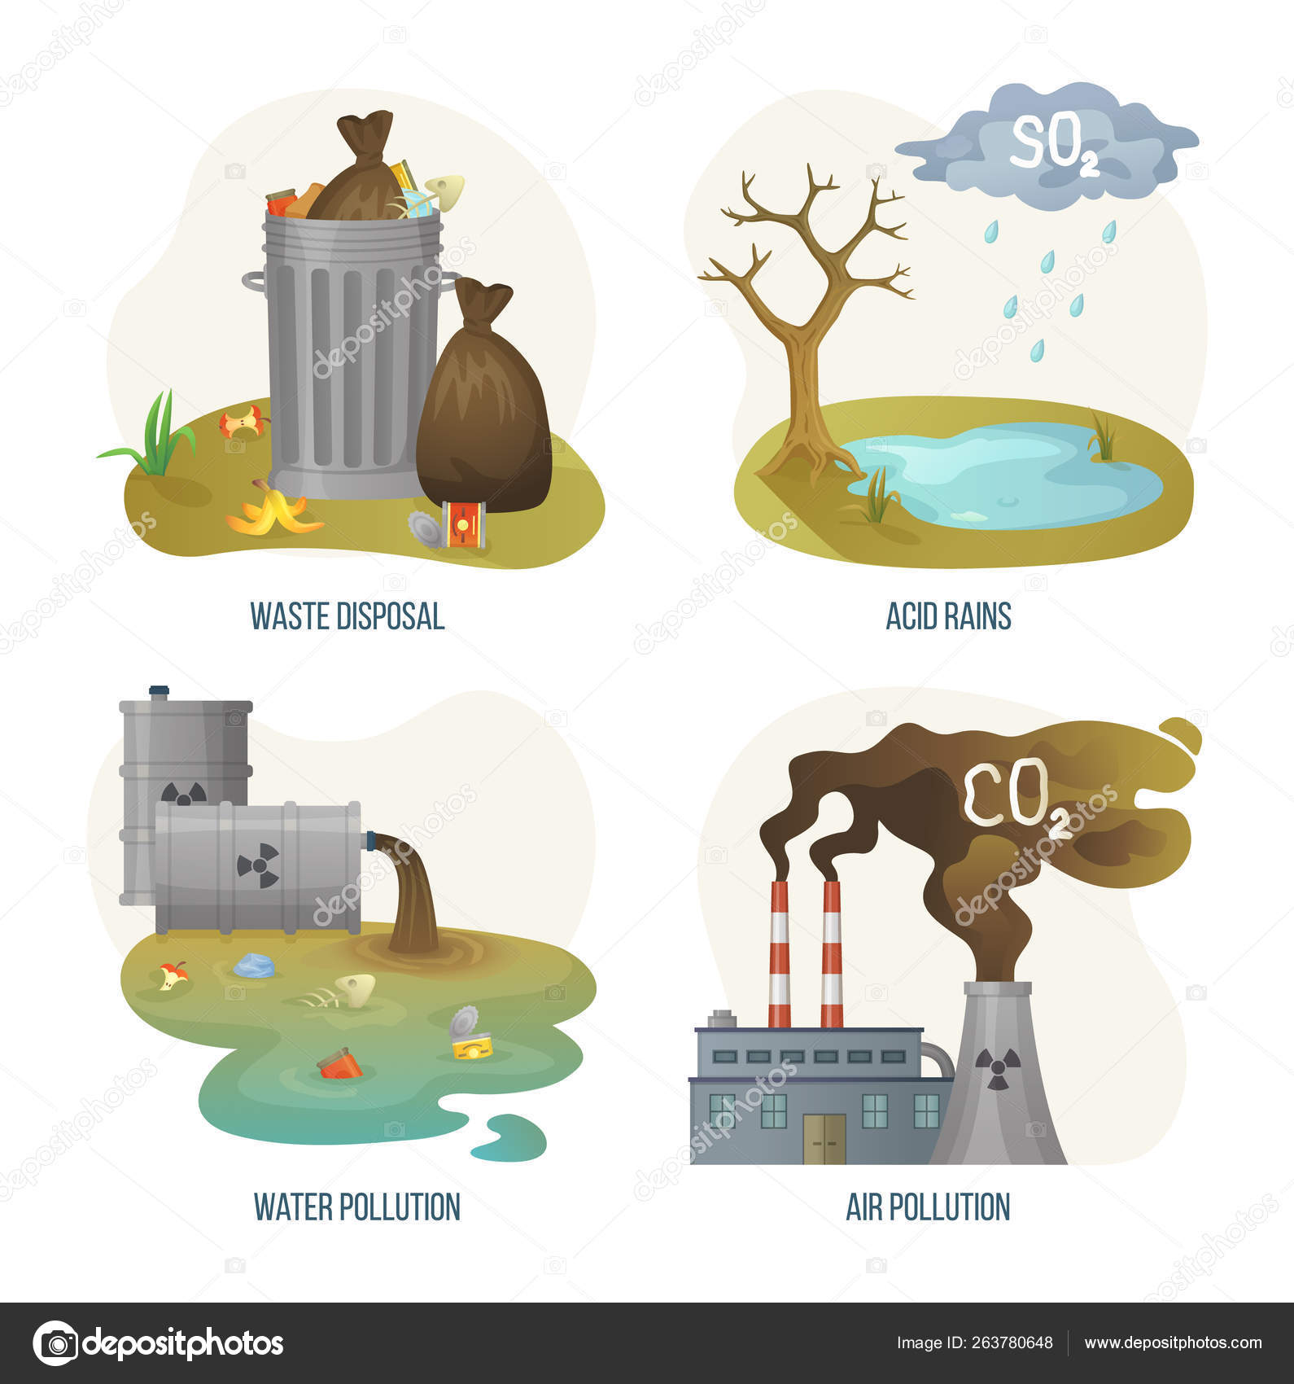


Cause of climate change
Pollution
Soil Degradation
Waste Disposal
Global warming
Overpopulation
Deforestation

Slide 4

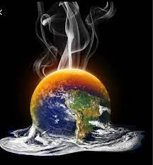
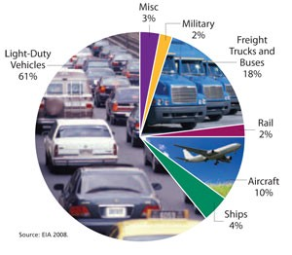

Effect
Higher temperatures are worsening many types of disasters, including storms, heat waves, floods, and droughts. A warmer climate creates an atmosphere that can collect, retain, and drop more water, changing weather patterns in such a way that wet areas become wetter and dry areas drier.

Slide 5


What we can do?
Reduce, reuse, and recycle.
Volunteer..
Educate.
Conserve water.
Choose sustainable.
Shop wisely.
Use long-lasting light bulbs.
Plant a tree.
Don't send chemicals into our waterways.
Use Bicycle.

Slide 6

Sustainability
Sustainability is the capacity to endure in a relatively ongoing way across various domains of life. In the 21st century, it refers generally to the capacity for Earth's biosphere and human civilization to co-exist.

Slide 7
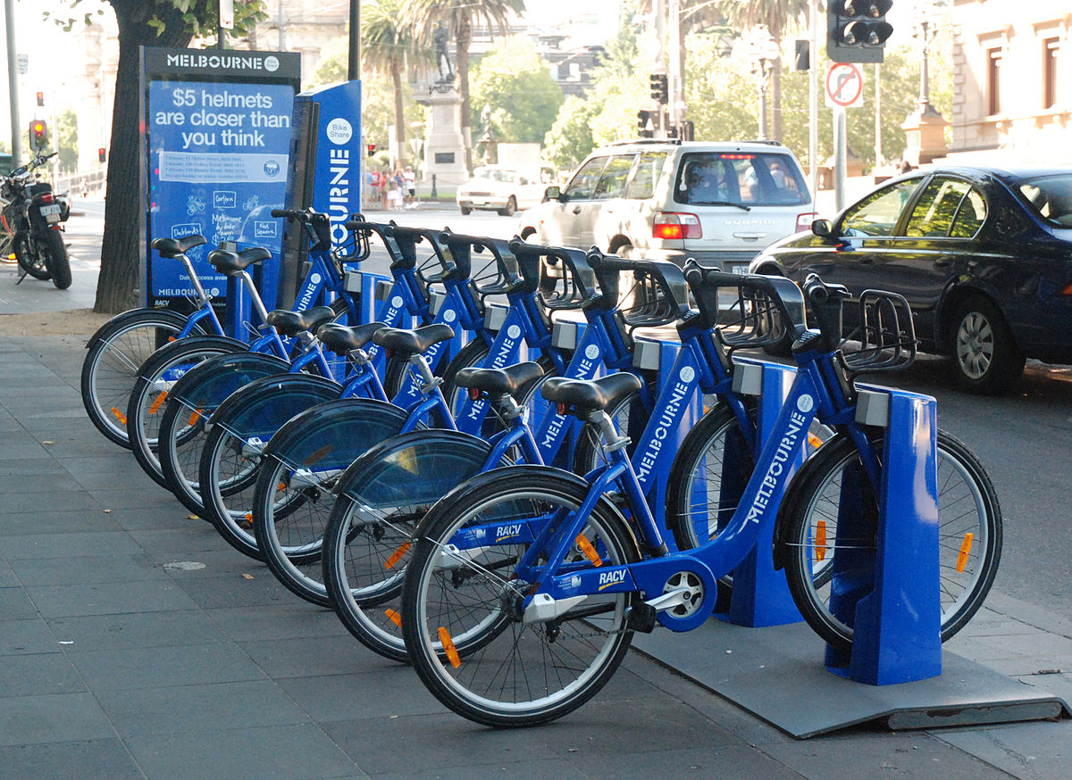

What is our idea?
Take your cycle from any public cycle stand
Bicycle will be ready for you
Scan the QR Code
Give valid details

Slide 8
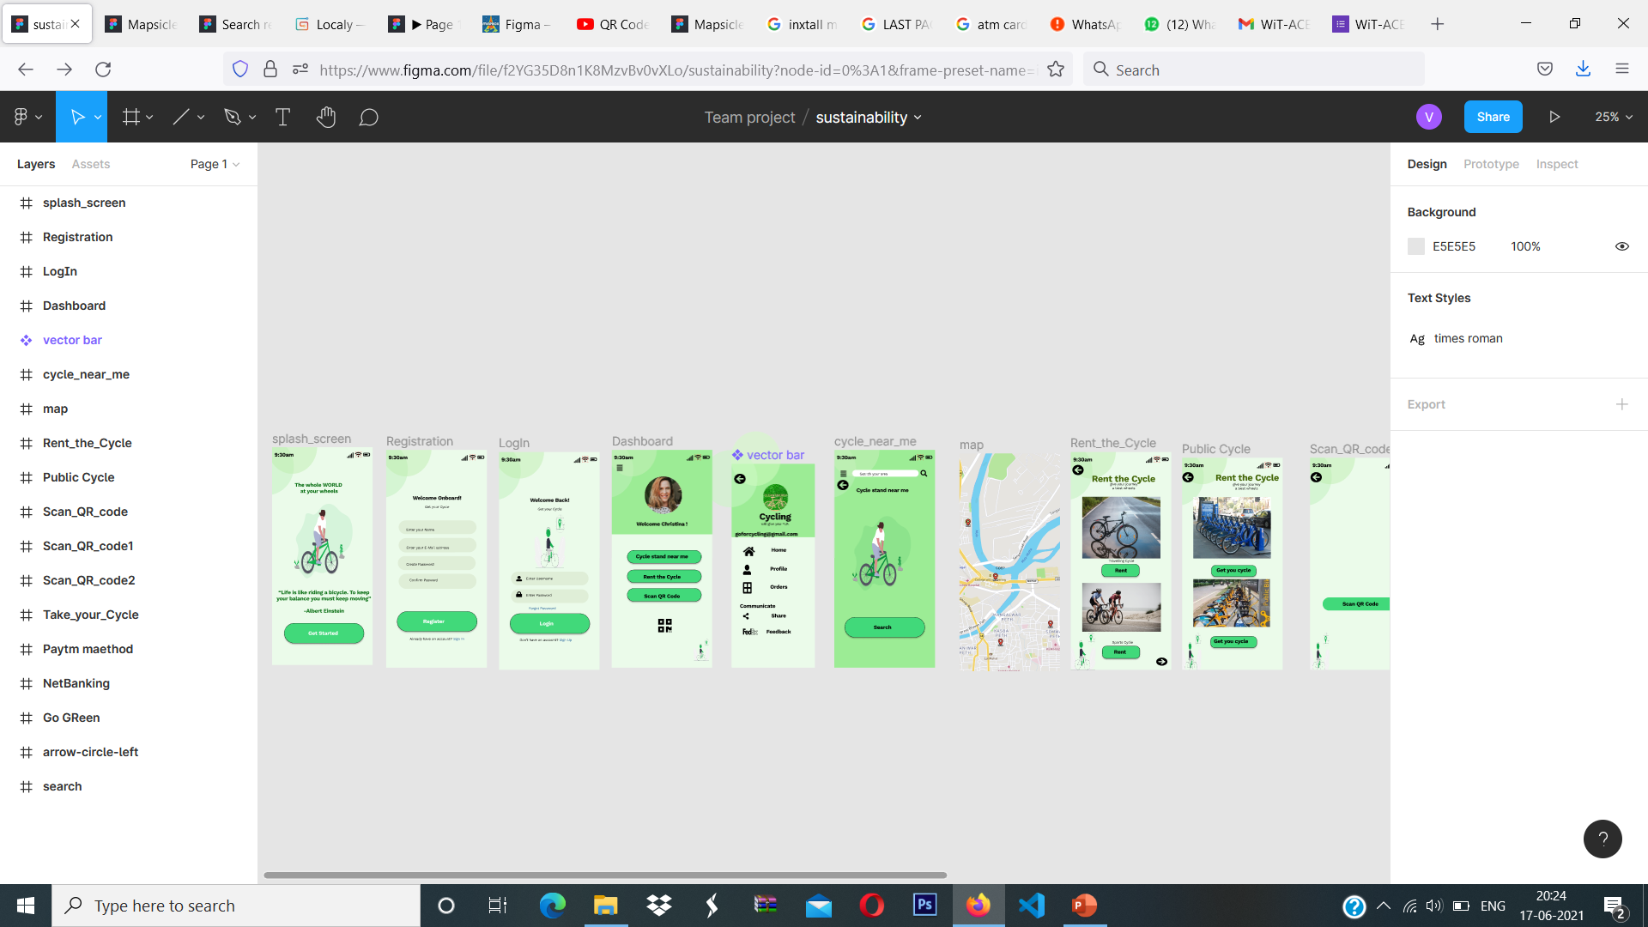
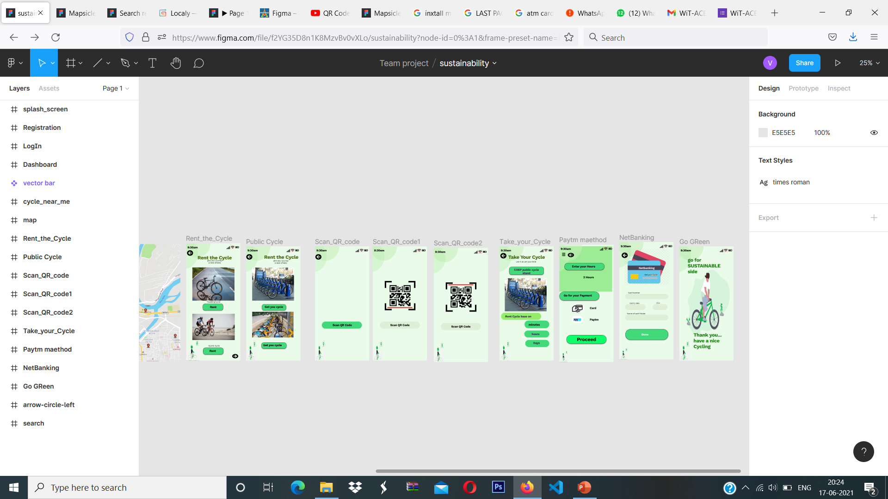
UI Diagram

Slide 9
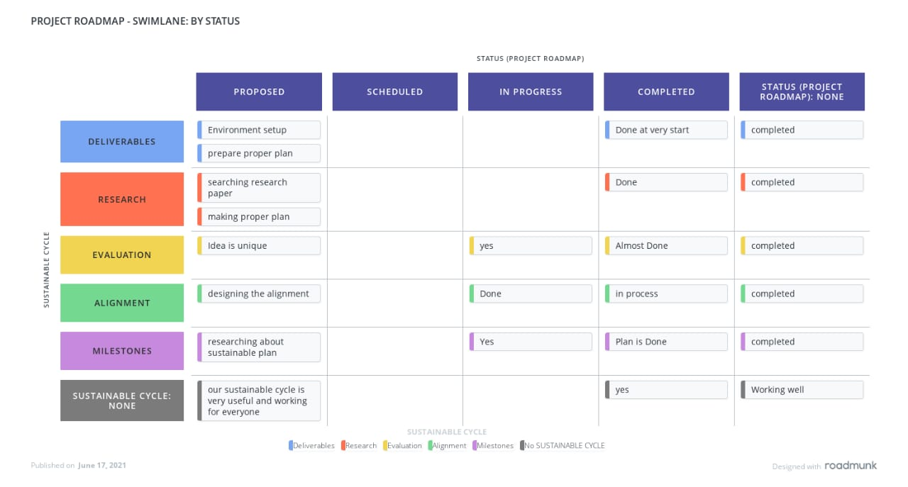
Thank You

Slide 10
LINKS
Prototype Design: https://www.figma.com/proto/f2YG35D8n1K8MzvBv0vXLo/sustainability?node-id=38%3A63&frame-preset-name=iPhone%2011%20Pro%20%2F%20X&scaling=scale-down&page-id=0%3A1
THANK YOU

