Slide 1
FCAPP - Future Programming Paradigms:
Parallel Programming Models
Prof. Raffaele Montella
http://raffaelemontella.it raffaele.montella@uniparthenope.it

Slide 2
Overview
Basic concepts
Programming models n Multiprogramming
Shared address space model
UMA versus NUMA
Distributed shared memory
Task parallel
Data parallel, vector and SIMD
Message passing model
Hybrid systems
BSP model

Slide 3
Parallel programming: Basic Concepts
Control
How is parallelism created, implicitly (hardwired) or explicitly? ̈ What orderings exist between operations?
How do different threads of control synchronize?
Naming data
What data is private and what is shared?
How is logically shared data accessed or communicated?
Operations on data
What are the basic operations on shared data? ̈ Which operations are considered atomic?
Cost
How do we account for the cost of each of the above to achieve parallelism (man hours spent, software/hardware cost)

Slide 4
Parallel Programming Models
Programming model is a conceptualization of the machine that a programmer uses for developing applications
Multiprogramming model A set of independence tasks, no communication or synchronization at program level, e.g. web server sending pages to browsers
Shared address space (shared memory) programming
Tasks operate and communicate via shared data, like bulletin boards
Message passing programming Explicit point-to-point communication, like phone calls (connection oriented) or email (connectionless, mailbox posts)

Slide 5
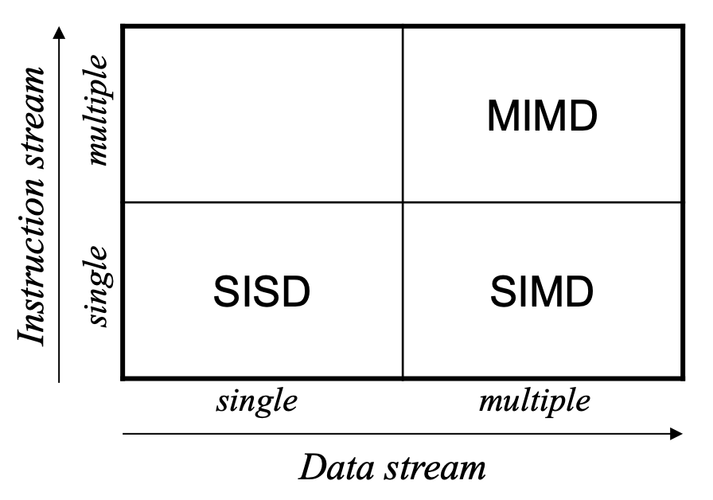
Flynn’s Taxonomy
Single instruction stream single data stream (SISD)
Traditional PC system
Single instruction stream multiple data stream (SIMD)
Similar to MMX/SSE/AltiVec multimedia instruction sets
MASPAR
Multiple instruction stream multiple data stream (MIMD)
Single program, multiple data (SPMD) programming: each processor executes a copy of the program

Slide 6
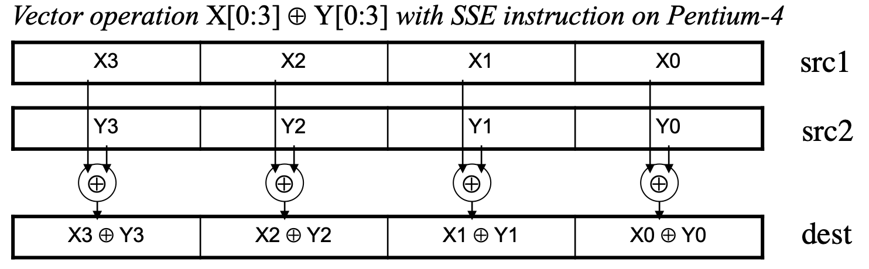
MIMD versus SIMD
Task parallelism, MIMD
Fork-join model with thread-level parallelism and shared memory ̈ Message passing model with (distributed processing) processes
Data parallelism, SIMD
Multiple processors (or units) operate on segmented data set
SIMD model with vector and pipeline machines
SIMD-like multi-media extensions, e.g. MMX/SSE/Altivec

Slide 7
Task versus Data Parallel
Task parallel (maps to high-level MIMD machine model)
Task differentiation, like restaurant cook, waiter, and receptionist
Communication via shared address space or message passing
Synchronization is explicit (via locks and barriers)
Underscores operations on private data, explicit constructs for communication of shared data and synchronization
Data parallel (maps to high-level SIMD machine model)
Global actions on data by tasks that execute the same code
Communication via shared memory or logically shared address space with underlying message passing
Synchronization is implicit (lock-step execution)
Underscores operations on shared data, private data must be defined explicitly or is simply mapped onto shared data space

Slide 8
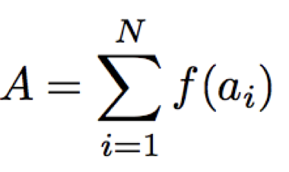
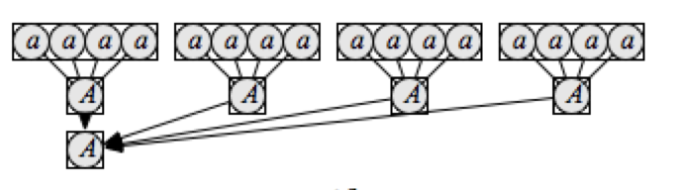
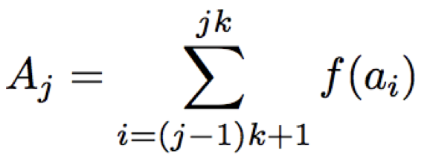
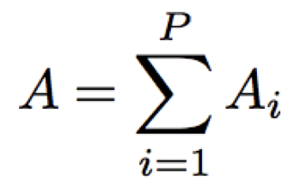
A Running Example
Parallel decomposition
Assign N/P elements to each processor
Each processor computes the partial sum
One processor collects the partial sums
Determine the data placement:
Logically shared: array a, global sum A
Logically private: the function f(ai) evaluations
Either logically shared or private: partial sums Aj

Slide 9
Programming Model 1
Shared address space (shared memory) programming
Task parallel, thread-based MIMD
Program is a collection of threads of control
Collectively operate on a set of shared data items
Global static variables, Fortran common blocks, shared heap
Each thread has private variables
Thread state data, local variables on the runtime stack
Threads coordinate explicitly by synchronization operations on shared variables, which involves
Thread creation and join
Reading and writing flags
Using locks and semaphores (e.g. to enforce mutual exclusion)

Slide 10
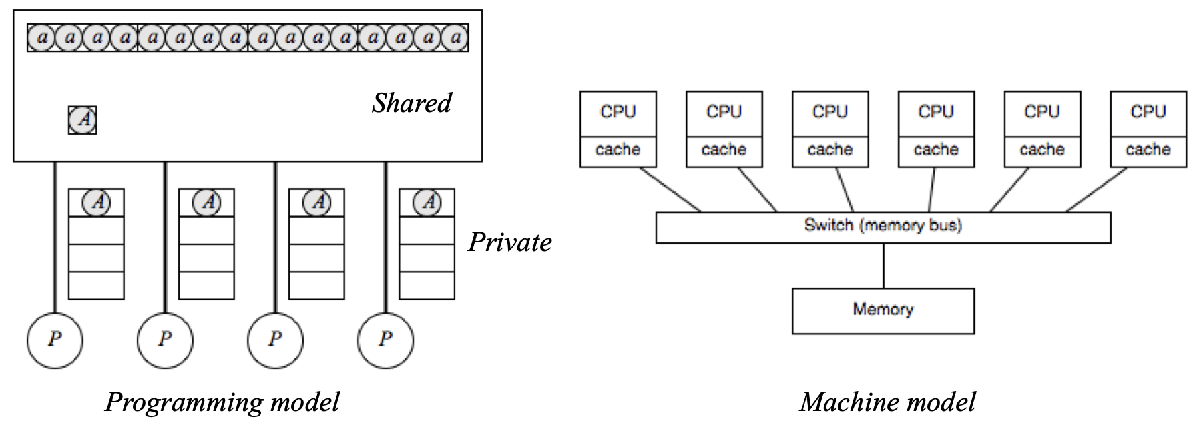
Programming Model 1
Uniform memory access (UMA) shared memory machine
Each processor has uniform access to memory
Symmetric multiprocessors (SMP)
No local/private memory, private variables are put in shared memory
Cache makes access to private variables seem “local”

Slide 11
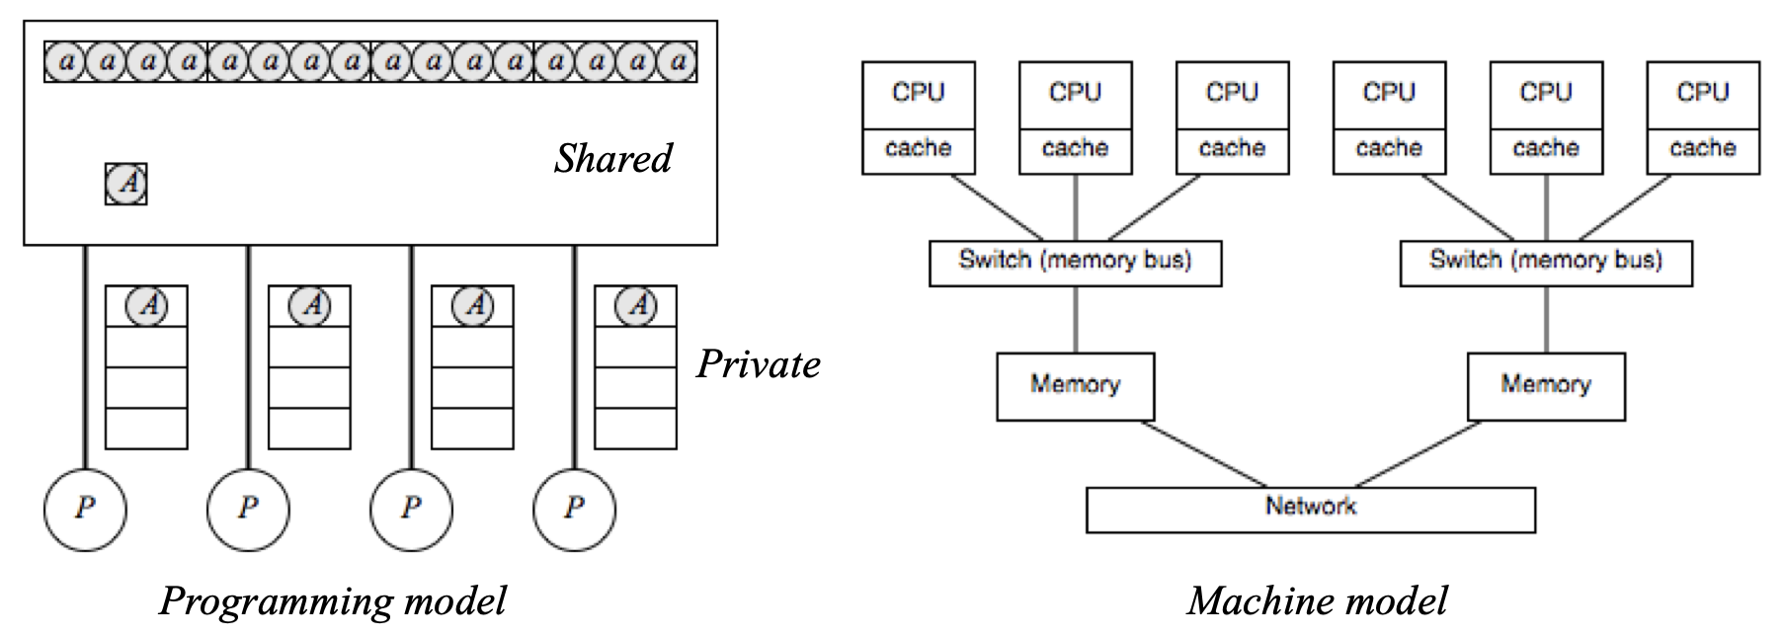
Programming Model 1
Nonuniform memory access (NUMA) shared memory machine
Memory access time depends on location of data relative to processor
Local access is faster
No local/private memory, private variables are put in shared memory

Slide 12
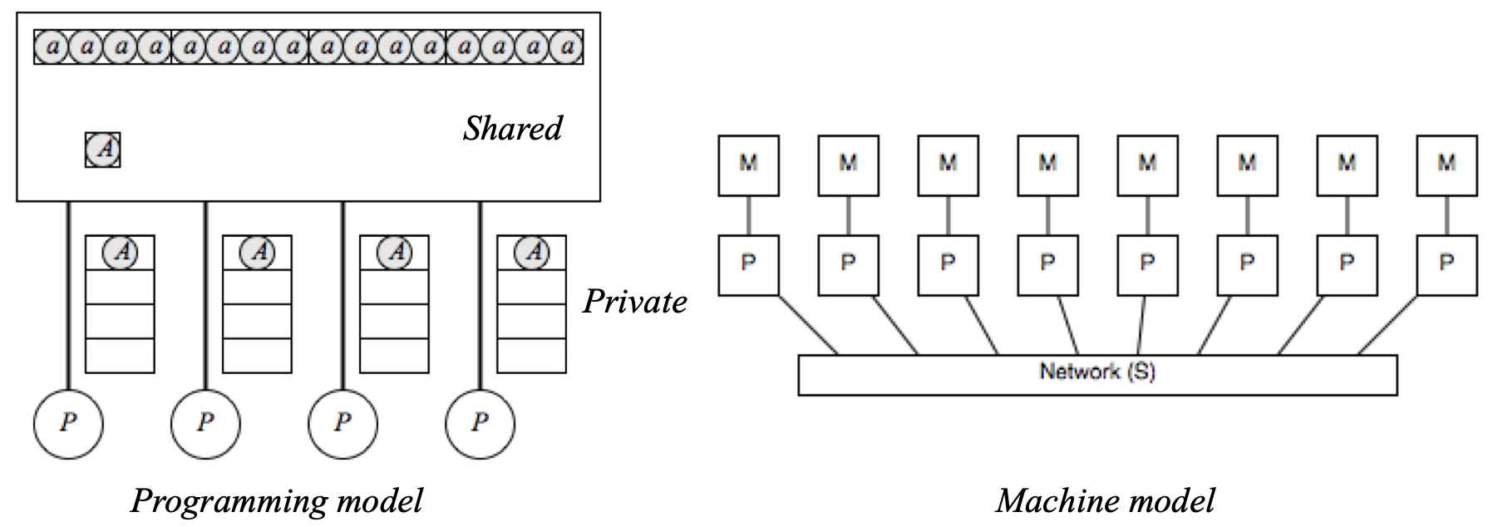
Programming Model 1
Distributed shared memory machine (DSM)
Logically shared address space
Remote memory access is more expensive (NUMA)
Remote memory access requires communication, automatic either done in hardware or via software layer

Slide 13
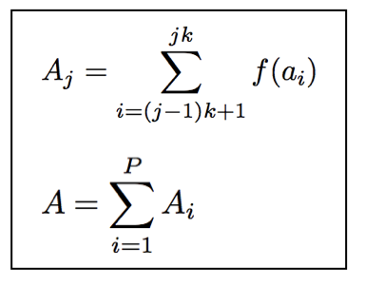
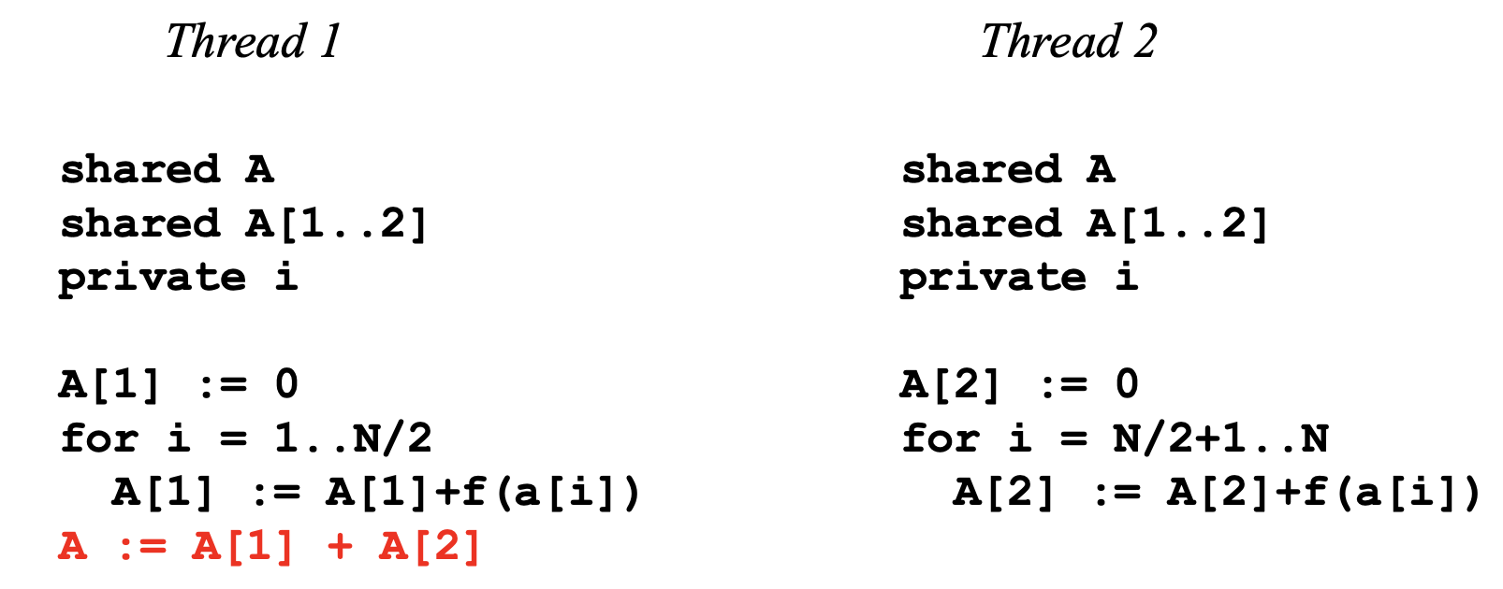
Programming Model 1
What could go wrong?

Slide 14
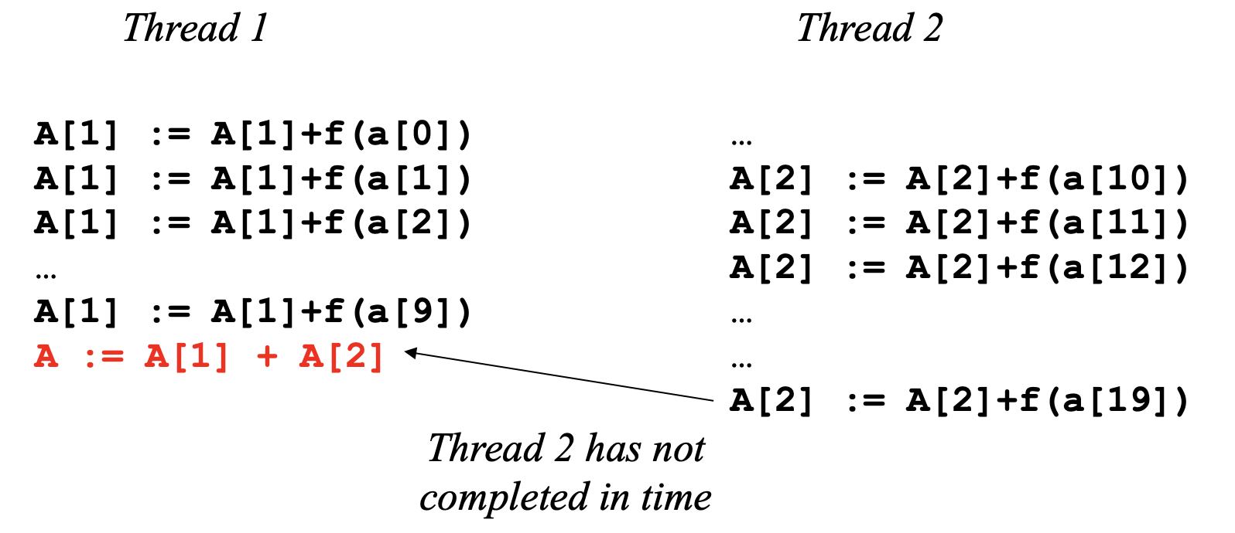
Programming Model 1

Slide 15
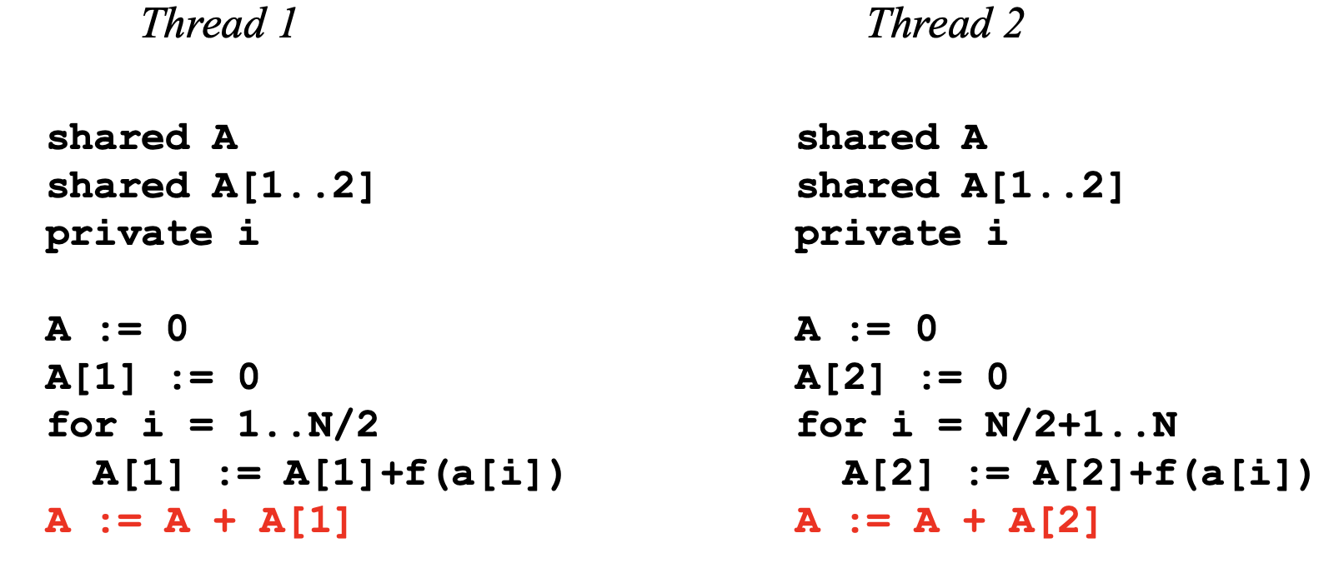
Programming Model 1
What could go wrong?

Slide 16
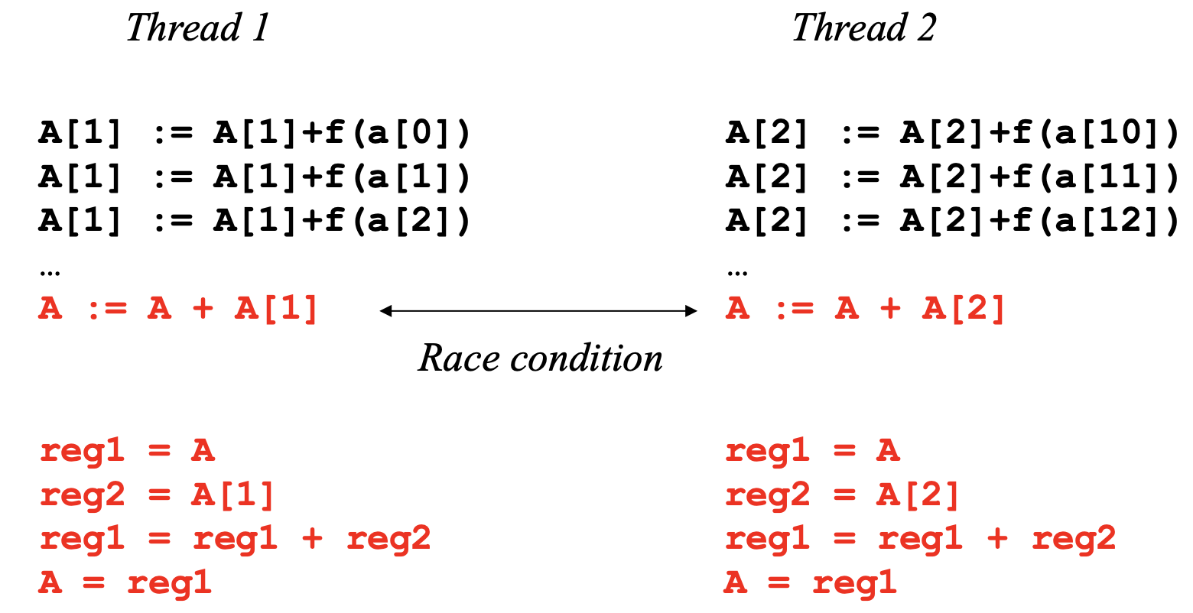
Programming Model 1
Instructions from different threads can be interleaved arbitrarily: the resulting value of A can be A[1], A[2], or A[1]+A[2]

Slide 17
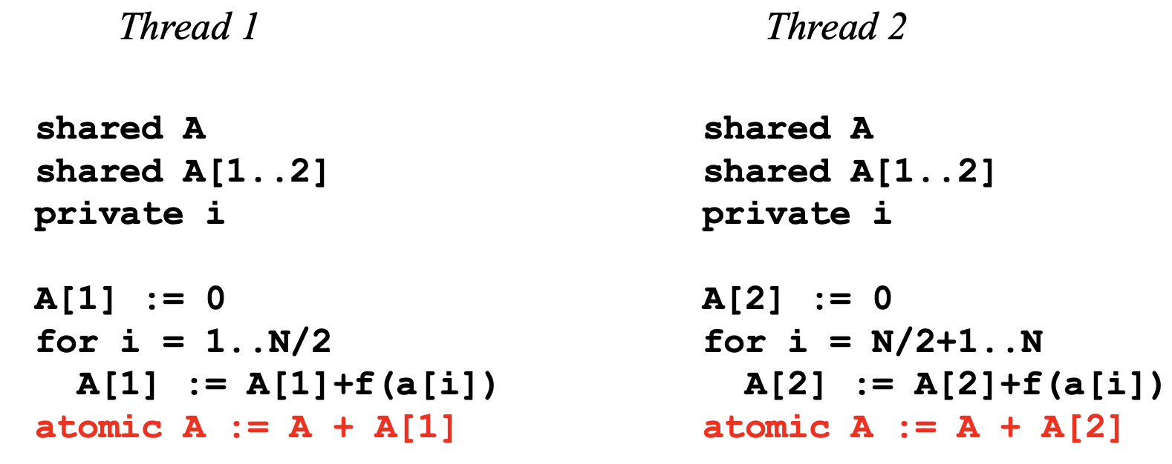
Programming Model 1
Solution with atomic operations to prevent race condition

Slide 18
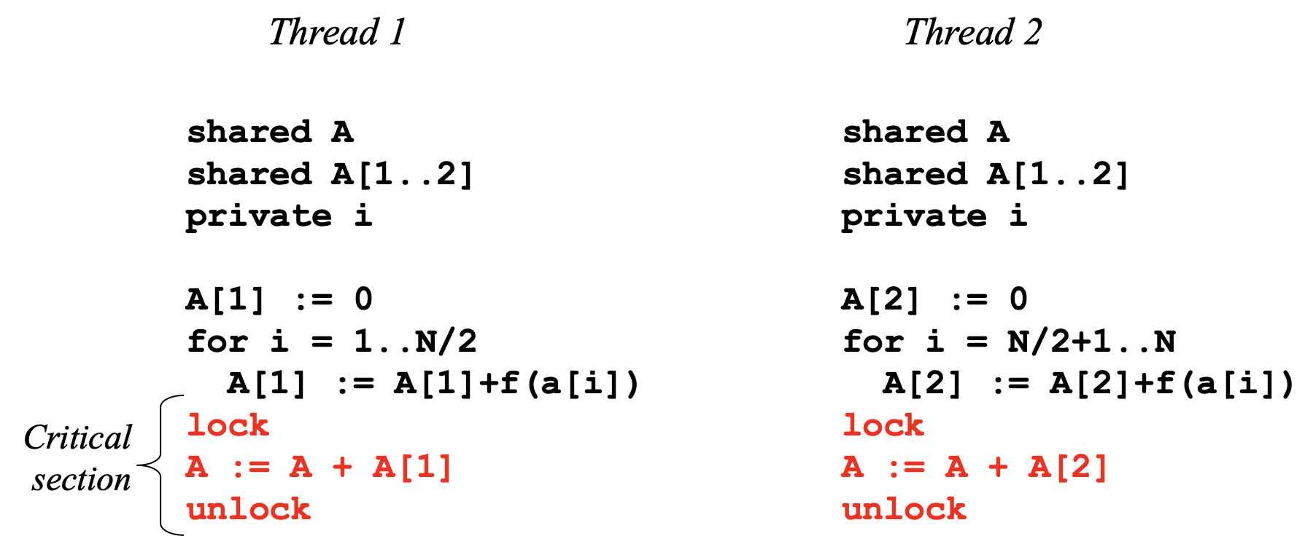
Programming Model 1
Solution with locks to ensure mutual exclusion
(But this can still go wrong when an FP add exception is raised, jumping to an exception handler without unlocking)

Slide 19
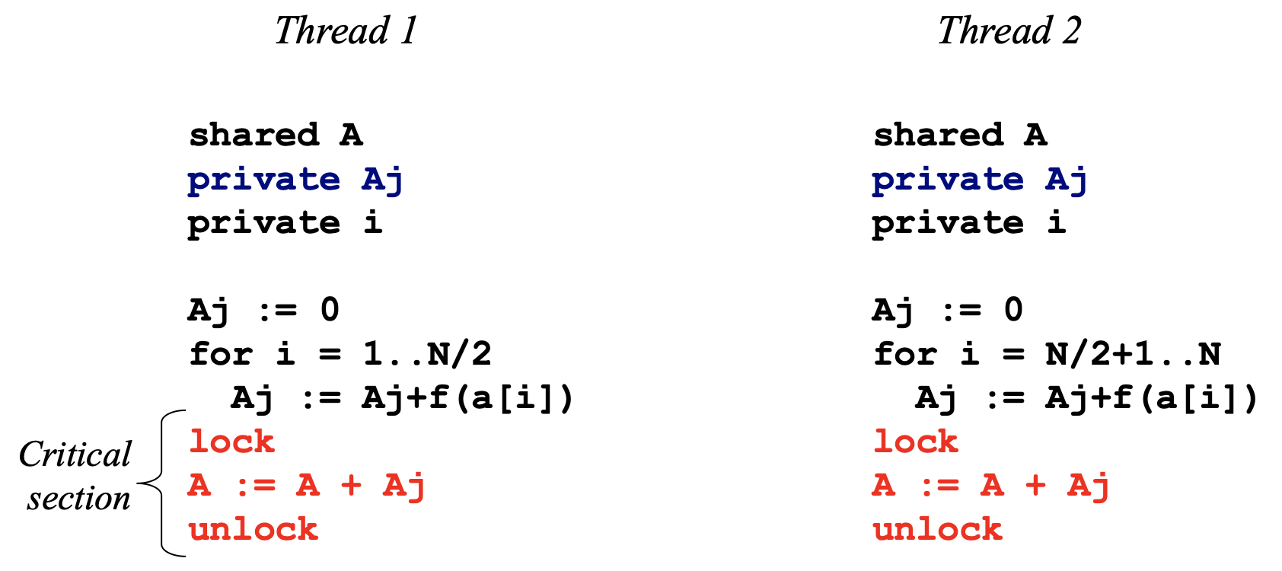
Programming Model 1
Note that the A[1] and A[2] are just local, so make them private

Slide 20
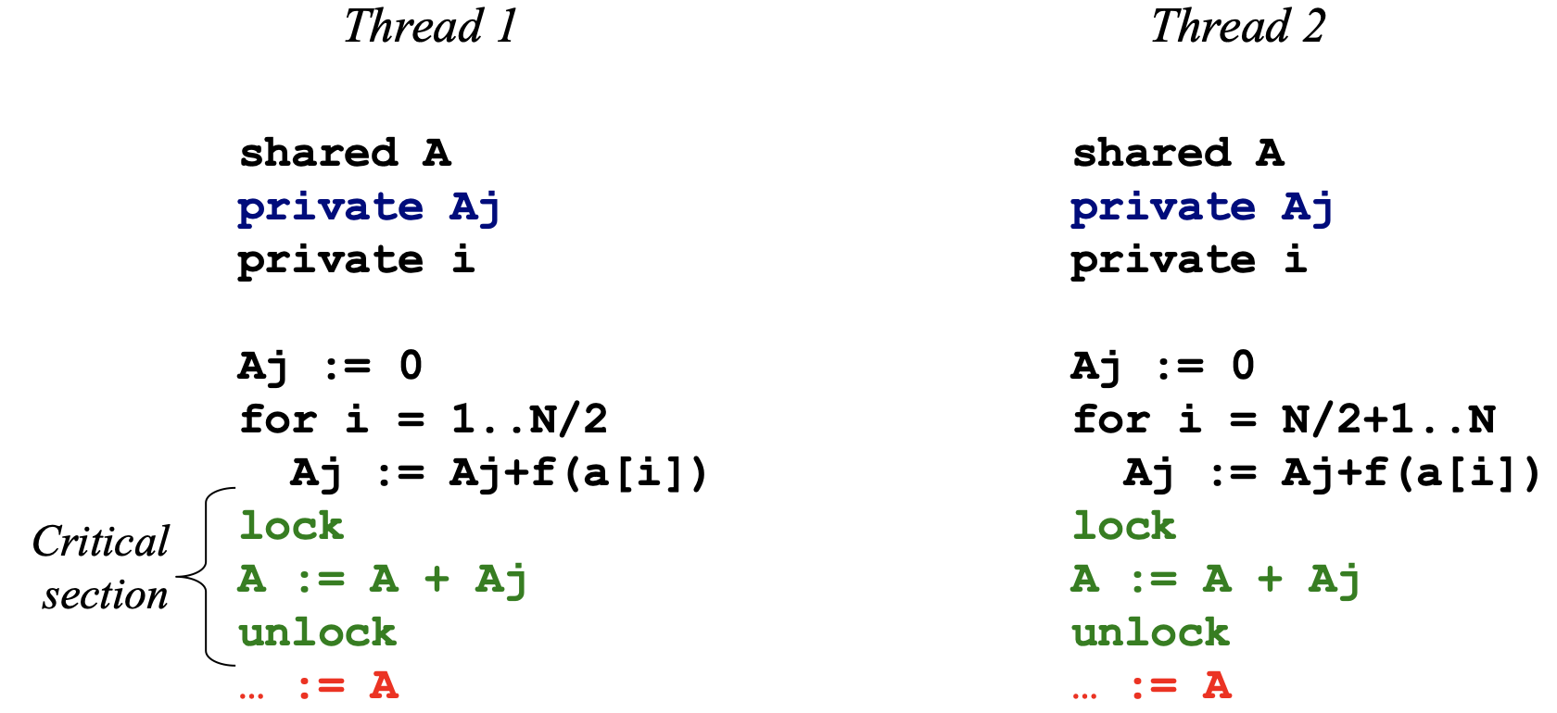
Programming Model 1
What could go wrong?

Slide 21
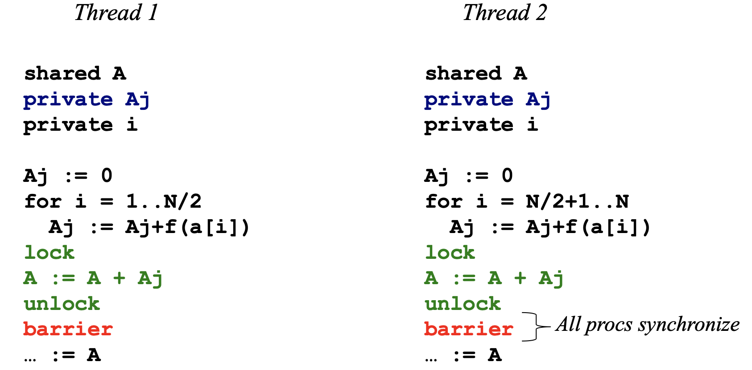
Programming Model 1
With locks, private Aj, and barrier synchronization

Slide 22
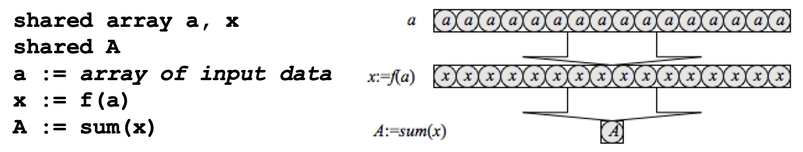
Programming Model 2
Shared address space (shared memory) programming
Data parallel programming
Single thread of control consisting of parallel operations
Parallel operations are applied to (a specific segment of) a data structure, such as an array
Communication is implicit
Synchronization is implicit

Slide 23
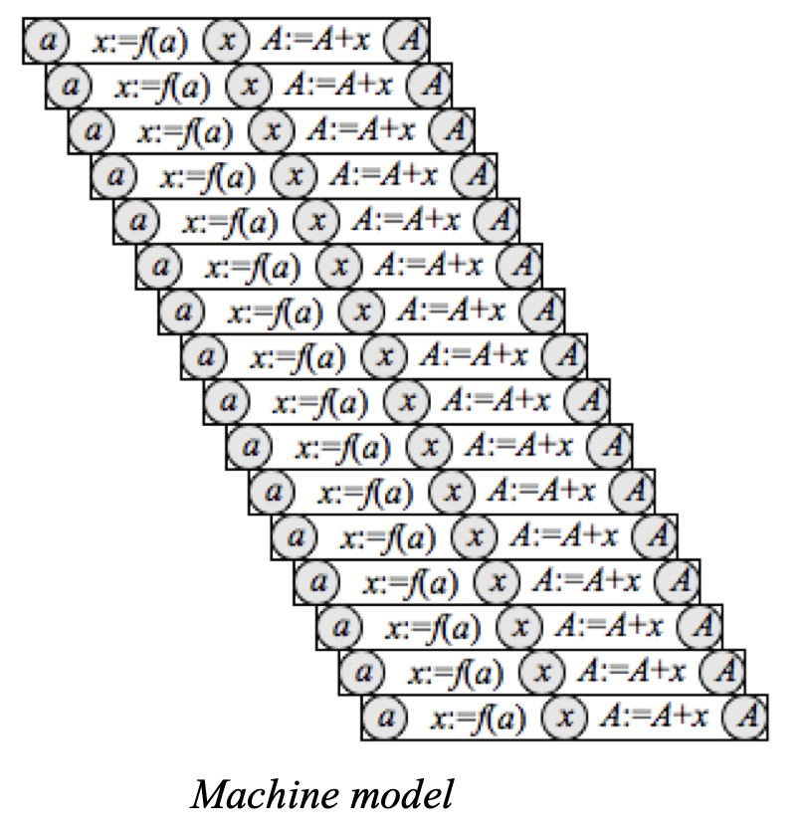
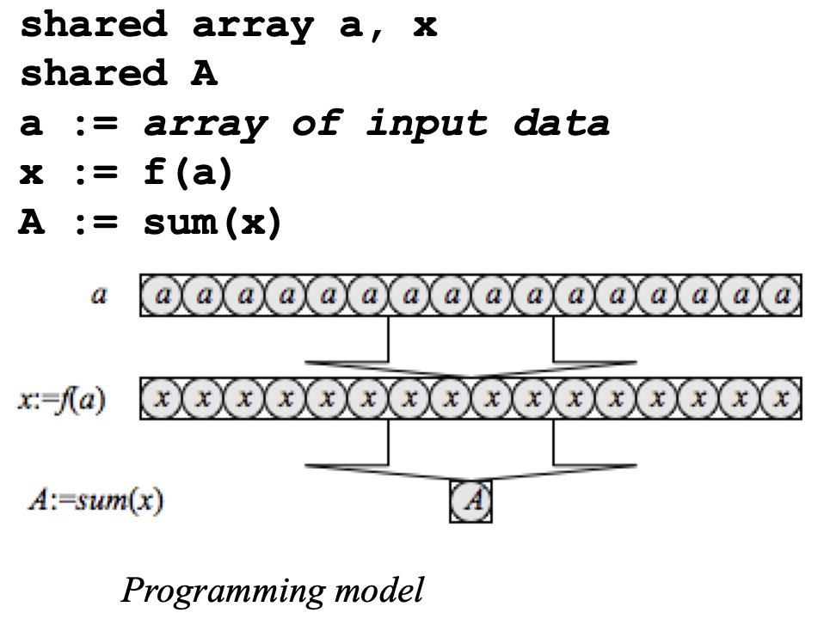
Programming Model 2
E.g. data parallel programming with a vector machine
One instruction executes across multiple data elements, typically in a pipelined fashion

Slide 24
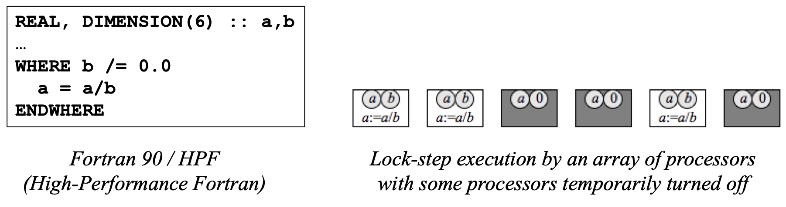
Programming Model 2
Data parallel programming with a SIMD machine
Large number of (relatively) simple processors
Like multimedia extensions (MMX/SSE/AltiVec) on uniprocessors, but with scalable processor grids
A control processor issues instructions to simple processors
Each processor executes the same instruction (in lock-step)
Processors are selectively turned off for control flow in program

Slide 25
Programming Mode 3
Message passing programming
Program is a set of named processes
Process has thread of control and local memory with local address space
Processes communicate via explicit data transfers
Messages between source and destination, where source and destination are named processors P0...Pn (or compute nodes)
Logically shared data is explicitly partitioned over local memories
Communication with send/recv via standard message passing libraries, such as MPI and PVM

Slide 26
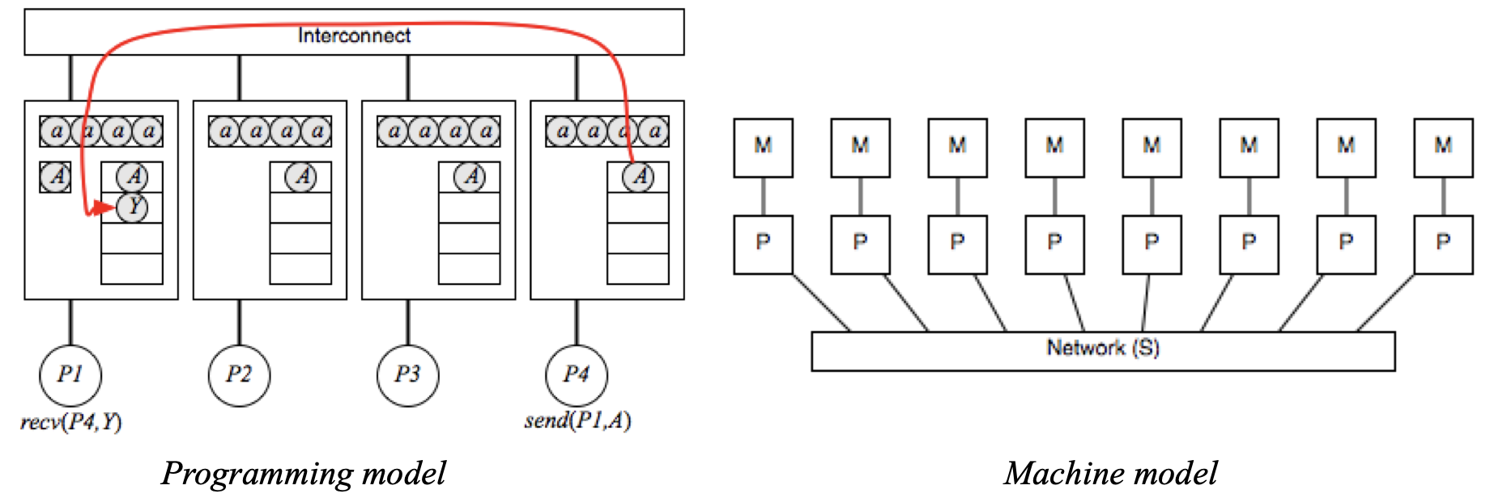
Programming Model 3
Message passing programming
Each node has a network interface
Communication and synchronization via network
Message latency and bandwidth is dependent on network topology and routing algorithms

Slide 27
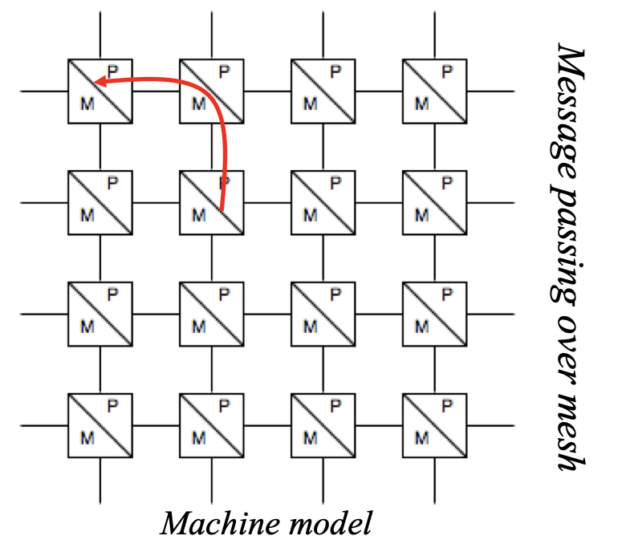
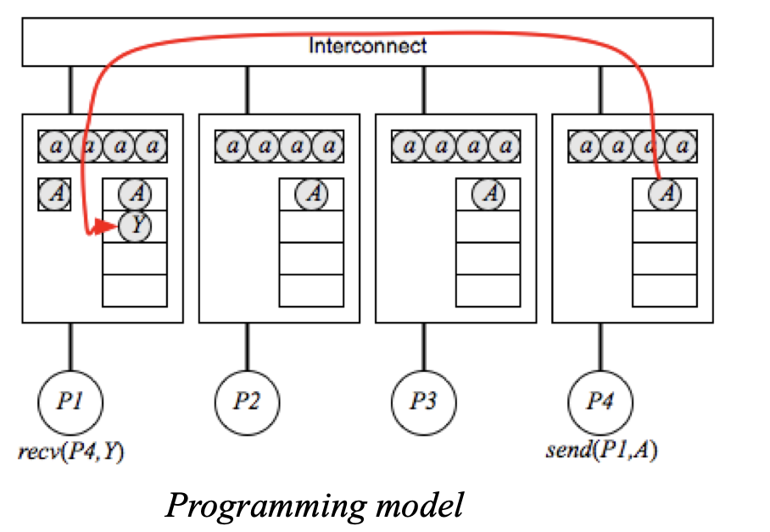
Programming Model 3
Message passing programming
Each node has a network interface
Communication and synchronization via network
Message latency and bandwidth is dependent on network topology and routing algorithms

Slide 28
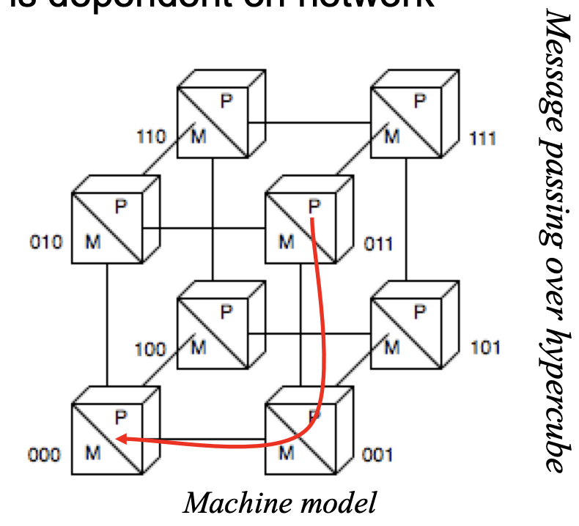
Programming Model 3
Message passing programming
Each node has a network interface
Communication and synchronization via network
Message latency and bandwidth is dependent on network topology and routing algorithms

Slide 29
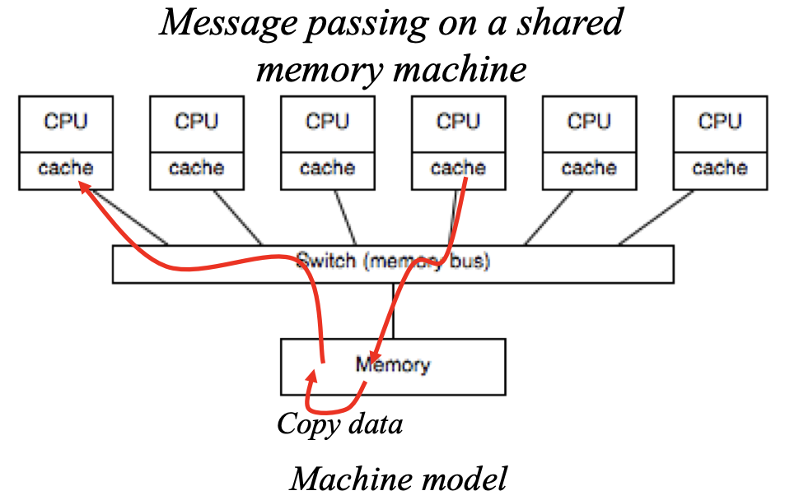
Programming Model 3
Message passing programming
On shared memory machine
Communication and synchronization via shared memory
Message passing library copies data (messages) in memory, less efficient (MPI call overhead) but portable

Slide 30
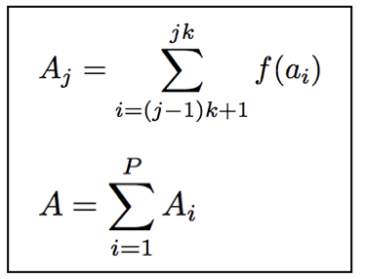
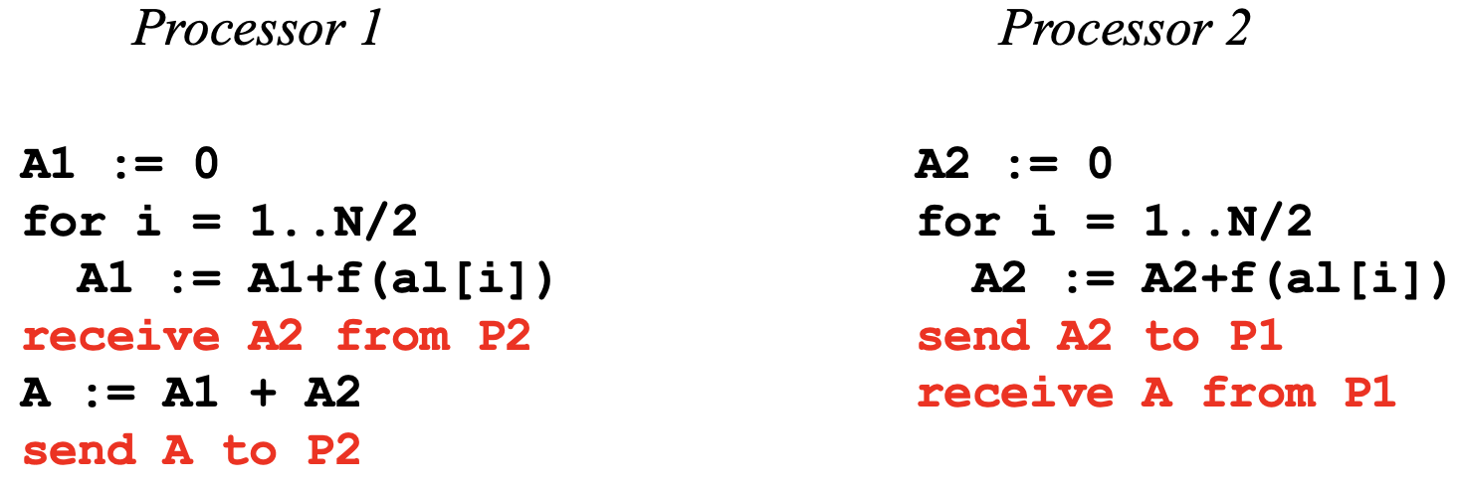
Programming Model 3
Solution with message passing, where global a[1..N] is distributed such that each processor has a local array al[1..N/2]

Slide 31
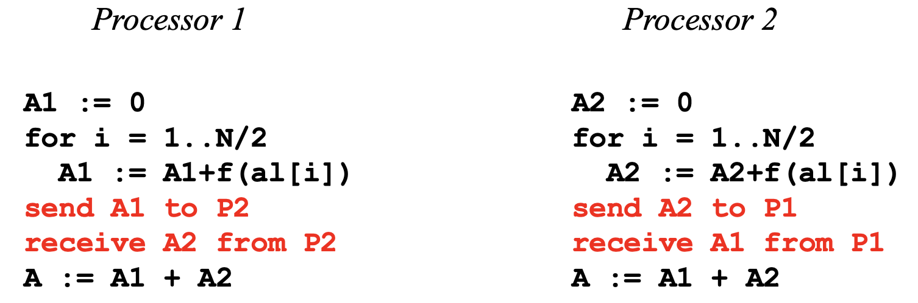
Programming Model 3
Alternative solution with message passing, where global a[1..N] is distributed such that each processor has a local array al[1..N/2]
What could go wrong?

Slide 32
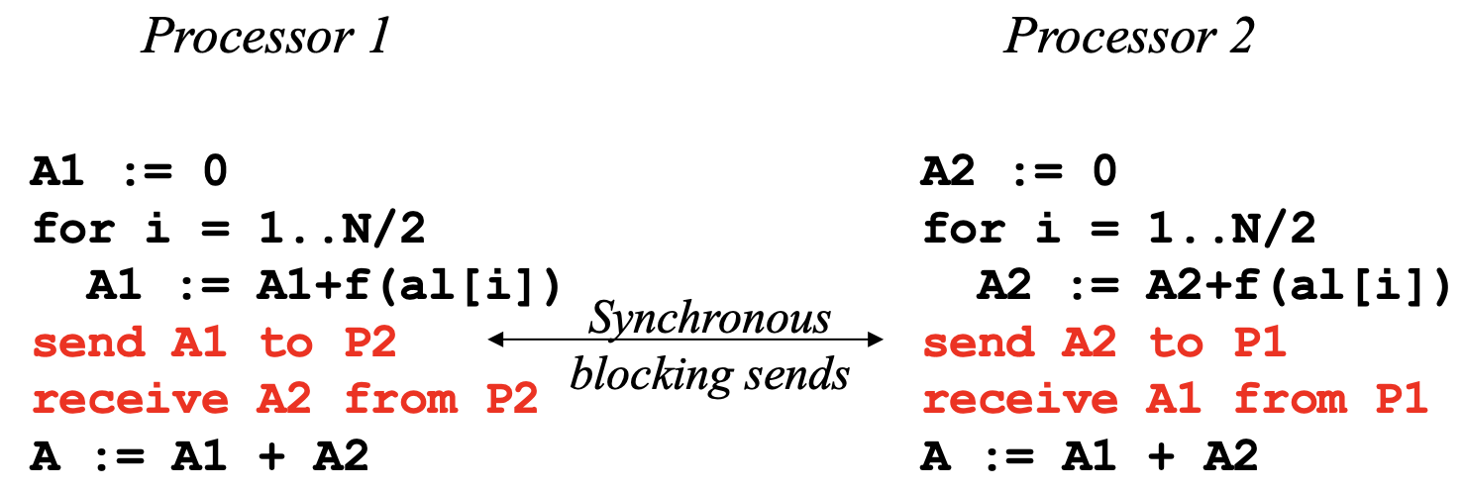
Programming Model 3
Deadlock with synchronous blocking send operations: both processors wait for data to be send to a receiver that is not ready to accept the message
Blocking and non-blocking versions of send/recv operations are available in message passing libraries: compare connection-oriented with rendezvous (telephone) to connectionless (mailbox)

Slide 33
Programming Model 4
Hybrid systems: clusters of SMPs
Shared memory within SMP, message passing outside
Programming model with three choices:
Treat as “flat” system: always use message passing, even within an SMP
Advantage: ease of programming and portability
Disadvantage: ignores SMP memory hierarchy and advantage of UMA shared address space
Program in two layers: shared memory programming and message passing
Advantage: better performance (use UMA/NUMA intelligently)
Disadvantage: harder (and ugly!) to program
Program in three layers: SIMD (e.g. SSE instructions) per core, shared memory programming between cores on an SMP node, and message passing between nodes

Slide 34
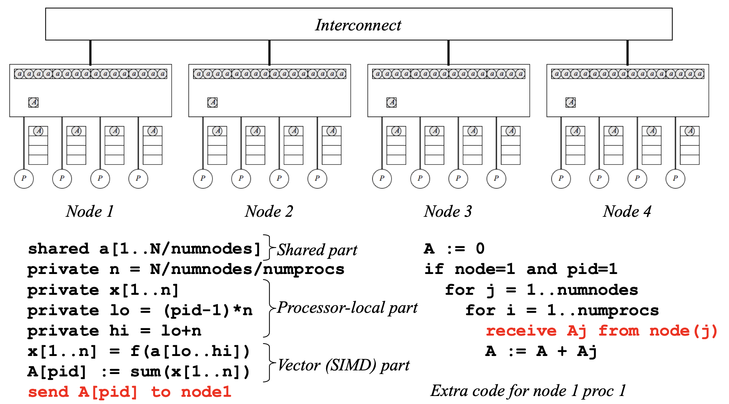
Programming Model 4

Slide 35
Programming Model 5
Bulk synchronous processing (BSP)
A BSP superstep consists of three phases
Compute phase: processes operate on local data (also read access to shared memory on SMP)
Communication phase: all processes cooperate in exchange of data or reduction of global data
Barrier synchronization
A parallel program is composed of supersteps
Ensures that computation and communication phases are completed before the next superstep
Simplicity of data parallel programming, without the restrictions

Slide 36
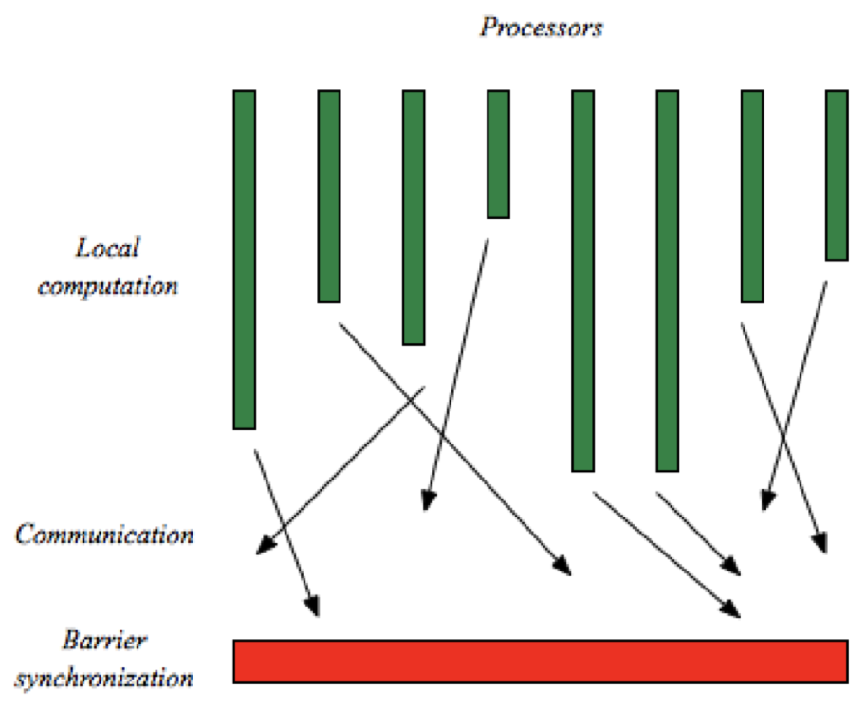
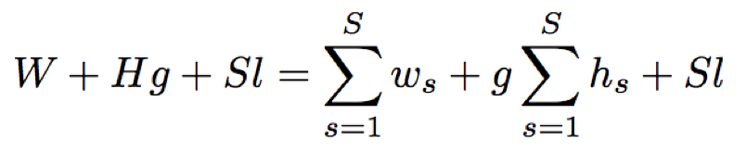
Programming Model 5
The cost of a BSP superstep s is composed of three parts
ws local computation cost of s
hs is the number of messages send in superstep s
l is the barrier cost
The total cost of a program with S supersteps is
where g is the communication cost such that it takes gh time to send h messages

Slide 37
Conclusions
Goal is to distinguish the programming model from underlying hardware
Message passing, data parallel, BSP
Objective is portable correct code
Hybrid
Tuning for the architecture
Objective is portable fast code
Algorithm design challenge (less uniformity)
Implementation challenge at all levels (fine to coarse grain)
Blocking at loop and data level (compiler and programmer)
SIMD vectorization at loop level (compiler and programmer)
Shared memory programming for each node (OpenMP)
Message passing between nodes (MPI)

