Slide 1
FCAPP - Future Programming Paradigms:
Parallel Programming Models
Prof. Raffaele Montella
http://raffaelemontella.it raffaele.montella@uniparthenope.it

Slide 2
Motivation
Compute performance
GPU/many-core computing is promising huge application-performance gains
caveat: sustained performance on “real-world”, scientific applications
observations:
apparent GPU success stories: PetaFlops performance (Gordon-Bell Price nominations)
from aggressive marketing for Intel MIC, NVIDIA GPU… towards more realistic attitudes: factor 2x..3x speedups (GPU vs. multi-core CPU)
Energy efficiency
GPU/many-core computing is promising substantial energy-efficiency gains (a must for exascale)
caveat: sustained efficiency on “real-world” CPU-GPU clusters
Existing resources
there is significant GPU/many-core-based compute-power around in the world
by many, the technology is considered inevitable for the future
caveat: the price to pay for application development ?

Slide 3
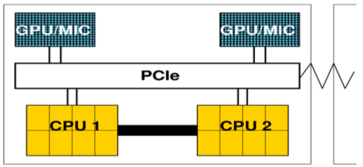
GPU and many core computing: a view from the top
Basic principle (today's GPUs, many-core coprocessors):
accelerator“cards” for standard cluster nodes (PCIe)
many (~50...500) “lightweight” cores (~ 1 GHz)
high thread concurrency, fast (local) memories
System architecture:
currently: x86 “Linux-clusters” with nodes comprising
2 CPUs (2x 8 cores)
max. 2...3 accelerator cards (GPU, MIC) per node
future: smaller CPU component (extreme: “host-less”, many-core chips)
Programming paradigms:
use CPU for program control, communication and maximum single-thread performance
“offload” data-parallel parts of computation to accelerator for maximum throughput performance
requires heterogeneous programming & load-balancing, careful assessment of “speedups”

Slide 4
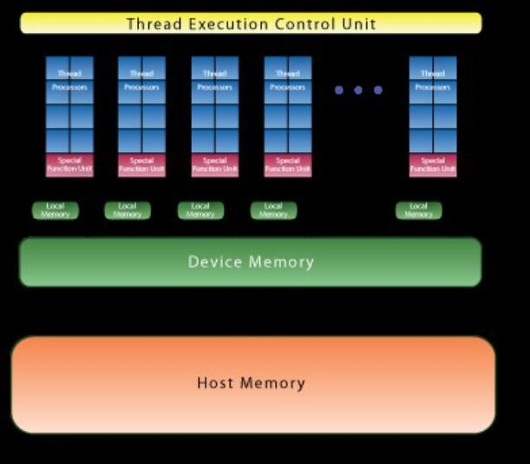
NVIDIA GPU Technology
Hardware overview (NVIDIA Tesla series)
since 2011: “Fermi”: first product with HW support for double-precision and ECC memory
up to 512 cores, 6 GB RAM
high internal memory bandwidth ~180 GB/s
0.5 TFlops (DP, floating point)
data exchange with host via PCIe (~8 GB/s)
enhancements: MPI optimization, intra-node comm. (“GPU direct”, “HyperQ”, ...)
Q1/2013: “Kepler K20”:
GK110 GPU: up to 2880 cores, 6...12 GB RAM
internal memory bandwidth: ~200 GB/s
nominal peak performance: ~ 1.3 TFlops (DP)
plans for a “hostless” chip (for Exascale)

Slide 5
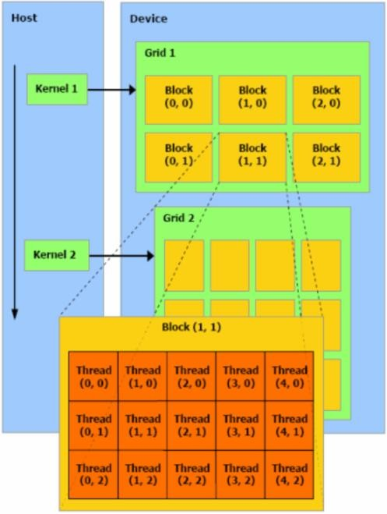
NVIDIA GPU Technology
Software & programming models
paradigm: split program into host code (CPU) and device code (GPU)
GPU hardware architecture requires highly homogeneous program flow (SIMT, no if-branches!)
PCIe bottleneck for communication of data between CPU and GPU: O(n2)...O(n3) computations for communication of n data
overlapping of communication and computation phases
Programming languages
CUDA (NVIDIA), OpenCL (open standard)
host program (C, executes on CPU) and device kernels (C, launch on GPU)
numerical libraries: CUBLAS, CUFFT, higher LA: CULA, MAGMA
tools: debuggers, profiling, system monitoring,…
CUDA-FORTRAN (PGI)
directive-based approaches (PGI, CRAY, CAPS, OpenACC, OpenMP-4)
high-level, comparable to OpenMP
proprietary (CRAY, PGI, HMPP, ...) → OpenACC → OpenMP

Slide 6
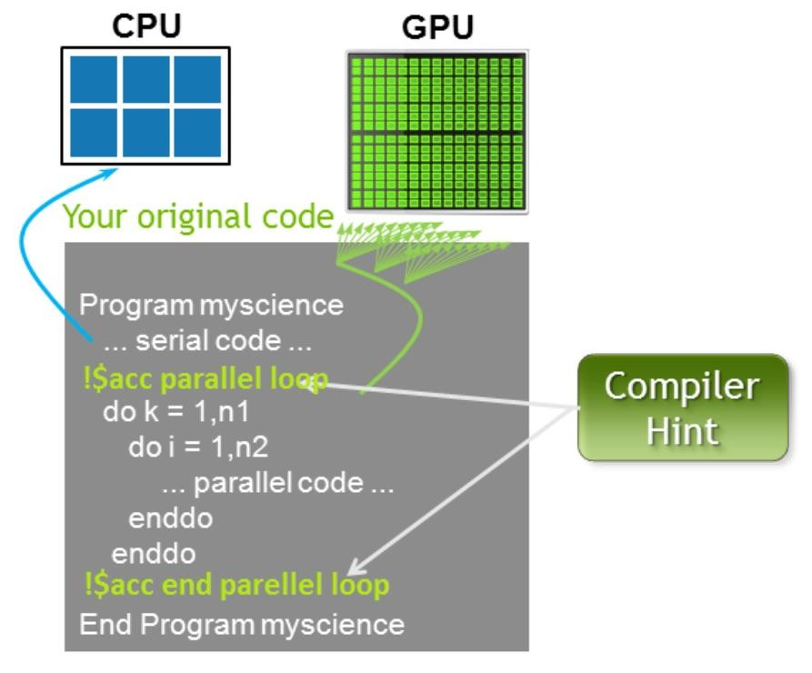
NVIDIA GPU Technology
OpenACC
joint effort of vendors to shortcut/guide OpenMP 4.0 standardization effort
functional (not performance) portability
minimally invasive to existing code
facilitates incremental porting
compilers: PGI, CRAY, CAPS
no free lunch!

Slide 7
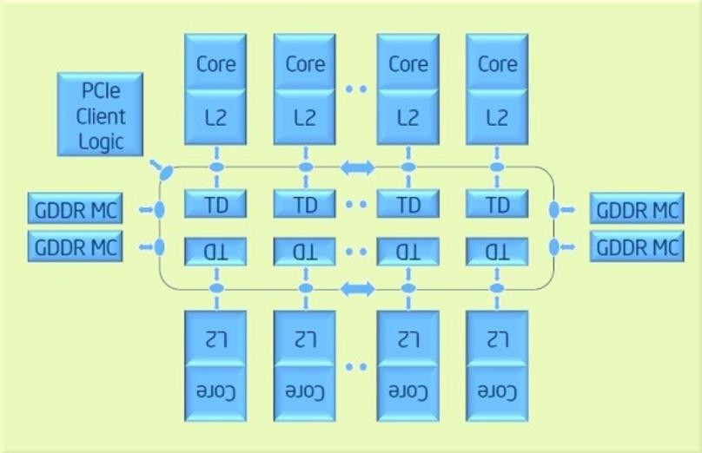
INTEL MIC Technology
INTEL MIC TECHNOLOGY
Hardware overview
since 2011: “Knights Ferry”: software development platform
Q4/2012: “Knights Corner”: first product of the new Intel Xeon Phi processor line (MIC arch)
approx 60 x86 cores (~ 1GHz), 8 GB RAM
internal memory bandwidth: 175 GB/s
nominal peak performance: 1 TFlops (DP)
more than a device: runs Linux OS, IP addressable
data exchange with host via PCIe (~8 GB/s)
towards a true many-core chip (“Knights Landing”, 2014)
Software & programming models
paradigms:
offload model (like GPU: split program into host code (CPU) and device code
(MIC))
cluster models (MPI ranks distributed across CPUs and/or MICs)
tools & libraries: the familiar Intel tool chain: compilers, MPI/OpenMP, MKL, ...
syntax: “data offload” directives + OpenMP (and/or MPI)
OpenCL

Slide 8
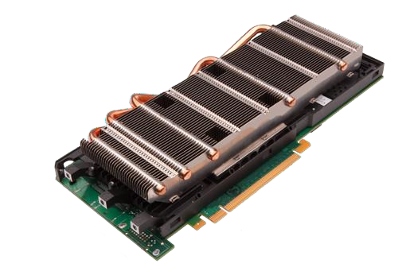
GPU Technology
Graphics Processor Unit
a device equipped with an highly parallel microprocessor (many-core) and a private memory with very high bandwidth
born in response to the growing demand for high definition 3D rendering graphic applications

Slide 9


CPU vs GPU Architecture
CPU vs GPU Architecturs
GPU hardware is specialized for problems which can be classified as intense data-
parallel computations
the same set of operation is executed many times in parallel on different data
designed such that more transistors are devoted to data processing rather than data caching and flow control
CPU
GPU
Control
ALU
ALU
ALU
ALU
Cache
DRAM
DRAM
“The GPU devotes more transistors to Data Processing”
(NVIDIA CUDA Programming Guide)
17

Slide 10







CPU vs GPU Architecture
Compute Unified Device Architecture (CUDA)
a general purpose parallel computing platform and programming model that easy GPU programming, which provides:
a new hierarchical multi-threaded programming paradigm
a new architecture instruction set called PTX (Parallel Thread eXecution)
a small set of syntax extensions to higher level programming languages (C, Fortran) to express thread parallelism within a familiar programming environment
A complete collection of development tools to compile, debug and profile CUDA programs.
CUDA C
OpenCL
CUDA
Fortran
DirectCompute
CUDA Parallel Computing Architecture
NVIDIA GPU + Driver
18

Slide 11
CUDA Programming Model
GPU is seen as an auxiliary coprocessor with its own memory space
data-parallel, computational-intensive portions of a program can be executed on the GPU
each data-parallel computational portion can be isolated into a function, called CUDA kernel, that is executed on the GPU
CUDA kernels are executed by many different threads in parallel each thread can compute different data elements independently
the GPU parallelism is very close to the SPMD (Single Program Multiple Data) paradigm. Single Instruction Multiple Threads (SIMT) according to the Nvidia definition.
GPU threads are extremely light weight
no penalty in case of a context-switch (each thread has its own registers)
the more are the threads in flight, the more the GPU hardware is able to hide memory or computational latencies, i.e better overall performances at executing the kernel function

Slide 12










CUDA Execution Model
serial portions of a program, or those with low level of parallelism, keep running on the CPU (host)
Data-parallel , computational intensive portions of the program are isolated into CUDA kernel function. The CUDA kernel are executed onto the GPU (device)
Host code (CPU)
. . .
Device code (GPU)
Host code (CPU)
. . .
Device code (GPU)
20

Slide 13





More on the CUDA Execution Model
when a CUDA kernel is invoked:
each thread block is assigned to a SM in a round-robin mode
a maximum number of blocks can be assigned to each SM, depending on hardware generation and on how many resorses each block needs to be executed (registers, shared memory, etc) the runtime system maintains a list of blocks that need to execute and assigns new blocks to SMs as they complete the execution of blocks previously assigned to them.
once a block is assigned to a SM, it remains on that SM until the work for all threads in the block is completed
each block execution is independent from the other
(no synchronization is possible among them)
Software
Hardware
...
Griglia
GPU
thread of each block are partitioned into warps of 32 thread each, so to map each thread with a unique consecutive thread index in the block, starting from index 0. the scheduler select for execution a warp from one of the residing blocks in each SM.
A warp execute one common instruction
at a time
each CUDA core take care of one thread in the warp
fully efficiency when all threads agree on their execution path
Blocco di Thread
Streaming Multiprocessor
CUDA
core
Thread

Slide 14
Trasparent Scalability
CUDA runtime system can execute blocks in any order relative to each other.
This flexibility enables to execute the same application code on hardware with different numbers of SM
Device
SM1
Kernel grid
Block 0
SM2
Block 1
Device
SM1 | SM2 | SM3 | SM4
Block 2
Block 3
Block 0
Block 1
Block 4
Block 5
Block 0
Block 1
Block 2
Block 3
Block 6
Block 7
Block 2
Block 3
time
Block 4
Block 5
Block 6
Block 7
Block 4
Block 5
Block 6
Block 7

Slide 15
CUDA syntax extensions to the C language
CUDA defines a small set of extensions to the high level language as the C in order to define the kernels and to configure the kernel execution.
A CUDA kernel function is defined using the global declaration
when a CUDA kernel is called, it will be executed N times in parallel by N different CUDA threads on the device
the number of CUDA threads that execute that kernel is specified using a new syntax, called kernel execution configuration
cudaKernelFunction <<<...>>> (arg_1, arg_2, ..., arg_n)
each thread has a unique thread ID
the built-in variables threadIdx are a 3-component vector
the thread ID is accessible within the CUDA kernel through the built-in threadIdx variable
use .x, .y, .z to access its components

Slide 16
A simple CUDA program
int main(int argc, char *argv[]) { int i;
const int N = 1000;
double u[N], v[N], z[N];
global
void gpuVectAdd( const double *u,
const double *v, double *z)
{ // use GPU thread id as index i = threadIdx.x;
z[i] = u[i] + v[i];
}
initVector | (u, | N, | 1.0);
initVector | (v, | N, | 2.0);
initVector | (z, | N, | 0.0);
printVector (u, N);
printVector (v, N);
// z = u + v
for (i=0; i<N; i++) z[i] = u[i] + v[i];
printVector (z, N); return 0;
}
int main(int argc, char *argv[]) {
...
// z = u + v
{
// run on GPU using
// 1 block of N threads in 1D
gpuVectAdd <<<1,N>>> (u, v, z);
}
...
}

Slide 17
CUDA Threads
threads are organized into blocks of threads
Grid
blocks can be 1D, 2D, 3D sized in threads
blocks can be organized into a 1D, 2D, 3D grid of blocks each block of threads will be executed independently
Block
(0,0)
Block
(1,0)
Block
(2,0)
Block
(0,1)
Block
(1,1)
Block
(2,1)
no assumption is made on the blocks execution order
each block has a unique block ID
the block ID is accessible within the CUDA kernel through the built-in
Thread (0,0) | Thread (1,0) | Thread (2,0) | Thread (3,0) | Thread (4,0)
Thread (0,1) | Thread (1,1) | Thread (2,1) | Thread (3,1) | Thread (4,1)
Thread (0,2) | Thread (1,2) | Thread (2,2) | Thread (3,2) | Thread (4,2)
Thread (0,3) | Thread (1,3) | Thread (2,3) | Thread (3,3) | Thread (4,3)
blockIdx variable
The built-in variable blockIdx is a 3-component vector
use .x, .y, .z to access its components
blockIdx:
block coordinates inside the grid
blockDim:
block dimensions in thread units
gridDim:
grid dimensions in block units

Slide 18
Simple 1D CUDA vector add
global
void gpuVectAdd( int N, const double *u, const double *v, double *z)
{
// use GPU thread id as index
index = blockIdx.x * blockDim.x + threadIdx.x;
// check out of border access if ( index < N ) {
z[index] = u[index] + v[index];
}
}
int main(int argc, char *argv[]) {
...
// use 1D block threads dim3 blockSize = 512;
// use 1D grid blocks
dim3 gridSize = (N + blockSize-1) / blockSize.x;
gpuVectAdd <<< gridSize,blockSize >>> (N, u, v, z);
...
}
26

Slide 19
Composing 2D CUDA Thread Indexing
threadIdx:
thread coordinates inside a block
blockIdx:
block coordinates inside the grid
blockDim:
block dimensions in thread units
gridDim:
grid dimensions in block units
(0,0)
(1,0)
(2,0)
j
(0,1)
(1,1)
(2,1)
i
(0,0) | (1,0) | (2,0) | (3,0) | (4,0)
(0,1) | (1,1) | (2,1) | (3,1) | (4,1)
 |  |  |  |  | (2,2)
(0,2) | (1,2) | (2,2) | (3,2) | (4,2)
*(index) (0,3) (1,3) (2,3) (3,3) (4,3)
(0,2)
(1,2)
(0,3)
(1,3)
(2,3)
gridDim.x * blockDim.x
i = blockIdx.x * blockDim.x + threadIdx.x;
j = blockIdx.y * blockDim.y + threadIdx.y;
index = j * gridDim.x * blockDim.x + i;

Slide 20
2D array element-wise add
(matrix add)
As an example, the following code adds two matrices A and B of size NxN and stores the result into
the matrix C
global void matrixAdd(int N, const float *A, const float *B, float *C) { int i = blockIdx * blockDim.x + threadIdx.x;
int j = blockIdx * blockDim.y + threadIdx.y;
// matrix elements are organized in row major order in memory int index = i * N + j;
C[index] = A[index] + B[index];
}
int main(int argc, char *argv[]) {
...
// add NxN matrices on GPU using 1 block of NxN threads
matrixAdd <<< 1, N >>> (N, A, B, C);
...
}

Slide 21
Memory allocation on GPU device
CUDA API provides functions to manage data allocation on the device global memory:
cudaMalloc(void** bufferPtr, size_t n):
It allocates a buffer into the device global memory
The first parameter is the address of a generic pointer variable that must point to the allocated buffer. it must be cast to (void**)!
The second parameter is the size in bytes of the buffer to be allocated
cudaFree(void* bufferPtr)
It frees the storage space of the object

Slide 22
Memory Initialization on GPU device
cudaMemset(void* devPtr, int value, size_t count):
It fills the first count bytes of the memory area pointed to by devPtr with the constant byte of the int value converted to unsigned char. It’s like the standard library C memset() function
devPtr - Pointer to device memory
value - Value to set for each byte of specified memory count - Size in bytes to set
To initialize an array of double (float, int, …) to a specific value you need to execute a CUDA kernel.

Slide 23
Memory copy between CPU and GPU
cudaMemcpy(void *dst, void *src, size_t size, direction)
dst: destination buffer pointer
src: source buffer pointer
size: number of bytes to copy
direction: macro name which defines the direction of data copy from CPU to GPU: cudaMemcpyHostToDevice (H2D), from GPU to CPU: cudaMemcpyDeviceToHost (D2H), on the same GPU: cudaMemcpyDeviceToDevice
the copy begins only after all previous kernel have finished
the copy is blocking: it prevents CPU control to proceed further in the program until last byte has been transferred
returns only after copy is complete

Slide 24
Three steps for a CUDA porting
identify data-parallel, computational intensive portions
isolate them into functions (CUDA kernels candidates)
identify involved data to be moved between CPU and GPU
translate identified CUDA kernel candidates into real CUDA kernels
choose the appropriate thread index map to access data
change code so that each thead acts on its own data
modify code in order to manage memory and kernel calls
allocate memory on the device
transfer needed data from host to device memory
insert calls to CUDA kernel with execution configuration syntax
transfer resulting data from device to host memory

Slide 25
Vector Sum: 1) identify data-parallel, computational intensive portions
int main(int argc, char *argv[]) { int i;
 | program vectoradd integer :: i
integer, parameter :: N=1000 real(kind(0.0d0)), dimension(N):: u, v, z call initVector (u, N, 1.0) call initVector (v, N, 2.0) call initVector (z, N, 0.0) call printVector (u, N) call printVector (v, N) ! z = u + v do i = 1,N z(i) = u(i) + v(i) end do call printVector (z, N) end program
const int N = 1000;
double u[N], v[N], z[N];
initVector | (u, | N, | 1.0);
initVector | (v, | N, | 2.0);
initVector | (z, | N, | 0.0);
printVector (u, N);
printVector (v, N);
// z = u + v
for (i=0; i<N; i++)
z[i] = u[i] + v[i];
printVector (z, N);
return 0;
}

Slide 26
Vector Sum: 2) translate the identified data-parallel portions into CUDA kernel
each thread execute the same kernel, but act on different data:
turn the loop into a CUDA kernel function
map each CUDA thread onto a unique index to access data
let each thread retrieve, compute and store its own data using the unique address
prevent out of border access to data if data is not a multiple of thread block size
const int N = 1000;
double u[N], v[N], z[N];
// z = u + v
for (i=0; i<N; i++) z[i] = u[i] + v[i];
global void gpuVectAdd (int N, const double *u, const double *v, double *z)
{
// index is a unique identifier for each GPU thread int index = blockIdx * blockDim.x + threadIdx.x ; if (index < N)
z[index] = u[index] + v[index];
}

Slide 27
Vector Sum: 2) translate the identified data-parallel portions into CUDA kernel
(0)
(1)
(0)
(1)
(2)
(3)
(4)
(3)
(2)
^(index)
global void gpuVectAdd (int N, const double *u, const double *v, double *z)
// index is a unique identifier of each GPU thread
{
int index = blockIdx.x * blockDim.x + threadIdx.x;
if (index < N)
z[index] = u[index] + v[index];
The global qualifier declares a CUDA kernel
}
CUDA kernels are special C functions:
can be called from host only
must be called using the execution configuration
syntax
the return type must be void
they are asynchronous: control is returned
immediately to the host code
an explicit synchronization is needed in order to be sure that a CUDA kernel has completed the execution

Slide 28
Vector Sum: 3) manage memory transfers and kernel calls
Insert calls to CUDA kernels using the execution configuration syntax:
kernelCUDA<<<numBlocks,numThreads>>>(...)
specifying the thread/block hierarchy you want to apply:
numBlocks: specify grid size in terms of thread blocks along each dimension
numThreads: specify the block size in terms of threads along each dimension
dim3 numThreads(32);
dim3 numBlocks( ( N + numThreads – 1 ) / numThreads.x );
gpuVectAdd<<<numBlocks, numThreads>>>( N, u_dev, v_dev, z_dev );
type(dim3) :: numBlocks, numThreads numThreads = dim3( 32, 1, 1 )
numBlocks = dim3( (N + numThreads.x - 1) / numThreads.x, 1, 1 ) call
gpuVectAdd<<<numBlocks,numThreads>>>( N, u_dev, v_dev, z_dev )

Slide 29

Heterogeneous High Performance Programming framework
“As the two major programming frameworks for GPU computing, OpenCL and CUDA have been competing for mindshare in the developer community for the past few years. Until recently, CUDA has attracted most of the attention from developers, especially in the high performance computing realm. But OpenCL software has now matured to the point where HPC practitioners are taking a second look.
Both OpenCL and CUDA provide a general-purpose model for data parallelism as well as low-level access to hardware, but only OpenCL provides an open, industry-standard framework. As such, it has garnered support from nearly all processor manufacturers including AMD, Intel, and NVIDIA, as well as others that serve the mobile and embedded computing markets. As a result, applications developed in OpenCL are now portable across a variety of GPUs and CPUs.”

Slide 30
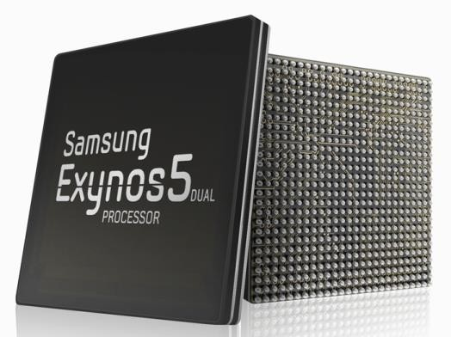
Heterogeneous High Performance Programming framework
A modern computing platform includes:
One or more CPUs
One of more GPUs
DSP processors
Accelerators
… other?
E.g. Samsung® Exynos 5:
Dual core ARM A15 1.7GHz, Mali T604 GPU
OpenCL lets Programmers write a single portable program that uses ALL resources in the heterogeneous platform

Slide 31
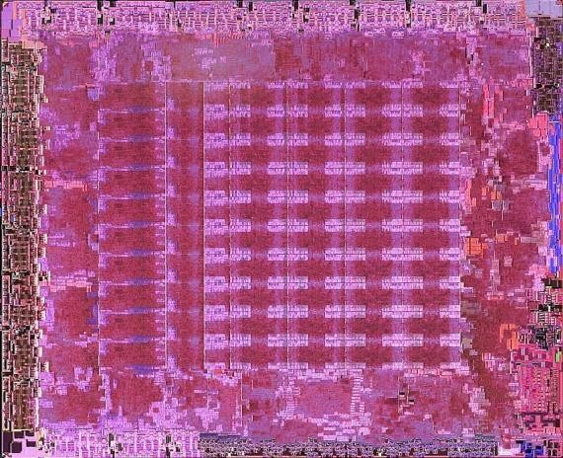
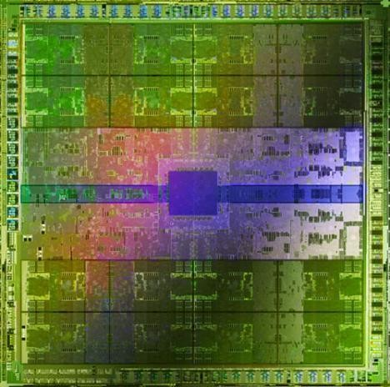
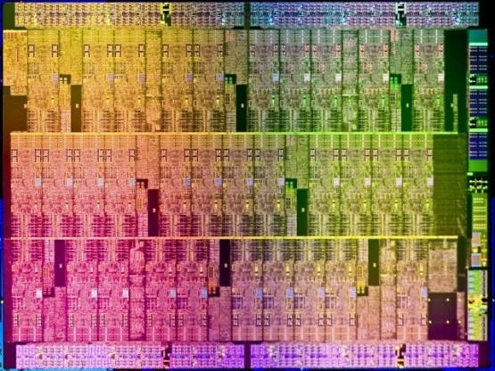
Microprocessor trends
Individual processors have many (possibly heterogeneous) cores.
ATI™ RV770
Intel® Xeon Phi™
coprocessor
NVIDIA® Tesla® C2090
The Heterogeneous many-core challenge:
How are we to build a software ecosystem for the
Heterogeneous many core platform?

Slide 32
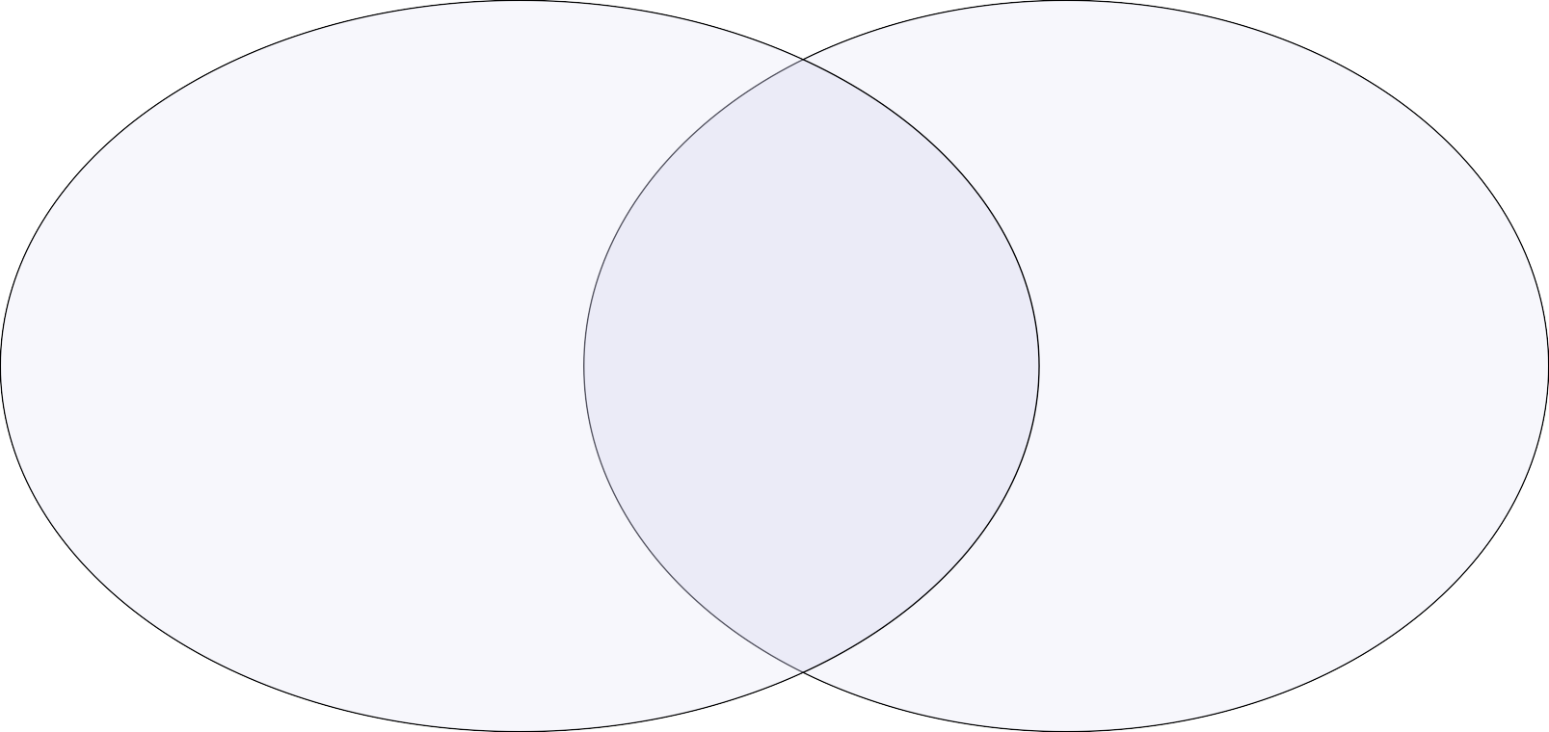

Industry Standards for Programming Heterogeneous Platforms
GPUs
Increasingly general purpose data-
parallel computing
CPUs
Multiple cores driving performance
increases
Emerging Intersection
Graphics APIs and Shading Languages
Multi-processor
programming – e.g.
OpenMP
Heterogeneous Computing
OpenCL – Open Computing Language
Open, royalty-free standard for portable, parallel programming of heterogeneous parallel computing CPUs, GPUs, and other processors

Slide 33




























OpenCL Working Group within Khronos
Diverse industry participation
Processor vendors, system OEMs, middleware vendors, application developers.
OpenCL became an important standard upon release by virtue of the market coverage of the companies behind it.

Slide 34
OpenCL Platform Model
One Host and one or more OpenCL Devices
Each OpenCL Device is composed of one or more Compute Units
Each Compute Unit is divided into one or more Processing Elements
Memory divided into host memory and device memory
……
…
…
…
…
…
Processing
Element
…
…
…
…
…
Host
……
…
Compute Unit
OpenCL Device

Slide 35
OpenCL Platform Example
CPUS:
Treated as one OpenCL device
One CU per core
1 PE per CU, or if PEs mapped to SIMD lanes, n PEs per CU, where n matches the SIMD width
Remember:
the CPU will also have to be its own host!
GPUS:
Each GPU is a separate OpenCL device
One CU per Streaming Multiprocessor
Can use CPU and all GPU devices concurrently through OpenCL
CU = Compute Unit; PE = Processing Element

Slide 36
Example: vector addition
The “hello world” program of data parallel programming is a program to add two vectors
C[i] = A[i] + B[i] for i=0 to N-1
For the OpenCL solution, there are two parts
Kernel code
Host code

Slide 37
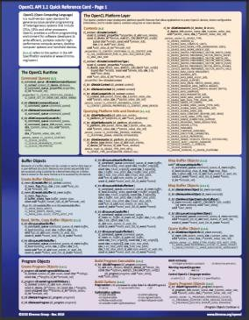
Vector Addition – Host
The host program is the code that runs on the host to:
Setup the environment for the OpenCL program
Create and manage kernels
5 simple steps in a basic host program:
Define the platform … platform = devices+context+queues
Create and Build the program (dynamic library for kernels)
Setup memory objects
Define the kernel (attach arguments to kernel functions)
Submit commands … transfer memory objects and execute kernels
Please, refer to the reference card. This will help you get used to the reference
card and how to pull information from the card and express it in code.

Slide 38
Vector Addition – Host Program
It’s complicated, but most of this is “boilerplate” and not as bad as it looks.
Build the
// create the OpenCL context on a GPU device
cl_context context = clCreateContextFromType(0, CL_DEVICE_TYPE_GPU, NULL, NULL, NULL);
// get the list of GPU devices associated with context clGetContextInfo(context, CL_CONTEXT_DEVICES, 0, NULL, &cb);
cl_device_id[] devices = malloc(cb);
clGetContextInfo(context,CL_CONTEXT_DEVICES,cb,devices,NULL);
// create a command-queue
cmd_queue = clCreateCommandQueue(context,devices[0],0,NULL);
// build the program
err = clBuildProgram(program, 0, NULL,NULL,NULL,NULL);
program
// create the kernel
kernel = clCreateKernel(program, “vec_add”, NULL);
// set the args values
err = clSetKernelArg(kernel, 0, (void *) &memobjs[0],
sizeof(cl_mem));
err |= clSetKernelArg(kernel, 1, (void *) &memobjs[1], sizeof(cl_mem));
err |= clSetKernelArg(kernel, 2, (void *) &memobjs[2],
sizeof(cl_mem));
// set work-item dimensions global_work_size[0] = n;
Define platform and queues
Create and setup kernel
// allocate the buffer memory objects
memobjs[0] = clCreateBuffer(context, CL_MEM_READ_ONLY | CL_MEM_COPY_HOST_PTR, sizeof(cl_float)*n, srcA, NULL);
memobjs[1] = clCreateBuffer(context, CL_MEM_READ_ONLY |
CL_MEM_COPY_HOST_PTR, sizeof(cl_float)*n, srcb, NULL);
Define memory objects
// execute kernel
err = clEnqueueNDRangeKernel(cmd_queue, kernel, 1, NULL, global_work_size, NULL,0,NULL,NULL);
Execute the kernel
memobjs[2] = clCreateBuffer(context, CL_MEM_WRITE_ONLY,
sizeof(cl_float)*n, NULL, NULL);
// create the program
program = clCreateProgramWithSource(context, 1,
&program_source, NULL, NULL);
// read output array
err = clEnqueueReadBuffer(cmd_queue, memobjs[2], CL_TRUE, 0,
n*sizeof(cl_float), dst,
0, NULL, NULL);
Create the program
Read results on the host

Slide 39
OpenCL C for Compute Kernels
Derived from ISO C99
A few restrictions: no recursion, function pointers, functions in C99 standard headers …
Preprocessing directives defined by C99 are supported (#include etc.)
Built-in data types
Scalar and vector data types, pointers
Data-type conversion functions:
convert_type<_sat><_roundingmode>
Image types:
image2d_t, image3d_t and sampler_t

Slide 40
OpenCL C for Compute Kernels
Built-in functions — mandatory
Work-Item functions, math.h, read and write image
Relational, geometric functions, synchronization functions
printf (v1.2 only, so not currently for NVIDIA GPUs)
Built-in functions — optional (called “extensions”)
Double precision, atomics to global and local memory
Selection of rounding mode, writes to image3d_t surface

Slide 41
OpenCL C Language Highlights
Function qualifiers
__kernel qualifier declares a function as a kernel
I.e. makes it visible to host code so it can be enqueued
Kernels can call other kernel-side functions
Address space qualifiers
__global, __local, __constant, __private
Pointer kernel arguments must be declared with an address space qualifier
Work-item functions
get_work_dim(), get_global_id(), get_local_id(), get_group_id()
Synchronization functions
Barriers - all work-items within a work-group must execute the barrier function before any work-item can continue
Memory fences - provides ordering between memory operations

Slide 42

Host programs can be “ugly”
OpenCL’s goal is extreme portability, so it exposes everything (i.e. it is quite verbose!).
But most of the host code is the same from one application to the next – the re-use makes the verbosity a non-issue.
You can package common API combinations into functions or even C++ or Python classes to make the reuse more convenient.

Slide 43
PORTING CUDA TO OPENCL
If you have CUDA code, you’ve already done the hard work!
I.e. working out how to split up the problem to run effectively on a many-core device
Switching between CUDA and OpenCL is mainly changing the host code syntax
Apart from indexing and naming conventions in the kernel code (simple to change!)

Slide 44
Allocating and copying memory
 | CUDA C | OpenCL C
Allocate | float* d_x; cudaMalloc(&d_x, sizeof(float)*size); | cl_mem d_x = clCreateBuffer(context, CL_MEM_READ_WRITE, sizeof(float)*size, NULL, NULL);
Host to Device | cudaMemcpy(d_x, h_x, sizeof(float)*size, cudaMemcpyHostToDevice); | clEnqueueWriteBuffer(queue, d_x, CL_TRUE, 0, sizeof(float)*size, h_x, 0, NULL, NULL);
Device to Host | cudaMemcpy(h_x, d_x, sizeof(float)*size, cudaMemcpyDeviceToHost); | clEnqueueReadBuffer(queue, d_x, CL_TRUE, 0, sizeof(float)*size, h_x, 0, NULL, NULL);

Slide 45
Allocating and copying memory
 | CUDA C | OpenCL C++
Allocate | float* d_x; cudaMalloc(&d_x, sizeof(float)*size); | cl::Buffer d_x(begin(h_x), end(h_x), true);
Host to Device | cudaMemcpy(d_x, h_x, sizeof(float)*size, cudaMemcpyHostToDevice); | cl::copy(begin(h_x), end(h_x), d_x);
Device to Host | cudaMemcpy(h_x, d_x, sizeof(float)*size, cudaMemcpyDeviceToHost); | cl::copy(d_x, begin(h_x), end(h_x));

Slide 46
Declaring dynamic local/shared memory
CUDA C
Define an array in the kernel
source as extern
shared int array[];
When executing the kernel, specify the third parameter as size in bytes of shared memory
func<<<num_blocks, num_threads_per_block, shared_mem_size>>>(args);
OpenCL C++
Have the kernel accept a local
array as an argument
kernel void func(
local int *array){}
Define a local memory kernel
kernel argument of the right size
cl::LocalSpaceArg localmem = cl::Local(shared_mem_size);
Pass the argument to the kernel invocation
func(EnqueueArgs(…),localmem);

Slide 47
Declaring dynamic local/shared memory
CUDA C
Define an array in the kernel
source as extern
shared int array[];
When executing the kernel, specify the third parameter as size in bytes of shared memory
func<<<num_blocks, num_threads_per_block, shared_mem_size>>>(args);
OpenCL C
Have the kernel accept a local
array as an argument
kernel void func(
local int *array) {}
Specify the size by setting the
kernel argument
clSetKernelArg(kernel, 0, sizeof(int)*num_elements, NULL);

Slide 48
Dividing up the work
Problem size
CUDA
OpenCL
Thread
Work-item
Thread block
Work-group
To enqueue the kernel
CUDA – specify the number of thread blocks and threads
per block
OpenCL – specify the problem size and (optionally)
number of work-items per work-group

Slide 49
Enqueue a kernel (C)
CUDA C
dim3 threads_per_block(30,20);
OpenCL C
const size_t global[2] =
{300, 200};
const size_t local[2] =
{30, 20};
clEnqueueNDRangeKernel( queue, &kernel, 2, 0, &global, &local,
0, NULL, NULL);
dim3 num_blocks(10,10);
kernel<<<num_blocks, threads_per_block>>>(…);

Slide 50
Enqueue a kernel (C++)
CUDA C
dim3 threads_per_block(30,20);
OpenCL C++
const cl::NDRange
global(300, 200);
const cl::NDRange
local(30, 20);
kernel(
EnqueueArgs(global, local),
…);
dim3 num_blocks(10,10);
kernel<<<num_blocks, threads_per_block>>>(…);

Slide 51
Indexing work
CUDA C
OpenCL C++
get_num_groups()get_group_id() get_local_size() get_global_size() get_local_id() get_global_id()
gridDim
blockIdx
blockDim
gridDim * blockDim
threadIdx
blockIdx * blockdim + threadIdx

Slide 52
Differences in kernels
Where do you find the kernel?
OpenCL: either a string (const char *), or read from
a file
CUDA: a function in the host code
Denoting a kernel
OpenCL: kernel
CUDA : global
When are my kernels compiled?
OpenCL: at runtime
CUDA: with compilation of host code

Slide 53
Host Code
By default, CUDA initializes the GPU automatically
If you needed anything more complicated (multi-
device etc.) you must do so manually
OpenCL always requires explicit device initialization
It runs not just on NVIDIA® GPUs and so you must tell it which device(s) to use

Slide 54
Thread Synchronization
CUDA C
OpenCL C++
__syncthreads() | barrier()
threadfenceblock() | mem_fence( CLK_GLOBAL_MEM_FENCE | CLK_LOCAL_MEM_FENCE)
No equivalent | read_mem_fence()
No equivalent | write_mem_fence()
threadfence() | Finish one kernel and start another

Slide 55
Translation from CUDA to OpenCL
CUDA | OpenCL
GPU | Device (CPU, GPU etc)
Multiprocessor | Compute Unit, or CU
Scalar or CUDA core | Processing Element, or PE
Global or Device Memory | Global Memory
Shared Memory (per block) | Local Memory (per workgroup)
Local Memory (registers) | Private Memory
Thread Block | Work-group
Thread | Work-item
Warp | No equivalent term (yet)
Grid | NDRange

Slide 56
Exercise
Goal:
To inspect and verify that you can run an OpenCL kernel on Eurora machines
Procedure:
Take the provided C vadd.c and vadd.cl source programs from VADD
directory
Compile and link vadd.c
Run on NVIDIA or Intel platform.
Expected output:
A message verifying that the vector addition completed successfully
Some useful info about OpenCL environment (Intel and NVIDIA)

Slide 57
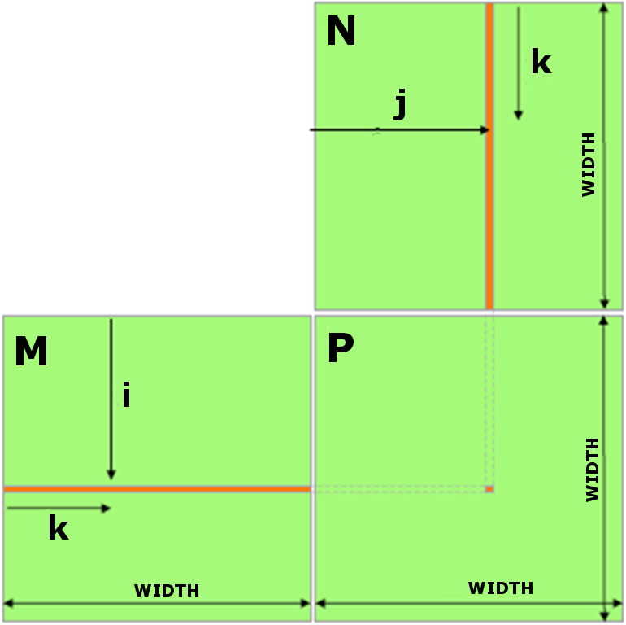
Matrix-Matrix product: HOST
void MatrixMulOnHost (float* M, float* N, float* P, int Width)
{
// loop on rows
for (int row = 0; row < Width; ++row) {
// loop on columns
for (int col = 0; col < Width; ++col) {
P = M * N
// accumulate element-wise products float pval = 0;
for (int k = 0; k < Width; ++k) { float a = M[row * Width + k]; float b = N[k * Width + col]; pval += a * b;
}
// store final results
P[row * Width + col] = pval;
}
}
}

Slide 58


Matrix-Matrix product: launch grid
(0,0)
MatrixWidth
(1,0)
(2,0)
j
(0,1)
(1,1)
(2,1)
Matrix
x
(0,2)
i
(1,2)
(2,2)
* inde
(0,3)
(1,3)
(2,3)
gridDim.x * blockDim.x
i = blockIdx.x * blockDim.x + threadIdx.x;
j = blockIdx.y * blockDim.y + threadIdx.y;
index = j * MatrixWidth + i;

Slide 59
Matrix-Matrix product: CUDA Kernel
global void MMKernel (float* dM, float *dN, float *dP,
int width) {
// row,col from built-in thread indeces(2D block of threads) int col = blockIdx.x * blockDim.x + threadIdx.x;
int row = blockIdx.y * blockDim.y + threadIdx.y;
// check if current CUDA thread is inside matrix borders if (row < width && col < width) {
// accumulate element-wise products
// NB: pval stores the dP element computed by the thread
float pval = 0;
for (int k=0; k < width; k++)
pval += dM[row * width + k] * dN[k * width + col];
// store final results (each thread writes one element)
dP[row * width + col] = Pvalue;
}
}

Slide 60
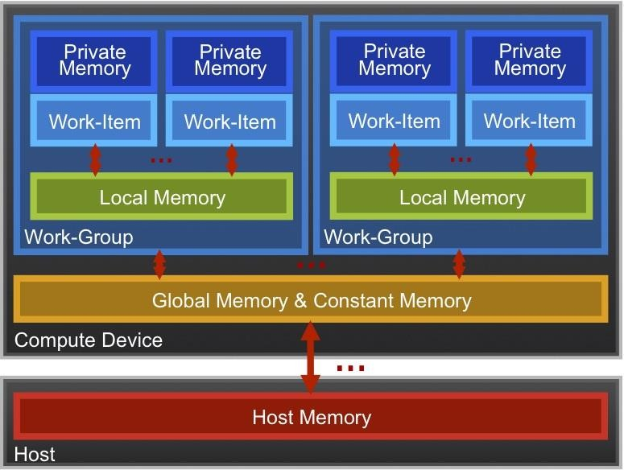
OpenCL Memory model
Private Memory
Per work-item
Local Memory
Shared within a
work-group
Global/Constant Memory
Visible to all
work-groups
Host memory
On the CPU
Memory management is explicit:
You are responsible for moving data from host → global → local and back

Slide 61
OpenCL Memory model
Private Memory
Fastest & smallest: O(10) words/WI
Local Memory
Shared by all WI’s in a work-group
But not shared between work-groups!
O(1-10) Kbytes per work-group
Global/Constant Memory
O(1-10) Gbytes of Global memory
O(10-100) Kbytes of Constant
memory
Host memory
On the CPU - GBytes
Memory management is explicit:
O(1-10) Gbytes/s bandwidth to discrete GPUs for
Host <-> Global transfers

Slide 62
OpenCL mapping
In OpenCL:
get_global_size(0)
Index Space
get_local_size(0)
Work Group (0, 0)
Work Group (1, 0)
Work Group (2, 0)
Work Group (0,0)
get_ global_ size(1)
Work Item (0, 0)
Work Item (1, 0)
Work Item (2, 0)
Work Item (3, 0)
Work Item (4, 0)
Work Group (0, 1)
Work Group (1, 1)
Work Group (2, 1)
get_ local_ size(1)
Work Item (0, 1)
Work Item (1, 1)
Work Item (2, 1)
Work Item (3, 1)
Work Item (4, 1)
Work Item (0, 2)
Work Item (1, 2)
Work Item (2, 2)
Work Item (3, 2)
Work Item (4, 2)

Slide 63
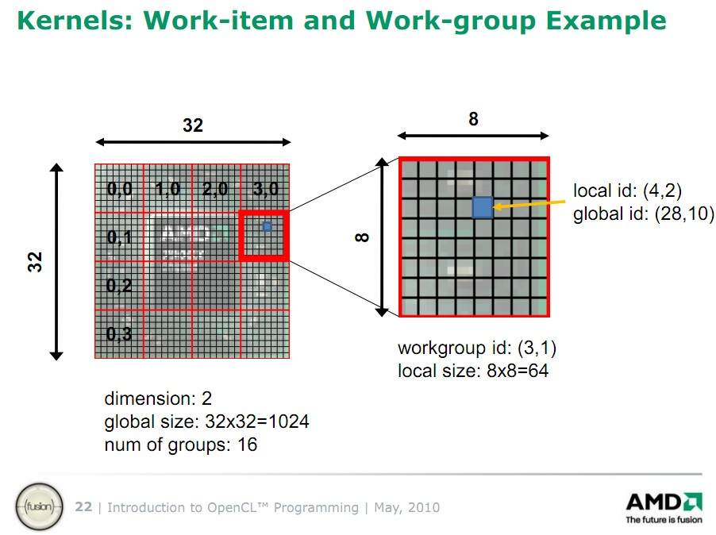
OpenCL mapping (again)
You should use OpenCL mapping functions for element values recovery(this may be a common source of bugs when write a kernel)

Slide 64
Matrix multiplication: OpenCL kernel
kernel void mat_mul(
const int Mdim, const int Ndim, const int Pdim,
global float *A, global float *B, global float *C)
{
int i, j, k;
for (i = 0; i < Ndim; i++) { for (j = 0; j < Mdim; j++) {
for (k = 0; k < Pdim; k++) {
// C(i, j) = sum(over k) A(i,k) * B(k,j) C[i*Ndim+j] += A[i*Ndim+k] * B[k*Pdim+j];
}
}
}
Remove outer loops and set work-item coordinates

Slide 65
Matrix multiplication: OpenCL kernel
kernel void mat_mul( const int Mdim, const int Ndim,
const int Pdim, global float *A, global float *B, global float *C)
{
int i, j, k;
j = get_global_id(0); i = get_global_id(1);
// C(i, j) = sum(over k) A(i,k) * B(k,j)
for (k = 0; k < Pdim; k++) {
C[i*Ndim+j] += A[i*Ndim+k] * B[k*Pdim+j];
}
}

Slide 66
Matrix multiplication: OpenCL kernel improved
Matrix multiplication: OpenCL kernel improved
Rearrange and use a local scalar for intermediate C element values (a common optimization in Matrix
Multiplication functions)
{
int k;
int j = get_global_id(0); int i = get_global_id(1); float tmp = 0.0f;
for (k = 0; k < Pdim; k++)
tmp += A[i*Ndim+k]*B[k*Pdim+j];
}
C[i*Ndim+j] += tmp;
}
kernel void mat_mul( const int Mdim, const int Ndim, const int Pdim, global float *A, global float *B, global float *C)

Slide 67
Matrix multiplication: OpenCL kernel improved
Matrix multiplication: OpenCL kernel improved
Rearrange and use a local scalar for intermediate C element values (a common optimization in Matrix
Multiplication functions)
{
int k;
int j = get_global_id(0); int i = get_global_id(1); float tmp = 0.0f;
for (k = 0; k < Pdim; k++)
tmp += A[i*Ndim+k]*B[k*Pdim+j];
}
C[i*Ndim+j] += tmp;
}
Matrix Size | Platfor m | Kernel time (sec.) | GFLOP/ s
2048 | NVIDIA K20s | 0.24 | 71
2048 | Intel MIC | 0.47 | 37

Slide 68
Matrix-Matrix product: selecting optimum thread block size
Which is the best thread block size/work-group size to select (i.e. TILE_WIDTH)?
On Fermi architectures: each SM can handle up to 1536 total threads
TILE_WIDTH = 8
8x8 = 64 threads >>> 1536/64 = 24 blocks needed to fully load a SM
… yet there is a limit of maximum 8 resident blocks per SM for cc 2.x
so we end up with just 64x8 = 512 threads per SM on a maximum of 1536 (only 33% occupancy)
TILE_WIDTH = 16
16x16 = 256 threads >>> 1536/256 = 6 blocks to fully load a SM 6x256 = 1536 threads per SM … reaching full occupancy per SM!
TILE_WIDTH = 32
32x32 = 1024 threads >>> 1536/1024 = 1.5 = 1 block fully load a SM 1024 threads per SM … reaching 66% occupancy per SM!
TILE_WIDTH = 16

Slide 69
Matrix-Matrix product: selecting optimum thread block size
Which is the best thread block size/work-group size to select (i.e. TILE_WIDTH)?
On Kepler architectures: each SM can handle up to 2048 total threads
TILE_WIDTH = 8
8x8 = 64 threads >>> 2048/64 = 32 blocks needed to fully load a SM
… yet there is a limit of maximum 16 resident blocks per SM for cc 3.x
so we end up with just 64x16 = 1024 threads per SM on a maximum of 2048 (only 50% occupancy)
TILE_WIDTH = 16
16x16 = 256 threads >>> 2048/256 = 8 blocks to fully load a SM 8x256 = 2048 threads per SM … reaching full occupancy per SM!
TILE_WIDTH = 32
32x32 = 1024 threads >>> 2048/1024 = 2 blocks fully load a SM 2x1024 = 2048 threads per SM … reaching full occupancy per SM!
TILE_WIDTH = 16 or 32

Slide 70
Matrix-Matrix product: selecting optimum thread block size
Which is the best thread block size/work-group size to select (i.e. TILE_WIDTH)?
On Kepler architectures: each SM can handle up to 2048 total threads
TILE_WIDTH = 8
8x8 = 64 threads >>> 2048/64 = 32 blocks needed to fully load a SM
… yet there is a limit of maximum 16 resident blocks per SM for cc 3.x
so we end up with just 64x16 = 1024 threads per SM on a maximum of 2048 (only 50% occupancy)
TILE_WIDTH = 16
16x16 = 256 threads >>> 2048/256 = 8 blocks to fully load a SM 8x256 = 2048 threads per SM … reaching full occupancy per SM!
TILE_WIDTH = 32
32x32 = 1024 threads >>> 2048/1024 = 2 blocks fully load a SM 2x1024 = 2048 threads per SM … reaching full occupancy per SM!
TILE_WIDTH | Kernel time (sec.) | GFLOP/s (NVIDIA K20)
8 | 0.33 | 52
16 | 0.20 | 82
32 | 0.16 | 104

Slide 71
Matrix-Matrix product: check inside matrix borders
global void MMKernel (float* dM, float *dN, float *dP,
int width) {
// row,col from built-in thread indeces(2D block of threads) int col = blockIdx.x * blockDim.x + threadIdx.x;
int row = blockIdx.y * blockDim.y + threadIdx.y;
// check if current CUDA thread is inside matrix borders if (row < width && col < width) {
...
...
}
kernel chek (Yes/No) | Matrices Size | Kernel Error | GFLOP/s (Intel MIC)
Yes | 2047 | / | 20
Yes | 2048 | / | 35
No | 2047 | Failed (different results from reference) | 21
No | 2048 | / | 37

Slide 72
Local Memory
Tens of KBytes per Compute Unit
As multiple Work-Groups will be running on each CU, this means only a fraction of the total Local Memory size is available to each Work-Group
Assume O(1-10) KBytes of Local Memory per Work-Group
Your kernels are responsible for transferring data between Local and Global/Constant memories … there are optimized library functions to help
Use Local Memory to hold data that can be reused by all the work-items in a work-group
Access patterns to Local Memory affect performance in a similar way to accessing Global Memory
Have to think about things like coalescence & bank conflicts

Slide 73
Local Memory
Local Memory doesn’t always help…
CPUs, MICs don’t have special hardware for it
This can mean excessive use of Local Memory might slow down kernels on
CPUs
GPUs now have effective on-chip caches which can provide much of the
benefit of Local Memory but without programmer intervention
So, your mileage may vary!

Slide 74
Using Local/Shared Memory for Thread Cooperation
Using Local/Shared Memory for Thread Cooperation
Threads belonging to the same block can cooperate
togheter using the shared memory to share data
if a thread needs some data which has been already retrived by another thread in the same block, this data can be shared using the shared memory
Typical Shared Memory usage:
(Device) Grid
Block (0, 0)
Block (1, 0)
Shared Memory
Shared Memory
Registers
Registers
Threads
Threads
declare a buffer residing on shared memory (this buffer is per block)
load data into shared memory buffer synchronize threads so to make sure all needed data is present in the buffer
perform operation on data
synchronize threads so all operations have been performed
write back results to global memory
Global Memory
Constant Memory
Texture Memory

Slide 75






Matrix-matrix using Shared Memory
Cij=0.
B
Cycle on block
kb=0, N/NB
it | = | threadIdx.y
jt | = | threadIdx.x
ib | = | blockIdx.y
jb | = | blockIdx.x
N
As(it,jt) = A(ib*NB + it, kb*NB + jt)
Bs(it,jt) = B(kb*NB + it, jb*NB + jt)
Thread Synchronization
N
NB
 | NB
Cycle on block k=1,NB
Cij=Cij+As(it,k)·Bs(k,jt)
Thread Synchronization
C(i,j)=Cij
A
C

Slide 76
Matrix-matrix using Shared Memory: OpenCL Kernel
Matrix-matrix using Shared Memory: OpenCL Kernel
for (int kb = 0; kb < (A.width / NB); ++kb) {
// Get the starting address of Asub and Bsub a_offset = get_offset (ib, kb, N);
b_offset = get_offset (kb, jb, N);
// Load Asub and Bsub from device memory to shared memory
// Each thread loads one element of each sub-matrix Asub[it][jt] = A[a_offset + it*N + jt];
Bsub[it][jt] = B[b_offset + it*N + jt
// Synchronize to make sure the sub-matrices are loaded
// before starting the computation
__syncthreads();
// Multiply Asub and Bsub together
for (int k = 0; k < NB; ++k) {
Cvalue += Asub[it][k] * Bsub[k][jt];
}
// Synchronize to make sure that the preceding
// computation is done
barrier(CLK_LOCAL_MEM_FENCE);
// Get the starting address (c_offset) of Csub c
_offset = get_offset (ib, jb, N);
// Each thread block computes one sub-matrix Csub of C
C[c_offset + it*N + jt] = Cvalue;
// Matrix multiplication kernel called by MatMul_gpu()
__kernel_ void MatMul_kernel (float *A, float *B, float *C, int N)
{
// Shared memory used to store Asub and Bsub respectively
__shared__ float Asub[NB][NB];
__shared__ float Bsub[NB][NB];
// Block row and column int ib = get_group_id(1); int jb = get_group_id(0);
// Thread row and column within Csub int it = get_local_id(1);
int jt = get_local_id(0);
int a_offset , b_offset, c_offset;
// Each thread computes one element of Csub
// by accumulating results into Cvalue
float Cvalue = 0;
// Loop over all the sub-matrices of A and B that are
// required to compute Csub
// Multiply each pair of sub-matrices together
// and accumulate the results
92

Slide 77
Matrix-matrix using Shared Memory: OpenCL Kernel
Matrix-matrix using Shared Memory: OpenCL Kernel
for (int kb = 0; kb < (A.width / NB); ++kb) {
// Get the starting address of Asub and Bsub a_offset = get_offset (ib, kb, N);
b_offset = get_offset (kb, jb, N);
// Load Asub and Bsub from device memory to shared memory
// Each thread loads one element of each sub-matrix Asub[it][jt] = A[a_offset + it*N + jt];
Bsub[it][jt] = B[b_offset + it*N + jt];
// Synchronize to make sure the sub-matrices are loaded
// before starting the computation barrier(CLK_LOCAL_MEM_FENCE);
// Multiply Asub and Bsub together
for (int k = 0; k < NB; ++k) {
Cvalue += Asub[it][k] * Bsub[k][jt];
}
// Synchronize to make sure that the preceding
// computation is done
barrier(CLK_LOCAL_MEM_FENCE);
// Get the starting address (c_offset) of Csub c
_offset = get_offset (ib, jb, N);
// Each thread block computes one sub-matrix Csub of C
C[c_offset + it*N + jt] = Cvalue;
// Matrix multiplication kernel called by MatMul_gpu()
__kernel_ void MatMul_kernel (float *A, float *B, float *C, int N)
{
// Shared memory used to store Asub and Bsub respectively
__local float Asub[NB][NB];
__local float Bsub[NB][NB];
// Block row and column int ib = get_group_id(1); int jb = get_group_id(0);
// Thread row and column within Csub int it = get_local_id(1);
int jt = get_local_id(0);
int a_offset , b_offset, c_offset;
// Each thread computes one element of Csub
// by accumulating results into Cvalue
float Cvalue = 0;
// Loop over all the sub-matrices of A and B that are
// required to compute Csub
// Multiply each pair of sub-matrices together
// and accumulate the results
92

Slide 78
Matrix-matrix using Shared Memory: OpenCL Kernel
Matrix-matrix using Shared Memory: OpenCL Kernel
for (int kb = 0; kb < (A.width / NB); ++kb) {
// Get the starting address of Asub and Bsub a_offset = get_offset (ib, kb, N);
b_offset = get_offset (kb, jb, N);
// Load Asub and Bsub from device memory to shared memory
// Each thread loads one element of each sub-matrix Asub[it][jt] = A[a_offset + it*N + jt];
Bsub[it][jt] = B[b_offset + it*N + jt];
// Synchronize to make sure the sub-matrices are loaded
// before starting the computation barrier(CLK_LOCAL_MEM_FENCE);
// Multiply Asub and Bsub together
for (int k = 0; k < NB; ++k) {
Cvalue += Asub[it][k] * Bsub[k][jt];
}
// Synchronize to make sure that the preceding
// computation is done
barrier(CLK_LOCAL_MEM_FENCE);
// Get the starting address (c_offset) of Csub c
_offset = get_offset (ib, jb, N);
// Each thread block computes one sub-matrix Csub of C
C[c_offset + it*N + jt] = Cvalue;
// Matrix multiplication kernel called by MatMul_gpu()
__kernel_ void MatMul_kernel (float *A, float *B, float *C, int N)
{
// Shared memory used to store Asub and Bsub respectively
__local float Asub[NB][NB];
__local float Bsub[NB][NB];
// Block row and column int ib = get_group_id(1); int jb = get_group_id(0);
// Thread row and column within Csub int it = get_local_id(1);
int jt = get_local_id(0);
int a_offset , b_offset, c_offset;
// Each thread computes one element of Csub
// by accumulating results into Cvalue
float Cvalue = 0;
// Loop over all the sub-matrices of A and B that are
// required to compute Csub
// Multiply each pair of sub-matrices together
// and accumulate the results
Matrix Size | Platform | Kernel time (sec.) | GFLOP/s
2048 | NVIDIA K20s | 0.10 | 166
2048 | Intel MIC | 0.15 | 115

Slide 79
Matrix-matrix on Intel MIC (results)
for i from 0 to NUM_OF_TILES_M-1
for j from 0 to NUM_OF_TILES_N-1
C_BLOCK = ZERO_MATRIX(TILE_SIZE_M, TILE_SIZE_N)
for k from 0 to size-1
for ib = from 0 to TILE_SIZE_M-1
for jb = from 0 to TILE_SIZE_N-1
C_BLOCK(jb, ib) = C_BLOCK(ib, jb) + A(k, i*TILE_SIZE_M + ib)*B(j*TILE_SIZE_N + jb, k)
end for jb
end for ib end for k
for ib = from 0 to TILE_SIZE_M-1
for jb = from 0 to TILE_SIZE_N-1
C(j*TILE_SIZE_M + jb, i*TILE_SIZE_N + ib) = C_BLOCK(jb, ib) end for jb
end for ib
end for j end for i
Matrices Size | Kernel time (sec.) | GFLOP/s (Intel MIC)
3968 | 0.3 | 415

Slide 80
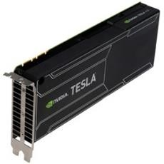
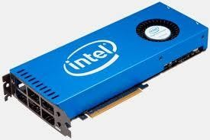
Conclusions
The future of Accelerator Programming
Most of the latest supercomputers are based on accelerators platform. This huge adoption is the result of:
High (peak) performances
Good energy efficiency
Low price
Accelerators should be used everywhere and all
the time. So, why aren’t there?

Slide 81
Conclusions
The future of Accelerator Programming
There are two main difficulties
with accelerators:
They can only execute certain type of programs efficiently (high parallelism, data reuse, regular control flow and data access)
Architectural disparity with respect to CPU (cumbersome programming, portability is an issue)
Accelerators should be used everywhere and all
the time. So, why aren’t there?

Slide 82
Conclusions
The future of Accelerator Programming
GPUs are now more general- purpose computing devices thanks to CUDA adoption. On the other hand, the fact that CUDA is a proprietary tool and its complexity triggered the creation of other programming approaches:
OpenCL
OpenAcc
…
…
Accelerators should be used everywhere and all
the time. So, why aren’t there?

Slide 83
Conclusions
The future of Accelerator Programming
OpenCL is the non-proprietary counterpart of CUDA (also supports AMD GPUs, CPUs, MIC, FPGAs….really portable!) but just like CUDA , is very low level and require a lot of programming skills to be used.
OpenACC is a very high-level approach. Similar to OpenMP (they should be merged in a near(?) future) but still at its infancy and currently supported by a few compilers
Other approaches like C++AMP only tied to exhotic HPC environment (Windows) and impractical for standard HPC applications
Accelerators should be used everywhere and all
the time. So, why aren’t there?

Slide 84
Conclusions
The future of Accelerator Programming
So, how to (efficiently) program actual and future devices?
A possible answer could be surprisingly simple and similar to how today’s multicore (CPUs) are used (including SIMD extensions, accelerators,…)
Basically, there are three levels:
Libraries
automated tools
Do-it-yourself
Programmers will employ library approach whenever possible. In absence of efficient libraries, tools could be used.
For the remaining cases, the do-it-yourself approach will have to be used (OpenCL or a derivative of it should be preferred to proprietary CUDA)
Accelerators will be used everywhere and all the
time. So, start to use them!

