Slide 1

FCAPP - Future Programming Paradigms:
Computational Malleability: meet FlexMPI
Prof. Raffaele Montella
http://raffaelemontella.it raffaele.montella@uniparthenope.it

Slide 2
Overview
Introduction
FlexMPI overview
Examples
FlexMPI internals
IC integration
Demo

Slide 3
Job Categories
Rigid
Moldable
Evolving
Malleable
Adaptive

Slide 4
Job categories
Rigid
Moldable
Evolving
Malleable
Adaptive
Job (t1)
Job (t2)
Job (t3)
time
Start execution time

Slide 5
Job categories
RMS
Rigid
Moldable
Evolving
Malleable
Adaptive
Set
size
Job cannot be reconfigured at runtime
Job (t1)
Job (t2)
Job (t3)
time
Start execution time

Slide 6
Job categories
RMS
Rigid
Moldable
Evolving
Malleable
Adaptive
Request
expansion
Job (t2)
Job (t3)
Job (t1)
time
Start execution time

Slide 7
Job categories
RMS
Rigid
Moldable
Evolving
Malleable
Adaptive
Perform
expansion
Job (t2)
Job (t3)
Job (t1)
time
Start execution time

Slide 8
Job categories
RMS
RMS
Rigid
Moldable
Evolving
Malleable
Adaptive
Perform
expansion
Request
resource de-allocation
Job (t2)
Job (t1)
Job (t3)
time
Start execution time

Slide 9
FlexMPI overview
Runtime that provides dynamic load balancing and performance-aware malleability capabilities to MPI applications
Written in C + MPI ( ~18,000 lines)
Used with iterative SPMD parallel applications
Consists of…
A multithreaded library executed within each MPI application
An external controller that coordinates the execution of multiple applications
An interface with third-party applications (scheduler, ADMIRE’s intelligent controller).
Source code released
https://gitlab.arcos.inf.uc3m.es/desingh/FlexMPI
Available under GNU GPL license.

Slide 10
FlexMPI overview
FLEX-MPI development started in 2012
Initial version released in 2015
LIMITLESS – LIght-weight MonItoring Tool for multicriteria scheduling. Microprocessors and Microsystems. (under review)
LIMITLESS - LIght-weight MonItoring Tool for LargE Scale Systems. 29th Euromicro International Conference on Parallel, Distributed and Network-based Processing (PDP 2021). 2021.
Performance-aware scheduling of parallel applications on non-dedicated clusters. Electronics. 2019.
Combining malleability and I/O control mechanisms to enhance the execution of multiple applications. Journal of Systems and Software. 2019.
Improving the energy efficiency of MPI applications by means of malleability. 24th Euromicro International Conference on Parallel, Distributed and Network-based Processing (PDP). 2016.
Enhancing the performance of malleable MPI applications by using performance-aware dynamic reconfiguration. Parallel Computing. 2015.
FLEX-MPI: an MPI extension for supporting dynamic load balancing on heterogeneous non-dedicated systems. European Conference on Parallel Computing (EUROPAR). 2013.
Runtime support for adaptive resource provisioning in MPI applications. The 19th European MPI Users’ Group Meeting - EuroMPI. 2012.

Slide 11
FlexMPI overview
FlexMPI features
Provide malleable capabilities to MPI applications
Provide adaptive capabilities to MPI applications with different policies:
Strict malleability
High-performance
Adaptive policies: efficiency, cost, and energy.
User-defined actions
Load balance for both dedicated and non-dedicated platforms
Application run-time monitoring -using hardware counters-
Controller features
Application scheduling
I/O scheduling (with CLARISSE support)

Slide 12
FlexMPI structure
MPI application
MPI calls
MPI wrapped calls
XMPI calls
FlexMPI library
MPI library
PMPI interface

Slide 13
FlexMPI structure: malleable configuration
MPI application
Resource Management
System
MPI calls
MPI wrapped calls
XMPI calls
FlexMPI library
Load balancing
Dynamic process management
Data redistribution
MPI library
PMPI interface
PAPI library

Slide 14
FlexMPI structure: adaptive configuration
MPI application
Performance objective and constraints
Power profile
data
Resource Management
System
MPI calls
MPI wrapped calls
XMPI calls
FlexMPI library
Monitoring
Computational prediction model
Reconfiguring policy
Power
prediction model
Load balancing
Dynamic process management
Data redistribution
Process
scheduler
MPI library
PMPI interface
PAPI library

Slide 15
FlexMPI controller
Compute node 1
Compute node 2
MPI application
Proc. 0
MPI application
Proc. 1
MPI application
Proc. 2
FlexMPI listener
FlexMPI
library
FlexMPI
library
FlexMPI
library
FlexMPI communication API
Controller
Executes multiple applications
Sends configuration commands
Receives and displays monitoring data
Terminates the applications
Controller

Slide 16
FlexMPI controller
Compute node 1
Compute node 2
MPI application
Proc. 0
MPI application
Proc. 1
MPI application
Proc. 2
MPI application
Proc. 3
FlexMPI listener
FlexMPI
library
FlexMPI
library
FlexMPI
library
FlexMPI
library
API command list:
1: Change adaptive policy
2: Perform load balancing
3: Display last sampling interval
4: Activate/deactivate monitoring service
5: Terminate application
6: Triggered malleability
7: Define performance counter for monitoring
8: Core binding
9: Delay I/O phase
10: Unlock I/O
11: Delayed malleability
6: spawn 1 process
Controller

Slide 17
FlexMPI controller
Compute node 1
Compute node 2
MPI application
Proc. 0
MPI application
Proc. 1
MPI application
Proc. 2
MPI application
Proc. 3
FlexMPI Monitor
FlexMPI listener
FlexMPI
library
FlexMPI
library
FlexMPI
library
FlexMPI
library
API command list:
1: Change adaptive policy
2: Perform load balancing
3: Display last sampling interval
4: Activate/deactivate monitoring service
5: Terminate application
6: Triggered malleability
7: Define performance counter for monitoring
8: Core binding
9: Delay I/O phase
10: Unlock I/O
11: Delayed malleability
monitoring data
4: activate monitoring
Monitor
Controller

Slide 18
FlexMPI controller
Compute node 1
Compute node 2
MPI application
Proc. 0
MPI application
Proc. 1
MPI application
Proc. 2
MPI application
Proc. 3
FlexMPI Monitor
FlexMPI listener
FlexMPI
library
FlexMPI
library
FlexMPI
library
FlexMPI
library
API command list:
1: Change adaptive policy
2: Perform load balancing
3: Display last sampling interval
4: Activate/deactivate monitoring service
5: Terminate application
6: Triggered malleability
7: Define performance counter for monitoring
8: Core binding
9: Delay I/O phase
10: Unlock I/O
11: Delayed malleability
monitoring data
4: activate monitoring
Monitor
Controller

Slide 19
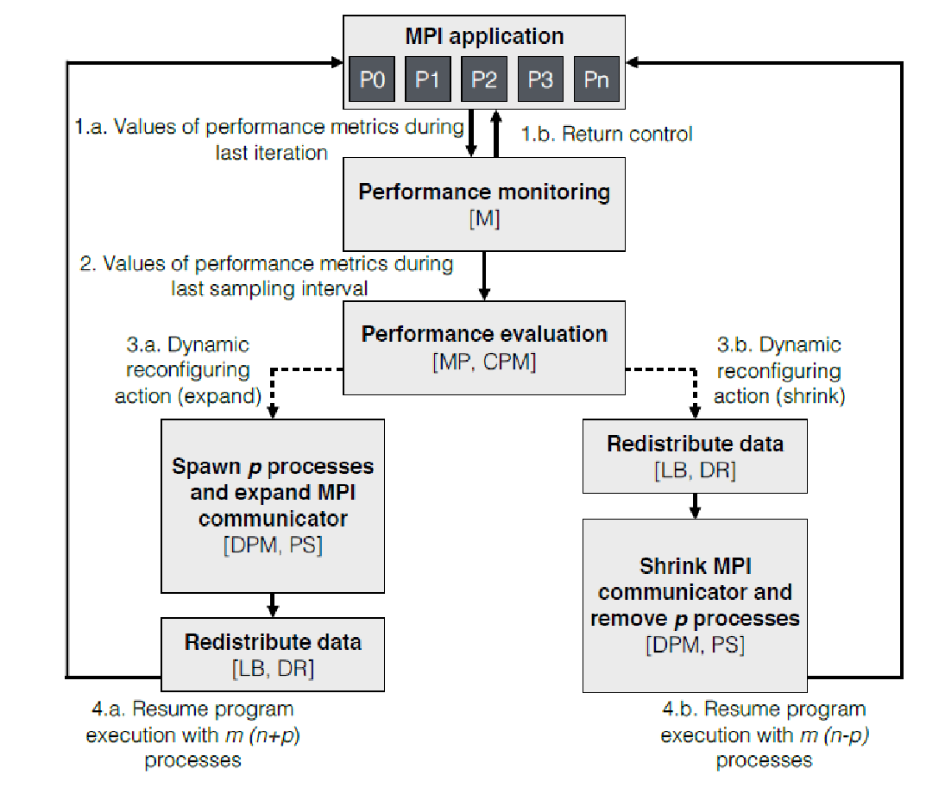
FlexMPI controlflow

Slide 20
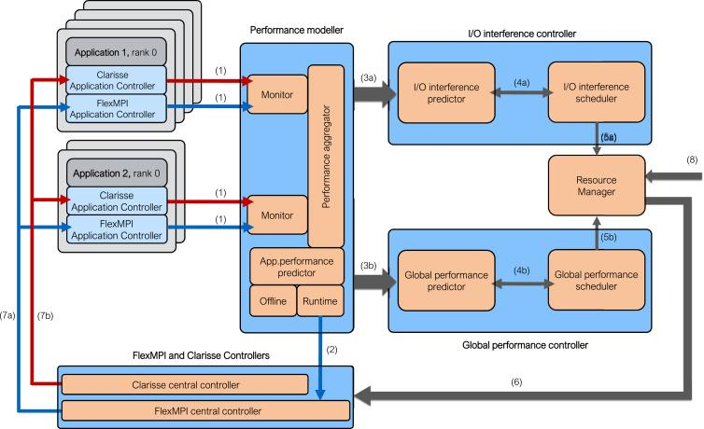
FlexMPI Integration with CLARISSE

Slide 21
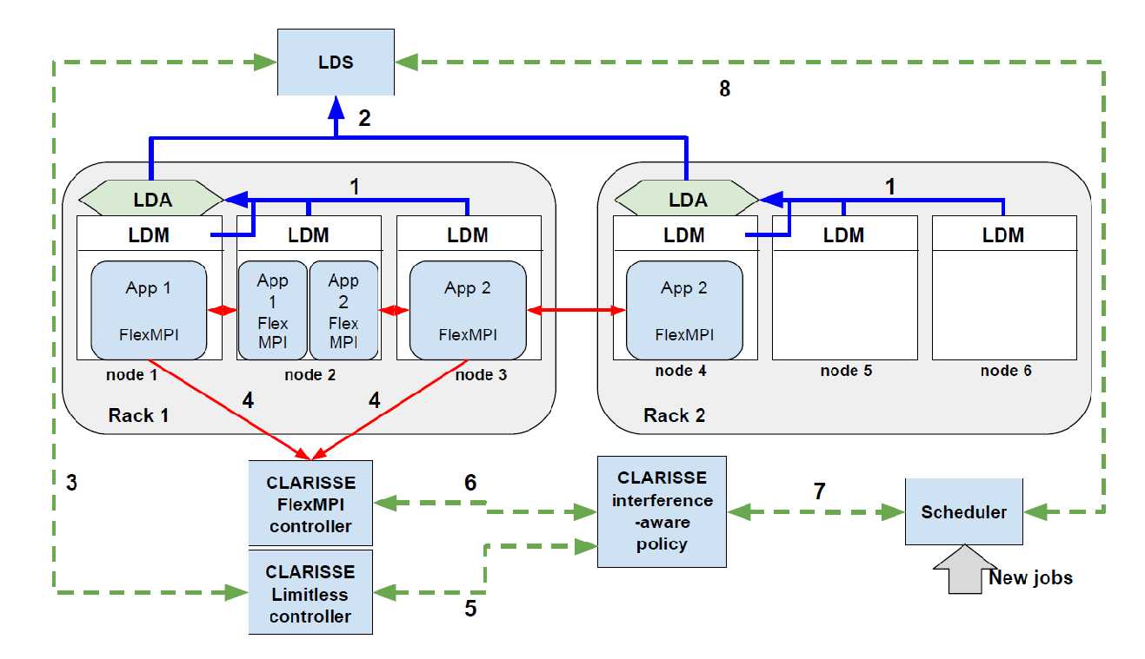
Integration with system monitoring

Slide 22
Applications (I)
Kernels
Jacobi-method kernel
CPU intensive, MPI communications, no I/O
Dense matrices
Good data locality
Conjugate Gradient kernel
CPU intensive, MPI communications, no I/O
Sparce matrices
Poor data locality
Synthetic kernel
Alternates CPU phases (Jacobi), communication and I/O phases
Phase intensities are parametrized
I/O access pattern can be parametrized (use of MPI views)

Slide 23
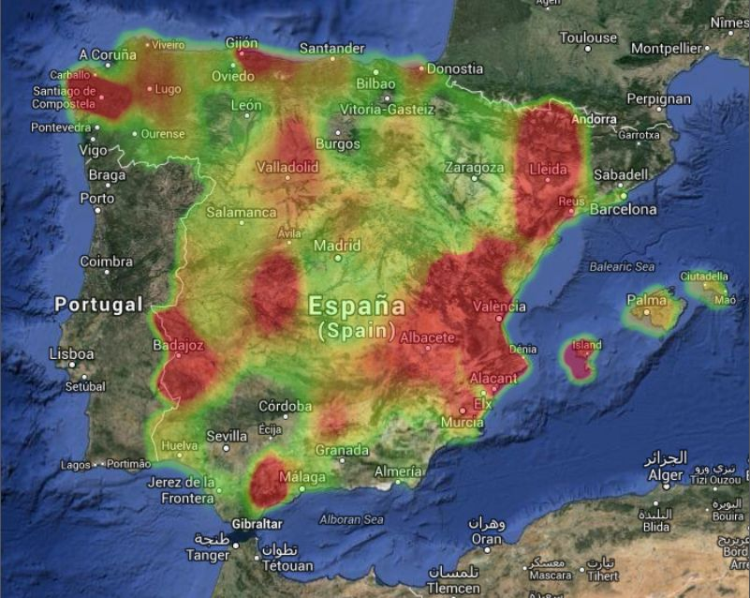
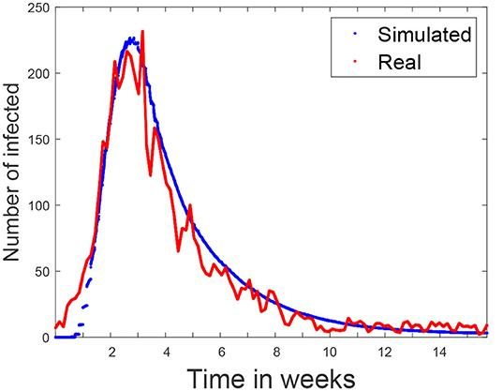
Applications (II)
Real application
EpiGraph: influenza and COVID-19 propagation simulator
https://www.arcos.inf.uc3m.es/epigraph/
Communication-intensive application
Sparse data structures
CPU and communication phases have variable intensities

Slide 24
FlexMPI internals: code example (I)
Instrumented code (FlexMPI)
MPI_init (...);
MPI_Comm_rank(...);
MPI_Comm_size(...);
EMPI_Get_wsize (...);
EMPI_Get_type (&type);
if (type == EMPI_NATIVE) {
… original initialization…
}
else{
EMPI_Get_shared(&it)
}
for (it; it < itmax; it++) {
EMPI_Monitor_init ();
for (i=despl; i < count; i ++) {
//Parallel computation
}
MPI_Allreduce (...);
EMPI_Monitor_end(...);
EMPI_Get_process_status (...);
if (status == EMPI_REMOVED) break;
}
MPI_Finalize ();
Legacy code (MPI)
MPI_Init(...);
MPI_Comm_rank(...);
MPI_Comm_size(...);
for (it=0; it < itmax; it++) {
for (i=0; i < count; i ++) {
//Parallel computation
}
MPI_Allreduce (...);
}
MPI_Finalize ();

Slide 25
FlexMPI internals: code example (II)
Instrumented code with data structures
MPI_init (...);
MPI_Comm_rank(...);
MPI_Comm_size(...);
EMPI_Get_wsize (...);
EMPI_Register (“matrix”,A, EMPI_DISJOINT);
EMPI_Get_type (&type);
if (type == EMPI_NATIVE) {
A = init();
}
else{
EMPI_Get_shared(&it)
A = EMPI_Get_addr("matrix");
}
for (it; it < itmax; it++) {
EMPI_Monitor_init ();
for (i=despl; i < count; i ++) {
//Parallel computation
...A[i]...
}
MPI_Allreduce (...);
EMPI_Monitor_end(...);
EMPI_Get_process_status (...);
if (status == EMPI_REMOVED) break;
A = EMPI_Get_addr("matrix");
}
MPI_Finalize ();
Legacy code (MPI)
MPI_Init(...);
MPI_Comm_rank(...);
MPI_Comm_size(...);
A = init();
for (it=0; it < itmax; it++) {
for (i=0; i < count; i ++) {
//Parallel computation
...A[i]...
}
MPI_Allreduce (...);
}
MPI_Finalize ();

Slide 26
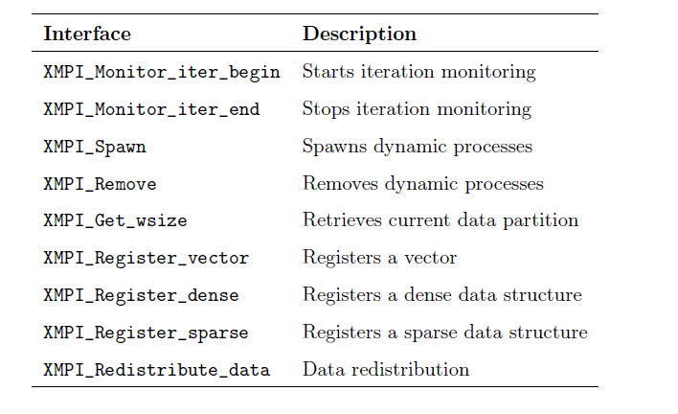
Flex-MPI low-level interfaces

Slide 27

FlexMPI internals
FlexMPI is used with
Iterative SPMD MPI applications
Flex-MPI
MPI application
0
100
200
300
400
500
Sampling interval
Time
Reconfiguration action
Notes:
In this work we conside SPMD iterative ….
The application is running with MPI and Flex-MPI library
Sampling interval: evaluation interval … we evaluate if the aplication fulfills the performande requirements
If not, we perform a reconfiguration action …. That is related to malleability
Criterion -> craitirion

Slide 28
FlexMPI internals
Different policies
Performance-oriented reconfiguration
Triggered reconfiguration
Flex-MPI
MPI application
0
100
200
300
400
500
Sampling interval
Adaptive reconfiguration
Reconfiguration action
Malleable reconfiguration
Triggered reconfiguration
Notes:
The thing is that there are many option for creating and scheduling processes
Each particular case, is an execution scenario

Slide 29
Communicator management
MPI_COMM_WORLD
MPI_COMM_WORLD
MPI_COMM_WORLD
1
P0
P1
P2
Spawn (nprocs=2)
P*
P*
XMPI_COMM_WORLD
MPI_COMM_WORLD
MPI_COMM_WORLD
MPI_COMM_WORLD
2
P0
P1
P2
P*
P*
XMPI_COMM_WORLD
remote_comm
remote_comm
MPI_COMM_WORLD
MPI_COMM_WORLD
MPI_COMM_WORLD
3
P0
P1
P2
P3
P*
XMPI_COMM_WORLD
remote_comm
MPI_COMM_WORLD
MPI_COMM_WORLD
MPI_COMM_WORLD
4
P0
P1
P2
P3
P4
XMPI_COMM_WORLD
Notes:
Create processes in order to meet the performance constraints

Slide 30
Communicator management
MPI_COMM_WORLD
MPI_COMM_WORLD
MPI_COMM_WORLD
1
P0
P1
P2
P3
P4
Remove (rank=4)
XMPI_COMM_WORLD
MPI_COMM_WORLD
MPI_COMM_WORLD
MPI_COMM_WORLD
2
P0
P1
P2
P3
P4
MPI_COMM_WORLD
MPI_COMM_WORLD
MPI_COMM_WORLD
3
P0
P1
P2
P3
P*
>>
XMPI_COMM_WORLD
Notes:
Create processes in order to meet the performance constraints

Slide 31


Data distribution
Application data
Data structures are registered in FlexMPI
Dense vectors
Dense and sparse matrices
FlexMPI automatically redistributes data
When load balance is applied
When processes are created/removed
removes
N
N
N
N

Slide 32
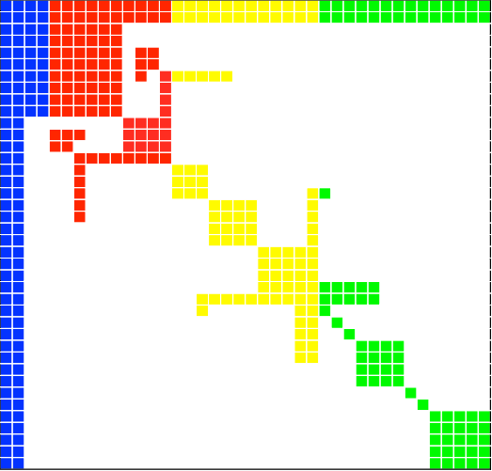
FlexMPI internals
Application data
Sparse matrix structures are supported
One-dimensional data decomposition with block partitioning
Count / displacement values
Data distribution schemes: distributed or replicated
N
N

Slide 33
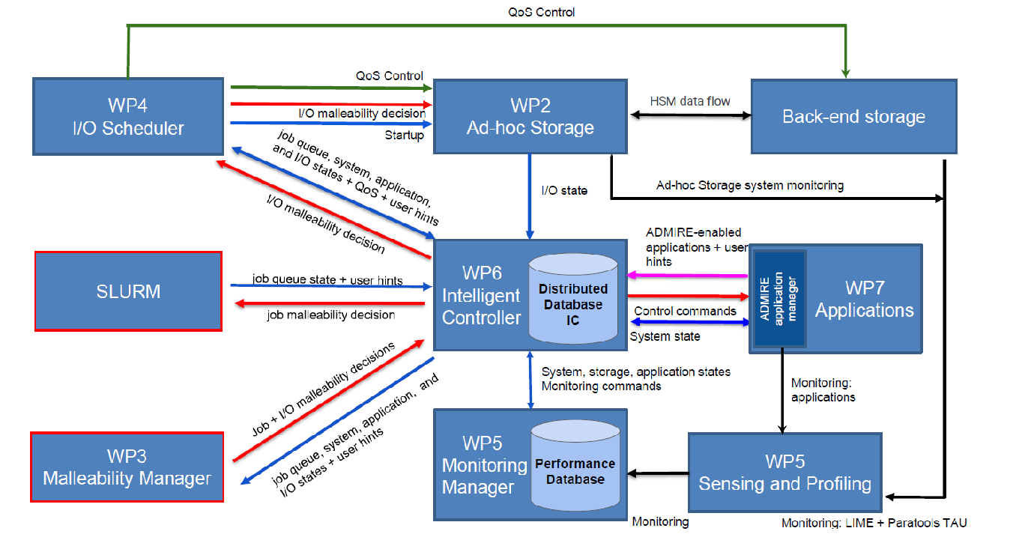
Intelligent Controller
IC integrates multiple data sources:
Monitoring
Application
Users
Slurm
I/O scheduler
Malleability Manager
Storage

Slide 34
Intelligent Controller
IC communicates with other components using RPCs.
IC cooperates with:
The monitor
The applications
The system job scheduler (Slurm)
The main goal is to create a distributed control infrastructure:
It will provide a single system image through a distributed consistency protocol.
It will be transparent to the users:
Novel runtime analysis tools 🡪 to tune I/O systems and applications behaviour.
Objective:
Efficient use of the resources under dynamic workloads in large scale systems.
Code available in the ADMIRE repository: https://gitlab.arcos.inf.uc3m.es/admire/project/
Readme.md includes detailed information about the installation, how to run the examples, and how to integrate libicc with other components.

Slide 35
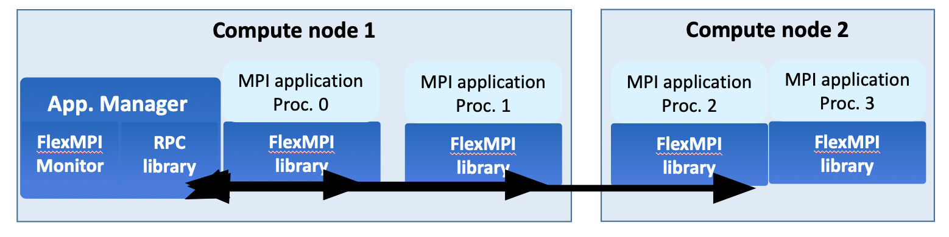
IC - Applications Architecture
Instruction list:
1: Bidirectional RPC connection
2: Unidirectional RPC between IC and the Application Manager
3: Sockets between processes
There is one AM per application
3: Internal FlexMPI communication
1: IC sends malleability commands
2: App. Manager sends data about
malleable regions
Malleability Manager
Redis
Intelligent Controller

Slide 36
RPC Library
Provides communication channels between each component and IC.
Two protocols:
If component A needs to receive data from IC (bidirectional RPC)
Examples: malleability commands
Register the RPC.
It sends the address of B to the IC, and both open the communication channel.
IC will send the information asynchronously.
There is a callback function that will receive and process the data in B.
If component B needs to send data to IC (unidirectional RPC)
Example: begin/end of malleable regions
Register the RPC.
Send the data.
Repeat as many times as needed.

Slide 37
RPC communication protocol
RPC unidirectional
IC
1. Register general RPCs and callbacks
3. Store ID and address
4. Check for information to send
Component / Application
2. Call the adequate RPC send function*
*Repeat as many times as needed

Slide 38
RPC communication protocol
Component / Application
2. Register the RPC (send its address)
4. Application execution
7. Receive commands
8. Take actions
IC
1. Create RPC services and callbacks
3. Store in Redis the ID and its address
5. Evaluate new actions taken
6. Send commands to the application

Slide 39
RPC communication instructions
// Call one-way RPC
// Send something to the IC
struct icc_context *icc;
int ret = icc_rpc_test(icc, 32, typeid, &rpcret);
if (ret == ICC_SUCCESS)
printf("icc_client: RPC \"TEST\" successful: retcode=%d\n", rpcret);
else
fprintf(stderr, "Error sending RPC to IC (retcode=%d)\n", ret);
ret = icc_fini(icc);
assert(ret == 0);
// Callback RPC
// Component and IC Exchange addresses
// and register RPCs to send and recv data
struct icc_context *icc;
icc_init(ICC_LOG_INFO, typeid, 0, &icc);
assert(icc != NULL);
ret = icc_fini(icc);
assert(ret == 0);
Call RPC (from component to IC)
rpc_send()
rpc_fini()
Callback RPC
icc_init()
In FlexMPI code, developers should implement the function to process the received data.
Incoming malleability instructions
Reception and processing are embedded into the FlexMPI code
It is no necessary to add any instruction to the application code

Slide 40
IC + FlexMPI example
Assumptions:
One compute node available
Max. processes per node is set to 8
Each application starts its execution using one process
Step 1: Run the IC server
It initializes everything needed to manage the communications.
Step 2: Run the Jacobi application
It registers the RPC to establish the communication with the IC.
It sends its address to the IC to allow bidirectional communications.
Step 3: IC reconfigures Jacobi to max. processes
IC reconfigures Jacobi to the max. processes in the compute node.
Step 4: Run the Conjugate Gradient application (CG)
It exchanges the required information with the IC
IC reconfigures the Jacobi application to make room enough for CG (4 processes)
Once CG has been executed, it is reconfigured to 4 processes.
Step 5: CG finishes its execution
IC reconfigures Jacobi to max. processes again

Slide 41
Intelligent Controller (next step)
Coordination with SLURM:
Communication function with Slurm
Current status (jobs, partitions, available resources, allocated resources, etc.)
Provide scheduling solution (for example, by allocating new resources for running applications)
Use case example:
IC sends a schedule solution to SLURM
SLURM executes the applications according to the planning
IC wants to reconfigure something based on the current status (Jobs and resources)
It sends a new configuration to SLURM
SLURM allocates/deallocates nodes dynamically to adjust the resources to the new configuration
IC reconfigures the applications based on the new available resources
By using malleability commands

Slide 42
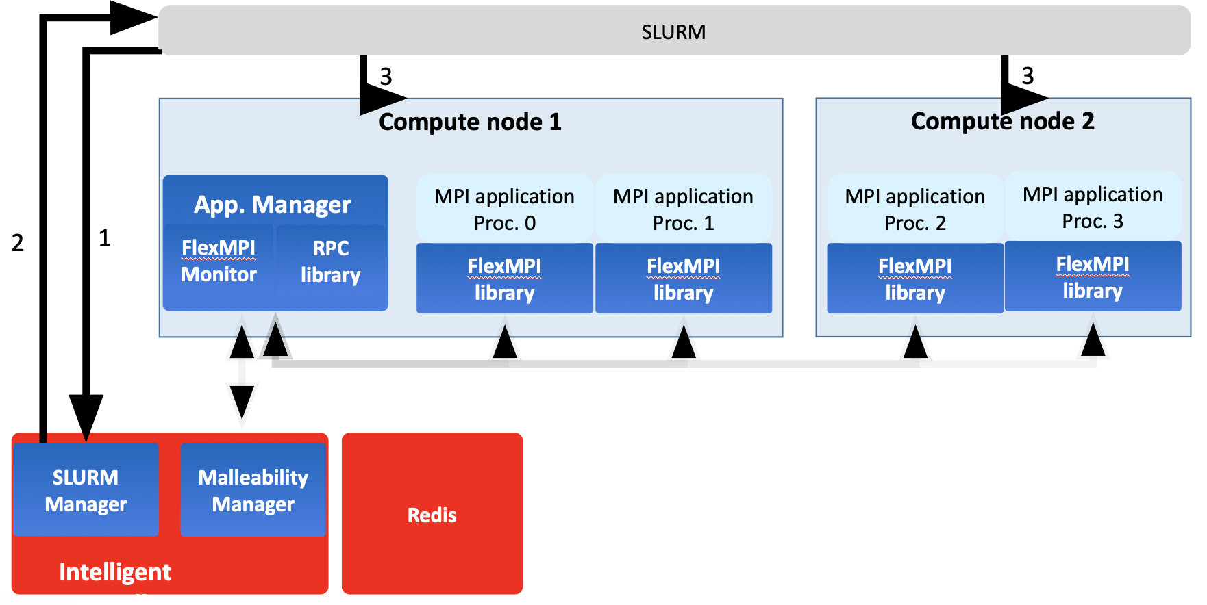
Intelligent Controller (next step)
Instruction list:
1: Get system status
2: Send scheduling solution
3: Slurm actions:
allocate/deallocate resources

Slide 43
IC + FlexMPI example (output)
Configuring node compute-1-2
FlexMPI: program configured to perform parallel MPI I/O
Host compute-1-2 maxprocs is 8. ID is 0
[0] Process spawned in compute-1-2 | Data loaded in 2.835658 secs.
[0] Jacobi started
[0] Configuration: nprocs: 1 dim: 21000 itmax: 800 diff_tol: 0.000010 cpu_intensity: 1 com_intensity: 0 IO_intensity: 0
Monitoring: Error adding hwpc_2
Error is PAPI_ECNFLCT
Received packet from 10.0.200.35:51886 Data: 6:compute-1-2:7
Command number is 6
Command: Create 7 processes in compute node: compute-1-2
Sent 0 bytes as response
Jacobi output
Gradient output

Slide 44
IC + FlexMPI example (output)
Spawn 7 at 20.931488
Host list: compute-1-2:7
FlexMPI: program configured to perform parallel MPI I/O
[2] Process spawned in compute-1-2 at 21 | Data received in 0.884813 secs.
[2] Jacobi started
[3] Process spawned in compute-1-2 at 21 | Data received in 0.884799 secs.
[3] Jacobi started
Spawn cost:: process_creation= 0.040095 data_redistribution= 0.884916 LoadBalance_computation= 0.000001
Iter: 20 FLOPs: 148216630512 MFLOPS:: 7081.196855 RTIME:: 20.931014 PTIME:: 20.931183 CTIME:: 0.000000 IOTime:: 0.000000 Size: 8
[4] Process spawned in compute-1-2 at 21 | Data received in 0.884848 secs.
[4] Jacobi started
[5] Process spawned in compute-1-2 at 21 | Data received in 0.884862 secs.
[5] Jacobi started
[6] Process spawned in compute-1-2 at 21 | Data received in 0.884889 secs.
[6] Jacobi started
[7] Process spawned in compute-1-2 at 21 | Data received in 0.884905 secs.
[7] Jacobi started
[1] Process spawned in compute-1-2 at 21 | Data received in 0.884937 secs.
[1] Jacobi started
Jacobi output
Gradient output

Slide 45
IC + FlexMPI example (output)
Iter: 40 FLOPs: 17652964026 MFLOPS:: 7039.955919 RTIME:: 2.507539 PTIME:: 2.507538 CTIME:: 0.000000 IOTime:: 0.000000 Size: 8
Iter: 60 FLOPs: 17652964014 MFLOPS:: 7068.989770 RTIME:: 2.497240 PTIME:: 2.497251 CTIME:: 0.000000 IOTime:: 0.000000 Size: 8
Iter: 80 FLOPs: 17652964011 MFLOPS:: 7113.690330 RTIME:: 2.481548 PTIME:: 2.481567 CTIME:: 0.000000 IOTime:: 0.000000 Size: 8
15:18:23
Iter: 100 FLOPs: 17652964520 MFLOPS:: 7021.469568 RTIME:: 2.514141 PTIME:: 2.503583 CTIME:: 0.000000 IOTime:: 0.000000 Size: 8
Iter: 120 FLOPs: 17652964057 MFLOPS:: 7087.557005 RTIME:: 2.490698 PTIME:: 2.490702 CTIME:: 0.000000 IOTime:: 0.000000 Size: 8
Iter: 140 FLOPs: 17652964010 MFLOPS:: 7095.122996 RTIME:: 2.488042 PTIME:: 2.488054 CTIME:: 0.000000 IOTime:: 0.000000 Size: 8
Iter: 160 FLOPs: 17652964018 MFLOPS:: 7116.038881 RTIME:: 2.480729 PTIME:: 2.480746 CTIME:: 0.000000 IOTime:: 0.000000 Size: 8
Iter: 180 FLOPs: 17652964006 MFLOPS:: 7093.275581 RTIME:: 2.488690 PTIME:: 2.488690 CTIME:: 0.000000 IOTime:: 0.000000 Size: 8
15:18:36
…
…
…
Jacobi output
Gradient output

Slide 46
IC + FlexMPI example (output)
Iter: 380 FLOPs: 17652963981 MFLOPS:: 7114.584820 RTIME:: 2.481236 PTIME:: 2.481279 CTIME:: 0.000000 IOTime:: 0.000000 Size: 8
Received packet from 10.0.200.35:33261 Data: 6:compute-1-2:-4
Command number is 6
Command: Create -4 processes in compute node: compute-1-2
Sent 0 bytes as response
Remove 4 at 69.591305
Process [7] removed from compute-1-2
Process [6] removed from compute-1-2
Process [5] removed from compute-1-2
Process [4] removed from compute-1-2
Removal cost:: process_destruction= 0.000264 data_redistribution= 0.551139 LoadBalance_computation= 0.000005
Iter: 400 FLOPs: 17652964486 MFLOPS:: 7032.002982 RTIME:: 2.510375 PTIME:: 2.499960 CTIME:: 0.000000 IOTime:: 0.000000 Size: 4
Iter: 420 FLOPs: 35296639543 MFLOPS:: 7131.217714 RTIME:: 4.949595 PTIME:: 4.949639 CTIME:: 0.000000 IOTime:: 0.000000 Size: 4
Iter: 440 FLOPs: 35296639586 MFLOPS:: 6833.200900 RTIME:: 5.165462 PTIME:: 5.165459 CTIME:: 0.000000 IOTime:: 0.000000 Size: 4
Configuring node compute-1-2
Configuring node compute-1-1
/home/alcasgar/LIBS/mpich/bin//mpiexec -genvall -f /home/alcasgar/FlexMPI/controller/rankfiles/rankfile1 -np 1 /tmp/gradient1 500000 1000 0.00000001 /home/alcasgar/FlexMPI/examples -cfile ../run/nodefile2.dat -policy-malleability-triggered -lbpolicy-static -ni 20 -ports 7670 7671 -controller compute-1-2 -IOaction 0.020000 -alloc:0
FlexMPI: program configured to perform dummy I/O of 0.020000 seconds
Jacobi output
Gradient output

Slide 47
IC + FlexMPI example (output)
Host compute-1-2 maxprocs is 8. ID is 0
DIM: 500000 NNZ: 39967238
Received packet from 10.0.200.35:38365 Data: 6:compute-1-2:3
Command number is 6
Command: Create 3 processes in compute node: compute-1-2
Sent 0 bytes as response
Iter: 460 FLOPs: 35296639524 MFLOPS:: 7126.463467 RTIME:: 4.952897 PTIME:: 4.952935 CTIME:: 0.000000 IOTime:: 0.000000 Size: 4
Iter: 480 FLOPs: 35296639509 MFLOPS:: 7215.483963 RTIME:: 4.891791 PTIME:: 4.891885 CTIME:: 0.000000 IOTime:: 0.000000 Size: 4
[0] Process spawned in compute-1-2 - Data loaded in 11.275096
[0] Gradient started
Iter: 500 FLOPs: 35296640004 MFLOPS:: 7201.284032 RTIME:: 4.901437 PTIME:: 4.884597 CTIME:: 0.000000 IOTime:: 0.000000 Size: 4
Spawn 3 at 4.910253
Host list: compute-1-2:3
[1] Process spawned in compute-1-2 at 21 | Data received in 0.172032 secs.
[3] Process spawned in compute-1-2 at 21 | Data received in 0.172090 secs.
[2] Process spawned in compute-1-2 at 21 | Data received in 0.172246 secs.
Spawn cost:: process_creation= 0.038902 data_redistribution= 0.172307 LoadBalance_computation= 0.002943
Iter: 20 FLOPs: 44033623140 MFLOPS:: 8988.077059 RTIME:: 4.899115 PTIME:: 4.909923 CTIME:: 0.010774 IOTime:: 0.000000 Size: 4
[1] Gradient started
[3] Gradient started
[2] Gradient started
Jacobi output
Gradient output

Slide 48
IC + FlexMPI example (output)
Iter: 40 FLOPs: 10162950941 MFLOPS:: 9503.671729 RTIME:: 1.069371 PTIME:: 1.104408 CTIME:: 0.035034 IOTime:: 0.000000 Size: 4
Iter: 520 FLOPs: 35296639583 MFLOPS:: 7132.513208 RTIME:: 4.948696 PTIME:: 4.948709 CTIME:: 0.000000 IOTime:: 0.000000 Size: 4
Iter: 60 FLOPs: 10240397619 MFLOPS:: 9569.973150 RTIME:: 1.070055 PTIME:: 1.112591 CTIME:: 0.042531 IOTime:: 0.000000 Size: 4
Iter: 80 FLOPs: 10515216776 MFLOPS:: 9835.283928 RTIME:: 1.069132 PTIME:: 1.140827 CTIME:: 0.071687 IOTime:: 0.000000 Size: 4
Iter: 100 FLOPs: 10599785640 MFLOPS:: 9957.029514 RTIME:: 1.064553 PTIME:: 1.145932 CTIME:: 0.081379 IOTime:: 0.000000 Size: 4
Iter: 120 FLOPs: 10542568344 MFLOPS:: 9896.606914 RTIME:: 1.065271 PTIME:: 1.139956 CTIME:: 0.074691 IOTime:: 0.000000 Size: 4
Iter: 540 FLOPs: 35296639529 MFLOPS:: 7108.611912 RTIME:: 4.965335 PTIME:: 4.965389 CTIME:: 0.000000 IOTime:: 0.000000 Size: 4
Iter: 140 FLOPs: 10219318040 MFLOPS:: 9544.288679 RTIME:: 1.070726 PTIME:: 1.110498 CTIME:: 0.039774 IOTime:: 0.000000 Size: 4
Iter: 160 FLOPs: 10258285328 MFLOPS:: 9608.347854 RTIME:: 1.067643 PTIME:: 1.112081 CTIME:: 0.044444 IOTime:: 0.000000 Size: 4
Iter: 580 FLOPs: 35296639530 MFLOPS:: 7082.234686 RTIME:: 4.983828 PTIME:: 4.983866 CTIME:: 0.000000 IOTime:: 0.000000 Size: 4
…
…
Gradient finishes
Jacobi output
Gradient output

Slide 49
IC + FlexMPI example (output)
Iter: 720 FLOPs: 35296639577 MFLOPS:: 7132.511766 RTIME:: 4.948697 PTIME:: 4.948769 CTIME:: 0.000000 IOTime:: 0.000000 Size: 4
Received packet from 10.0.200.35:41873 Data: 6:compute-1-2:4
Command number is 6
Command: Create 4 processes in compute node: compute-1-2
Sent 0 bytes as response
Spawn 4 at 155.474022
Host list: compute-1-2:4
Spawn cost:: process_creation= 0.039829 data_redistribution= 0.501175 LoadBalance_computation= 0.000001
Iter: 740 FLOPs: 35296639530 MFLOPS:: 7079.620931 RTIME:: 4.985668 PTIME:: 4.985746 CTIME:: 0.000000 IOTime:: 0.000000 Size: 8
[5] Process spawned in compute-1-2 at 741 | Data received in 0.501245 secs.
[5] Jacobi started
[6] Process spawned in compute-1-2 at 741 | Data received in 0.501286 secs.
[6] Jacobi started
[7] Process spawned in compute-1-2 at 741 | Data received in 0.501269 secs.
[7] Jacobi started
[4] Process spawned in compute-1-2 at 741 | Data received in 0.501295 secs.
[4] Jacobi started
Iter: 760 FLOPs: 17652963910 MFLOPS:: 7117.309822 RTIME:: 2.480286 PTIME:: 2.480313 CTIME:: 0.000000 IOTime:: 0.000000 Size: 8
Iter: 780 FLOPs: 17652963908 MFLOPS:: 7128.072545 RTIME:: 2.476541 PTIME:: 2.476554 CTIME:: 0.000000 IOTime:: 0.000000 Size: 8
Jacobi finishes.
Jacobi output
Gradient output

Slide 50
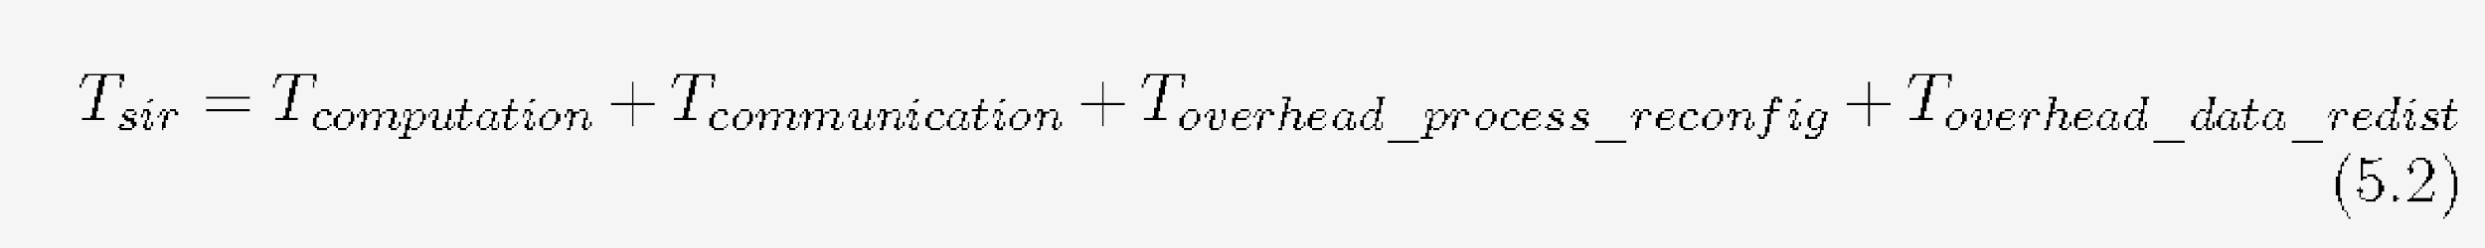
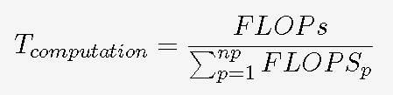
FlexMPI: Performance models
T_{sir} is the application total execution time
T_{computation} is calculated using the processes FLOPS

Slide 51
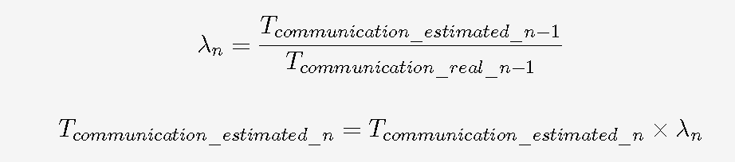
FlexMPI: Performance models
T_{communication} takes into account the communication model of each MPI primitive
It is also corrected at run-time by means of λ factor
T_{overhead} is computed at run-time

Slide 52
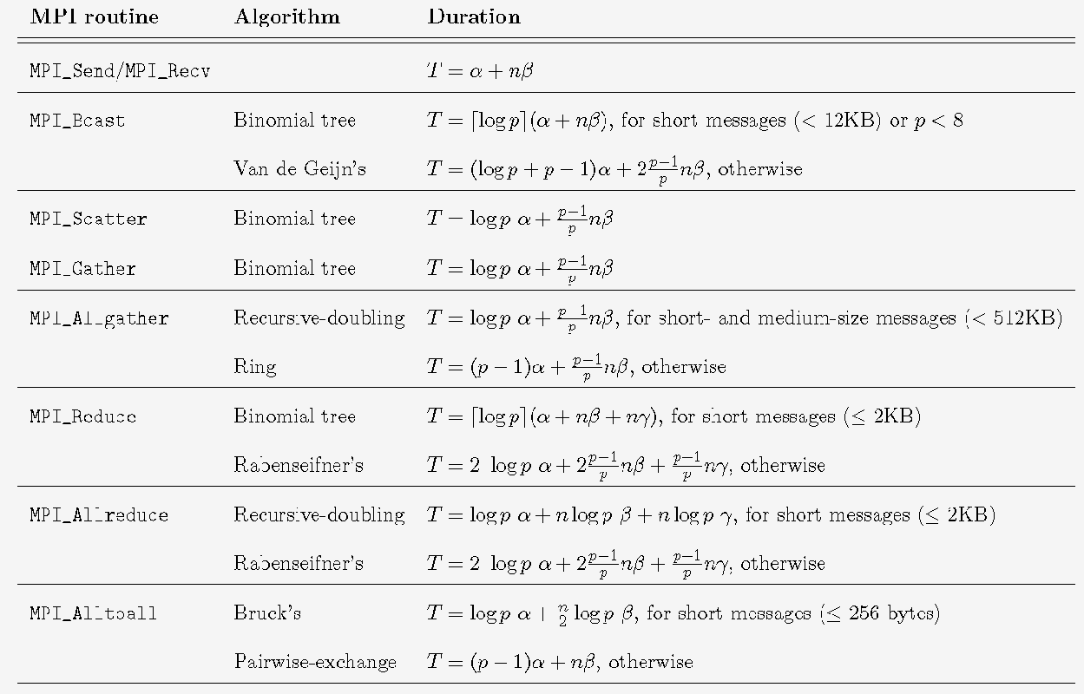
FlexMPI: MPI communication models

