Slide 1

FCAPP - Future Programming Paradigms:
Practice and Experience with FlexMPI
Prof. Raffaele Montella
http://raffaelemontella.it raffaele.montella@uniparthenope.it

Slide 2
FlexMPI: application examples
Dynamic load balance
Application monitoring
Application performance/energy modelling
Performance-aware malleability
Reducing I/O congestion
Application scheduling in non-dedicated clusters
Multicriteria scheduling
Application malleable clones
Reducing InfiniBand network congestion (ongoing)

Slide 3
Applications
Kernels
Jacobi
Conjugate Gradient
Synthetic kernel
Application clones
Applications
NEK5000 (Fortran, ongoing)
Quatum Espresso (Fortran, ongoing)
WaComm++ (C++)
EpiGraph (C)

Slide 4
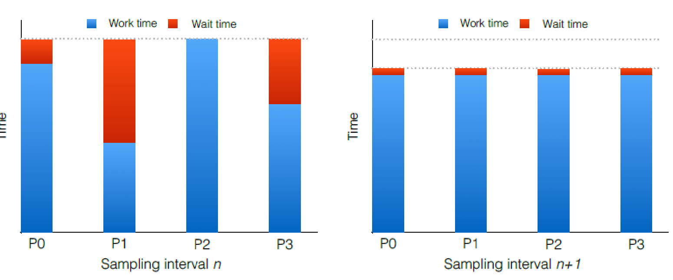
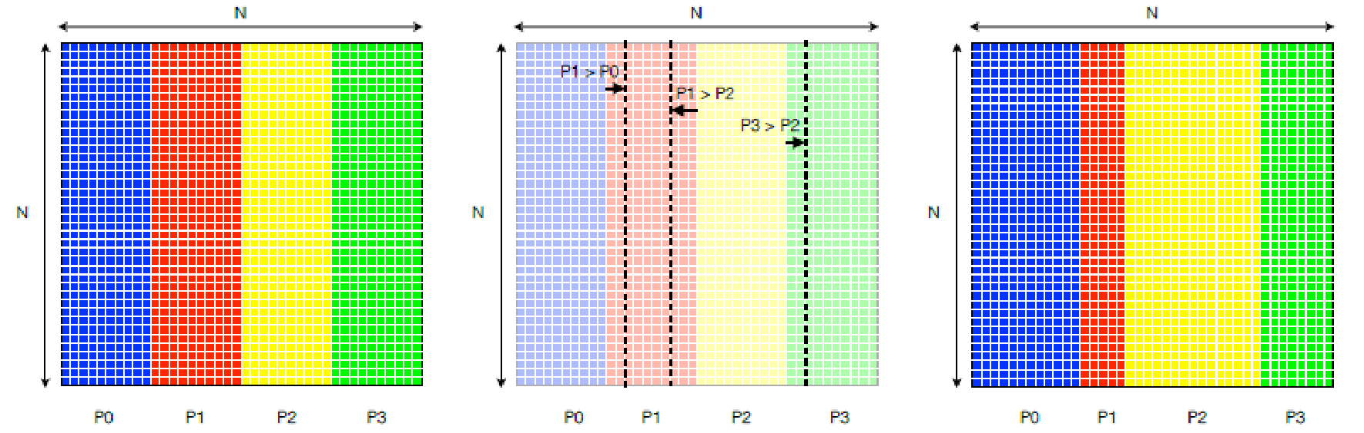
Dynamic load balance
Load balancing is performed when:
New processes are created or removed
Application are executed on platforms with different performance compute nodes
Application are executed on platform with non-dedicated compute nodes

Slide 5
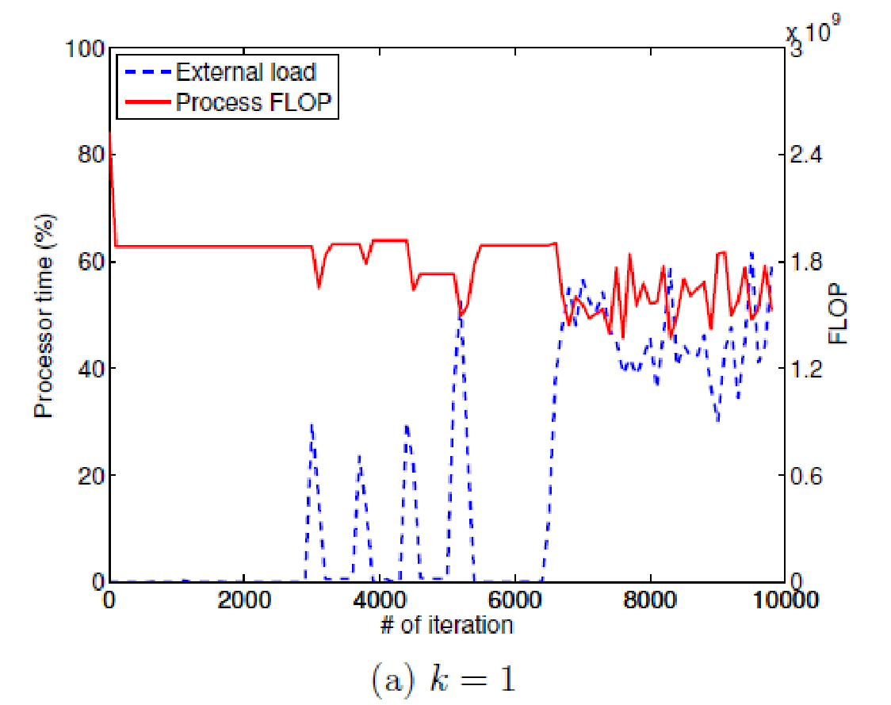
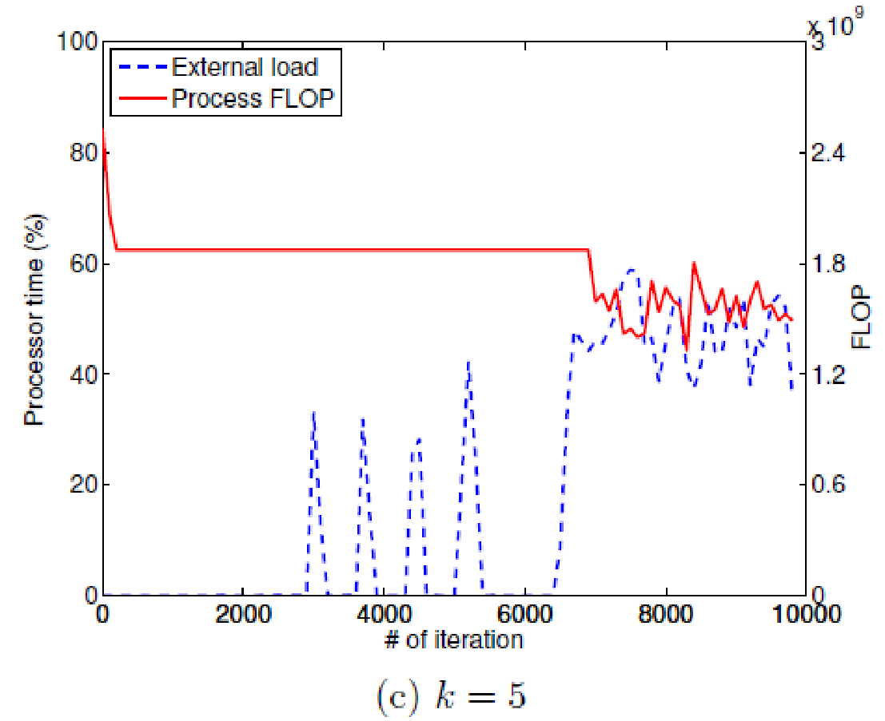
Dynamic load balancing
Example of application load balance under external workloads
K is the sensibility of the load balance algorithm (the higher the bigger)

Slide 6
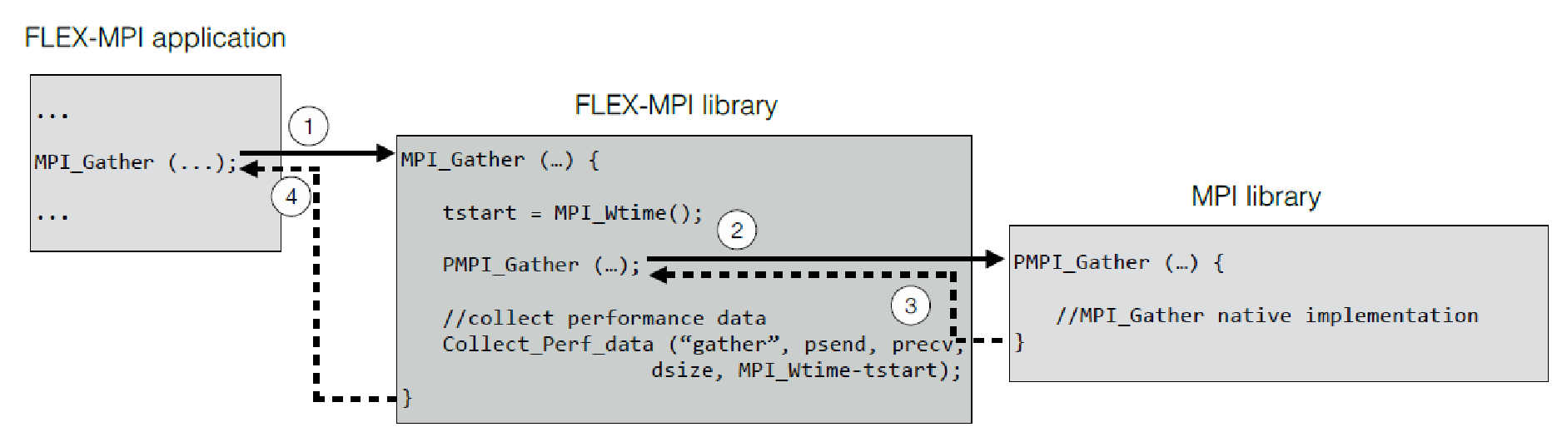
Application monitoring
CPU monitoring: FlexMPI control points
Communication monitoring: MPI communication calls are wrapped
I/O monitoring: MPI I/O calls are wrapped

Slide 7


Application performance modelling
Communication time is obtained based on models for each communication primitive
The predicted communication time is dynamically corrected

Slide 8
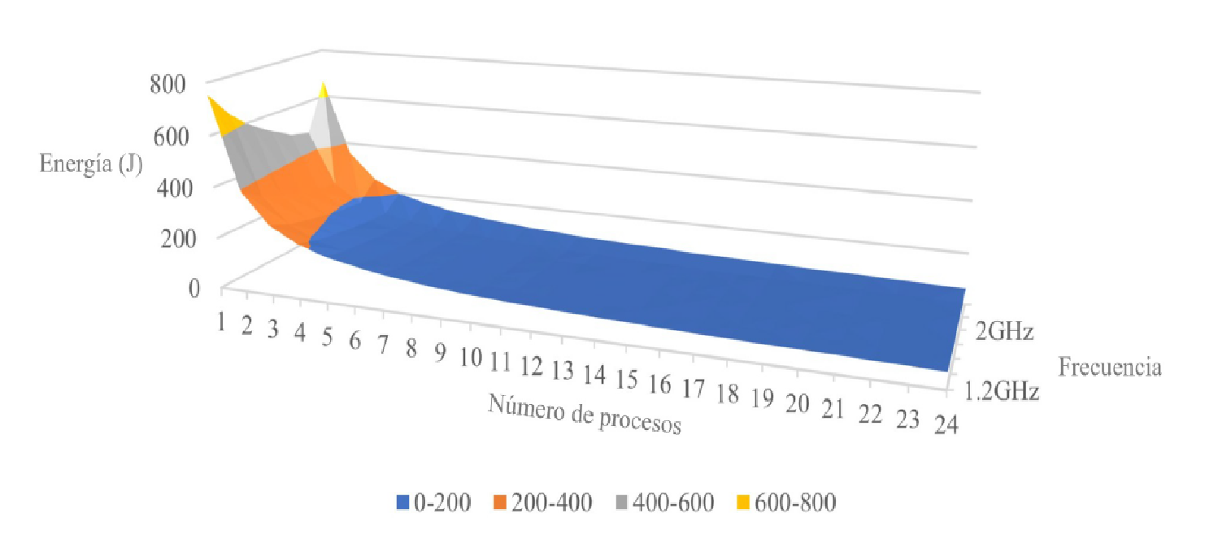
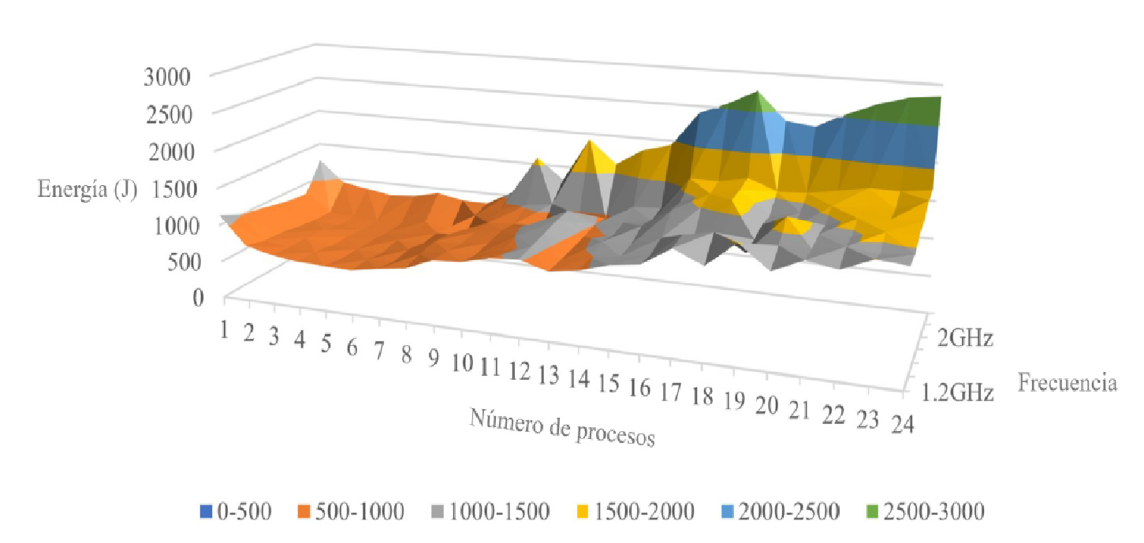
Application energy modelling
Combining malleability and dynamic voltage and frequency scaling (DVFS)
Energy profile for different applications
CPU-intensive (left) and I/O intensive (right)
Dynamic energy profile generation

Slide 9
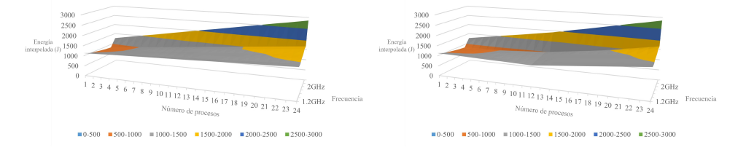
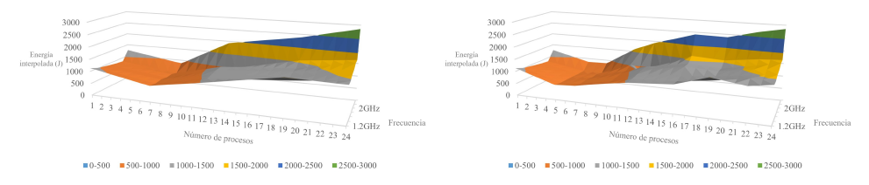
Application energy modelling
Dynamic energy profile example for I/O intensive application

Slide 10
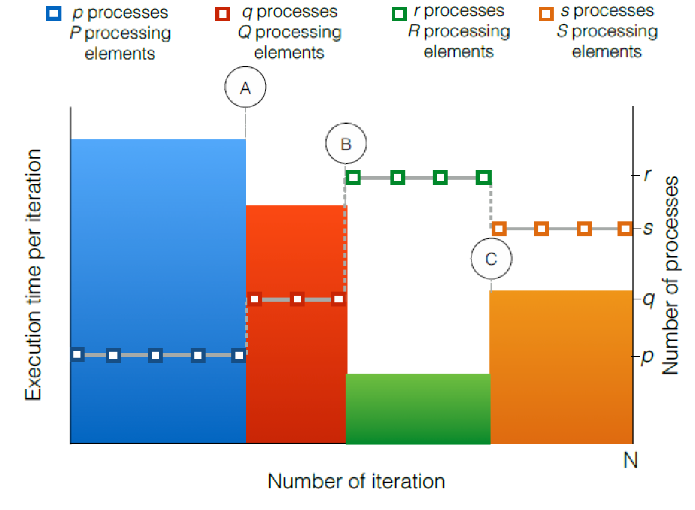
Performance-aware malleability
Strict malleability policy
Reconfiguration commands are externally generated (ADMIRE’s Intelligent Controller)
Delayed reconfiguration

Slide 11
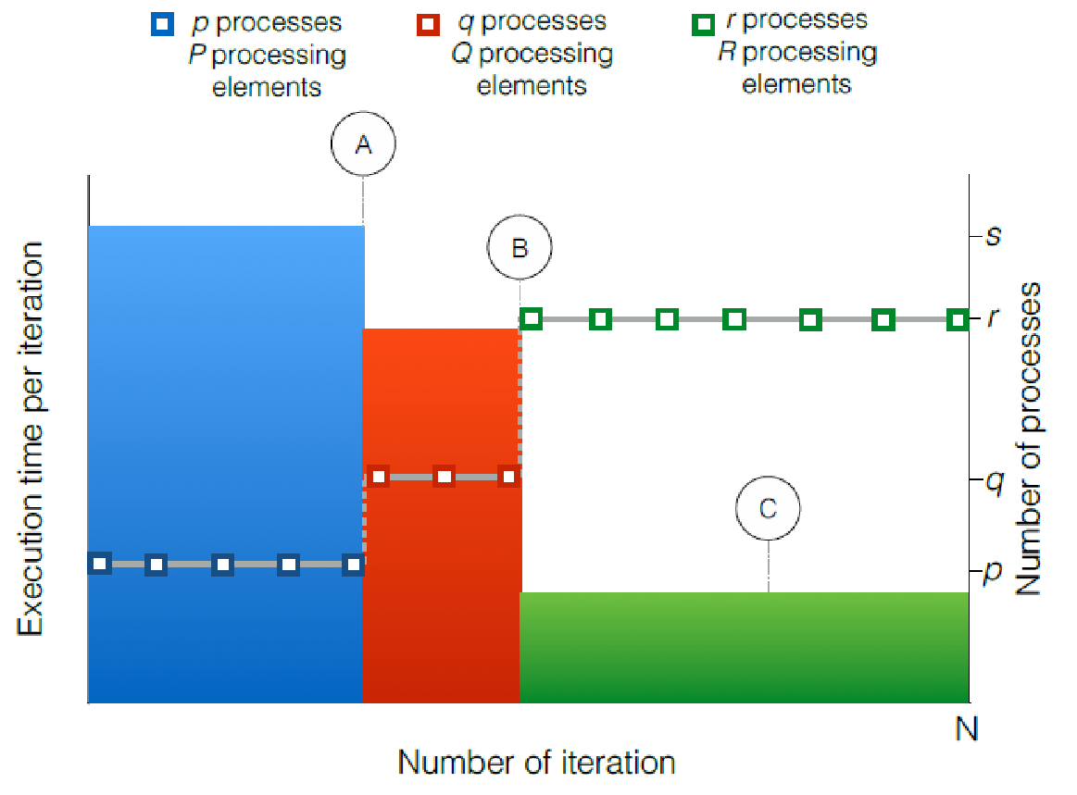
Performance-aware malleability
High performance malleability policy
Aims to maximize the application performance
Considers both the application performance model and compute node characteristics

Slide 12
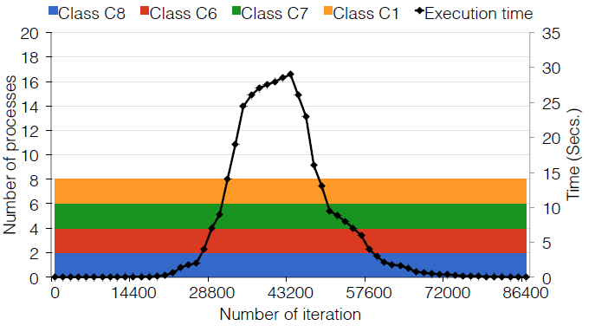
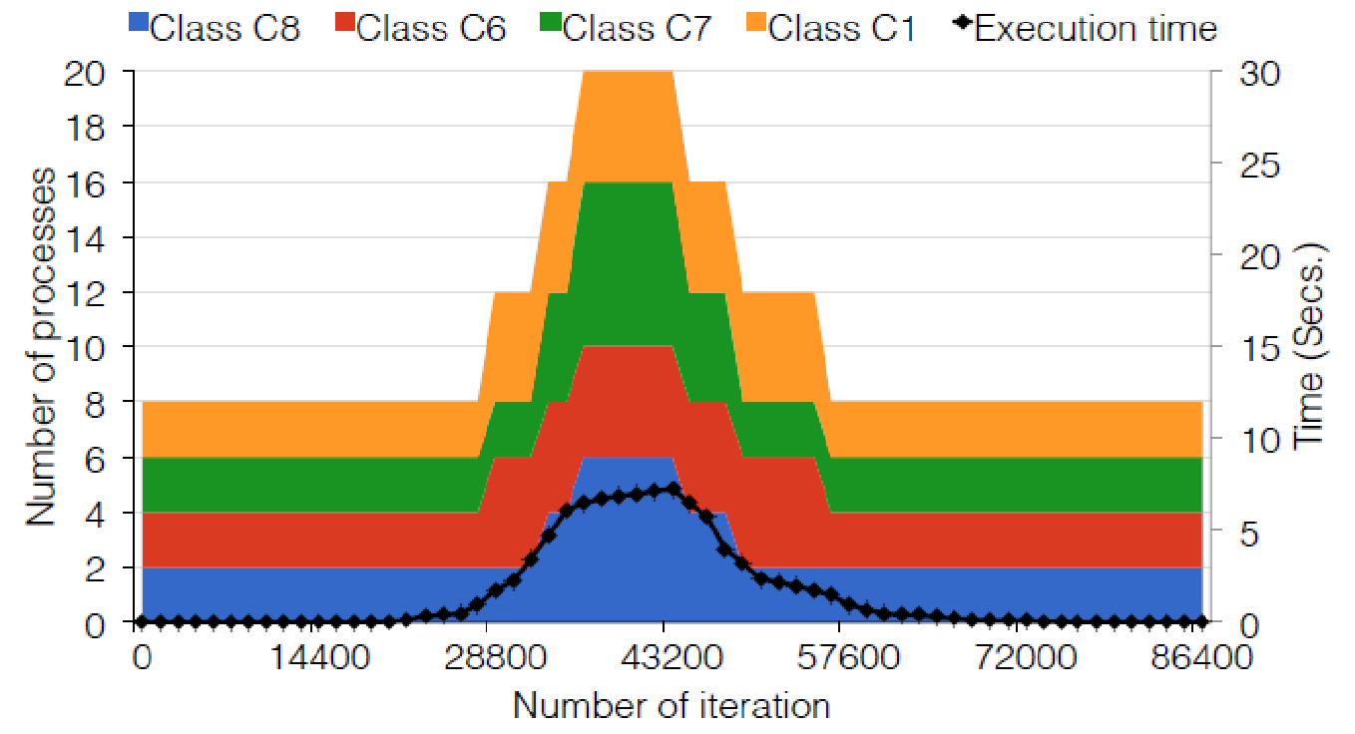
Performance-aware malleability
High performance malleability policy

Slide 13
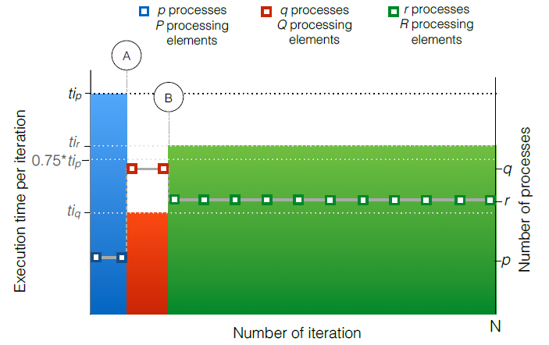
Performance-aware malleability
Adaptive malleability policy
Introduces a performance objective.
Example: reduce execution time a 25%
Considers both the application performance model and compute node characteristics

Slide 14
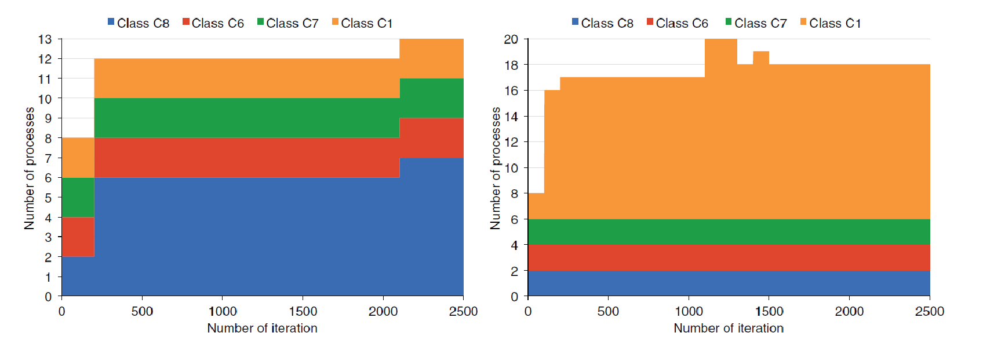
Adaptive application under constraints
Execution on cluster with different classes of compute nodes.
Objectives: minimize the operational cost
(a) Efficiency
(b) Cost

Slide 15
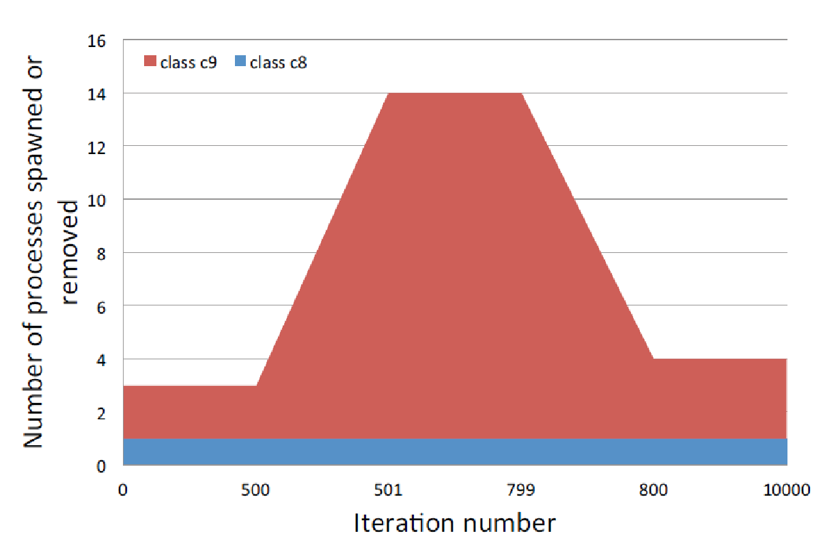
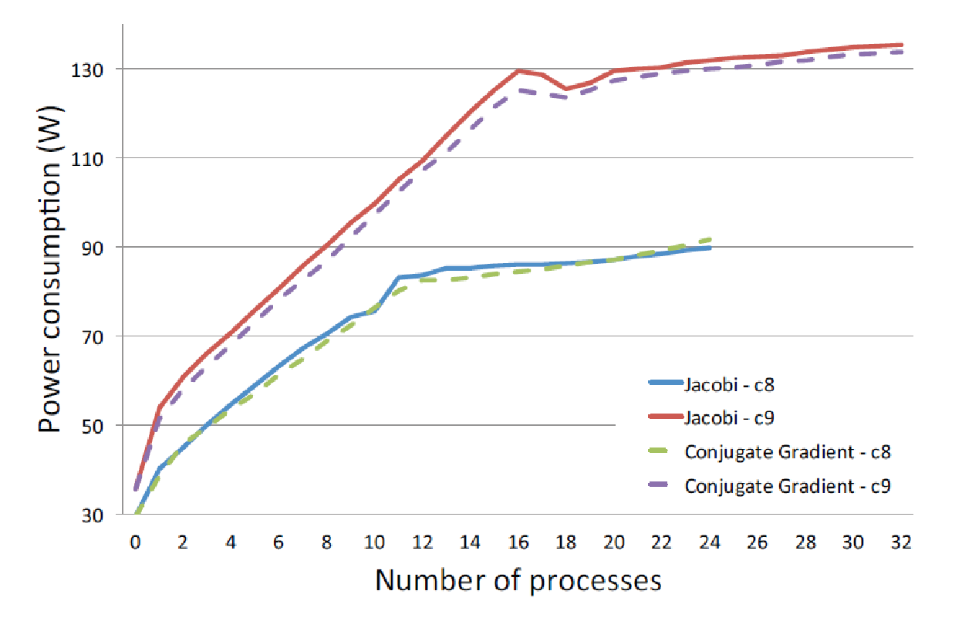
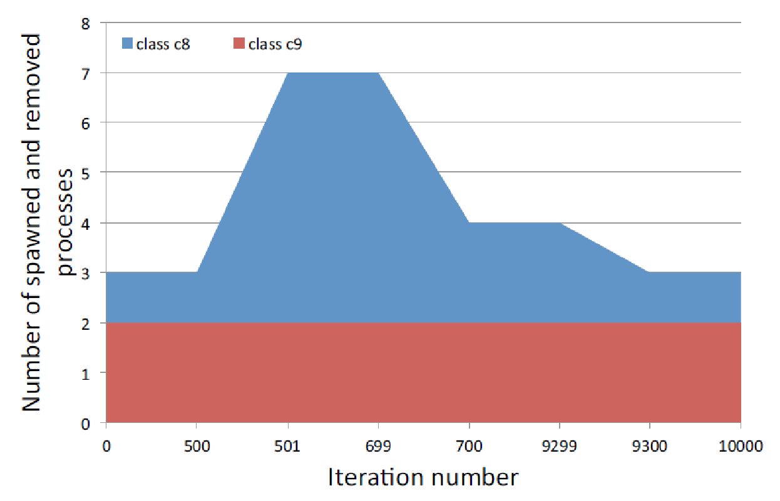
Energy-aware malleability
Malleable applications executed in different classes of compute nodes
Performance per Watt Maximization
Reducing I/O congestion
Energy minimization

Slide 16
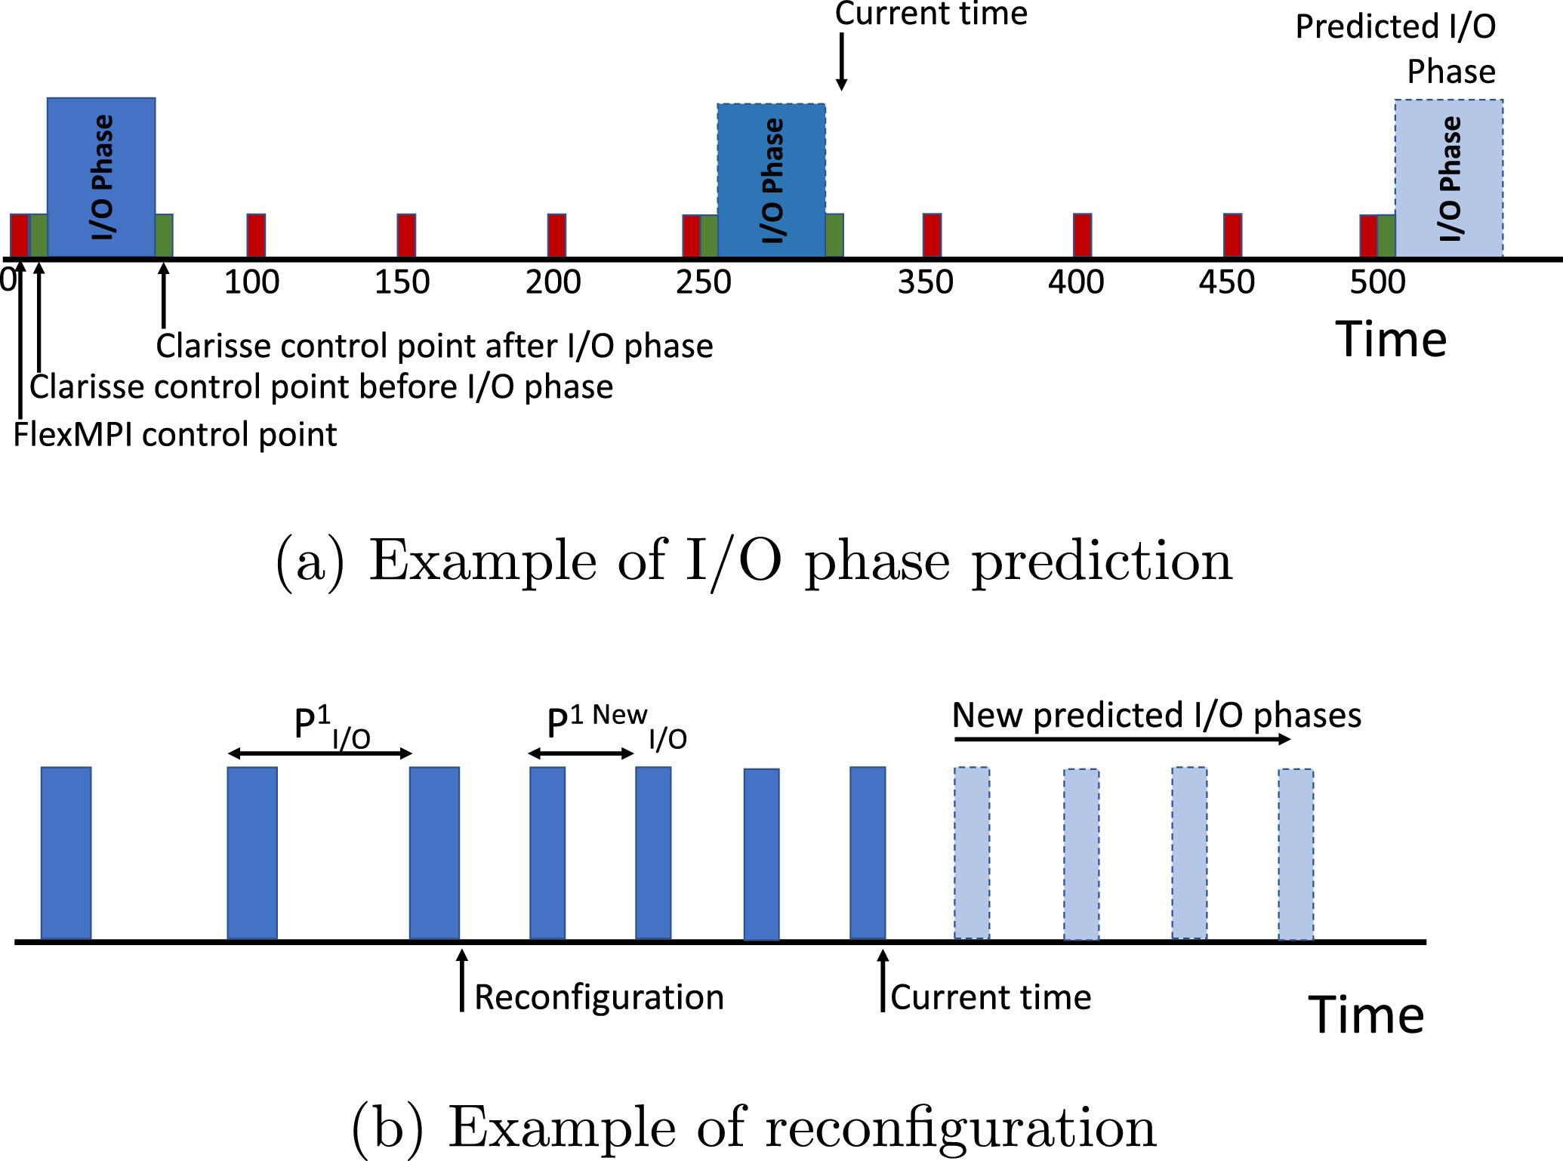
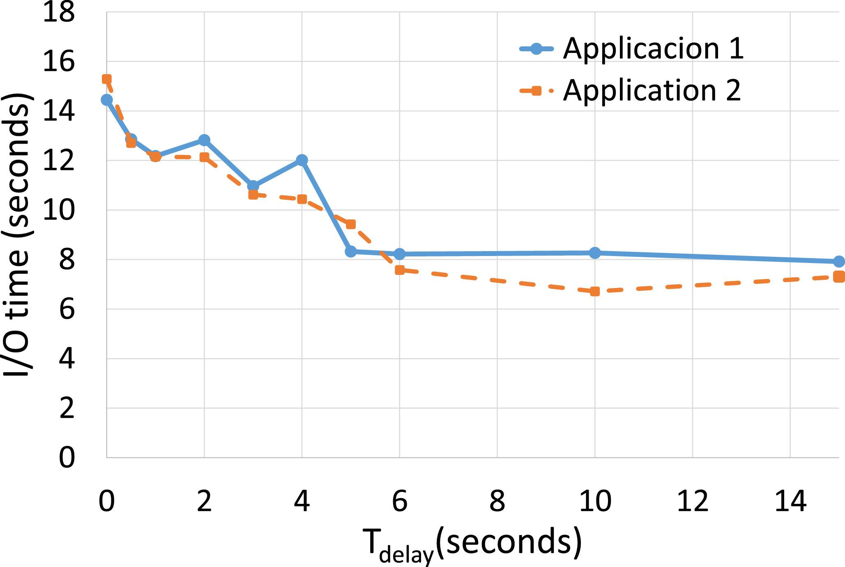
Reducing I/O congestion
I/O congestion: multiple application simultaneously performing I/O

Slide 17
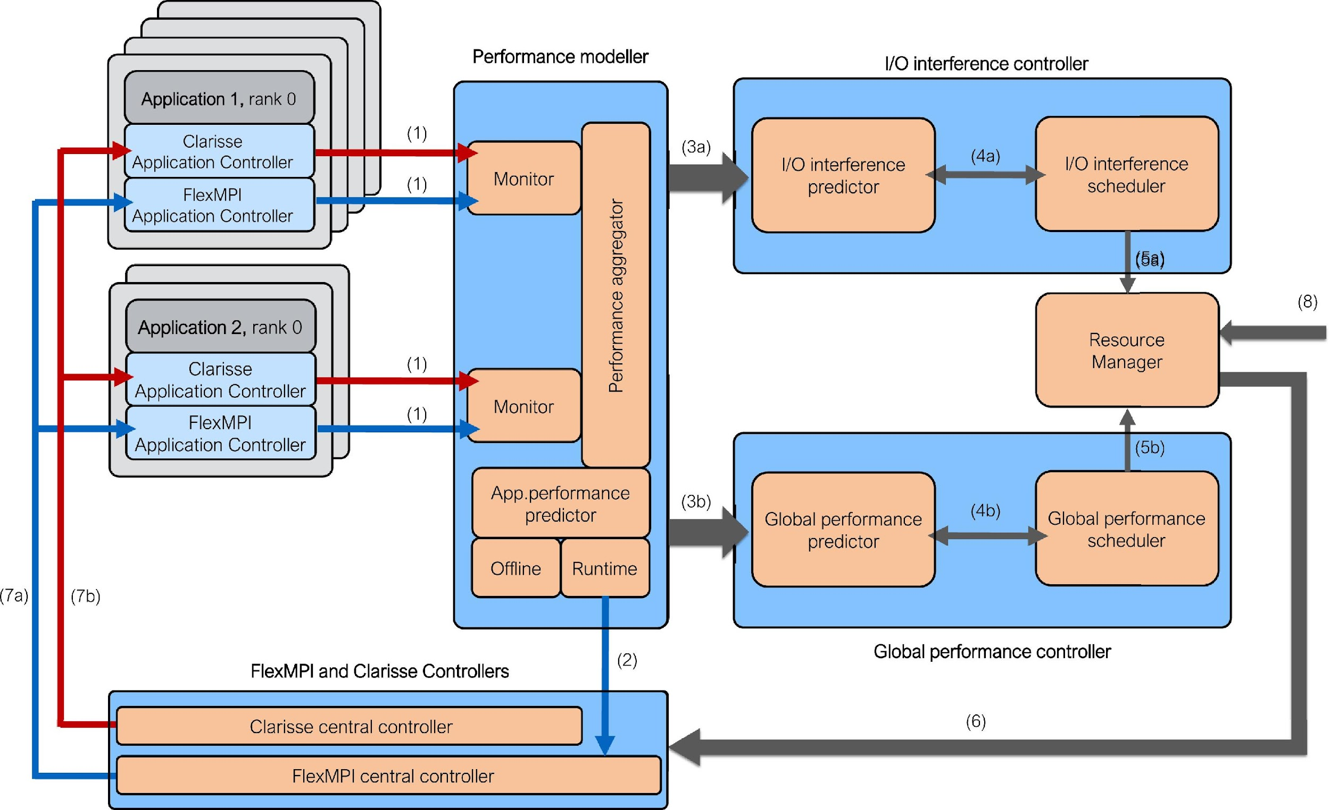
Reducing I/O congestion

Slide 18
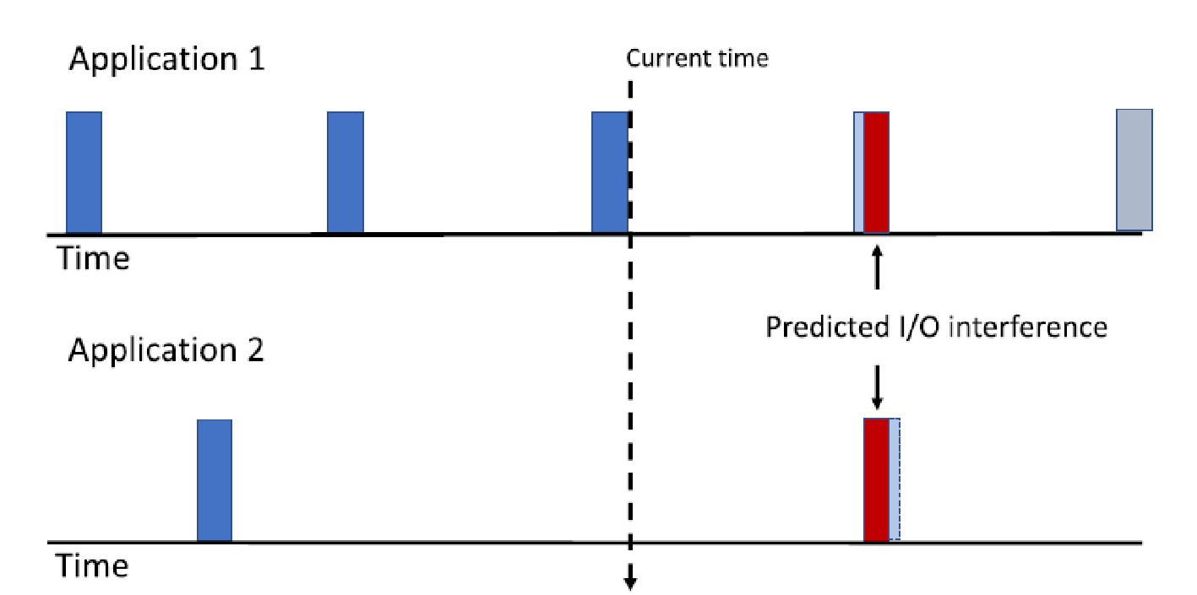
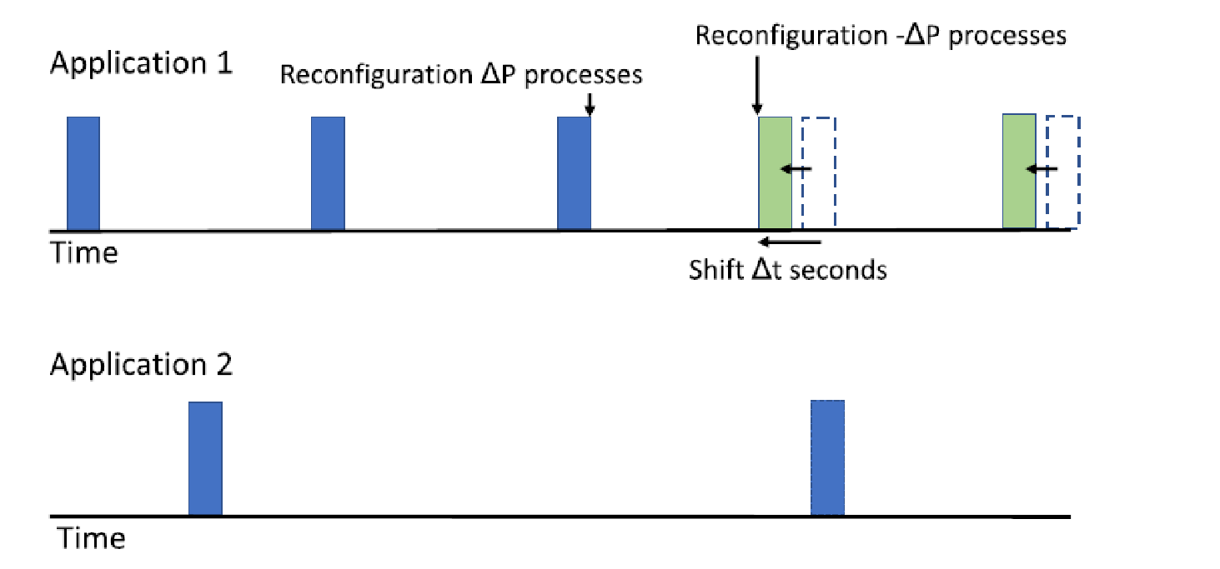
Reducing I/O congestion
Detection and prevention of inter-application I/O conflicts
The I/O frequency (I/O phase interval and duration) is changed by malleable actions

Slide 19
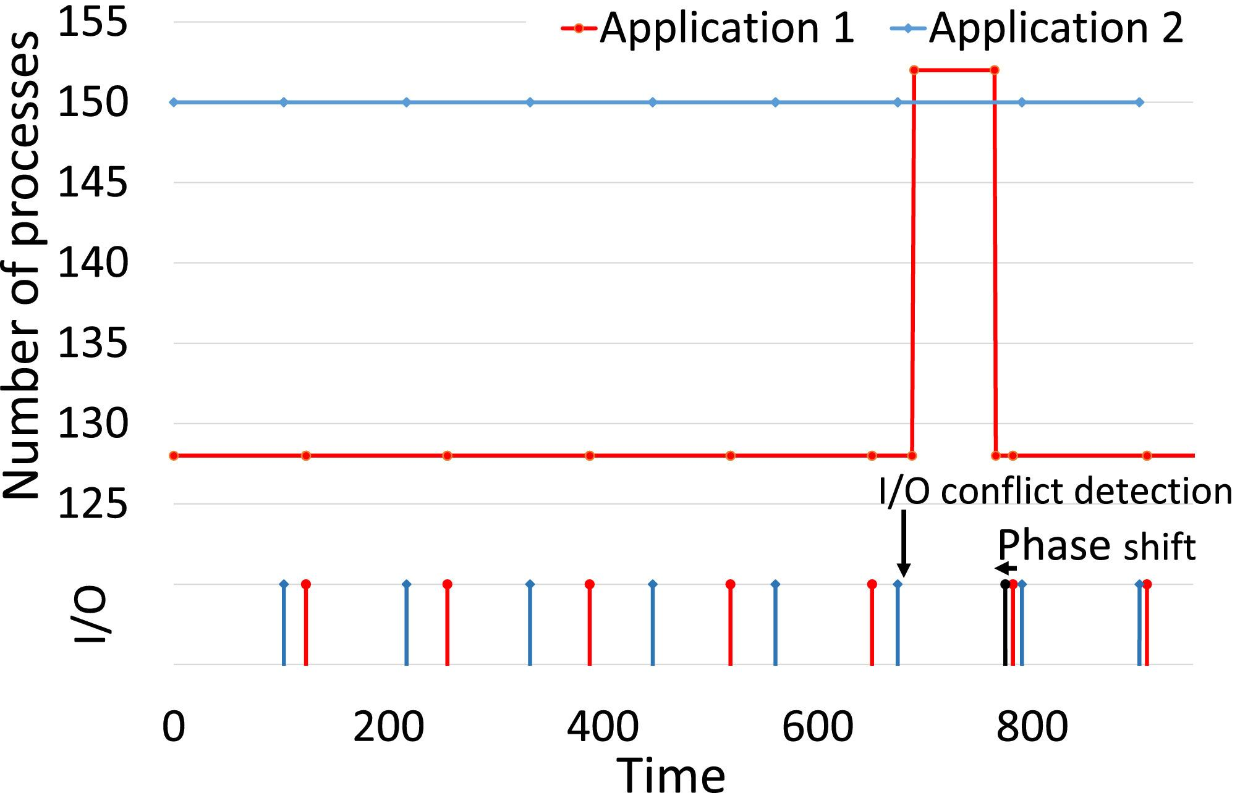
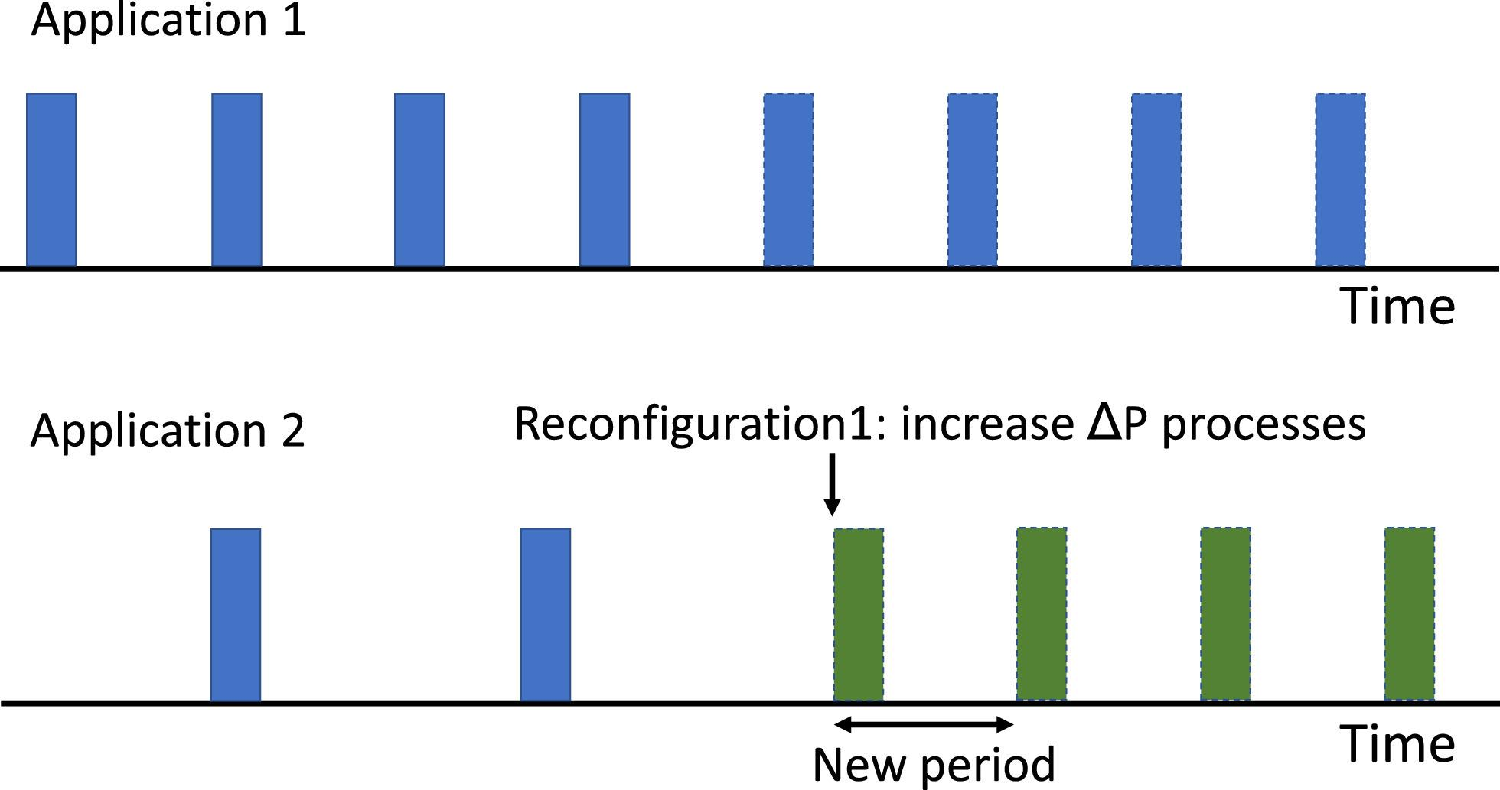
Reducing I/O congestion
Two I/O strategies: phase shifting (left) and period coupling (right)

Slide 20
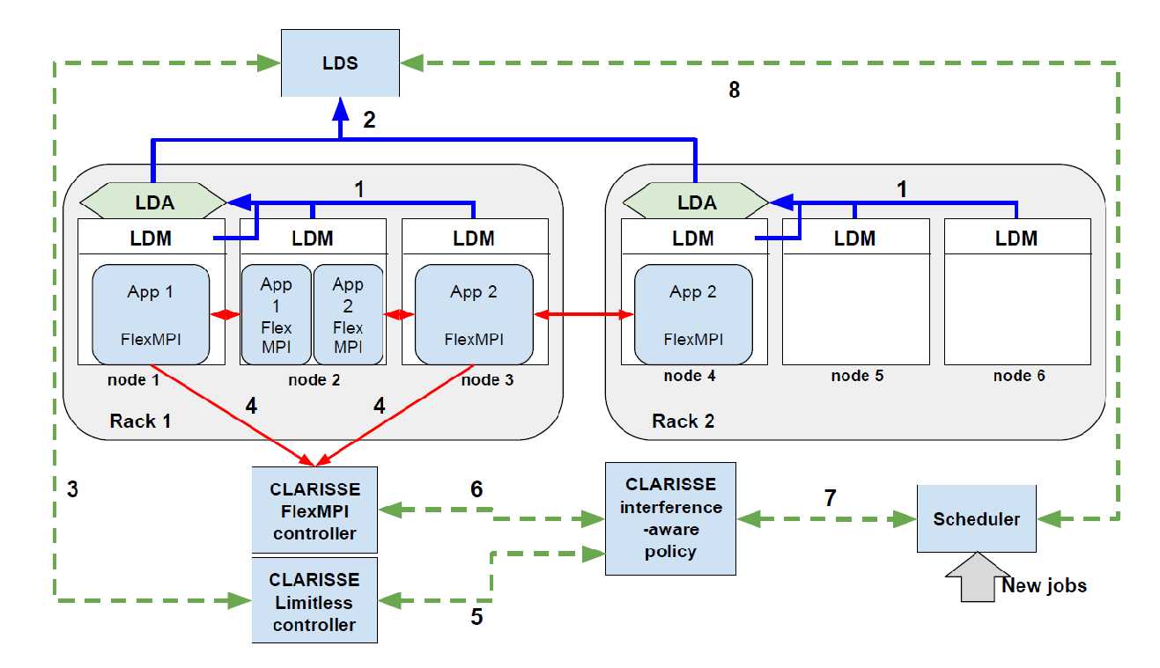
Application scheduling in non-dedicated clusters

Slide 21
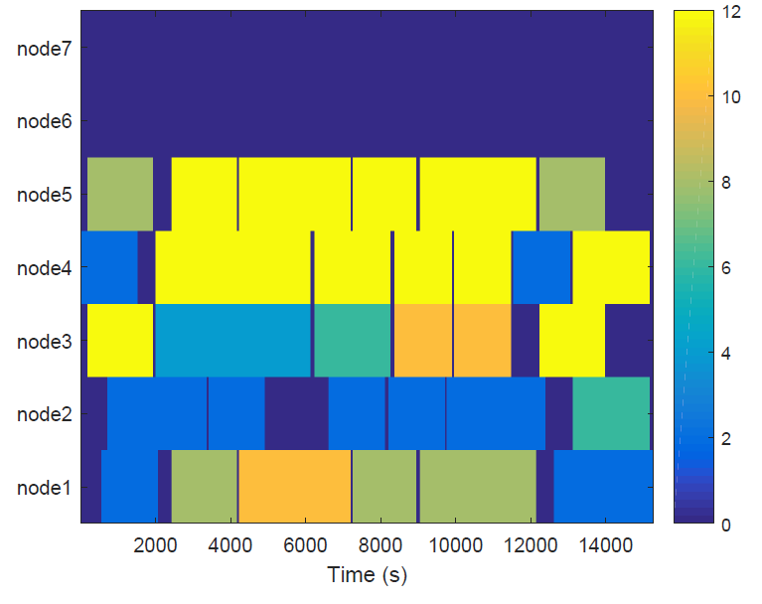
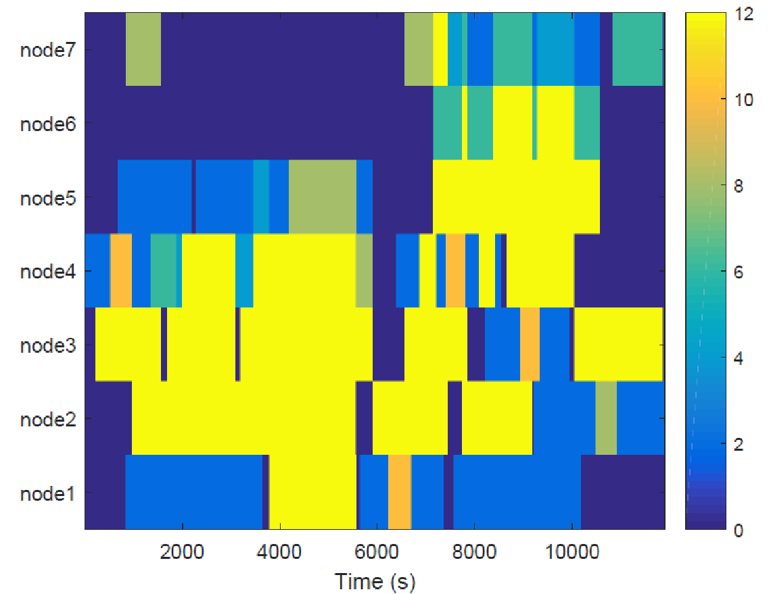
Application scheduling in non-dedicated clusters
Idea: permit execution of multiple applications in the same compute nodes
Conflicting applications are dynamically migrated by malleability
System utilization when compute nodes are exclusively assigned (left) and shared (right)

Slide 22
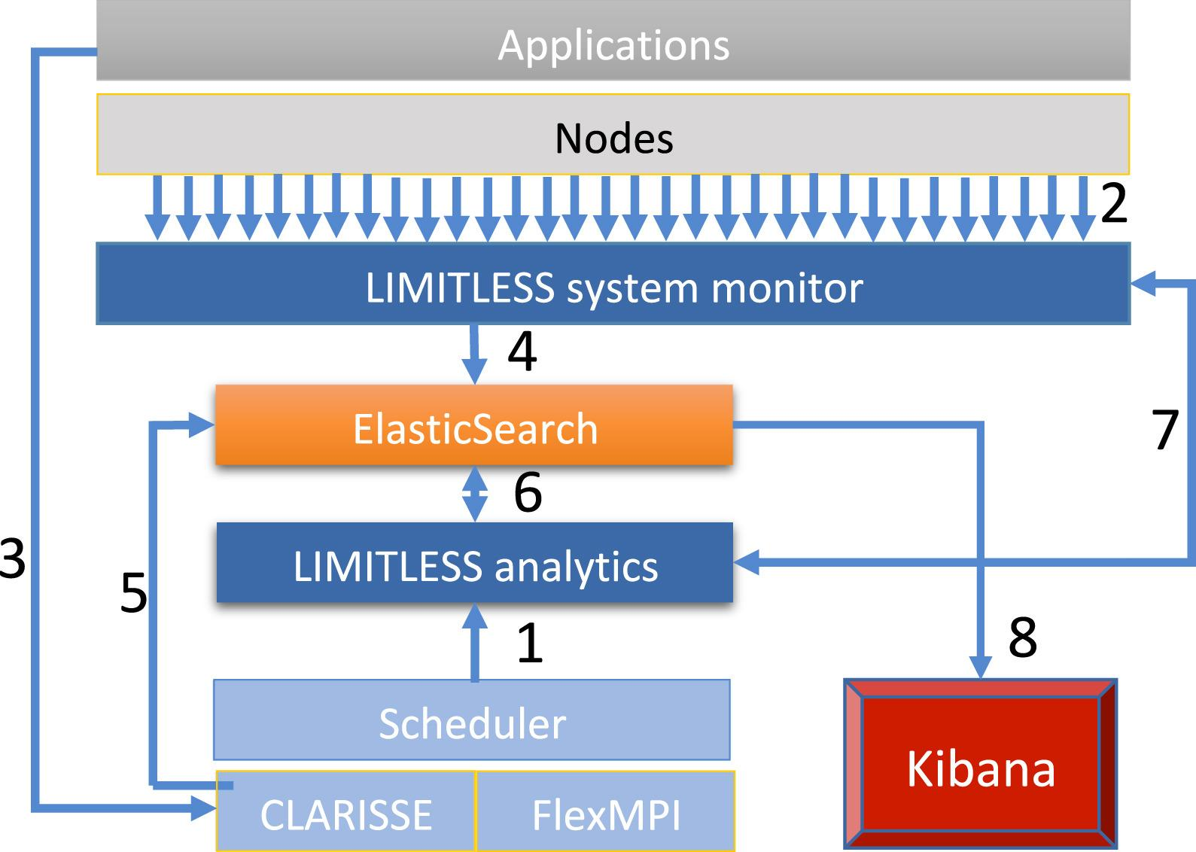
Multicriteria scheduling
Scheduler combines information from: monitor, FlexMPI, users and pre-defined application performance models.
Integration of application (FlexMPI) and compute-node (LIMITLESS) monitoring.
Application modelling based on machine learning algorithms.

Slide 23
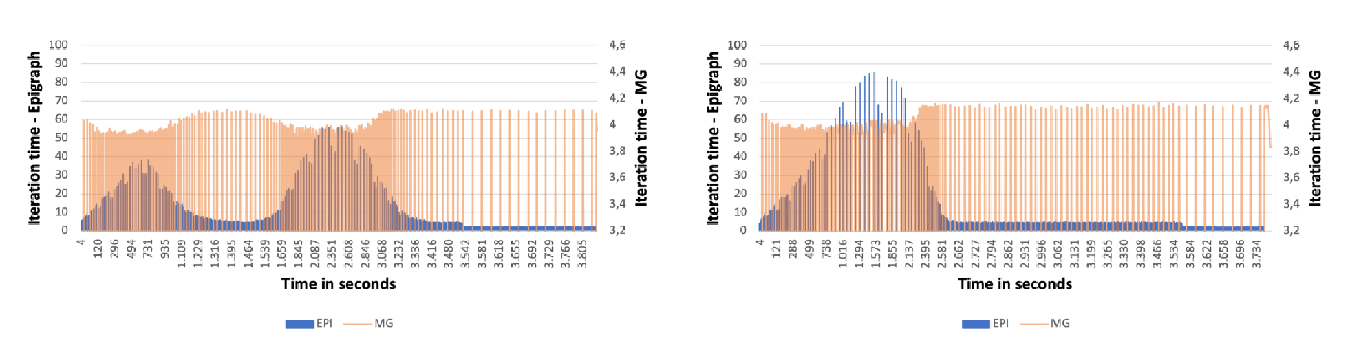
Multicriteria scheduling
Malleability is used for migrating one application between compute nodes
When different application share some compute nodes
Conflicting application can be partially (or completely) migrated to other compute nodes

Slide 24
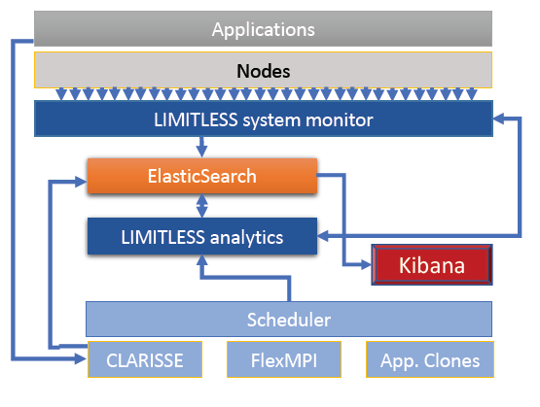
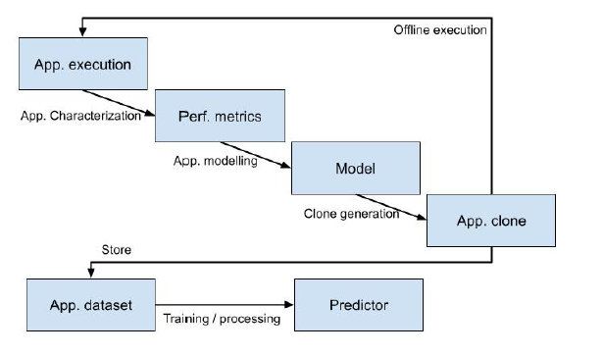
Application malleable clones
Synthetic malleable micro-benchmarks
Reproduce the application behavior under different number of processes
Multiple data distribution schemes

Slide 25
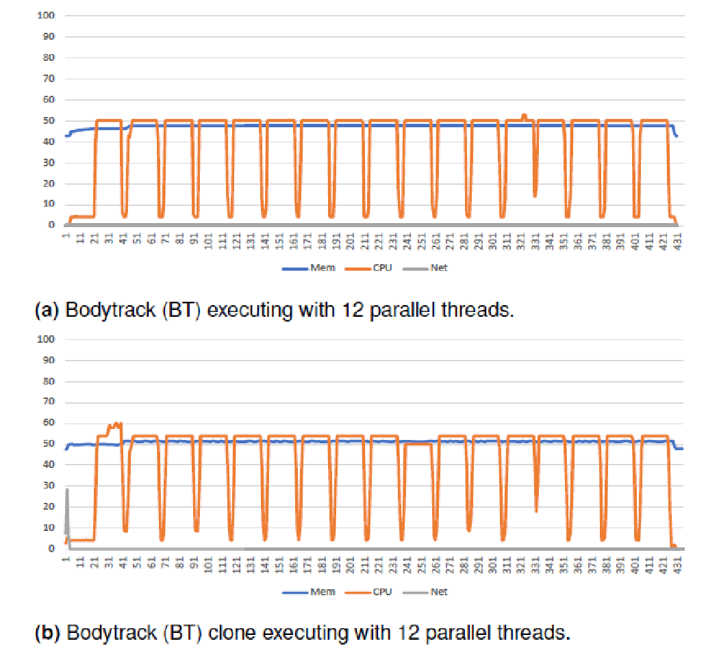
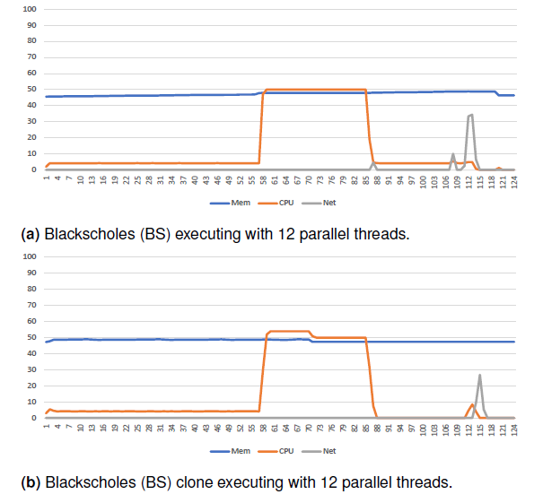
Application malleable clones
Modelling of CPU, memory, communication and I/O phases
Clones used to improve the application modelling and interference analysis

Slide 26
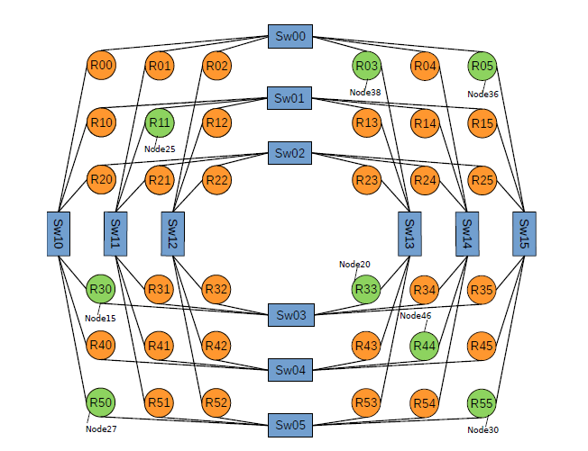
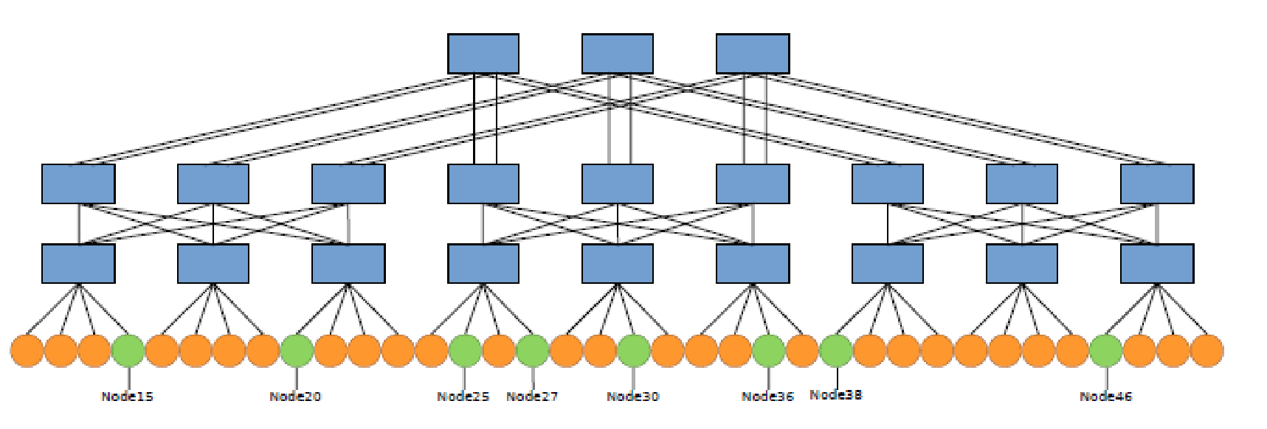
Reducing InfiniBand network congestion
LIMITLESS used to obtain accurate information of congestion in InfiniBand (IBA) networks.
Combine application scheduling and migration strategies with OpenSM control software.
Goals:
Dynamically enhance the IBA congestion control mechanism
Prevent potential future congestion situations

