Slide 1


Tutorial: Storage and Computational Malleability
Ciro Giuseppe De Vita

Slide 2
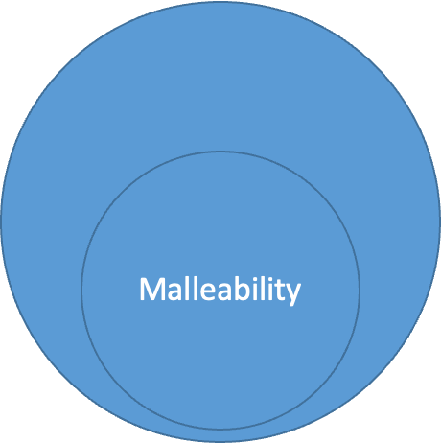
Dynamicity vs Malleability
Malleability:
Ability of an entity to adapt its resource usage on demand.
Dynamicity:
Ability of an entity to adapt its performance or behaviour to deal with changes in the workload.
Dynamicity

Slide 3
Focus on malleability
Change the number of processes of an application in run time.
Two operation types:
Expansion spawn processes.
Reduction shrink processes.
Benefits:
Improve the performance by acquiring more resources.
Balance the load between the allocated compute nodes.
Free unused (or underused) resources to improve other applications.

Slide 4
FlexMPI overview
Runtime that provides dynamic load balancing and performance-aware malleability capabilities to MPI applications
Written in C + MPI ( ~18,000 lines)
Used with iterative SPMD parallel applications
Consists of…
A multithreaded library executed within each MPI application
An external controller that coordinates the execution of multiple applications (optional)
An interface with third-party applications (scheduler).
Notes:
Runtime che fornisce bilanciamento dinamico del carico e capacità di malleabilità delle prestazioni alle applicazioni MPI
Scritto in C + MPI (~18.000 righe)
Utilizzato con applicazioni parallele iterative SPMD
Consiste in...
Una libreria multithread eseguita all'interno di ogni applicazione MPI che permette di creare/rimuove processi

Slide 5
FlexMPI overview
FlexMPI features:
Provide malleable capabilities to MPI applications
Provide adaptive capabilities to MPI applications with different policies:
Strict malleability
High-performance
Adaptive policies: efficiency,cost, and energy
User-defined actions
Load balance for both dedicated and non-dedicated platforms
Application run-time monitoring -using hardware counters-
Node-level monitoring -in coordination with external monitors
Controller features
Application scheduling
I/O scheduling

Slide 6
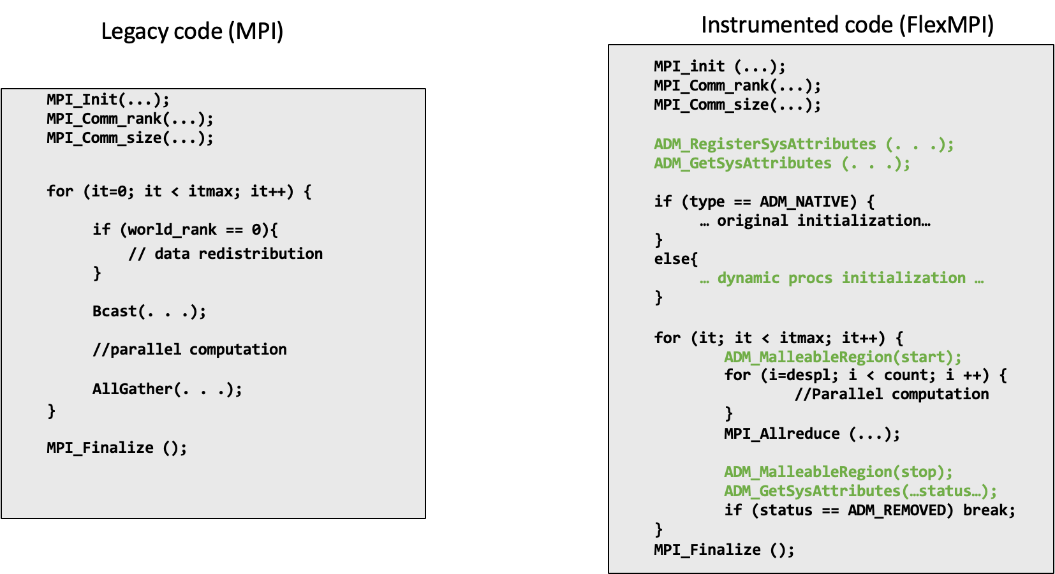
FlexMPI internals: code example
Notes:
Passare da MPI a FlexMPI

Slide 7
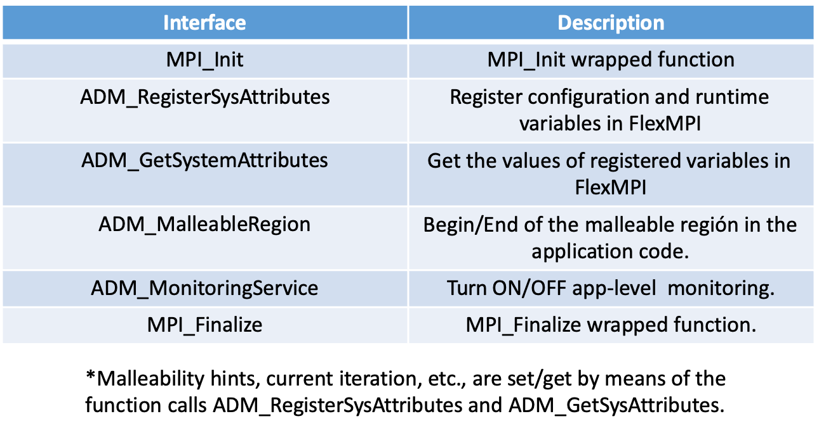
Flex-MPI basic interfaces

Slide 8
Docker cluster setup
Requirements:
Docker framework installed
Bash console and related tools
Download:
https://drive.google.com/file/d/1xXRRuMcwEfr7llzSnVkaqGmUnjAclH2P/view?usp=share_link
Cluster installation:
Decompress downloaded file sh> unzip slurm_cluster_itadata.zip
Activate the docker cluster sh> cd slurm_cluster_itadata sh> ./launch-slurm-cluster.sh –n 3 –c 2

Slide 9
Malleability environment setup
Set monitoring tools
Open a console to each cluster node and run monitor (htop): sh> docker exec -it slurm-node-1-1 /bin/bash sh> htop
Set htop to look for a specific application (F4 + “app. name”)
Notes:
Aprire 3 terminali per ciascun cluster e mostrare htop, cercare l’app Aprire un altro terminare con “watch squeue”

Slide 10
Malleability environment setup
Set Intelligent controller server
Open a console and run slurm view script sh> docker exec -it slurm-node-1-1 /bin/bash sh> icc_server
Compile samples
Open a console and execute make sh> docker exec -it slurm-node-1-1 /bin/bash sh> cd tutorial_examples
sh> make
Launch samples
Open a console and launch sample (ex. helloworld_mpi) from home using absolute path sh> docker exec -it slurm-node-1-1 /bin/bash sh> sbatch /home/admin/tutorial_examples/….sbatch
Notes:
Lanciare l’intelligent controller
Eseguire un’app di esempio
sbatch /home/admin/tutorial_examples/helloworld/helloworld_mpi.sbatch

Slide 11
Samples versions
Version to modify:
No suffix
This version start with the same code as original version.
But the makefile compiles it as a malleable version.
Original version:
Suffix: _mpi
This version is implemented using plain MPI (no malleability).
Executes 4 processes in 2 nodes (no changes).

Slide 12
Samples versions
Malleable version:
Suffix: _adm
This version is implemented using malleability features.
Starts executing 2 processes in 1 node.
Malleability sequence:
spawn 2 processes in 1 node.
spawn 2 processes in 1 node.
remove 2 processes from 1 node.
remove 2 processes from 1 node.
Notes:
Dopo questo, mostrare il file helloword_mpi e descriverlo Poi aprire il file helloword_adm

Slide 13
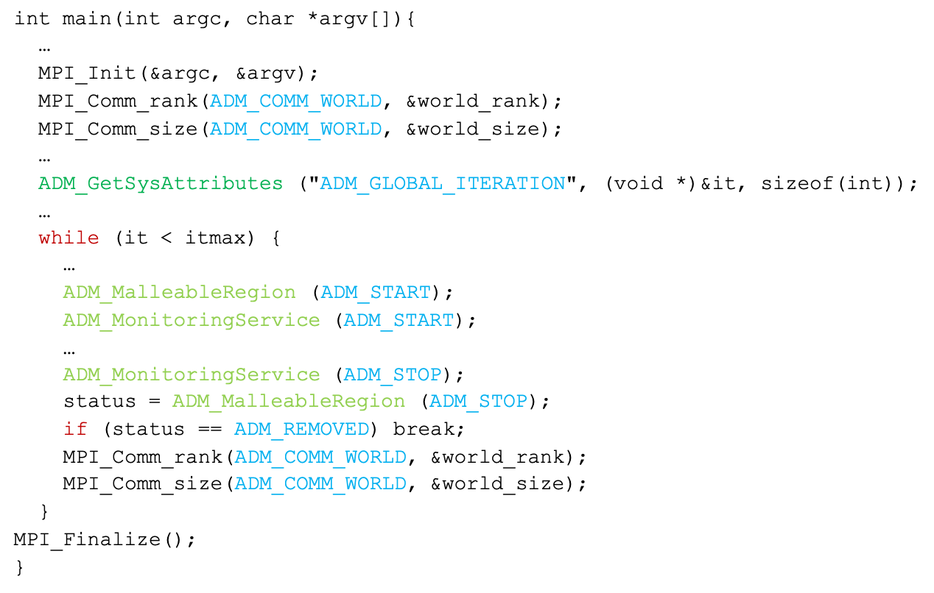
Example: Malleability Skeleton

Slide 14
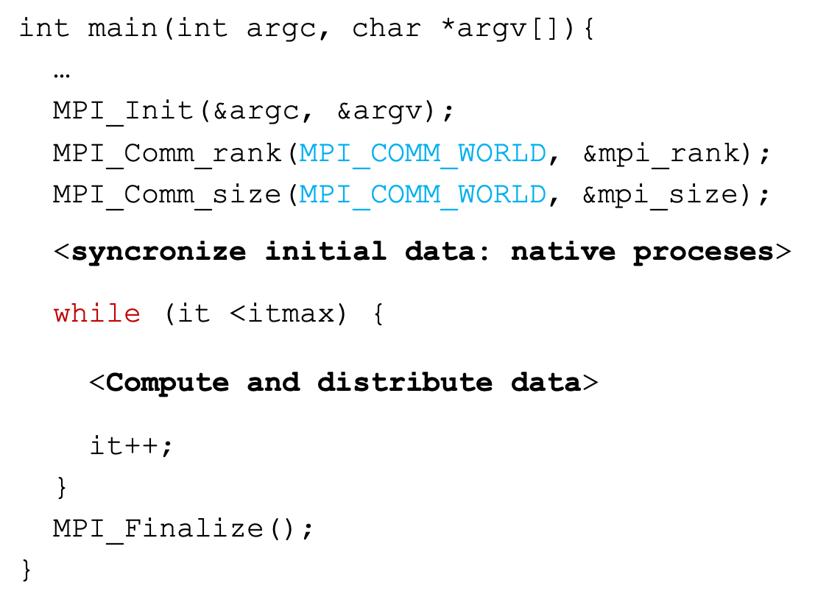
Original application pattern: C-based
Notes:
Inizializziamo MPI
Otteniamo il rank e il size

Slide 15
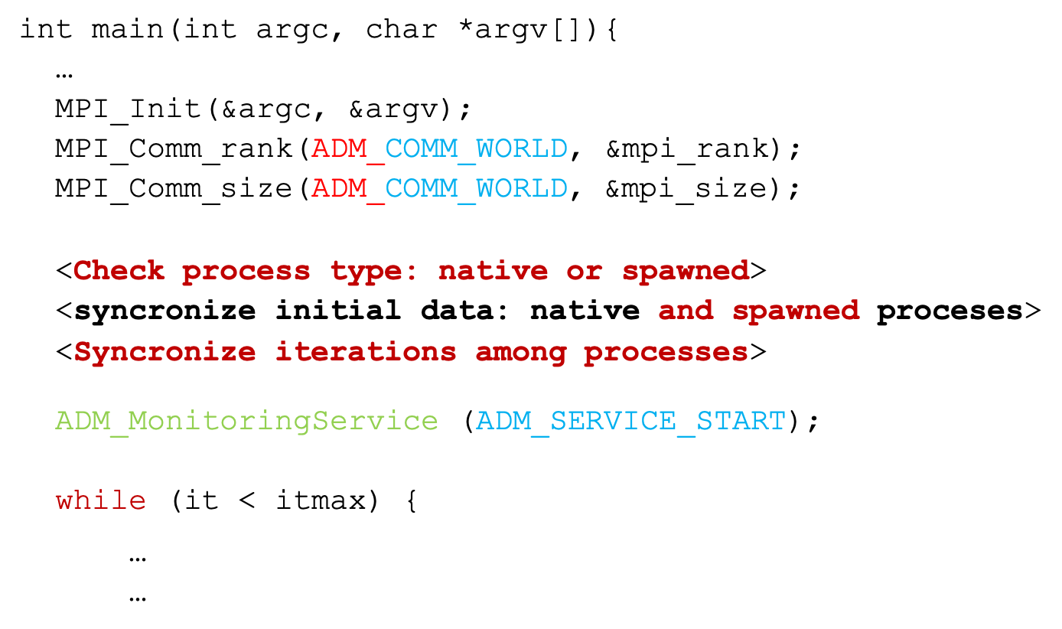
Malleable application pattern: C-based

Slide 16
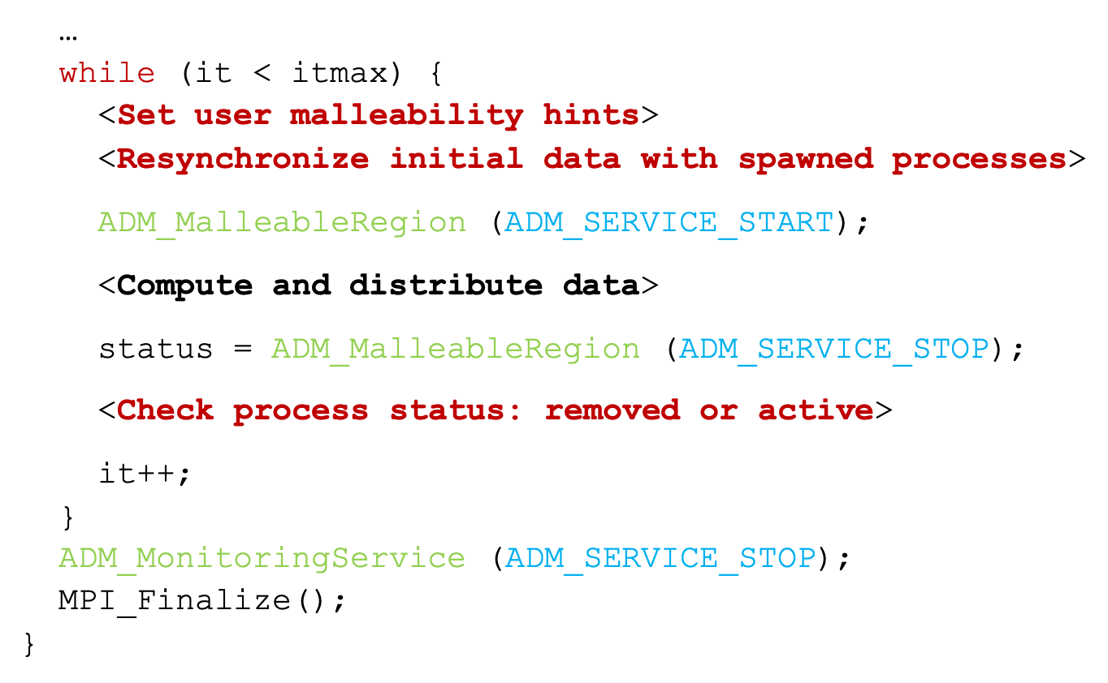
Malleable application pattern: C-based

Slide 17
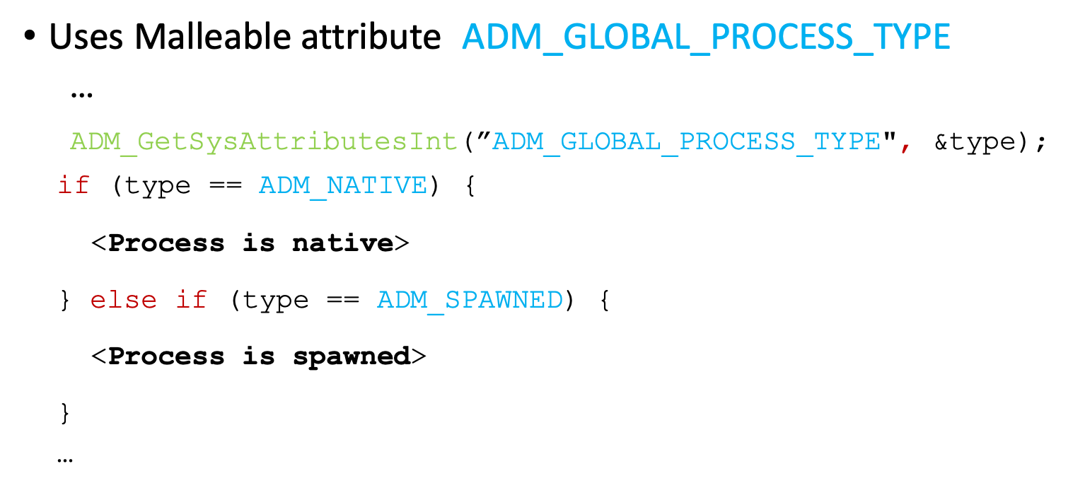
Modified sections: Check process type

Slide 18
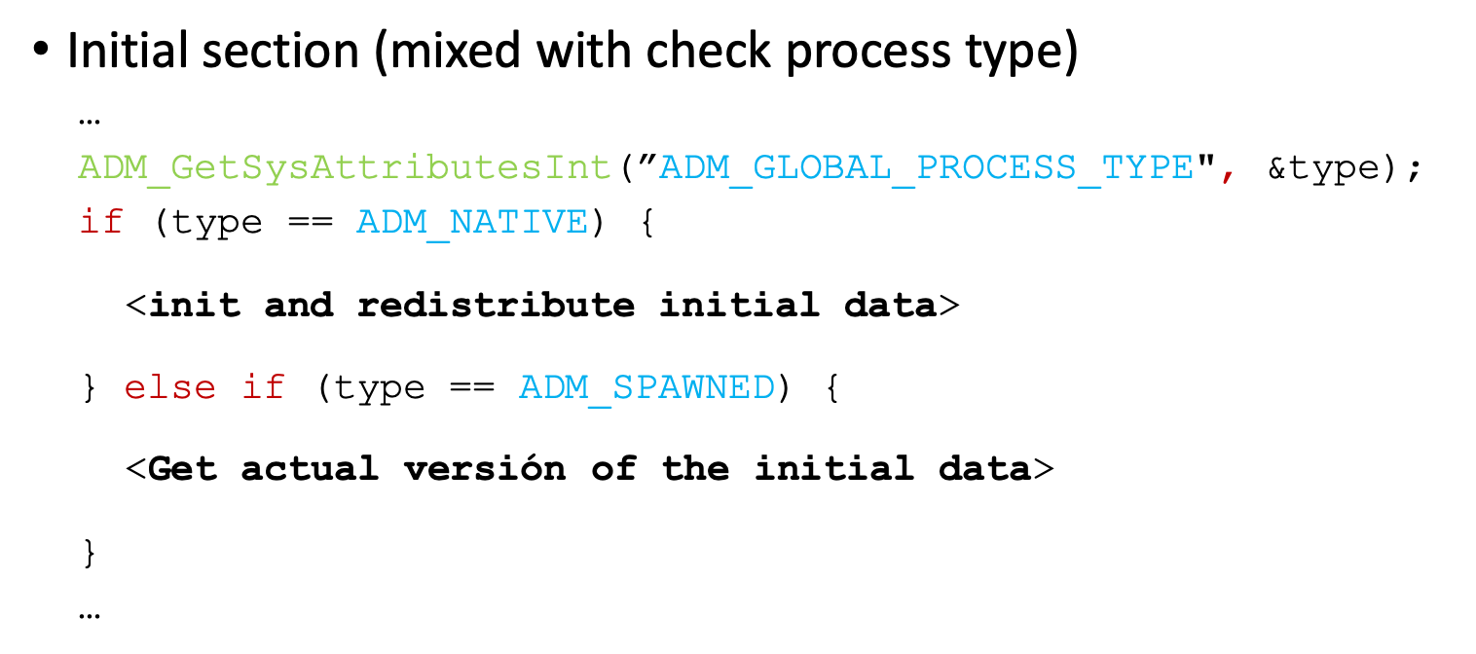
Modified sections: Re/synchronize initial data

Slide 19
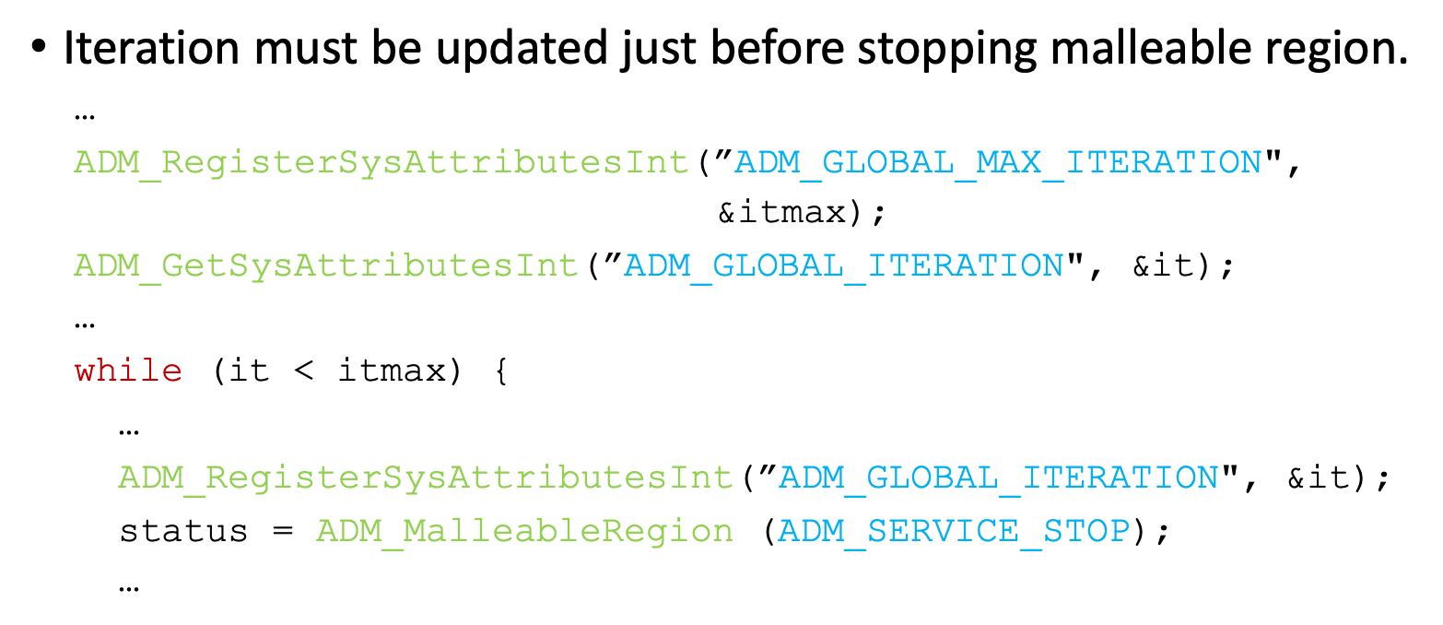
Modified sections: Synchronize iterations

Slide 20
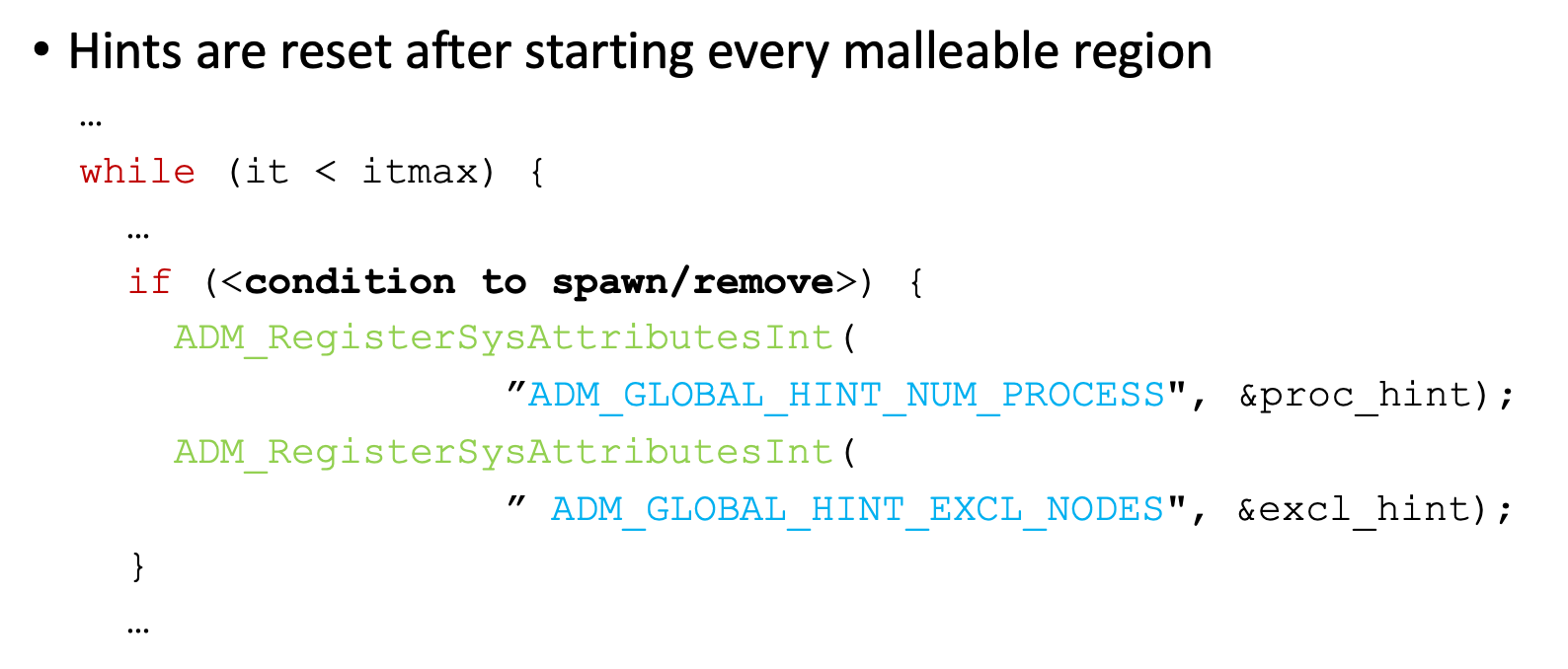
Modified sections: Set user hints

Slide 21
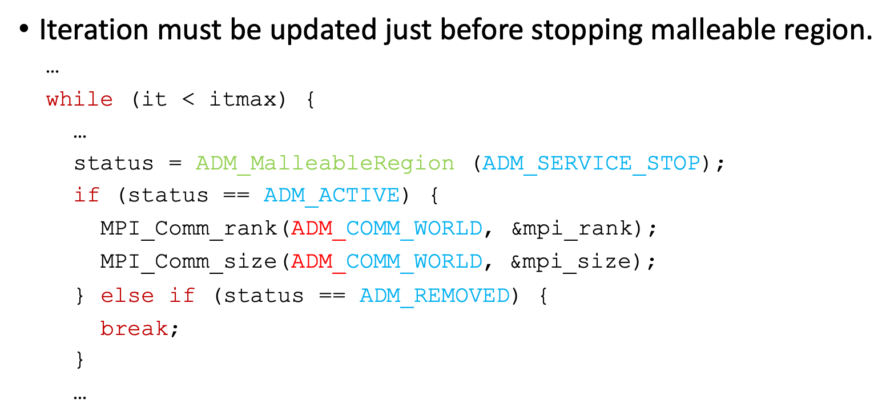
Modified sections: Check process status

