Slide 1
AQUARIUM
ICG PRESENTATION
-SHARAN SK / CED18I049

Slide 2
Execution Instructions:
To compile :
Command:g++ aqua.cpp -lglut -lGL –lGLEW –lGLU –o 2 && ./2
Make sure the 'windows.h' is included / uncommented for compilation in Windows OS
To Render next frame / Create Animation :
GlutPostRedisplay() and glutSwapbuffers() had been used in display function

Slide 3
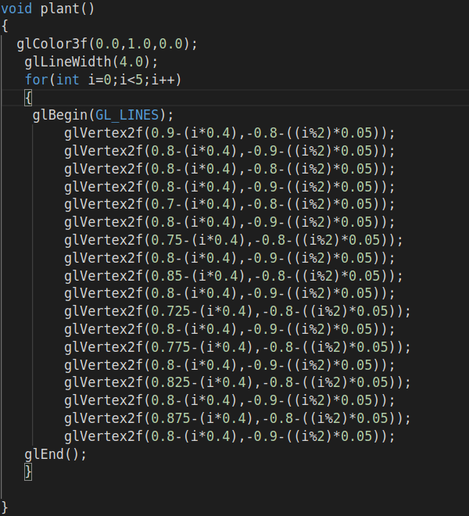
Creating Pebbles and Plants:
Plants :
Plants are created using many lines placed together with less spacing and at different angles using GL_LINES and using glVertex2f to connect end points
Line Width is increased to make the plant look dense using glLineWidth() and Color is set to green using glColor3f()
Pebbles:
Sand is created using GL_POLYGON with all the vertices connected manually

Slide 4
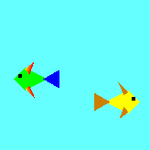
Creating Fish
Every Fish is Created by combining different polygons together I.e tail,fins,eye and body combined.
Polygons are constructed using GL_TRIANGLES and GL_POLYGONS and the vertices are hardcoded and eye is created using GL_POINTS.
The vertices are reversed for fish pointed towards right as opposed to fish towards left.

Slide 5
Fish Animation using Translation
Before making the fish move we have to ensure that the animation is applied only to the specified object for which we have would be using glPushMatrix() and glPopMatrix() and in the display function ,glutPostRedisplay() ,glFlush() and glutSwapbuffers() are to be applied because of the following reason.
GlutPostRedisplay():Responsible for rendering the next frame
GlFlush():Forces to refresh frame buffer.
GlSwapBuffers():Since for the next frame to be displayed , the program would have to be in Double buffering mode and this functions displays the current frame while next frame is buffered to be shown next.
OpenGL keeps a stack of matrices to quickly apply and remove transformations.PushMatrix pushes the transformation onto the stack and PopMatrix removes the stack object.
Transformations which are to applied to the object and the object definition are present inside between the PushMatrix and PopMatrix .
For the animation shown on right , the fish would be translated along X-axis by a value of 'a'.Every time the display function is called ,'a' value will be updated and based on the updation ,the translation will be applied on the next call
The bubbles and sand shown in the gif also follows the same method as above .A circle is drawn and is translated towards up based on a variable. Similarly sand is also translated.

Slide 6
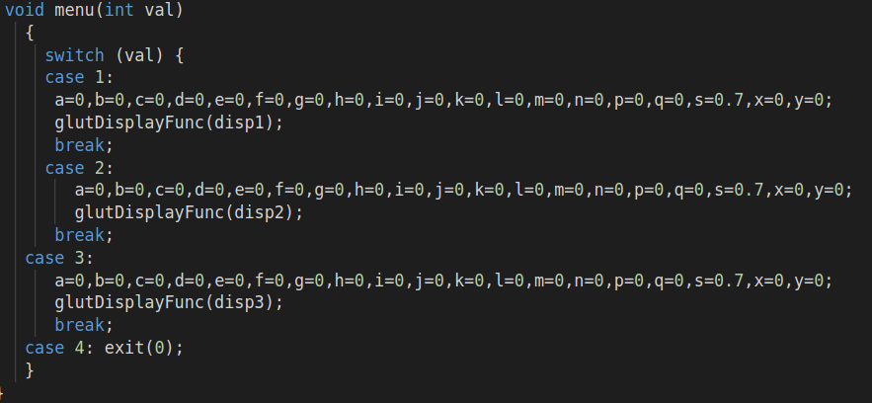
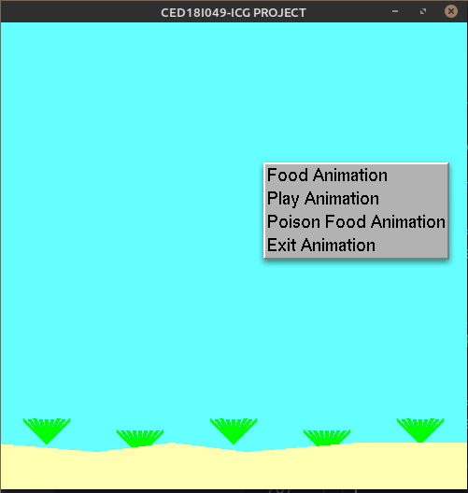
Create menu for various animations:
Menu has been created in Opengl using the code below in order where 'menu' is the function that calls the correspomdnding functions:
glutCreateMenu(menu);
glutAddMenuEntry("Food Animation", 1);
glutAddMenuEntry("Play Animation", 2);
glutAddMenuEntry("Poison Food Animation", 3);
glutAddMenuEntry("Exit", 4);
glutAttachMenu(GLUT_RIGHT_BUTTON);
Menu functions calls 'disp1' function for Food.'disp2' for Play and 'disp3' for Poison Food Animation using glutDisplayFunc() and passing the function as parameters
The created menu can be seen on the right side.

Slide 7
Play Animation
The fishes are spawned at different location of screen and is made to move along X-axis .
Movement along positive and negative axis is achieved using glTranslationf() and by varying x value being passed into the function. The x value being passed is increased or decreased depending on its movement.
Once the fish moves out of the screen ,the x value of translation will be reset and the animation repeats.Since the display function is called during every frame rendering ,a simple 'if' loop is enough to check whether the value 'x' is out of bounds
The fishes are made big using glScalef().

Slide 8
Food Animation:
Food Animation has 'Play Animation' embedded into it. Onto the frame three fishes are added on either sides.
The Food is spawned as points at different location and the fish is made to translate from its current location to the food along X and Y axis. Once the translation 'x' and 'y' values reach the corresponding threshold ,the 'y' value is reduced and is moved towards the food along x-axis after which the fish crosses the food and the points are removed from the loop.
The above sequence of events are for one fish,for the other two fishes,separate translation variables are maintained to keep track of their animation.

Slide 9
Poison Animation
The poison animation starts with a food and a yellow fishbeing spawned.The fish is along the line and is translated along x axis towards the food.
The fish is spawned using split_fish() function in which the translation is done manually by slowly subtracting a value from Xpoints of the fish vertices every time the frame renders to simulate the fish moving,In this way translation is applied to every part of the fish:body,tail and fins.
Once the threshold x value is reached ,where the point is placed ,the point is removed and using GL_POINTS ,every part of the fish becomes seperated into chunks since GL_POINTS treats each polygon as points of large scale.

Slide 10

END OF PRESENTATION

