Slide 1
Development of Semi-Supervised Learning Model on Diabetes & Marketing Dataset using Super Learner
Group A
Nishita Vikas Shewale
Trivikram Bhavesh Budhabhatti

Slide 2
Project Overview
Objective:
Develop a semi-supervised learning model using a super learner.
Key Steps:
Preprocessing of the Diabetes & Marketing Datasets
Generate labels with K-means
Feature extraction with PCA
Classify using Super Learner
Applying the model on the new dataset (Marketing Dataset)

Slide 3
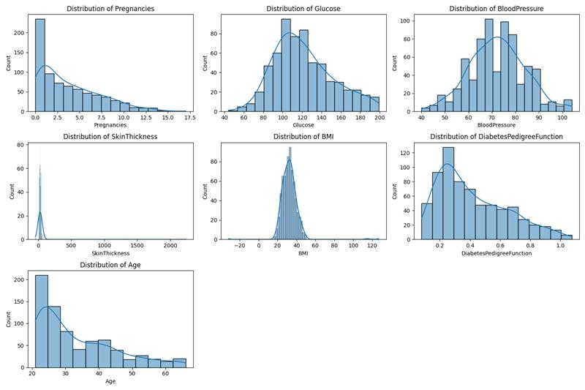
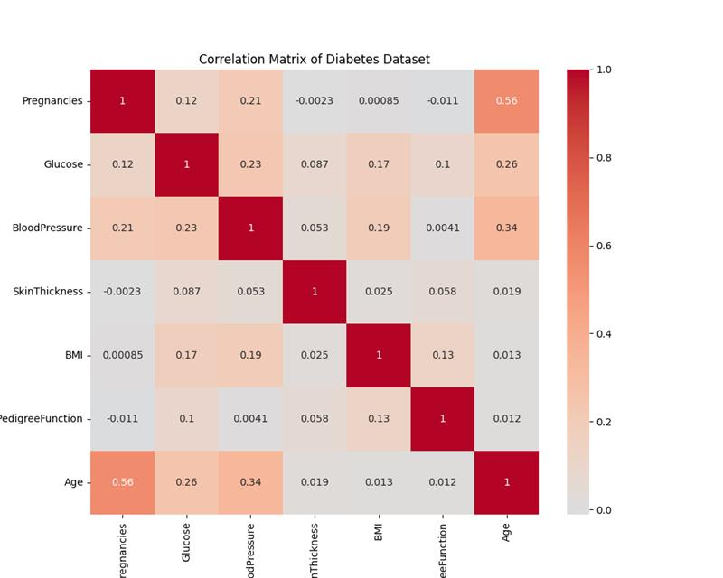
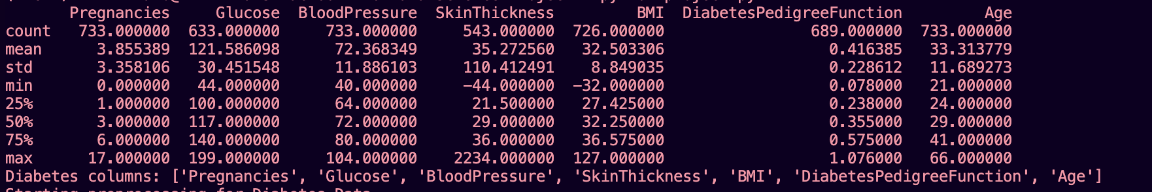
Data Profiling- Diabetes

Slide 4
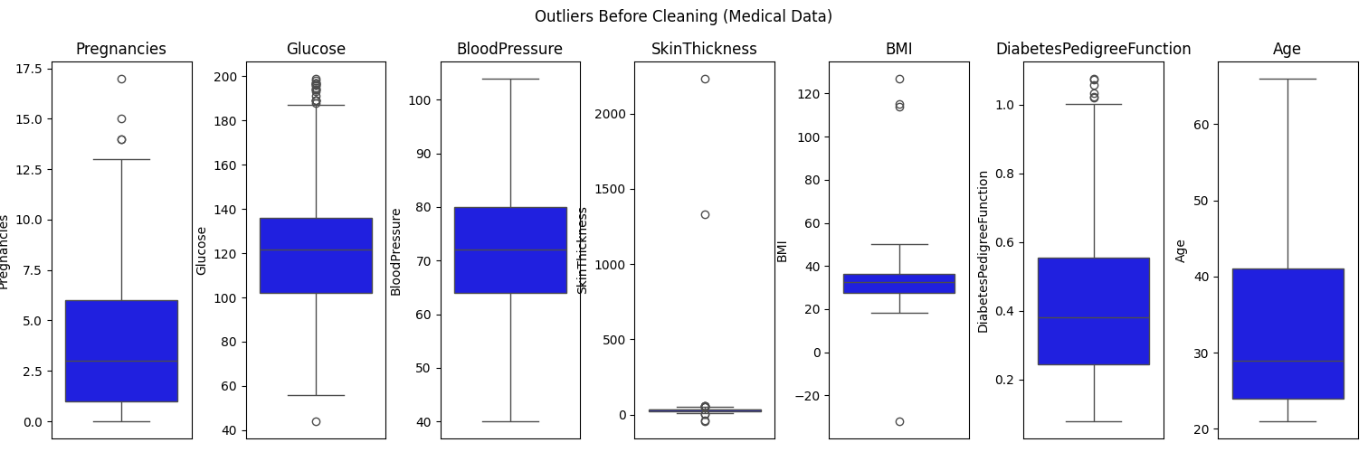
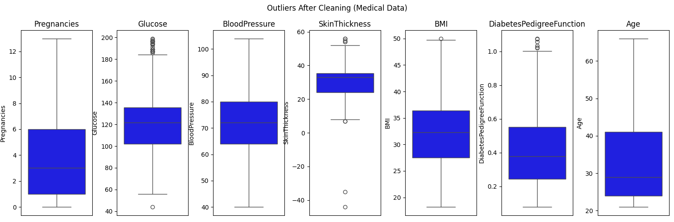
Data Preprocessing - Diabetes
Analyzed and Removed outliers using Z-score
Imputed missing values with mean
Visualized Before & After Data Preprocessing with the help of Boxplots

Slide 5
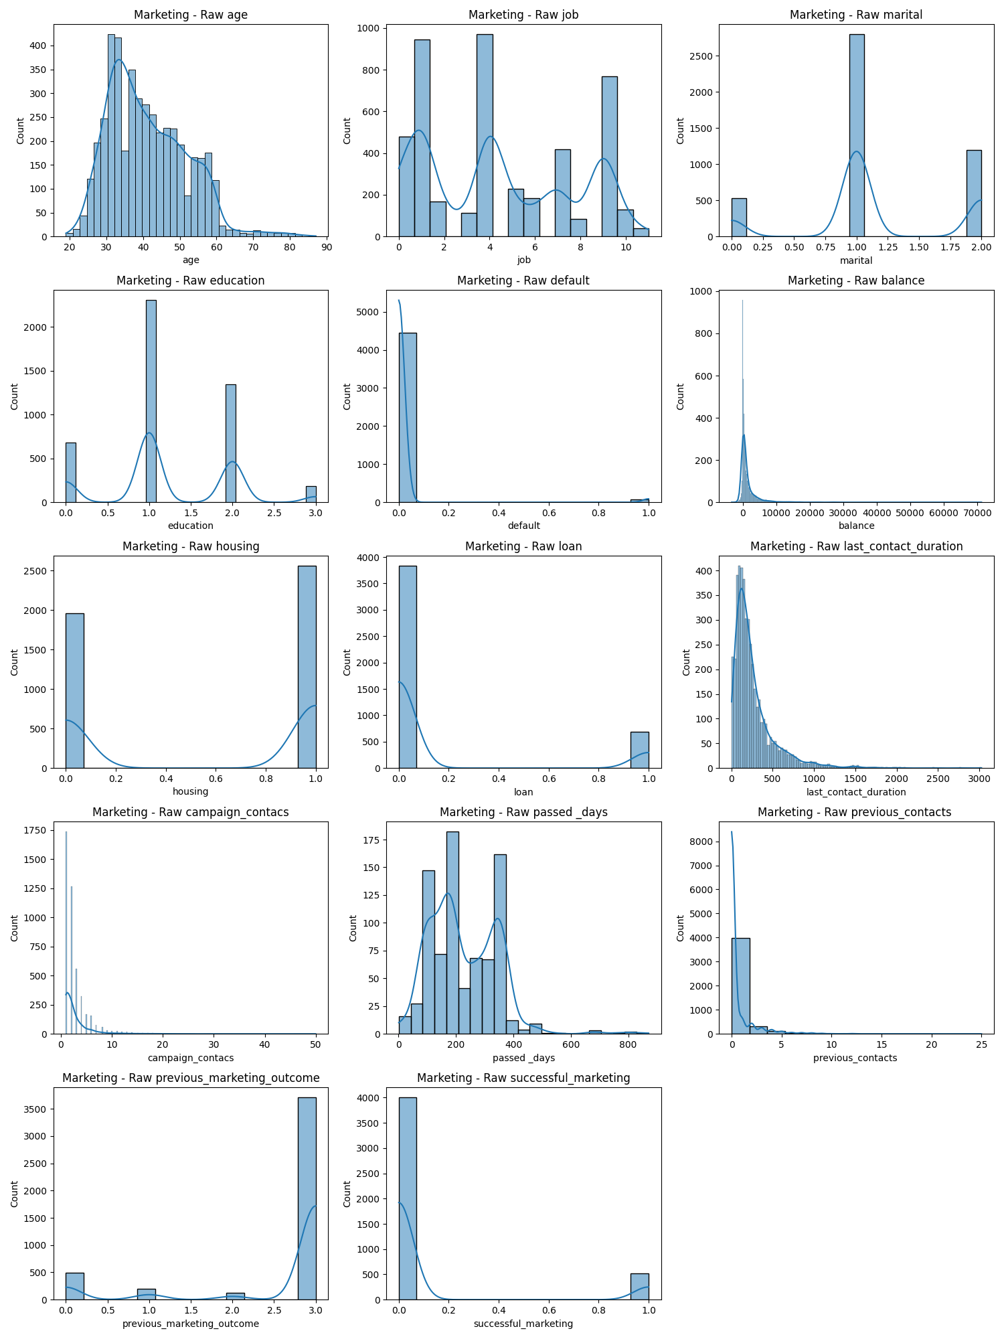
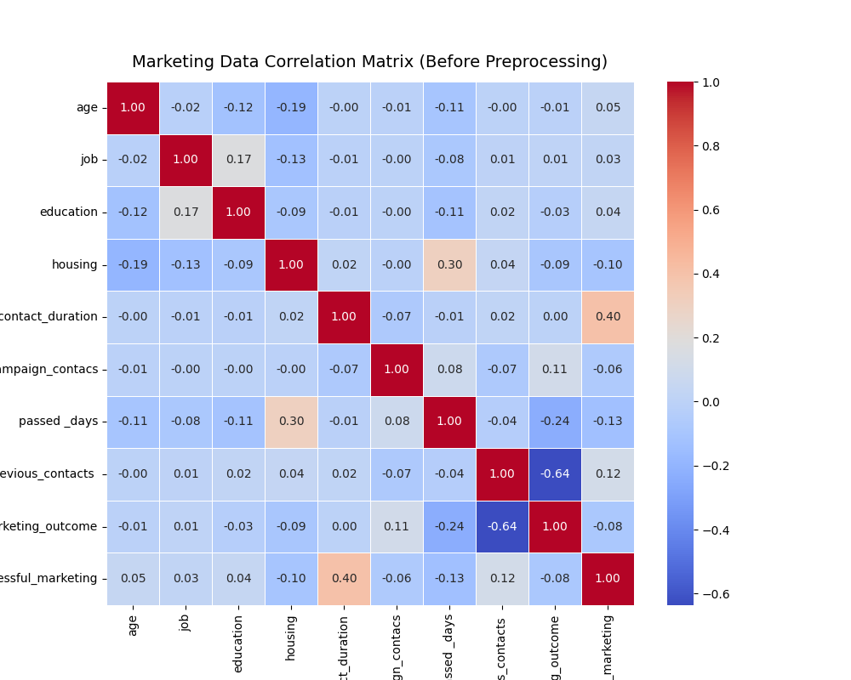
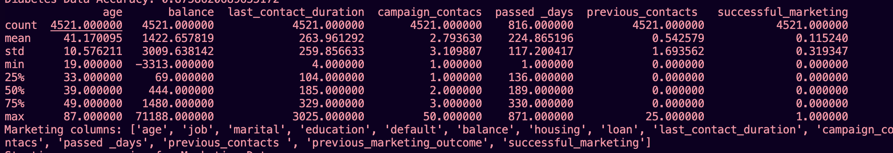
Data Profiling- Marketing

Slide 6
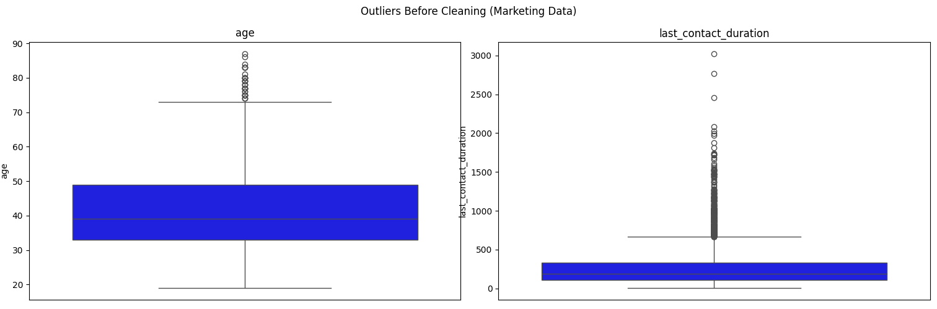
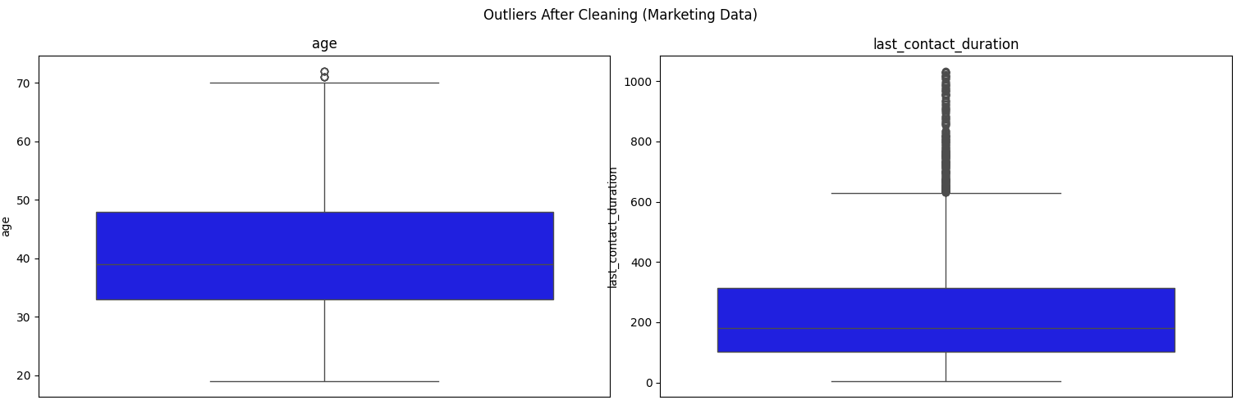
Data Preprocessing - Marketing

Slide 7
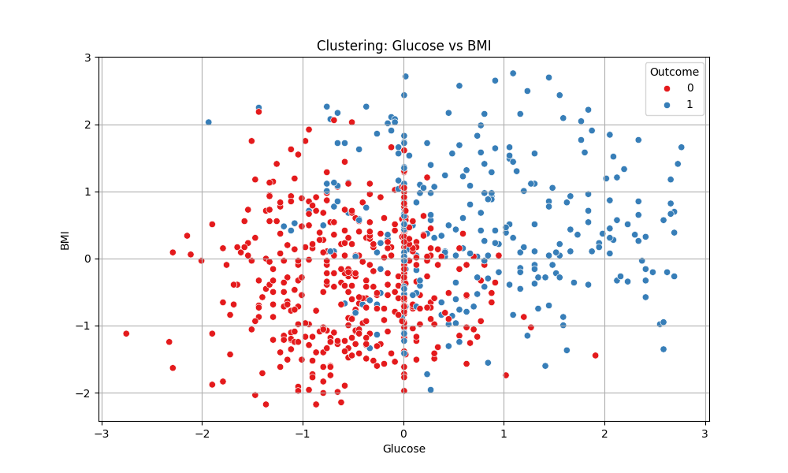
Label Generation (Unsupervised)
K-means clustering method on Glucose, BMI, Age columns
Cluster based on Glucose mean labeled as ‘Diabetes’
Outcome column created as (1 = Diabetes, 0 = No Diabetes)

Slide 8
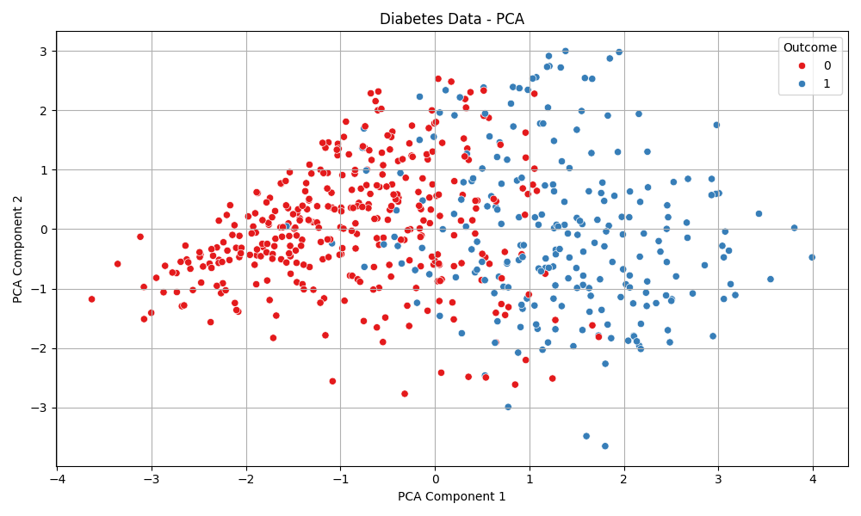
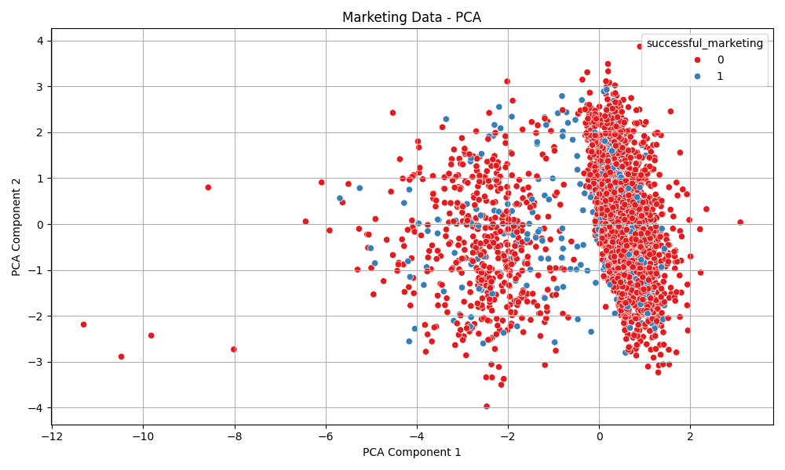
Feature Extraction
Data split: 80% training, 20% testing
PCA used to extract 4 Principal components
Training and Test data projected to PCA space

Slide 9
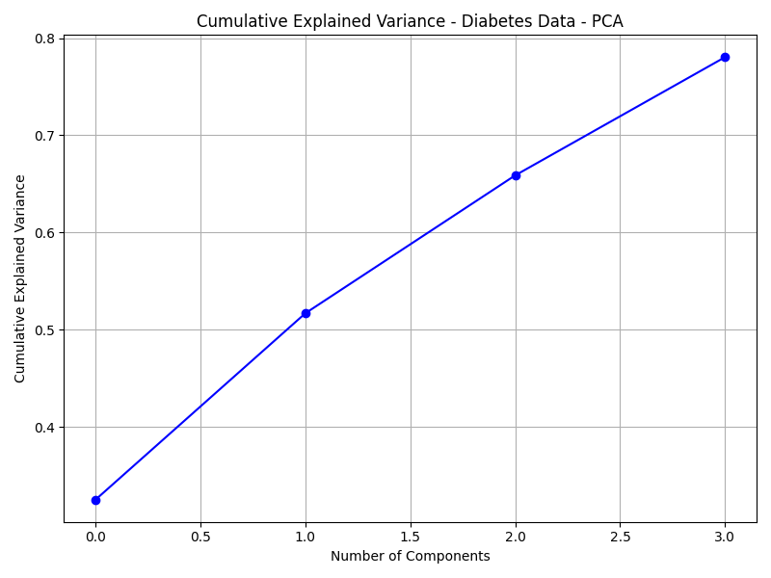
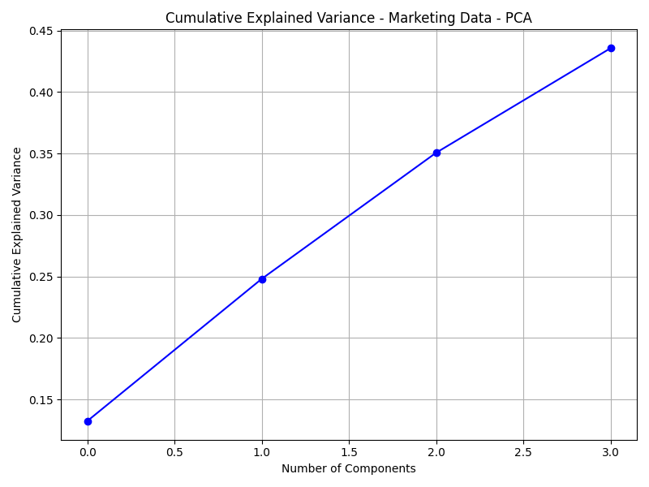
PCA Component
Balance Between Dimensionality Reduction and Information Retention
Aim to reduce features while preserving important variance in the data.
Preserve Model Performance
Selected 4 components to maintain the predictive power of the model.
Improve Efficiency & Reduce Overfitting
Fewer features speed up training and help prevent model overfitting.

Slide 10
Super Learner Architecture
Base learners:
Naïve Bayes
Neural Network
KNN
Meta learner: Decision Tree
5-fold cross-validation
Hyperparameter tuning using GridSearchCV

Slide 11
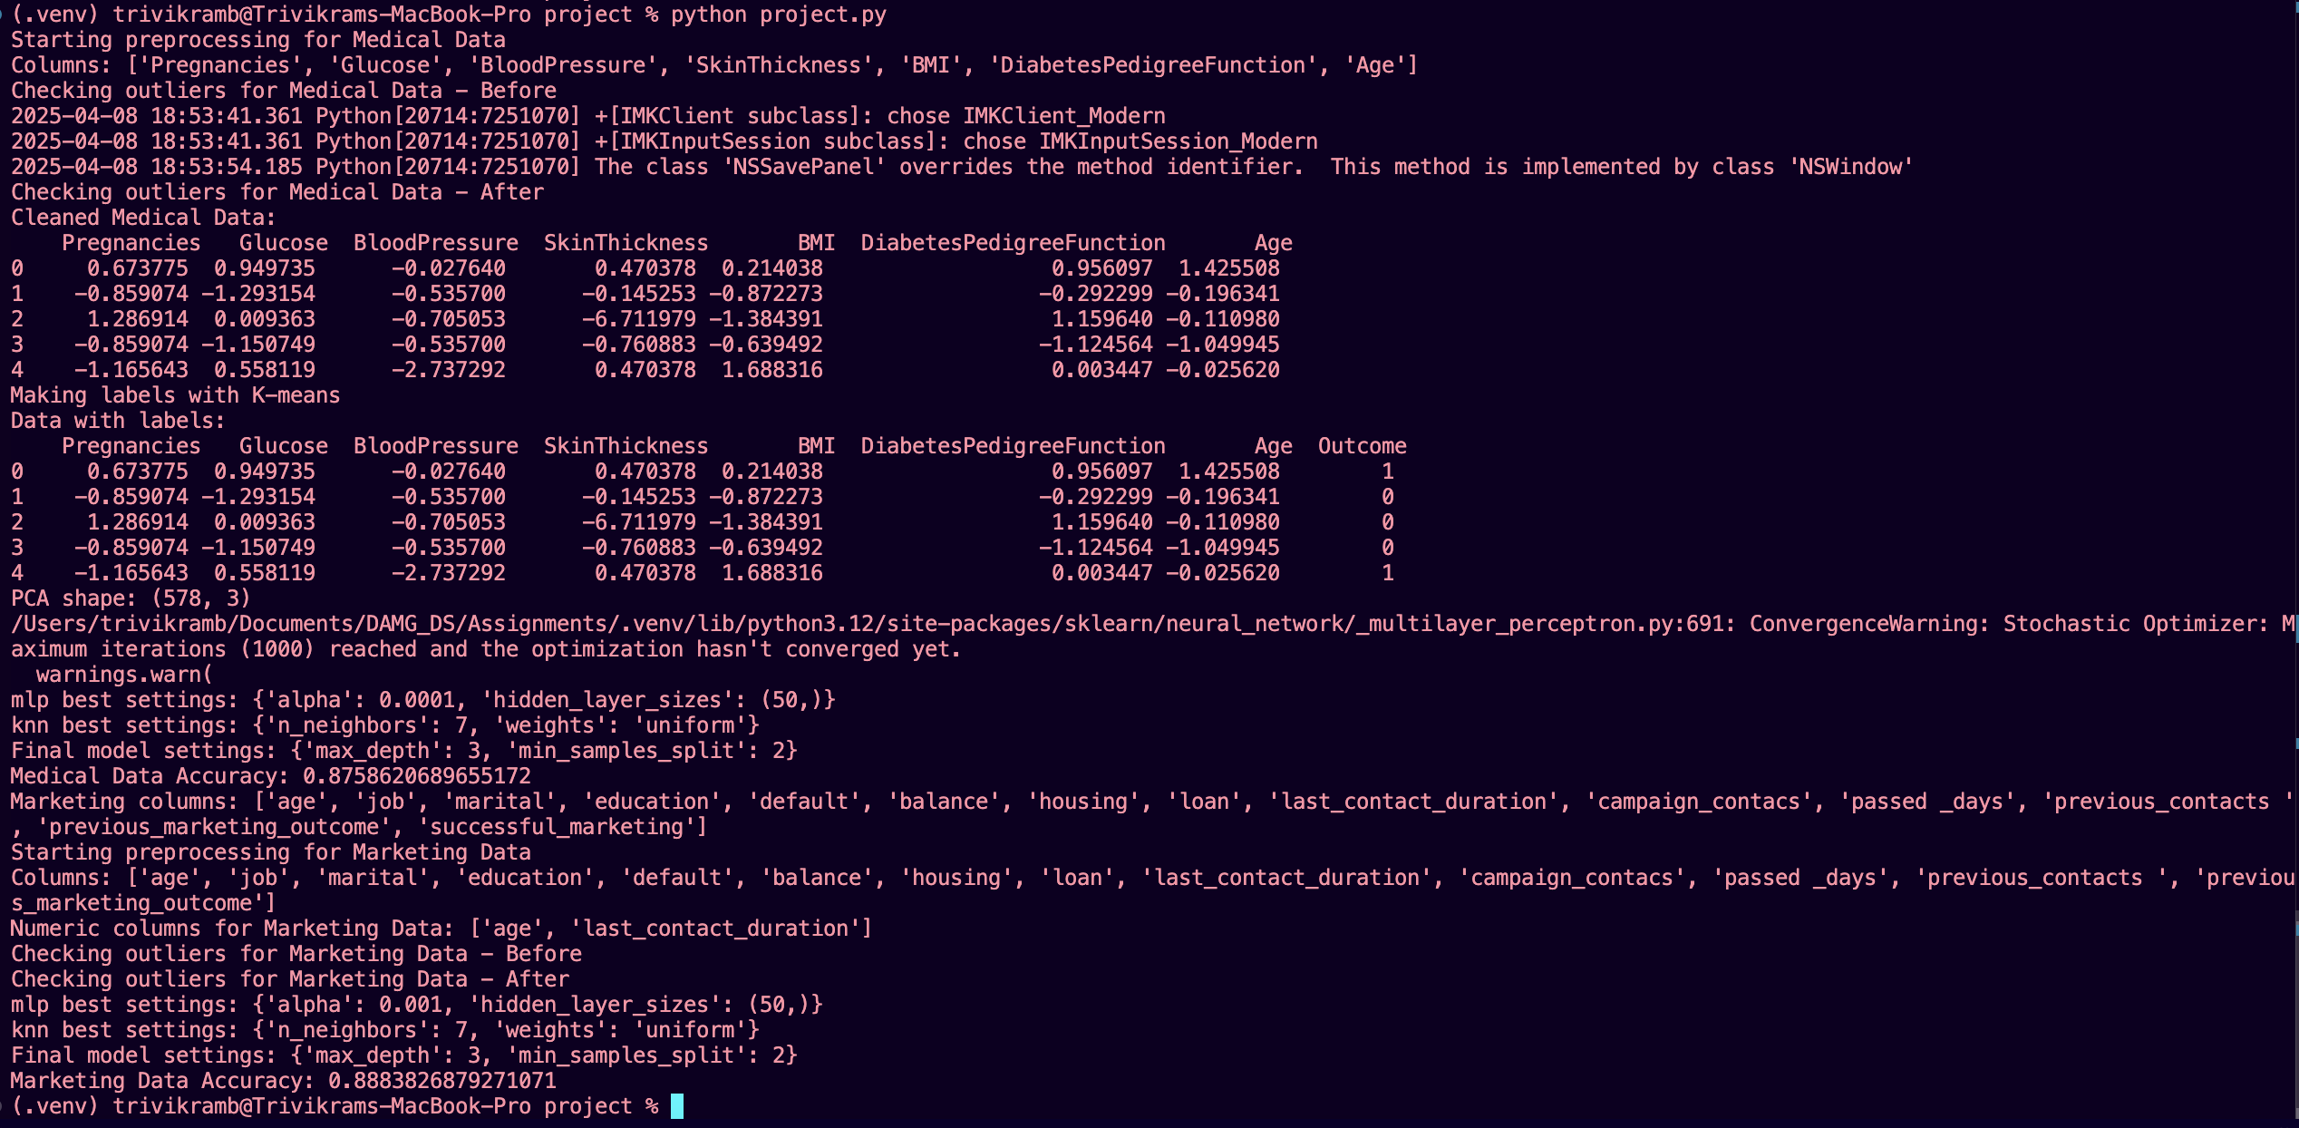
Model Accuracy
Medical Data Accuracy: 87.59 %
Marketing Data Accuracy: 88.84 %
Model generalizes well across datasets
Trained using predictions from base models

Slide 12
Future Applications and Use Cases
Healthcare:
The diabetes prediction model could be used in clinical decision support systems to flag high-risk patients for early intervention.
Marketing:
Predicting successful marketing campaign outcomes using client history.
Identifying high-value clients for retention strategies.
Smart Wearables & IoT:
Real-time classification of patient health status using live sensor data.
Detecting anomalies in physical activity patterns (e.g., fall detection in elderly patients).
Model Deployment and API Integration
Convert the trained model into a deployable REST API using Flask or FastAPI for real-time predictions in clinical or marketing environments.

Slide 13
Conclusion
Achieved High accuracy using Super Learner Method
Model effectively handles semi-supervised learning
Successfully applied to unseen Marketing dataset
Followed best practices with OOPS concepts and modular code
Scalable for more complex datasets
Reference Code
https://github.com/trivikram-bhavesh-budhabhatti/Data-Science-Project

Slide 14


