Slide 1
Development of Semi-Supervised Learning Model on Diabetes & Marketing Dataset using Super Learner
Group A
Nishita Vikas Shewale
Trivikram Bhavesh Budhabhatti

Slide 2
Project Overview
Objective:
Develop a semi-supervised learning model using a super learner.
Key Steps:
Preprocessing of the Diabetes & Marketing Datasets
Generate labels with K-means
Feature extraction with PCA
Classify using Super Learner
Applying the model on the new dataset (Marketing Dataset)

Slide 3
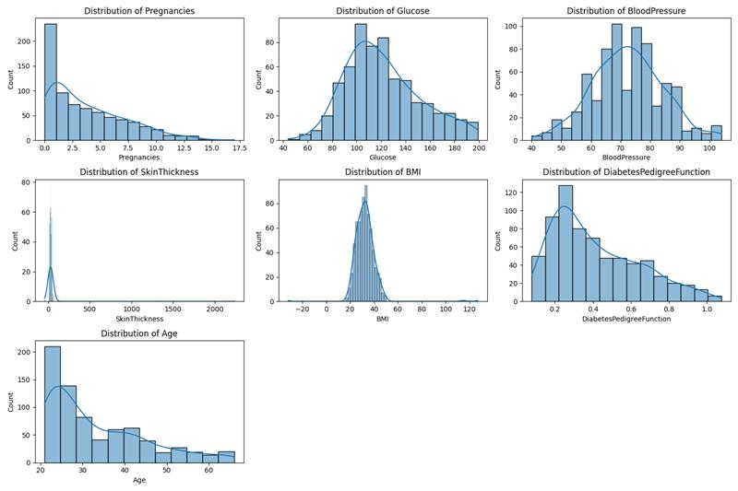
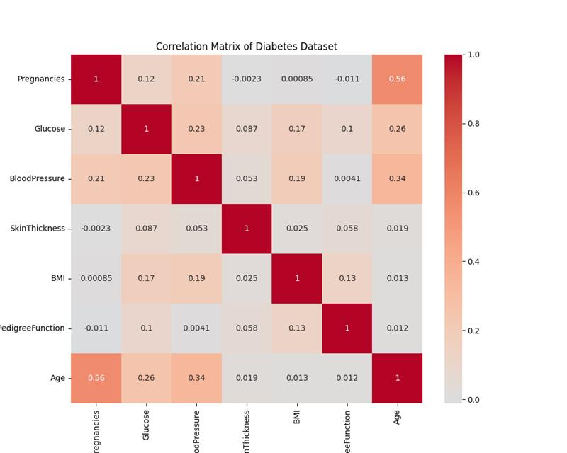
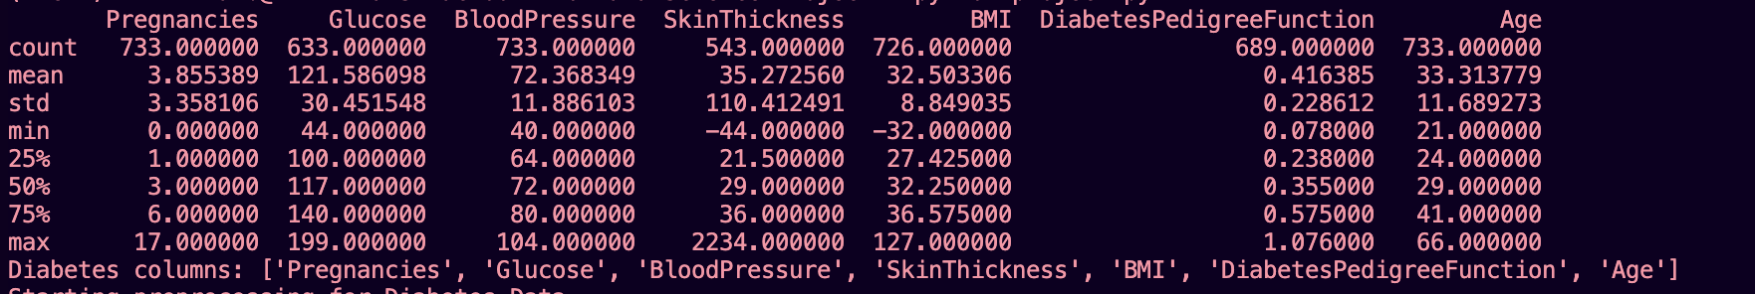
Data Profiling- Diabetes

Slide 4
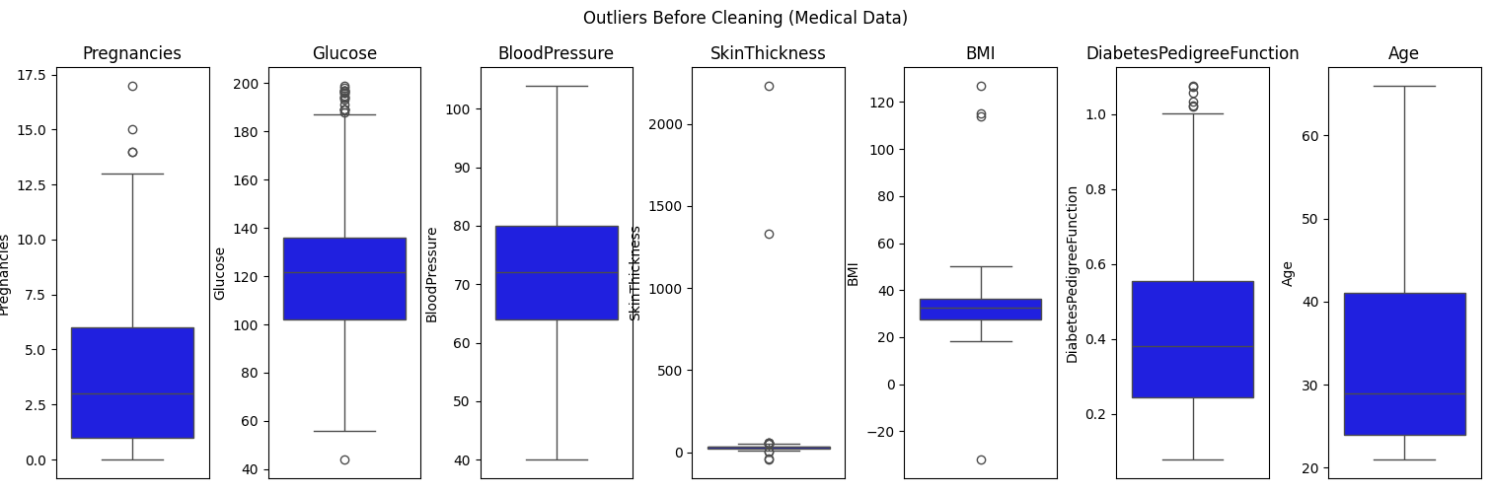
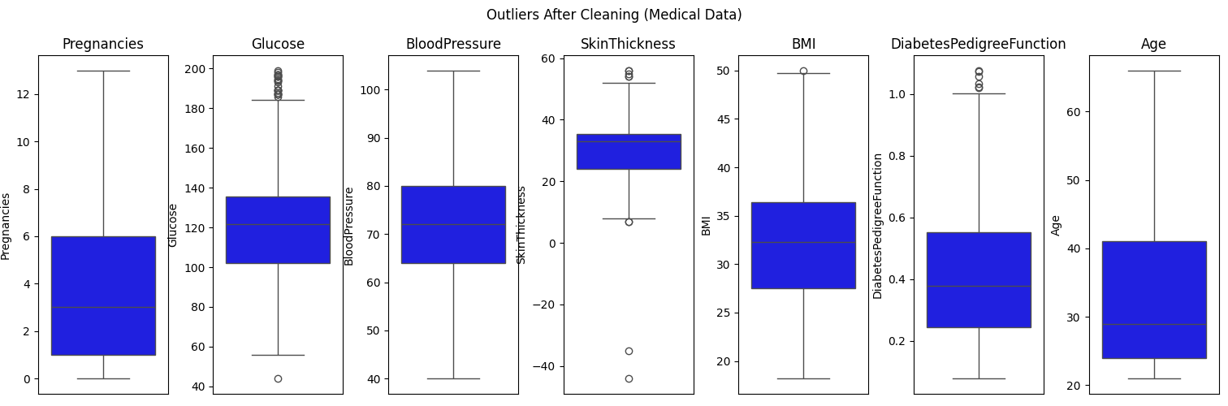
Data Preprocessing - Diabetes
Analyzed and Removed outliers using Z-score
Imputed missing values with mean
Visualized Before & After Data Preprocessing with the help of Boxplots

Slide 5
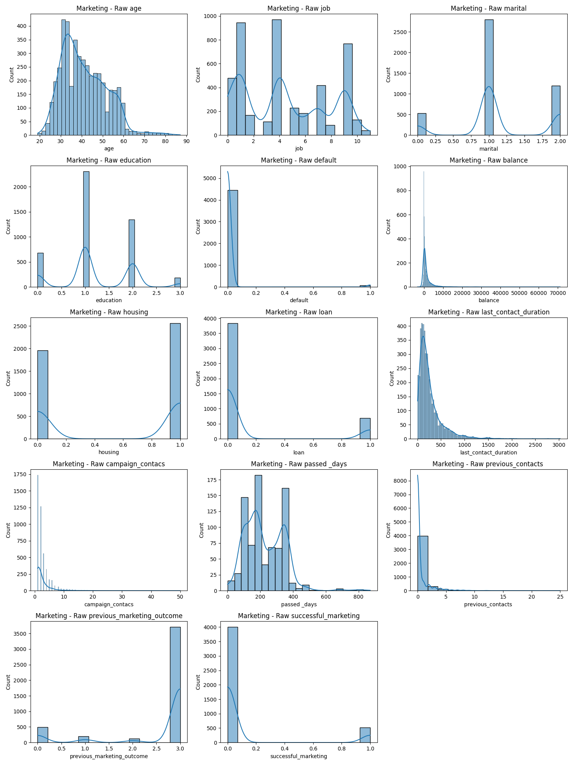
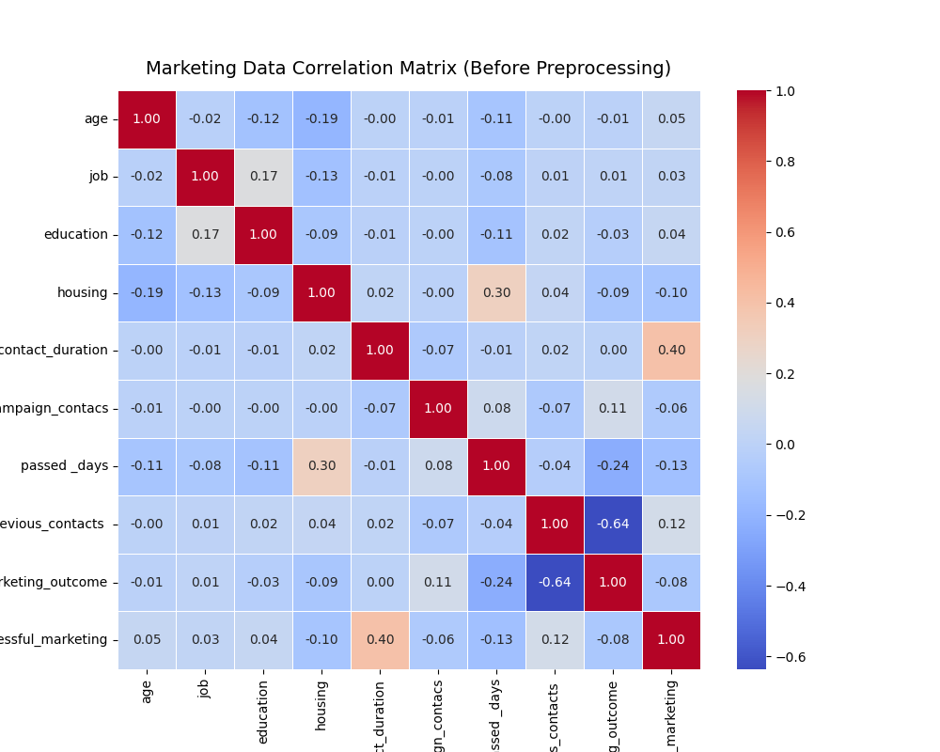
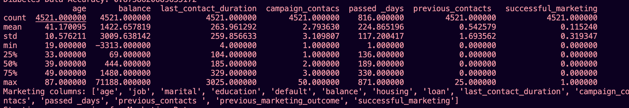
Data Profiling- Marketing

Slide 6
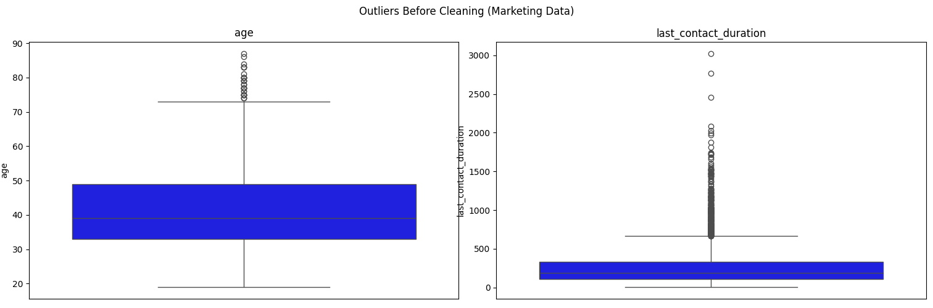
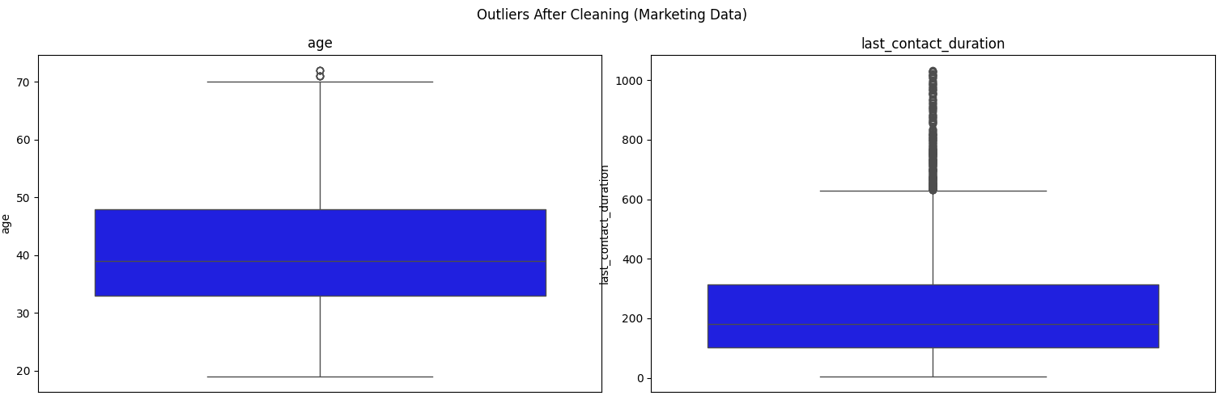
Data Preprocessing - Marketing

Slide 7
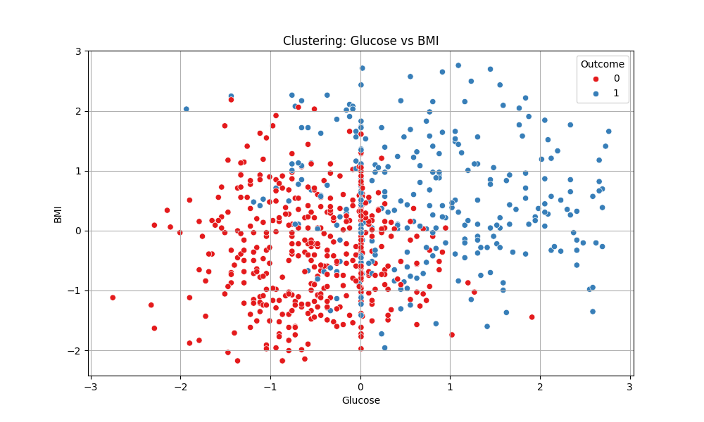
Label Generation (Unsupervised)
K-means clustering method on Glucose, BMI, Age columns
Cluster based on Glucose mean labeled as ‘Diabetes’
Outcome column created as (1 = Diabetes, 0 = No Diabetes)

Slide 8
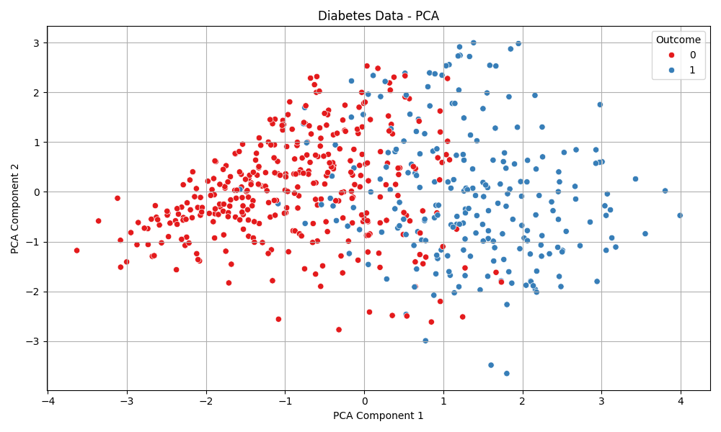
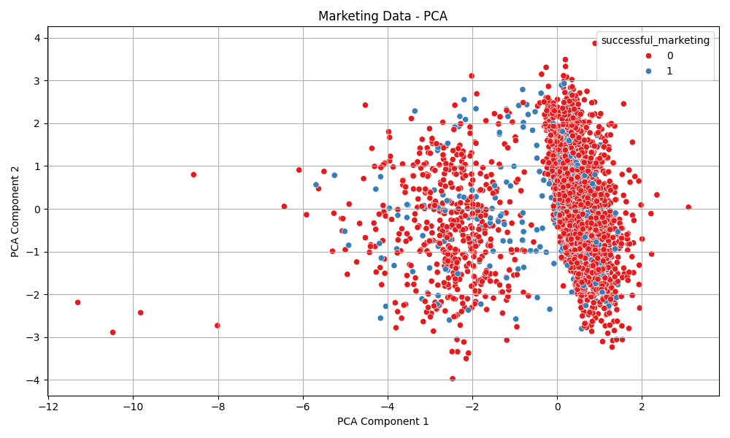
Feature Extraction
Data split: 80% training, 20% testing
PCA used to extract 3 Principal components
Training and Test data projected to PCA space

Slide 9
Super Learner Architecture
Base learners:
Naïve Bayes
Neural Network
KNN
Meta learner: Decision Tree
5-fold cross-validation
Hyperparameter tuning using GridSearchCV

Slide 10
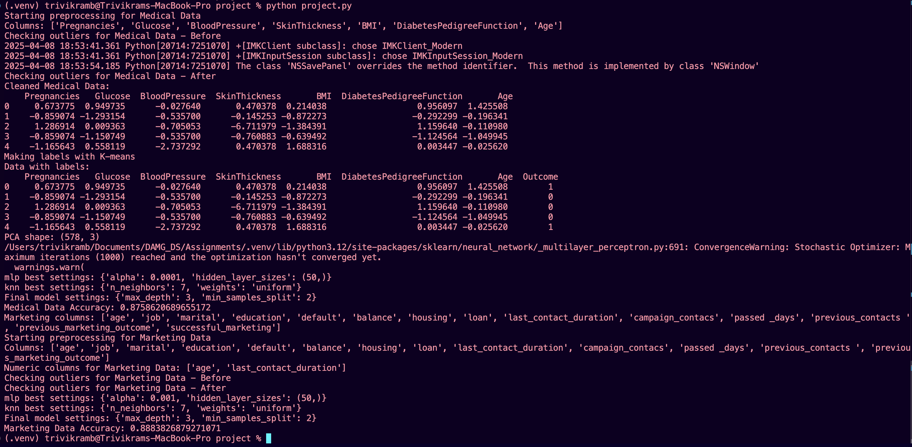
Model Accuracy
Medical Data Accuracy: 87.59 %
Marketing Data Accuracy: 88.84 %
Model generalizes well across datasets
Trained using predictions from base models

Slide 11
Conclusion
Achieved High accuracy using Super Learner Method
Model effectively handles semi-supervised learning
Successfully applied to unseen Marketing dataset
Followed best practices with OOPS concepts and modular code
Scalable for more complex datasets
Reference Code
https://github.com/trivikram-bhavesh-budhabhatti/Data-Science-Project

Slide 12


