Slide 1
Semi-Supervised Learning on Diabetes Dataset using Super Learner
Group A
Nishita Vikas Shewale
Trivikram Bhavesh Budhabhatti

Slide 2
Project Overview
Objective:
Develop a semi-supervised learning model using a super learner.
Key Steps:
Preprocess data
Generate labels with K-means
Feature extraction with PCA
Classify with ensemble model
Apply on new dataset

Slide 3
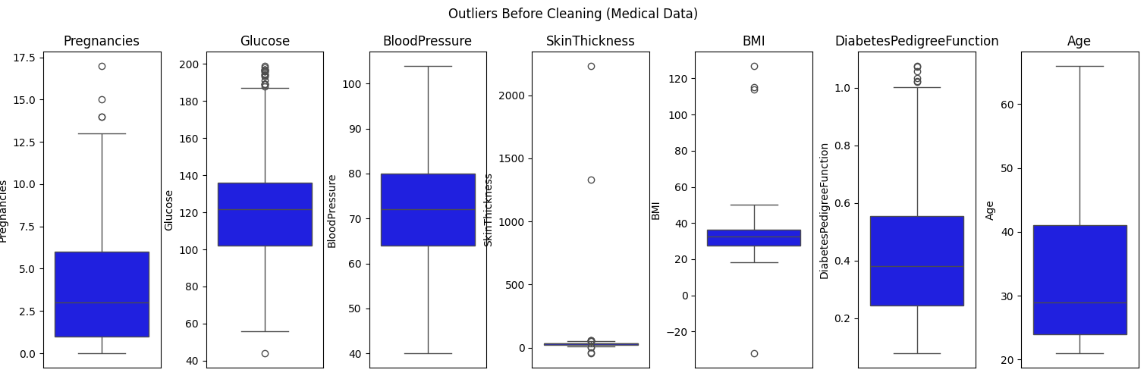
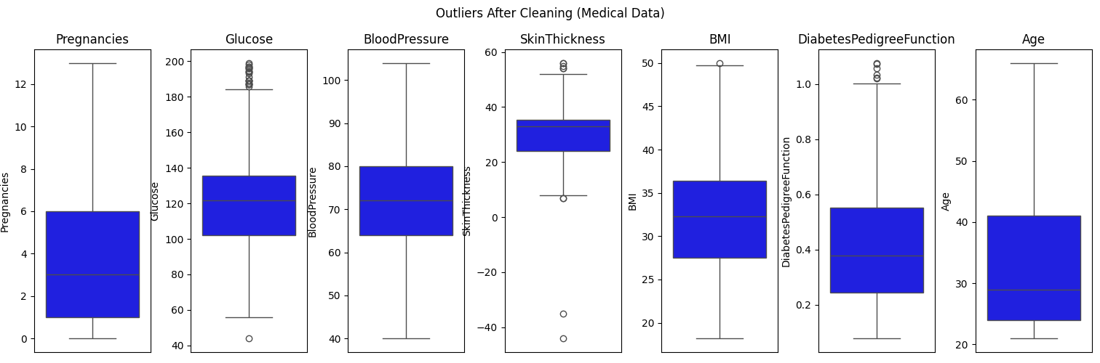
Data Preprocessing - Diabetes
Removed outliers using Z-score
Imputed missing values with mean
Scaled data using StandardScaler
Modular code using DataPreprocessor class
Visualized with boxplots

Slide 4
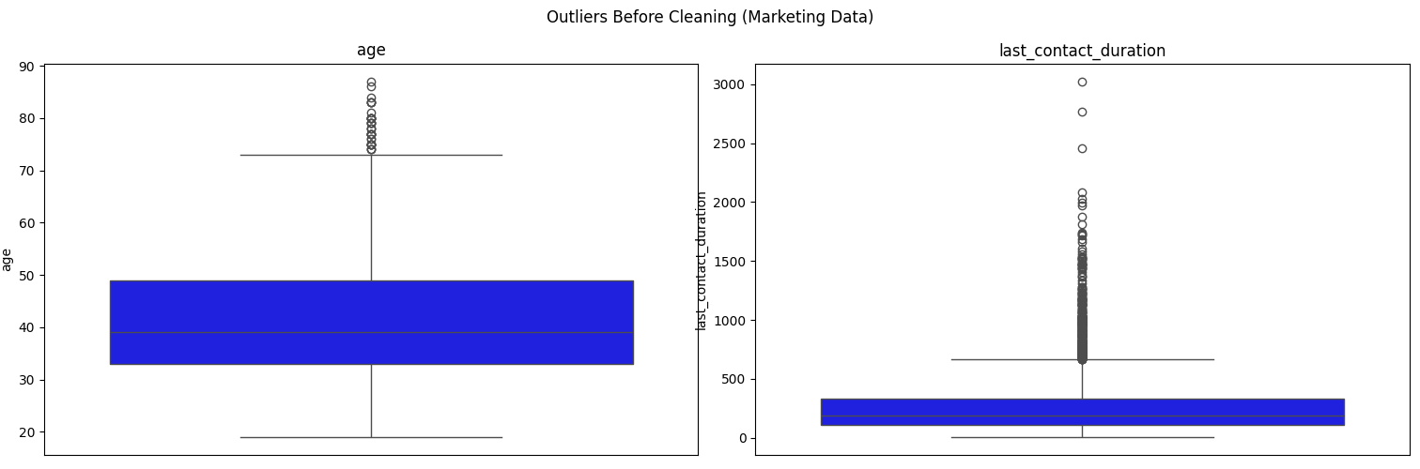
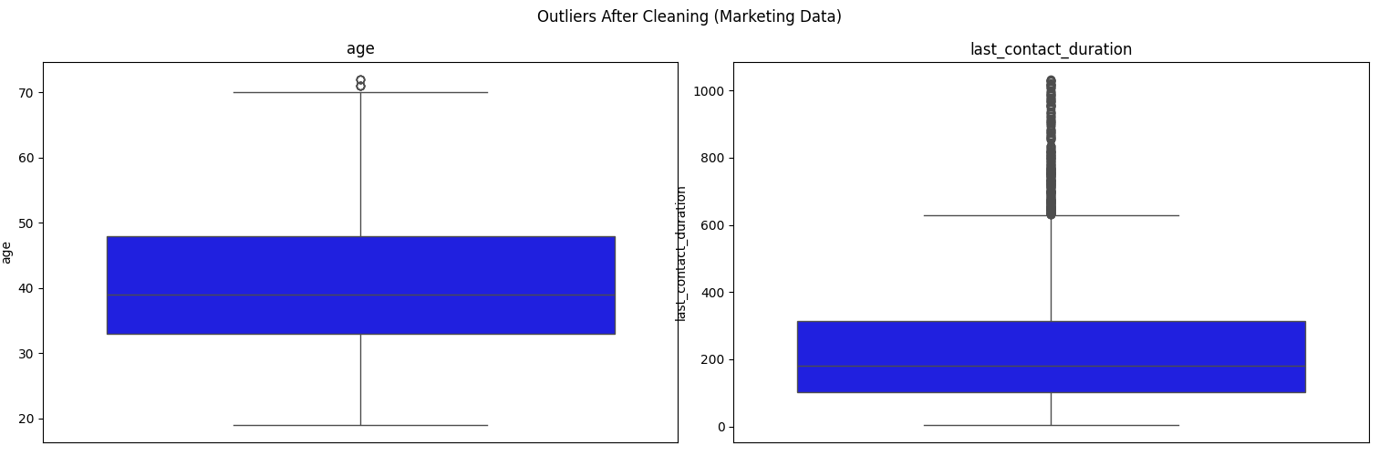
Data Preprocessing - Marketing
Removed outliers using Z-score
Imputed missing values with mean
Scaled data using StandardScaler
Modular code using DataPreprocessor class
Outliers removed and visualized

Slide 5
Label Generation (Unsupervised)
K-means clustering on Glucose, BMI, Age
Cluster with higher Glucose labeled as ‘Diabetes’
Outcome column created (1 = Diabetes, 0 = No Diabetes)
Implemented via LabelMaker class

Slide 6
Feature Extraction
Data split: 80% training, 20% testing
PCA used to extract 3 principal components
Training and test data projected to PCA space
Done with FeatureExtractor class

Slide 7
Super Learner Architecture
Base learners:
Naïve Bayes
Neural Network
KNN
Meta learner: Decision Tree
5-fold cross-validation
Hyperparameter tuning using GridSearchCV

Slide 8
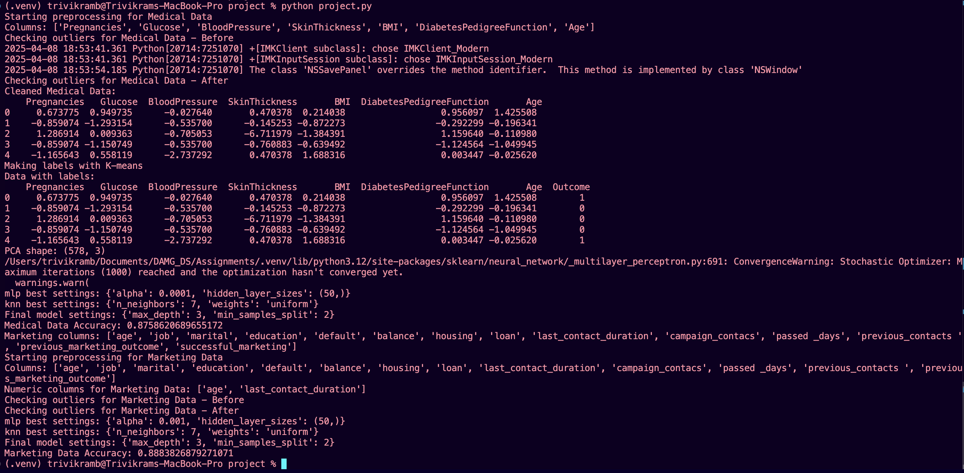
Model Accuracy
Medical Data Accuracy: 87.59 %
Marketing Data Accuracy: 88.84 %
Model generalizes well across datasets
Trained using predictions from base models

Slide 9
Conclusion
Achieved high accuracy using ensemble method
Model effectively handles semi-supervised learning
Successfully applied to unseen dataset
Followed best practices with OOP and modular code
Scalable for more complex datasets

