Slide 1

Weather-Robust Road Damage Detection with Enhanced Small Pothole Detection
Under the guidance of
Dr. S. Satish kumar
Assistant Professor
Department of Computer Science And Engineering
Batch-047
221FA04086 Syed. Ashraf. Ali
221FA04137 G. Trivikram

Slide 2
Introduction
Road potholes threaten global transportation by causing accidents, vehicle damage, and traffic delays, demanding efficient detection solutions.
Manual and basic image-processing methods are labor-intensive, costly, and unreliable across diverse road conditions.
Deep learning models like YOLOv8/YOLOv11 variants enable real-time, automated pothole detection for safer roads and proactive maintenance.
Attention-enhanced YOLO systems improve small pothole detection in adverse weather using MWPD dataset.

Slide 3
Dataset Identification
Dataset: Multi-Weather Pothole Detection (MWPD)
Source: Kaggle
DatasetLink:https://www.kaggle.com/datasets/jocelyndumlao/multi-weather-pothole-detection-mwpd
Total Samples: Approximately 3000
Image Type: RGB road-scene images
Images | No. of Samples
Train | 2730
Test | 97
Total | 2827

Slide 4
Tools & Technologies
Programming Language:
Python
Libraries:
NumPy, OpenCV, Ultralytics (for YOLO)
Deep Learning Frameworks:
PyTorch
Datasets:
Multi-Weather Pothole Detection (MWPD)
Models:
YOLOv10m, YOLOv11n/s/m
Development Platform:
Google Colab

Slide 5
OBJECTIVES OF THE PROJECT
To develop weather-robust road damage detection with small pothole enhancement.
To enhance model performance using attention mechanisms.
To compare baseline YOLOv8 with enhanced YOLO variants.
To evaluate performance using standard detection metrics.
To reduce manual effort and dependency on road inspectors.

Slide 6
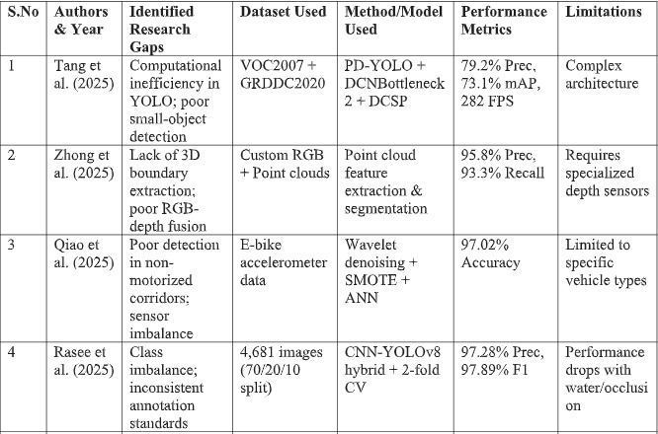
LITERATURE SURVEY

Slide 7
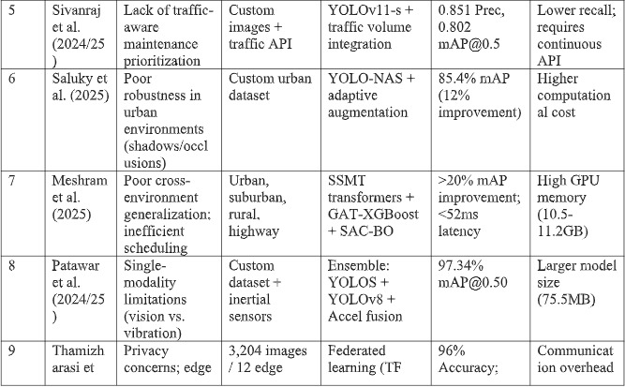

Slide 8
METHODOLOGY
1. Dataset Collection
The project uses the Multi-Weather Pothole Detection (MWPD) dataset.
It contains pothole images across diverse weather conditions (rain, fog, night, sunny).
The dataset includes small and large potholes with real-world road variations, ideal for robust detection.
2. Image Preprocessing
All images are resized to 640 × 640 pixels for optimal YOLO input dimensions.
Pixel values are normalized to 0–1 range with data augmentation (mosaic, mixup, weather simulation).
The dataset is split into training, validation, and testing sets (70:20:10 ratio).
3. Feature Extraction using YOLO
YOLOv8n/s/m extract multi-scale features from road images.
Detects texture, edges, and shape patterns of potholes against complex backgrounds.
Lightweight CSPDarknet provides efficient computation for real-time edge deployment.

Slide 9
4. Small Pothole Enhancement Module
Specialized attention mechanism (C2f-CBAM) integrated into YOLO neck after backbone.
Focuses on small pothole regions by emphasizing fine crack textures and edges.
Suppresses weather artifacts (rain, shadows, glare) and enhances road damage representation.
5. Multi-Scale Detection Heads
Enhanced features pass through:
PAFPN for multi-scale feature fusion
Three detection heads (small/medium/large scales)
CIoU loss for precise bounding box regression
NMS filters detections for final pothole outputs with confidence scores.
6. Model Evaluation
Precision
Recall
mAP@0.5
FPS (Frames Per Second)

Slide 10
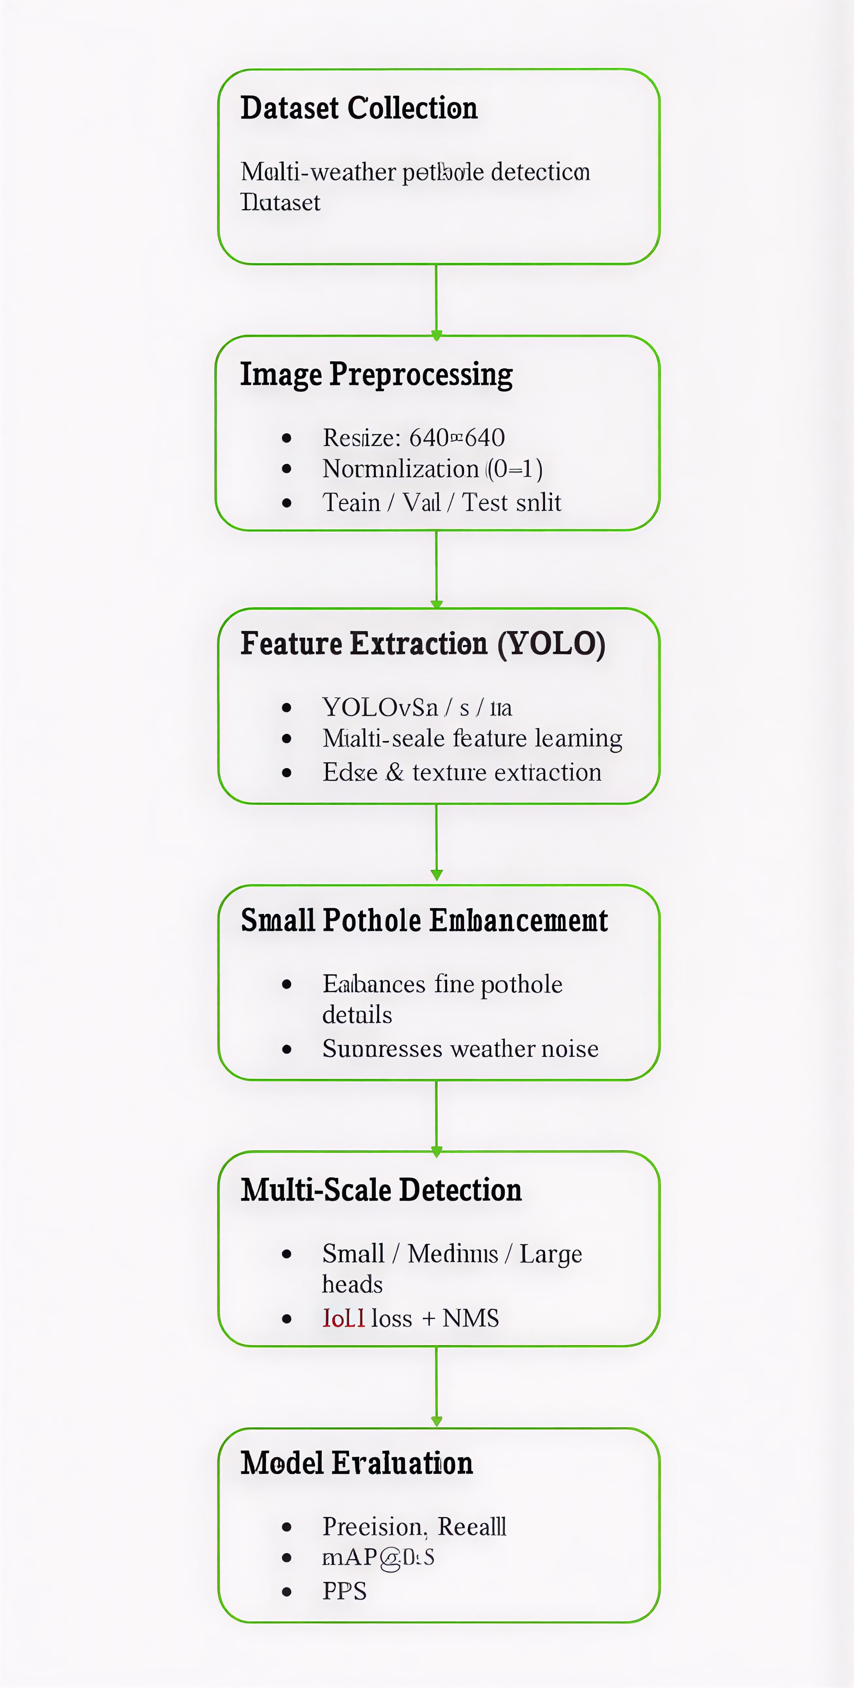
Fig 1: Methodology

Slide 11
Basic and Proposed Models
Base Model: Standard YOLOv8n/s/m used as baseline for road damage detection without specialized enhancements.
Feature Extraction: Multi-scale road features extracted using CSPDarknet backbone from weather-affected images.
Proposed Model: Attention-enhanced YOLO variants (YOLOv9s/e, YOLOv10m, YOLOv11n/s/m) with small pothole enhancement modules.
Goal: To improve weather-robust pothole detection accuracy by focusing on small damage regions and suppressing weather noise.

Slide 12
Implementation Plan & Timeline
 | DEC 22-31 | JAN 1-14 | JAN 15-31 | FEB 1-14 | FEB 15-28 | MAR 1-14 | MAR 15-31 | APRIL 1-14 | APRIL 15-30
Problem Definition & objectives
Literature Review
Dataset Collection/Preparation
Methodology Design
Experiments & Tuning
Result Analysis
Paper Writing(Draft)
Revision & Formatting
Plagiarism Check & Proofreading
Journal Selection &Submission
Gantt
chart:

Slide 13
THANK YOU

