Slide 1

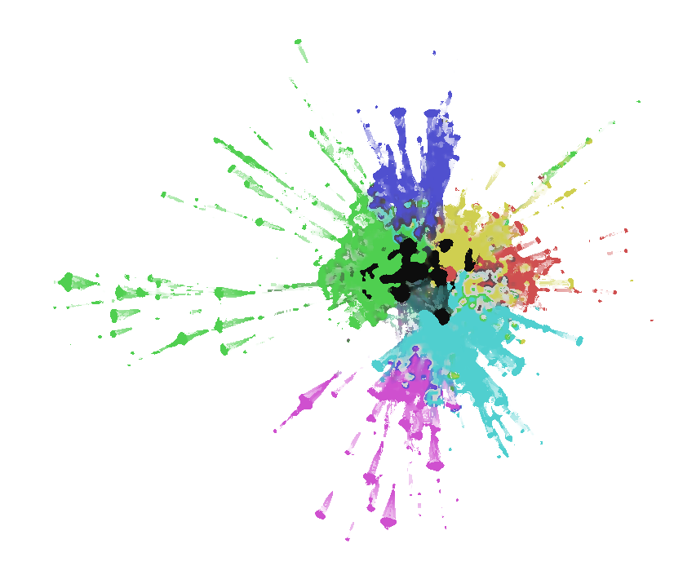
Discovery
Bayesian Inference
Machine Learning
Human Behaviour
Data
Open Source GIS
Engineering
Visualisation
Development
Initiatives
Policy Evaluation
Dynamics
Computational Modelling
Spatiotemporal Dynamics
Dependencies & Vulnerabilities

