Slide 1
CSE-4201 Computer Graphics
Pabon Shaha
Lecturer
Dept. of CSE
Bangladesh University

Slide 2
Curves
A curve is an infinitely large set of points.
Each point has two neighbors except endpoints.
Types of Curves
Curves can be broadly classified into three categories −
i) explicit,
ii) implicit, and
iii) parametric

Slide 3
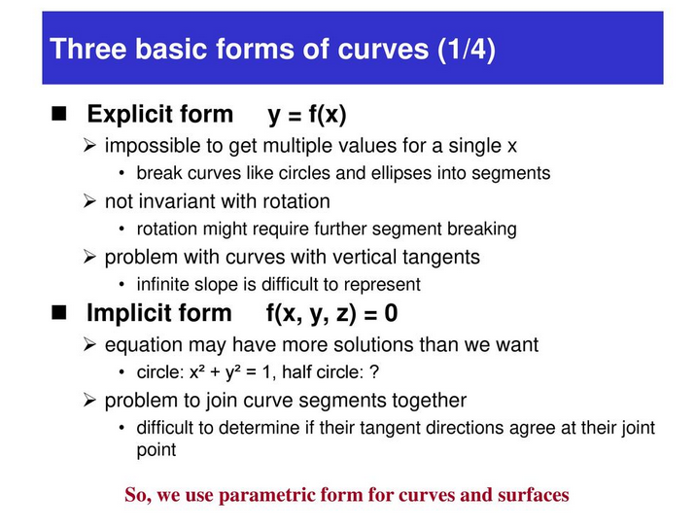

Slide 4
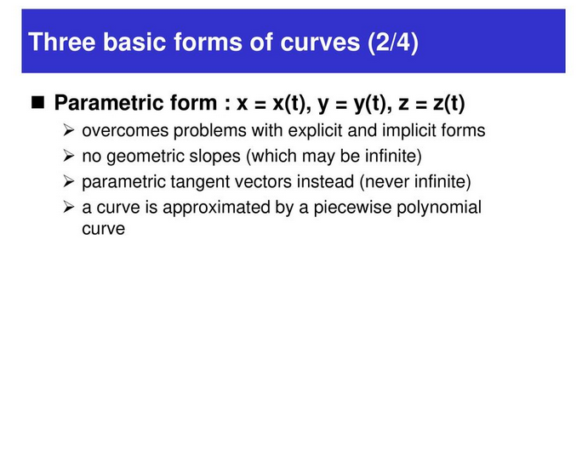

Slide 5
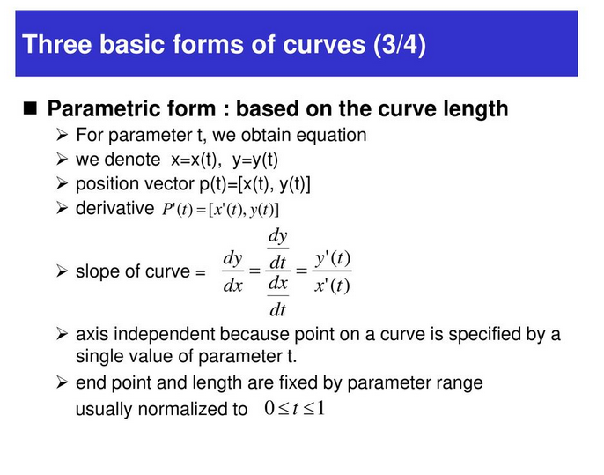

Slide 6
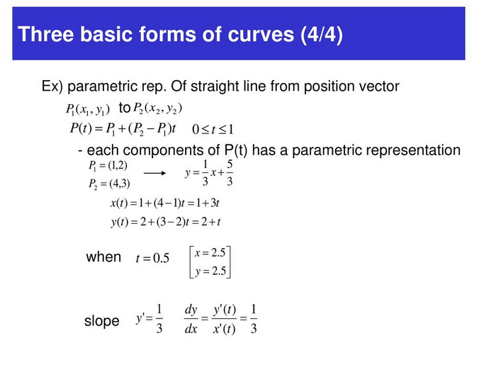

Slide 7
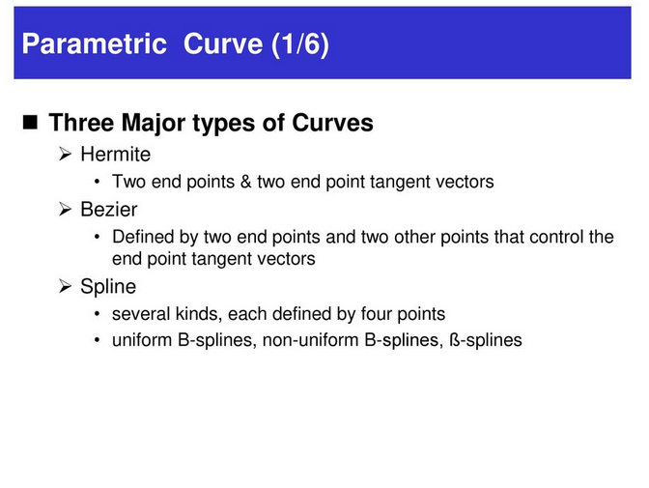

Slide 8
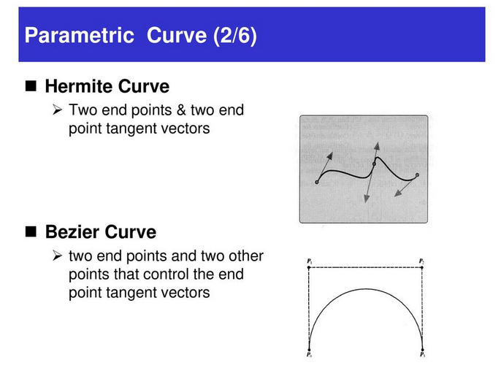

Slide 9
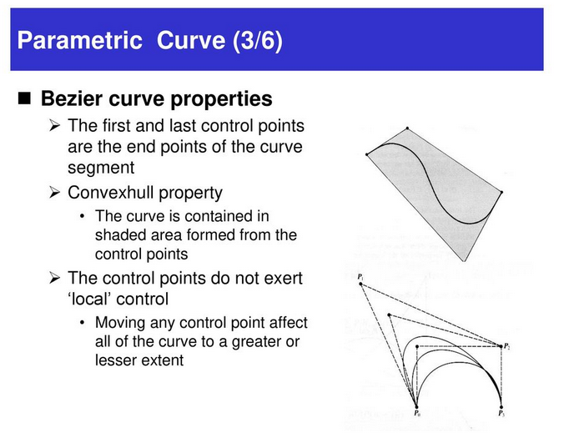

Slide 10
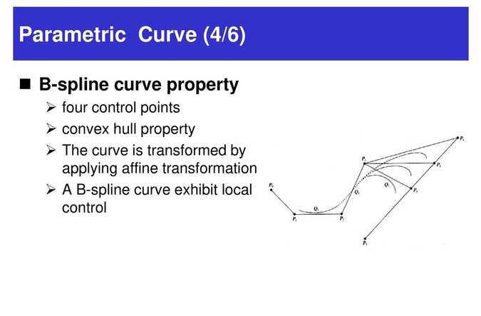

Slide 11
Bezier Curves
Bezier curve is discovered by the French engineer Pierre Bézier.
These curves can be generated under the control of other points.
Approximate tangents by using control points are used to generate curve.

Slide 12
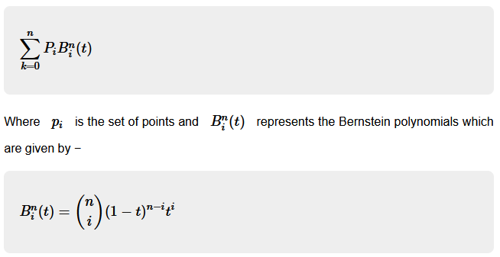
The Bezier curve can be represented mathematically as −

Slide 13
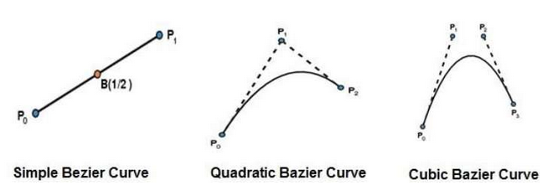
Different types of Bezier Curve
j

Slide 14
Properties of Bezier Curves
Bezier curves are widely available and used in various CAD systems, in general graphics packages such as GL.
The slope at beginning of the curve is along the line joining the first two control points and the slope at the end of the curve is along the line joining the last two points
Bezier curve always passes through the first and last points i.e p(o)=po, p(1,=pnlie)
The curves lies entirely within the convex hall formed by the four control points
The slope at the beginning of the curve is along the line joining the first two control points and the slope at the end of the curve is along the line joining the last two points.
The degree of polynomial defining the curve segment is one less than the no of defining the polygon.

Slide 15
hidden surface problems
There are two approaches for removing hidden surface problems −
Object-Space method and
Image-space method.
The Object-space method is implemented in physical coordinate system and
image-space method is implemented in screen coordinate system.

Slide 16
Depth Buffer Method
This method is developed by Cutmull.
It is an image-space approach.
The basic idea is to test the Z-depth of each surface to determine the closest visible surface.
In this method each surface is processed separately one pixel position at a time across the surface.
The depth values for a pixel are compared and the closest smallestz surface determines the color to be displayed in the frame buffer.

Slide 17
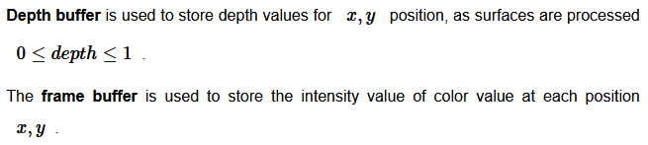
Depth Buffer Method
It is applied very efficiently on surfaces of polygon.
Surfaces can be processed in any order.
To override the closer polygons from the far ones, two buffers named frame buffer and depth buffer, are used

Slide 18
A-Buffer method
The A-buffer method is an extension of the depth-buffer method.
The A-buffer method is a visibility detection method developed at Lucas film Studios for the rendering system Renders Everything You Ever Saw REYES.
The A-buffer expands on the depth buffer method to allow transparencies.
The key data structure in the A-buffer is the accumulation buffer.

Slide 19
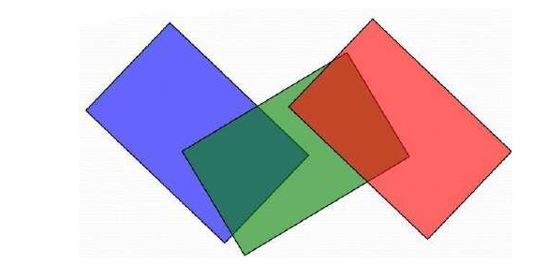
kkkkkkk

Slide 20
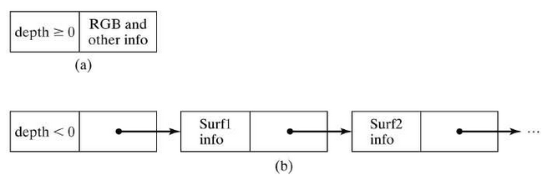
Each position in the A-buffer has two fields −
Depth field − It stores a positive or negative real number
Intensity field − It stores surface-intensity information or a pointer value

