Slide 1

A Spotify EDA
Conducted by Mihir Jetly
This Photo by Unknown Author is licensed under CC BY-NC-ND

Slide 2
Why Should We Care?
Spotify is one of the most popular music streaming platforms out there to date. We need to see how music trends have been changing over the past few years in order to predict how using specific types of music will affect business.

Slide 3
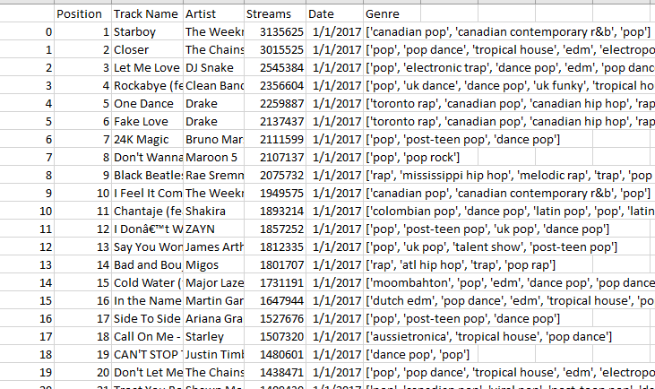
What are we working with
We are using a dataset from Kaggle that lists the top 200 daily song list from Spotify from 2017-2021
This dataset includes columns such as Position, Track Name, Artist, Streams, Date, and Genre

Slide 4
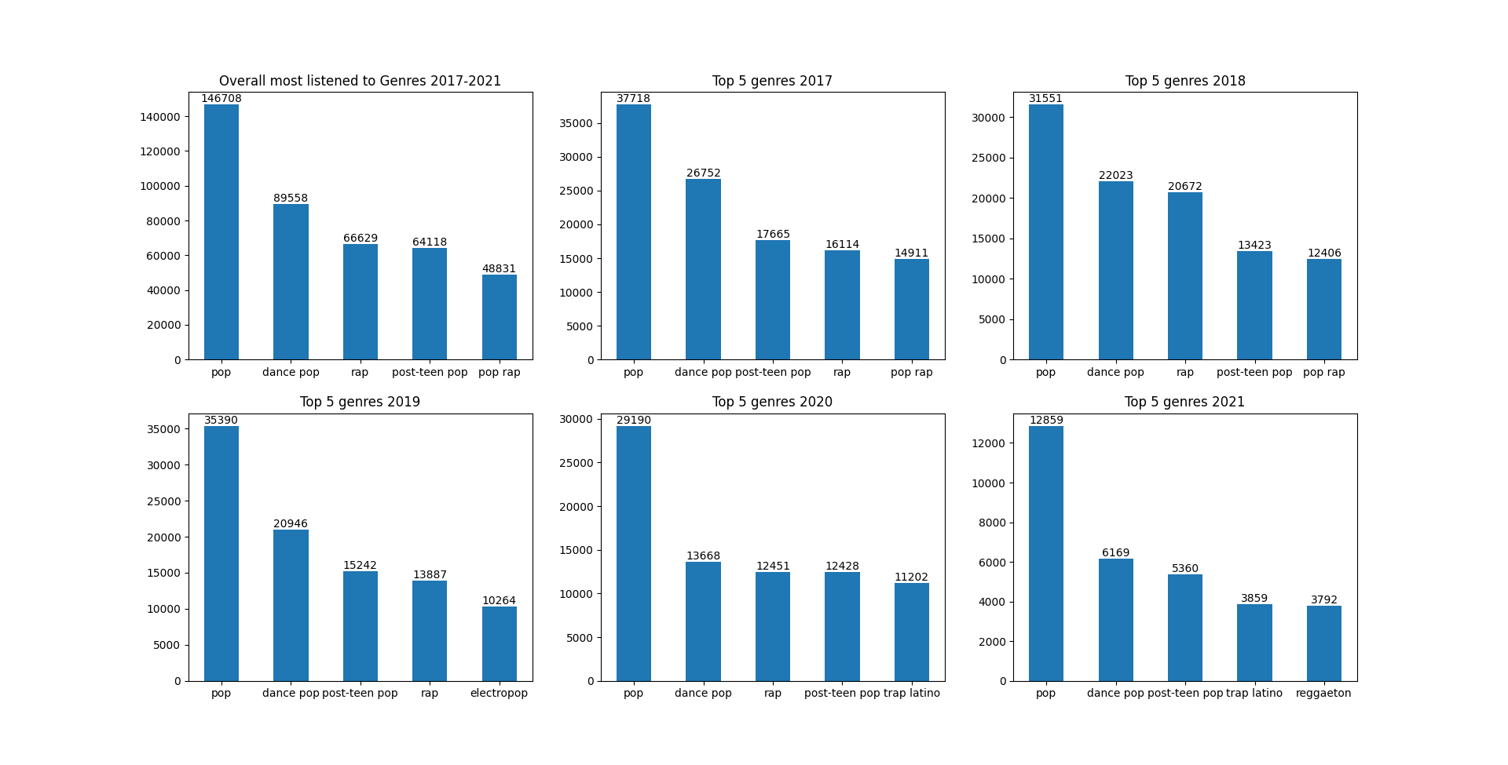
The Top 5 Genres Over the Years
We want to see the top 5 Genres over the years, in order to get a feel for the trends.
We can see that the top 5 genres are a mix of various styles of pop and rap.

Slide 5
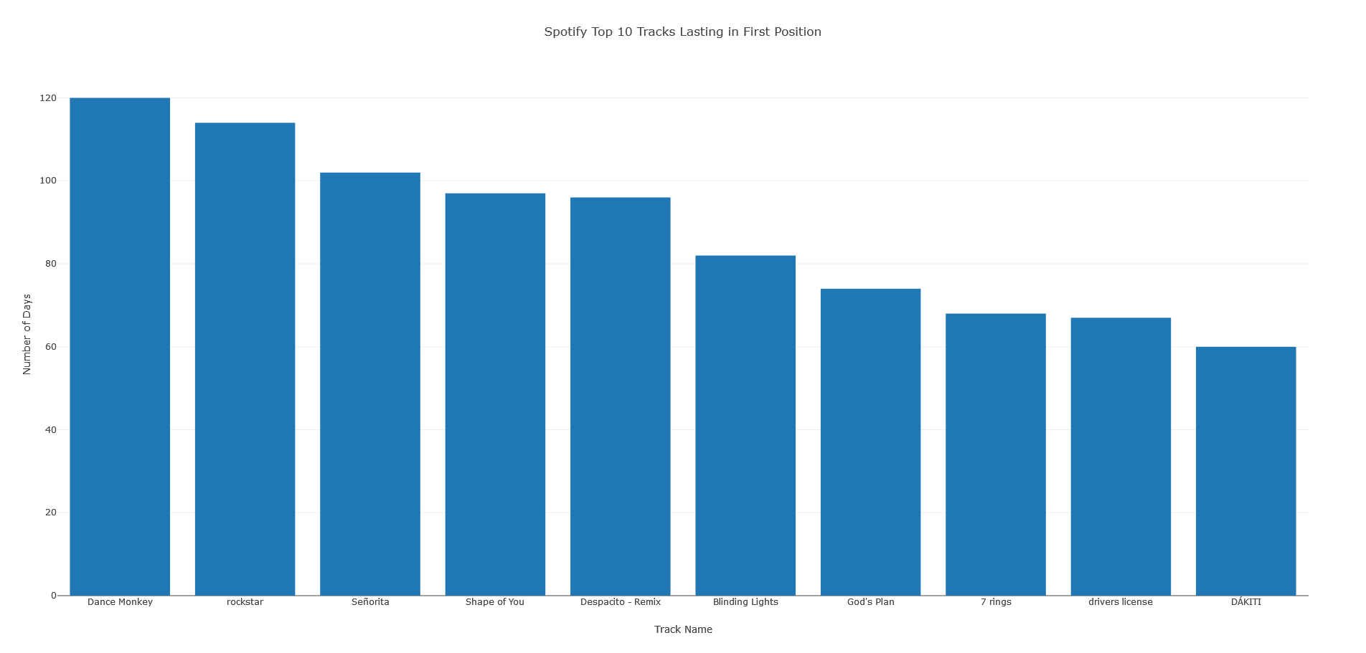
Now to Find the Top Songs
We now want to find the songs that were the most popular. We find the 10 songs that held the #1 position the longest in our dataset.
We can see that the tracks are mostly pop or rap, which we observed in our analysis of the top 5 genres

Slide 6

Now to Find the Top Artists by Year
We want to find the top artists by year so that we can view the trends for how branding affects music trends.

Slide 7
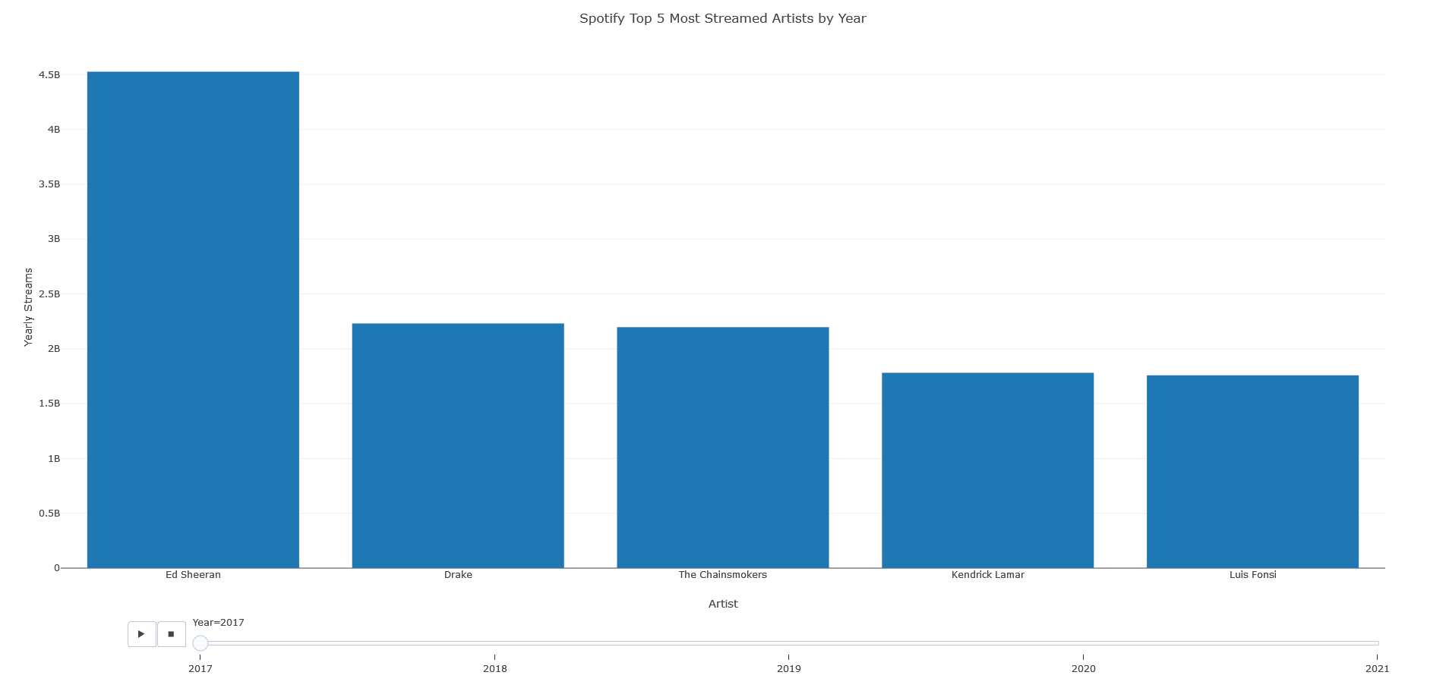
Finding the Top 5 Artists by Year - 2017
We can see Ed Sheeran is the most popular artist by a large margin

Slide 8
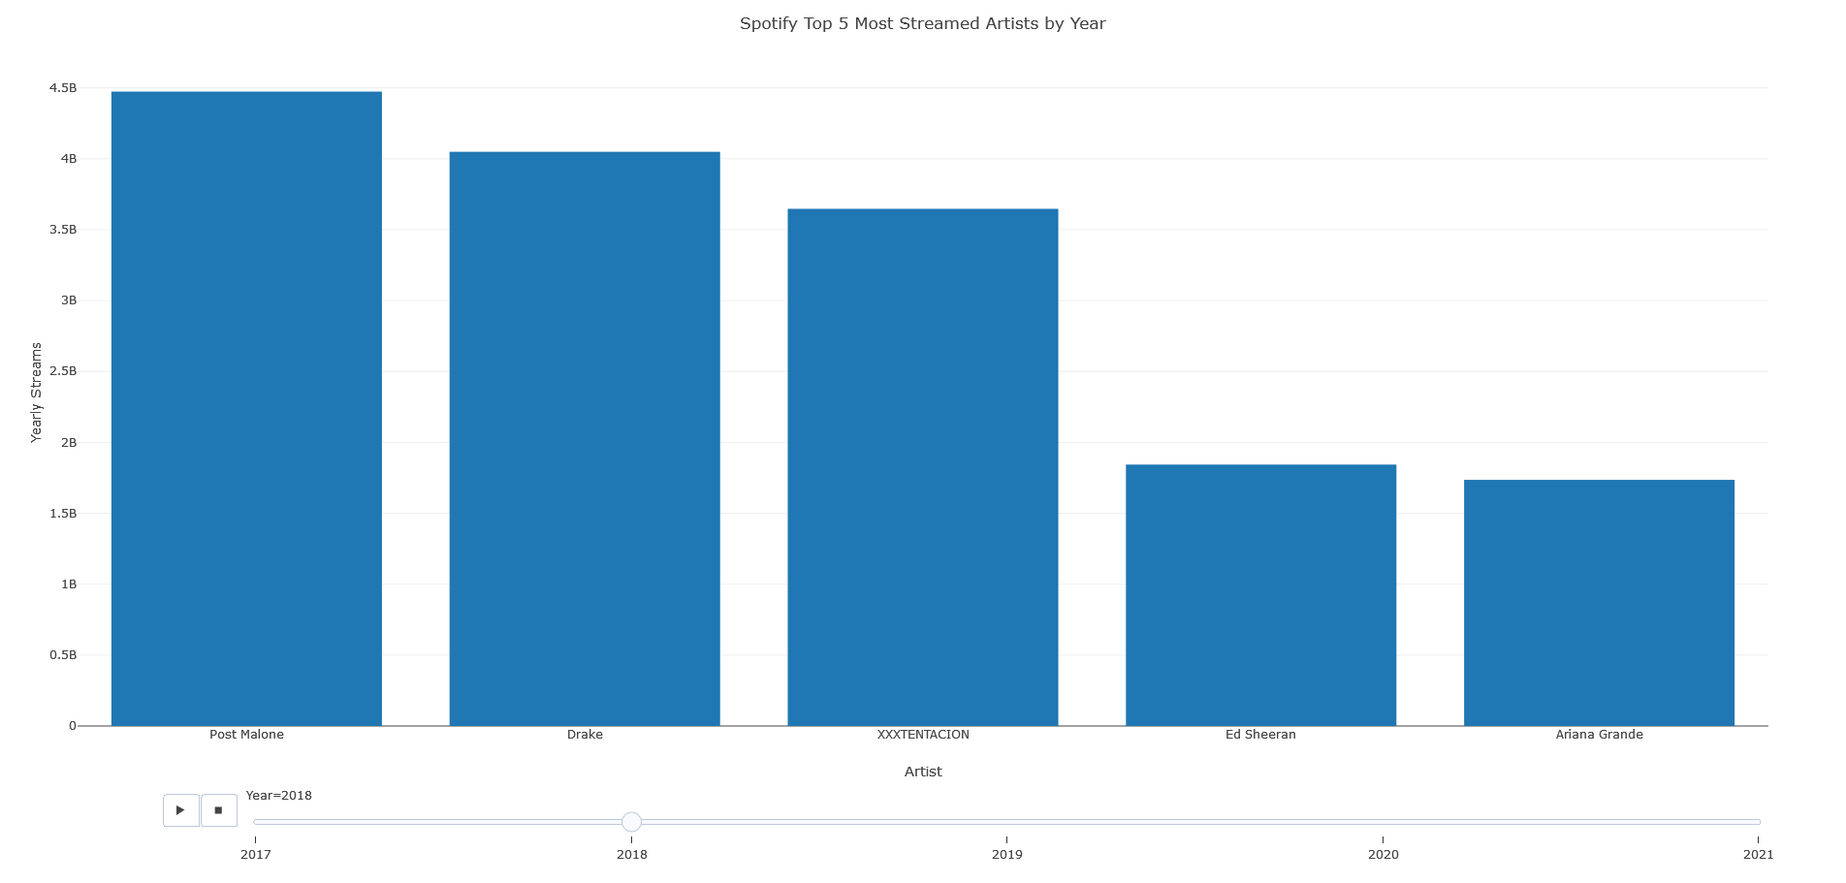
Finding the Top 5 Artists by Year - 2018
We see a more even distribution of streams between artists this year

Slide 9
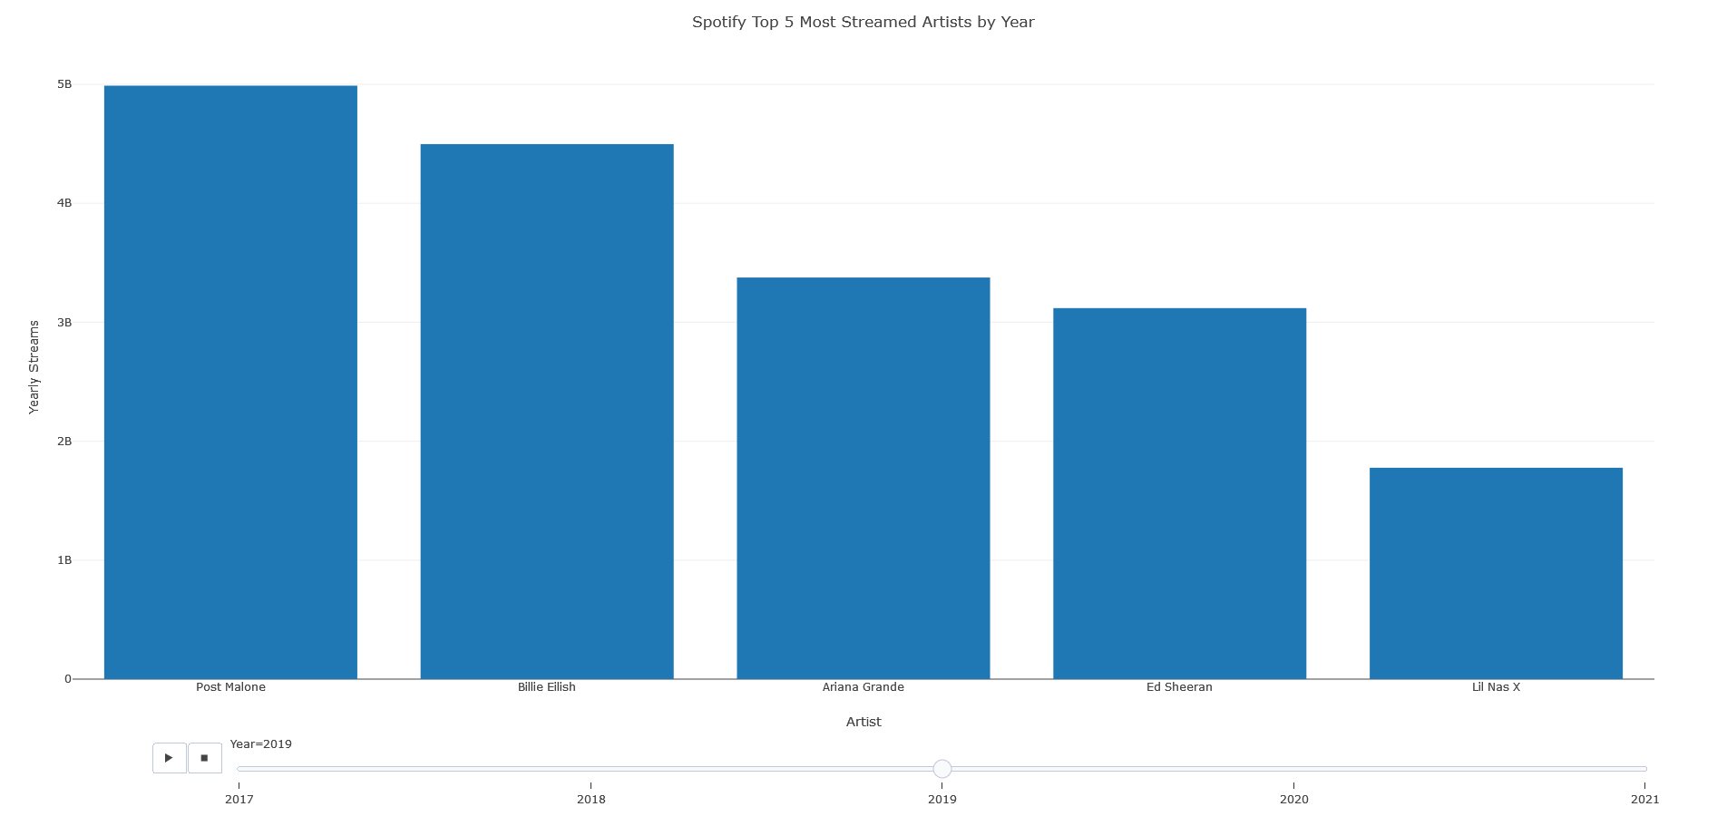
Finding the Top 5 Artists by Year - 2019
We see that there are almost entirely new artists dominating the top 5 this year

Slide 10
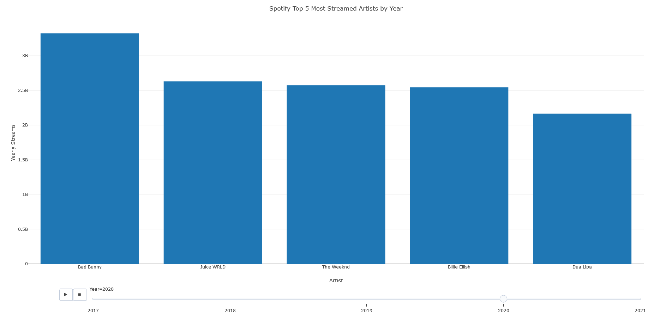
Finding the Top 5 Artists by Year - 2020
The distribution this year is very even with many artists that weren’t seen prior

Slide 11
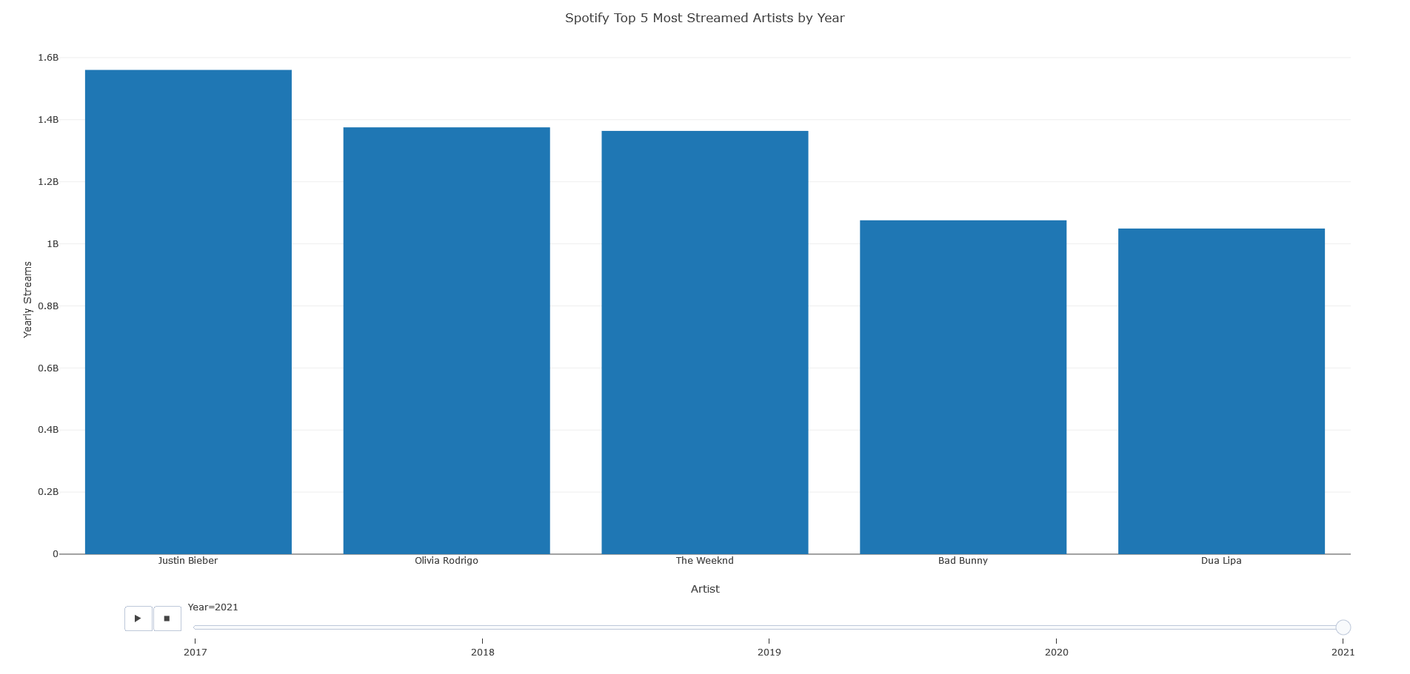
Finding the Top 5 Artists by Year - 2021
We see the distribution take on another change, but this one is small

Slide 12

What Are Some Constraints We See?
We can see that the main constraint is that 2021 only has half a year’s worth of data. This can cause some inaccuracy in our analysis for 2021, and skew our overall data a little bit.
We start with 2017, so we cannot see how past trends have affected these current trends.

Slide 13
Conclusions
We looked at the trends for the Spotify top 200 daily songs from 2017-2021. We have found that the most popular genres are various types of pop and rap, and that the songs with the longest amount of time in the #1 position reflected this.
We then looked at the top 5 artists by year, and found that the popularity of artists is starting to become a more even distribution as the years progress. This indicates a flexibility with which artist to hire for promotion of product.

