Slide 1
Spring Integration
Zülfikar Karakaya

Slide 2
EIP + dependency injection + method invocation
event driven architecture
low coupling and high cohesion
pipes-and-filters architectural design

Slide 3
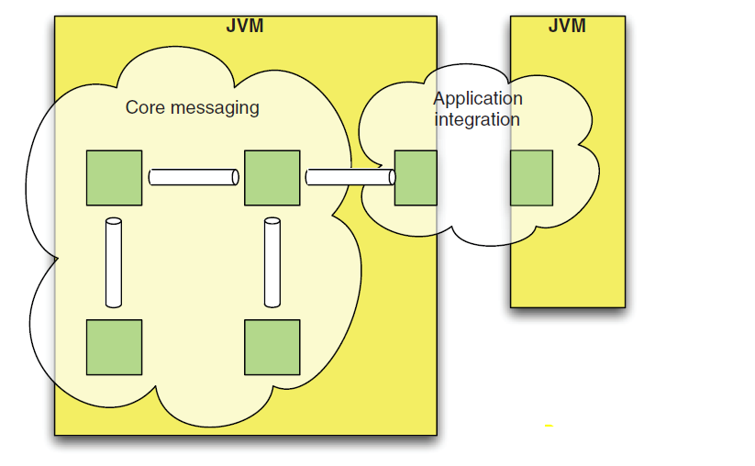
intra- application
inter application
Two areas of focus for Spring Integration
lightweight intra-application messaging
flexible interapplication integration

Slide 4
The Spring Integration 2.0 distribution
includes support for the following adapters
Filesystem, FTP, or Secured File Transfer Protocol (SFTP)
User Datagram Protocol (UDP)
Transmission Control Protocol (TCP)
HTTP (Representational State Transfer [REST])
Web services (SOAP)
Mail (POP3 or IMAP for receiving, SMTP for sending)
Java Message Service (JMS)
Java Database Connectivity (JDBC)
Java Management Extensions (JMX)
Remote Method Invocation (RMI)
Really Simple Syndication (RSS) feeds
Twitter
Extensible Messaging and Presence Protocol (XMPP)
channel adapters (unidirectional) or gateways (bidirectional)

Slide 5
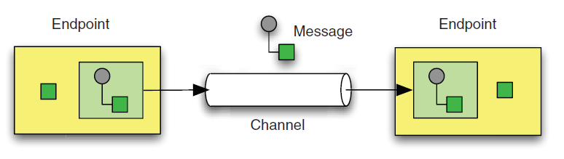
three base enterprise integration patterns message, message channel, and message endpoint

Slide 6
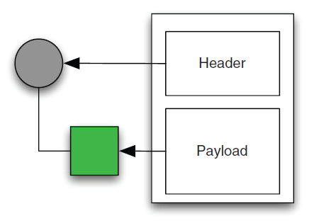
The message’s payload may be XML, a simple string, or a primary key referencing a record in a database Messages can have different functions. For example, a Command Message tells the receiver to do something, an Event Message notifies the receiver that something has happened, and a Document Message transfers some data from the sender to the receiver.
The Message!

Slide 7
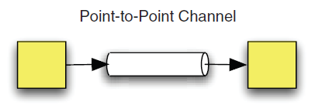
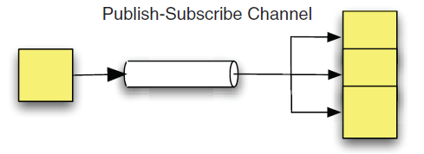
Message Channels
connection between multiple endpoints
how and where a message is delivered
key enabler for loose coupling
can be categorized as
according to the handoff type, synchronous or asynchronous
according to the delivery type,
point-to-point (should include support for load balancing and failover)
publish-subscribe (require failure-handling patterns)

Slide 8
Message Endpoints
Message endpoints are the components that actually do something with the message.
Message endpoints basically provide the connections between functional services and the messaging framework.
A message can leave the channel successfully only by being consumed by an endpoint, and a message can enter the channel only by being produced by an endpoint.
channel adapters
messaging gateways
service activators

Slide 9
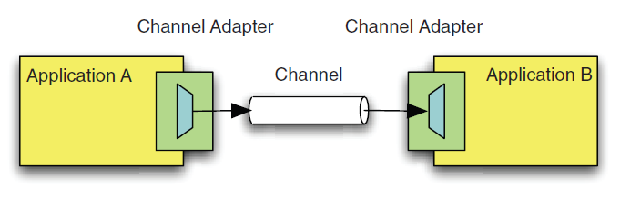
CHANNEL ADAPTER
Connects an application to the messaging system.
Channel adapter is placed at the beginning and the end of a unidirectional message flow.
Many different kinds of channel adapters exist, ranging from a method-invoking channel adapter to a web service channel adapter.

Slide 10
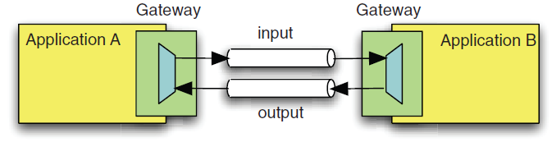
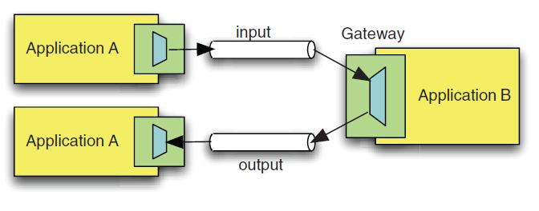
MESSAGING GATEWAY
Outbound gateways can be used for invoking web services and for synchronous
request-reply interactions over JMS

Slide 11
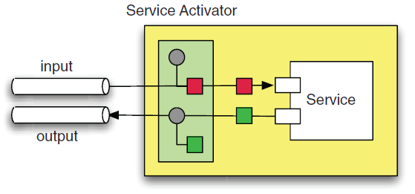
SERVICE ACTIVATOR
is a component that invokes a service based on an incoming message and sends an outbound message based on the return value of this service invocation.
in Spring Integration, the definition is constrained to local method calls.
a service activator as a method-invoking outbound gateway.

Slide 12
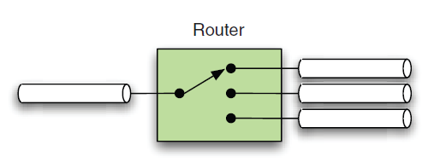
ROUTER
determines the next channel a message should be sent to based on the incoming message.
can be useful to send messages with different payloads to different, specialized consumers (Content-Based Router).

Slide 13
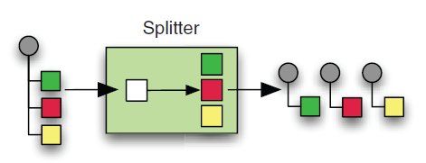
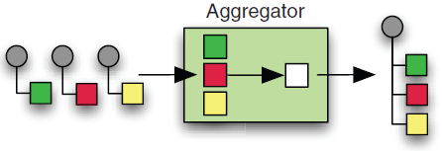
SPLITTER
AGGREGATOR
A Splitter is useful whenever the act of processing message content can be split into multiple steps and executed by different consumers at the same time.
An Aggregator waits for a group of correlated messages and merges them together when the group is complete.
A splitter and an aggregator are often used in a symmetric setup, where some work is done in parallel after a splitter, and the aggregated result is sent back to the upstream gateway.

Slide 14
<splitter input-channel="orders"
output-channel="items"/>
<aggregator input-channel="processedItems"
release-strategy="orderCompletionChecker"
output-channel="processedOrders"/>
Strategy Method pattern
Visit www.springframework.org/schema/integration to explore Spring Integration’s various XML schema namespace configurations.

Slide 15
a simple JMS example
public interface MessageListener {
void onMessage(Message message);
}
<jms:listener-container>
<jms:listener destination="someDestination"
ref="someListenerImplementsJMSMessageListener" />
</jms:listener-container>
JMS default message listener interface,
no return value
a custom method with return value,
no scheduling
public class HelloService {
public String sayHello(String name) {...}
}
<jms:listener-container>
<jms:listener destination="helloRequests" ref="helloService"
method="sayHello" />
</jms:listener-container>
<bean id="helloService" class="example.HelloService" />

Slide 16
schedule a file poller
Scheduling a task programmatically
Runnable task = new Runnable() {
public void run() {
File file = filePoller.poll();
if (file != null) {
fileProcessor.process(file);
}
}
};
long initialDelay = 0;
long rate = 60;
ScheduledExecutorService scheduler = Executors.newScheduledThreadPool(5);
scheduler.scheduleAtFixedRate(task, initialDelay, rate,TimeUnit.SECONDS);
Scheduling a task with Spring
<task:scheduled-tasks scheduler="myScheduler">
<task:scheduled ref="filePoller" method="poll"fixed-rate="60000" />
</task:scheduled-tasks>
<task:scheduler id="myScheduler" pool-size="5" />

Slide 17
Spring Integration way message listener + method invoker + task scheduler
<file:inbound-channel-adapter directory="/tmp/example" channel="files">
<poller max-messages-per-poll="10"
cron="0 * 9-17 * * MON-FRI"/>
</file:inbound-channel-adapter>
<service-activator input-channel="files" ref="helloService" method="sayHello"/>

Slide 18
JMS cons
dependency on the JMS API
this inhibits testing and also pollutes the business logic
Light-weight with Spring only, without spring an EJB container required
with version 2.0, Spring introduced its own MessageListener containers as a lightweight alternative
As with message-driven beans, a listener is registered with a certain JMS destination
but with Spring, the listener’s container is a simple object that is itself managed by Spring.
JMS default message listener has a void return type
That means you can’t easily send a reply message from the listener method’s implementation
RPC cons
certain detail about remoting can’t be safely hidden or ignored
serialization

Slide 19
Hello World example
Gateway
Note that the gateway element refers to a service interface. This is similar to the way the Spring Framework handles remoting.
The caller should only need to be aware of an interface, while the framework creates a proxy that implements that interface.
The proxy is responsible for handling the underlying concerns such as serialization and remote invocation, or in this case, message construction and delivery
Wire Tap
allows you to route messages to a separate location while they are being forwarded to the ultimate destination.

Slide 20
avoid coupling
method invocations with message
passing over channels
<beans:bean id="bookingDao" class="example.SimpleBookingDao" />
<beans:bean id="bookingService" class="example.BookingService">
<beans:constructor-arg ref="bookingDao" />
</beans:bean>
<channel id="mealPreferenceUpdatesChannel" />
<service-activator input-channel="mealPreferenceUpdatesChannel"
output-channel="bookingEnrichedMealUpdates" ref="bookingService"
method="populatePreference" />
<channel id="bookingEnrichedMealUpdates" />
<beans:bean id="updateRequestTransformer"
class="example.MealPreferenceRequestTransformer" />
<service-activator input-channel="bookingEnrichedMealUpdates"
output-channel="xmlMealUpdates" ref="updateRequestTransformer"
method="buildMealPreferenceUpdateRequest" />
<channel id="xmlMealUpdates" />
<ws:outbound-gateway uri="http://example.com/mealupdates"
request-channel="xmlMealUpdates" />
Reducing coupling is one of the main concerns when integrating applications

Slide 21
Event driven architecture
Event-driven architecture (EDA) is an architectural pattern in which complex applications
are broken down into a set of components or services that interact via events
Where events are communicated via channels that can act as buffers in
periods of high throughput, such a system can be described as having a staged event driven
architecture (SEDA). SEDA-based systems generally respond better to significant
spikes in load than do standard multithreaded applications and are also easier to
configure at runtime, for example, by modifying the number of consumers processing
a certain event type. This allows for optimizations based on the actual requirements of
the application, which in turn provides a better usage experience
Spring Integration provides the building blocks to create both EDA and SEDA applications.
Event-Driven Consumer pattern, but here the consumer is consuming messages rather than events - it’s just that the consumption is triggered by the event of a message becoming available.

Slide 22
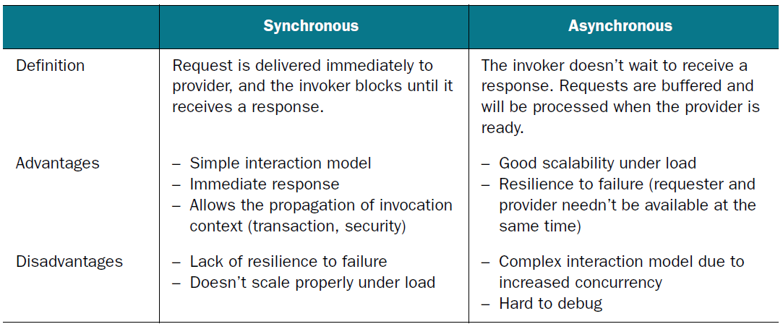
Synchronous and asynchronous communication compared
Traditionally, the integration between enterprise
applications is based on message-driven, asynchronous mechanisms

Slide 23
Spring Integration Way
<channel id="input" />
<payload-type-router input-channel="input">
<mapping type="example.Order" channel="orders"/>
<mapping type="example.Notification" channel="notifications"/>
</payload-type-router>
<channel id="orders" />
<channel id="notifications" />
<service-activator ref="ordersProcessor"
input-channel="orders" output-channel="results" />
<service-activator ref="notificationsProcessor"
input-channel="notifications" output-channel="results" />
<channel id="results" />

Slide 24
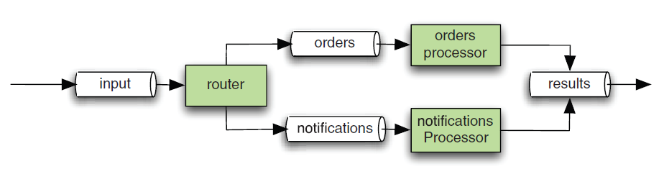
Spring Integration Way
The structure doesn’t seem to tell what kind of interaction takes place
(is it synchronous
or asynchronous?)

Slide 25
Spring Integration Way
Spring Integration supports both approaches by using two different
types of message channels
DirectChannel (synchronous) and QueueChannel (asynchronous)
Both types of channels are configured using the same <channel/> element. By default, its behavior is synchronous
If you want to buffer the messages instead of passing them
directly through a channel and to follow an asynchronous approach, you can use a queue to store them, like this
<channel id="input">
<queue capacity="10"/>
</channel>

Slide 26
Message (Revisited)
public interface Message<T> {
MessageHeaders getHeaders();
T getPayload();
}
public final class MessageHeaders
implements Map<String, Object>, Serializable {
/* implementation omitted */
}
message headers are immutable
to avoid issues with concurrency

Slide 27
Channels
public interface MessageChannel {
boolean send(Message<?> message);
boolean send(Message<?> message, long timeout);
}
it provides
no methods for receiving messages

Slide 28
Channels
I’ll let you know when I’ve got something!
public interface SubscribableChannel extends MessageChannel {
boolean subscribe(MessageHandler handler);
boolean unsubscribe(MessageHandler handler);
}
Do you have any messages for me?
public interface PollableChannel extends MessageChannel {
Message<?> receive();
Message<?> receive(long timeout);
}

Slide 29
Selecting right channel for the job
<channel id="bookingConfirmationRequests"/>
<service-activator input-channel="bookingConfirmationRequests"
output-channel="chargedBookings"
ref="billForBookingService" />
<channel id="chargedBookings" />
<service-activator input-channel="chargedBookings"
output-channel="emailConfirmationRequests"
ref="seatAvailabilityService" />
<channel id="emailConfirmationRequests" />
<outbound-channel-adapter channel="emailConfirmationRequests"
ref="emailConfirmationService" />
In Spring Integration, the default channels are SubscribableChannels, and the message
transmission is synchronous.
So there is one thread and single transaction here

Slide 30
Email is slow and our servers are unreliable
<channel id="emailConfirmationRequests">
<queue />
</channel>
what if you need to connect one producer
with not just one, but two (or more) consumers?
Telling everyone who needs to know that a booking occured
<service-activator input-channel="chargedBookings"
output-channel="emailConfirmationRequests"
ref="seatAvailabilityService" />
<publish-subscribe-channel id="completedBookings" />
<bridge input-channel="completedBookings"
output-channel="emailConfirmationRequests" />
<channel id="emailConfirmationRequests">
<queue />
</channel>

Slide 31
Some customers are more equal than others
<channel id="bookingConfirmationRequests">
<priority-queue comparator="customerPriorityComparator" />
</channel>
this causes the framework to instantiate an instance of PriorityChannel
you can provide an instance of a class implementing Comparator<Message<?>>

Slide 32
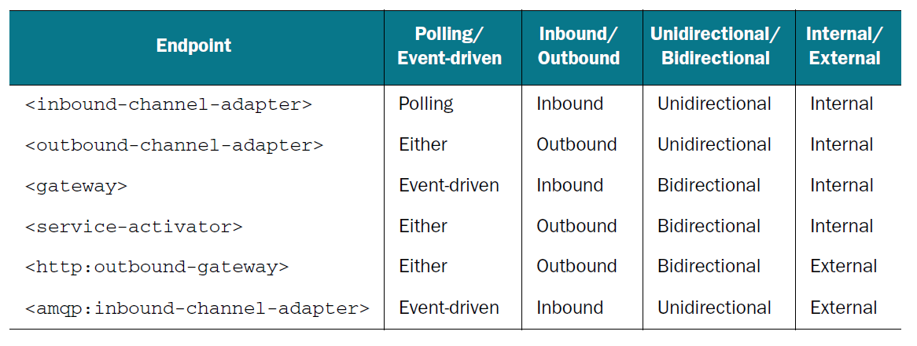
Endpoints
Polling or event-driven
Inbound or outbound
Unidirectional or bidirectional
Internal or external

Slide 33
Spring Integration
References
Spring Integration in Action,
MARK FISHER, JONAS PARTNER, MARIUS BOGOEVICI, IWEIN FULD
Zülfikar Karakaya

