Slide 1
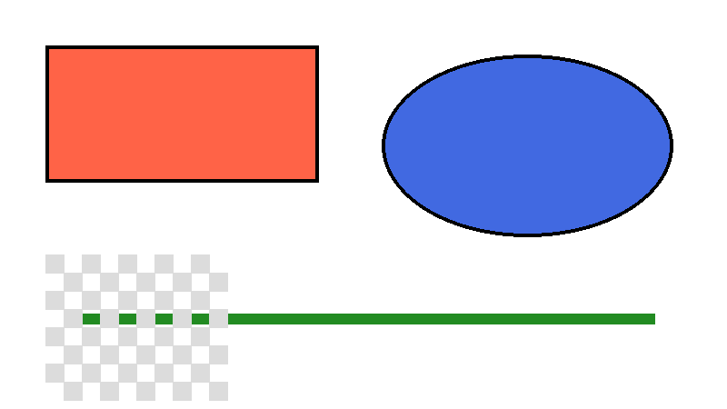
Images: crop & rotate
Crop: 15% L/R, 10% T/B. Rotate: -12°.

