Slide 1
Multi-slide: 1/3

Slide 2
Multi-slide: 2/3
Slide 2 text box

Slide 3
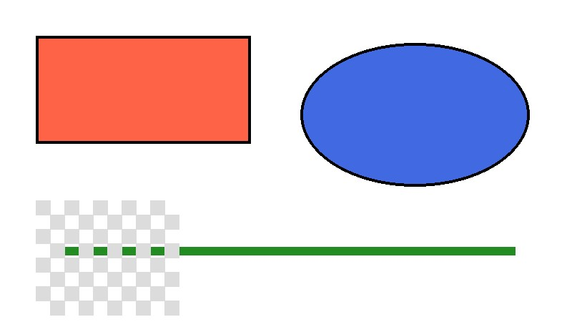
Multi-slide: 3/3

