Slide 2
The weather is nice today, but it might rain later

Slide 3
1 | 2 | - | 64
2
-
-
512
1 | 2 | - | 64
1 | 2 | - | 64
1 | 2 | - | 64
1 | 2 | - | 64
2
-
-
512
1 | 2 | - | 64
1 | 2 | - | 64
1 | 2 | - | 64
1 | 2 | - | 64
2
-
-
512
1 | 2 | - | 64
1 | 2 | - | 64
1 | 2 | - | 64
1 | 2 | - | - | 512
1 | 2 | - | - | 512
1 | 2 | - | - | 512

Slide 4
Z RELU
Z RELU
1
1
1
2
-
-
512
2
Z RELU
2
Z RELU
1
2
-
-
512
1
2
-
-
512
1
2
-
-
512
1
2
-
-
512
1
2
-
-
512
1
2
-
-
512
1
2
-
-
512
Z RELU
Z RELU
-
-
-
-
N tokens
Z RELU
Z RELU
512
1024

Slide 6
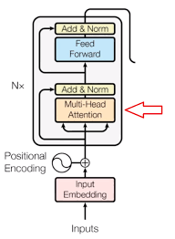
1 | 2 | - | 64
2
-
N
1 | 2 | - | 64
2
-
N
1 | 2 | - | 64
2
-
N
1 | 2 | - | 64
2
-
-
512
1 | 2 | - | 64
2
-
-
512
1 | 2 | - | 64
2
-
-
512
1 | 2 | - | - | 512
2
-
N
1 | 2 | - | - | 512

