Slide 2
The weather is nice today, but it might rain later

Slide 3

Traditional Networks Including RNN’s
Imagine you're reading a storybook, and suddenly the words are all jumbled up!
Traditional networks treat sequences like a bag of words—no order, no understanding.
They stumble with long texts, forget the beginning while reading the end.
Imagine reading a novel with no sense of characters, plot, or chapters.
Notes:
Classic networks can't handle long sequences, lose context, and can't tell what's important in a sea of information.

Slide 4
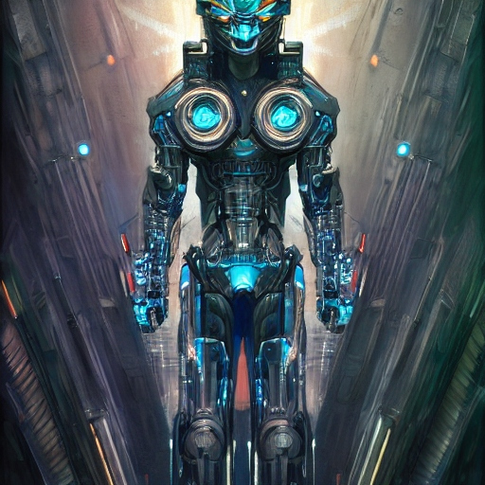
Transformers are the superheroes of the AI world!
Transformers are like detectives who read between the lines.
They use 'attention' to grasp context and find important clues.
Imagine if you could instantly spot the vital words in a massive text.
Notes:
Transformers use 'attention' to focus on the right parts of the sequence, just like you focus on the most important words in a story. This helps them understand context, relationships, and long-range connections.

Slide 5
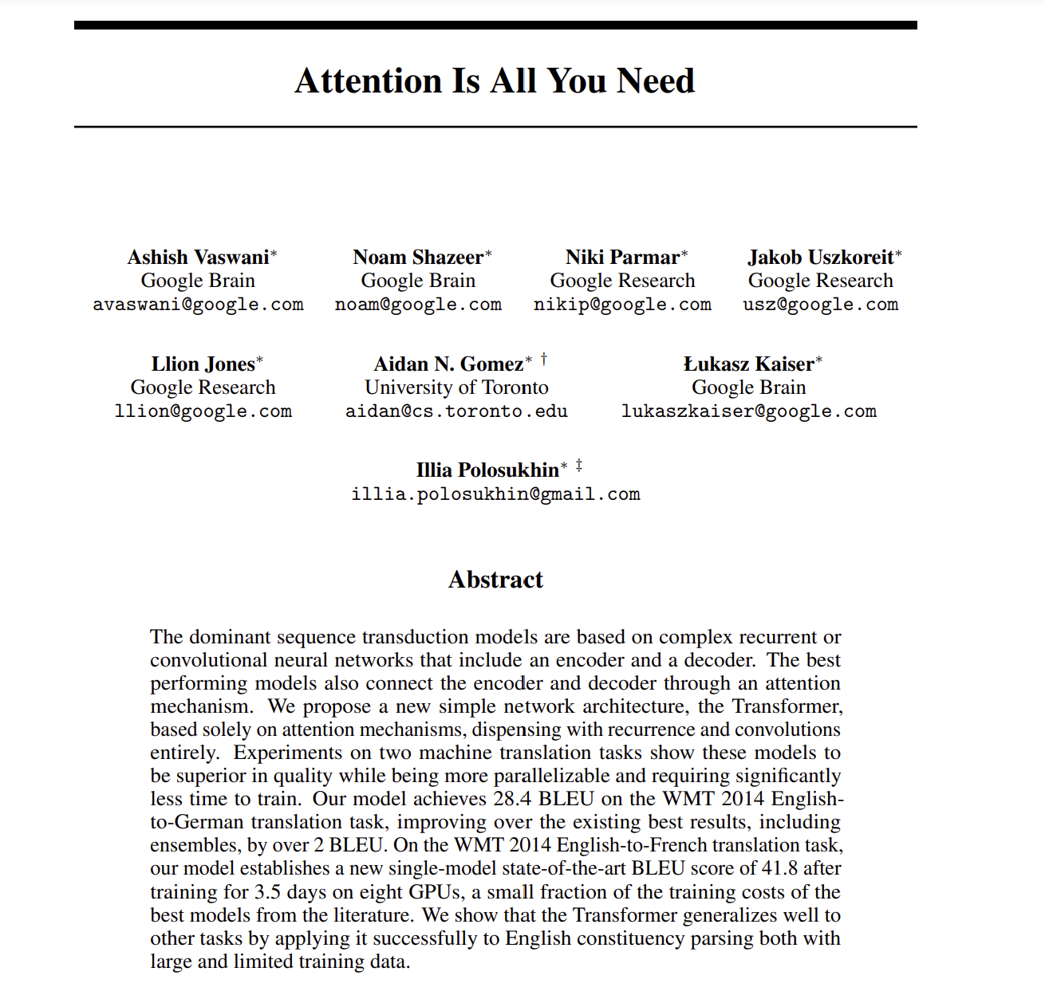
Why Transformers Matter
Transformers are game-changers in AI
Scale efficiently
Parallel process
Attention to input meaning
Notes:
Transformers use 'attention' to focus on the right parts of the sequence, just like you focus on the most important words in a story. This helps them understand context, relationships, and long-range connections.

Slide 6
Transformers Applications
Sentiment Analysis, Classification
Machine Translation
Named Entity Recognition
Text Summarization
Image Captioning
Object Detection
Automatic Speech Recognition (ASR)
Text-to-Speech (TTS) Synthesis
Personalized Content Recommendations
Stock Market Prediction
….
Notes:
Transformers use 'attention' to focus on the right parts of the sequence, just like you focus on the most important words in a story. This helps them understand context, relationships, and long-range connections.

Slide 7
Output probabilities
Linear & Softmax
Decoder
Encoder
Positional Embedding
Positional Embedding
Input Embedding
output Embedding
(shifted right)

Slide 8
Output probabilities
Linear & Softmax
Decoder
Encoder
Positional Embedding
Positional Embedding
Inputs
Input Embedding
output Embedding
(shifted right)
Token ID’s
142
975
456
428
372
I
went
to
the
store

Slide 9
Output probabilities
Linear & Softmax
Decoder
Encoder
Positional
Positional Embedding
Positional Embedding
Inputs
Input Embedding
output Embedding
(shifted right)
Token ID’s
142
975
456
428
372
I
went
to
the
store

Slide 10
Output probabilities
Linear & Softmax
Decoder
Encoder
Positional
Positional Embedding
Positional Embedding
Inputs
Input Embedding
output Embedding
(shifted right)
Token ID’s
142
975
456
428
372
I
went
to
the
store

Slide 11
Output probabilities
Linear & Softmax
Decoder
Encoder
embedding
embedding
Positional
Positional Embedding
Positional Embedding
Inputs
Input Embedding
output Embedding
(shifted right)
142
975
456
428
372
I
went
to
the
store

Slide 12
Output probabilities
Linear & Softmax
Decoder
Encoder
embedding
embedding
Positional
Positional Embedding
Positional Embedding
Inputs
Input Embedding
output Embedding
(shifted right)
Token ID’s
142
975
456
428
372
I
went
to
the
store

Slide 13
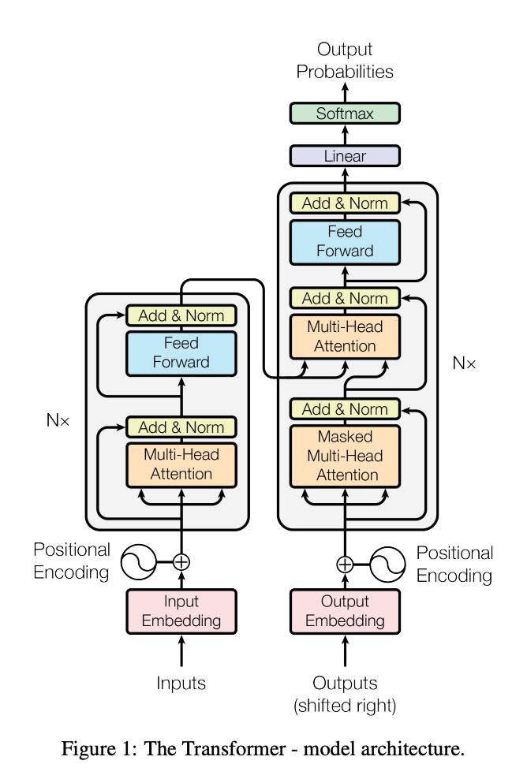
Output probabilities
Linear & Softmax
Decoder
Encoder
Encoder
embedding
Positional Embedding
Positional Embedding
Input Embedding
output Embedding
(shifted right)

Slide 14
Output probabilities
Linear & Softmax
Decoder
Encoder
embedding
Positional Embedding
Positional Embedding
Input Embedding
output Embedding
(shifted right)

Slide 15
Output probabilities
Linear & Softmax
Decoder
Encoder
embedding
Positional Embedding
Positional Embedding
Input Embedding
output Embedding
(shifted right)

Slide 16
Output probabilities
Linear & Softmax
Decoder
Encoder
embedding
Positional Embedding
Positional Embedding
Input Embedding
output Embedding
(shifted right)

Slide 17
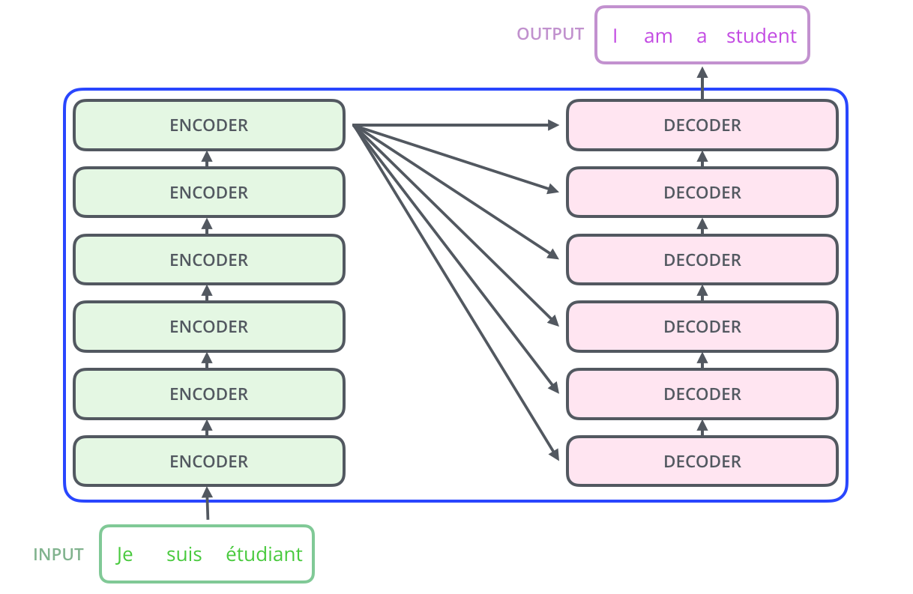
Output probabilities
Linear & Softmax
Decoder
Encoder
embedding
Positional Embedding
Positional Embedding
Input Embedding
output Embedding
(shifted right)

Slide 18
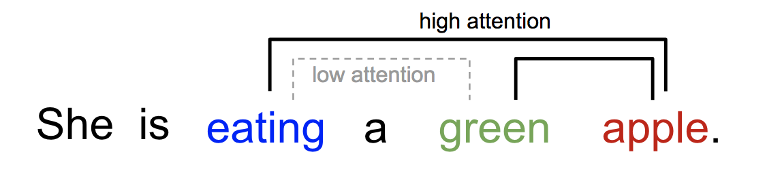
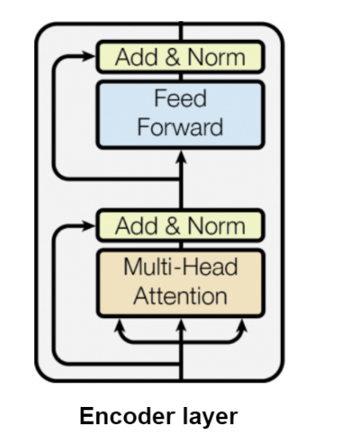

Slide 19
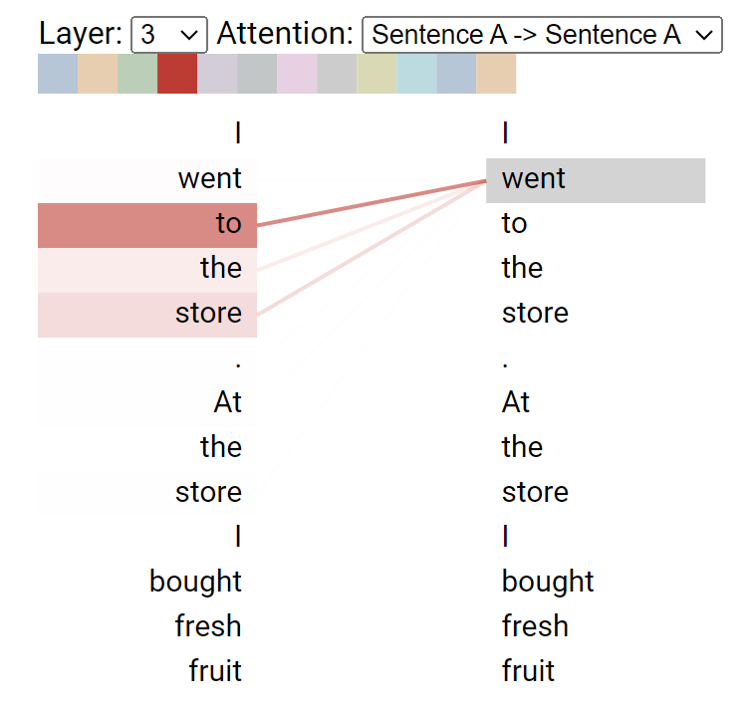

Slide 20
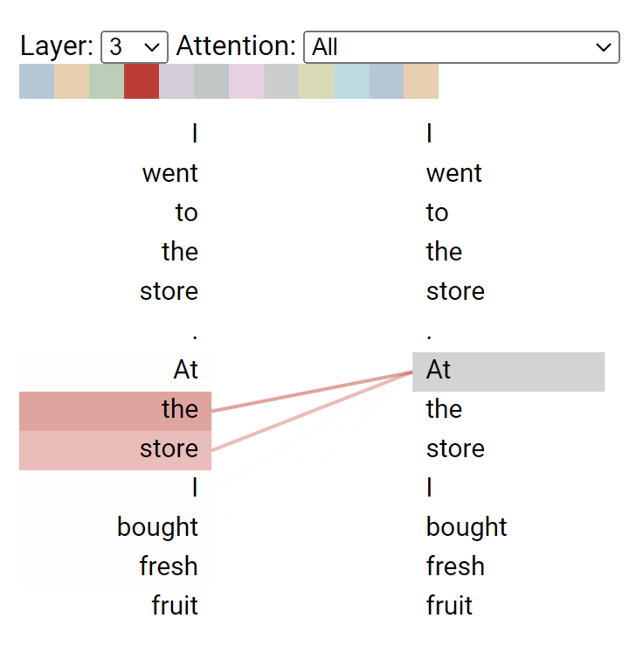

Slide 21
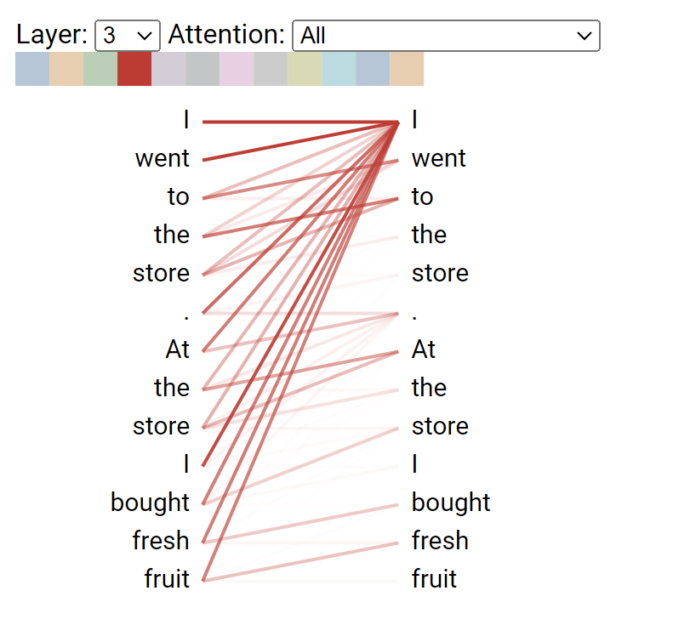

Slide 22
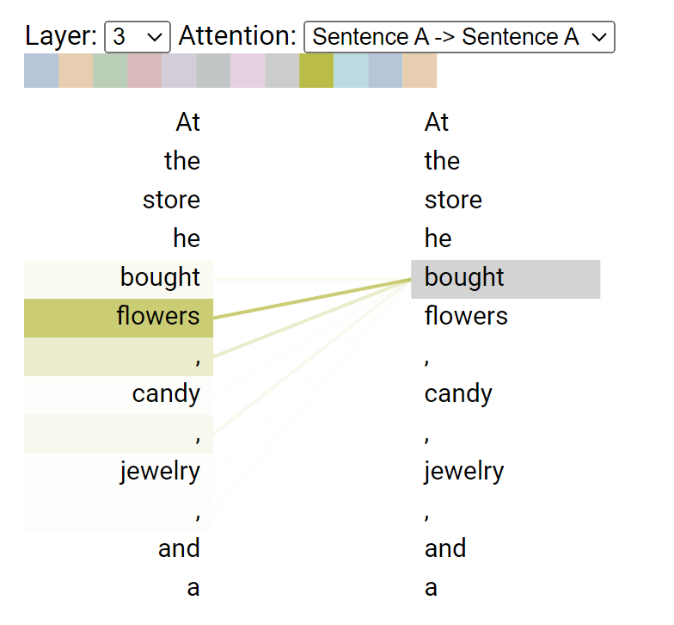

Slide 23
1 | 2 | . | 64
1 | 2 | . | 64
1 | 2 | . | 64
1 | 2 | . | 64
1 | 2 | . | 64
1 | 2 | . | 64
1 | 2 | . | 64
1 | 2 | . | 64
1 | 2 | . | 64
1 | 2 | . | 64
1 | 2 | . | 64
1 | 2 | . | 64
1 | 2 | . | . | 512
1 | 2 | . | . | 512
1 | 2 | . | . | 512
1 | 2 | . | . | 512

Slide 24
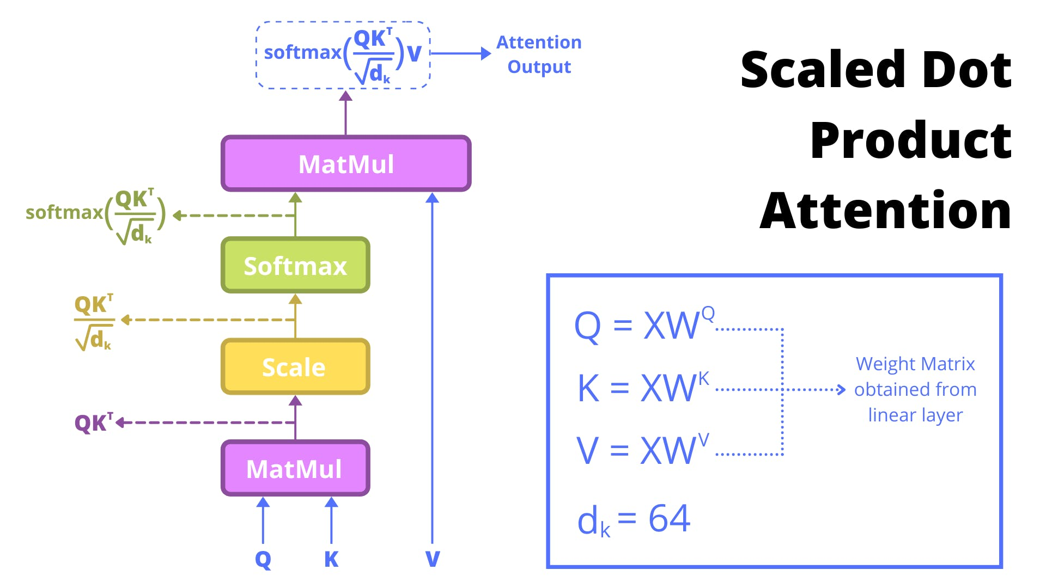
1 | 2 | . | . | 512
1 | 2 | . | . | 512
2
.
64
1 | 2 | . | 64
1 | 2 | . | 64
1 | 2 | . | 64
1 | 2 | . | 64
1 | 2 | . | 64
1 | 2 | . | 64
1 | 2 | . | 64
1 | 2 | . | 64
1 | 2 | . | 64
1 | 2 | . | 64
1 | 2 | . | 64
0.75
0.001
0.0007
0.0002
0.237
15
6.5
5.75
4.25
13.75
120
52
46
34
110
1 | 2 | . | 64
1 | 2 | . | 64
1 | 2 | . | 64
1 | 2 | . | 64
1 | 2 | . | 64
1 | 2 | . | 64
1 | 2 | . | 64
1 | 2 | . | 64
1 | 2 | . | 64
1 | 2 | . | 64
1 | 2 | . | . | 512
1 | 2 | . | . | 512
1 | 2 | . | . | 512
1 | 2 | . | . | 512
1 | 2 | . | . | 512

Slide 25
1 | 2 | . | . | 512
2
.
64
1 | 2 | . | . | 512
1 | 2 | . | . | 512
2
.
64
1 | 2 | . | 64
1 | 2 | . | . | 512
2
.
64
1 | 2 | . | 64
1 | 2 | . | 64
1 | 2 | . | 64
1 | 2 | . | 64
1 | 2 | . | 64
1 | 2 | . | 64
1 | 2 | . | 64
1 | 2 | . | 64
1 | 2 | . | 64
1 | 2 | . | 64
1 | 2 | . | 64
1 | 2 | . | 64
1 | 2 | . | 64
0.75
0.001
0.0007
0.0002
0.237
15
6.5
5.75
4.25
13.75
120
52
46
34
110
1 | 2 | . | 64
1 | 2 | . | 64
1 | 2 | . | 64
1 | 2 | . | 64
1 | 2 | . | 64
1 | 2 | . | 64
1 | 2 | . | 64
1 | 2 | . | 64
1 | 2 | . | 64
1 | 2 | . | 64
1 | 2 | . | . | 512
1 | 2 | . | . | 512
1 | 2 | . | . | 512
1 | 2 | . | . | 512
1 | 2 | . | . | 512

Slide 26
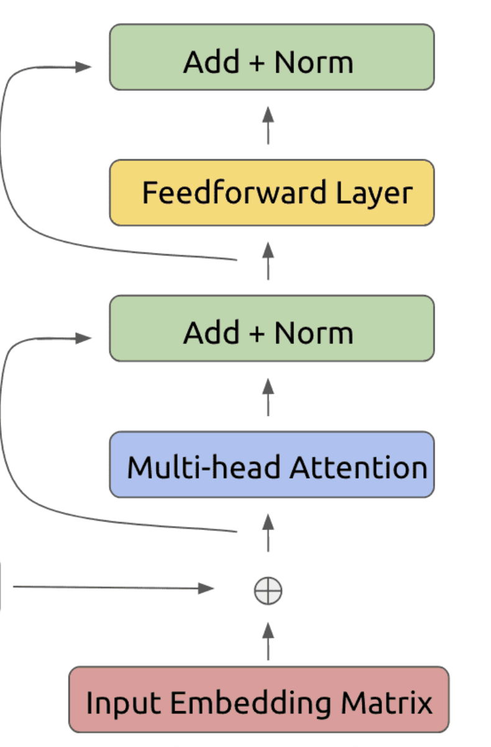
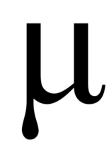


$$ν\frac{x−u}{σ}+β$$
LayerNorm(x + Sublayer(x))
0.1 | 0.5 | . | . | 0.9
0.6 | 0.7 | . | . | -0.2
0.7 | 1.2 | . | . | 0.7
1 | 2 | . | . | 512
0.7
0.1
0.2 | 0.8 | . | . | 0.2

Slide 27
1
.
.
512
1
.
.
512
1
.
.
512
1
.
.
512
1
.
.
512
1
.
.
512
1
2
.
.
512
1
.
.
512
1
.
.
512
1
2
.
.
512

Slide 28
Output probabilities
Linear & Softmax
Decoder
Encoder
contextual embedding
Positional Embedding
Positional Embedding
Input Embedding
output Embedding
(shifted right)

Slide 29
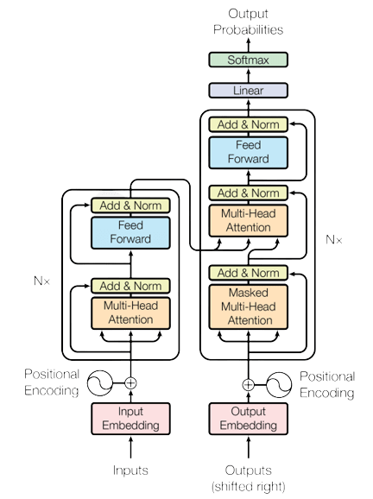
Output probabilities
Linear & Softmax
Decoder
Encoder
Positional Embedding
Positional Embedding
Input Embedding
output Embedding
(shifted right)

Slide 30
Output probabilities
Linear & Softmax
Decoder
Encoder
Positional Embedding
Positional Embedding
Input Embedding
output Embedding
(shifted right)

Slide 31
3
2
1

Slide 32
Output
Linear & Softmax
K, V matrix
Encoder
Decoder
.
.
.
.
.
.
Encoder
Decoder
Encoder
Decoder
Embeddings
Inputs
Output
I
went
to
the
store
Fui
a
la
tienda

Slide 33
Output
Linear & Softmax
Encoder
Decoder
.
.
.
.
.
.
Encoder
Decoder
Encoder
Decoder
Inputs
I
went
to
the
store

Slide 34
Output
Linear & Softmax
Encoder
Decoder
.
.
.
.
.
.
Encoder
Decoder
Encoder
Decoder
Inputs
I
went
to
the
store

Slide 35
Output
Linear & Softmax
Encoder
Decoder
.
.
.
.
.
.
Encoder
Decoder
Encoder
Decoder
Embeddings
Inputs
I
went
to
the
store

Slide 36
Output
Linear & Softmax
K, V matrix
Encoder
Decoder
.
.
.
.
.
.
Encoder
Decoder
Encoder
Decoder
Embeddings
Inputs
I
went
to
the
store

Slide 37
K, V matrix
Output
Linear & Softmax
K, V values
Encoder
Decoder
.
.
.
.
.
.
Encoder
Decoder
Encoder
Decoder
Embeddings
Inputs
I
went
to
the
store

Slide 38
Output
Linear & Softmax
K, V matrix
Encoder
Decoder
.
.
.
.
.
.
Encoder
Decoder
Encoder
Decoder
Embeddings
Inputs
Output
I
went
to
the
store
Fui
a
la
tienda

Slide 39
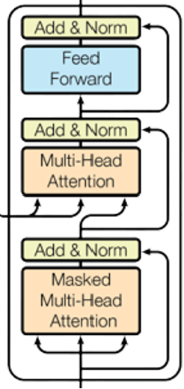
Output
Linear & Softmax
K, V matrix
Encoder
Decoder
.
.
.
.
.
.
Encoder
Decoder
Encoder
Decoder
Embeddings
Embeddings
Inputs
Output
I
went
to
the
store
<SOS>

Slide 40
Output
Fui
Linear & Softmax
K, V matrix
Encoder
Decoder
.
.
.
.
.
.
Encoder
Decoder
Encoder
Decoder
Embeddings
Embeddings
Inputs
Output
I
went
to
the
store
<SOS>

Slide 41
Output
Fui
Linear & Softmax
K, V matrix
Encoder
Decoder
.
.
.
.
.
.
Encoder
Decoder
Encoder
Decoder
Embeddings
Embeddings
Inputs
Output
I
went
to
the
store
<SOS>
FUI

Slide 42
Output
Fui
a
Linear & Softmax
K, V matrix
Encoder
Decoder
.
.
.
.
.
.
Encoder
Decoder
Encoder
Decoder
Embeddings
Embeddings
Inputs
Output
I
went
to
the
store
<SOS>
FUI

Slide 43
Output
Fui
a
la
Linear & Softmax
K, V matrix
Encoder
Decoder
.
.
.
.
.
.
Encoder
Decoder
Encoder
Decoder
Embeddings
Embeddings
Inputs
Output
I
went
to
the
store
<SOS>
FUI
a

Slide 44
Output
Fui
a
la
tienda
Linear & Softmax
K, V matrix
Encoder
Decoder
.
.
.
.
.
.
Encoder
Decoder
Encoder
Decoder
Embeddings
Embeddings
tienda
Inputs
Output
I
went
to
the
store
<SOS>
FUI
a
la

Slide 45
Output
Fui
a
la
tienda
<EOS>
Linear & Softmax
K, V matrix
Encoder
Decoder
.
.
.
.
.
.
Encoder
Decoder
Encoder
Decoder
Embeddings
Embeddings
tienda
Inputs
Output
I
went
to
the
store
<SOS>
FUI
a
la
tienda

Slide 46
Output
Linear & Softmax
K, V matrix
Encoder
Decoder
P1 | P2 | P3 | … | … | … | … | … | … | … | … | … | … | … | … | … | … | … | Pn
.
.
.
.
.
.
Encoder
Decoder
Encoder
Decoder
Embeddings
Inputs
I
went
to
the
store

Slide 47
Output
Linear & Softmax
K, V matrix
Encoder
Decoder
.
.
.
.
.
.
Encoder
Decoder
Encoder
Decoder
Embeddings
Inputs
I
went
to
the
store

Slide 48
Output
Linear & Softmax
K, V matrix
Encoder
Decoder
Encoder
Decoder
Encoder
Decoder
Embeddings
Inputs
Output
I
went
to
the
store
Fui
a
la
tienda

Slide 49
Output
Fui
Linear & Softmax
K, V matrix
Encoder
Decoder
Encoder
Decoder
Encoder
Decoder
Embeddings
Inputs
I
went
to
the
store

Slide 50
Output
Fui
a
Linear & Softmax
K, V matrix
Encoder
Decoder
Encoder
Decoder
Encoder
Decoder
Embeddings
Inputs
Output
I
went
to
the
store
Fui

Slide 51
Fui
a
Output
la
Linear & Softmax
K, V matrix
Encoder
Decoder
Encoder
Decoder
Encoder
Decoder
Embeddings
Inputs
Output
I
went
to
the
store
Fui
a

Slide 52
Fui
a
la
Output
tienda
Linear & Softmax
K, V matrix
Encoder
Decoder
Encoder
Decoder
Encoder
Decoder
Embeddings
Inputs
Output
I
went
to
the
store
Fui
a
la

Slide 53
Fui
a
la
EOS
Output
tienda
Linear & Softmax
K, V matrix
Encoder
Decoder
Encoder
Decoder
Encoder
Decoder
Embeddings
Inputs
Output
I
went
to
the
store
Fui
a
la
tienda

Slide 54
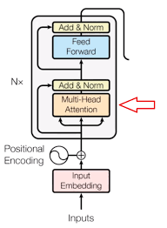
1 | 2 | - | 64
2
-
N
1 | 2 | - | 64
2
-
N
1 | 2 | - | 64
2
-
N
1 | 2 | - | 64
2
-
-
512
1 | 2 | - | 64
2
-
-
512
1 | 2 | - | 64
2
-
-
512
1 | 2 | - | - | 512
2
-
N
1 | 2 | - | - | 512

