Slide 1

Spring HATEOAS
Hieu Tran
trmhieu999@gmail.com

Slide 2
Agenda
Richardson Maturity model
HATEOAS
Spring HATEOAS

Slide 3
Agenda
Richardson Maturity model
HATEOAS
Spring HATEOAS

Slide 4
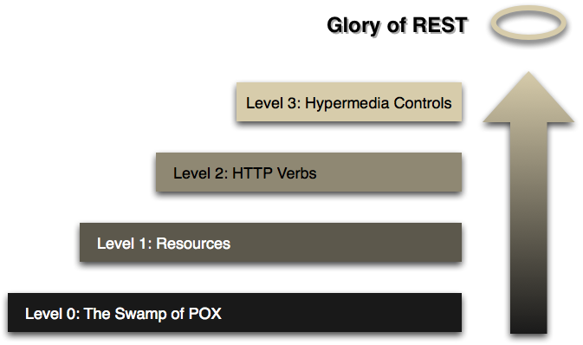
Richardson Maturity model
1
Notes:
Developed by Leonard Richardson. He analyzed several different web service designs and divide them into 4 level based on how much they are REST compliant.
- This model is a division of REST services to consider the maturity of web services.
- Richardson used three factors to decide the maturity of a service: URI, HTTP Methods and HATEOAS (Hypermedia).

Slide 5
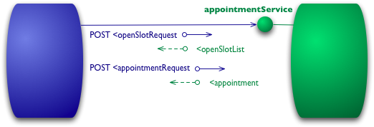
Richardson Maturity model
Level 0 – The Swamp of POX
Notes:
Single URI and use a single HTTP method (typically POST)

Slide 6
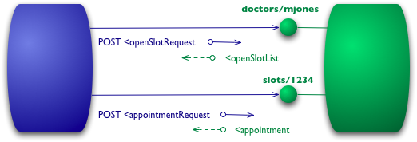
Richardson Maturity model
Level 1 - Resources
Notes:
Several URIs and single HTTP verb (POST)
http://server/services
http://server/service/1
http://server/service/2

Slide 7
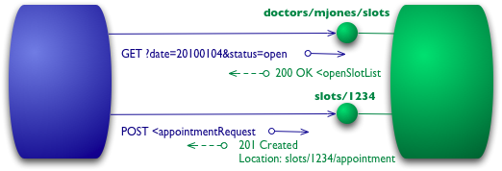
Richardson Maturity model
Level 2 – HTTP verbs
Notes:
Several URIs and several HTTP verbs, status code
http://server/services
http://server/service/1
http://server/service/2

Slide 8
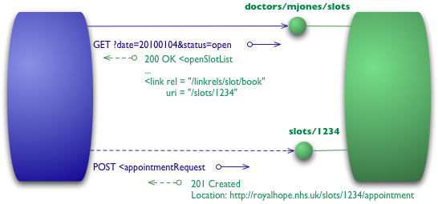
Richardson Maturity model
Level 3 - Hypermedia Controls
Notes:
Each slot now has a link element which contains a URI to tell us how to book an appointment.
The point of hypermedia controls is that they tell us what we can do next, and the URI of the resource we need to manipulate to do it.
You will tell not only about the information being requested but also about the next possible actions that the service consumer can do

Slide 9
Agenda
Richardson Maturity model
HATEOAS
Spring HATEOAS

Slide 10
HATEOAS
What is HATEOAS?
Should I use HATEOAS for my project?
Is there library support for HATEOAS?

Slide 11
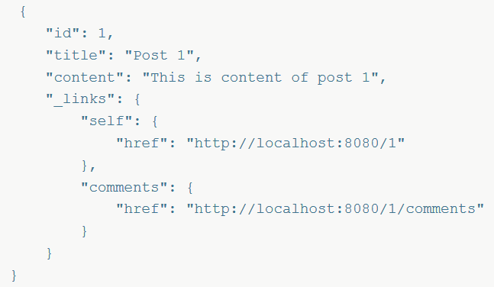
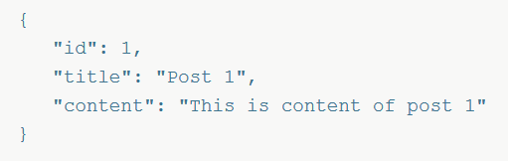
What is HATEOAS?
“Hypermedia As The Engine Of Application State (HATEOAS) is a component of the REST application architecture that distinguishes it from other network application architectures” - Wikipedia
Without HATEOAS With HATEOAS

Slide 12
Should we use HATEOAS for our project?
Benefit
Easy for client
Server control
Maintainability
Authorization
Disadvantages
Harder to implement in server
Needs more resources
Excessive information

Slide 13


Is there library support for HATEOAS?
Notes:
Spring HATEOAS – the standard way of doing HATEOAS with Spring- waiting for the version 1.0 at the time of writing. Since I am a Spring aficionado, this is what I would recommend
Jersey – being the reference implementation of JAX-RS provides HATEOAS support
VRaptor – if you enjoy CDI beans, this MVC framework provides HATEOAS support explored by ZeroTurnaround

Slide 14
Agenda
Richardson Maturity model
HATEOAS
Spring HATEOAS

Slide 15
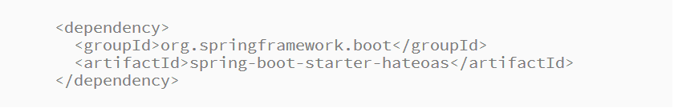
Spring HATEOAS
Provides some APIs to ease creating REST representations that follow the HATEOAS principle. The core problem it tries to address is link creation and representation assembly.
Model classes for link, resource representation models
Link builder API to create links pointing to Spring MVC controller methods
Support for hypermedia formats like HAL

Slide 16
Spring HATEOAS
Create
Create Links
Create
Create Resources
Add
Add links into resources

Slide 17
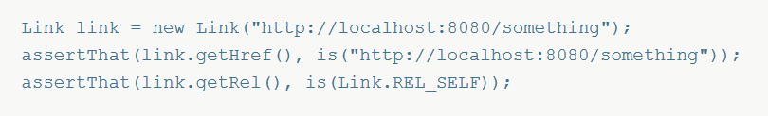
Links
“The Link value object follows the Atom link definition and consists of a rel and an href attribute. It contains a few constants for well known rels such as self, next etc.” – Spring HATEOAS Reference Documentation
rel means relationship.
href is a complete URL that uniquely defines the resource.

Slide 18

How to obtain links?
Links builder
Building links pointing to methods
EntityLinks

Slide 19
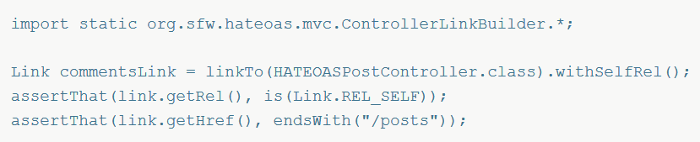
Links builder
Spring Hateoas provides LinkBuilder interface to ease building Link instances. ControllerLinkBuilder is one of the implementation of this interface, which helps building Link instances pointing to controllers:

Slide 20
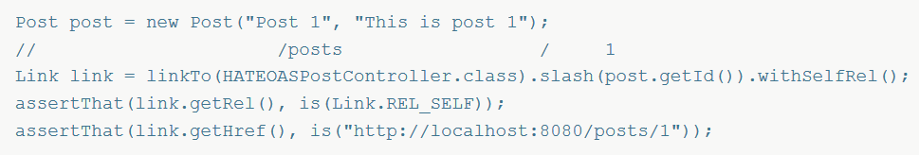
Links builder
The ControllerLinkBuilder uses Spring’s ServletUriComponentsBuilder to obtain the basic URI information from the current request:
Build more nested links:

Slide 21
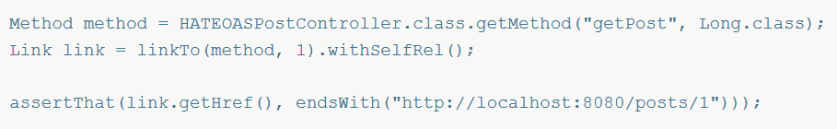
Building links pointing to methods
Handing a Method instance to the ControllerLinkBuilder:
=> Dissatisfying as we have to get a Method instance first, which throws an exception and is generally quite cumbersome.

Slide 22
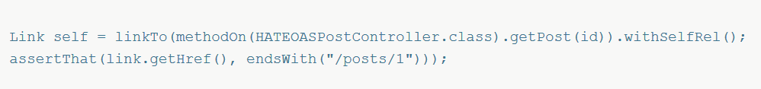
Building links pointing to methods
ControllerLinkBuilder provides method methodOn to create a dummy method invocation of the target method on a controller proxy:

Slide 23
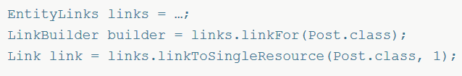
EntityLinks
The EntityLinks interface now exposes an API to lookup a Link or LinkBuilder based on the model types. The methods essentially return links to either point to the collection resource (e.g. /posts) or a single resource (e.g. /posts/1).
@EnableEntityLinks : make EntityLinks is available for DI. Instead of that @EnableHypermediaSupport additionally enables this functionality as well.
@ExposesResourceFor(…) : exposes which model type the controller manages.

Slide 24
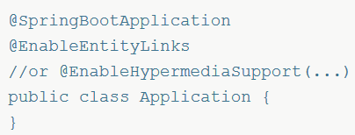
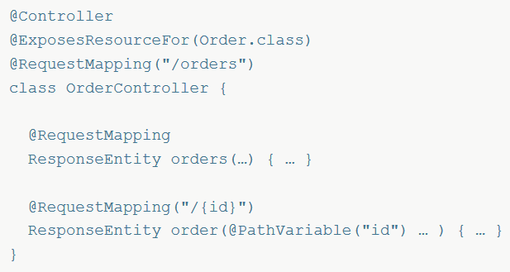
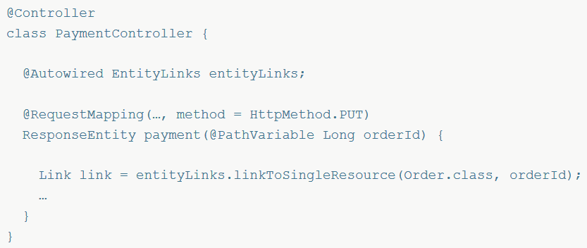
EntityLinks

Slide 25
Resources
Create resource using ResourceSupport
Converting entities to resource types with ResourceAssembler
Wrapping domain objects with Resource And Resources Classes

Slide 26
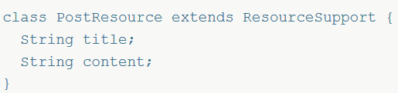
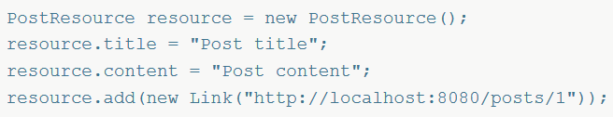
Create resource using ResourceSupport
Spring HATEOAS module provides ResourceSupport class which allows to add hypermedia links with the web responses. We need to extend our POJOS from ResourceSupport.
Create resource by extend ResourceSupport:
Add link into resource:

Slide 27
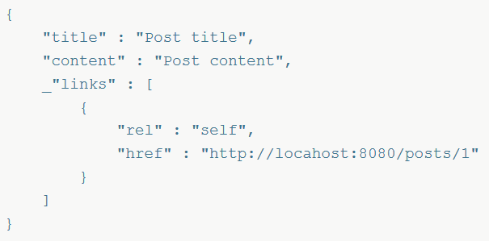
Create resource using ResourceSupport
Output:

Slide 28
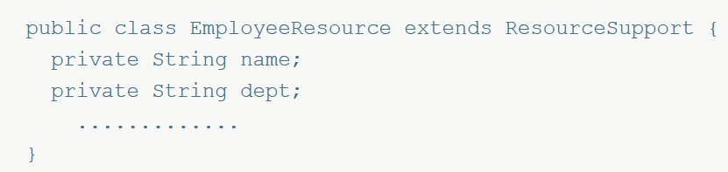
Converting entities to resource types with ResourceAssembler
Spring HATEOAS provides ResourceAssembler interface to converting domain types to REST resource types. This helps us not to repeat resources and their links creation at multiple places in controller classes.
Create resource:

Slide 29
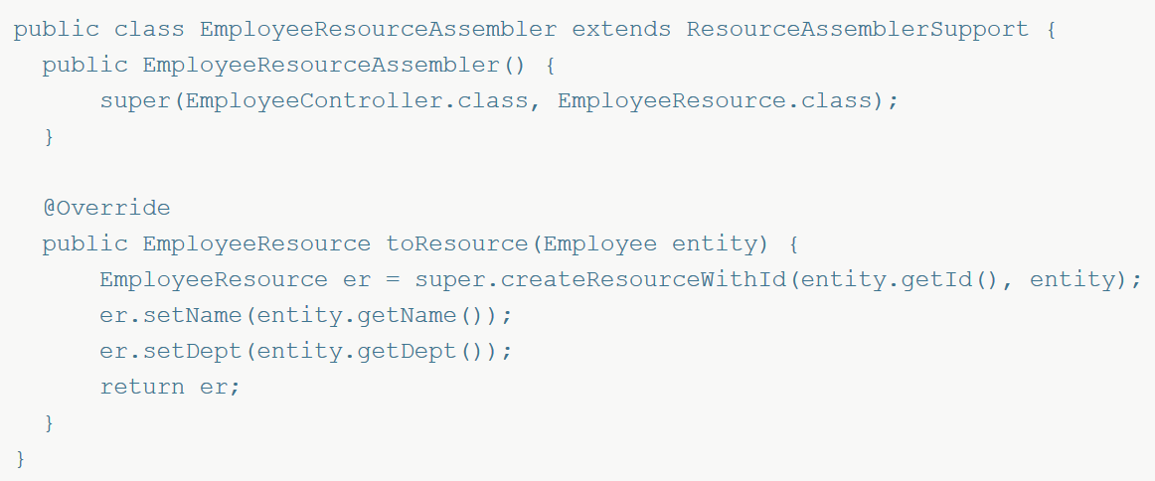
Converting entities to resource types with ResourceAssembler
Create a dedicated class to convert domain type to resource type:

Slide 30
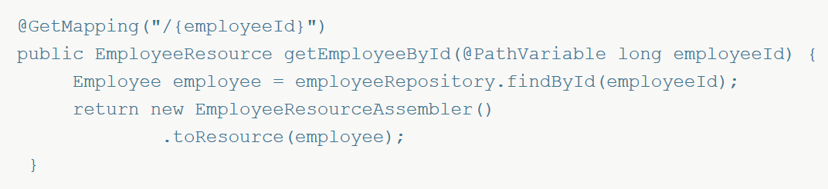
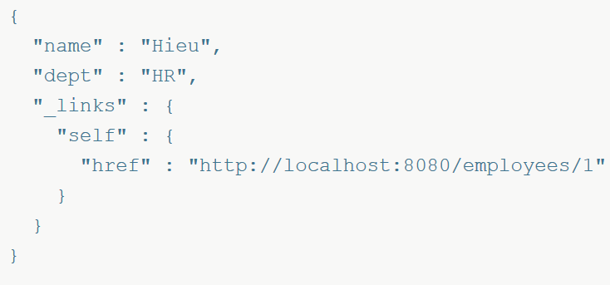
Converting entities to resource types with ResourceAssembler
Controller class:
Output:

Slide 31
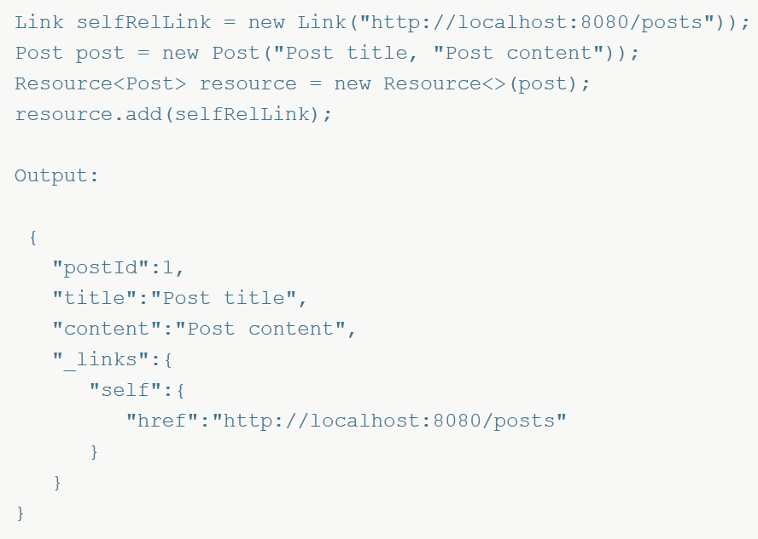
Wrapping domain objects with Resource And Resources Classes
Spring HATEOAS provides Resource and Resources helper classes to wrap a domain object or collection of domain objects instead of extending ResourceSupport.
Wrap a domain object:

Slide 32
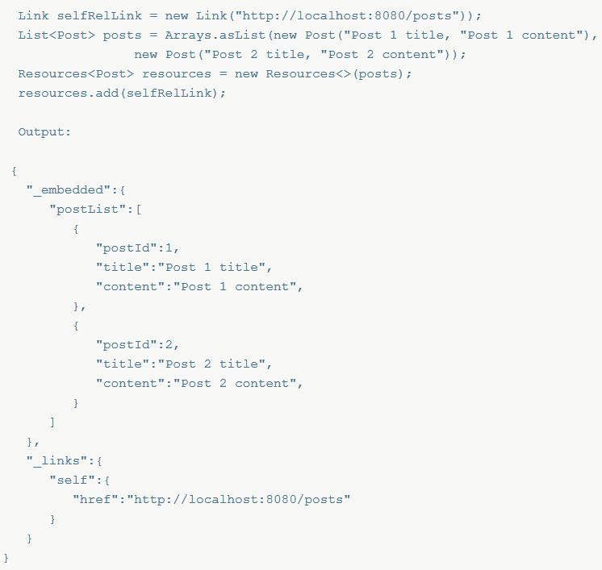
Wrapping domain objects with Resource And Resources Classes
Wrap a collection of domain objects:

Slide 33
References
https://docs.spring.io/spring-hateoas/docs/current/reference/html/
https://github.com/spring-projects/spring-hateoas
https://en.wikipedia.org/wiki/HATEOAS
https://www.baeldung.com/spring-hateoas-tutorial
https://martinfowler.com/articles/richardsonMaturityModel.html
http://stateless.co/hal_specification.html

Slide 34
Demo

Slide 35

Thank you!

