Slide 1
DOM TEAM
DATASTORM 2025
Reconstructing Demand and Forecasting for Fresh Retail
A Data-driven Solution to the Demand Illusion

Slide 2
The Fresh Retail Dilema
The fresh food industry faces a high-stakes balancing act:
  Overstocking: Leads to spoilage, financial loss, and significant food waste.
  Understocking: Results in stockouts, lost sales, and reduced customer loyalty.
This is a fragile equilibrium between satisfying volatile demand and avoiding waste.

Slide 3
CORE PROBLEM
What it is
When a product stocks out, sales data records '0' or a capped amount.
The "Illusion”
Traditional models misinterpret these zeros as "no demand"
The Vicious Cycle
Stockout occurs
⟶ Model leanrs “low demand”
⟶ Retailer under-orders
⟶ Stockout happen sooner, reinforcing the false signal

Slide 4
Our Hypothesis
The Vicious Cycle is in the Data
  Dataset: FreshRetailNet-50K.
  Hypothesis: The "demand illusion" is not theoretical; it is an active, measurable flaw in this dataset.
  Our Goal: To find the statistical "signature" of demand censoring through Exploratory Data Analysis (EDA).

Slide 5
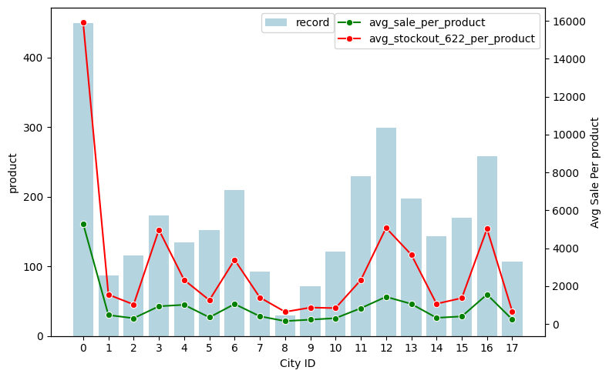
Proof of Concept (1/3)
Per-Product Analysis
  High-performing products (e.g., City 0, 3, 12) see a corresponding spike in stockouts.
  This is the signature of demand censoring. Recorded sales (green line) are an understated representation of true demand.

Slide 6
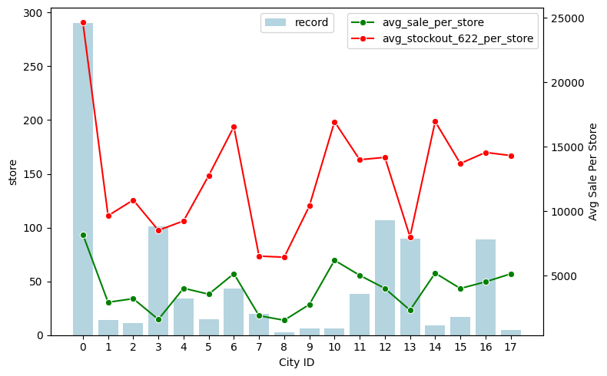
Proof of Concept (2/3)
Per-Store Analysis
  High-Efficiency (e.g., City 3): High sales (green) with low stockouts (red). They manage inventory well.
  Low-Efficiency (e.g., City 10, 12): High sales but critically high stockout rates.

Slide 7
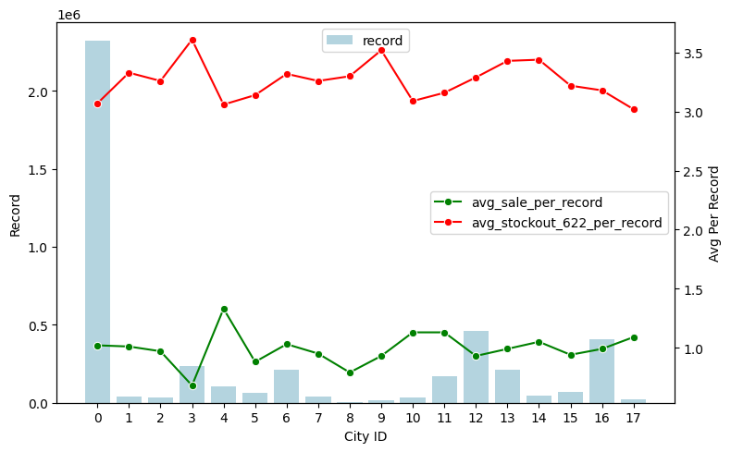
Proof of Concept (2/3)
Per-Record Analysis
  The average stockout hours per record (red line) is consistently flat at ~3-3.5 hours for all cities
  Conclusion: It's an endemic flaw in the baseline inventory policy that artificially depresses sales data across the entire network

Slide 8
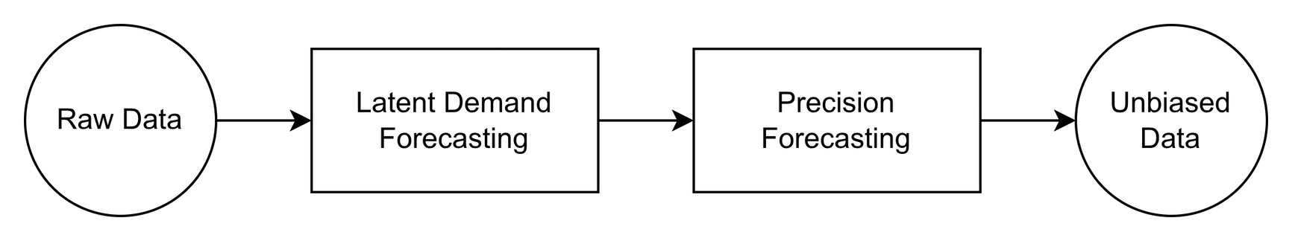
Our Vision
A Two-Stage Solution

Slide 9
Latent Demand Reconstruction
  Objective: To estimate the unobserved, "true" demand during stockout periods.
  Challenge: We must infer demand (D_t) when we only know that it was greater than or equal to the observed sales (S_t).
  Our Approach: A custom-designed neural network with a Hybrid Loss Function.
  For non-stockouts: Uses standard Mean Squared Error (MSE).
  For stockouts: Uses a "survival" loss, penalizing the model only if it predicts a demand lower than the observed sales.

Slide 10
Precision Forecasting
  Objective: To generate highly accurate, multi-horizon forecasts using the reconstructed demand data from Stage 1.
  Our Model: The Temporal Fusion Transformer (TFT).
  This state-of-the-art model was chosen for its unique advantages in solving this specific problem.

Slide 11
Why the Temporal Fusion Transformer (TFT)?
  Native Multi-Horizon Forecasting: Predicts the entire week at once, not just "one day at a time," which reduces error accumulation.
  Handles Heterogeneous Inputs: Seamlessly combines static data (store ID), known future data (promotions), and time-varying data (price, weather).
  Built-in Interpretability: It's not a "black box". It shows which past days and which features (e.g., "holiday," "promotion") were most important for its forecast

Slide 12
Measuring Success
Aligning Metrics with Value
  Primary Business Metric: WAPE (Weighted Absolute Percentage Error).
  Why? It avoids "division by zero" errors and, more importantly, weights errors by sales volume. A 10% error on a high-selling item is treated as more significant, aligning the model with financial impact.
  Primary Training Metric: RMSE + Quantile Loss.
  Why? This generates probabilistic forecasts (10th, 50th, 90th percentiles), giving managers a risk-adjusted range for ordering, not just a single number .

Slide 13
Strategic Impact
The Triple Bottom Line
  Profit (Economic): Maximizes revenue and optimizes inventory by eliminating forecasting bias.
  People (Social): Enhances customer satisfaction (fewer stockouts) and stabilizes workforce operations.
  Planet (Environmental): Directly reduces food waste by aligning orders with true demand.

Slide 14
Aligning with Global Goals
  By minimizing food waste through data-driven insights, our solution directly supports SDG 12: Responsible Consumption and Production.
  This moves beyond a simple technical exercise to create tangible environmental and social value.

Slide 15
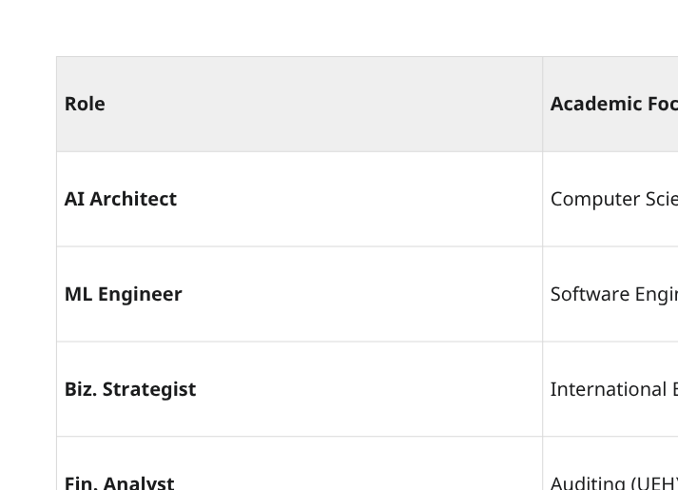
Our Team

Slide 16
Round 1 Project Roadmap (3 Weeks)
  Week 1 (26/10 - 2/11): Data Deep-Dive & PoC
  Week 2 (2/10 - 9/11): Solution Architecture
  Week 3 (9/11 - 16/11): Synthesis & Finalization

Slide 17
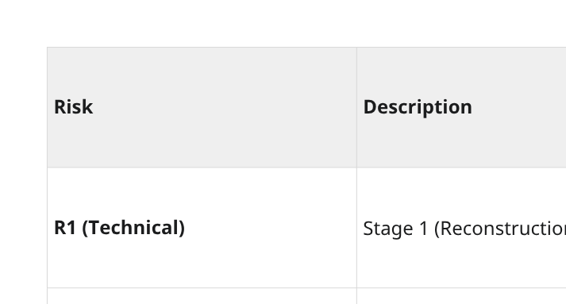
Risk Assessment & Mitigation

Slide 18
Key Differentiators
  Novel Problem Formulation: We aren't just forecasting sales. We are solving for demand censoring—the hidden flaw behind most errors.
  Advanced Technical Approach: We apply a state-of-the-art model (TFT) to reconstructed demand data for unprecedented accuracy.
  Interdisciplinary Team: Our team combines technical (AI/SWE) with business (Finance/Logistics) expertise, ensuring the solution is not only accurate but commercially viable and operationally relevant.

