Slide 1

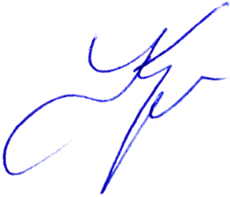





C E R T I F I C A T E
OF ATTENDANCE
……………………….
FOR PARTICIPATION IN THE THIRD IT-SCHOOL OF YOUNG SCIENTISTS
“MODERN IT-TECHNOLOGIES FOR THE DECISION OF
SCIENTIFIC TASKS”
May 31 – June 1, 2021
Vladikavkaz
Vladimir V. KORENKOV
Director LIT JINR

