Slide 1
Modelling and Simulation of the Growth of Viruses
ELEC 6910S
by Prof. Luca Daniel
Thomas Narayana Swamy
Umer Abdullah
Srazhidinov Radik

Slide 2
Content
Virus Growth (Conservations and Constitute Laws)
Investigation of Numerical Integration Techniques:
Forward Euler Approximation
Backward Euler Approximation
Trapezoidal Rule Approximation
Model Reduction (SDV, TBR, Krylov subspace analysis)

Slide 3
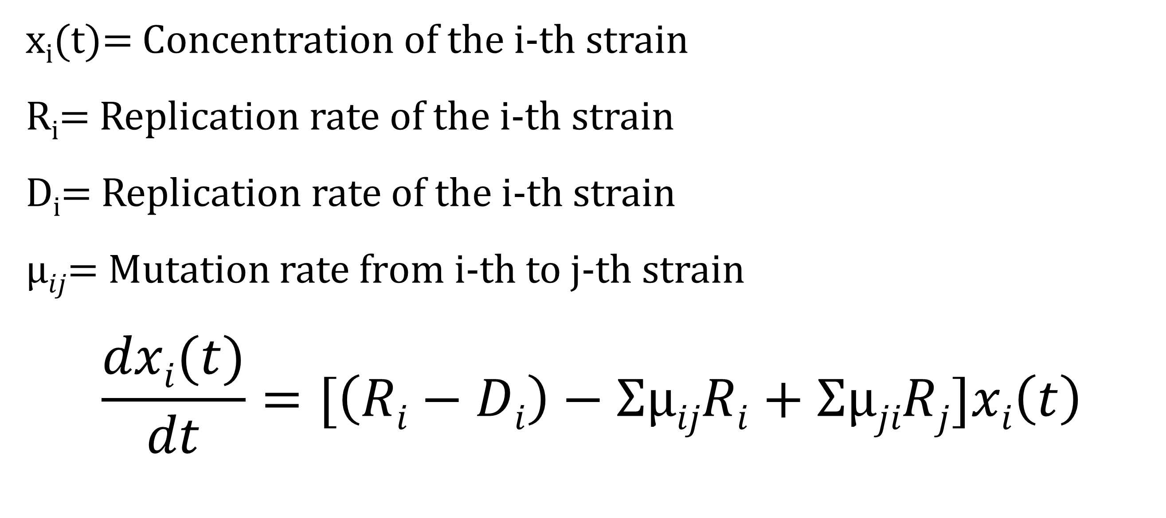
System
x_{i}(t)= Concentration of the i-th strain
R_{i}= Replication rate of the i-th strain
D_{i}= Replication rate of the i-th strain
$µij$= Mutation rate from i-th to j-th strain
$$\frac{dxi(t)}{dt}=[\left(Ri−Di\right)−ΣµijRi+ΣµjiRj]xi\left(t\right)$$
Domingo E, Sheldon J, Perales C. Viral Quasispecies Evolution. Microbiology and Molecular Biology Reviews : MMBR. 2012;76(2):159-216

Slide 4
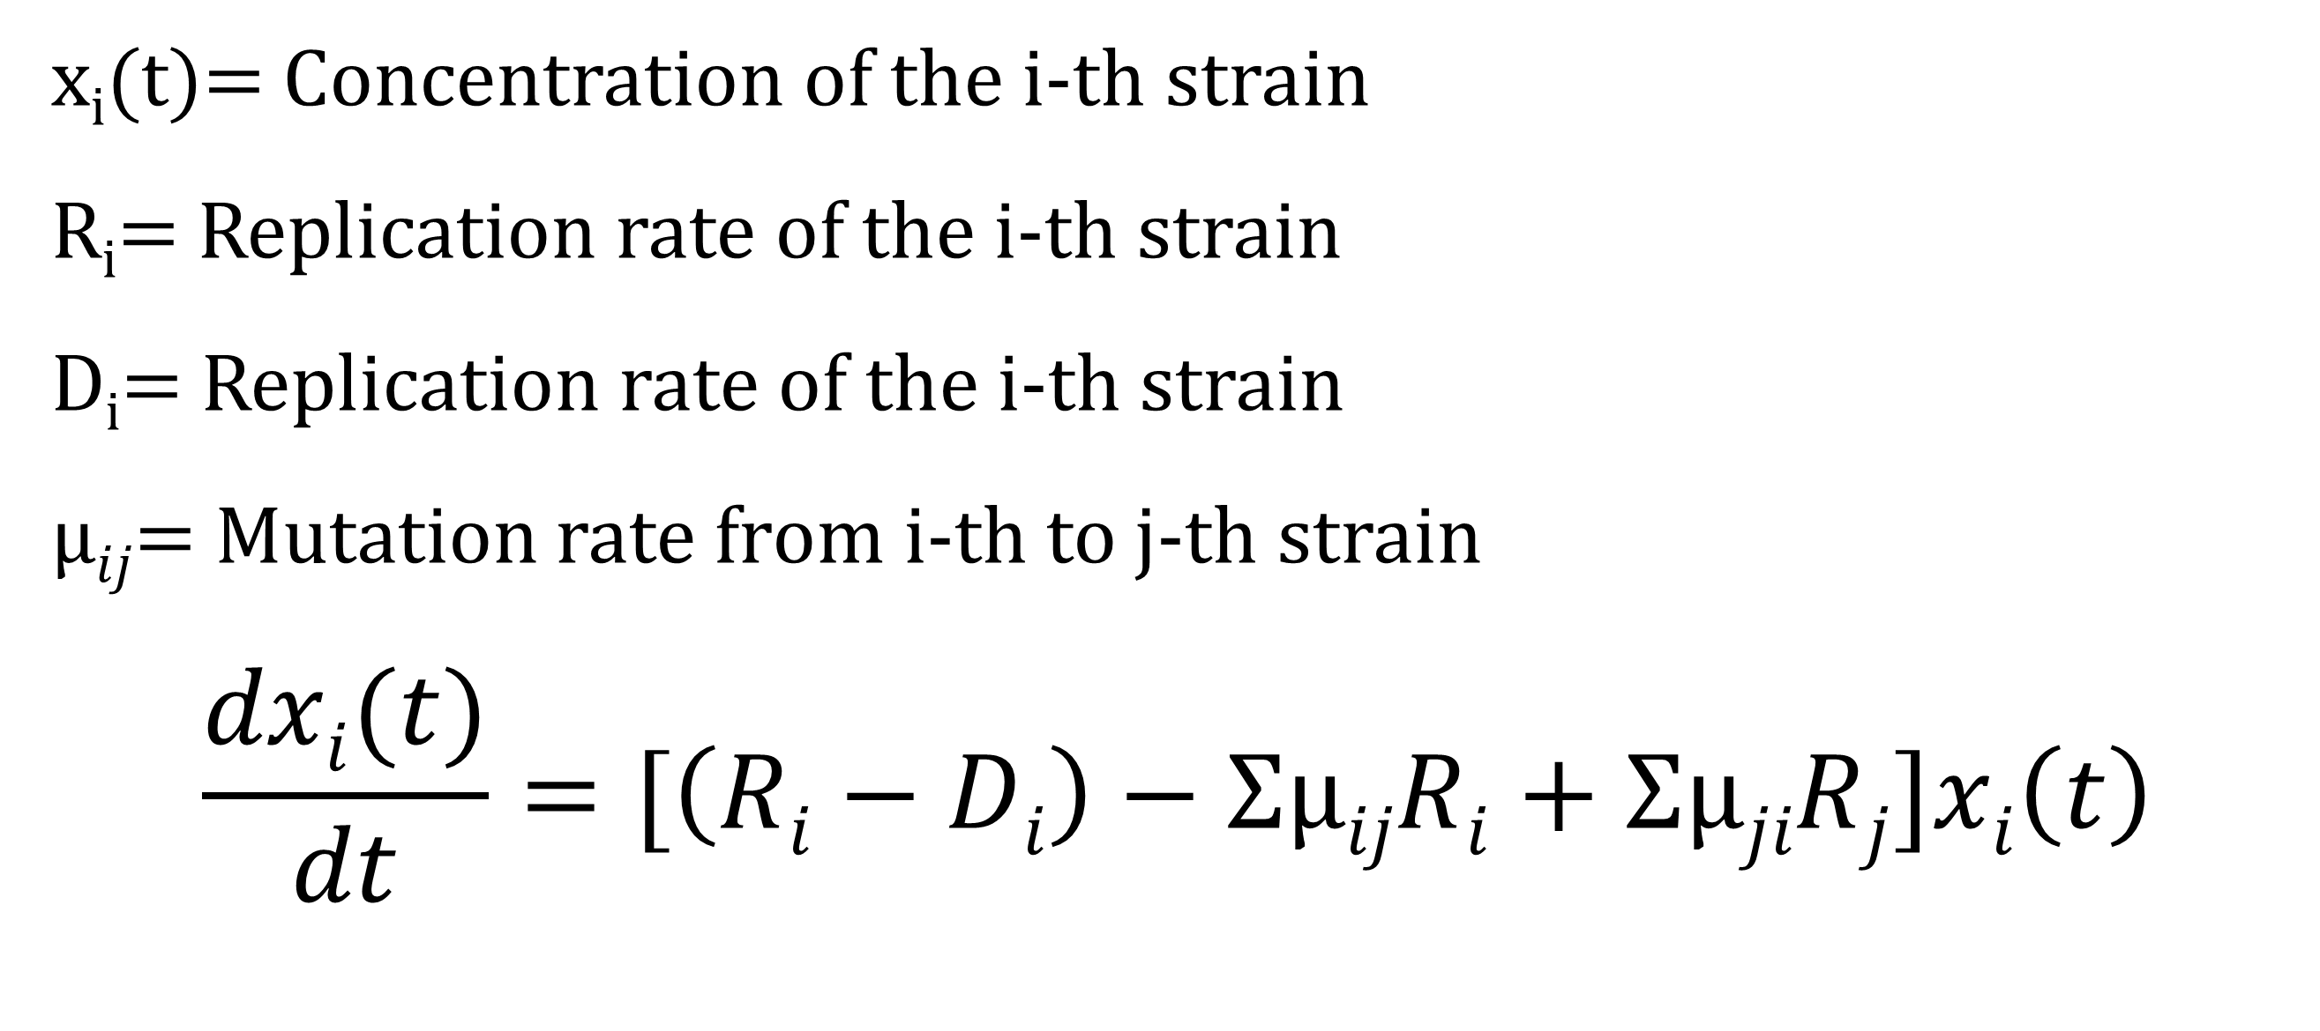
System
x_{i}(t)= Concentration of the i-th strain
R_{i}= Replication rate of the i-th strain
D_{i}= Replication rate of the i-th strain
$µij$= Mutation rate from i-th to j-th strain
$$\frac{dxi(t)}{dt}=[\left(Ri−Di\right)−ΣµijRi+ΣµjiRj]xi\left(t\right)$$
Domingo E, Sheldon J, Perales C. Viral Quasispecies Evolution. Microbiology and Molecular Biology Reviews : MMBR. 2012;76(2):159-216

Slide 5

Framework
x(t)= Vector of viral concentrations
y(t) = Concentration of the fittest strain
$$\frac{dx}{dt}=A x\left(t\right)+Bu\left(t\right),$$
$$y\left(t\right)=Cx\left(t\right)+Du\left(t\right),$$
$$x\left(0\right)=x_{0}$$

Slide 6
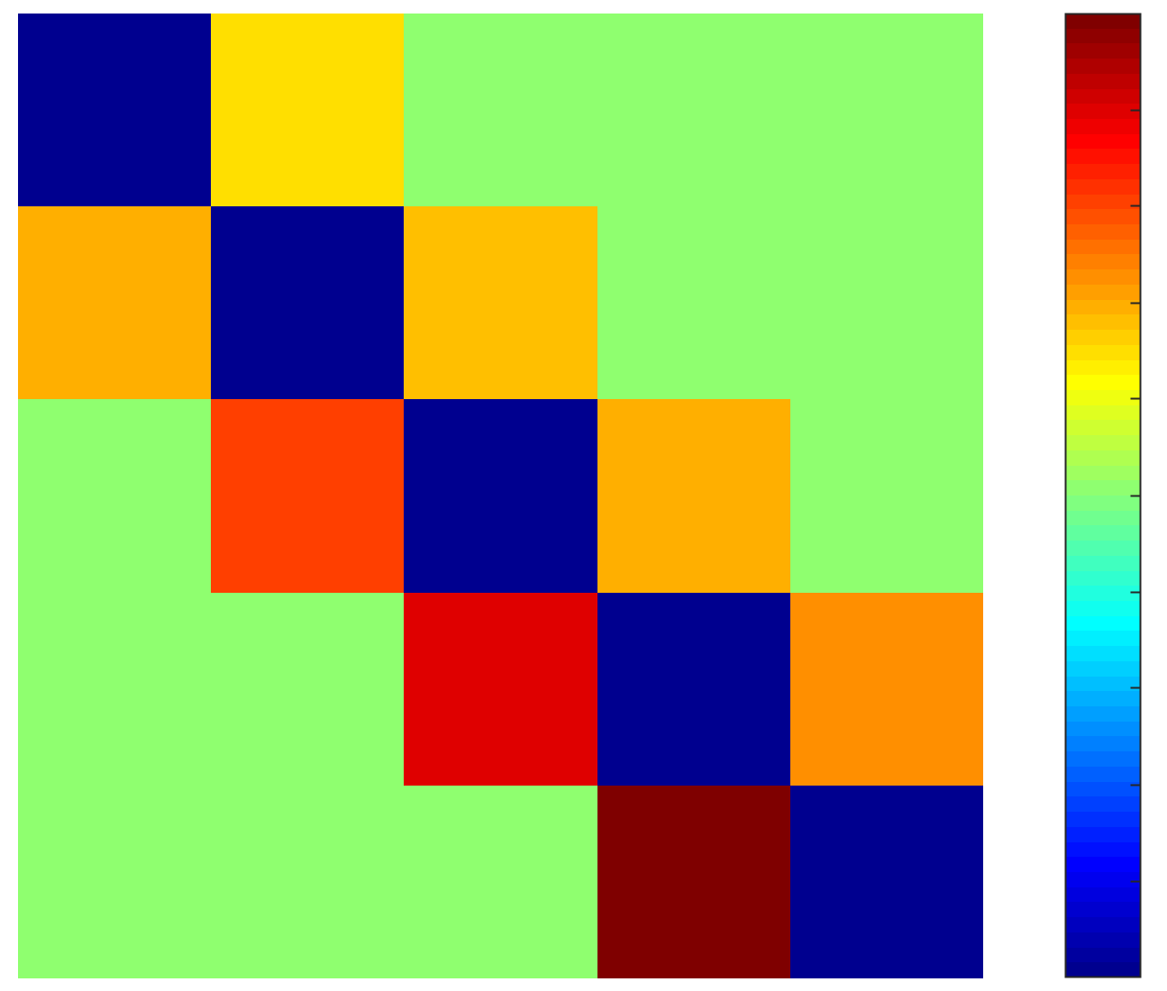
Framework
A= B=[1 1 1 1 1]^{t}
C=[0 0 0 0 1]
D=[0]

Slide 7
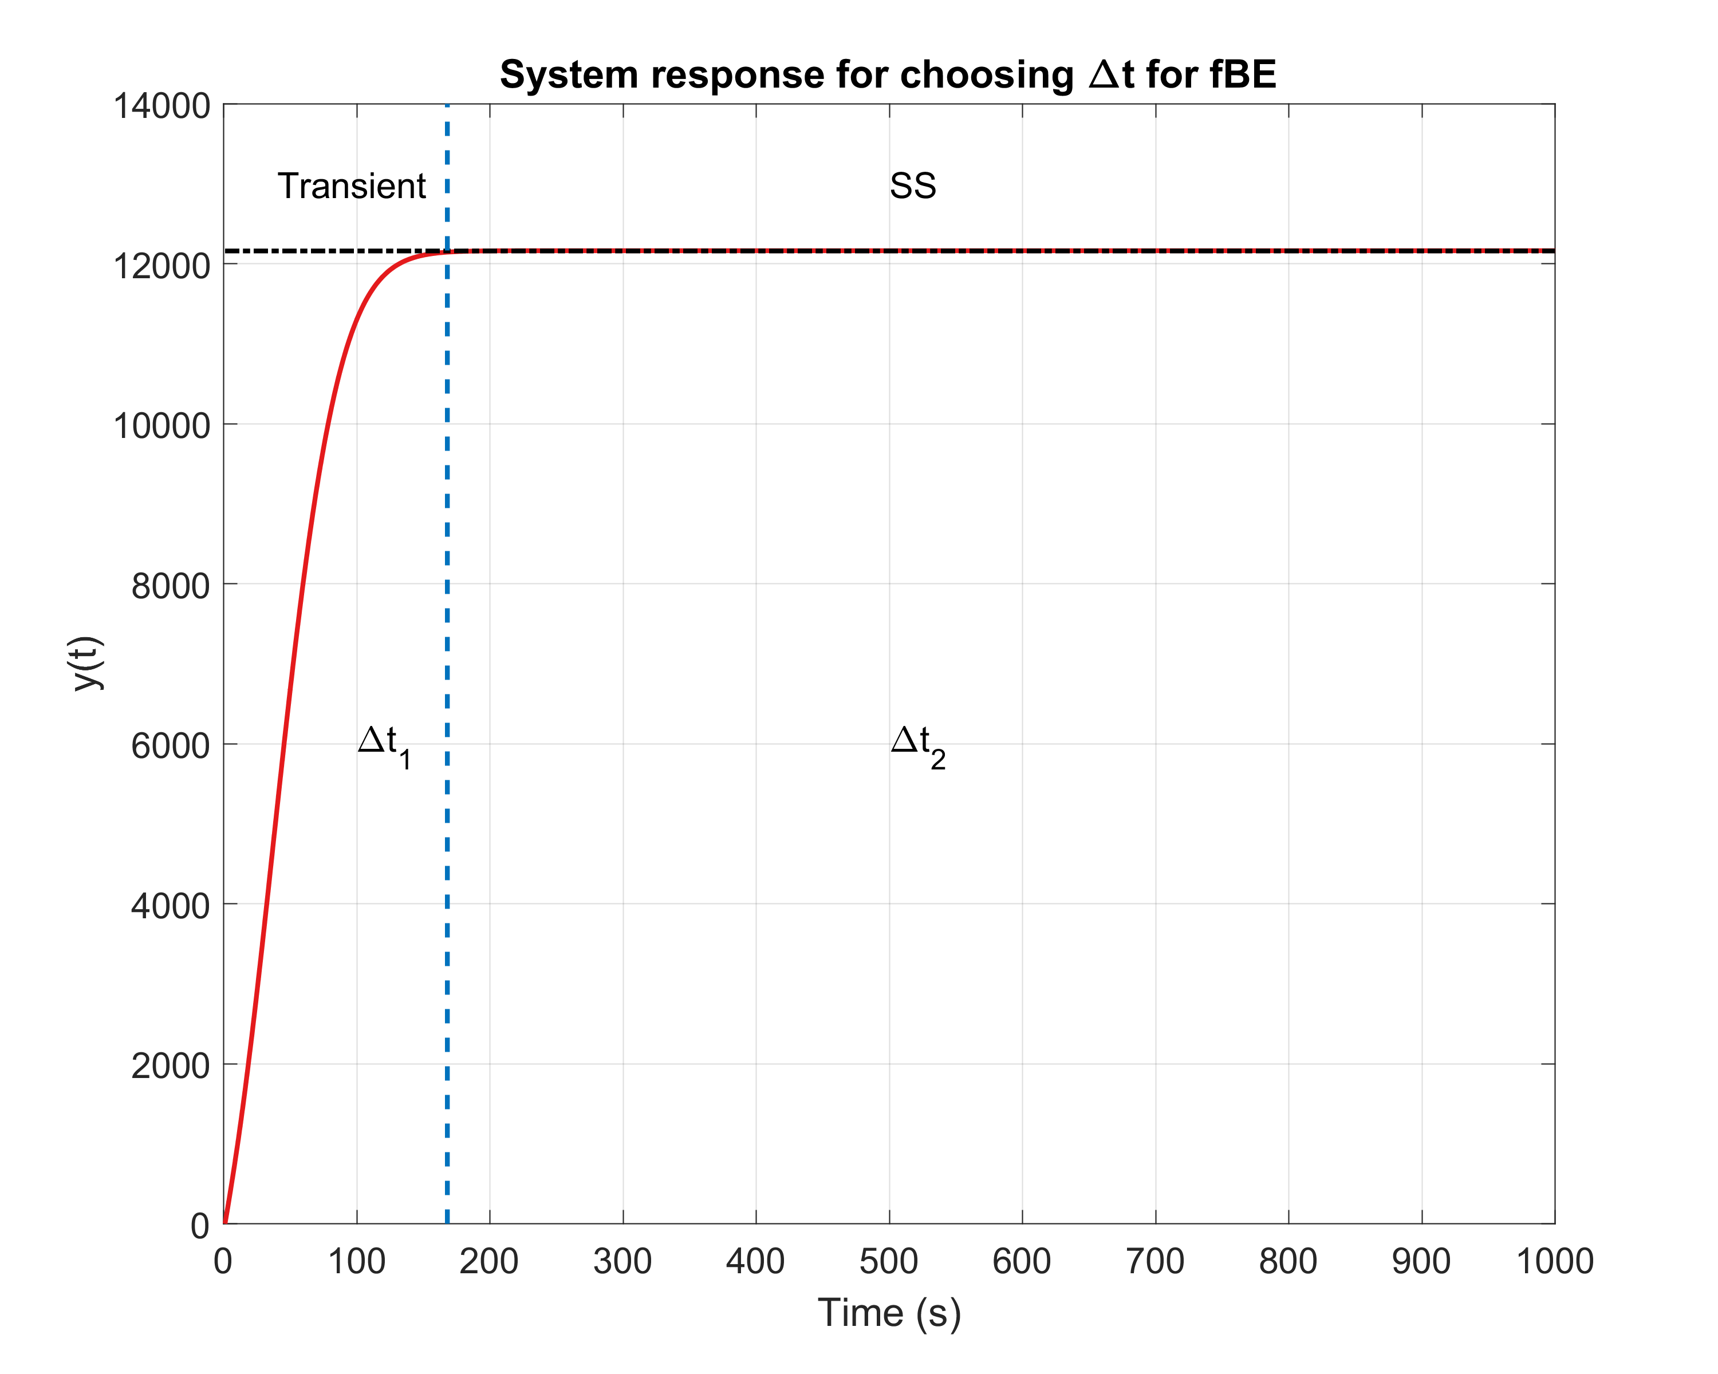
Fast Backward Euler Approximation

Slide 8

Fast Backward Euler Approximation
Inputs: $A,B,C,u, x_{start}(1), t_{start}, t_{stop}, ∆t,nodes,∆t_{1},∆t_{2},$
Compute: $t_{1}=length\left(0:∆t_{1}:0.1\right),$
$t_{2}=length\left(0.1:∆t_{2}:(t_{stop}−0.1)\right),$
For $i=1:t_{1}$ For $i=t_{1}:(t_{1}+t_{2})$
$∆t=min⁡(∆t,t_{stop}−t_{start})$ $∆t=min⁡(∆t,t_{stop}−t_{start})$
$x_{start}\left(i+1\right)={(I−∆t_{1}×A)}^{−1}×(x_{start}\left(i\right)+∆t_{1}×B×u)$ $x_{start}\left(i+1\right)={(I−∆t_{2}×A)}^{−1}×(x_{start}\left(i\right)+∆t_{2}×B×u)$
$t_{start}=t_{start}+∆t_{1}$ $t_{start}=t_{start}+∆t_{2}$
Output: $x_{start}$
Transient response
Steady-state response

Slide 9
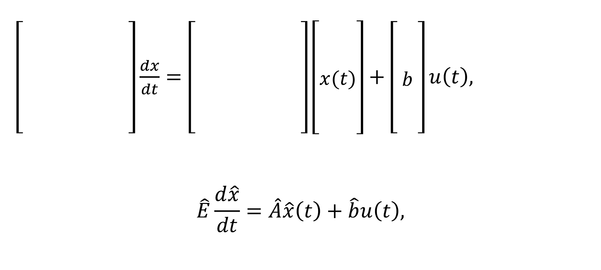
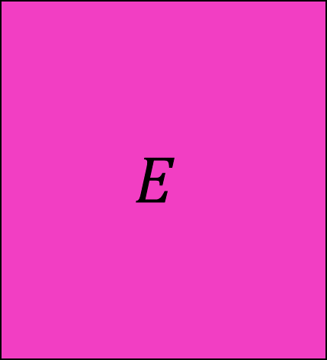

Model Reduction
Reduce the number of states

Slide 10

Model Reduction using SVD
Inputs: $A,B,C,X, t_{start}, t_{stop}, ∆t$
Compute: $x_{comp}=X\left(1:end, 1:10:ceil\left(\frac{t_{stop}−t_{start}}{∆t}\right)\right)$,
$\left[U,S\right]=svd\left(x_{comp}\right)$,
$U1=U(1:end, 1)$,
$A_{red}={U1}^{∗}×A×U1$,
$B_{red}={U1}^{∗}×B$,
$C_{red}=C×$U1,
Output: $A_{red}, B_{red}, C_{red}$.

