Slide 1
GitKraken
Tomas Rolny

Slide 2
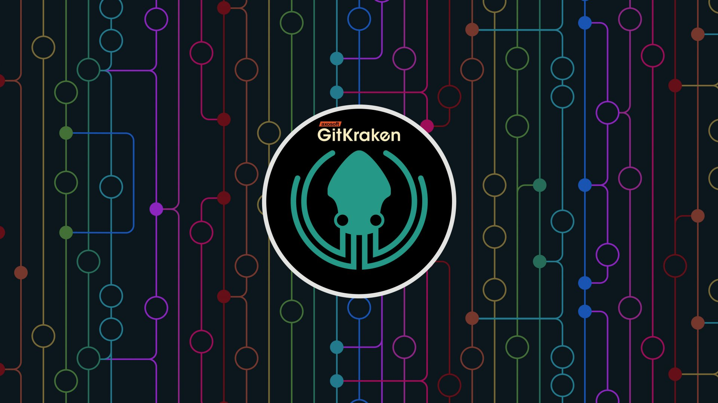
GitKraken – GUI for git repository administration

Slide 3


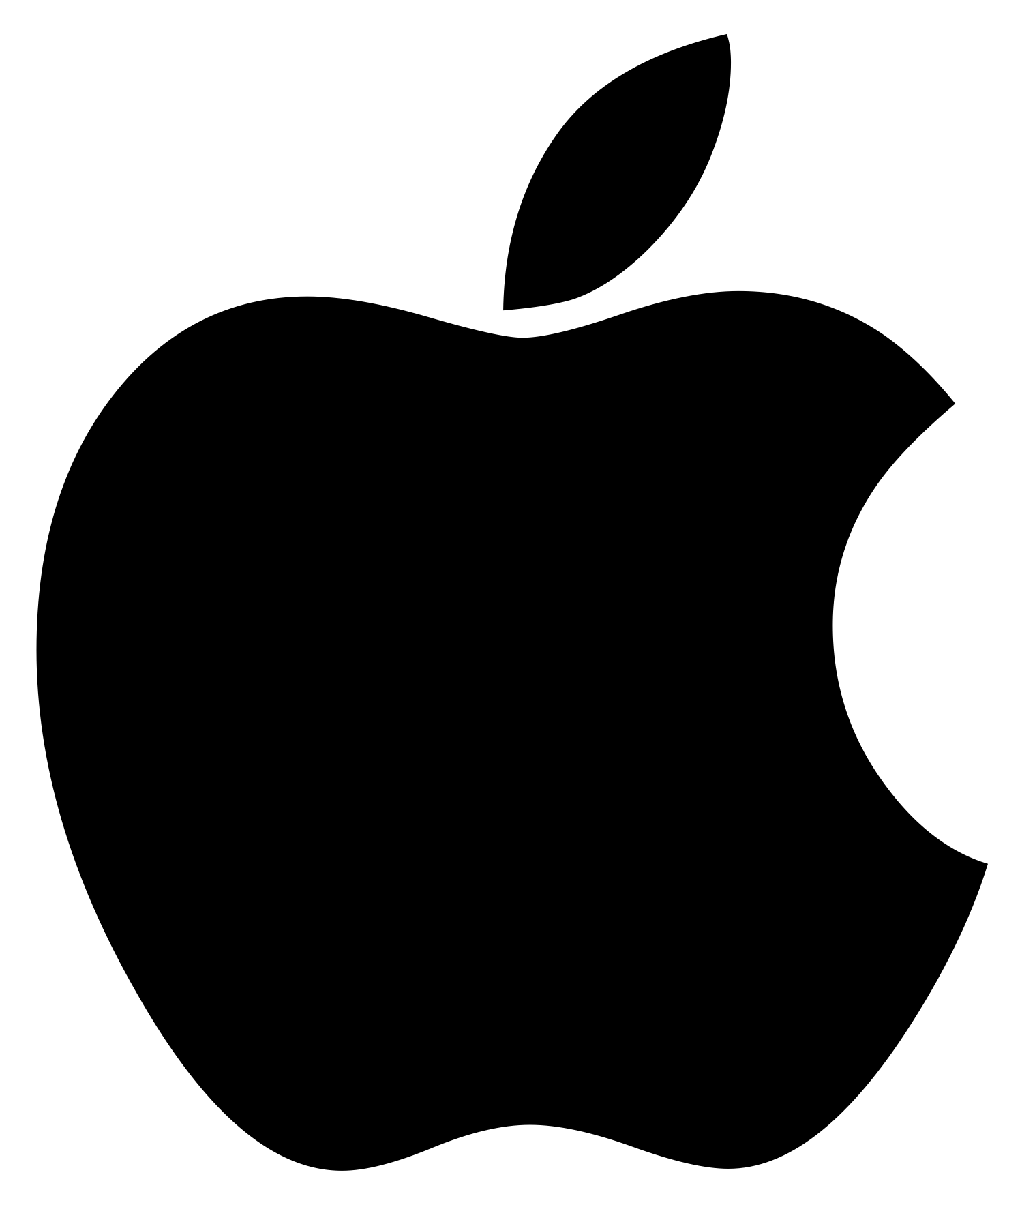
GitKraken is multiplatform supports
Windows -
Linux -
Mac -

Slide 4
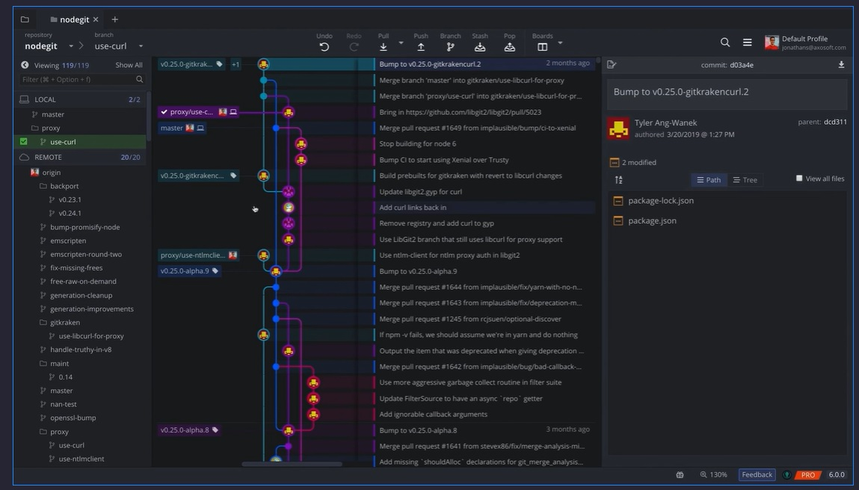
Interactive graph of branches

Slide 5




Integration of remote services
GitHub -
GitLab -
Bitbucket -
Azure DevOps - paid feature

Slide 6
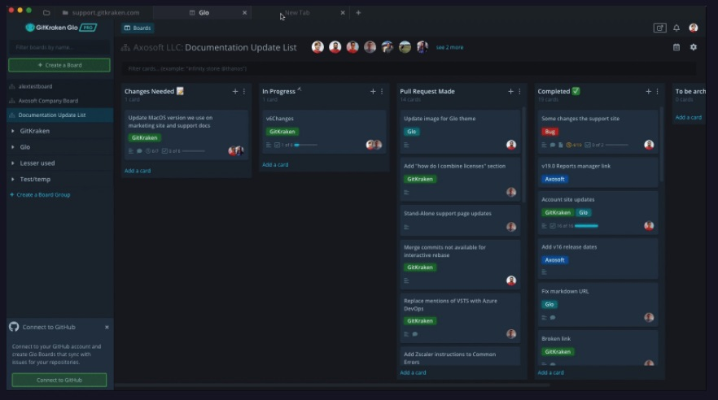
More repositories in tabs

Slide 7
License
GitKraken is free but, you will need GitKraken account
The free version is also limited for non-commercial use
Paid version $49/user/year

Slide 8
Usefull links
https://www.gitkraken.com/
https://support.gitkraken.com/start-here/interface/

