Slide 1
Robinson Tamilselvan

Slide 2
Mapping Types
Maps to another DW field
Maps to an OLTP field
Is a Calculated Field
Is a Translation Field
You are Uncertain

Slide 3
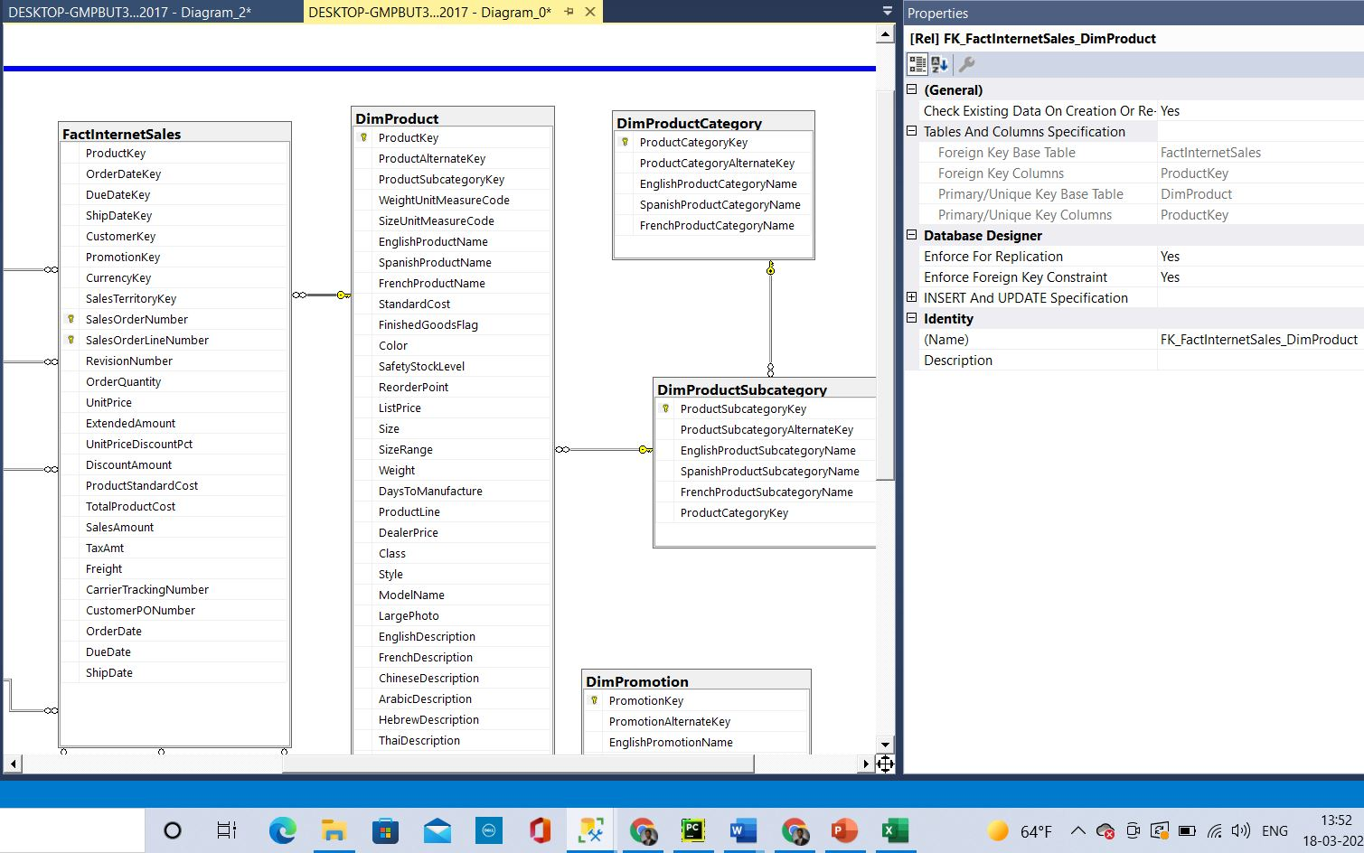
Maps to another DW field
Data Warehouse Table | Data Warehouse Field | Type of Mapping | Mapped Table | Mapped Field
FactInternetSales | ProductKey | Maps to another DW field | DimProduct | ProductKey
Here the productkey is used to connect the tables DimProduct and FactInternetSales. And also there are no related field in OLTP. In DataWarehouse the productkey will be generated.

Slide 4
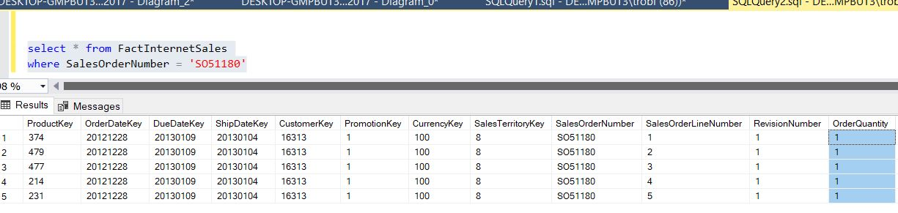
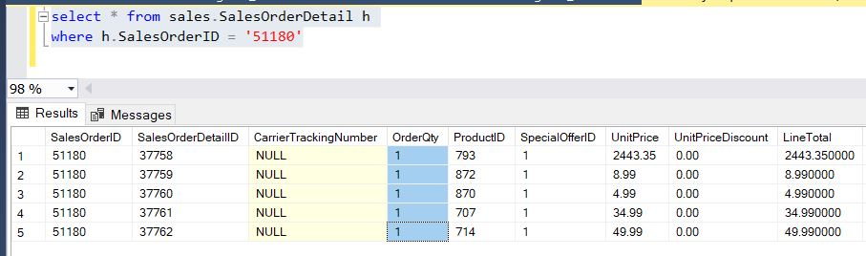
Maps to an OLTP field
Data Warehouse Table | Data Warehouse Field | Type of Mapping | Mapped Table | Mapped Field
FactInternetSales | OrderQuantity | Maps to an OLTP field | SalesOrderDetail | OrderQty
DataWarehouse field (OLAP)
Database field (OLTP)
In the above screenshots we can see the values are matching and coming from the OLTP to the DataWarehouse

Slide 5
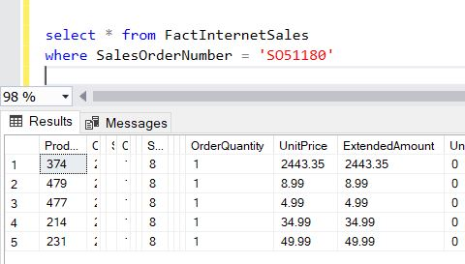
Is a Calculated Field
Data Warehouse Table | Data Warehouse Field | Type of Mapping | Calculation and Notes
FactInternetSales | ExtendedAmount | Is a Calculated Field | OrderQty*UnitPrice
Here we can see that the Extended amount is the multiple of OrderQuantity and UnitPrice

Slide 6
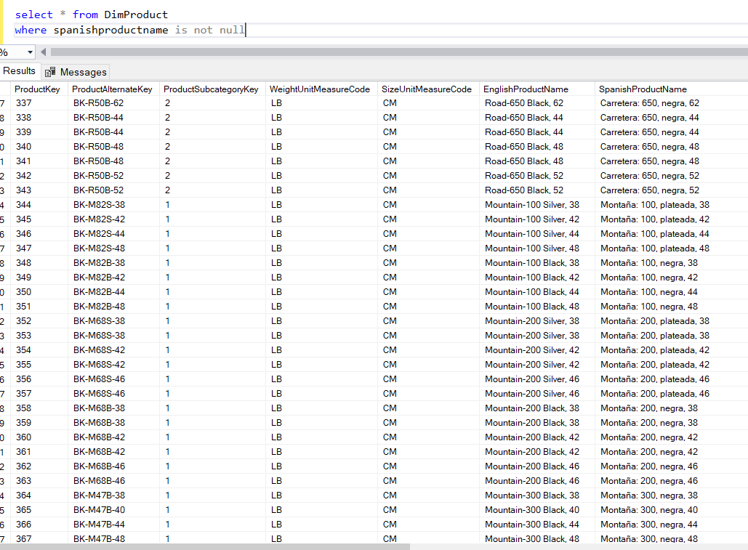
Is a Translation Field
Data Warehouse Table | Data Warehouse Field | Type of Mapping | Mapped Table | Mapped Field
FactInternetSales | OrderDate | Maps to an OLTP field | SalesOrderHeader | OrderDate
DimProduct | SpanishProductName | Uncertain |  | is language translated from Production.Product.Name
We can see that the SpanishProductName has the translation of the EnglishProductName

Slide 7
You are Uncertain
Data Warehouse Table | Data Warehouse Field | Type of Mapping
DimProduct | DealerPrice | Uncertain
For this field I couldn’t find any relevant values in the Datawarehouse and also in the Database (OLTP). It looks like a calculated field but couldn’t figure out how it is being calculated as well. Therefore this field falls into the category of Uncertain.

Slide 8
Thank you
Robinson Tamilselvan​
rtamilselvan@ualr.edu

