Slide 1
Insights on Riots/Protests in India
Information Visualization Final Project Presentation
Group H (Robinson, Pavithra, Ashfaqur )

Slide 2
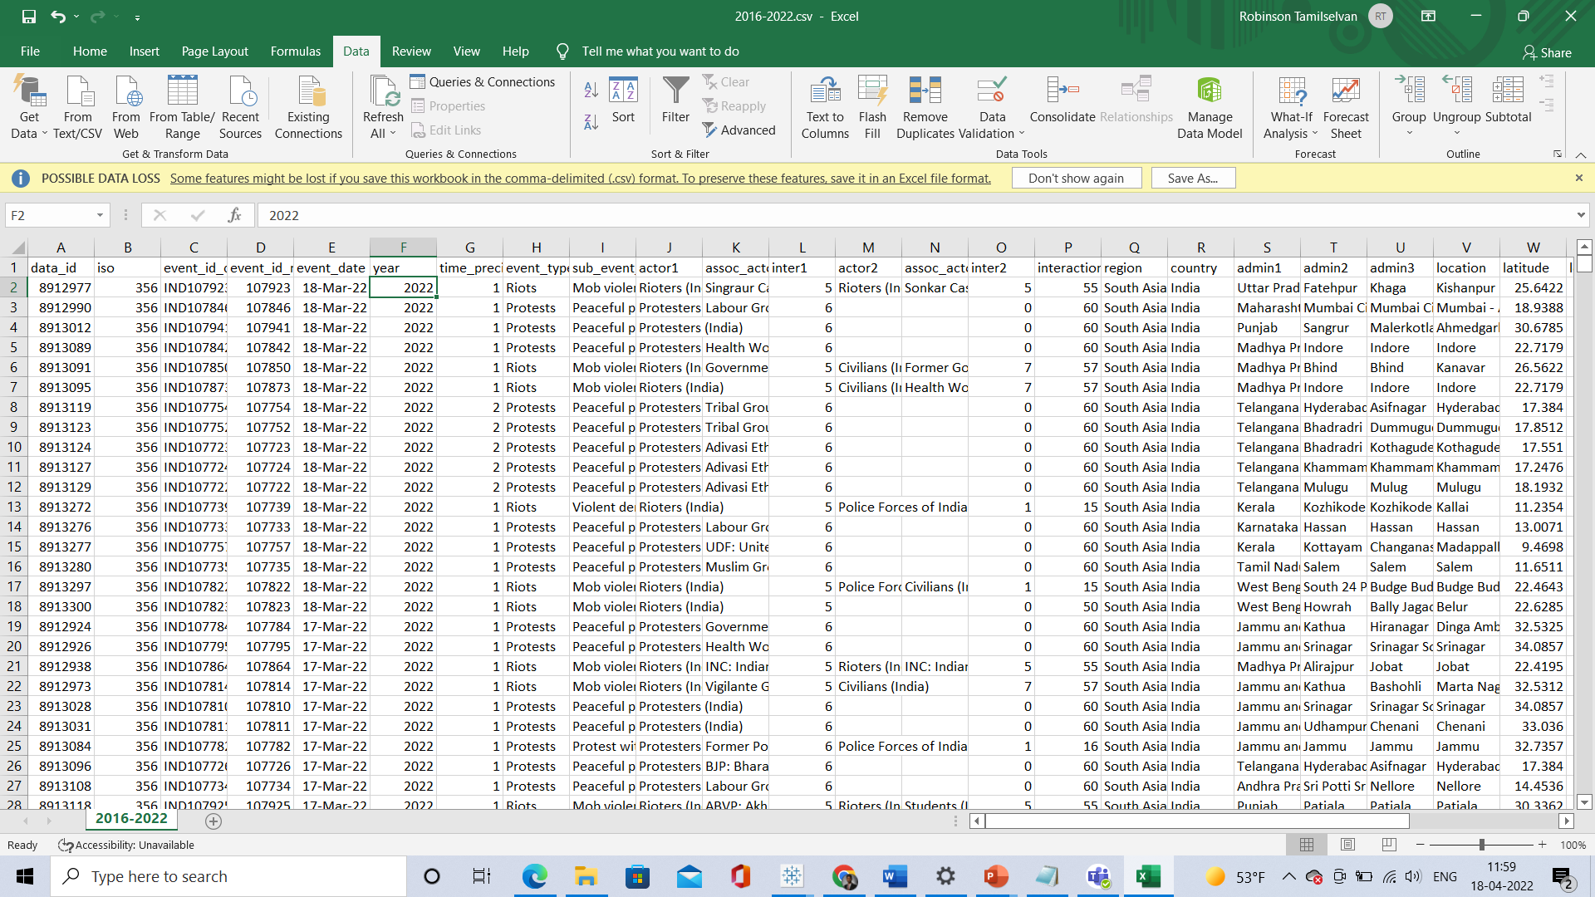
Data used for the Project

Slide 3
Details about Data
No of rows present – 1,07,690
No of columns present – 35
This dataset contains riots and protests that took place in India along with the actors and geolocations. This record ranges from 2016 and 2022
India has 36 states and Union Territories and each has state has their own language, culture and traditions.

Slide 4
Data Pre-processing
Collected population data and the zone data from the Wikipedia for India.
Imported data into a Table in Oracle Database and created columns population, zone, rate.
Updated the 1,07,690 rows for the zone, population, rate values by refering to the data collected from Wikipedia using Oracle plsql.
Calculated rate using the formula round(Total number of SubEvents in each state/(each state population/1000000),5)
Attaching the SQL and PLSQL code along with this slide.

Slide 5
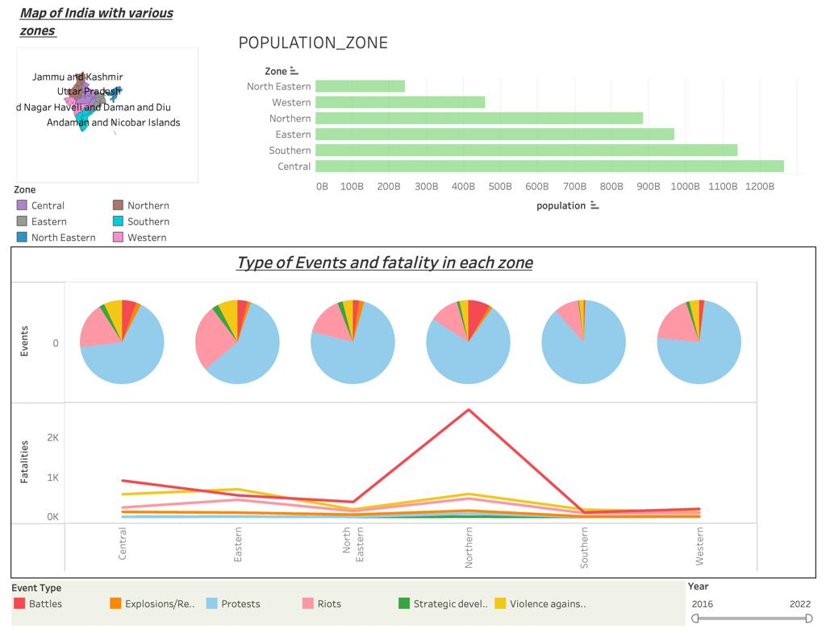
Type of Events and Fatality in each zone
This chart follow the Tufte principle of “Use small multiples”. Spatial substrate – Alignment is also implemented here

Slide 6
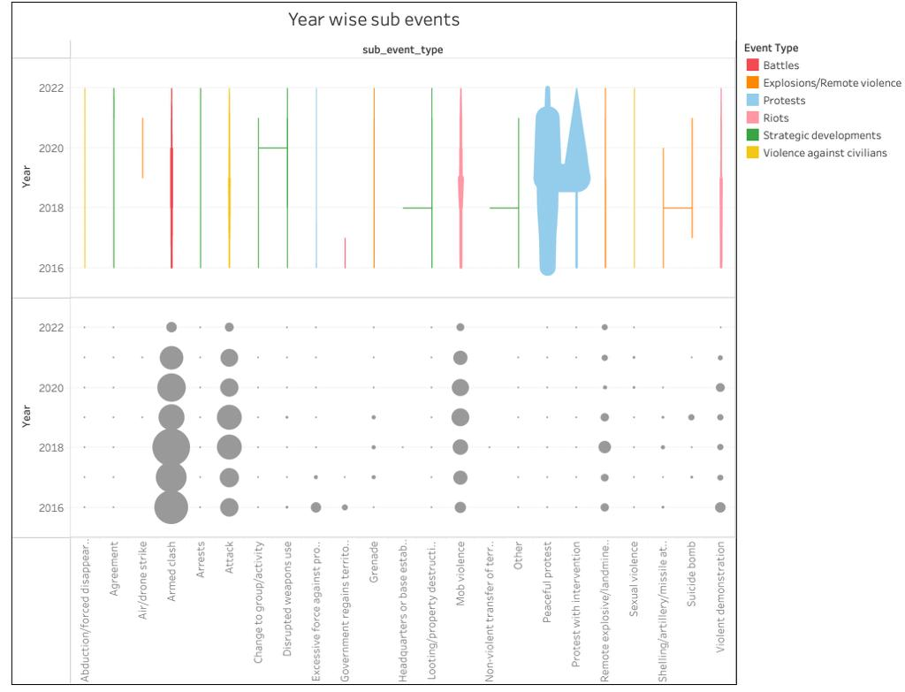
Year wise Sub events and Fatalities
1st attribute - Sub events
2nd attribute - Year
3rd attribute – Fatalities size (circle) , sub event (line)
4th attribute – colour is used to indicate events
Spatial substrate Alignment is applied here with the same axis

Slide 7
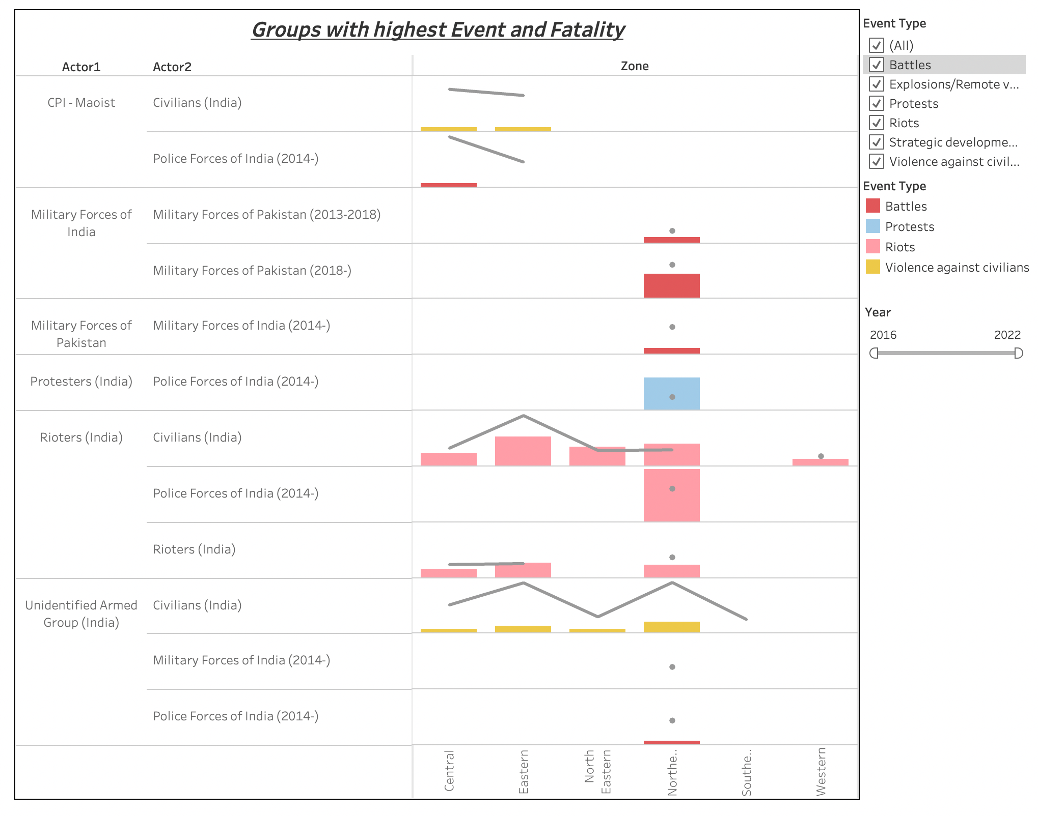
Groups with Highest Event and Fatalities
The filtering and multiple attributes are applied here. This graph also follows the Tufte principle of “multi functioning graphical elements”

Slide 8
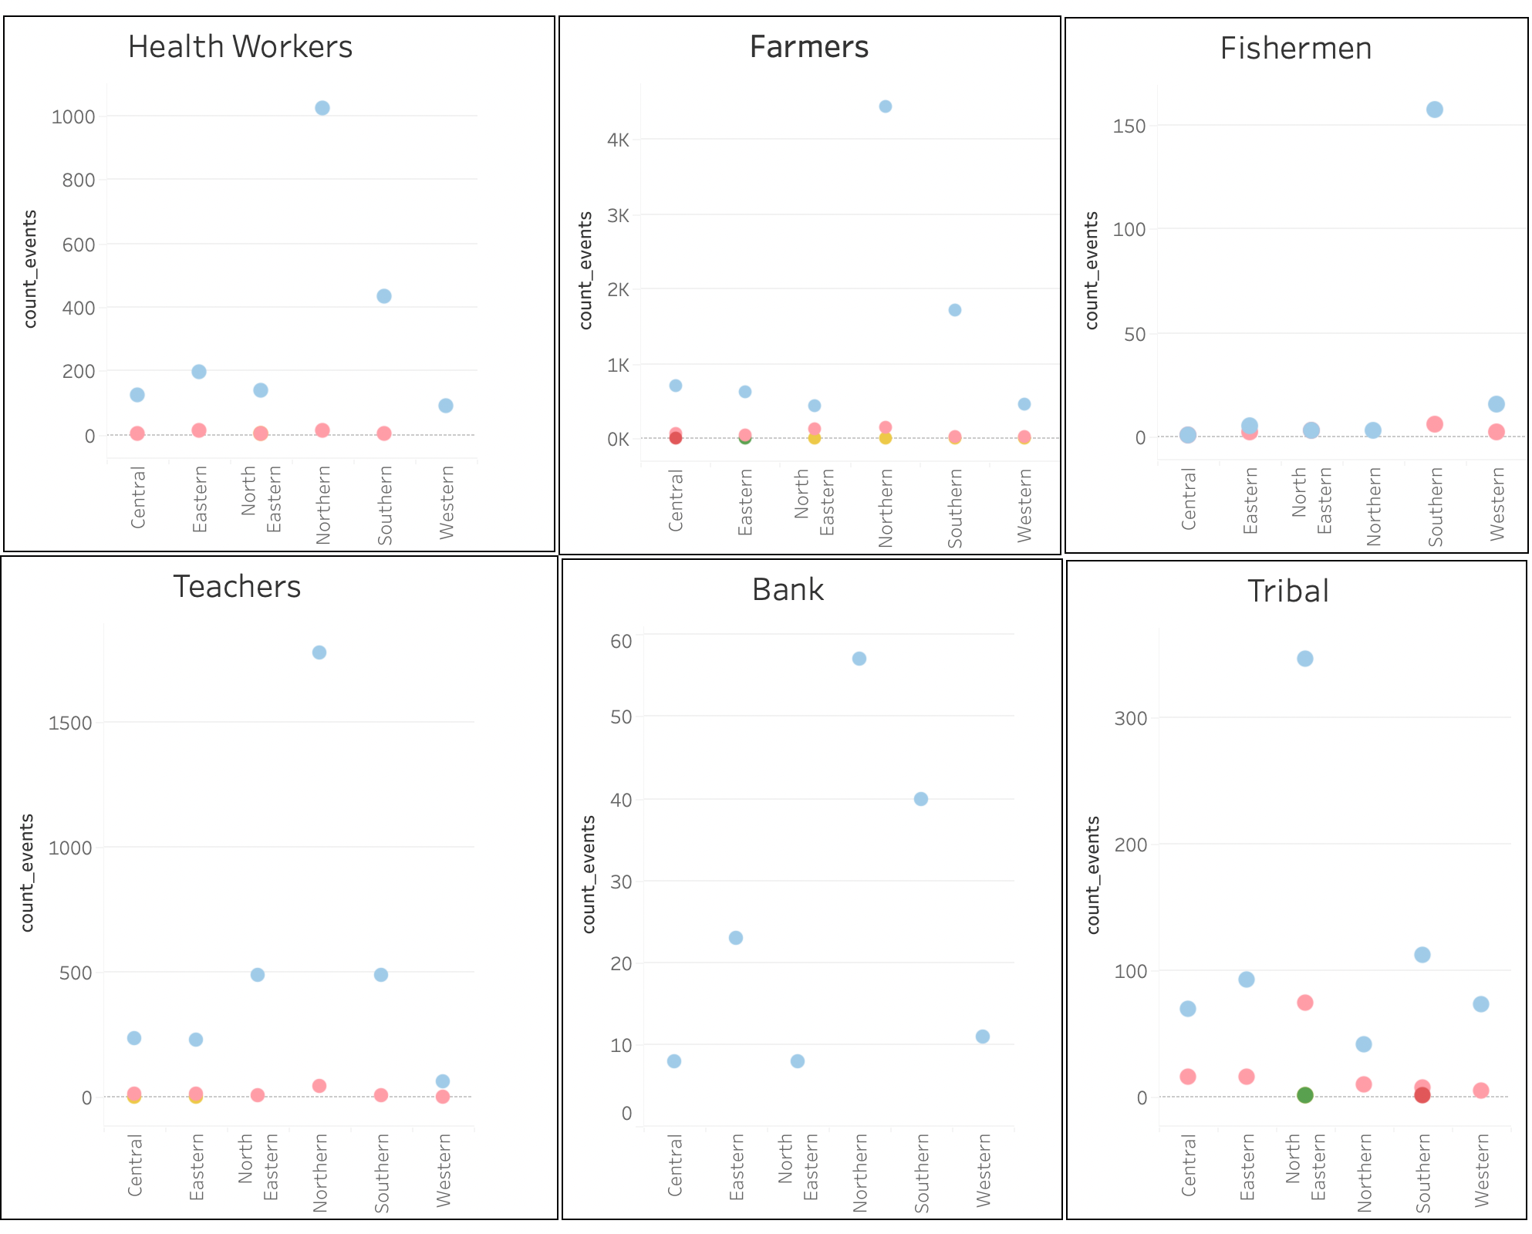
Analysis of People who organised the Events
This chart is best example of Tufte “Small multiples”

Slide 9
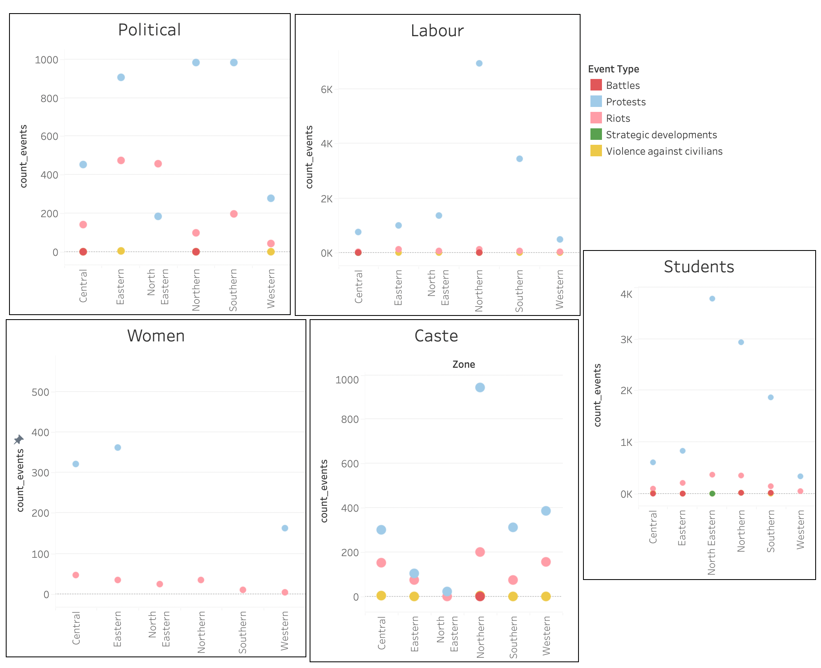
Analysis of People who organised the Events
This chart is best example of Tufte “Small multiples”

Slide 10
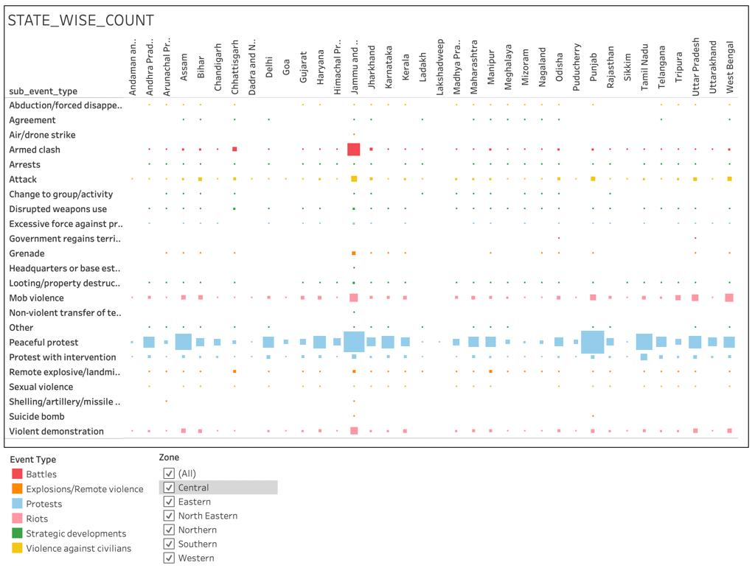
State wise sub events
Filtering concept is used here in this visualisation. 3 attributes are conveyed in this chart (State, Sub events, Events)

Slide 11
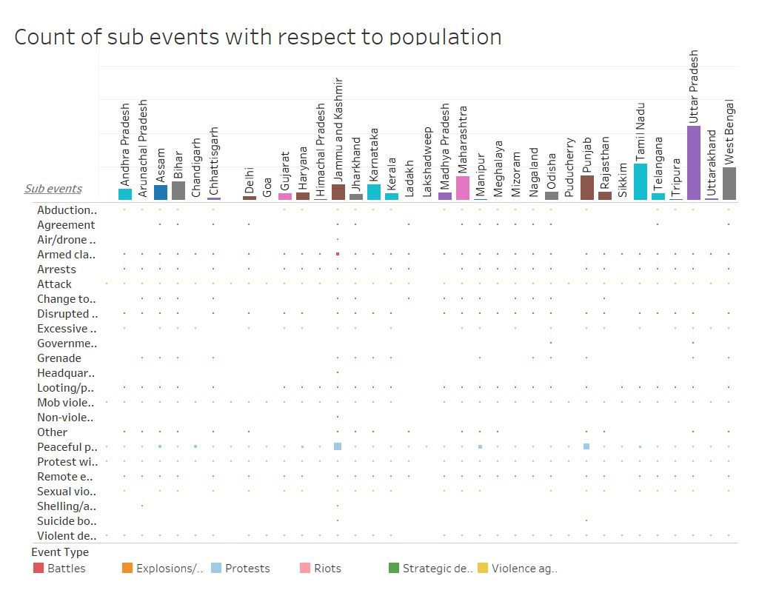
State wise sub events considering the population
4 attributes are conveyed in this chart (State, Sub events, Events, Population)

Slide 12
Work done by Individuals
Pavithra Sridhar
Type of Events and Fatality in each zone
Year wise Sub events and Fatalities
Groups with Highest Event and Fatalities
Robinson Tamilselvan
State wise sub events
State wise sub events considering the population
Data Pre-Processing
MD. Ashfaqur Rahman
Analysis of People who organised the Events
Maximum events year wise and their groups

Slide 13
Theory Implementation in Alternatives
Technologies and Tools used
Tableau - Visualization
Python - Visualization
Excel - Data
Oracle- Sql – Data preprocessing
Oracle- Plsql – Data preprocessing
We also used Tree map, Sun burst to display the hierarchy in the alternative charts
Simpson’s paradox – comet concept is implemented in the Alternative chart “Fatalities with respect to Actor1 and Actor2”.
Word cloud is also used

Slide 14
Thank you!

