Slide 1
Cracks in cycled LCO70: do they break the LCO network?
Crack segmentation, connectivity and tortuosity from FIB-SEM: what we tried and what we found
A970 7030 cycled · slices 1–600 · 20 × 20 × 50 nm voxels · November 2026
Notes:
Summary of the crack work on the cycled LCO70 sample: improving crack detection, LCO connectivity and tortuosity with and without cracks, and sensitivity tests on whether the crack effect is underestimated.

Slide 2
Cracks lengthen the electronic paths in LCO but do not cut them
≤ 0.02 %
2.7–4.8 %
< 4 %
of LCO cut off from the current collector by cracks
lower effective electronic conductivity of LCO through the thickness
of LCO cut off even with more than 10× the detected crack volume
all crack models, slices 1–600
v6 to v6_all, slices 1–150
sensitivity tests, 36-slice stack
Crack detection is a lower bound, but the connectivity result holds even if the cracks are several times more extensive than detected. The crack effect shows up only as longer, narrower conduction paths (tortuosity).
Notes:
Three numbers to remember. Connectivity: essentially unchanged by cracks. Conductivity: a few percent lower, through tortuosity. Robustness: even far more cracking than detected does not disconnect LCO.

Slide 3
From FIB-SEM slices to transport metrics
1
2
3
4
5
Segment
Grow in 3D
Filter
Connectivity
Tortuosity
Random forest per slice: pore, LCO, LLZTO, crack
Add voxels with crack probability > 0.15 connected to a detected crack
Drop cracks < 0.5 µm long; trim to the dark core (mean width ≈ 49 nm)
LCO connected to the collector (6-connectivity), cracks as void vs filled
taufactor in y at full resolution, cracks as void vs filled → ε/τ ratio
Sample: A970 7030 cycled, Merged_clean stack, slices 1–600 = 30 µm in z; 1001 × 1001 px = 20 × 20 µm in x, y; 20 nm pixels, 50 nm slices; LCO ≈ 60 vol%.
Validation: leave-one-slice-out on 3 annotated slices, each predicted with ±5 neighbouring slices through the full 3D chain.
Notes:
Orange steps produce the crack segmentation, teal steps the transport metrics. Every transport number compares the same volume with cracks treated as void and with cracks filled back into LCO.

Slide 4
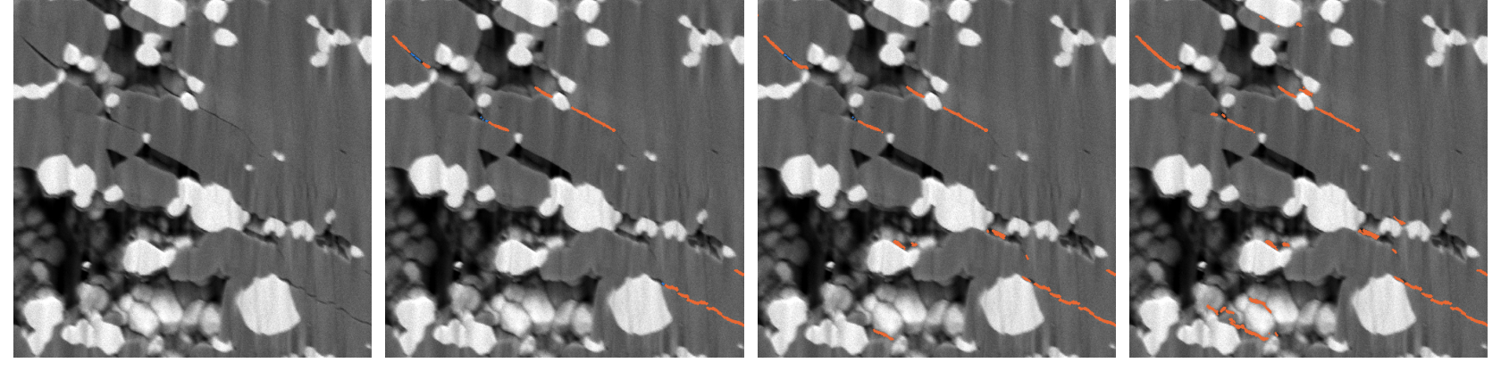
Crack detection improved from 91 % to 95–98 %
Model | Cracks found | Crack px/slice
Old recipe (v3) | 91 % | 1,740
v6 (new default) | 95 % | 2,600
v6_all (+ LCO50 slices) | 98 % | 5,570
Unmarked cracks were trained as "not crack" (~15k px vs ~1.5k marked per slice); now left unlabelled
Growth threshold 0.2 → 0.15; in 3D the 0.5 µm length limit loses no annotated crack
Neighbouring-slice features: no gain with only 2 training slices
Bug fixed: annotation images in the slice folder had been segmented as extra slices
Annotated cracks found on held-out slices, full 3D chain
Held-out slice 0038 (10 × 10 µm): SEM, old recipe, v6, v6_all. Orange = detected crack, blue = annotated but missed. v6_all also flags spots among small particles.
Notes:
The biggest gain came from not training unmarked cracks as background. Annotations are incomplete, so the false-alarm rate is not measured: v6 is the conservative model, v6_all the generous one.

Slide 5
Connectivity unchanged, conductivity 2.7–4.8 % lower
 | Old (v3) | v6 | v6_all
Crack, vol% (slices 1–600) | 0.19 | 0.21 | 0.47
LCO cut off from collector | 0.00 % | 0.00 % | 0.02 %
τ, cracks void vs filled | +1.6 % | +2.4 % | +4.1 %
ε, cracks void vs filled | −0.3 % | −0.4 % | −0.8 %
ε/τ, cracked / uncracked | 0.980 | 0.973 | 0.952
Tortuosity: slices 1–150 (7.5 µm), full resolution, paired on the same volume.
The solver's swing in τ (±0.05) cancels: the void–filled gap stayed constant at every checkpoint (v6: 0.039–0.046).
Notes:
Almost all of the loss is in tau (longer, narrower paths); the crack volume itself removes less than 1 % of the conducting volume. The range reflects crack detection, not solver noise.

Slide 6
Even much more cracking would not disconnect the LCO
3.2 % → 0.00 %
LCO cut off per 2D slice vs in 3D, with every crack extended across 1 µm gaps
A region a crack isolates in one slice reconnects through the neighbouring slices
Width is not the limit: +100 nm closes all gaps < 200 nm, still nothing is cut off
To lower connectivity, cracks would have to seal whole LCO bands in 3D
36-slice test stack (slices 10–45), model v6
Notes:
Each test assumes more cracking than detected. Neck test: opening the LCO removes every neck thinner than about twice the radius, i.e. treats it as cracked; values are the extra LCO cut off beyond the 0.18 % that is isolated anyway.

Slide 7
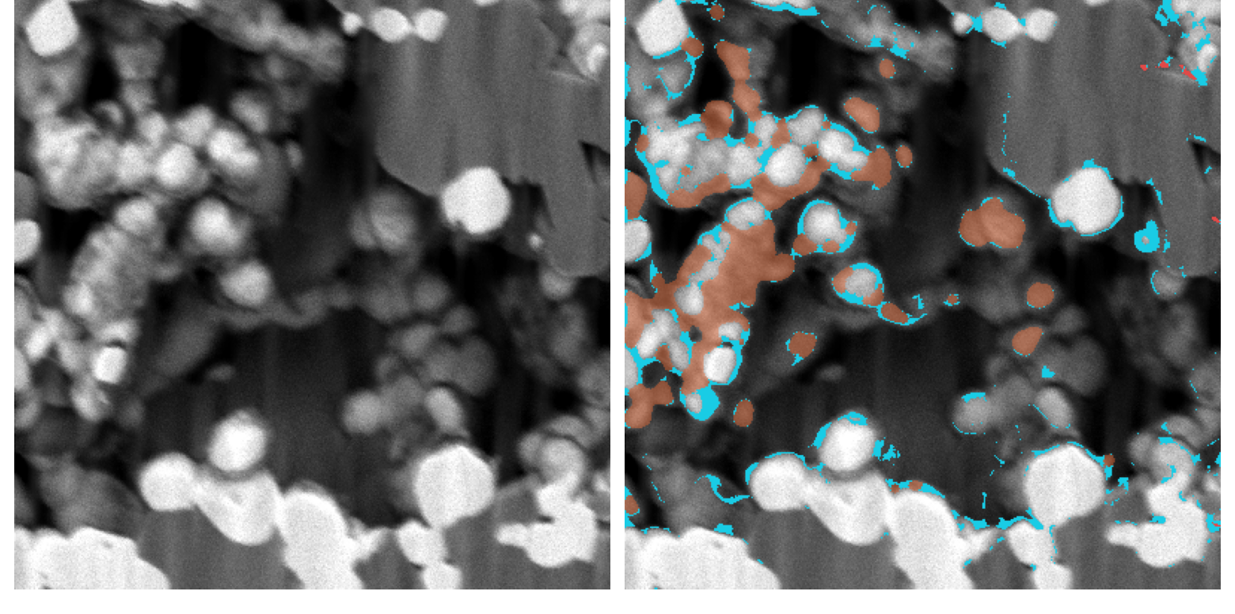
Cracks stop short; thin LCO necks sit among small particles
Slice 0044, 8 × 8 µm (left SEM, right overlay): if every LCO neck < ~120 nm were cracked (cyan), the orange LCO would be cut off; detected cracks red. Almost all of it is small particles in the porous region.
4,233 crack tips; median gap 140 nm, 46 % of tips within 200 nm of pore, LLZTO or another crack
Notes:
Most crack tips nearly reach a boundary, so the cracks are short segments within the grains. The LCO that could be disconnected by unresolved contacts sits in the fine-particle regions, not in the large cracked grains.

Slide 8
Conclusions and open points
What we can say
Limitations
Next steps
The LCO network stays connected after cycling (≤ 0.02 % cut off)
Cracks lower LCO effective conductivity in y by 2.7–4.8 %, through longer paths
Robust to under-detection: < 4 % cut off even at > 10× crack volume
Annotations mark only some cracks: false-alarm rate not measured
Contacts thinner than one 20 nm voxel count as conducting
Tortuosity so far for one 150-slice block
Complete crack annotations of a few regions
Tortuosity for all four z-blocks and the inflation sweep
LCO/LLZTO contact and LLZTO network vs uncycled; impedance before/after cycling
Notes:
Cracking does not disconnect the electronic LCO network in this electrode; its effect on electronic transport is a few percent via tortuosity. Degradation is therefore likely elsewhere, e.g. at the LCO/LLZTO interface, which is the next analysis.

