Slide 1
Kalman Filters
CMSC 477: Robotics: Planning and Perception
Slide Credits: Pratap Tokekar

Slide 2
http://www.probabilistic-robotics.org

Slide 3
Today
So far, we have assumed perfect control
If we ask the robot to go north, it’ll go north
So far, we have assumed perfect feedback
We always know where the robot is

Slide 4
Today
So far, we have assumed perfect control
If we ask the robot to go north, it’ll go north
So far, we have assumed perfect feedback
We always know where the robot is
We will no longer assume we have perfect control and perfect feedback
Today:
uncertainty in control
noisy observations

Slide 5
If we don’t know where the robot is, what do we have?
Anyone knows?

Slide 6
If we don’t know where the robot is, what do we have?
We will have a belief
s(t) true (unknown) state of robot at time t
b(s(t)) belief of state of robot at time t
A belief represents the probability distribution over all possible states that the robot can be at t
b(s(t) = x) what is the probability that the true state is x at time t?

Slide 7
If we don’t know where the robot is, what do we have?
We will have a belief
s(t) true (unknown) state of robot at time t
b(s(t)) belief of state of robot at time t
A belief represents the probability distribution over all possible states that the robot can be at t
Examples of b(s(t))?

Slide 8
Noisy robot
Belief can be a vector (discrete state space)
Or can be a pdf (continuous state space)

Slide 9
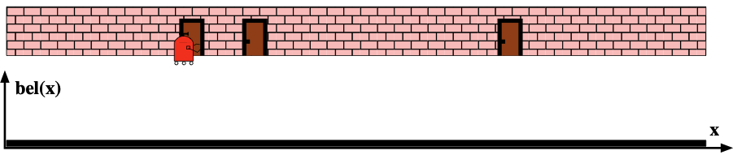
1D robot (continuous state space)
1. With no prior information at all, what would the belief be?

Slide 10
1D robot (continuous state space)
b(s(t)) will be a uniform distribution over the state space
1. With no prior information at all, what would the belief be?

Slide 11
1D robot (continuous state space)
b(s(t)) will be a uniform distribution over the state space
1. With no prior information at all, what would the belief be?
2. Now say we have an observation that the robot is near a door, what would the belief look like?

Slide 12
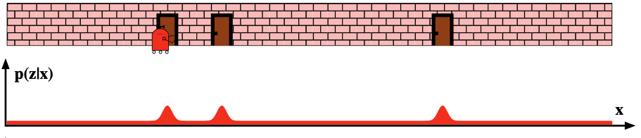
1D robot (continuous state space)
b(s(t) | z) will be something like this
1. With no prior information at all, what would the belief be?
2. Now say we have an observation that the robot is near a door, what would the belief look like?

Slide 13
1D robot (continuous state space)
b(s(t) | z) will be something like this
1. With no prior information at all, what would the belief be?
2. Now say we have an observation that the robot is near a door, what would the belief look like?
3. Now say that the robot moves to the right by 1m, what would the belief look like?

Slide 14
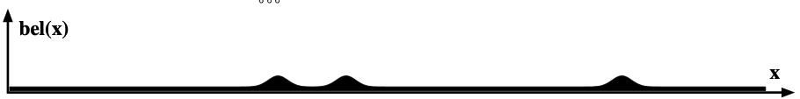
1D robot (continuous state space)
Before moving
After moving
1. With no prior information at all, what would the belief be?
3. Now say that the robot moves to the right by 1m, what would the belief look like?

Slide 15
1D robot (continuous state space)
Before moving
After moving
1. With no prior information at all, what would the belief be?
4. Now we again observe that the robot is near a door?

Slide 16
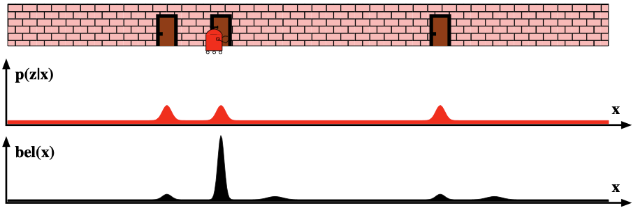
1D robot (continuous state space)
Before observing
After observing
4. Now we again observe that the robot is near a door?

Slide 17
This is basically Kalman Filtering
Before moving
p(x_{t-1})
1. Prediction step
After moving
p(x_{t} |x_{t-1}, u_{t})
1. With no prior information at all, what would the belief be?

Slide 18
Before moving
p(x_{t-1})
1. Prediction step
After moving
p(x_{t} |x_{t-1}, u_{t})
1. With no prior information at all, what would the belief be?
Before observing
2. Update step
p(x_{t} |x_{t-1}, u_{t})
After observing
p(x_{t} |x_{t-1}, u_{t}, z_{t})

Slide 19
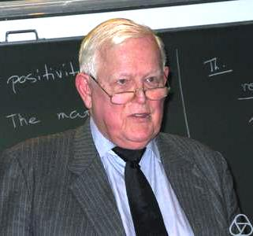
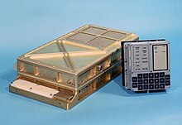
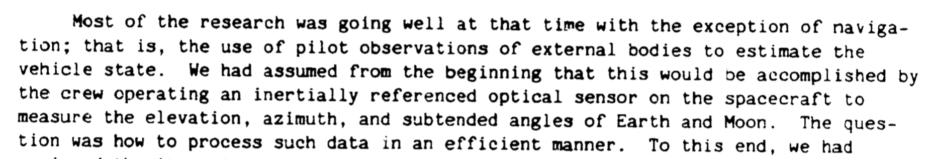
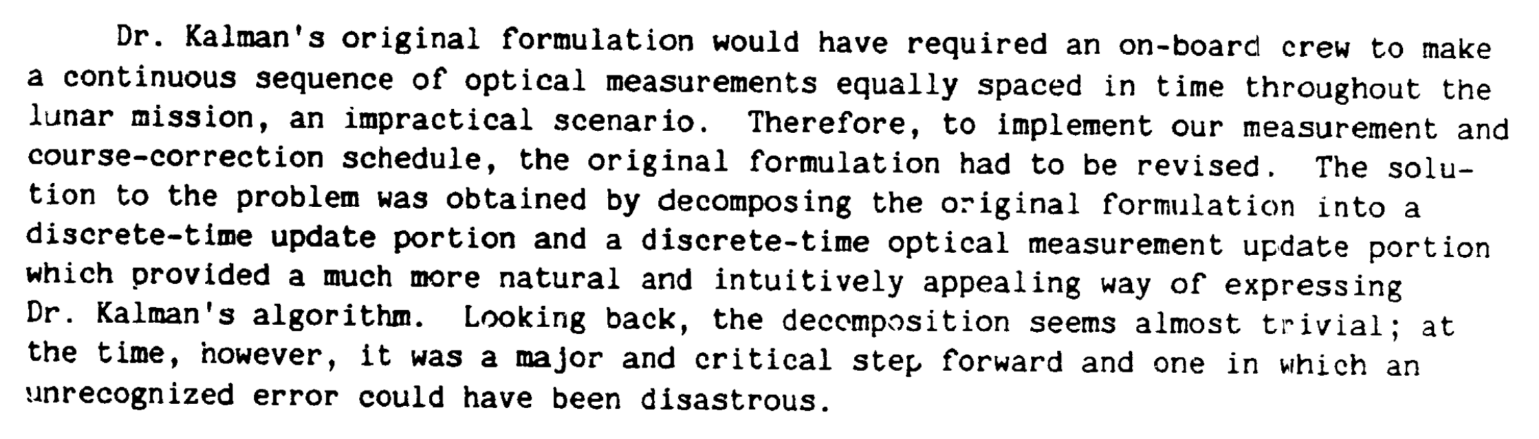
Kalman Filter
Rudolf Kalman, one of the primary developers (several similar ideas by contemporaries)
Used in the Apollo Guidance Computer
https://ntrs.nasa.gov/citations/19860003843

Slide 20
Plan
I’ll show you the 1D version of the Kalman Filter prediction/update equations
Then I’ll show you the general d-D version
We’ll assume linear dynamics and observation
We’ll extend this to non-linear systems
Then we’ll see how to fuse this with actual camera observations

Slide 21
Kalman Filter Basics
Belief will be represented as a Gaussian distribution
Assumptions
Linear dynamics
Additive motion noise (aka process aka system noise)
Linear observation model
Additive measurement noise

Slide 22
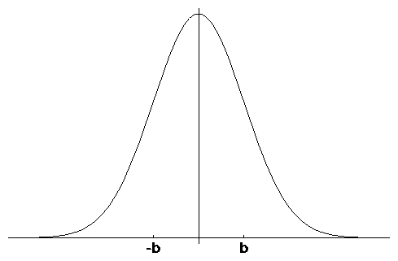
1D Gaussian Random Variable
μ
-σ
σ
Mean
Variance

Slide 23
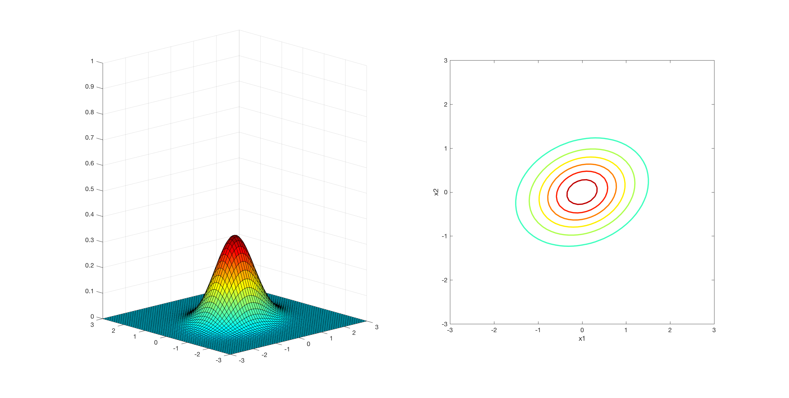
d-dimensional Gaussian RV
x and mu are a d-dimensional vectors

Slide 24
Contours of Equal Probability
are ellipses

Slide 25
Properties of Gaussians
We stay in the “Gaussian world” as long as we start with Gaussians and perform only linear transformations.

Slide 26
Kalman Filter Basics
Belief will be represented as a Gaussian distribution
Assumptions
Linear dynamics
Additive motion noise (aka process aka system noise)
Linear observation model
Additive measurement noise

Slide 27
1D Navigation Problem
Point robot moves on a line
Real state space is a line
let’s ignore the boundaries for now
We have a noisy position sensor
sensor returns a position observation that is corrupted by noise
Random variable x_{t} denotes the position of the robot on the line at time t

Slide 28
1D Robot Example
Assume linear action/motion discrete time model
action/control
next state
zero-mean,
Gaussian noise
current state

Slide 29
Before moving
p(x_{t-1})
1. Prediction step
After moving
p(x_{t} |x_{t-1}, u_{t})
1. With no prior information at all, what would the belief be?
Before observing
2. Update step
p(x_{t} |x_{t-1}, u_{t})
After observing
p(x_{t} |x_{t-1}, u_{t}, z_{t})

Slide 30
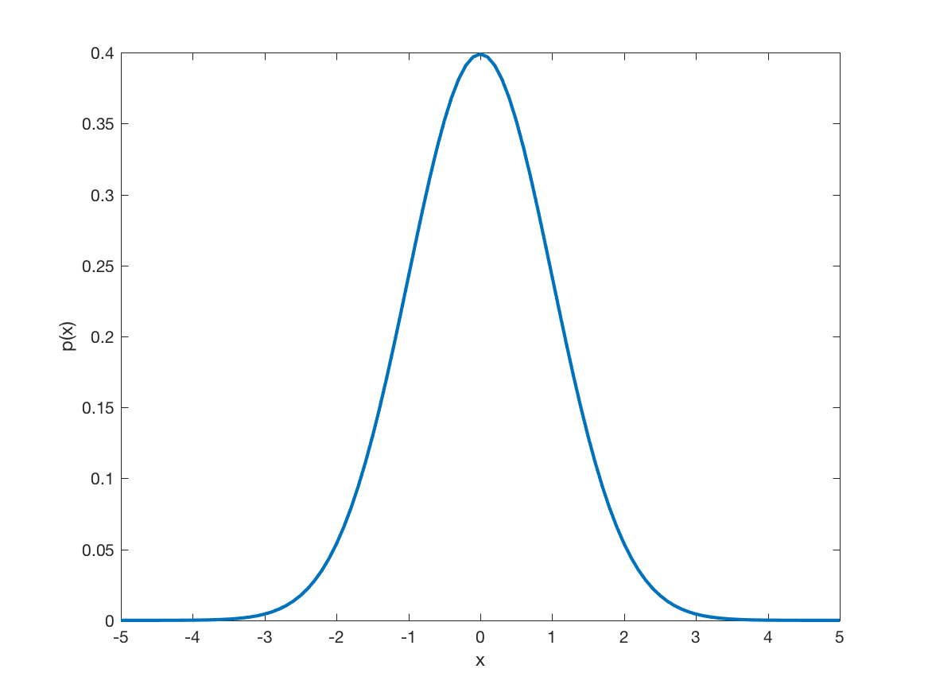
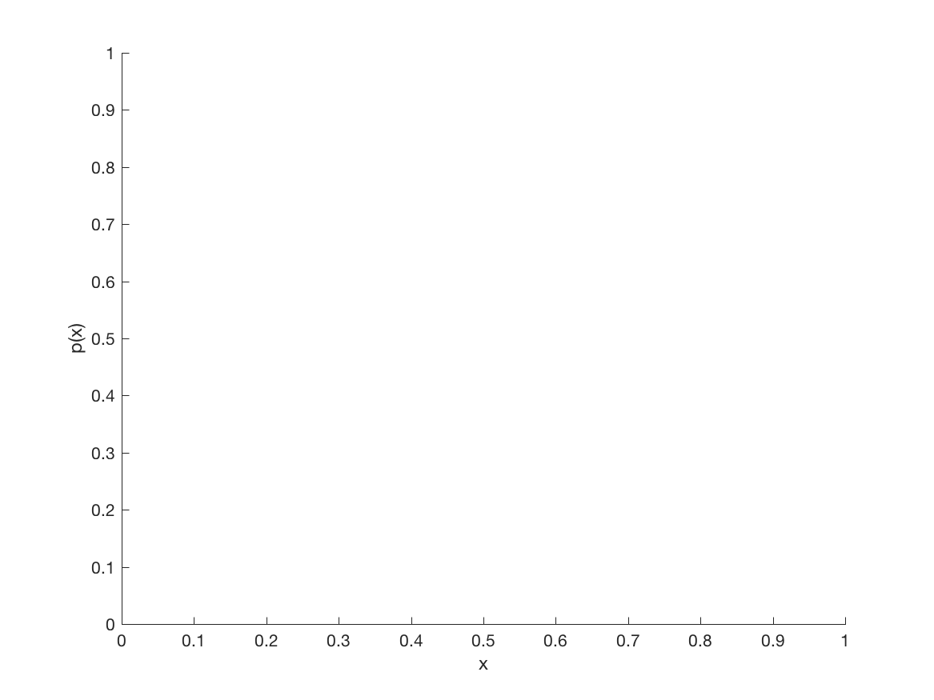
Step 1: Prediction (aka Propagation)
prior belief b = p(x_{t-1})
posterior p(x_{t} | x_{t-1,} u_{t})
take action u_{t}
b
b’ = ??

Slide 31
Before moving
p(x_{t-1})
1. Prediction step
After moving
p(x_{t} |x_{t-1}, u_{t})
1. With no prior information at all, what would the belief be?
Before observing
2. Update step
p(x_{t} |x_{t-1}, u_{t})
After observing
p(x_{t} |x_{t-1}, u_{t}, z_{t})

Slide 32
1D Robot Example
We have a noisy sensor that measures the position of the robot
measurement
zero-mean, additive
Gaussian noise
true state

Slide 33
Step 2: Update (aka Correction) step
prior belief b = p(x_{t} | x_{t-1}, u_{t})
posterior p(x_{t} | x_{t-1,} u_{t}, z_{t})
observe z_{t}
b
b’ = ??

Slide 34
Computing the posterior
Prediction:
Based on the prior belief and action, predict the new belief about the robot’s position
Correction:
Correct the prediction using the measurement

Slide 35
The Prediction-Correction-Cycle
Prediction
t|t
t | t-1
Correction

Slide 36
Demo

Slide 37
Bayes’ Theorem
likelihood
posterior
prior
evidence
If prior, likelihood, and evidence are Gaussian distributions, then posterior will be Gaussian as well.

Slide 38
Correction (Note, simplified notation)
Since posterior is Gaussian, MAP = mean
Notes:
MAP estimate (xhat_{MAP}) is simply the value of x_t that makes the posterior probability as large as possible

Slide 39
Bayesian Estimation
Assume we know the prior pdf
If we know the likelihood, p(z_{t} | x_{t}), we can compute the posterior.

Slide 40
Bayesian Estimation
Assume we know the prior pdf
If we know the likelihood, p(z_{t} | x_{t}), we can compute the posterior.
Any idea what the likelihood model is?

Slide 41
Likelihood Model
Also called sensor model or measurement model. Assume noise to be a zero-mean Gaussian.
Therefore, likelihood is also Gaussian with mean equal to x_{t} and same variance as noise model.

Slide 42
Example: 1D robot

Slide 43
Example: 1D robot

Slide 44
1D Robot MAP Estimate
Weighted sum of prior mean and measurement.
Weights inversely proportional to variances.
prior
residual
Kalman Gain

Slide 45
Posterior Variance
If likelihood and prior are Gaussians, then posterior is also a Gaussian

Slide 46
So far, we have only considered the observation model
Now lets consider actions as well
Think of the robot as a process
x₀ -> a₁ --> o₁ --> a₂ --> ...
We will use u_{i} to denote action a_{i}
u_{i} is the control vector

Slide 47
Assume Linear Transition Model
Matrix (n x n) that describes how the state evolves from t to t-1 without controls or noise.
Matrix (n x l) that describes how the control u_{t} changes the state from t to t-1.
Process noise assumed to be independent and normally distributed with covariance R_{t}

Slide 48
Linear Observation Model
with a measurement
Matrix (k x n) that describes how to map the state x_{t} to an observation z_{t}.
Measurement noise assumed to be independent and normally distributed with covariance Q_{t}

Slide 49
Goal 1:
Goal 2:
Assume,

Slide 50
Recall that Gaussians are a closed system
Linear transformation of Gaussian random variable gives you a Gaussian

Slide 51
Properties of Gaussians
We stay in the “Gaussian world” as long as we start with Gaussians and perform only linear transformations.

Slide 53
This is our prediction step.
Next, measurement update

Slide 54
Back to our MAP estimator

Slide 55
The Prediction-Correction-Cycle
Prediction
t|t
t | t-1
Correction

Slide 56
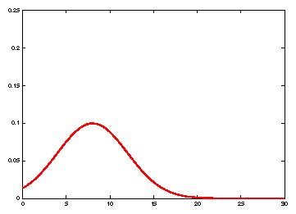
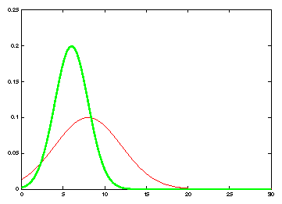
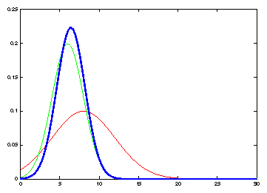
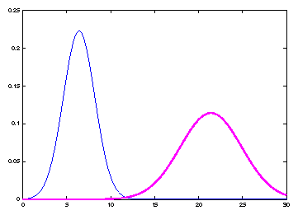
Kalman Filter Updates in 1D
Measurement
likelihood
prior
Prediction
given u_{t}
update

Slide 57
Kalman Filter Algorithm
Algorithm Kalman_filter( μ_{t-1}, Σ_{t-1}, u_{t}, z_{t}):
Prediction:
Correction:
Return μ_{t}, Σ_{t}

Slide 58
Properties of Kalman Filter
If the system is linear, and noise is Gaussian, then KF is optimal Minimum Mean Squared Error estimator
If noise is not Gaussian, however, is modeled as Gaussian using the mean and variance, then KF is the optimal linear MMSE

