Slide 1
Kalman Filters
Troi Williams
Slide Credits: Pratap Tokekar

Slide 2
http://www.probabilistic-robotics.org

Slide 3
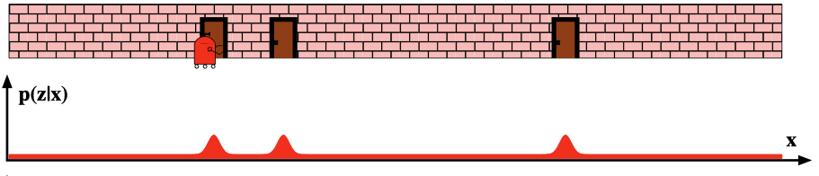
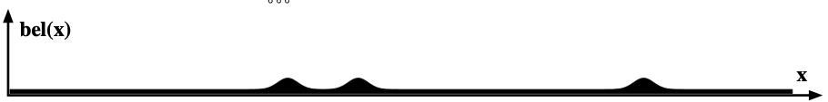
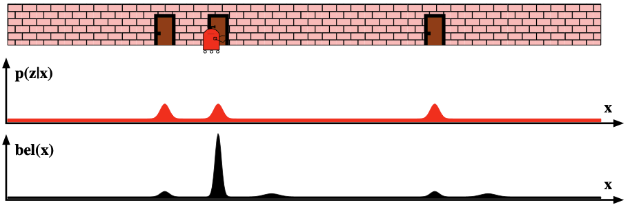
Before moving
p(x_{t-1})
1. Prediction step
After moving
p(x_{t} |x_{t-1}, u_{t})
1. With no prior information at all, what would the belief be?
Before observing
2. Update step
p(x_{t} |x_{t-1}, u_{t})
After observing
p(x_{t} |x_{t-1}, u_{t}, z_{t})

Slide 4
Plan
I’ll show you the 1D version of the Kalman Filter prediction/update equations
Then I’ll show you the general d-D version
We’ll assume linear dynamics and observation
We’ll extend this to non-linear systems
Then we’ll see how to fuse this with actual camera observations

Slide 5
Kalman Filter Basics
Belief will be represented as a Gaussian distribution
Assumptions
Linear dynamics
Additive motion noise (aka process aka system noise)
Linear observation model
Additive measurement noise

Slide 6
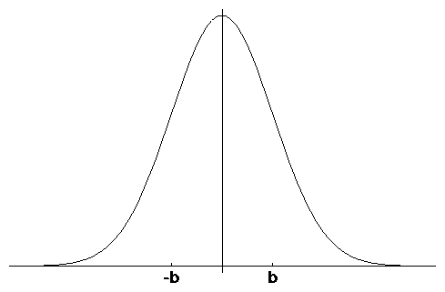
1D Gaussian Random Variable
μ
-σ
σ
Mean
Variance

Slide 7
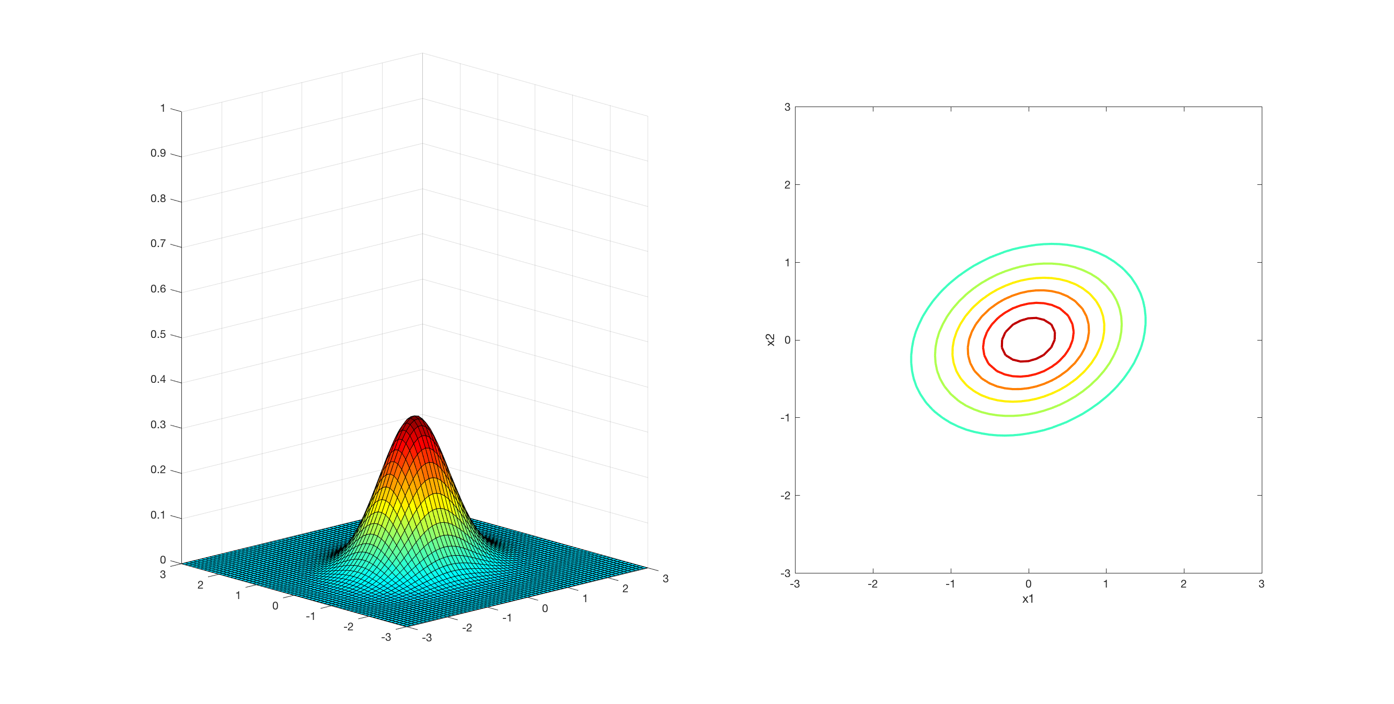
d-dimensional Gaussian RV
x and mu are a d-dimensional vectors

Slide 8
Contours of Equal Probability
are ellipses

Slide 9
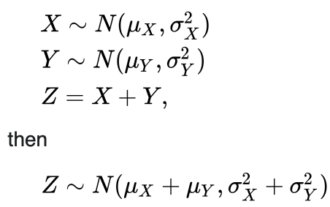
Properties of Gaussians

Slide 10
Kalman Filter Basics
Belief will be represented as a Gaussian distribution
Assumptions
Linear dynamics
Additive motion noise (aka process aka system noise)
Linear observation model
Additive measurement noise

Slide 11
1D Navigation Problem
Point robot moves on a line
Real state space is a line
let’s ignore the boundaries for now
We have a noisy position sensor
sensor returns a position observation that is corrupted by noise
Random variable x_{t} denotes the position of the robot on the line at time t

Slide 12
1D Robot Example
Assume linear action/motion discrete time model
action/control
next state
zero-mean,
Gaussian noise
current state

Slide 13
Before moving
p(x_{t-1})
1. Prediction step
After moving
p(x_{t} |x_{t-1}, u_{t})
1. With no prior information at all, what would the belief be?
Before observing
2. Update step
p(x_{t} |x_{t-1}, u_{t})
After observing
p(x_{t} |x_{t-1}, u_{t}, z_{t})

Slide 14
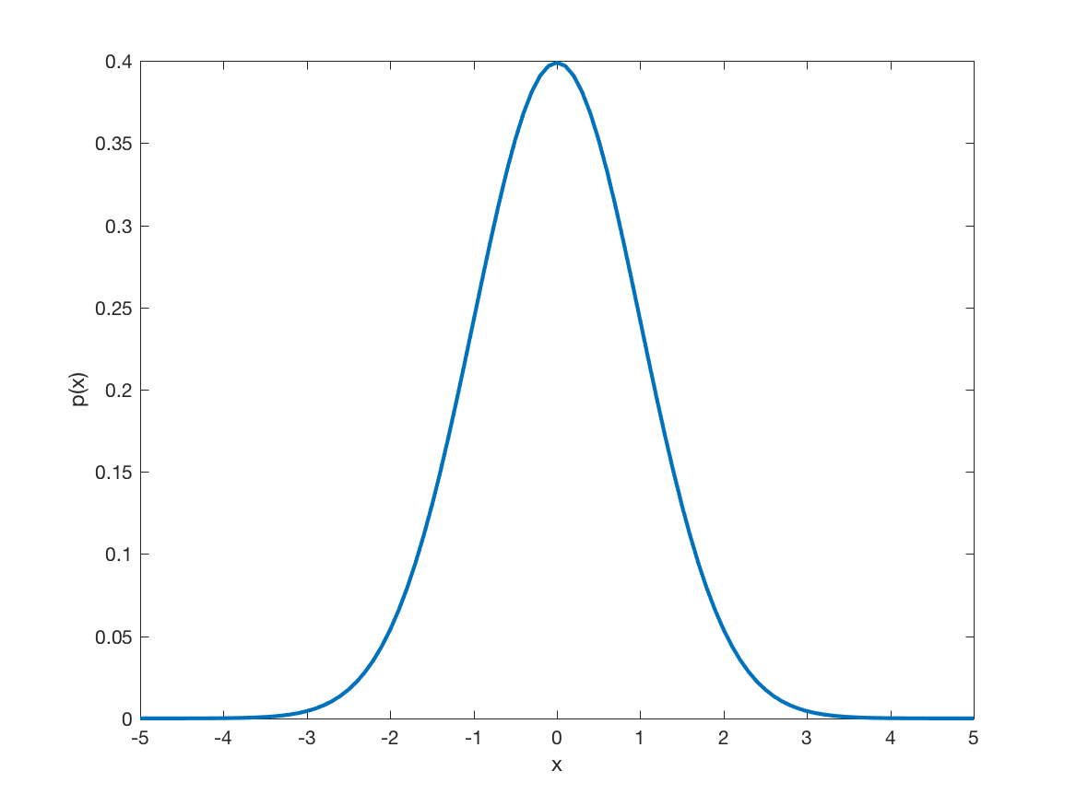
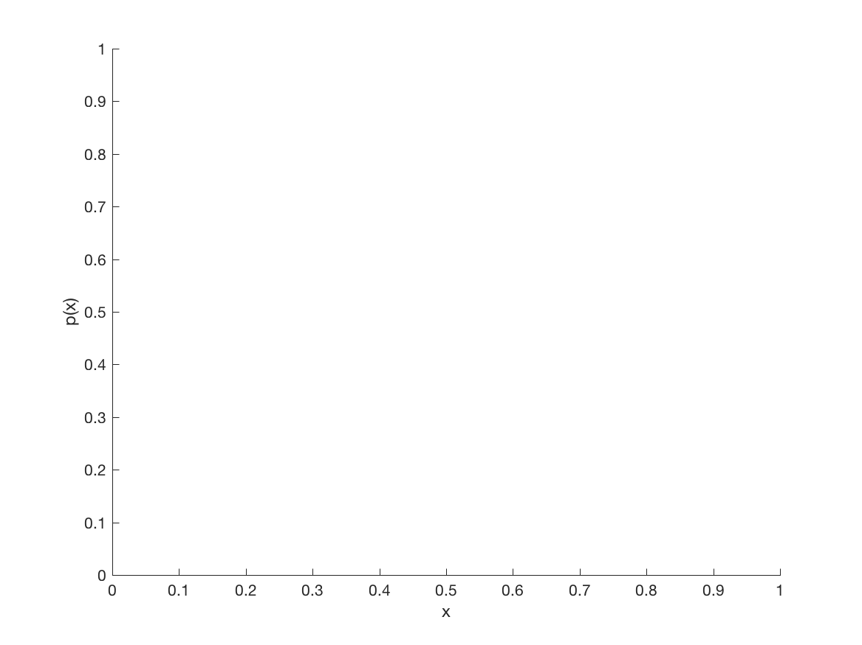
Step 1: Prediction (aka Propagation)
prior belief b = p(x_{t-1})
posterior p(x_{t} | x_{t-1,} u_{t})
take action u_{t}
b
b’ = ??

Slide 15
Properties of Gaussians

Slide 16

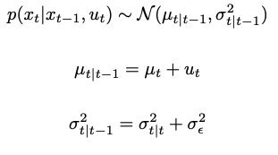
action/control
next state
zero-mean,
Gaussian noise
current state

Slide 17
Before moving
p(x_{t-1})
1. Prediction step
After moving
p(x_{t} |x_{t-1}, u_{t})
1. With no prior information at all, what would the belief be?
Before observing
2. Update step
p(x_{t} |x_{t-1}, u_{t})
After observing
p(x_{t} |x_{t-1}, u_{t}, z_{t})

Slide 18
1D Robot Example
We have a noisy sensor that measures the position of the robot
measurement
zero-mean, additive
Gaussian noise
true state

Slide 19
Step 2: Update (aka Correction) step
prior belief b = p(x_{t} | x_{t-1}, u_{t})
posterior p(x_{t} | x_{t-1,} u_{t}, z_{t})
observe z_{t}
b
b’ = ??

Slide 20
Computing the posterior
Prediction:
Based on the prior belief and action, predict the new belief about the robot’s position
Correction:
Correct the prediction using the measurement

Slide 21
Bayes’ Theorem
likelihood
posterior
prior
evidence
If prior, likelihood, and evidence are Gaussian distributions, then posterior will be Gaussian as well.

Slide 22
Correction (Note, simplified notation)
Since posterior is Gaussian, MAP = mean

Slide 23
Bayesian Estimation
Assume we know the prior pdf
If we know the likelihood, p(z_{t} | x_{t}), we can compute the posterior.

Slide 24
Likelihood Model
Also called sensor model or measurement model. Assume noise to be a zero-mean Gaussian.
Therefore, likelihood is also Gaussian with mean equal to x_{t} and same variance as noise model.

Slide 25
Example: 1D robot

Slide 26
Example: 1D robot

Slide 27
1D Robot MAP Estimate
Weighted sum of prior mean and measurement.
Weights inversely proportional to variances.
prior
residual
Kalman Gain

Slide 28
Posterior Variance
If likelihood and prior are Gaussians, then posterior is also a Gaussian

Slide 29
General Linear Transition Model
Matrix (n x n) that describes how the state evolves from t to t-1 without controls or noise.
Matrix (n x l) that describes how the control u_{t} changes the state from t to t-1.
Process noise assumed to be independent and normally distributed with covariance R_{t}

Slide 30
Linear Observation Model
with a measurement
Matrix (k x n) that describes how to map the state x_{t} to an observation z_{t}.
Measurement noise assumed to be independent and normally distributed with covariance Q_{t}

Slide 32
This is our prediction step.
Next, measurement update

Slide 33
Back to our MAP estimator

Slide 34
The Prediction-Correction-Cycle
Prediction
t|t
t | t-1
Correction

Slide 35
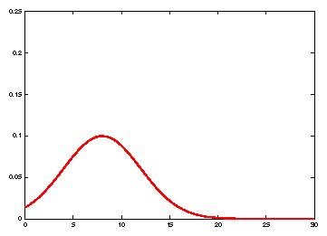
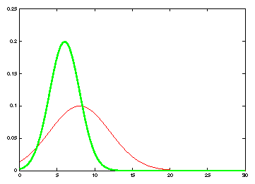
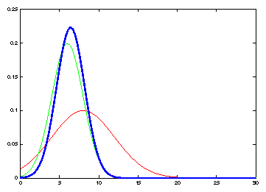
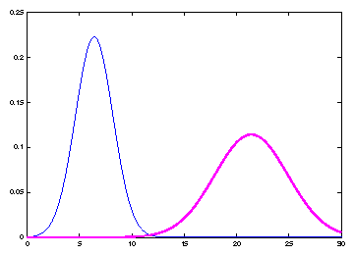
Kalman Filter Updates in 1D
Measurement
likelihood
prior
Prediction
given u_{t}
update

Slide 36
Kalman Filter Algorithm
Algorithm Kalman_filter( μ_{t-1}, Σ_{t-1}, u_{t}, z_{t}):
Prediction:
Correction:
Return μ_{t}, Σ_{t}

Slide 37
Properties of Kalman Filter
If the system is linear, and noise is Gaussian, then KF is optimal Minimum Mean Squared Error estimator
If noise is not Gaussian, however, is modeled as Gaussian using the mean and variance, then KF is the optimal linear MMSE

Slide 38
Practical Matters
Non-linearity
Rejecting outliers
Measuring performance
Sensor fusion
Data association

Slide 39
Nonlinear Systems
Most realistic estimation problems involve nonlinear functions
Non-linear motion
Non-linear measurements

Slide 40
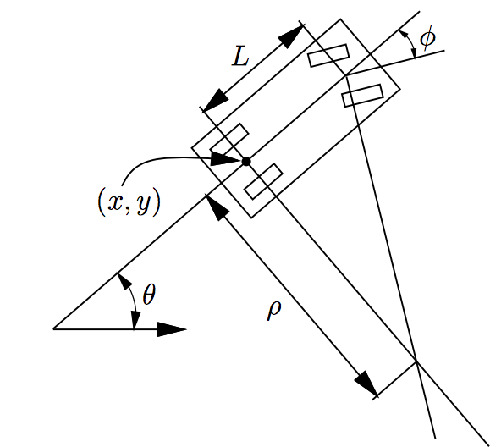
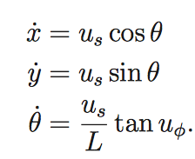
Examples

Slide 41
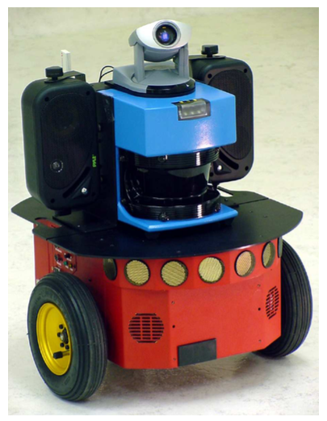
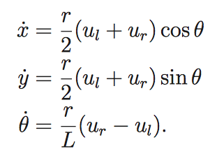
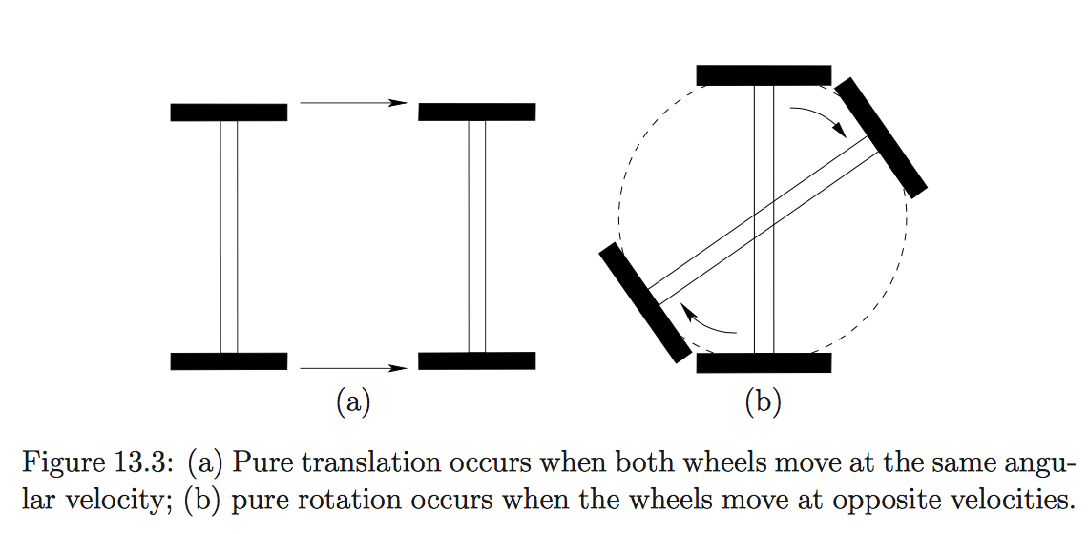
Examples

Slide 42

Non-linear Measurements Example
Distance sensor
z = distance to landmark
Known landmark position

Slide 43
Nonlinear Systems
Most realistic estimation problems involve nonlinear functions

Slide 44
Taylor Series
About a point x = a
Linear in x

Slide 45
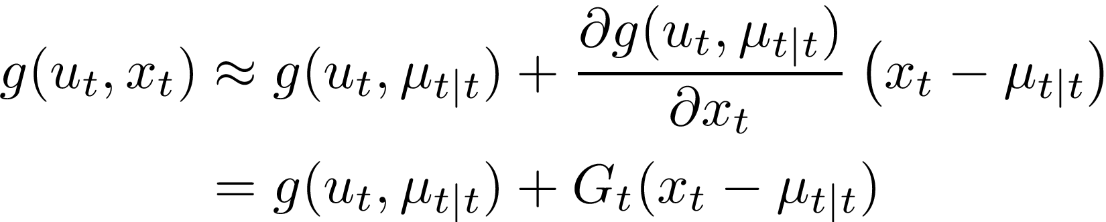
Linearization
Constants that can be computed based on mu

Slide 46
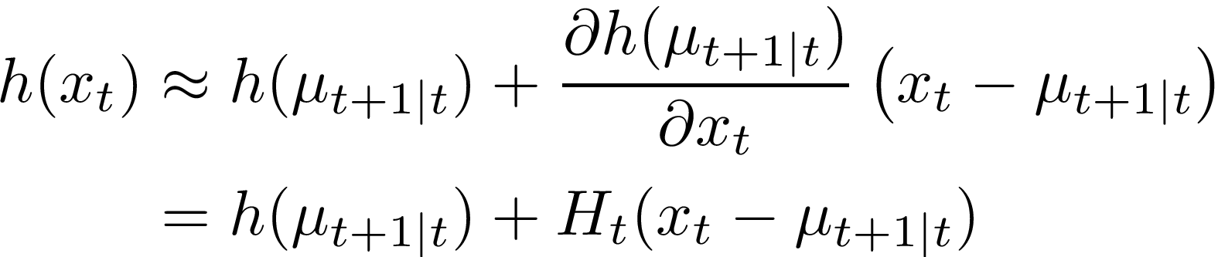
Linearization
Constants that can be computed based on mu

Slide 47
EKF Algorithm
Algorithm Extended_Kalman_filter( μ_{t|t}, Σ_{t|t}, u_{t}, z_{t}):
Prediction:
Correction:
Return μ_{t+1|t+1}, Σ_{t+1|t+1}
KF version
Jacobean

Slide 48
Practical Matters
Non-linearity
Rejecting outliers
Sensor fusion
Data association

Slide 49
Outliers
What happens if delta_{t} is very large?
Posterior mean = weighted sum of prior mean and measurement
If delta_{t} is large, then posterior mean will get pulled away from the true value

Slide 50
Dealing with Outliers
If delta_{t} is large, then posterior mean will get pulled away from the true value
If delta_{t} is large, then discard the measurement, that is, do not perform a correction
How to detect if delta_{t} is large?

Slide 51
Dealing with Outliers
We can’t detect if delta_{t} is large, since we do not know the true state x_{t}
But, we do know an estimate of the true state. That is, mu_{t|t-1}

Slide 52
Innovation (aka residual)
Innovation = actual measurement – expected measurement
Idea: if innovation is larger than a threshold, then discard the measurement

Slide 53
Innovation (aka residual)
mu is only an estimate of the true state x
Therefore, innovation is only an estimate of the true error (delta_{t})
We do have a confidence measure (i.e., variance) of the estimate

Slide 54
Innovation
Innovation covariance (S) measures the uncertainty in the estimate (mu, given by the first term) and the measurement (z, given by the second term)

Slide 55
Measurement Validation Gate
Compute the Mahalanobis distance (innovation weighted by its covariance)
This distance follows a chi-square distribution
Set a threshold (validation gate).
If Mahalanobis distance is less than threshold, accept the measurement. Else, reject.

Slide 56
Practical Matters
Non-linearity
Rejecting outliers
Sensor fusion
Data association

Slide 57
Target 2
How to associate measurement to KF estimate?
Target 1
Two KF (one per target)

Slide 58
Practical Matters
Non-linearity
Rejecting outliers
Sensor fusion
Data association

