Slide 1
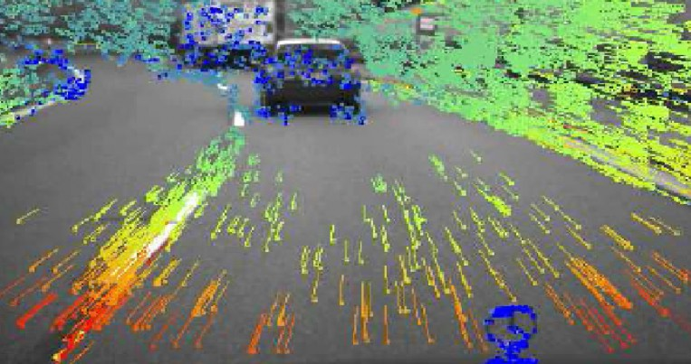
Optical flow
Troi Williams
Slides Courtesy: Kris Kitani (CMU)

Slide 2
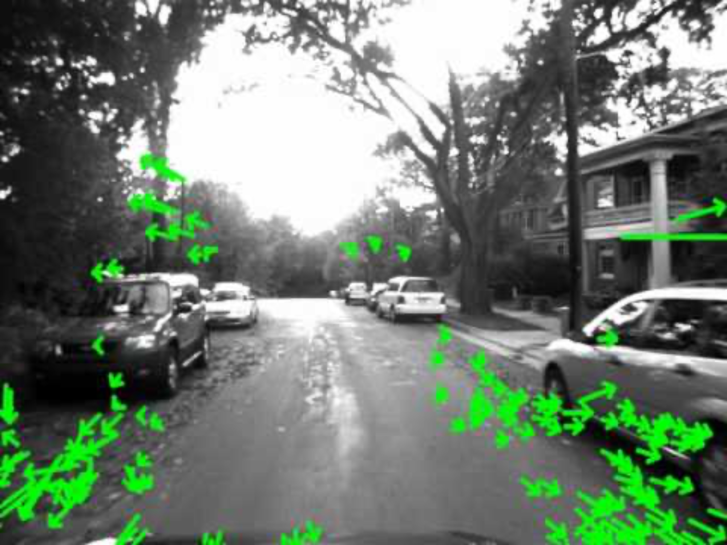
Optical flow while driving through streets

Slide 3
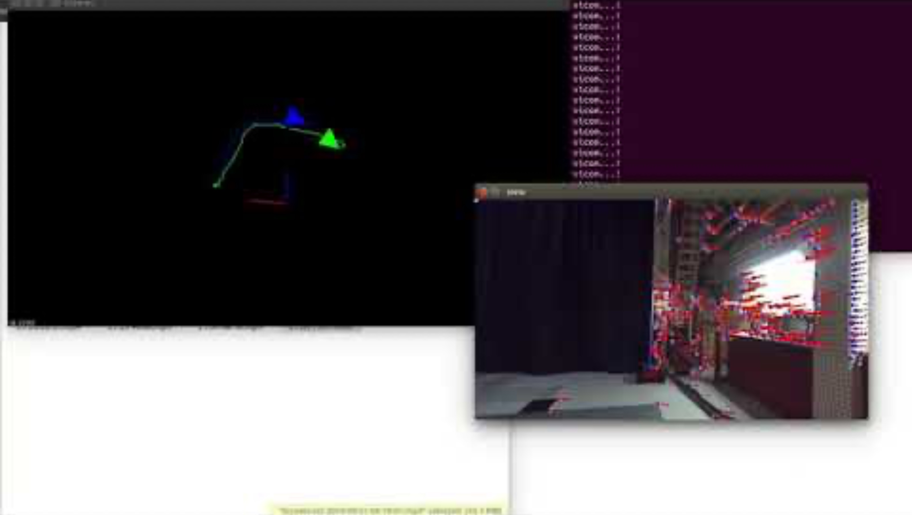
Optical flow used for motion estimation in visual odometry

Slide 4
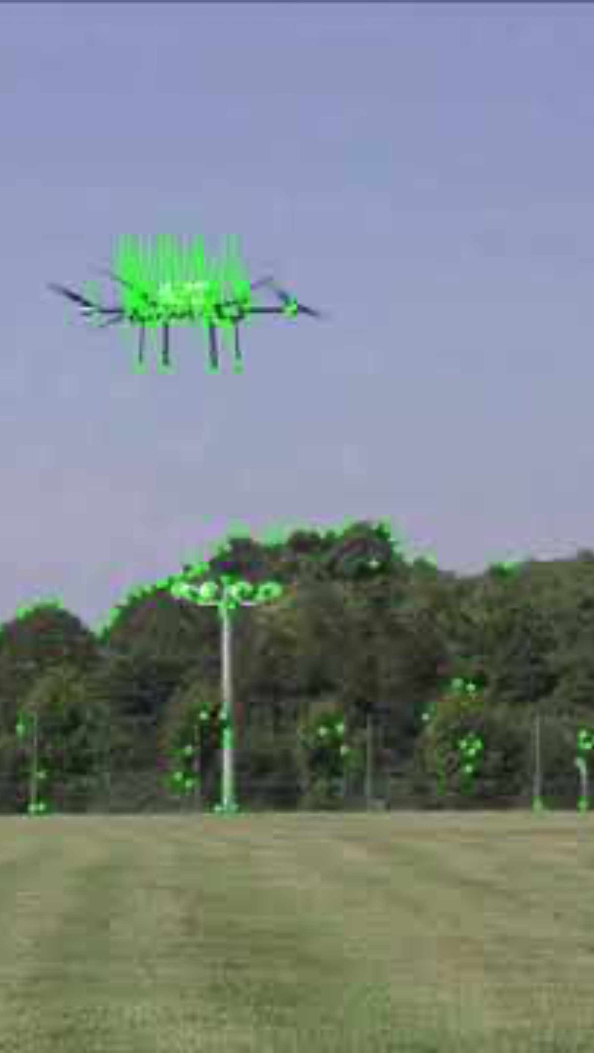
Optical flow for tracking objects

Slide 5
Optical flow

Slide 6
(Dense) Optical Flow
Problem Definition
Given two consecutive image frames, estimate the motion of each pixel
Assumptions Brightness constancy Small motion

Slide 7







Optical Flow
(Problem definition)
Estimate the motion (flow) between these two consecutive images
How is this different from estimating Visual Odometry?

Slide 8
(Dense) Optical Flow
Problem Definition
Given two consecutive image frames, estimate the motion of each pixel
Assumptions Brightness constancy Small motion

Slide 9
Scope (Global vs Local)?
Optical Flow
Visual Odometry

Slide 10
Scope
Optical Flow
Scope: Local (pixels)---how the pixels moved
Visual Odometry
Global---how the camera moved

Slide 11
Which space are we dealing with?
Optical Flow
Scope: Local (pixels)---how the pixels moved
Visual Odometry
Global---how the camera moved

Slide 12
Which space are we dealing with?
Optical Flow
Scope: Local (pixels)---how the pixels moved
Space: Image
Visual Odometry
Global---how the camera moved
World

Slide 13
Motion described as?
Optical Flow
Scope: Local (pixels)---how the pixels moved
Space: Image
Visual Odometry
Global---how the camera moved
World

Slide 14
Motion described as?
Optical Flow
Scope: Local (pixels)---how the pixels moved
Space: Image
Motion: (u,v) vectors
Visual Odometry
Global---how the camera moved
World
Relative Transforms T

Slide 15

Motion described as?
Optical Flow
Scope: Local (pixels)---how the pixels moved
Space: Image
Motion: (u,v) vectors
We’ll learn more about this today!
Visual Odometry
Global---how the camera moved
Relative Transforms T

Slide 16
Key Assumptions
(unique to optical flow)
Color Constancy
(Brightness constancy for intensity images)
Implication: allows for pixel-to-pixel comparison (not image features)
Small Motion
(pixels only move a little bit)
Implication: linearization of the brightness constancy constraint

Slide 17
Overall Goal!
Look for nearby pixels with the same color
(small motion) (color constancy)

Slide 18













Assumption 1
Brightness constancy
Scene point moving through image sequence

Slide 19



Assumption 1
Brightness constancy
Scene point moving through image sequence

Slide 20
Assumption 1
Brightness constancy
Scene point moving through image sequence
Assumption: Brightness of the point will remain the same

Slide 21

Assumption 1
Brightness constancy
Scene point moving through image sequence
Assumption: Brightness of the point will remain the same
constant

Slide 22
Assumption 1
Brightness constancy
Scene point moving through image sequence
Assumption: Brightness of the point will remain the same
constant
When could the assumption fail?

Slide 23
Assumption 1
Brightness constancy
Scene point moving through image sequence
Assumption: Brightness of the point will remain the same
constant
When could the assumption fail? E.g., Shadows, variations in light, etc.

Slide 24








Assumption 2
Small motion

Slide 25




Assumption 2
Small motion

Slide 26


Assumption 2
Small motion
Optical flow (velocities):
Displacement:

Slide 27

Assumption 2
Small motion
Optical flow (velocities): Displacement:
For a really small space-time step…
… the brightness between two consecutive image frames is the same

Slide 28

These assumptions yield the …
Brightness Constancy Equation
total derivative
partial derivative
Equation is not obvious. Where does this come from?

Slide 29
For small space-time step, brightness of a point is the same

Slide 30
For small space-time step, brightness of a point is the same
Insight:
If the time step is really small,
we can linearize the intensity function

Slide 31
Multivariable Taylor Series Expansion
(First order approximation, two variables)

Slide 32

Multivariable Taylor Series Expansion
(First order approximation, two variables)
assuming small motion

Slide 33
Multivariable Taylor Series Expansion
(First order approximation, two variables)
partial derivative
assuming small motion
fixed point

Slide 34

Multivariable Taylor Series Expansion
(First order approximation, two variables)
assuming small motion
cancel terms

Slide 35
Multivariable Taylor Series Expansion
(First order approximation, two variables)
assuming small motion
divide by take limit

Slide 36

Multivariable Taylor Series Expansion
(First order approximation, two variables)
assuming small motion
divide by take limit

Slide 37
Multivariable Taylor Series Expansion
(First order approximation, two variables)
assuming small motion
divide by take limit
Brightness Constancy Equation

Slide 38


Brightness Constancy Equation
shorthand notation
(x-flow)
(y-flow)
vector form
(1 x 2)
(2 x 1)

Slide 39
(putting the math aside for a second…)
What do the terms of the brightness constancy equation represent?

Slide 40
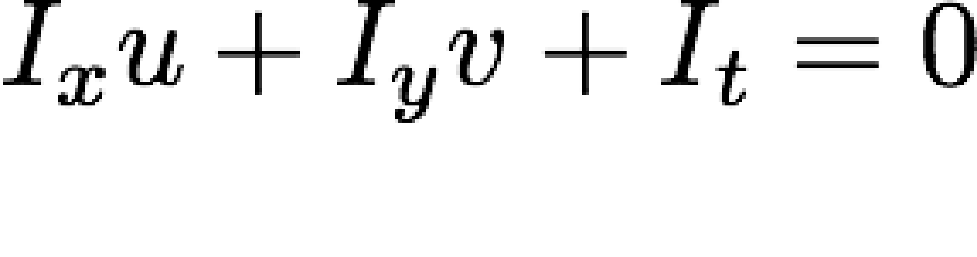




(putting the math aside for a second…)
What do the terms of the brightness constancy equation represent?
Image gradients
(at a point p)

Slide 41






(putting the math aside for a second…)
What do the terms of the brightness constancy equation represent?
flow velocities
Image gradients
(at a point p)

Slide 42

(putting the math aside for a second…)
What do the terms of the brightness constancy equation represent?
flow velocities
Image gradients
(at a point p)
temporal gradient
How do you compute these terms?

Slide 43


How do you compute …
spatial derivative

Slide 44
How do you compute …
spatial derivative
Forward difference Sobel filter
Derivative-of-Gaussian filter
…

Slide 45

How do you compute …
spatial derivative
temporal derivative
Forward difference Sobel filter
Derivative-of-Gaussian filter
…

Slide 46
How do you compute …
spatial derivative
temporal derivative
Forward difference Sobel filter
Derivative-of-Gaussian filter
…
frame differencing

Slide 47
Frame differencing
1 | 1 | 1 | 1 | 1
1 | 1 | 1 | 1 | 1
1 | 10 | 10 | 10 | 10
1 | 10 | 10 | 10 | 10
1 | 10 | 10 | 10 | 10
1 | 10 | 10 | 10 | 10
1 | 1 | 1 | 1 | 1
1 | 1 | 1 | 1 | 1
1 | 1 | 1 | 1 | 1
1 | 1 | 10 | 10 | 10
1 | 1 | 10 | 10 | 10
1 | 1 | 10 | 10 | 10
0 | 0 | 0 | 0 | 0
0 | 0 | 0 | 0 | 0
0 | 9 | 9 | 9 | 9
0 | 9 | 0 | 0 | 0
0 | 9 | 0 | 0 | 0
0 | 9 | 0 | 0 | 0
-
=
(example of a forward difference)

Slide 48
Example:
 |  |  |  |  |  | x
 | 1 | 1 | 1 | 1 | 1
 | 1 | 1 | 1 | 1 | 1
 | 1 | 10 | 10 | 10 | 10
 | 1 | 10 | 10 | 10 | 10
 | 1 | 10 | 10 | 10 | 10
 | 1 | 10 | 10 | 10 | 10
y |  |  |  |  |  |  | y
x
1 | 1 | 1 | 1 | 1
1 | 1 | 1 | 1 | 1
1 | 1 | 1 | 1 | 1
1 | 1 | 10 | 10 | 10
1 | 1 | 10 | 10 | 10
1 | 1 | 10 | 10 | 10
3 x 3 patch
x
x
x
- | 0 | 0 | 0 | -
- | 0 | 0 | 0 | -
- | 9 | 0 | 0 | -
- | 9 | 0 | 0 | -
- | 9 | 0 | 0 | -
- | 9 | 0 | 0 | -
- | - | - | - | -
0 | 0 | 0 | 0 | 0
0 | 9 | 9 | 9 | 9
- | 0 | 0 | 0 | 0
0 | 0 | 0 | 0 | 0
- | - | - | - | -
0 | 0 | 0 | 0 | 0
0 | 0 | 0 | 0 | 0
0 | 9 | 9 | 9 | 9
0 | 9 | 0 | 0 | 0
0 | 9 | 0 | 0 | 0
0 | 9 | 0 | 0 | 0
y
y
y
-1
-1 0 1
0
1

Slide 49


How do you compute …
spatial derivative
optical flow
temporal derivative
Forward difference Sobel filter
Derivative-of-Gaussian filter
…
How do you compute this?
frame differencing

Slide 50
How do you compute …
spatial derivative
optical flow
temporal derivative
Forward difference Sobel filter
Derivative-of-Gaussian filter
…
We need to solve for this! (this is the unknown in the optical flow problem)
frame differencing

Slide 51
How do you compute …
spatial derivative
optical flow
temporal derivative
Forward difference Sobel filter
Derivative-of-Gaussian filter
…
frame differencing
Solution lies on a line
Cannot be found uniquely with a single constraint

Slide 52
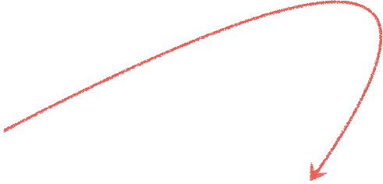

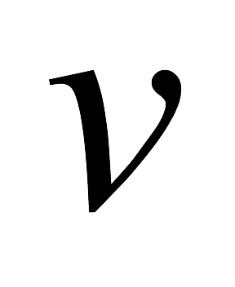
Solution lies on a straight line
many combinations of u and v will satisfy the equality
The solution cannot be determined uniquely with a single constraint (a single pixel)

Slide 53









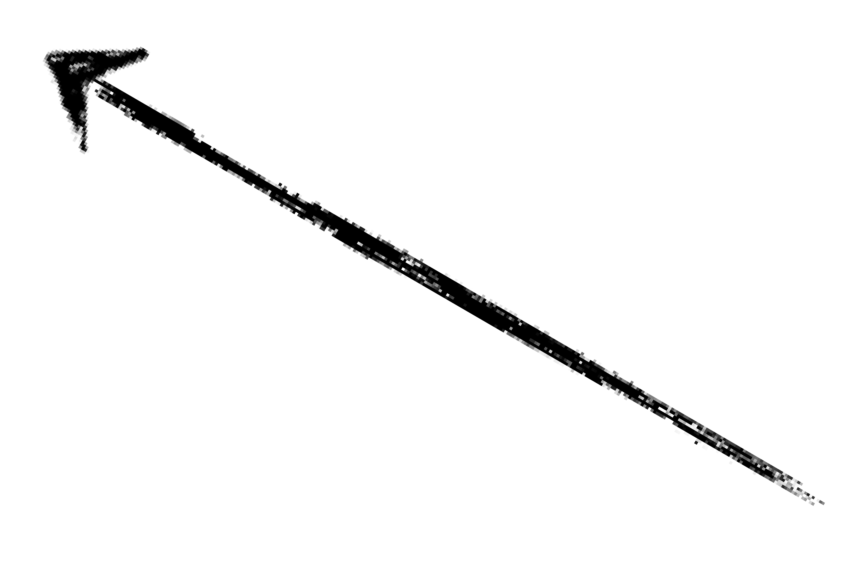
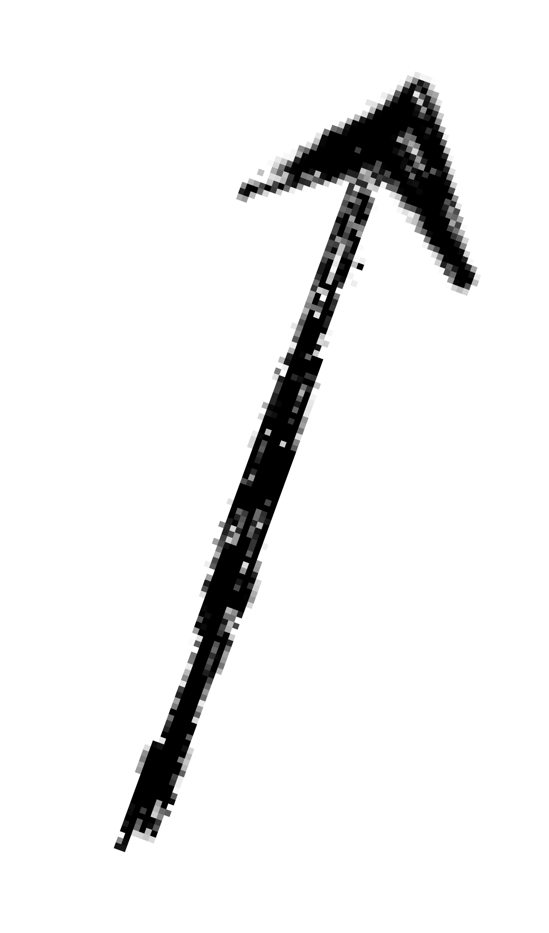
unknown
known
We need at least equations to solve for 2 unknowns.

Slide 54
unknown
known
Where do we get more equations (constraints)?

Slide 55
Constant flow

Slide 56
Where do we get more equations (constraints)?
Assume that the surrounding patch (say 5x5) has ‘constant flow’

Slide 57
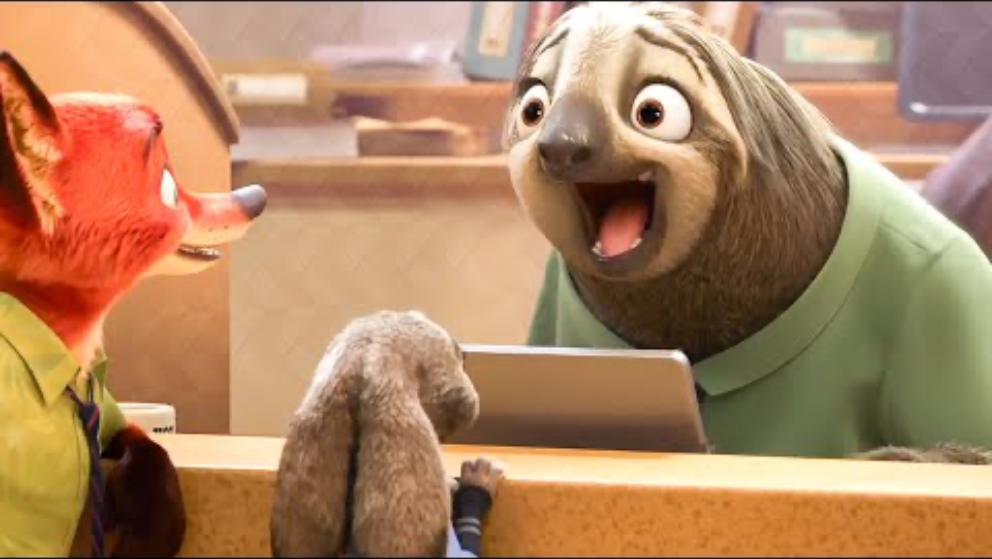
Let’s get some intuition…
What can you tell me about Flash’s claw as it moves? Look at neighboring pixels…

Slide 58
Assumptions:
Flow is locally smooth
Neighboring pixels have same displacement
Using a 5 x 5 image patch, gives us 25 equations

Slide 59
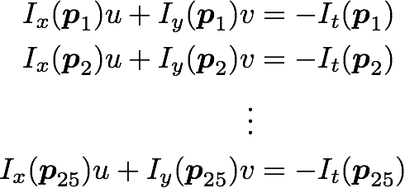
Assumptions:
Flow is locally smooth
Neighboring pixels have same displacement
Using a 5 x 5 image patch, gives us 25 equations

Slide 60


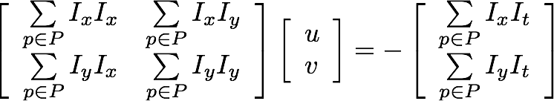

Equivalent to solving:
where the summation is over each pixel p in patch P

Slide 61
Equivalent to solving:
where the summation is over each pixel p in patch P
Sometimes called ‘Lucas-Kanade Optical Flow’
(can be interpreted to be a special case of the LK method with a translational warp model)

Slide 62

When is this solvable?

Slide 63
When is this solvable?
A^{T}A should be invertible
A^{T}A should not be too small
A and A should not be too small
1 2
A^{T}A should be well conditioned
A /A should not be too large (A =larger eigenvalue)
1 2 1

Slide 64
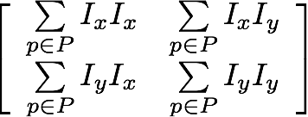
Where have you seen this before?
=

Slide 65
Where have you seen this before?
=
Harris Corner Detector!

Slide 66
Where have you seen this before?
=
Harris Corner Detector!
What are the implications?

Slide 67
Implications
Corners are when λ1, λ2 are big; this is also when Lucas-Kanade optical flow works best
Corners are regions with two different directions of gradient (at least)
Corners are good places to compute flow!
What happens when you have no ‘corners’?

Slide 68
You want to compute optical flow.
What happens if the image patch contains only a line?

Slide 69

Barber’s pole illusion

Slide 70

Barber’s pole illusion

Slide 71

Barber’s pole illusion

Slide 72
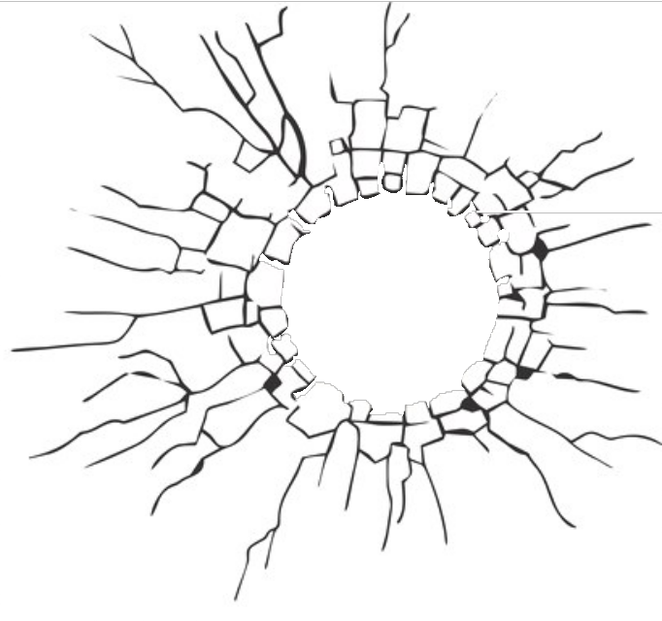




Aperture Problem
small visible image patch
In which direction is the line moving?

Slide 73
Aperture Problem
small visible image patch
In which direction is the line moving?

Slide 74
Aperture Problem

Slide 75
Aperture Problem

Slide 76
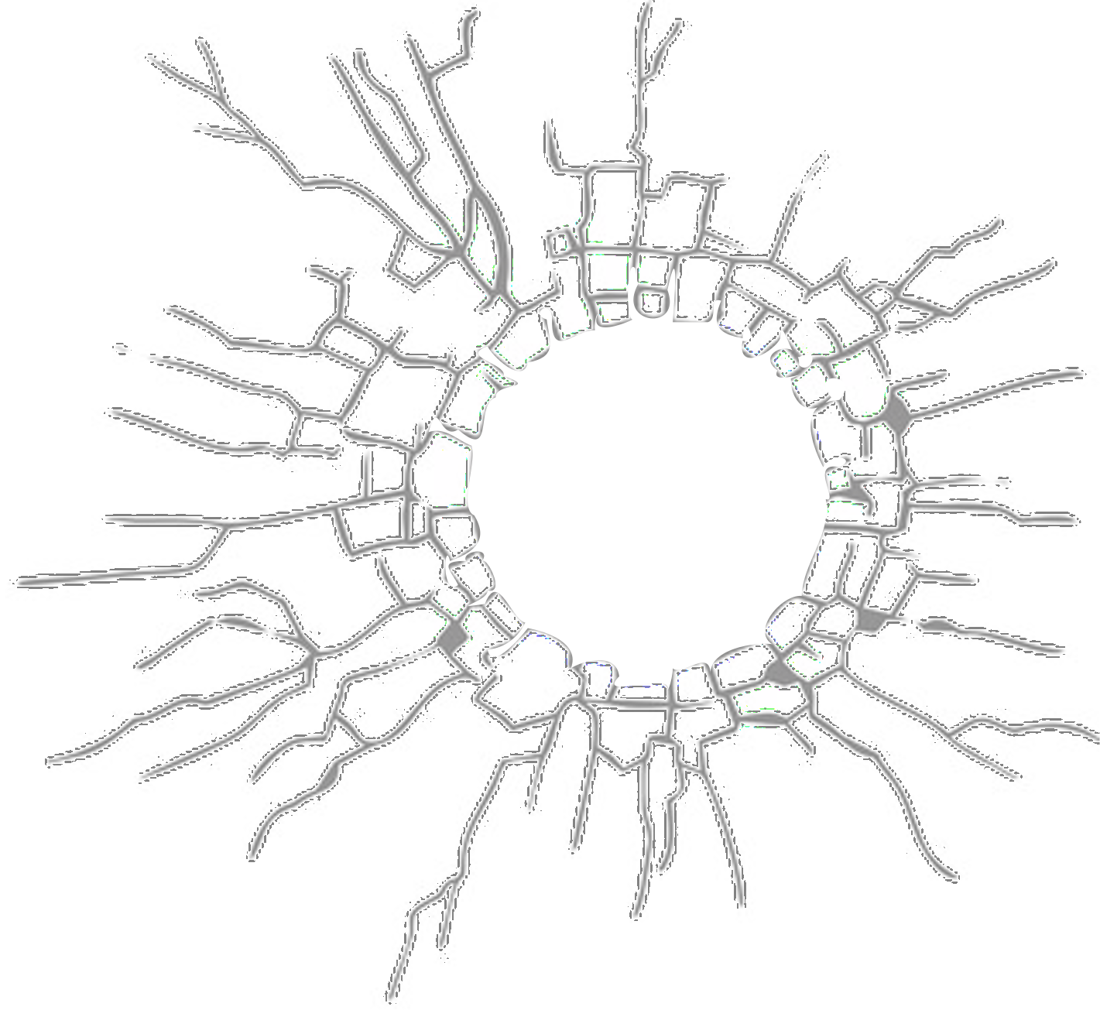
Aperture Problem

Slide 77
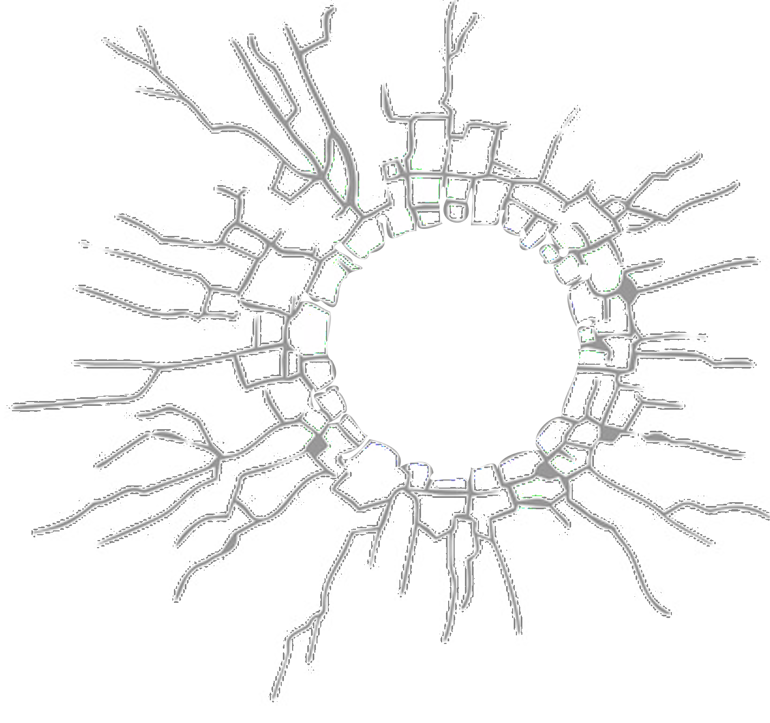
Aperture Problem

Slide 78

Want patches with different gradients to the avoid aperture problem

Slide 79
Want patches with different gradients to the avoid aperture problem

Slide 80






H(x,y) = y
I(x,y)
1 | 1 | 1 | 1
2 | 2 | 2 | 2
3 | 3 | 3 | 3
4 | 4 | 4 | 4
5 | 5 | 5 | 5
x
- | - | - | -
- | 1 | 1 | 1
- | 2 | 2 | 2
- | 3 | 3 | 3
- | 4 | 4 | 4
x
optical flow: (1,1)
y
y
Compute gradients
Solution:
We recover the v of the optical flow but not the u.
This is the aperture problem.

Slide 81
Horn-Schunck optical flow

Slide 82
Horn-Schunck Optical Flow (1981)
Lucas-Kanade Optical Flow (1981)
‘smooth’ flow
(flow can vary from pixel to pixel)
global method (dense)
‘constant’ flow
(flow is constant for all pixels)
local method (sparse)

Slide 83
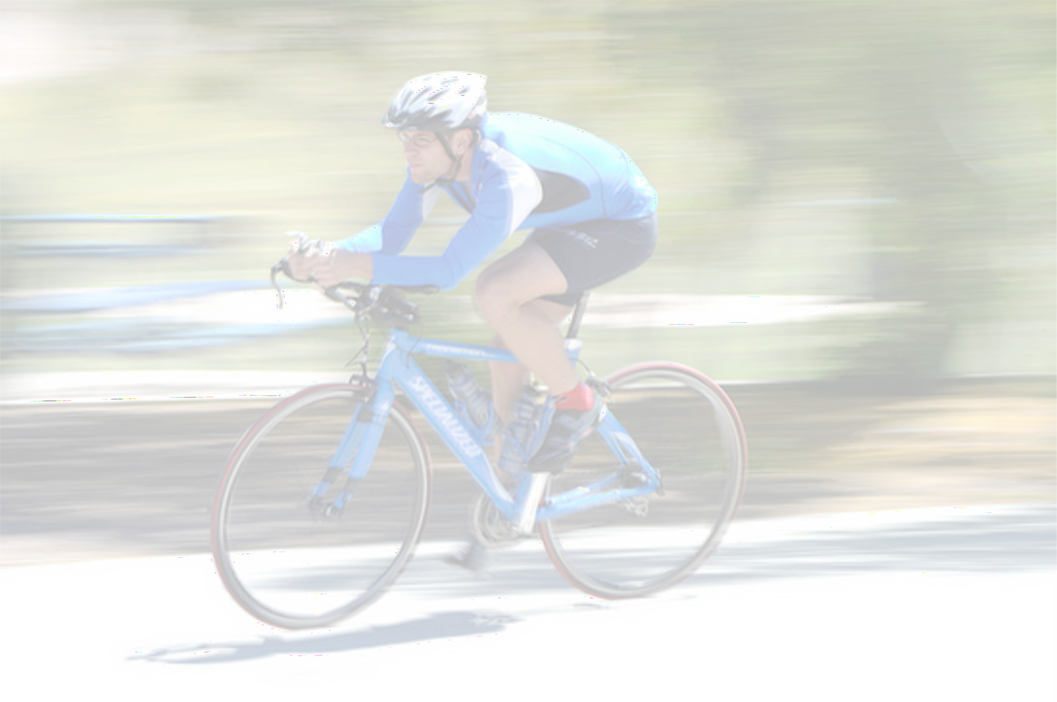
Smoothness
most objects in the world are rigid or deform elastically
moving together coherently
we expect optical flow fields to be smooth

Slide 84
Key idea
(of Horn-Schunck optical flow)
Enforce
brightness constancy
Enforce
smooth flow field
to compute optical flow

Slide 85
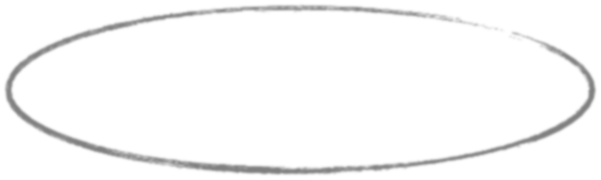
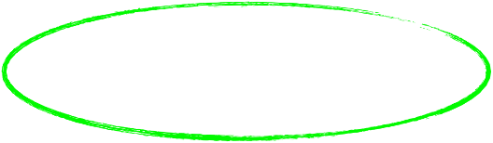
Key idea
(of Horn-Schunck optical flow)
Enforce
brightness constancy
Enforce
smooth flow field
to compute optical flow

Slide 86

Enforce
brightness constancy
For every pixel,

Slide 87


Enforce
brightness constancy
For every pixel,
lazy notation for

Slide 88

Enforce
brightness constancy
Note: differs from finding (u,v) over a block.
For every pixel,
lazy notation for

Slide 89
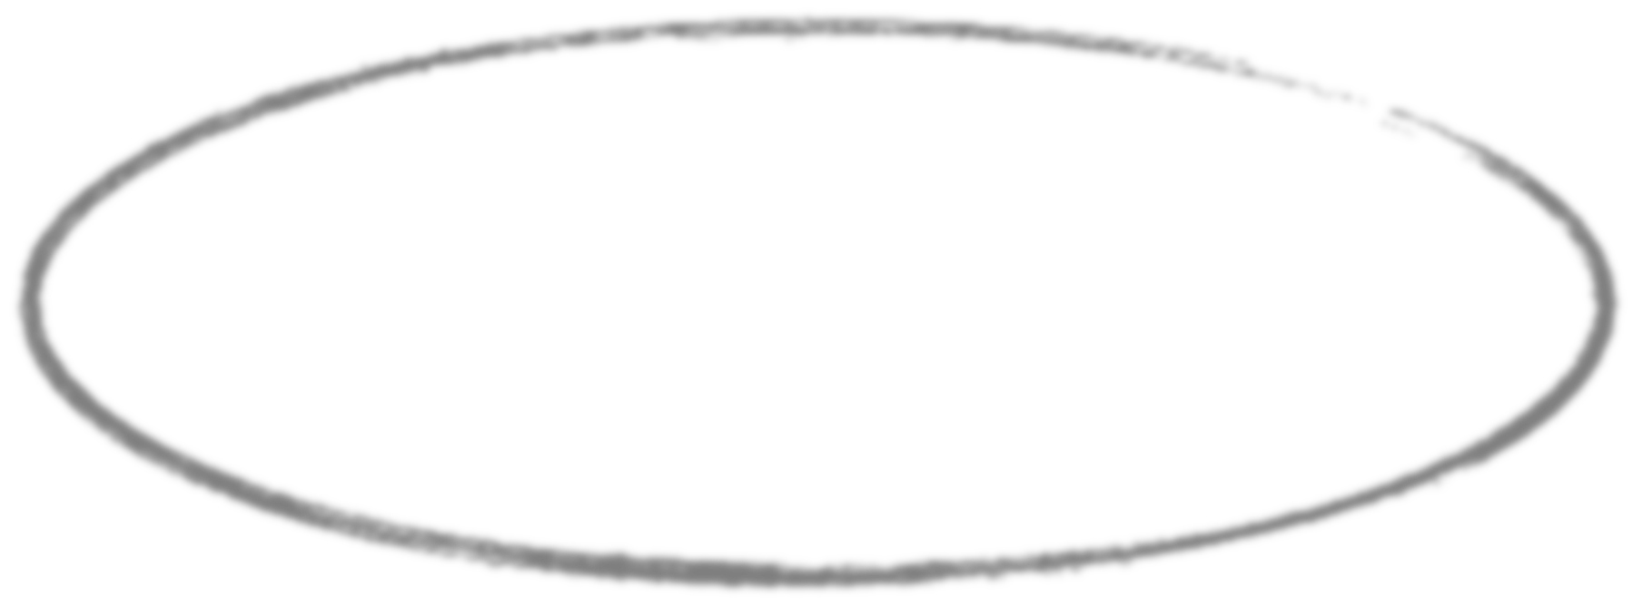

Key idea
(of Horn-Schunck optical flow)
Enforce
brightness constancy
Enforce
smooth flow field
to compute optical flow

Slide 90





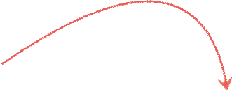









Enforce smooth flow field
u-component of flow
Notes:
Goal → We want the motion to be consistent. If a pixel is moving to the right, its immediate neighbor is probably moving to the right, too.
The min function is a penalty for neighboring pixels that disagree on flow. (horizontal and vertical)

Slide 91
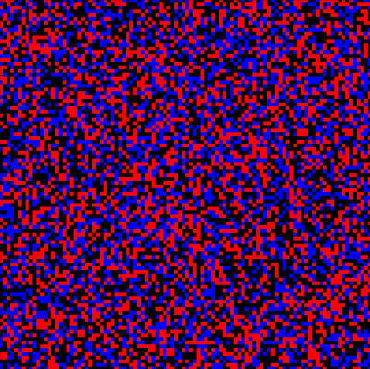



Which flow field optimizes the objective?
?

Slide 92
Which flow field optimizes the objective?
big
small

Slide 93
Key idea
(of Horn-Schunck optical flow)
Enforce
brightness constancy
Enforce
smooth flow field
to compute optical flow
bringing it all together…

Slide 94

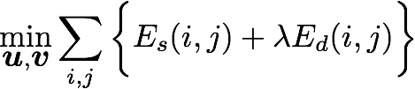

Horn-Schunck optical flow
smoothness
brightness constancy
weight

Slide 95











HS optical flow objective function
Brightness constancy
Smoothness

Slide 96
How do we solve this minimization problem?

Slide 97
How do we solve this minimization problem?
Compute partial derivative, derive update equations
(gradient decent!)

Slide 98
How do we solve this minimization problem?
Compute partial derivative, derive update equations
(gradient decent!)
There are a series of steps we must do to arrive at the end… look at the hidden slides if you’re interested!

Slide 99
Compute the partial derivatives of this huge sum!
smoothness term
brightness constancy

Slide 100

Compute the partial derivatives of this huge sum!
it’s not so bad…
how many u terms depend on k and l?

Slide 101
Compute the partial derivatives of this huge sum!
it’s not so bad…
how many u terms depend on k and l?
FOUR from smoothness ONE from brightness constancy

Slide 102

Compute the partial derivatives of this huge sum!
it’s not so bad…
how many u terms depend on k and l?
FOUR from smoothness ONE from brightness constancy

Slide 103
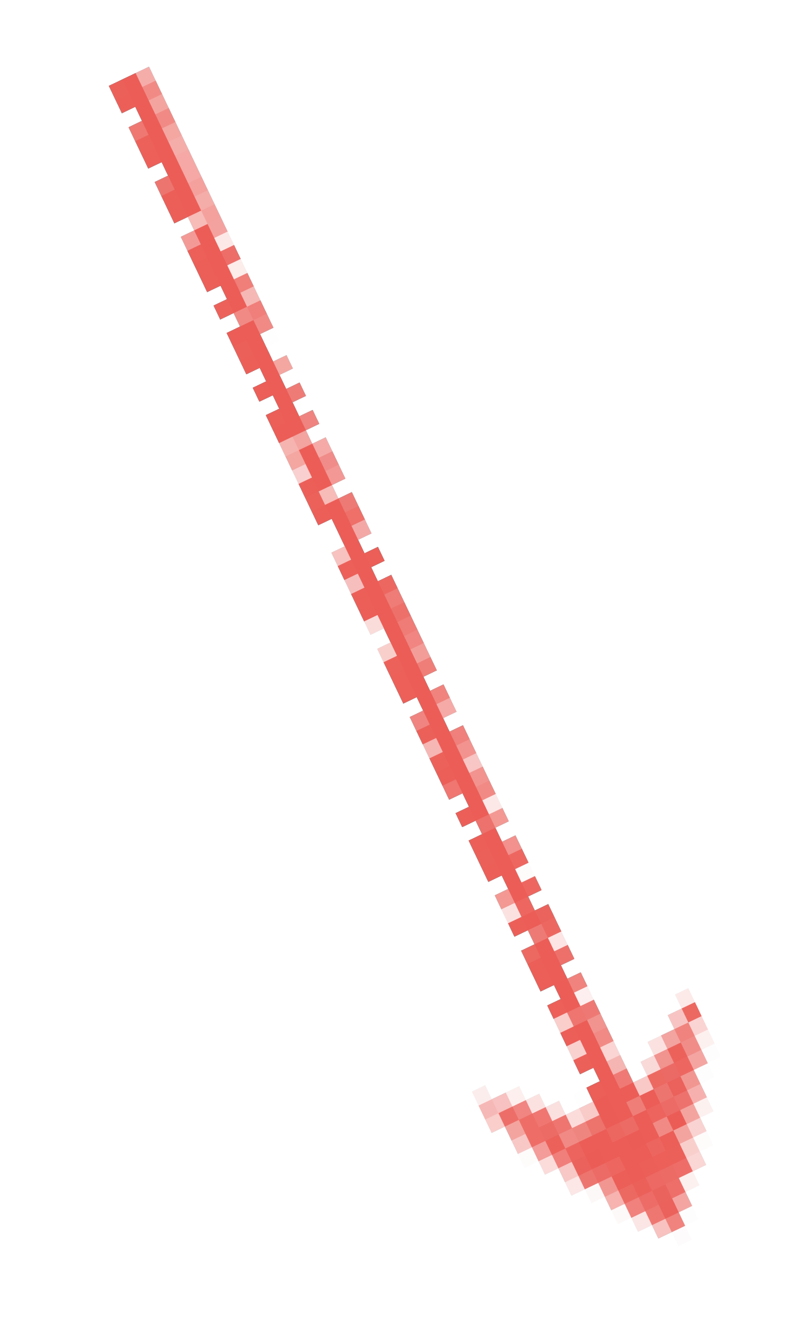




Compute the partial derivatives of this huge sum!
(variable will appear four times in sum)

Slide 104


Compute the partial derivatives of this huge sum!
(variable will appear four times in sum)
short hand for local average

Slide 105
Where are the extrema of E?

Slide 106
Where are the extrema of E?
(set derivatives to zero and solve for unknowns u and v)

Slide 107
Where are the extrema of E?
(set derivatives to zero and solve for unknowns u and v)
this is a linear system
how do you solve this?

Slide 108

Recall

Slide 109

Recall
Same as the linear system:
(det A)
(det A)

Slide 110


Rearrange to get update equations:
new value
old average

Slide 111
Recall:
When lambda is small (lambda inverse is big)…
new value
old average

Slide 112
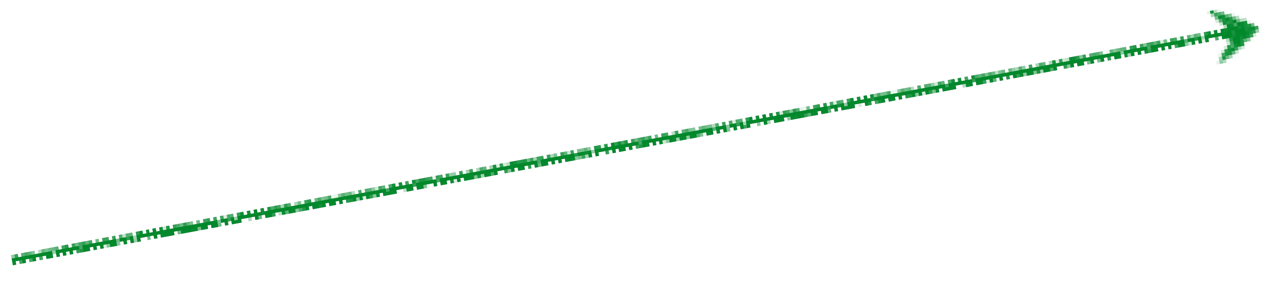


Recall:
When lambda is small (lambda inverse is big)…
goes to zero
new value
old average
goes to zero

Slide 113

Recall:
When lambda is small (lambda inverse is big)…
goes to zero
new value
old average
goes to zero
…we only care about smoothness.

Slide 114
ok, take a step back, why did we do all this math?

Slide 115
We are solving for the optical flow (u,v) given two constraints
smoothness
brightness constancy
We needed the math to minimize this (now to the algorithm)

Slide 116

Horn-Schunck Optical Flow Algorithm
Precompute image gradients
Precompute temporal gradients
Initialize flow field
While not converged
Compute flow field updates for each pixel:
Just 8 lines of code!

Slide 117





Horn-Schunck Optical Flow Algorithm
Precompute image gradients
Precompute temporal gradients
Initialize flow field
While not converged
Compute flow field updates for each pixel:
Estimated flow
Neighborhood Avg
Brightness error
Damping factor
Gradient direction
Notes:
Damping factor – how much we trust the image data vs smoothness,

